Slide 1
Constraints
Tables/Columns wrt Oracle

Slide 2
Integrity Constraints
It is a rule that restricts the values for one or more columns in a table.
Constraints are used :
•To avoid invalid entry of data into table.
•To enforce rules at table level whenever a row is inserted, updated or deleted from the table. The constraint must be satisfied for operation to succeed.
•To prevent the deletion of a table if there are dependencies from other tables.
Oracle allows user to define constraints at two levels.
1. Column level constraint : constraints are defined along with the column specification
2. Table level constraint :Constraints defined after defining all the column

Slide 3
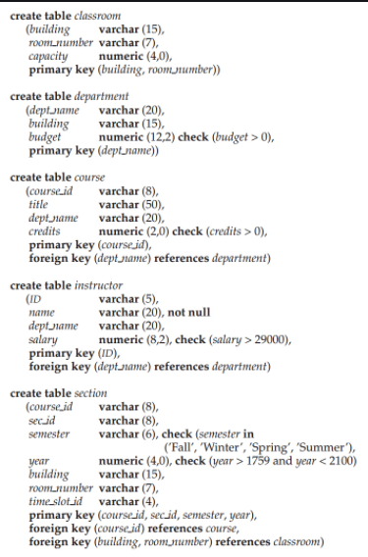
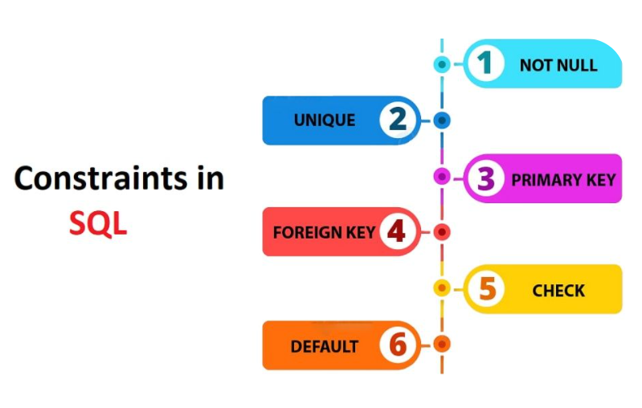
Types Of Constraints
NOT NULL - Will not allow NULL values
CHECK- Checks for the given condition
Entity Integrity: Entity is data recorded in a database.
UNIQUE- Will not allow duplicate values. NULL’s are allowed
PRIMARY KEY- Will not allow duplicate values and
NULL’s are not allowed
Referential Integrity:
FOREIGN KEY- A column value which is derived from
PRIMARY KEY column of another table.
Image Source: Google Images & padakuu.com

