Slide 1
DATABASES
Details as on July 2021

Slide 2
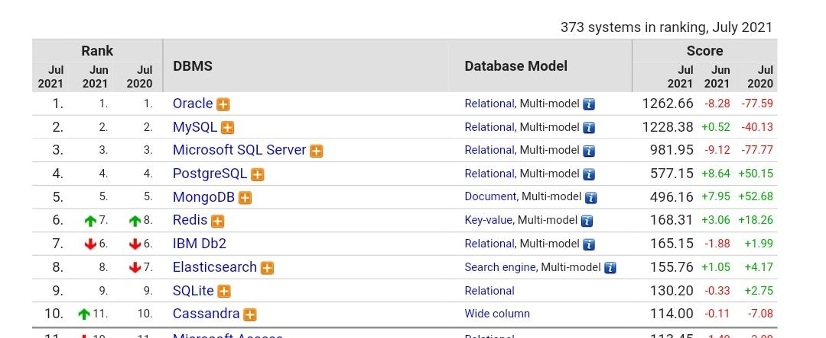
Top Databases
Source: https://db-engines.com/en/ranking

Slide 3

SQL DATABASE
SQL:
RELATIONAL DATABASE MANAGEMENT SYSTEM (RDBMS)
These databases have fixed or static or predefined schema
These databases are not suited for hierarchical data storage.
These databases are best suited for complex queries
Vertically Scalable
Follows ACID property
Source: Google Images

Slide 4
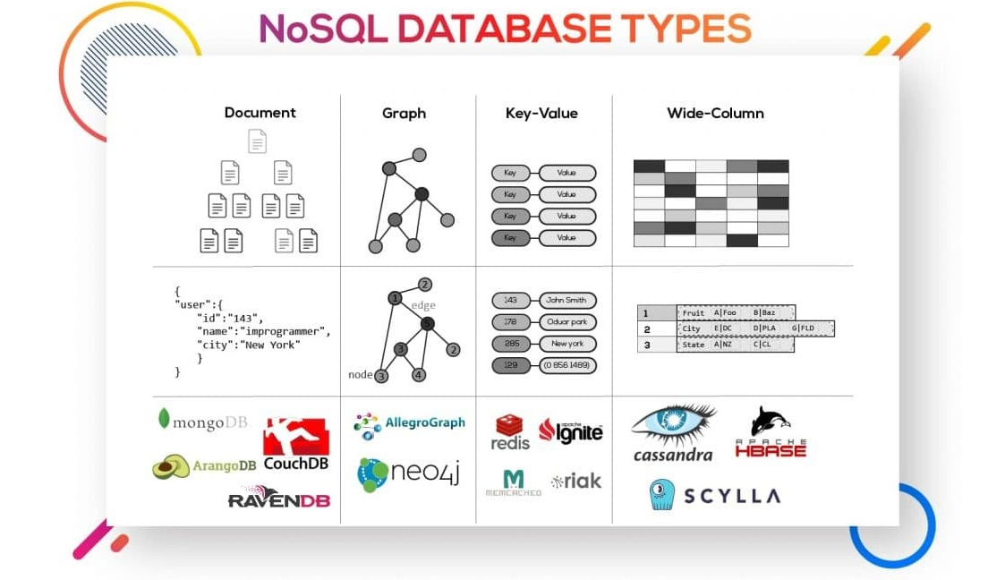
NoSQL DATABASE
NoSQL:
Non-relational or distributed database system.
They have dynamic schema
These databases are best suited for hierarchical data storage.
These databases are not so good for complex queries
Horizontally scalable
Follows CAP(consistency, availability, partition tolerance)
Source: https://www.improgrammer.net/

Slide 5
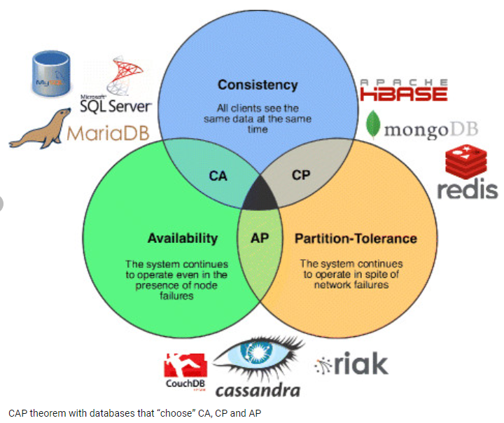
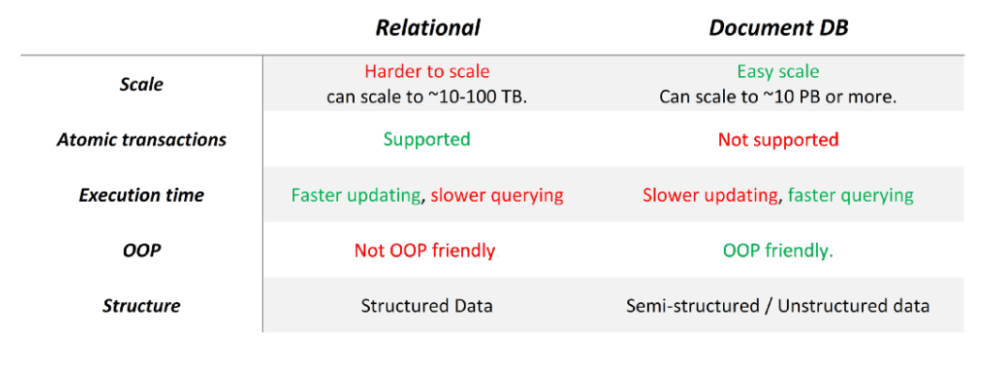
How to choose Database
Source: Google Images

