Slide 1
Joins
With Examples

Slide 2
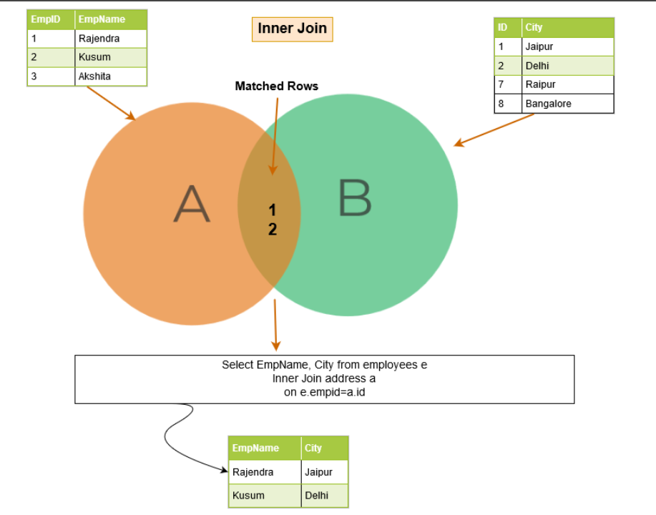
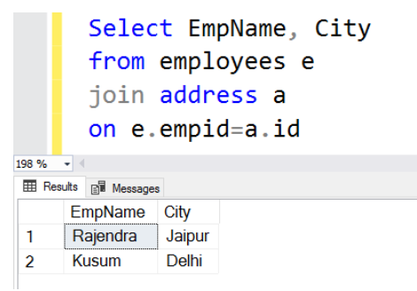
Inner Join
The inner join returns matching rows from both tables; therefore, it is also known as Equi join. If we don’t specify the inner keyword, SQL Server performs the inner join operation.

Slide 3
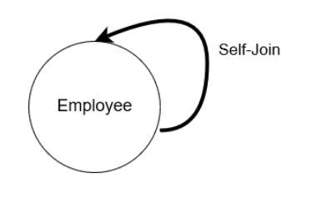
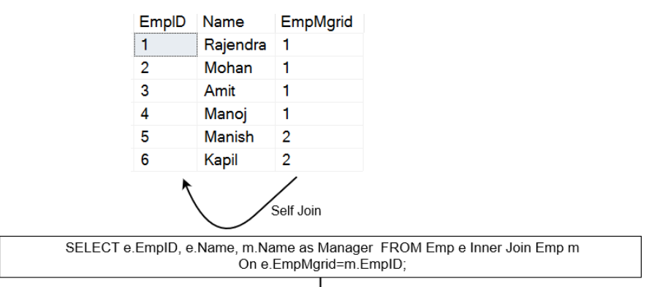
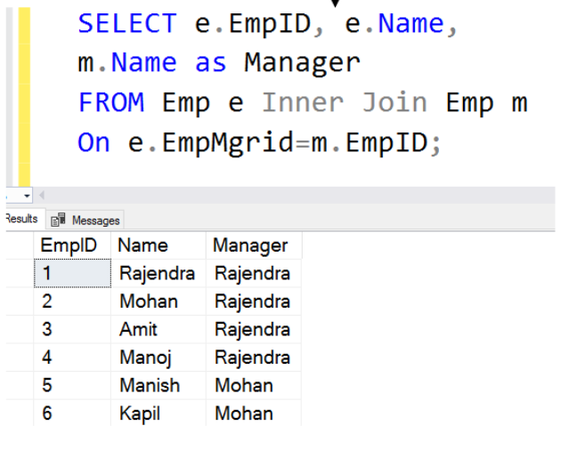
Self Join
The self-join is useful for querying hierarchical data.

Slide 4
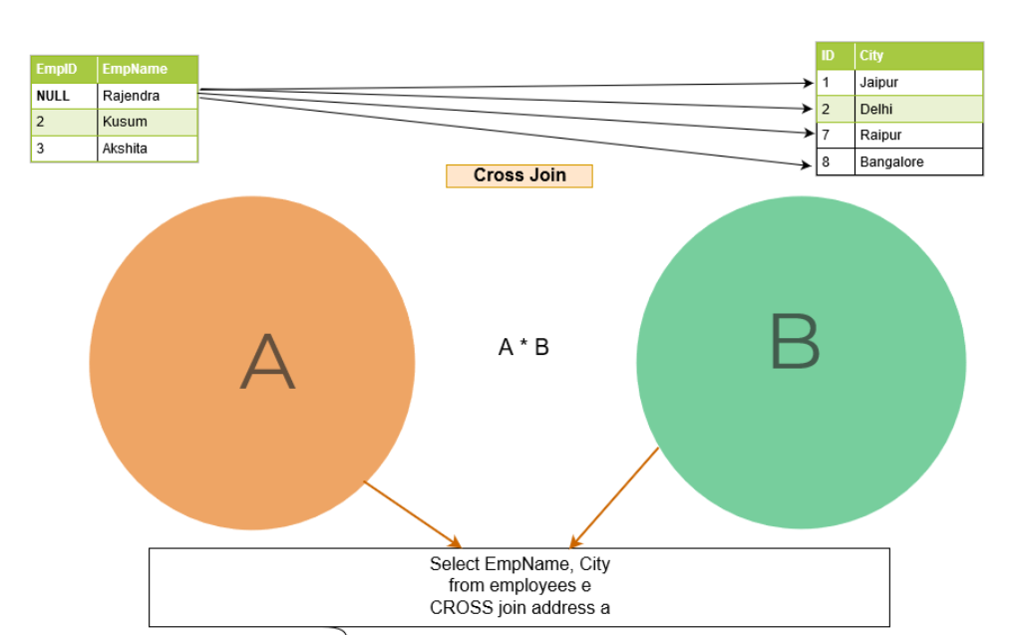
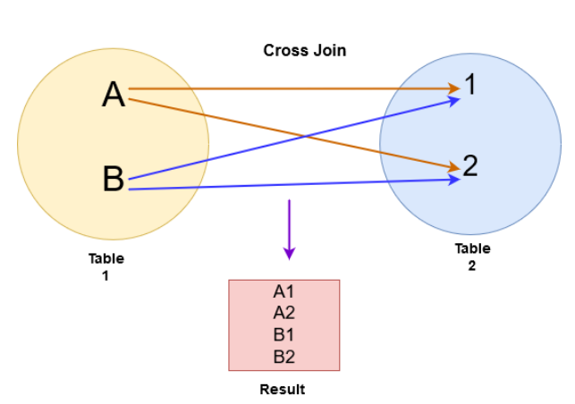
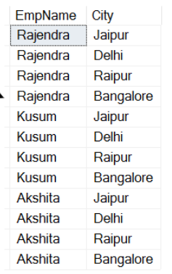
Cross Join
The cross join joins each row from table A to every row available in table B. Therefore, the output is also known as a Cartesian product of both tables.

Slide 5
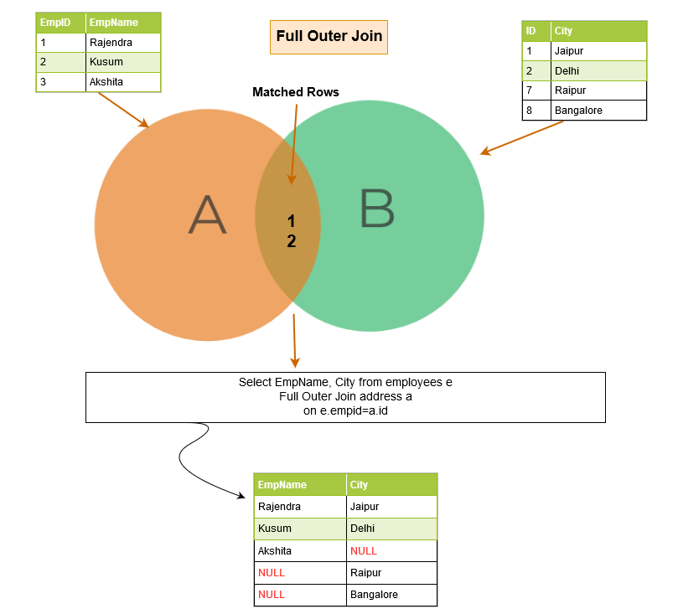
Outer Join
SQL outer join, it not only lists the matching rows, but it also returns the unmatched rows from the other tables. The unmatched row depends on the left, right or full keywords.

Slide 6
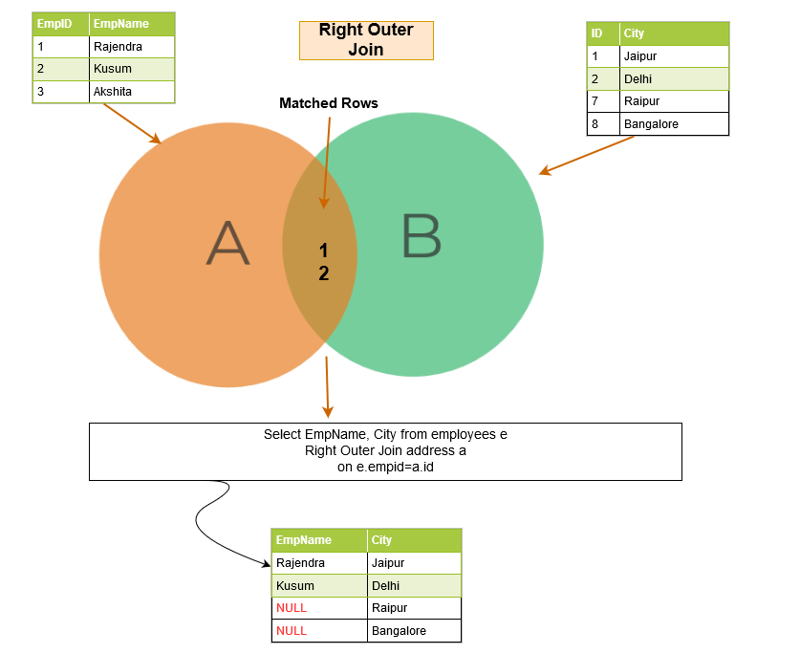
Right Outer Join
SQL right outer join returns the matching rows of both tables along with the unmatched rows from the right table. If a record from the right table does not have any matched rows in the left table, it displays the record with NULL values.

Slide 7
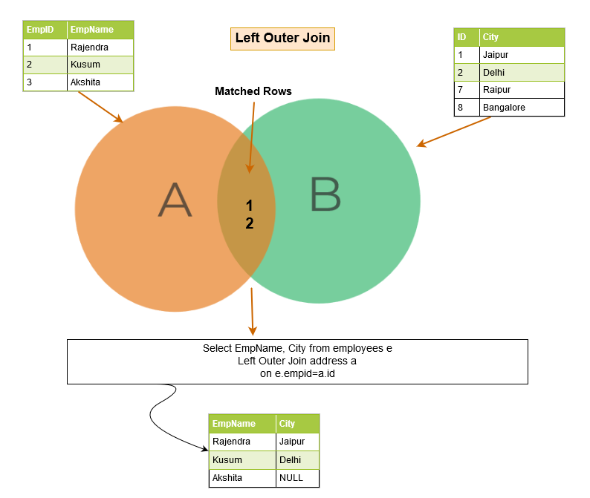
Left Outer Join
SQL left outer join returns the matching rows of both tables along with the unmatched rows from the left table. If a record from the left table doesn’t have any matched rows in the right table, it displays the record with NULL values.

Slide 8
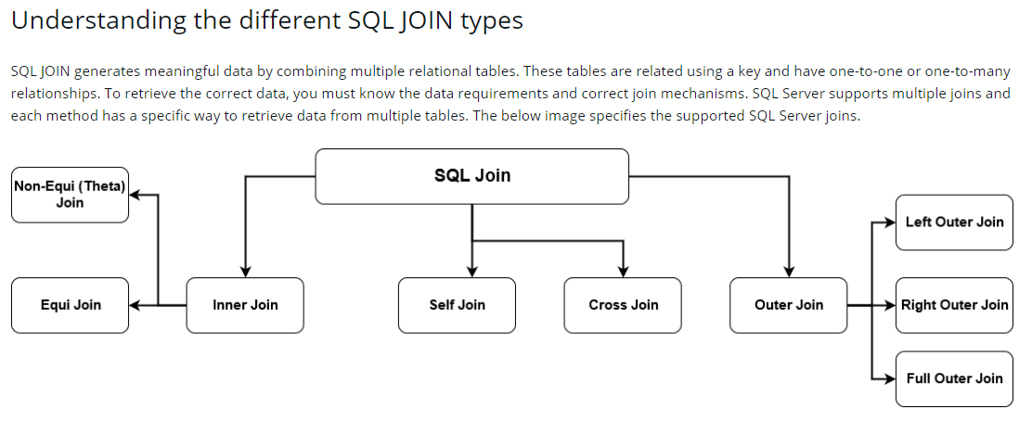
Joins

Slide 9
Notes
Types: Inner , Self , Cross , Outer , Left Outer , Right Outer , Full Outer
Here are a few important best practices to remember and apply when using SQL joins.
Inner joins output the matching rows from the join condition in both of the tables.
Cross join returns the Cartesian product of both tables.
Outer join returns the matched and unmatched rows depending upon the left, right and full keywords.
SQL self-join joins a table to itself.
You should always use a table alias while using the joins in the queries.
Always use the two-part name [table alias].[column] name format for columns in queries.
In the case of multiple SQL joins in a query, you should use the logical orders of the tables in such a way to satisfy your data requirement and minimize the data flow between various operators of the execution plan.
You can combine multiple joins such as inner join, outer join and self-join together. However, you should use the joins and their orders to get the required data.
Source: QUEST.COM

