Slide 1
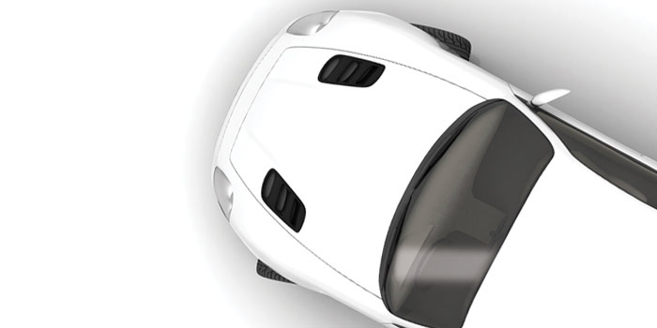
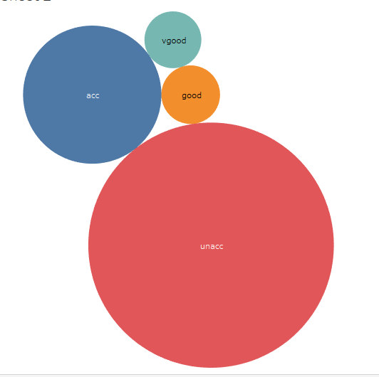
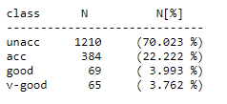
Car Evaluation Data Set:
AI@blueprint
Abhishek Jaiswal
easy2insure
Bangalore, India
Visualization of Target/Class: Using Tableau
Details about Data set used.
Link: http://archive.ics.uci.edu/ml/datasets/car+evaluation
Data Set Characteristics : Multivariate
Number of Instances : 1728
Attribute Characteristics : Categorical
Number of Attributes: : 6 (buying/maint/doors/persons/lug_boot/safety)
Target/class : 4 levels(unacc/acc/good/vgood)
Date Donated : 1997-06-01
Associated Tasks: : Classification

Slide 2
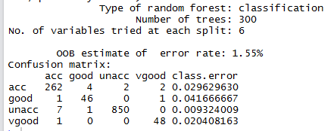
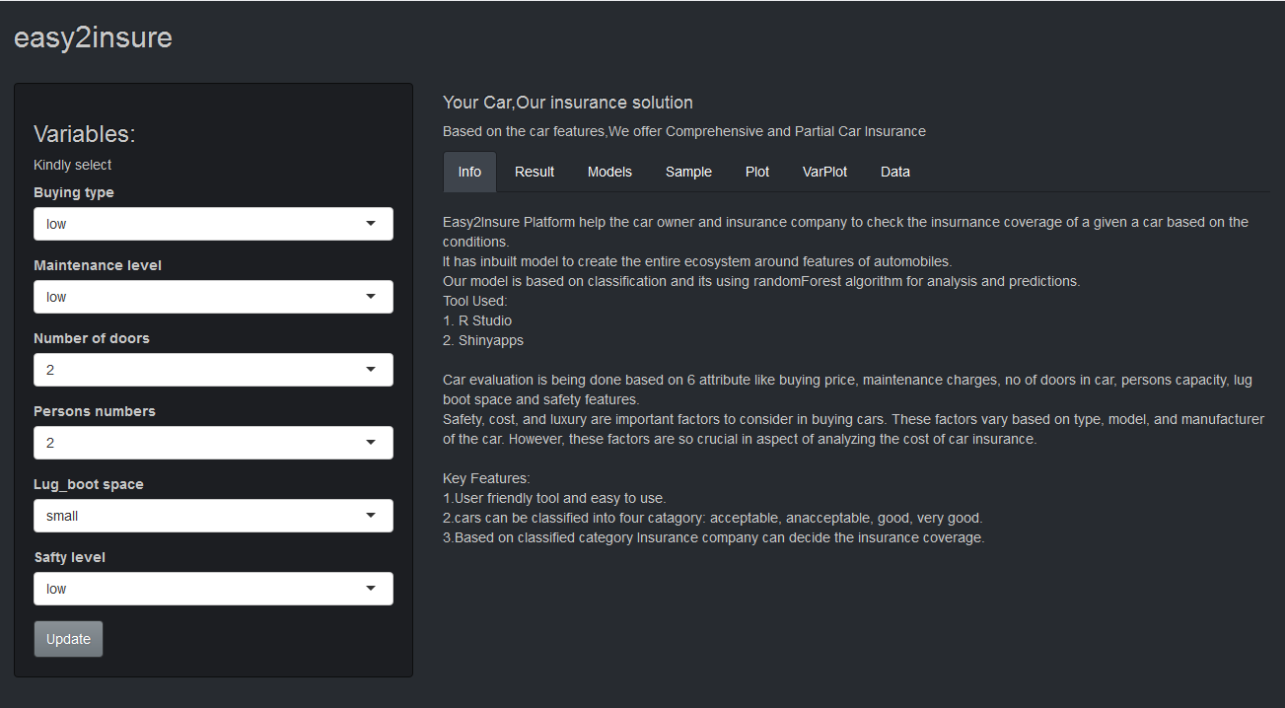
Business case:
On the basis of class/Target, cars will be evaluated for getting car insurance of 2 types:
If a Car class is vgood or good, then that car can get complete cover
If a Car class is acc or unacc, then it will get partial cover.
Classification Algorithm used:
Naive Bayes Algorithm: Accuracy:85.11%
k-Nearest Neighbors Algorithm: Accuracy:90.11%
Decision Tree Algorithm: Accuracy:92.13%
CART Algorithm: Accuracy:70.05%
C50 Algorithm: Accuracy:95.83%
Random Forest Algorithm: Accuracy:98.21%
Future Scope:
In Sample:
We can add many attributes like color, mileage, model, vehicle type, fuel type etc
We need to increase number of sample size.
In UI:
Integration with chatbot
In Business:
1. Tap in to market of buying , selling and getting loans
Shinyapps.io used for model deployment.

