Slide 1


Exposure Java 2013
APCS Edition
Chapter 8
Review Slides
For Teachers
PowerPoint Presentation
created by:
Mr. John L. M. Schram
and Mr. Leon Schram
Authors of Exposure Java

Slide 2
Do You Understand Methods and Parameters?
In this section you will be shown 25 different programs.
Most of these programs have some type of error.
A few, and very few programs are actually correct.

Slide 3

Teacher/Student Versions, Tablet PCs, and Inking
The “For Teachers” version of this presentation has 2 slides for each program.
The first slide only shows the program.
The second shows the program, and an
explanation of the error(s).
The “For Students” version
only has 1 slide for each
program with no provided
explanations. Students are
expected to determine the errors either on paper, or ideally they can “ink” directly on their laptops.

Slide 4
// Review0801.java is supposed to display the value
// of the <num> parameter.
public class Review0801
{
public static void main(String args[])
{
System.out.println("\nReview0801.JAVA\n");
System.out.println();
}
public static void method1(int num)
{
System.out.println("Method1 displays " + num);
}
}

Slide 5
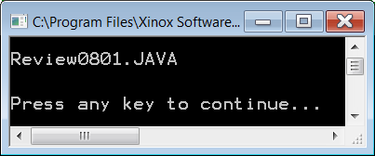
// Review0801.java is supposed to display the value
// of the <num> parameter.
public class Review0801
{
public static void main(String args[])
{
System.out.println("\nReview0801.JAVA\n");
System.out.println();
}
public static void method1(int num)
{
System.out.println("Method1 displays " + num);
}
}
<method1> is never called.

Slide 6
// Review0802.java is supposed to display the value
// of the <num> parameter.
public class Review0802
{
public static void main(String args[])
{
System.out.println("\nReview0802.JAVA\n");
method2(int num = 100);
System.out.println();
}
public static void method2(int num)
{
System.out.println("Method2 displays " + num);
}
}

Slide 7
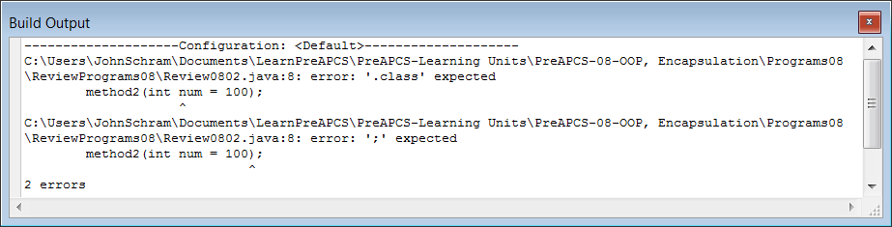
// Review0802.java is supposed to display the value
// of the <num> parameter.
public class Review0802
{
public static void main(String args[])
{
System.out.println("\nReview0802.JAVA\n");
method2(int num = 100);
System.out.println();
}
public static void method2(int num)
{
System.out.println("Method2 displays " + num);
}
}
You cannot declare
an actual parameter
inside the method call.

Slide 8
// Review0803.java is supposed to display the value of the <pi> parameter.
public class Review0803
{
public static void main(String args[])
{
System.out.println("\nReview0803.JAVA\n");
double pi = 3.14159;
method3(pi);
System.out.println();
}
public static void method3(int num)
{
System.out.println("Method3 displays " + num);
}
}

Slide 9
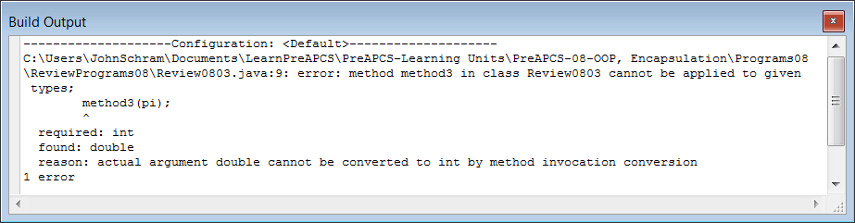
// Review0803.java is supposed to display the value of the <pi> parameter.
public class Review0803
{
public static void main(String args[])
{
System.out.println("\nReview0803.JAVA\n");
double pi = 3.14159;
method3(pi);
System.out.println();
}
public static void method3(int num)
{
System.out.println("Method3 displays " + num);
}
}
The data types of the actual parameter
and formal parameter do not match.

Slide 10
// Review0804.java is supposed to display the sum of the parameters.
public class Review0804
{
public static void main(String args[])
{
System.out.println("\nReview0804.JAVA\n");
double num1 = 100;
double num2 = 200;
method4(num1);
System.out.println();
}
public static void method4(double a, double b)
{
double sum = a + b;
System.out.println("Method4 displays " + sum);
}
}

Slide 11
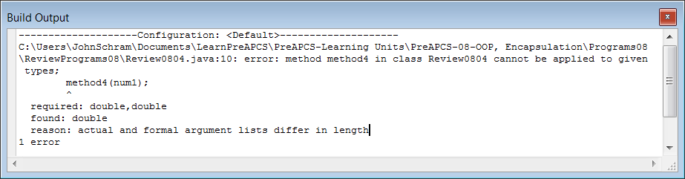
// Review0804.java is supposed to display the sum of the parameters.
public class Review0804
{
public static void main(String args[])
{
System.out.println("\nReview0804.JAVA\n");
double num1 = 100;
double num2 = 200;
method4(num1);
System.out.println();
}
public static void method4(double a, double b)
{
double sum = a + b;
System.out.println("Method4 displays " + sum);
}
}
The number of actual parameters
and formal parameters do not match.

Slide 12
// Review0805.java is supposed to display the difference of num1 - num2.
public class Review0805
{
public static void main(String args[])
{
System.out.println("\nReview0805.JAVA\n");
double num1 = 200;
double num2 = 100;
method5(num1,num2);
System.out.println();
}
public static void method5(double number2, double number1)
{
double difference = number2 - number1;
System.out.println("Method5 displays " + difference);
}
}

Slide 13
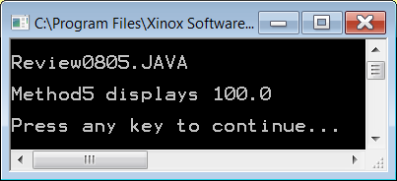
// Review0805.java is supposed to display the difference of num1 - num2.
public class Review0805
{
public static void main(String args[])
{
System.out.println("\nReview0805.JAVA\n");
double num1 = 200;
double num2 = 100;
method5(num1,num2);
System.out.println();
}
public static void method5(double number2, double number1)
{
double difference = number2 - number1;
System.out.println("Method5 displays " + difference);
}
}
This question is tricky. There is nothing technically wrong.
The parameters are named illogically, but the correct
computation is performed to display num1 - num2.

Slide 14
// Review0806.java is supposed to display the difference of num1 - num2.
public class Review0806
{
public static void main(String args[])
{
System.out.println("\nReview0806.JAVA\n");
double num1 = 200;
double num2 = 100;
method6(num1,num2);
System.out.println();
public static void method6(double number1, double number2)
{
double difference = number1 - number2;
System.out.println("Method6 displays " + difference);
}
}

Slide 15
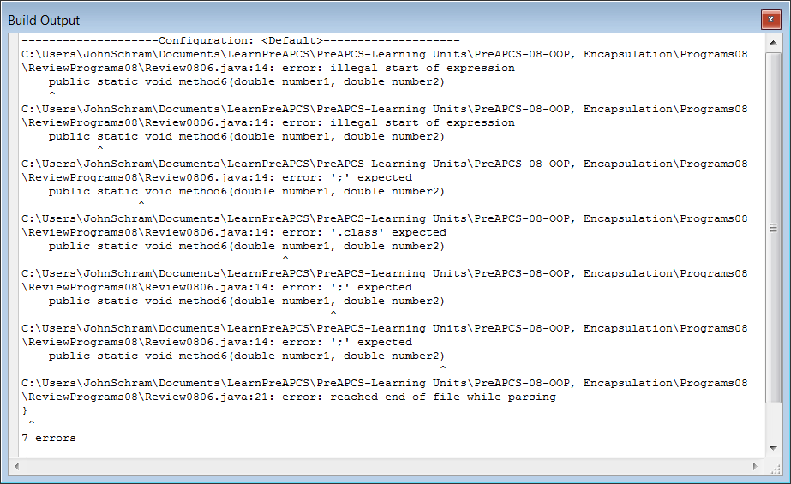
// Review0806.java is supposed to display the difference of num1 - num2.
public class Review0806
{
public static void main(String args[])
{
System.out.println("\nReview0806.JAVA\n");
double num1 = 200;
double num2 = 100;
method6(num1,num2);
System.out.println();
public static void method6(double number1, double number2)
{
double difference = number1 - number2;
System.out.println("Method6 displays " + difference);
}
}
The main method does not have a closing brace.

Slide 16
// Review0807.java is supposed to display the difference of num1 - num2.
public class Review0807
{
public static void main(String args[])
{
System.out.println("\nReview0807.JAVA\n");
double num1 = 200;
double num2 = 100;
method7(num1,num2);
System.out.println();
public static void method7(double number1, double number2)
{
double difference = number1 - number2;
System.out.println("Method7 displays " + difference);
}
}
}

Slide 17
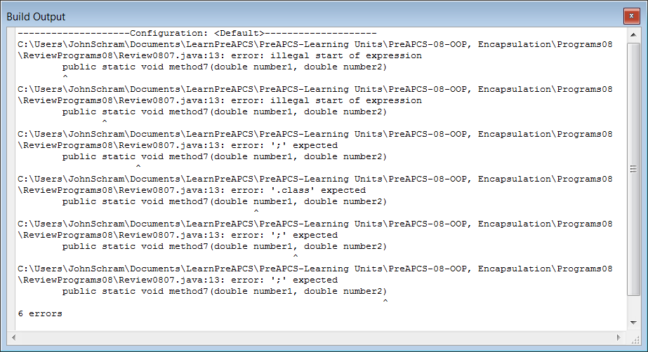
// Review0807.java is supposed to display the difference of num1 - num2.
public class Review0807
{
public static void main(String args[])
{
System.out.println("\nReview0807.JAVA\n");
double num1 = 200;
double num2 = 100;
method7(num1,num2);
System.out.println();
public static void method7(double number1, double number2)
{
double difference = number1 - number2;
System.out.println("Method7 displays " + difference);
}
}
}
<method7> is placed inside the <main> method.

Slide 18
// Review0808.java is supposed to display the difference of num1 - num2.
public class Review0808
{
public static void main(String args[])
{
System.out.println("\nReview0808.JAVA\n");
double num1 = 200;
double num2 = 100;
method8();
System.out.println();
}
public static void method8()
{
double difference = num1 - num2;
System.out.println("Method8 displays " + difference);
}
}

Slide 19
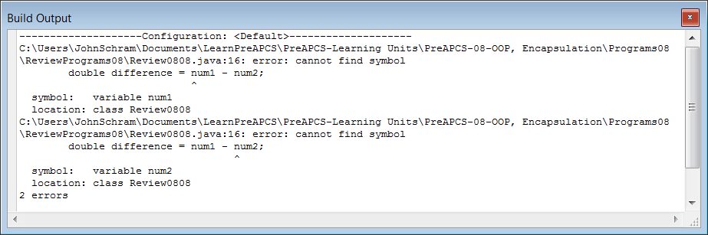
// Review0808.java is supposed to display the difference of num1 - num2.
public class Review0808
{
public static void main(String args[])
{
System.out.println("\nReview0808.JAVA\n");
double num1 = 200;
double num2 = 100;
method8();
System.out.println();
}
public static void method8()
{
double difference = num1 - num2;
System.out.println("Method8 displays " + difference);
}
}
There are no parameters passed to <method8>.
Variables <num1> and <num2> are unknown in <method8>.

Slide 20
// Review0809.java is supposed to display the sum and difference
// of <num1> and <num2>.
public class Review0809
{
public static void main(String args[])
{
System.out.println("\nReview0809.JAVA\n");
double num1 = 200;
double num2 = 100;
add(num1,num2);
subtract(num1,num2);
System.out.println();
}
}
class Calc
{
public static void add(double a, double b) { System.out.println(a + b); }
public static void subtract(double a, double b) { System.out.println(a – b); }
}

Slide 21
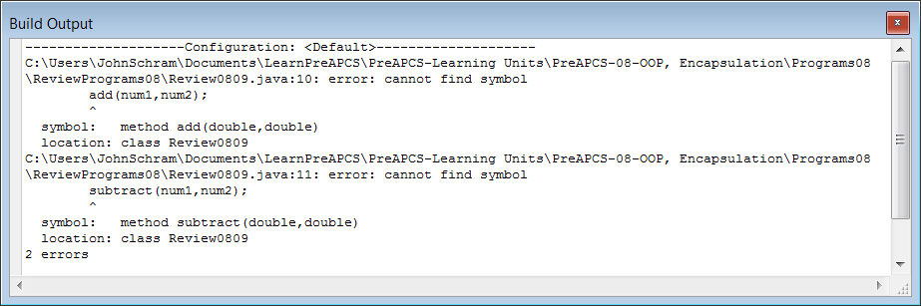
// Review0809.java is supposed to display the sum and difference
// of <num1> and <num2>.
public class Review0809
{
public static void main(String args[])
{
System.out.println("\nReview0809.JAVA\n");
double num1 = 200;
double num2 = 100;
add(num1,num2);
subtract(num1,num2);
System.out.println();
}
}
class Calc
{
public static void add(double a, double b) { System.out.println(a + b); }
public static void subtract(double a, double b) { System.out.println(a – b); }
}
The <add> & <subtract> methods
are in a different class.
You need to use the class identifier
to call them.
Examples: Calc.add & Calc.subtract

Slide 22
// Review0810.java is supposed to display the sum and difference
// of <num1> and <num2>.
public class Review0810
{
public static void main(String args[])
{
System.out.println("\nReview0810.JAVA\n");
double num1 = 200;
double num2 = 100;
Calc.add(num1,num2);
Calc.subtract(num1,num2);
System.out.println();
}
}
public class Calc
{
public static void add(double a, double b) { System.out.println(a + b); }
public static void subtract(double a, double b) { System.out.println(a – b); }
}

Slide 23
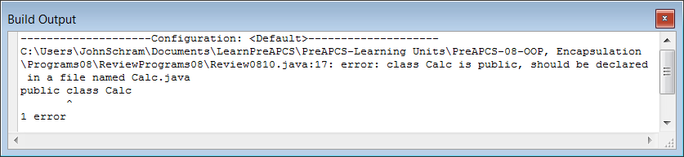
// Review0810.java is supposed to display the sum and difference
// of <num1> and <num2>.
public class Review0810
{
public static void main(String args[])
{
System.out.println("\nReview0810.JAVA\n");
double num1 = 200;
double num2 = 100;
Calc.add(num1,num2);
Calc.subtract(num1,num2);
System.out.println();
}
}
public class Calc
{
public static void add(double a, double b) { System.out.println(a + b); }
public static void subtract(double a, double b) { System.out.println(a – b); }
}
There can only be one public class in a file,
which is the class with the same name as the file.

Slide 24
// Review0811.java is supposed to display the sum and difference
// of <num1> and <num2>.
public class Review0811
{
public static void main(String args[])
{
System.out.println("\nReview0811.JAVA\n");
double num1 = 200;
double num2 = 100;
Calc.add(num1,num2);
Calc.subtract(num1,num2);
System.out.println();
}
}
class Calc
{
public static void add(double a, double b); { System.out.println(a + b); }
public static void subtract(double a, double b); { System.out.println(a - b); }
}

Slide 25
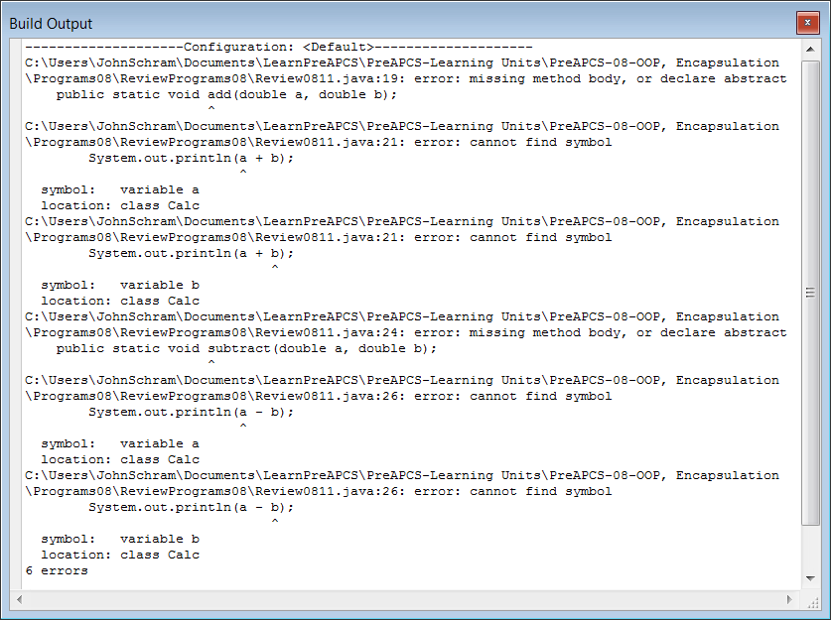
// Review0811.java is supposed to display the sum and difference
// of <num1> and <num2>.
public class Review0811
{
public static void main(String args[])
{
System.out.println("\nReview0811.JAVA\n");
double num1 = 200;
double num2 = 100;
Calc.add(num1,num2);
Calc.subtract(num1,num2);
System.out.println();
}
}
class Calc
{
public static void add(double a, double b); { System.out.println(a + b); }
public static void subtract(double a, double b); { System.out.println(a - b); }
}
Method headings do not use a semicolon ( ; ).

Slide 26
// Review0812.java is supposed to display the sum and difference
// of <num1> and <num2>.
public class Review0812
{
public static void main(String args[])
{
System.out.println("\nReview0812.JAVA\n");
double num1 = 200;
double num2 = 100;
System.out.println(Calc.add(num1,num2));
System.out.println(Calc.subtract(num1,num2));
System.out.println();
}
}
class Calc
{
public static void add(double a, double b) { return a + b; }
public static void subtract(double a, double b) { return a – b; }
}

Slide 27
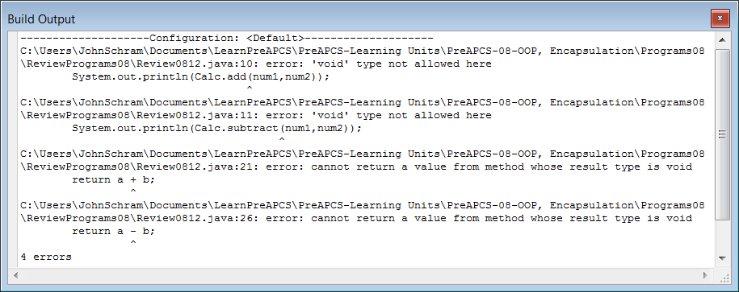
// Review0812.java is supposed to display the sum and difference
// of <num1> and <num2>.
public class Review0812
{
public static void main(String args[])
{
System.out.println("\nReview0812.JAVA\n");
double num1 = 200;
double num2 = 100;
System.out.println(Calc.add(num1,num2));
System.out.println(Calc.subtract(num1,num2));
System.out.println();
}
}
class Calc
{
public static void add(double a, double b) { return a + b; }
public static void subtract(double a, double b) { return a – b; }
}
Methods <add> and <subtract> return a value,
but they are declared as "void" methods.
Instead of “void” we should see a data type.

Slide 28
// Review0813.java is supposed to display the sum and difference
// of <num1> and <num2>.
public class Review0813
{
public static void main(String args[])
{
System.out.println("\nReview0813.JAVA\n");
double num1 = 200;
double num2 = 100;
System.out.println(Calc.add(num1,num2));
System.out.println(Calc.subtract(num1,num2));
System.out.println();
}
}
class Calc
{
public static double add(double a, double b) { double sum = a + b; }
public static double subtract(double a, double b) { double difference = a -b; }
}

Slide 29
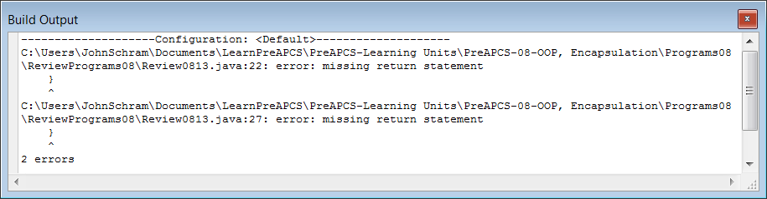
// Review0813.java is supposed to display the sum and difference
// of <num1> and <num2>.
public class Review0813
{
public static void main(String args[])
{
System.out.println("\nReview0813.JAVA\n");
double num1 = 200;
double num2 = 100;
System.out.println(Calc.add(num1,num2));
System.out.println(Calc.subtract(num1,num2));
System.out.println();
}
}
class Calc
{
public static double add(double a, double b) { double sum = a + b; }
public static double subtract(double a, double b) { double difference = a -b; }
}
Methods <add> and <subtract>
are declared as"return" methods,
but they have no return statements.

Slide 30
// Review0814.java is supposed to display the sum and difference of <num1> and <num2>.
public class Review0814
{
public static void main(String args[])
{
System.out.println("\nReview0814.JAVA\n");
double num1 = 200;
double num2 = 100;
Calc.add(num1,num2);
Calc.subtract(num1,num2);
System.out.println();
}
}
class Calc
{
public static double add(double a, double b)
{
double sum = a + b;
return sum;
}
public static double subtract(double a, double b)
{
double difference = a -b;
return difference;
}
}

Slide 31
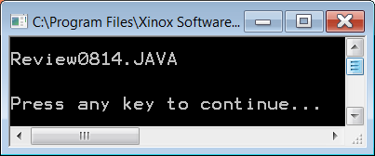
// Review0814.java is supposed to display the sum and difference of <num1> and <num2>.
public class Review0814
{
public static void main(String args[])
{
System.out.println("\nReview0814.JAVA\n");
double num1 = 200;
double num2 = 100;
Calc.add(num1,num2);
Calc.subtract(num1,num2);
System.out.println();
}
}
class Calc
{
public static double add(double a, double b)
{
double sum = a + b;
return sum;
}
public static double subtract(double a, double b)
{
double difference = a -b;
return difference;
}
}
This program does
not display anything.
The methods return
the proper values,
but nothing is done
with these values.
A return method should
be called as part of
some other statement.

Slide 32
// Review0815.java is supposed to display the sum and difference of <num1> and <num2>.
public class Review0815
{
public static void main(String args[])
{
System.out.println("\nReview0815.JAVA\n");
double num1 = 200;
double num2 = 100;
System.out.println(Calc.add(num1,num2);
System.out.println(Calc.subtract(num1,num2);
System.out.println();
}
}
class Calc
{
public static double add(double a, double b)
{
double sum = a + b;
return sum;
}
public static double subtract(double a, double b)
{
double difference = a -b;
return difference;
}
}

Slide 33
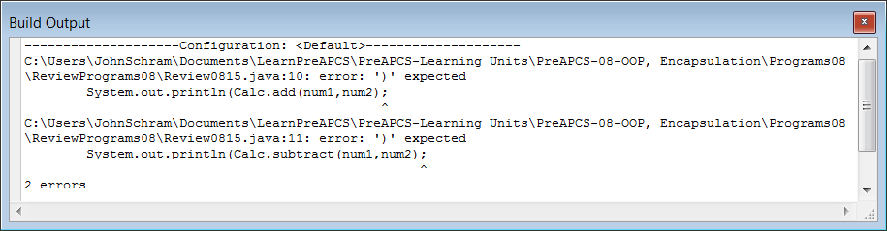
// Review0815.java is supposed to display the sum and difference of <num1> and <num2>.
public class Review0815
{
public static void main(String args[])
{
System.out.println("\nReview0815.JAVA\n");
double num1 = 200;
double num2 = 100;
System.out.println(Calc.add(num1,num2);
System.out.println(Calc.subtract(num1,num2);
System.out.println();
}
}
class Calc
{
public static double add(double a, double b)
{
double sum = a + b;
return sum;
}
public static double subtract(double a, double b)
{
double difference = a -b;
return difference;
}
}
The method
calls are
missing a
second set
of closing
parenthesis.

Slide 34
// Review0816.java is supposed to construct a <Widget> object
// and initialize its data.
public class Review0816
{
public static void main(String args[])
{
System.out.println("\nReview0816.JAVA\n");
Widget w = new Widget();
w.initWidgets(100);
System.out.println();
}
}
class Widget
{
private int numWidgets;
public static void initWidgets(int n) { numWidgets = n; }
}

Slide 35
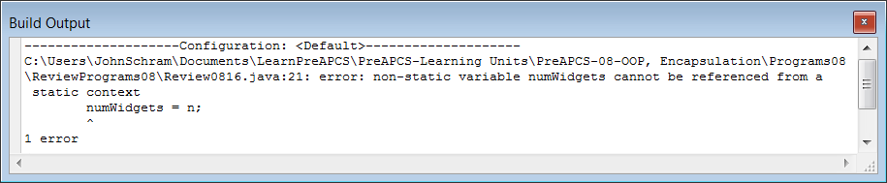
// Review0816.java is supposed to construct a <Widget> object
// and initialize its data.
public class Review0816
{
public static void main(String args[])
{
System.out.println("\nReview0816.JAVA\n");
Widget w = new Widget();
w.initWidgets(100);
System.out.println();
}
}
class Widget
{
private int numWidgets;
public static void initWidgets(int n) { numWidgets = n; }
}
<initWidgets> is declared
"static" like a “class” method,
but it is called like an object method.
Also, “static” methods can only
access “static” data.

Slide 36
// Review0817.java is supposed to construct a
// <Widget> object and initialize its data.
public class Review0817
{
public static void main(String args[])
{
System.out.println("\nReview0817.JAVA\n");
Widget w = new Widget();
w.numWidgets = 100;
System.out.println();
}
}
class Widget
{
int numWidgets;
}

Slide 37
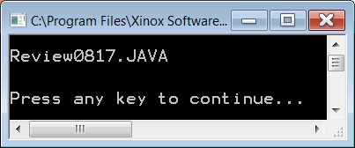
// Review0817.java is supposed to construct a
// <Widget> object and initialize its data.
public class Review0817
{
public static void main(String args[])
{
System.out.println("\nReview0817.JAVA\n");
Widget w = new Widget();
w.numWidgets = 100;
System.out.println();
}
}
class Widget
{
int numWidgets;
}
This program compiles,
but object data should
not be accessed directly.

Slide 38
// Review0818.java is supposed to construct a
// <Widget> object and initialize its data.
public class Review0818
{
public static void main(String args[])
{
System.out.println("\nReview0818.JAVA\n");
Widget w = new Widget(100);
System.out.println();
}
}
class Widget
{
private int numWidgets;
public void Widget(int n) { numWidgets = n; }
}

Slide 39
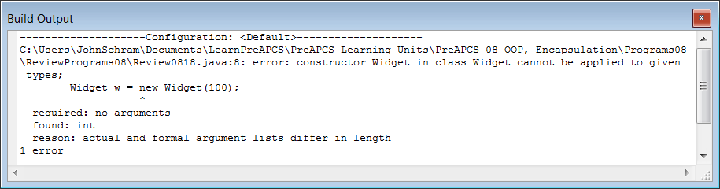
// Review0818.java is supposed to construct a
// <Widget> object and initialize its data.
public class Review0818
{
public static void main(String args[])
{
System.out.println("\nReview0818.JAVA\n");
Widget w = new Widget(100);
System.out.println();
}
}
class Widget
{
private int numWidgets;
public void Widget(int n) { numWidgets = n; }
}
A constructor is neither a <void> method nor a <return> method.
The words “void” or “return” cannot be in a constructor.

Slide 40
// Review0819.java is supposed to construct a
// <Widget> object and initialize its data.
public class Review0819
{
public static void main(String args[])
{
System.out.println("\nReview0819.JAVA\n");
Widget w = new Widget(100);
System.out.println();
}
}
class Widget
{
private int numWidgets;
private Widget(int n) { numWidgets = n; }
}

Slide 41
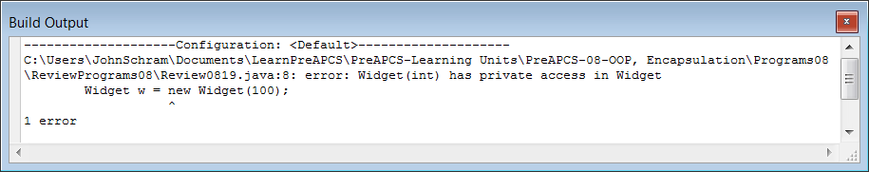
// Review0819.java is supposed to construct a
// <Widget> object and initialize its data.
public class Review0819
{
public static void main(String args[])
{
System.out.println("\nReview0819.JAVA\n");
Widget w = new Widget(100);
System.out.println();
}
}
class Widget
{
private int numWidgets;
private Widget(int n) { numWidgets = n; }
}
A constructor
cannot be declared
as a private method.

Slide 42
// Review0820.java is supposed to display the <Widget> data.
public class Review0820
{
public static void main(String args[])
{
System.out.println("\nReview0820.JAVA\n");
Widget w = new Widget(100);
int count = w.getWidgets();
System.out.println(count);
System.out.println();
}
}
class Widget
{
private int numWidgets;
public Widget(int n) { numWidgets = n; }
public int getWidgets() { System.out.println(numWidgets); }
}

Slide 43
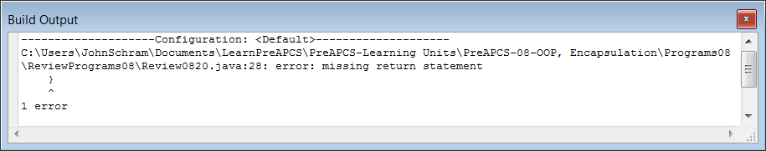
// Review0820.java is supposed to display the <Widget> data.
public class Review0820
{
public static void main(String args[])
{
System.out.println("\nReview0820.JAVA\n");
Widget w = new Widget(100);
int count = w.getWidgets();
System.out.println(count);
System.out.println();
}
}
class Widget
{
private int numWidgets;
public Widget(int n) { numWidgets = n; }
public int getWidgets() { System.out.println(numWidgets); }
}
Method <getWidgets>
is missing a
<return> statement.

Slide 44
// Review0821.java is supposed to alter and display the <Widget> data.
public class Review0821
{
public static void main(String args[])
{
System.out.println("\nReview0821.JAVA\n");
Widget w = new Widget(100);
int count = 200;
w.setWidgets();
System.out.println(w.getWidgets());
System.out.println();
}
}
class Widget
{
private int numWidgets;
public Widget(int n) { numWidgets = n; }
public int getWidgets() { return numWidgets; }
public void setWidgets() { numWidgets = count; }
}

Slide 45
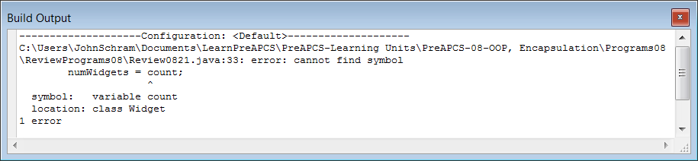
// Review0821.java is supposed to alter and display the <Widget> data.
public class Review0821
{
public static void main(String args[])
{
System.out.println("\nReview0821.JAVA\n");
Widget w = new Widget(100);
int count = 200;
w.setWidgets();
System.out.println(w.getWidgets());
System.out.println();
}
}
class Widget
{
private int numWidgets;
public Widget(int n) { numWidgets = n; }
public int getWidgets() { return numWidgets; }
public void setWidgets() { numWidgets = count; }
}
Variable <count> is not passed as parameter.
Method <setWidgets> does not have access to <count>.

Slide 46
// Review0822.java is supposed to alter and display the <Widget> data.
public class Review0822
{
public static void main(String args[])
{
System.out.println("\nReview0822.JAVA\n");
Widget w = new Widget(100);
int count = 200;
w.setWidgets(count);
System.out.println(w.getWidgets());
System.out.println();
}
}
class Widget
{
private int numWidgets;
public Widget(int n) { numWidgets = n; }
public int getWidgets() { return numWidgets; }
public void setWidgets(int n) { numWidgets = n; }
}

Slide 47
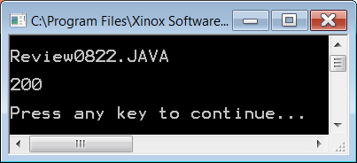
// Review0822.java is supposed to alter and display the <Widget> data.
public class Review0822
{
public static void main(String args[])
{
System.out.println("\nReview0822.JAVA\n");
Widget w = new Widget(100);
int count = 200;
w.setWidgets(count);
System.out.println(w.getWidgets());
System.out.println();
}
}
class Widget
{
private int numWidgets;
public Widget(int n) { numWidgets = n; }
public int getWidgets() { return numWidgets; }
public void setWidgets(int n) { numWidgets = n; }
}
There is nothing wrong with this program.
The names of the actual and formal parameters
do not need to match. There is nothing wrong
with <count> pasing data to <n>.

Slide 48
// Review0823.java is supposed to alter and display the <Widget> data.
public class Review0823
{
public static void main(String args[])
{
System.out.println("\nReview0823.JAVA\n");
Widget w = new Widget(100);
int count = 200;
setWidgets(count);
System.out.println(getWidgets());
System.out.println();
}
}
class Widget
{
private int numWidgets;
public Widget(int n) { numWidgets = n; }
public int getWidgets() { return numWidgets; }
public void setWidgets(int n) { numWidgets = n; }
}

Slide 49
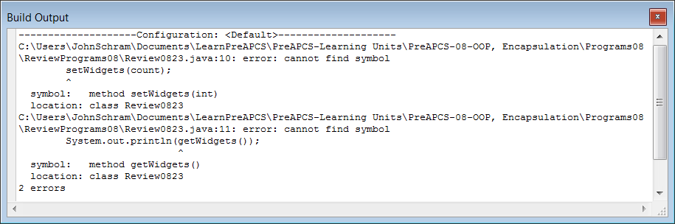
// Review0823.java is supposed to alter and display the <Widget> data.
public class Review0823
{
public static void main(String args[])
{
System.out.println("\nReview0823.JAVA\n");
Widget w = new Widget(100);
int count = 200;
setWidgets(count);
System.out.println(getWidgets());
System.out.println();
}
}
class Widget
{
private int numWidgets;
public Widget(int n) { numWidgets = n; }
public int getWidgets() { return numWidgets; }
public void setWidgets(int n) { numWidgets = n; }
}
In the <main> method there are object methods
called without the object identifier.

Slide 50
// Review0824.java is supposed to alter and display the <Widget> data.
public class Review0824
{
public static void main(String args[])
{
System.out.println("\nReview0824.JAVA\n");
int count = 200;
Widget.setWidgets(count);
System.out.println(Widget.getWidgets());
System.out.println();
}
}
class Widget
{
private int numWidgets;
public Widget(int n) { numWidgets = n; }
public int getWidgets() { return numWidgets; }
public void setWidgets(int n) { numWidgets = n; }
}

Slide 51
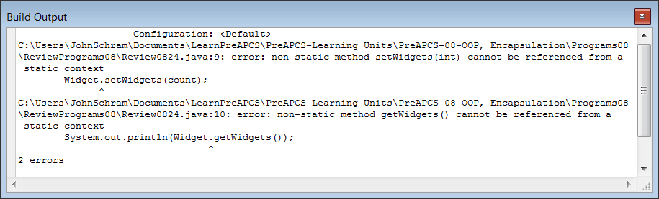
// Review0824.java is supposed to alter and display the <Widget> data.
public class Review0824
{
public static void main(String args[])
{
System.out.println("\nReview0824.JAVA\n");
int count = 200;
Widget.setWidgets(count);
System.out.println(Widget.getWidgets());
System.out.println();
}
}
class Widget
{
private int numWidgets;
public Widget(int n) { numWidgets = n; }
public int getWidgets() { return numWidgets; }
public void setWidgets(int n) { numWidgets = n; }
}
The <Widget> class has object methods,
but here they are called like class methods.

Slide 52
// Review0825.java is supposed to alter and display the <Widget> data.
public class Review0825
{
public static void main(String args[])
{
System.out.println("\nReview0822.JAVA\n");
Widget w = new Widget(100);
int count = 200;
w.setWidgets(count);
System.out.println(w.getWidgets());
System.out.println();
}
}
class Widget
{
private int numWidgets;
public Widget(int n) { numWidgets = n; }
private int getWidgets() { return numWidgets; }
private void setWidgets(int n) { numWidgets = n; }
}

Slide 53
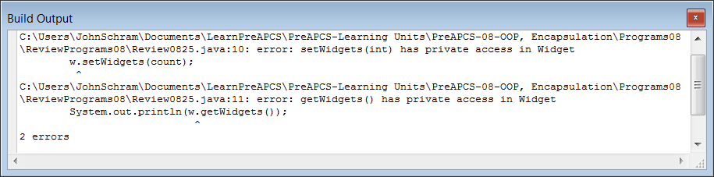
// Review0825.java is supposed to alter and display the <Widget> data.
public class Review0825
{
public static void main(String args[])
{
System.out.println("\nReview0822.JAVA\n");
Widget w = new Widget(100);
int count = 200;
w.setWidgets(count);
System.out.println(w.getWidgets());
System.out.println();
}
}
class Widget
{
private int numWidgets;
public Widget(int n) { numWidgets = n; }
private int getWidgets() { return numWidgets; }
private void setWidgets(int n) { numWidgets = n; }
}
It is not possible to access <getWidgets> and
<setWidgets> when they are declared <private>.

