Slide 1


Exposure Java 2013
APCS Edition
Chapter 8 Slides
Focus on OOP, Encapsulation
PowerPoint Presentation
created by:
Mr. John L. M. Schram
and Mr. Leon Schram
Authors of Exposure Java

Slide 2
Section 8.1
Introduction

Slide 3
Objects, Variables & Methods
Java encapsulates data and action modules that access the data in one container, called an object.
Object members that perform some task are called methods.
Object members that store data are called attributes.

Slide 4
Section 8.2
Creating a
New Class

Slide 5
The CardDeck Case Study
CardDeck Methods | CardDeck Data
Initialize Deck | # of Decks
Shuffle Deck | # of Players
Deal Cards From Deck | # of Cards Dealt
Count Leftover Cards | # of Cards Left
You could probably think of many more methods and attributes.

Slide 6
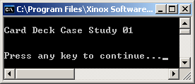
// Java0801.java
// CardDeck Case Study #01
// This shows a minimal class declaration.
// This class has no practical value, but it compiles and executes.
public class Java0801
{
public static void main(String args[])
{
System.out.println("\nCard Deck Case Study 01\n");
CardDeck d = new CardDeck();
System.out.println();
}
}
class CardDeck
{
}

Slide 7
Section 8.3
Restricting
Attribute Access

Slide 8
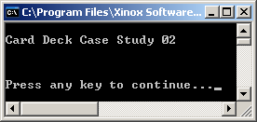

// Java0802.java
// CardDeck Case Study #02
// Variables, called attributes or data fields, are added to the <CardDeck> class.
public class Java0802
{
public static void main(String args[])
{
System.out.println("\nCard Deck Case Study 02\n");
System.out.println();
CardDeck d = new CardDeck();
System.out.println();
}
}
class CardDeck
{
String cardGame; // name of the card game
int numDecks; // number of decks in a game
int numplayers; // number of players in a game
int cardsLeft; // number of cards left in the deck(s)
}

Slide 9
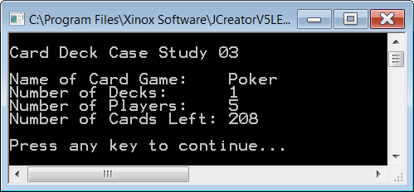

// Java0803.java
// CardDeck Case Study #03
// <CardDeck> variables are accessed directly by the <main> method.
// This program violates encapsulation, even though it compiles, and executes.
// This approach greatly compromises program reliability.
public class Java0803
{
public static void main(String args[])
{
System.out.println("\nCard Deck Case Study 03\n");
CardDeck d = new CardDeck();
d.cardGame = "Poker";
d.numDecks = 1;
d.numPlayers = 5;
d.cardsLeft = 208;
System.out.println("Name of Card Game: " + d.cardGame);
System.out.println("Number of Decks: " + d.numDecks);
System.out.println("Number of Players: " + d.numPlayers);
System.out.println("Number of Cards Left: " + d.cardsLeft);
System.out.println();
}
}
class CardDeck
{
String cardGame;
int numDecks;
int numPlayers;
int cardsLeft;
}

Slide 10

// Java0804.java
// CardDeck Case Study #04
// All the variables in the <CardDeck> class are
// now declared as private access.
// This prevents improper, public access to the
// data variables.
public class Java0804
{
public static void main(String args[])
{
System.out.println("\nCard Deck Case Study 04\n");
CardDeck d = new CardDeck();
d.cardGame = "Poker";
d.numDecks = 4;
d.numPlayers = 5;
d.cardsLeft = 208;
System.out.println("Name of Card Game: " + d.cardGame);
System.out.println("Number of Decks: " + d.numDecks);
System.out.println("Number of Players: " + d.numPlayers);
System.out.println("Number of Cards Left: " + d.cardsLeft);
System.out.println();
}
}
class CardDeck
{
private String cardGame;
private int numDecks;
private int numPlayers;
private int cardsLeft;
}

Slide 11
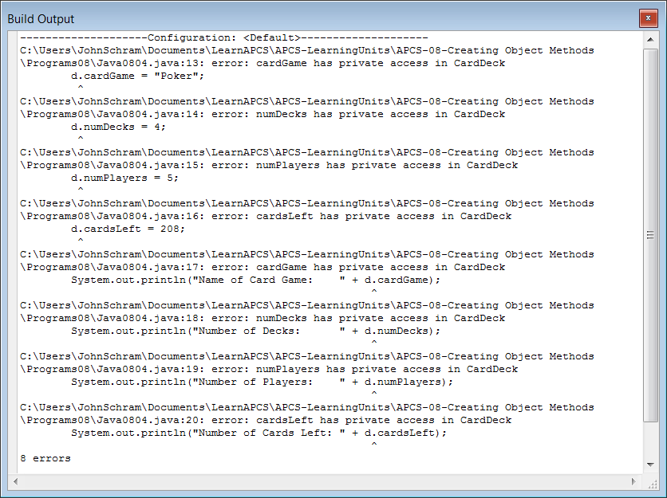

Slide 12
private & public Members
Members in a class need to be declared as private or public.
private members cannot be accessed by any program segments outside the class.
Data attributes of a class usually need to be declared private.
public members of a class can be accessed by program segments outside the class.

Slide 13
“Mr. Schram, how does using private give you any security when you can just change it back to public?”
Think of any video game that you
have ever purchased.
Do you ever see the source code?
Only the programmers have the source code.
What they sell to users is an executable file.

Slide 14
Section 8.4
Get & Set
Methods

Slide 15
// Java0805.java
// CardDeck Case Study #05
// The <CardDeck> class now has four "get" methods to return
// the data values of <CardDeck> objects.
// Note that Java assigns initial values to object data.
public class Java0805
{
public static void main(String args[])
{
System.out.println("\nCard Deck Case Study 05\n");
CardDeck d = new CardDeck();
System.out.println("Name of Card Game: " + d.getGame());
System.out.println("Number of Decks: " + d.getDecks());
System.out.println("Number of Players: " + d.getPlayers());
System.out.println("Number of Cards Left: " + d.getCards());
System.out.println();
}
}

Slide 16
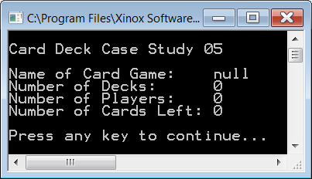
class CardDeck
{
private String cardGame;
private int numDecks;
private int numPlayers;
private int cardsLeft;
public String getGame() { return cardGame; }
public int getDecks() { return numDecks; }
public int getPlayers() { return numPlayers; }
public int getCards() { return cardsLeft; }
}

Slide 17
// Java0806.java
// CardDeck Case Study #06
// The <CardDeck> class adds four "set" methods
// to alter the data attributes of <CardDeck> objects.
public class Java0806
{
public static void main(String args[])
{
System.out.println("\nCard Deck Case Study 06\n");
CardDeck d = new CardDeck();
d.setGame("Bridge");
d.setDecks(1);
d.setPlayers(4);
d.setCards(52);
System.out.println("Name of Card Game: " + d.getGame());
System.out.println("Number of Decks: " + d.getDecks());
System.out.println("Number of Players: " + d.getPlayers());
System.out.println("Number of Cards Left: " + d.getCards());
}
}

Slide 18
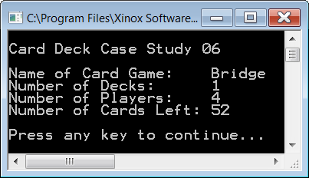
class CardDeck
{
// Data attributes
private String cardGame;
private int numDecks;
private int numPlayers;
private int cardsLeft;
// Get return Methods
public String getGame() { return cardGame; }
public int getDecks() { return numDecks; }
public int getPlayers() { return numPlayers; }
public int getCards() { return cardsLeft; }
// Set void Methods
public void setGame(String cG) { cardGame = cG; }
public void setDecks(int nD) { numDecks = nD; }
public void setPlayers(int nP) { numPlayers = nP; }
public void setCards(int cL) { cardsLeft = cL; }
}

Slide 19
Section 8.5
Constructor
Methods

Slide 20
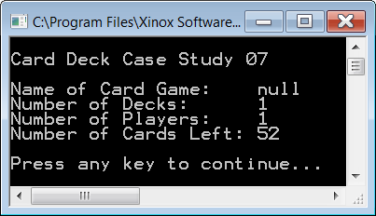
// Java0807.java
// CardDeck Case Study #07
// This <CardDeck> class uses a constructor to initialize variables
// during the instantiation of a new <CardDeck> object.
// This is an example of increasing reliability by an automatic constructor call.
public class Java0807
{
public static void main(String args[])
{
System.out.println("\nCard Deck Case Study 07\n");
CardDeck d = new CardDeck();
System.out.println("Name of Card Game: " + d.getGame());
System.out.println("Number of Decks: " + d.getDecks());
System.out.println("Number of Players: " + d.getPlayers());
System.out.println("Number of Cards Left: " + d.getCards());
System.out.println();
}
}

Slide 21
class CardDeck
{
private String cardGame;
private int numDecks;
private int numPlayers;
private int cardsLeft;
// Constructor
public CardDeck()
{
cardGame = null;
numDecks = 1;
numPlayers = 1;
cardsLeft = 52;
}
public String getGame() { return cardGame; }
public int getDecks() { return numDecks; }
public int getPlayers() { return numPlayers; }
public int getCards() { return cardsLeft; }
public void setGame(String cG) { cardGame = cG; }
public void setDecks(int nD) { numDecks = nD; }
public void setPlayers(int nP) { numPlayers = nP; }
public void setCards(int cL) { cardsLeft = cL; }
}

Slide 22
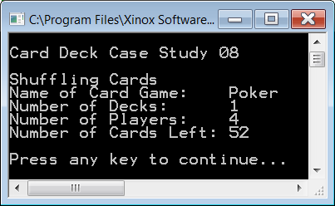
// Java0808.java
// CardDeck Case Study #08
// This program adds the <shuffleCards> method, which is a <private>
// helper method used by the <CardDeck> constructor.
public class Java0808
{
public static void main(String args[])
{
System.out.println("\nCard Deck Case Study 08\n");
CardDeck d = new CardDeck();
System.out.println("Name of Card Game: " + d.getGame());
System.out.println("Number of Decks: " + d.getDecks());
System.out.println("Number of Players: " + d.getPlayers());
System.out.println("Number of Cards Left: " + d.getCards());
System.out.println();
}
}

Slide 23

class CardDeck
{
private String cardGame;
private int numDecks;
private int numPlayers;
private int cardsLeft;
public CardDeck()
{
cardGame = "Poker";
numDecks = 1;
numPlayers = 4;
cardsLeft = 52;
shuffleCards();
}
private void shuffleCards() { System.out.println("Shuffling Cards"); }
public String getGame() { return cardGame; }
public int getDecks() { return numDecks; }
public int getPlayers() { return numPlayers; }
public int getCards() { return cardsLeft; }
public void setGame(String cG) { cardGame = cG; }
public void setDecks(int nD) { numDecks = nD; }
public void setPlayers(int nP) { numPlayers = nP; }
public void setCards(int cL) { cardsLeft = cL; }
}

Slide 24
// Java0809.java
// CardDeck Case Study #09
// A second, overloaded constructor, method is added to the program.
// It is now possible to specify card deck details during instantiation.
public class Java0809
{
public static void main(String args[])
{
System.out.println("\nCard Deck Case Study 09\n");
CardDeck d1 = new CardDeck();
CardDeck d2 = new CardDeck("BlackJack",4,5);
System.out.println();
System.out.println("Name of Card Game: " + d1.getGame());
System.out.println("Number of Decks: " + d1.getDecks());
System.out.println("Number of Players: " + d1.getPlayers());
System.out.println("Number of Cards Left: " + d1.getCards());
System.out.println();
System.out.println("Name of Card Game: " + d2.getGame());
System.out.println("Number of Decks: " + d2.getDecks());
System.out.println("Number of Players: " + d2.getPlayers());
System.out.println("Number of Cards Left " + d2.getCards());
System.out.println();
}
}

Slide 25
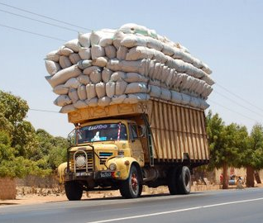
class CardDeck
{
private String cardGame;
private int numDecks;
private int numPlayers;
private int cardsLeft;
public CardDeck()
{
System.out.println("Default Constructor");
cardGame = "Poker";
numDecks = 1;
numPlayers = 4;
cardsLeft = 52;
shuffleCards();
}
public CardDeck(String cG, int nD, int nP)
{
System.out.println("Overloaded Constructor");
cardGame = cG;
numDecks = nD;
numPlayers = nP;
cardsLeft = nD * 52;
shuffleCards();
}
private void shuffleCards() { System.out.println("Shuffling Cards"); }
// CardDeck get and set methods will no longer be shown.

Slide 26
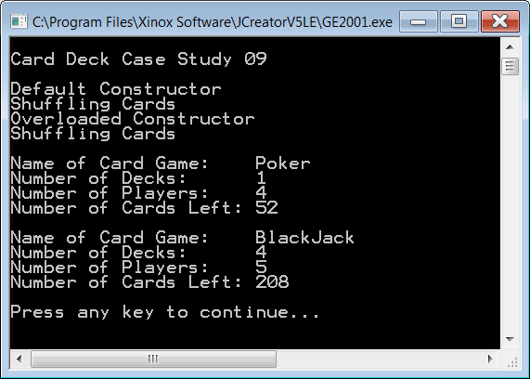
Output for
Program
Java0809.java

Slide 27

Instantiation & Construction
A class is a template that can form many objects.
An object is a single variable instance of a class.
Objects are sometimes called instances.
An object is created with the new operator.
The creation of a new object is called:
instantiation of an object
construction of an object
The special method that is called during the instantiation of a new object is the constructor.

Slide 28




Constructor Notes
Constructors are methods, which are called during the
instantiation of an object with the new operator.
The primary purpose of a constructor is to
initialize all the attributes of newly created object.
Constructors have the same identifier as the class.
Constructors are neither void methods nor are they
return methods. They are simply constructors.
Constructors are always declared public.
Constructors can be overloaded methods.
The method identifier can be the same, but the method
signature (which is the parameter list) must be different.
A constructor with no parameters
is called a default constructor.

Slide 29
Section 8.6
The Cube
Case Study

Slide 30

The Cube Case Study
Cube Methods | Cube Data
Draw Cube | x Coordinate
Erase Cube | y Coordinate
Move Cube | size

Slide 31
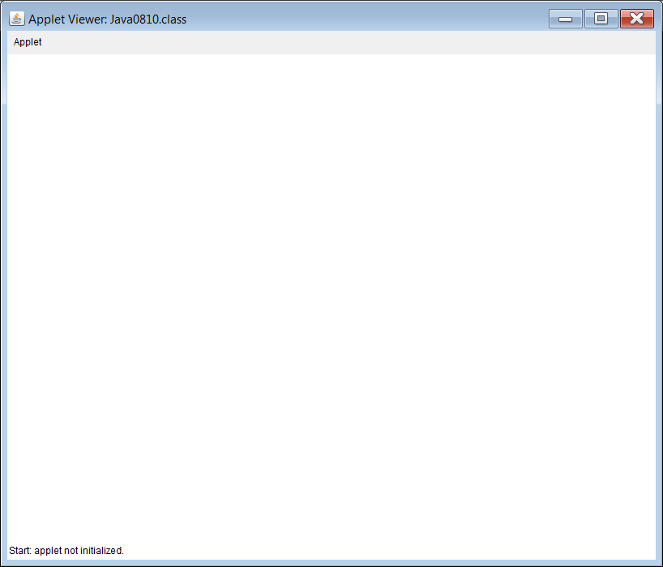
// Java0810.java
// Cube Casestudy #1
// Stage #1 presents a <Cube> class with a default constructor.
// This program does not display a cube.
// The Cube Case Study uses applets. Run the html file to execute.
public class Java0810 extends Applet
{
public void paint(Graphics g)
{
Cube cube = new Cube(g);
}
}
class Cube
{
private int tlX; // topleft X coordinate of the Cube's position
private int tlY; // topleft y coordinate of the Cube's position
public Cube(Graphics g)
{
tlX = 50;
tlY = 50;
}
}

Slide 32
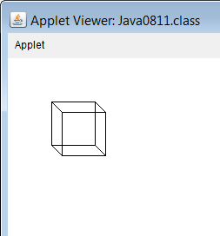

// Java0811.java Cube Casestudy #2
// Stage #2 presents adds a <draw> method to display one cube object.
public class Java0811 extends Applet
{
public void paint(Graphics g)
{
Cube cube = new Cube(g);
cube.draw(g);
}
}
class Cube
{
private int tlX; // topleft X coordinate of the Cube's position
private int tlY; // topleft y coordinate of the Cube's position
public Cube(Graphics g) { tlX = 50; tlY = 50; }
public void draw(Graphics g)
{
int tlX2 = tlX + 12;
int tlY2 = tlY + 12;
g.setColor(Color.black);
g.drawRect(tlX,tlY,50,50);
g.drawRect(tlX2,tlY2,50,50);
g.drawLine(tlX,tlY,tlX2,tlY2);
g.drawLine(tlX+50,tlY,tlX2+50,tlY2);
g.drawLine(tlX,tlY+50,tlX2,tlY2+50);
g.drawLine(tlX+50,tlY+50,tlX2+50,tlY2+50);
}
}

Slide 33
// Java0812.java Cube Casestudy #3 // Stage #3 adds a second, overloaded constructor. // It is now possible to specify the size and the location of the cube. // The <draw> method needs to be altered to handle different cube sizes.
import java.awt.*; import java.applet.*; public class Java0812 extends Applet { public void paint(Graphics g) { Cube cube1 = new Cube(g,50,50,50); cube1.draw(g); Cube cube2 = new Cube(g,400,50,100); cube2.draw(g); Cube cube3 = new Cube(g,50,300,150); cube3.draw(g); Cube cube4 = new Cube(g,400,300,200); cube4.draw(g); } } class Cube { private int tlX; private int tlY; private int size; | public Cube(Graphics g) { tlX = 50; tlY = 50; size = 50; } public Cube(Graphics g, int x, int y, int s) { tlX = x; tlY = y; size = s; } public void draw(Graphics g) { int tlX2 = tlX + size/3; int tlY2 = tlY + size/3; g.setColor(Color.black); g.drawRect(tlX,tlY,size,size); g.drawRect(tlX2,tlY2,size,size); g.drawLine(tlX,tlY,tlX2,tlY2); g.drawLine(tlX+size,tlY,tlX2+size,tlY2); g.drawLine(tlX,tlY+size,tlX2,tlY2+size); g.drawLine(tlX+size,tlY+size,tlX2+size,tlY2+size); } }

Slide 34
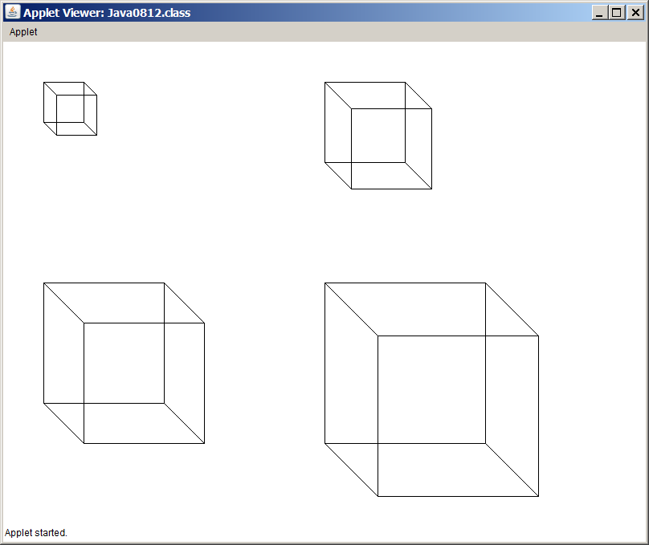

Slide 35
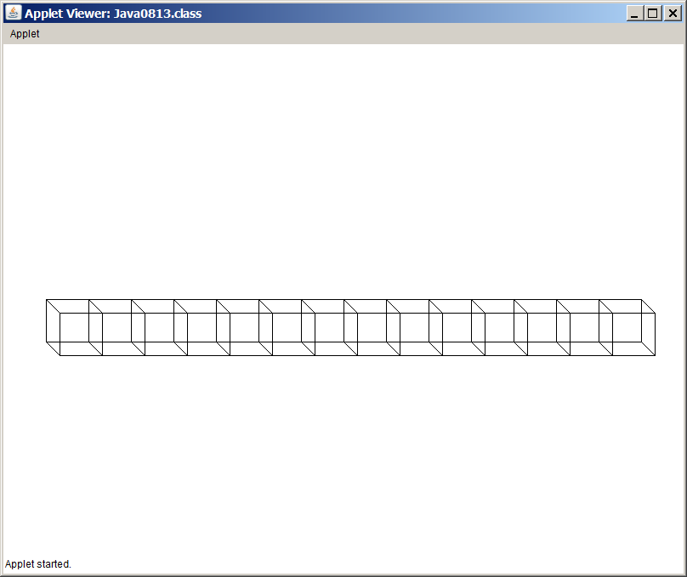

// Java0813.java Cube Casestudy #4
// Stage #4 adds a <move> method, which updates the cube's coordinates
// and draws a cube at the new location.
// Only new methods are shown.
public class Java0813 extends Applet
{
public void paint(Graphics g)
{
Cube cube = new Cube(g,50,50,50);
for (int x = 50; x < 750; x += 50)
cube.move(g,x,300);
}
}
class Cube
{
private int tlX; // topleft X coordinate of the Cube's position
private int tlY; // topleft y coordinate of the Cube's position
private int size; // the size of the cube along one edge
public void move(Graphics g, int x, int y)
{
tlX = x; tlY = y; draw(g);
}
}

Slide 36
// Java0814.java Cube Casestudy #5 // Stage #5 adds an <erase> method, which erases the cube at the current [tlX,tlY] coordinates. // This program has a problem because the cube object is erased immediately after it is drawn.
import java.awt.*; import java.applet.*; public class Java0814 extends Applet { public void paint(Graphics g) { Cube cube = new Cube(g,50,50,50); for (int x = 50; x < 750; x += 50) { cube.move(g,x,300); cube.erase(g); } } } | class Cube { private int tlX; // topleft X coordinate of the Cube's position private int tlY; // topleft y coordinate of the Cube's position private int size; // the size of the cube along one edge public void erase(Graphics g) { int tlX2 = tlX + size/3; int tlY2 = tlY + size/3; g.setColor(Color.white); g.drawRect(tlX,tlY,size,size); g.drawRect(tlX2,tlY2,size,size); g.drawLine(tlX,tlY,tlX2,tlY2); g.drawLine(tlX+size,tlY,tlX2+size,tlY2); g.drawLine(tlX,tlY+size,tlX2,tlY2+size); g.drawLine(tlX+size,tlY+size,tlX2+size,tlY2+size); } }

Slide 37
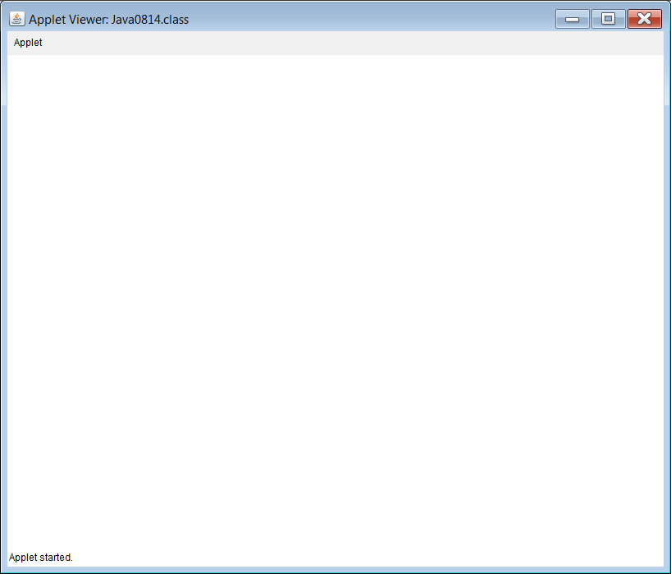
It seams like there is no output.
The problem is the output is
so fast you cannot see it.

Slide 38

// Java0815.java Cube Casestudy #6 // Stage #6 adds a <delay> method which stops program execution for a specified number of // milli seconds. This makes the cube visible and creates a simple type of animation.
import java.awt.*; import java.applet.*; public class Java0815 extends Applet { public void paint(Graphics g) { Cube cube = new Cube(g,50,50,50); for (int x = 50; x < 750; x += 50) { cube.move(g,x,300); cube.delay(100); cube.erase(g); } } } | class Cube { private int tlX; // topleft X coordinate of the Cube's position private int tlY; // topleft y coordinate of the Cube's position private int size; // the size of the cube along one edge public void delay(int n) { long startDelay = System.currentTimeMillis(); long endDelay = 0; while (endDelay - startDelay < n) endDelay = System.currentTimeMillis(); } }

Slide 39

Note: Output simulated
with PowerPoint
Try This:
For smoother output
change the delay to 10
and the x+=20 to x+=2.

Slide 40
// Java0816.java Cube Casestudy #7 // Stage #7 adds three methods that return the values of instance variables. // They are methods <getX>, <getY> and <getSize>.
import java.awt.*; import java.applet.*; public class Java0816 extends Applet { public void paint(Graphics g) { Cube cube = new Cube(g,50,50,50); Cube cube = new Cube(g,400,300,200); cube.draw(g); System.out.println("Top Left X: " + cube.getX()); System.out.println("Top Left Y: " + cube.getY()); System.out.println("Cube Size: " + cube.getSize()); } | class Cube { private int tlX; // topleft X coordinate of the Cube's position private int tlY; // topleft y coordinate of the Cube's position private int size; // the size of the cube along one edge public int getX() { return tlX; } public int getY() { return tlY; } public int getSize() { return size; } }
Outputs shown on the next 3 slides.

Slide 41
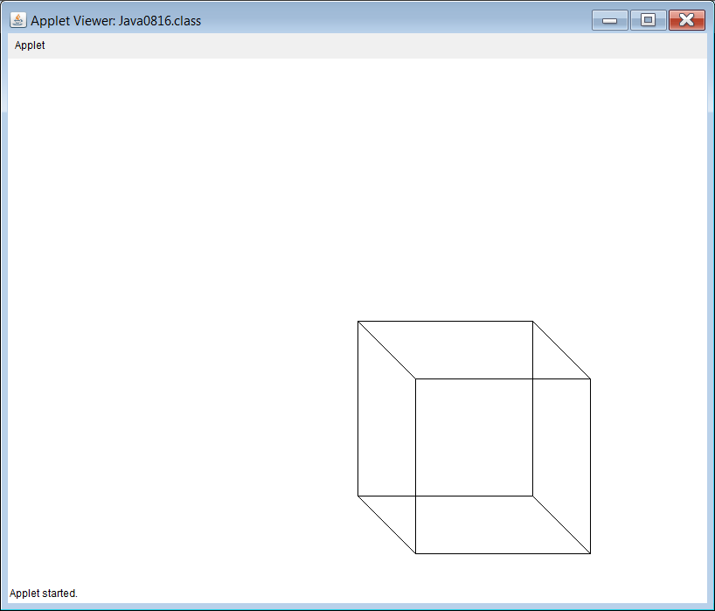
GUI Output of
Program Java0816.java

Slide 42
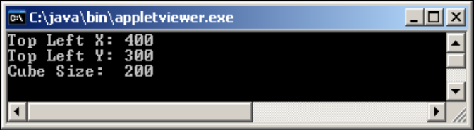
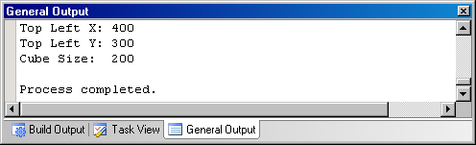
Located behind the GUI window
Possible Text Outputs of
Program Java0816.java
Located at the bottom of JCreator

Slide 43
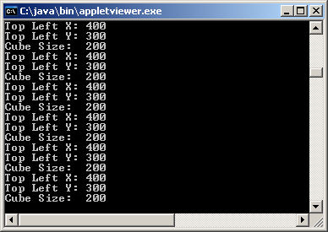
Weird Output!
You might get this output when switching between the GUI and Text windows.
This happens if you drag something in front of the GUI window or resize it.
The GUI window will need to be refreshed which will cause the paint method to be called repeatedly.

Slide 44
Section 8.7
The Consequences
of Scope

Slide 45
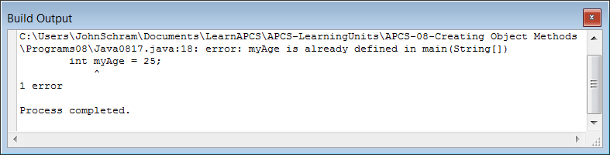
// Java0817.java
// This program demonstrates how one variable name <counter>
// can be declared twice correctly.
// It also shows <myAge> declared twice incorrectly.
public class Java0817
{
public static void main(String args[])
{
for (int counter = 1; counter <= 5; counter++)
System.out.print(counter + " ");
for (int counter = 10; counter <= 15; counter++)
System.out.print(counter + " ");
int myAge = 16;
int myAge = 25;
}
}

Slide 46
// Java0818.java
// This program demonstrates the scope of a variable.
public class Java0818
{
public static void main(String args[])
{
int var1 = 10;
System.out.println("var1 in main is " + var1);
System.out.print("var2 inside the main method for loop is ");
for (int var2 = 1; var2 < 10; var2++)
{
System.out.print(var2 + " ");
}
System.out.println();
Boo boo = new Boo(var1);
System.out.println("var4 in Boo is " + boo.getData());
System.out.println();
}
}

Slide 47
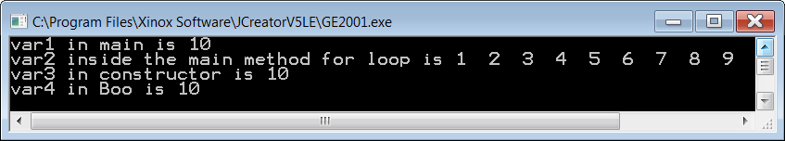
class Boo
{
private int var4;
public Boo(int var3)
{
var4 = var3;
System.out.println("var3 in constructor is " + var3);
}
public int getData()
{
return var4;
}
}

Slide 48
// Java0818.java
// This program demonstrates the scope of a variable.
public class Java0818
{
public static void main(String args[])
{
int var1 = 10;
System.out.println("var1 in main is " + var1);
System.out.print("var2 inside the main method for loop is ");
for (int var2 = 1; var2 < 10; var2++)
{
System.out.print(var2 + " ");
}
System.out.println();
Boo boo = new Boo(var1);
System.out.println("var4 in Boo is " + boo.getData());
System.out.println();
}
}
Scope of var1

Slide 49
// Java0818.java
// This program demonstrates the scope of a variable.
public class Java0818
{
public static void main(String args[])
{
int var1 = 10;
System.out.println("var1 in main is " + var1);
System.out.print("var2 inside the main method for loop is ");
for (int var2 = 1; var2 < 10; var2++)
{
System.out.print(var2 + " ");
}
System.out.println();
Boo boo = new Boo(var1);
System.out.println("var4 in Boo is " + boo.getData());
System.out.println();
}
}
Scope of var2

Slide 50
class Boo
{
private int var4;
public Boo(int var3)
{
var4 = var3;
System.out.println("var3 in constructor is " + var3);
}
public int getData()
{
return var4;
}
}
Scope of var3

Slide 51
class Boo
{
private int var4;
public Boo(int var3)
{
var4 = var3;
System.out.println("var3 in constructor is " + var3);
}
public int getData()
{
return var4;
}
}
Scope of var4

Slide 52
Scope Definition
What is scope? The scope of a variable - simple, primitive data type or complex object - is the segment of a program during which a variable is defined, has allocated memory to store values and can be accessed.
If two variables have the same identifier and also the same scope, Java will object with a duplicate definition compile error.

Slide 53
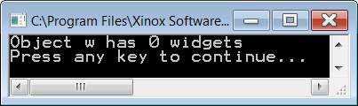
// Java0819.java
// This program shows the logic problem that results from using two variables
// with the same name identifier, but two different scopes.
public class Java0819
{
public static void main(String args[])
{
Widget w = new Widget(100);
System.out.println("Object w has " + w.getWidgets() + " widgets");
}
}
class Widget
{
private int numWidgets;
public Widget(int numWidgets)
{
numWidgets = numWidgets;
}
public int getWidgets()
{
return numWidgets;
}
}

Slide 54
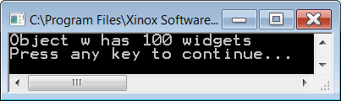
// Java0820.java
// Using different variable names is one solution to the
// problem caused by program Java0819.java.
public class Java0820
{
public static void main(String args[])
{
Widget w = new Widget(100);
System.out.println("Object w has " + w.getWidgets() + " widgets");
}
}
class Widget
{
private int numWidgets;
public Widget(int nW)
{
numWidgets = nW;
}
public int getWidgets()
{
return numWidgets;
}
}

Slide 55
// Java0821.java
// Using the <this> reference is a second solution to the
// problem in program Java0819.java.
public class Java0821
{
public static void main(String args[])
{
Widget w = new Widget(100);
System.out.println("Object w has " + w.getWidgets() + " widgets");
}
}
class Widget
{
private int numWidgets;
public Widget(int numWidgets)
{
this.numWidgets = numWidgets; // required use of this
}
public int getWidgets()
{
return this.numWidgets; // optional use of this
}
}

Slide 56
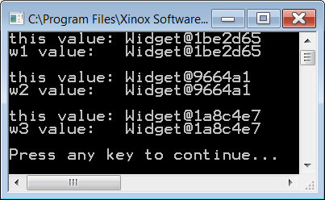
// Java0822.java
// Comparing the value of the three <Widget> objects demonstrates
// that the <this> reference value is equal to the current object used.
public class Java0822
{
public static void main(String args[])
{
Widget w1 = new Widget(100);
System.out.println("w1 value: " + w1);
System.out.println();
Widget w2 = new Widget(100);
System.out.println("w2 value: " + w2);
System.out.println();
Widget w3 = new Widget(100);
System.out.println("w3 value: " + w3);
System.out.println();
}
}
class Widget
{
private int numWidgets;
public Widget(int numWidgets)
{
this.numWidgets = numWidgets;
System.out.println("this value: " + this);
}
}

Slide 57
// Java0823.java
// The <moveTo> method of the <Actor> class used by the GridWorld
// case study shows two uses of the <this> reference.
// This file is incomplete and will not compile.
public class Actor
{
public void moveTo(Location newLocation)
{
if (grid == null)
throw new IllegalStateException("This actor is not in a grid.");
if (grid.get(location) != this)
throw new IllegalStateException(
"The grid contains a different actor at location " + location + ".");
if (!grid.isValid(newLocation))
throw new IllegalArgumentException("Location " + newLocation
+ " is not valid.");
if (newLocation.equals(location))
return;
grid.remove(location);
Actor other = grid.get(newLocation);
if (other != null)
other.removeSelfFromGrid();
location = newLocation;
grid.put(location, this);
}
}

Slide 58
// Java0823.java
// The <moveTo> method of the <Actor> class used by the GridWorld
// case study shows two uses of the <this> reference.
// This file is incomplete and will not compile.
public class Actor
{
public void moveTo(Location newLocation)
{
if (grid == null)
throw new IllegalStateException("This actor is not in a grid.");
if (grid.get(location) != this)
throw new IllegalStateException(
"The grid contains a different actor at location " + location + ".");
if (!grid.isValid(newLocation))
throw new IllegalArgumentException("Location " + newLocation
+ " is not valid.");
if (newLocation.equals(location))
return;
grid.remove(location);
Actor other = grid.get(newLocation);
if (other != null)
other.removeSelfFromGrid();
location = newLocation;
grid.put(location, this);
}
}

Slide 59
// Java0823.java
// The <moveTo> method of the <Actor> class used by the GridWorld
// case study shows two uses of the <this> reference.
// This file is incomplete and will not compile.
public class Actor
{
public void moveTo(Location newLocation)
{
if (grid == null)
throw new IllegalStateException("This actor is not in a grid.");
if (grid.get(location) != this)
throw new IllegalStateException(
"The grid contains a different actor at location " + location + ".");
if (!grid.isValid(newLocation))
throw new IllegalArgumentException("Location " + newLocation
+ " is not valid.");
if (newLocation.equals(location))
return;
grid.remove(location);
Actor other = grid.get(newLocation);
if (other != null)
other.removeSelfFromGrid();
location = newLocation;
grid.put(location, this);
}
}
A void method can have a return statement as long as it does not return anything. This return simply exits the method.

Slide 60
Section 8.8
Method
Summary

Slide 61
Class or Static Methods
Class methods are sometimes called static methods because they have the keyword static in their heading.
A class method is called with the class identifier, not with an object of the class.
This is practical when there is no need to make multiple objects of a class.
A good example is Java’s Math class.

Slide 62
Class or Static Methods
public class Demo
{
public static void main(String args[])
{
Piggy.initData();
Piggy.showData();
Piggy.addData(1200);
Piggy.showData();
}
}
class Piggy
{
public static double savings;
public static void initData() { savings = 0; }
public static void addData(double s) { savings += s; }
public static void showData() { System.out.println("Savings: " + savings); }
}

Slide 63
Object or Non-Static Methods
Object methods are sometimes called non-static methods because they do NOT have the keyword static in their heading.
Object methods are meant for those situations where multiple objects of a class must be constructed.
An object must be constructed first with the new operator, and then object methods are called by using the object identifier.

Slide 64
Object or Non-Static Methods
public class Demo
{
public static void main(String args[])
{
Piggy tom = new Piggy();
tom.initData();
tom.showData();
tom.addData(1200);
tom.showData();
}
}
class Piggy
{
private double savings;
public void initData() { savings = 0; }
public void addData(double s) { savings += s; }
public void showData() { System.out.println("Savings: " + savings); }
}

Slide 65

Public Methods
Essentially, public methods
can be accessed anywhere.
The majority of methods are public.
public int getCards()
{
return cardsLeft;
}

Slide 66

Private or Helper Methods
Occasionally, a method is created in a class that is never called outside of the class.
In such a case, the method
should be declared private.
These private methods are sometimes called helper methods because they help and support the other methods of the class.

Slide 67
Void Methods
Void methods do NOT return a value and use the reserved word void to indicate that no value will be returned.
public void showData()
{
System.out.println("Name: " + name);
System.out.println("Savings: " + savings);
}

Slide 68
Return Methods
Return methods are methods that return a value.
Two features are necessary for a return method:
First, you will see that the method heading indicates a data type, which is the type that the method returns.
Second, you see a return statement at the end of the method body.
public double getSavings()
{
return savings;
}

Slide 69
Default Constructor Methods
A constructor is a special method that is automatically called during the instantiation
of a new object.
If no visible constructor is provided, Java will provide its own constructor, called a
default constructor.
Additionally, we also call a
no-parameter constructor
a default constructor.
public CardDeck()
{
numDecks = 1;
numPlayers = 1;
cardsLeft = 52;
shuffleCards();
}

Slide 70
Overloaded Constructor Methods
An overloaded constructor is a second, third or more, constructor that allows a new object to be instantiated according to some specifications that are passed by parameters.
public CardDeck(int d, int p)
{
numDecks = d;
numPlayers = p;
cardsLeft = d * 52;
shuffleCards();
}

Slide 71
Accessing or Get Methods
Methods that only access object data without altering the data are called accessing or get methods.
Most accessing methods are return methods, which return object private data information.
public int getDecks()
{
return numDecks;
}

Slide 72
Altering or Modifier or Mutator or Set Methods
These are methods that not only access the private data of an object; they also alter the value of the data.
public void savingsDeposit(double s)
{
savings += s;
}

Slide 73
Section 8.9
GridWorld’s
main Method

Slide 74
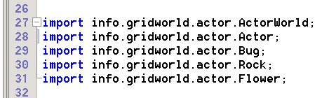
Use Correct import Statements
This shows the import statements of some GridWorld file. These import statements are necessary to give access to the classes used by the program. Java has many, many standard libraries that can be accessed by import statements. The GridWorld Case Study has created its own set of packages to organize the many available classes.

Slide 75
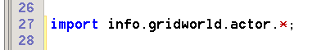
Using a Wildcard in an import Statement
This 1 import statement with an asterisk * wildcard:
does the same thing as these 5 import statements:

Slide 76
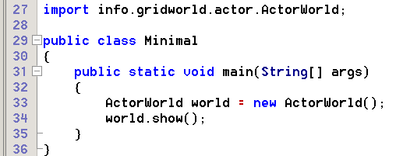
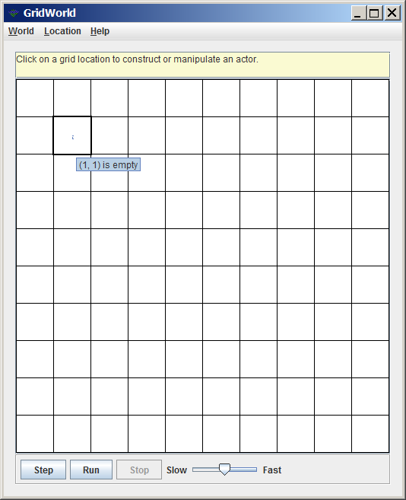
Minimal GridWorld main Method
Clicking on an empty cell may bring a surprise.
You are told that the cell is empty and there is no list of constructors to select from for the creation of a new object.

Slide 77
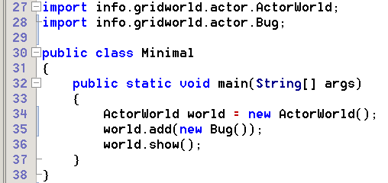
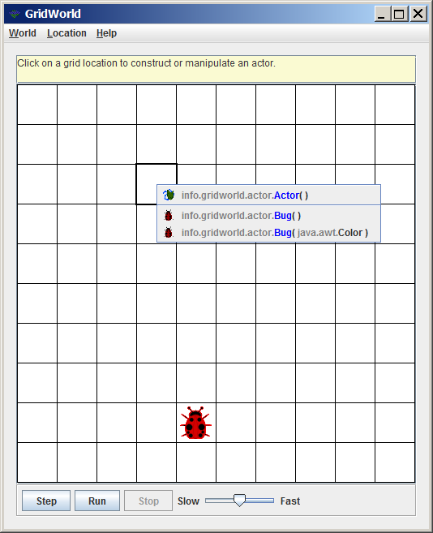
Adding a Bug Object
Adding a Bug object in the program makes it possible to add Bug and Actor objects during execution by clicking on an empty cell.

Slide 78
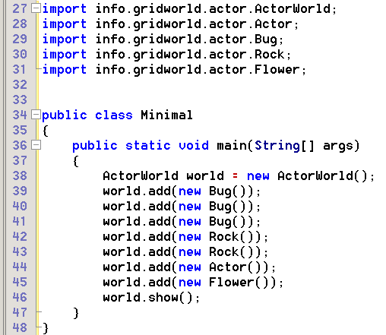
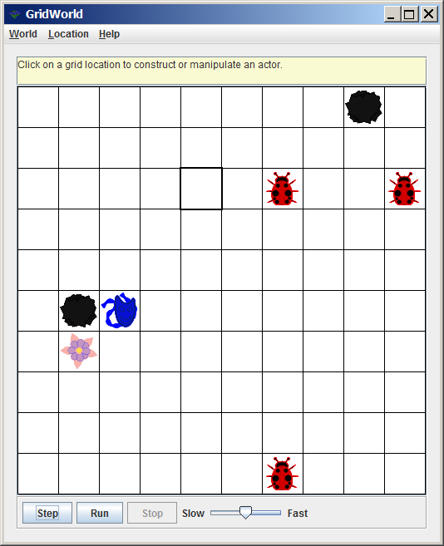
New Objects at Random Locations
Execution #1

Slide 79
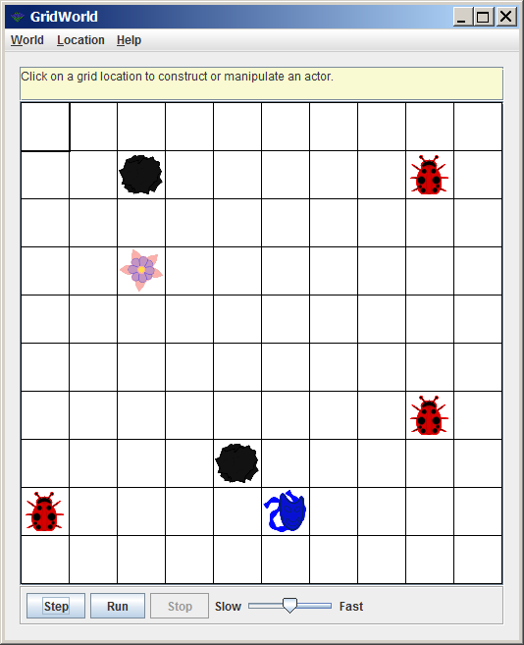
New Objects at Random Locations
Execution #2

Slide 80
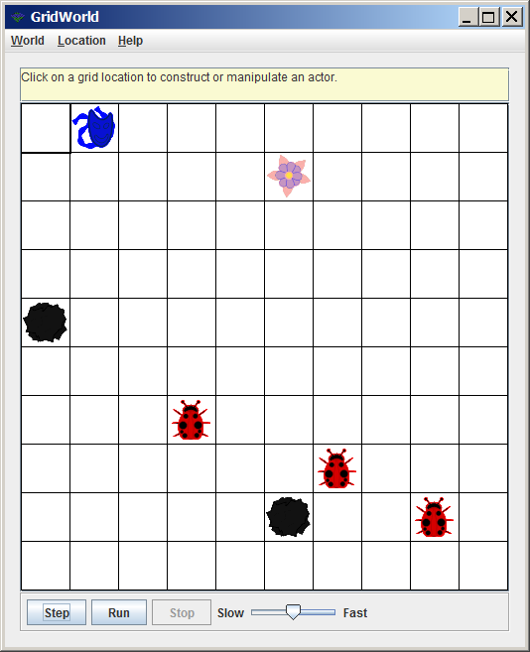
New Objects at Random Locations
Execution #3

Slide 81
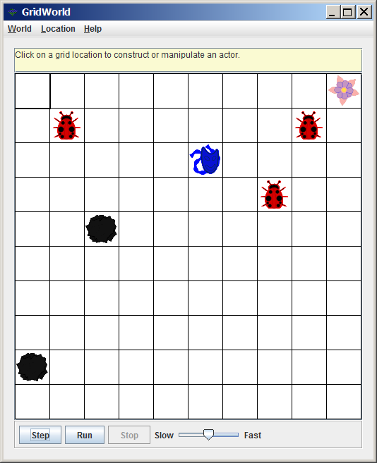
New Objects at Random Locations
Execution #4

Slide 82
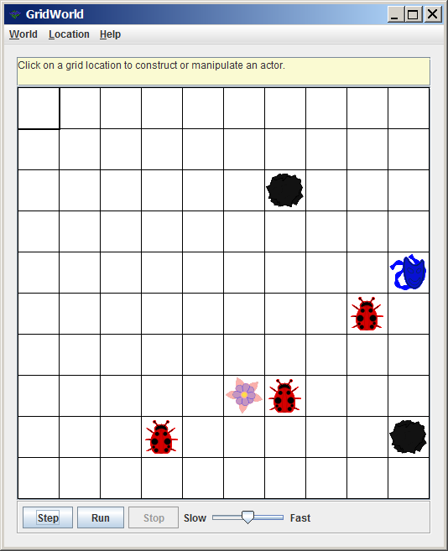
New Objects at Random Locations
Execution #5

Slide 83
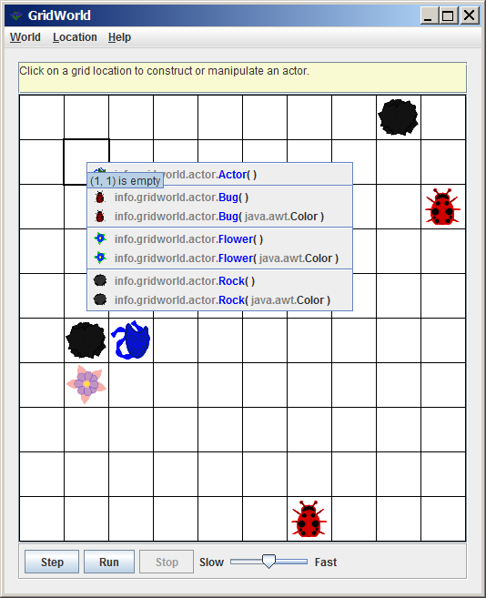
Adding More Objects During Execution
Since the program has added at least one of each of the following objects: Bug, Rock, Actor & Flower – we can add them during program execution by clicking on an empty cell.

Slide 84
Wait a minute!
Why is it possible to add an Actor object during execution if no Actor object is added in the program?

Slide 85
Answer
Because a Bug is an Actor.
A Rock or a Flower is an Actor as well. This will be explained in great detail in the next chapter on Inheritance.

Slide 86
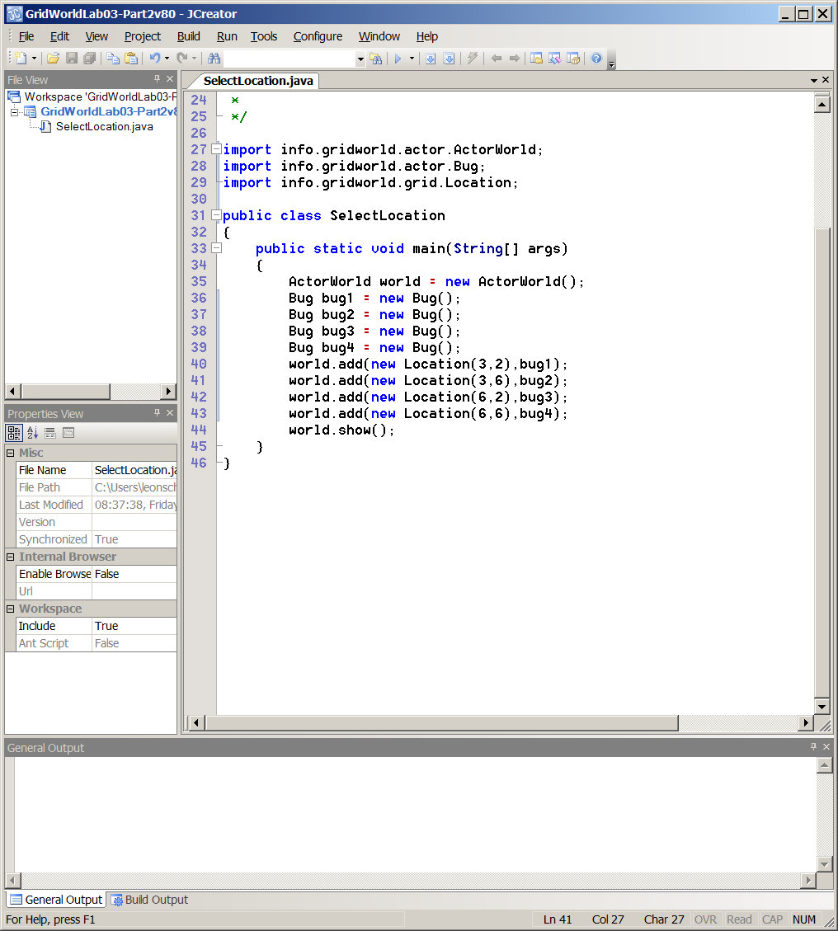
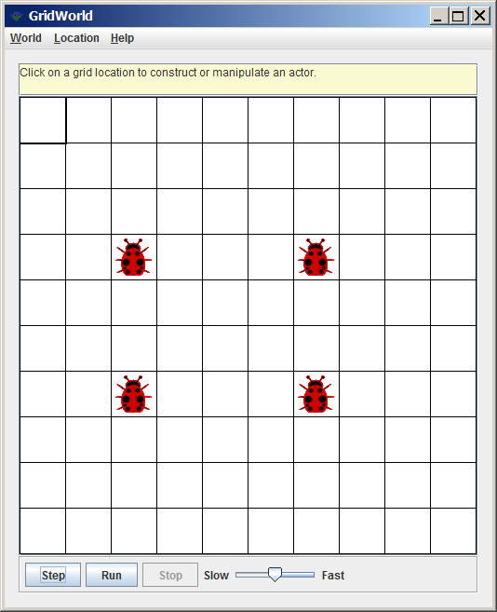
New Objects at Specified Locations
Execution #1

Slide 87
New Objects at Specified Locations
Execution #2

Slide 88
New Objects at Specified Locations
Execution #3

Slide 89
New Objects at Specified Locations
Execution #4

Slide 90
Named Objects and Anonymous Objects
Bug bug1 = new Bug();
// constructs a named Bug object
World.add(new Bug());
// constructs an anonymous Bug object

Slide 91
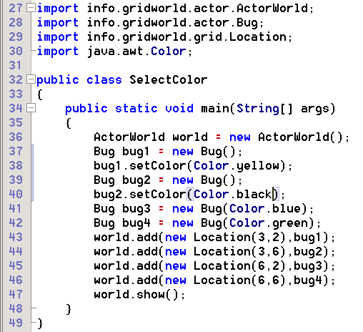
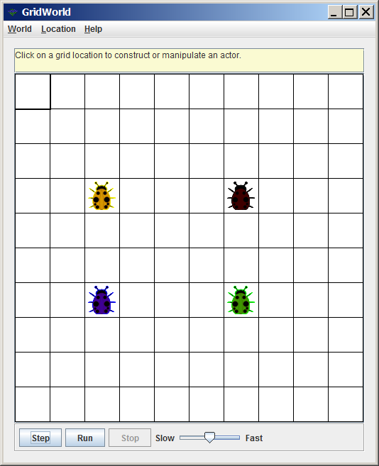
Controlling Object Color

