Slide 1


Exposure Java 2013
APCS Edition
Chapter 9 Slides
Focus on OOP:
Class Interaction with Inheritance
PowerPoint Presentation
created by:
Mr. John L. M. Schram
and Mr. Leon Schram
Authors of Exposure Java

Slide 2
Section 9.2
“Is-A” & “Has-A”
Relationships

Slide 3
Inheritance
Inheritance is the process of using features (both attributes and methods) from an existing class.
The existing class is called the superclass and the new class, which inherits the superclass features, is called the subclass.
superclass: Car
subclasses:
Truck, Limo & Racecar

Slide 4
“Is-A” and “Has-A”
The creation of new classes with the help of existing classes makes an important distinction between two approaches.
An "is-a" relationship declares a new class as a special “new-and-improved” case of an existing class. In Geometry, a parallelogram "is-a" quadrilateral with special properties.
A “has-a” relationship declares a new class composed of an existing class or classes. A line "has" points, a square "has" lines, and a cube "has" squares.
A truck "is-a" car, but it "has-an" engine.
In computer science an "is-a" relationship involves class interaction that is called inheritance and a "has-a" relationship involves class interaction that is called composition.

Slide 5
Section 9.3
GridWorld
Inheritance
Observations

Slide 6
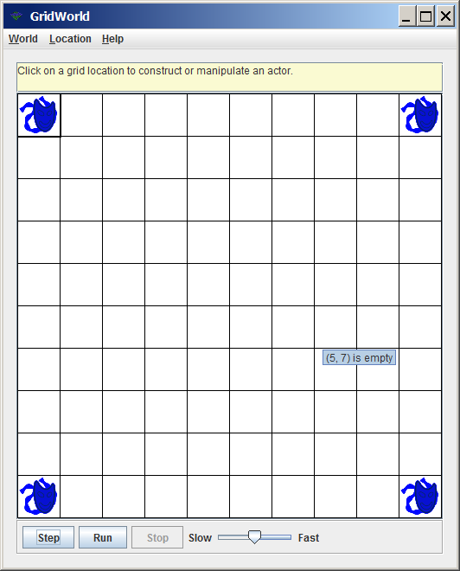
/*
* AP(r) Computer Science GridWorld Case Study:
* Copyright(c) 2005-2006 Cay S. Horstmann (http://horstmann.com)
*
* 04-12-12 by Leon Schram
* Used for Java0901 project
*/
import info.gridworld.actor.ActorWorld;
import info.gridworld.actor.Actor;
import info.gridworld.grid.Location;
public class TestJava0901
{
public static void main(String[] args)
{
ActorWorld world = new ActorWorld();
Actor actor1 = new Actor();
Actor actor2 = new Actor();
Actor actor3 = new Actor();
Actor actor4 = new Actor();
world.add(new Location(0,0),actor1);
world.add(new Location(0,9),actor2);
world.add(new Location(9,0),actor3);
world.add(new Location(9,9),actor4);
world.show();
}
}
public class Spider
{
}

Slide 7
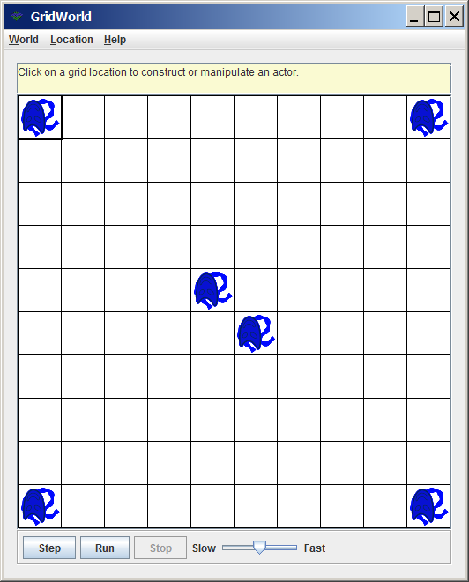
/*
* AP(r) Computer Science GridWorld Case Study:
* Copyright(c) 2005-2006 Cay S. Horstmann (http://horstmann.com)
*
* 04-12-12 by Leon Schram
* Used for Java0902 project
*/
import info.gridworld.actor.ActorWorld;
import info.gridworld.actor.Actor;
import info.gridworld.grid.Location;
public class TestJava0902
{
public static void main(String[] args)
{
ActorWorld world = new ActorWorld();
Actor actor1 = new Actor();
Actor actor2 = new Actor();
Actor actor3 = new Actor();
Actor actor4 = new Actor();
world.add(new Location(0,0),actor1);
world.add(new Location(0,9),actor2);
world.add(new Location(9,0),actor3);
world.add(new Location(9,9),actor4);
world.add(new Location(4,4),new Spider());
world.add(new Location(5,5),new Spider());
world.show();
}
}
import info.gridworld.actor.Actor;
public class Spider extends Actor
{
}

Slide 8
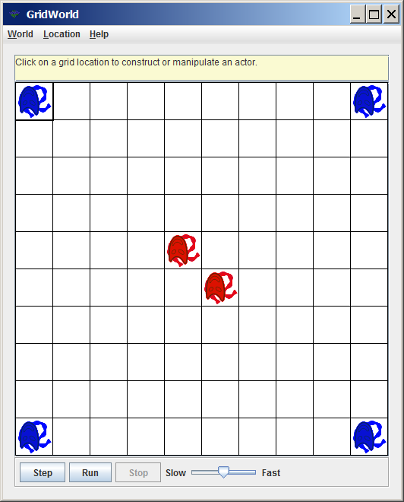
/*
* AP(r) Computer Science GridWorld Case Study:
* Copyright(c) 2005-2006 Cay S. Horstmann (http://horstmann.com)
*
* 04-12-12 by Leon Schram
* Used in Java0903 project
*/
import info.gridworld.actor.Actor;
import java.awt.Color;
public class Spider extends Actor
{
public Spider()
{
setColor(Color.red);
}
}
// driving class remains the same
// and will no longer be shown

Slide 9
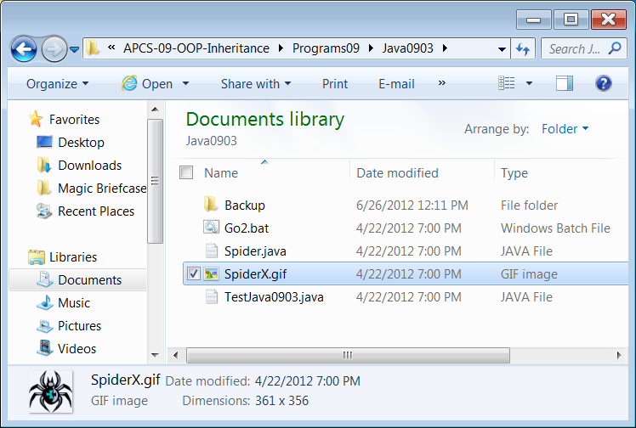
Altering Object Appearance
Rename SpiderX.gif to Spider.gif
Now a graphics file has the same name as the class.

Slide 10
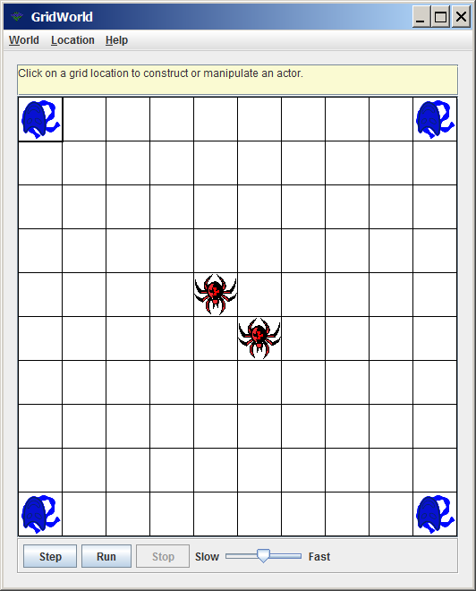
/*
* AP(r) Computer Science GridWorld Case Study:
* Copyright(c) 2005-2006 Cay S. Horstmann (http://horstmann.com)
*
* 04-12-12 by Leon Schram
* Used in Java0903 project
*/
import info.gridworld.actor.Actor;
import java.awt.Color;
public class Spider extends Actor
{
public Spider()
{
setColor(Color.red);
}
}
Re-execute the Java0903 project.

Slide 11

/*
* AP(r) Computer Science GridWorld Case Study:
* Copyright(c) 2005-2006 Cay S. Horstmann (http://horstmann.com)
*
* 04-12-12 by Leon Schram
* Used in Java0904 project
*/
public class LazySpider extends Spider
{
public void act()
{
}
}
This re-defines the act method.
This means is will not inherit
the original act method from its grandparent, the Actor class.

Slide 12
Subclass Methods
Never alter a well-designed, and tested, existing class.
Write a new subclass class to use the methods of the existing class and create new methods in your new class.
Write methods in the subclass that are re-definitions
of the existing superclass methods or write totally new-definitions.

Slide 13
Section 9.4
Accesing
Class
Members

Slide 14
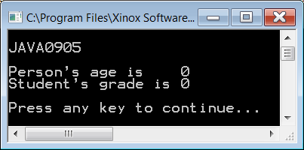
// Java0905.java
// This program demonstrates fundamental inheritance with <extends>.
// There are no constructors yet, which results in Java handling the
// construction and assigning default values to the attributes.
public class Java0905
{
public static void main(String args[])
{
System.out.println("\nJAVA0905\n");
Student tom = new Student();
System.out.println("Person's age is " + tom.getAge());
System.out.println("Student's grade is " + tom.getGrade());
System.out.println();
}
}
class Person
{
private int age;
public int getAge() { return age; }
}
class Student extends Person
{
private int grade;
public int getGrade() { return grade; }
}

Slide 15
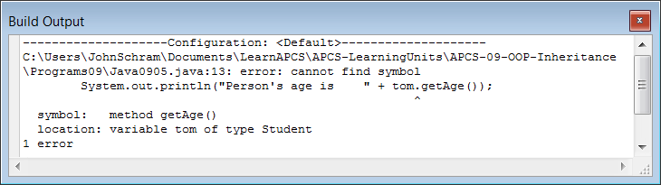
// Java0905.java
// This program demonstrates fundamental inheritance with <extends>.
// There are no constructors yet, which results in Java handling the
// construction and assigning default values to the attributes.
public class Java0905
{
public static void main(String args[])
{
System.out.println("\nJAVA0905\n");
Student tom = new Student();
System.out.println("Person's age is " + tom.getAge());
System.out.println("Student's grade is " + tom.getGrade());
System.out.println();
}
}
class Person
{
private int age;
public int getAge() { return age; }
}
class Student // extends Person
{
private int grade;
public int getGrade() { return grade; }
}
Output with extends Person removed.

Slide 16

// Java0906.java
// This program reverses the access between the classes.
// A person object now tries to access a subclass method.
public class Java0906
{
public static void main(String args[])
{
System.out.println("\nJAVA0906\n");
Person tom = new Person();
System.out.println("Person's age is " + tom.getAge());
System.out.println("Student's grade is " + tom.getGrade());
System.out.println();
}
}
class Person
{
private int age;
public int getAge() { return age; }
}
class Student extends Person
{
private int grade;
public int getGrade() { return grade; }
}

Slide 17
Access with Inheritance
When two classes have an inheritance interaction then access is only possible from the subclass to the superclass members.
It is not possible to access subclass members from the superclass.

Slide 18
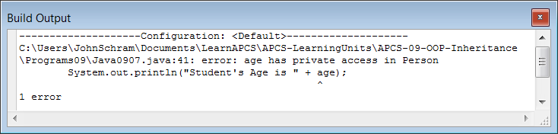
// Java0907.java
// This program shows that the subclass does not have access to the private data of the superclass.
// This program will not compile.
public class Java0907
{
public static void main(String args[])
{
System.out.println("\nJAVA0907\n");
Student tom = new Student();
tom.showData();
System.out.println();
}
}
class Person
{
private int age;
public Person() { age = 17; }
}
class Student extends Person
{
private int grade;
public Student() { grade = 12; }
public void showData()
{
System.out.println("Student's Grade is " + grade);
System.out.println("Student's Age is " + age);
}
}

Slide 19
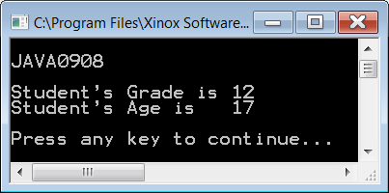
// Java0908.java
// This program changes private member data to "protected" data.
// The <Student> class can now access data from the <Person> class.
public class Java0908
{
public static void main(String args[])
{
System.out.println("\nJAVA0908\n");
Student tom = new Student();
tom.showData();
System.out.println();
}
}
class Person
{
protected int age;
public Person() { age = 17; }
}
class Student extends Person
{
protected int grade;
public Student() { grade = 12; }
public void showData()
{
System.out.println("Student's Grade is " + grade);
System.out.println("Student's Age is " + age);
}
}

Slide 20
public, private & protected
Attributes & methods declared public can be accessed by methods declared both outside and inside the class.
Attributes & methods declared private can only be accessed by methods declared inside the class.
Attributes & methods declared protected can be accessed by methods declared inside the class or subclass.

Slide 21
Section 9.5
Inheritance
Constructor
Issues

Slide 22
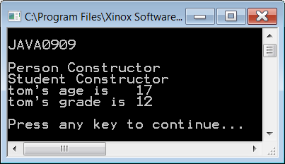
// Java0909.java
// This program adds output in the constructors to the <Person> and <Student> classes.
// Note how the <Person> constructor is called, even though there does
// not appear to be a <Person> object instantiated.
public class Java0909
{
public static void main(String args[])
{
System.out.println("\nJAVA0909\n");
Student tom = new Student();
System.out.println("tom's age is " + tom.getAge());
System.out.println("tom's grade is " + tom.getGrade());
System.out.println();
}
}
class Person
{
private int age;
public Person() { System.out.println("Person Constructor"); age = 17; }
public int getAge() { return age; }
}
class Student extends Person
{
private int grade;
public Student() { System.out.println("Student Constructor"); grade = 12; }
public int getGrade() { return grade; }
}

Slide 23
// Java0910.java
// This program adds a call to <super> in the <Student> constructor.
// The program output is identical to the previous program.
// Java automatically makes the call to <super>.
class Student extends Person
{
private int grade;
public Student()
{
super();
System.out.println("Student Constructor");
grade = 12;
}
public int getGrade()
{
return grade;
}
}
// The other 2 classes and the output are identical
// to program Java0909 and are not shown here.

Slide 24
Inheritance and Constructor Calls
When an object of a subclass is instantiated, the constructor of the superclass is called first, followed by a call to the constructor of the subclass.
An invisible - to the programmer - call is made by Java to the super method, which generates a call to the superclass constructor. This statement can be written in the subclass constructor with the same results, but it is not required.

Slide 25
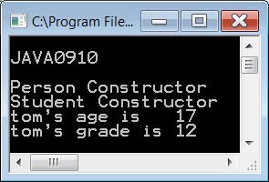
// Java0911.java
// This program demonstrates how a subclass
// constructor passes parameter information
// to a superclass constructor.
public class Java0911
{
public static void main(String args[])
{
System.out.println("\nJAVA0911\n");
Student tom = new Student(12,17);
tom.showData();
System.out.println();
}
}
class Person
{
protected int age;
public Person(int a)
{
System.out.println(
"Person Parameter Constructor");
age = a;
}
public int getAge() { return age; }
}
class Student extends Person
{
protected int grade;
public Student(int g, int a)
{
super(a); // this must be the first call
grade = g;
System.out.println(
"Student Parameter Constructor");
}
public int getGrade() { return grade; }
public void showData()
{
System.out.println("Student's Grade is "
+ getGrade());
System.out.println("Student's Age is "
+ getAge());
}
}

Slide 26
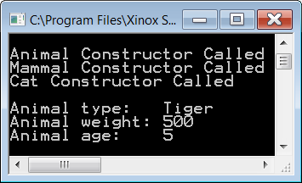
// Java0912.java
// This program demonstrates inheritance at three levels.
public class Java0912 { public static void main(String args[]) { System.out.println("\nJAVA0909\n"); Cat tiger = new Cat("Tiger",500,5); System.out.println(); System.out.println("Animal type: " + tiger.getType()); System.out.println("Animal weight: " + tiger.getWeight()); System.out.println("Animal age: " + tiger.getAge()); System.out.println(); } } class Animal { protected int age; public Animal(int a) { System.out.println("Animal Constructor Called"); age = a; } public int getAge() { return age; } } | class Mammal extends Animal { protected int weight; public Mammal(int w, int a) { super(a); weight = w; System.out.println( "Mammal Constructor Called"); } public int getWeight() { return weight; } } class Cat extends Mammal { protected String type; public Cat(String t, int w, int a) { super(w,a); type = t; System.out.println( "Cat Constructor Called"); } public String getType() { return type; } }

Slide 27
Multi-Level Inheritance & Multiple Inheritance
The previous program showed an example of Multi-Level Inheritance.
Multiple Inheritance is something different. It occurs when one subclass inherits from two or more superclasses.
This feature is available in C++.
It is NOT available in Java.

Slide 28
Multi-Level Inheritance | Multiple Inheritance
Animal
Reptile
Extinct
Mammal
Dinosaur
Dog
Terrier

Slide 29
Section 9.6
super Calling a
SuperClass Method

Slide 30
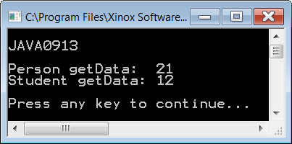
// Java0913.java
// In this program both the <Person> class and the <Student> class each have a <getData> method.
public class Java0913
{
public static void main(String args[])
{
System.out.println("\nJAVA0913\n");
Person ann = new Person();
Student tom = new Student();
System.out.println("Person getData: " + ann.getData());
System.out.println("Student getData: " + tom.getData());
System.out.println();
}
}
class Person
{
protected int age;
public Person() { age = 21; }
public int getData() { return age; }
}
class Student extends Person
{
protected int grade;
public Student() { grade = 12; }
public int getData() { return grade; }
}

Slide 31
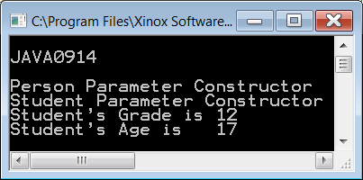
// Java0914.java
// This program demonstrates that it is possible
// to distinguish between two methods with the
// same identifier using <super>.
public class Java0914
{
public static void main(String args[])
{
System.out.println("\nJAVA0914\n");
Student tom = new Student(12,17);
tom.showData();
System.out.println();
}
}
class Person
{
protected int age;
public Person(int a)
{
System.out.println(
"Person Parameter Constructor");
age = a;
}
public int getData() { return age; }
}
class Student extends Person
{
protected int grade;
public Student(int g, int a)
{
super(a);
grade = g;
System.out.println(
"Student Parameter Constructor");
}
public int getData() { return grade; }
public void showData()
{
System.out.println("Student's Grade is "
+ getData());
System.out.println("Student's Age is "
+ super.getData());
}
}

Slide 32
Using super
The keyword super used as the first statement in a constructor passes information to the super class constructor, like super(a);
The same keyword super used in front of a method indicates that a method of the superclass needs to be called, like super.getData();
Information can be passed up to multiple inheritance levels, but it can only be passed one level at one time.

Slide 33

Section 9.7
Umbrella
Classes

Slide 34
SuperClass Declarations
You are used to seeing the same identifier at the start and end of an object definition, like
Bug barry = new Bug();
It is possible to declare an object with a superclass identifier and construct it with
a subclass identifier.
Actor barry = new Bug;

Slide 35
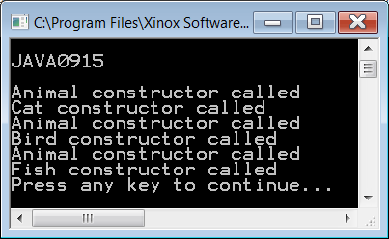


// Java0915.java // This program demonstrates that it is // possible to use the super class identifier // <Animal> to declare each subclass object. public class Java0915 { public static void main(String args[]) { Animal tiger = new Cat("Tiger"); Animal eagle = new Bird("Eagle"); Animal shark = new Fish("Shark"); } } class Animal { public Animal() { System.out.println( "Animal constructor called"); } } | class Cat extends Animal { protected String catType; public Cat(String ct) { System.out.println("Cat constructor called"); catType = ct; } } class Bird extends Animal { protected String birdType; public Bird(String bt) { System.out.println("Bird constructor called"); birdType = bt; } } class Fish extends Animal { protected String fishType; public Fish(String ft) { System.out.println("Fish constructor called"); fishType = ft; } }

Slide 36
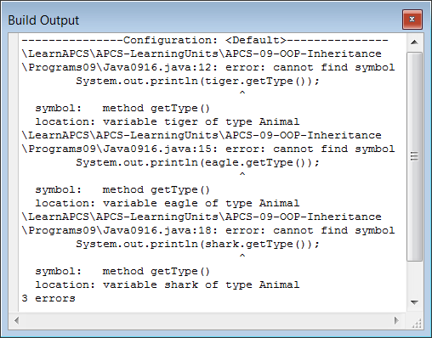
// Java0916.java // This program adds <getType> methods for each // one of the three <Animal> sub classes. // The program does not compile, because // <getType> is not an <Animal> method. public class Java0916 { public static void main(String args[]) { Animal tiger = new Cat("Tiger"); System.out.println(tiger.getType()); Animal eagle = new Bird("Eagle"); System.out.println(eagle.getType()); Animal shark = new Fish("Shark"); System.out.println(shark.getType()); } } class Animal { public Animal() { System.out.println( "Animal constructor called"); } } | class Cat extends Animal { protected String catType; public Cat(String ct) { catType = ct; } public String getType() { return catType; } } class Bird extends Animal { protected String birdType; public Bird(String bt) { birdType = bt; } public String getType() { return birdType; } } class Fish extends Animal { protected String fishType; public Fish(String ft) { fishType = ft; } public String getType() { return fishType; } }

Slide 37
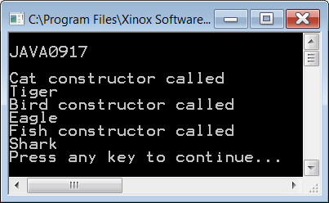
// Java0917.java // This program does compile, because each // object is a <Cat>, <Bird> or <Fish>, which // does have a <getType> method. public class Java0917 { public static void main(String args[]) { System.out.println("\nJAVA0917\n"); Cat tiger = new Cat("Tiger"); System.out.println(tiger.getType()); Bird eagle = new Bird("Eagle"); System.out.println(eagle.getType()); Fish shark = new Fish("Shark"); System.out.println(shark.getType()); } } | class Cat { protected String catType; public Cat(String ct) { System.out.println("Cat constructor called"); catType = ct; } public String getType() { return catType; } } class Bird { protected String birdType; public Bird(String bt) { System.out.println("Bird constructor called"); birdType = bt; } public String getType() { return birdType; } } class Fish { protected String fishType; public Fish(String ft) { System.out.println("Fish constructor called"); fishType = ft; } public String getType() { return fishType; } }

Slide 38
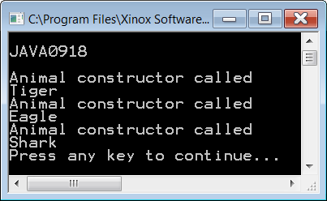
// Java0918.java // This program solves the problem of the // program Java0916.java. The <Animal> // superclass has a "fake" <getType> method // that is re-defined for each subclass. public class Java0918 { public static void main(String args[]) { System.out.println("\nJAVA0918\n"); Animal tiger = new Cat("Tiger"); System.out.println(tiger.getType()); Animal eagle = new Bird("Eagle"); System.out.println(eagle.getType()); Animal shark = new Fish("Shark"); System.out.println(shark.getType()); } } class Animal { public Animal() { System.out.println("Animal constructor called"); } public String getType() { return ""; } } | class Cat { protected String catType; public Cat(String ct) { catType = ct; } public String getType() { return catType; } } class Bird { protected String birdType; public Bird(String bt) { birdType = bt; } public String getType() { return birdType; } } class Fish { protected String fishType; public Fish(String ft) { fishType = ft; } public String getType() { return fishType; } }

