Slide 1


Exposure Java 2013
APCS Edition
Chapter 12 Slides
Focus on OOP:
Class Interaction with Composition
PowerPoint Presentation
created by:
Mr. John L. M. Schram
and Mr. Leon Schram
Authors of Exposure Java

Slide 2
Section 12.1
Introduction

Slide 3
OOP Review
Object Oriented Programming (OOP) is a style of programming that incorporates these 3 features:
Encapsulation
Polymorphism
Class Interaction

Slide 4
Class Interaction
Class interaction is further divided into inheritance and composition.
You learned about inheritance,
in Chapter 9.
We will investigate composition,
in this chapter.

Slide 5
Inheritance vs. Composition
In computer science an "is-a" relationship is called inheritance | and a "has-a" relationship is called composition.
“A TireSwing is-a Swing”. | “A TireSwing has-a Tire.”
Subclass:
TireSwing
Superclass:
Swing
Contained
class: Tire

Slide 6
Section 12.2
Simple
Composition
Examples

Slide 7

Composition
Composition occurs when the data attributes of one class are objects of another class.
You do NOT say “A Car is-an Engine” or “A Car is 4 tires” but you DO say “A Car has-an Engine” & “A car has 4 tires.”
class: Car
Contained
Objects:
1 Engine
4 Tires

Slide 8
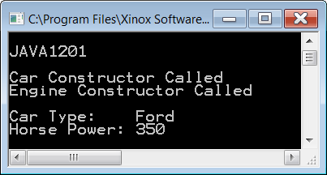
// Java1201.java
// This program uses an <Engine> object in a "has-a" composition relationship.
public class Java0910 { public static void main(String args[]) { System.out.println("\nJAVA1201\n"); Car car = new Car("Ford",350); System.out.println(); car.getData(); System.out.println(); } } class Engine { private int horsePower; public Engine(int hp) { System.out.println( "Engine Constructor Called"); horsePower = hp; } public int getHorsePower() { return horsePower; } } | class Car { private String type; private Engine engine; public Car(String t, int hp) { System.out.println("Car Constructor Called"); type = t; engine = new Engine(hp); } public void getData() { System.out.println("Car Type: " + type); System.out.println("Horse Power: " + engine.getHorsePower()); } }

Slide 9
// Java1202.java
// This program uses multiple classes not in an "is-a" inheritance
// relationship, but a "has-a" composition relationship.
public class Java1202
{
public static void main(String args[])
{
System.out.println("\nJAVA1202\n");
Car car = new Car("Ford",6,350,"Red");
System.out.println();
car.getData();
System.out.println();
}
}

Slide 10
class Wheel
{
private int wheelCount;
public Wheel(int wc)
{
System.out.println("Wheel Constructor Called");
wheelCount = wc;
}
public int getWheelCount()
{
return wheelCount;
}
}

Slide 11
class Engine
{
private int horsePower;
public Engine(int hp)
{
System.out.println("Engine Constructor Called");
horsePower = hp;
}
public int getHorsePower()
{
return horsePower;
}
}

Slide 12
class Paint
{
private String paintColor;
public Paint(String pc)
{
System.out.println("Paint Constructor Called");
paintColor = pc;
}
public String getPaintColor()
{
return paintColor;
}
}

Slide 13
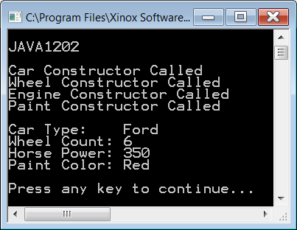
class Car
{
private String type;
private Wheel wheel;
private Engine engine;
private Paint paint;
public Car(String t, int wc, int hp, String pc)
{
System.out.println("Car Constructor Called");
type = t;
wheel = new Wheel(wc);
engine = new Engine(hp);
paint = new Paint(pc);
}
public void getData()
{
System.out.println("Car Type: " + type);
System.out.println("Wheel Count: " + wheel.getWheelCount());
System.out.println("Horse Power: " + engine.getHorsePower());
System.out.println("Paint Color: " + paint.getPaintColor());
}
}

Slide 14
Section 12.3
Jack-O'-lantern
Case Study

Slide 15
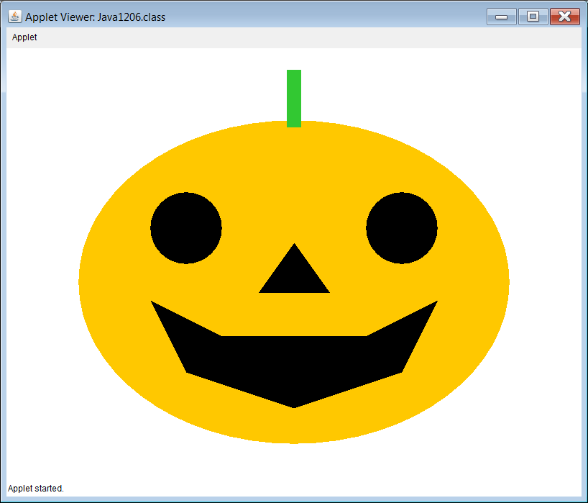
Jack-O'-lantern Case Study
We will now look at a simple 4-step Case Study that will ultimately draw a Jack-O’-lantern.
The end result is shown below:
Inspired by Kristen Graber - Berkner HS student 2005

Slide 16
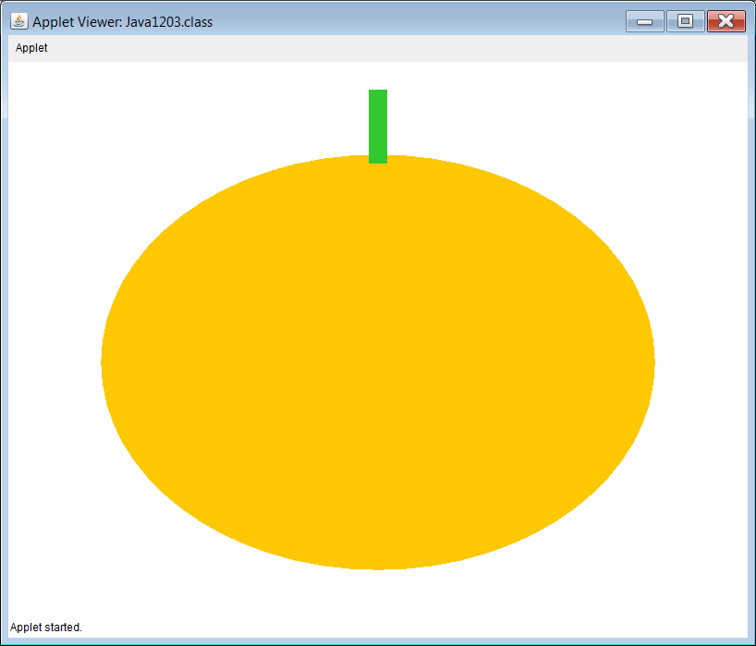
// Java1203.java
// Jack O'lantern Case Study, Stage #1
// This program draws a pumpkin.
// There is neither inheritance nor composition present.
import java.awt.*;
import java.applet.*;
public class Java1203 extends Applet
{
public void paint(Graphics g)
{
Pumpkin p = new Pumpkin(g);
}
}
class Pumpkin
{
public Pumpkin(Graphics g) { drawPumpkin(g); }
public void drawPumpkin(Graphics g)
{
g.setColor(Color.orange);
g.fillOval(100,100,600,450);
g.setColor(new Color(50,200,50));
g.fillRect(390,30,20,80);
}
}

Slide 17
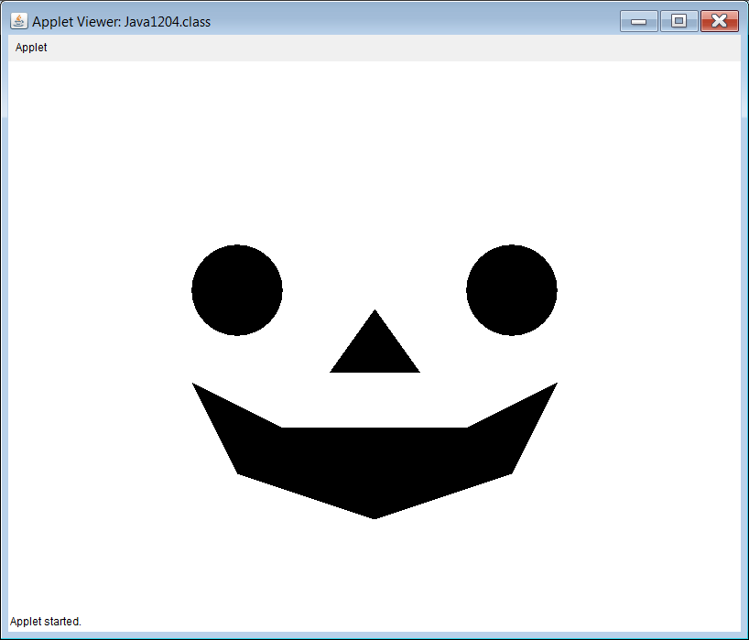
// Java1204.java // Jack O'lantern Case Study, Stage #2 // This program draws a face. // There is neither inheritance nor // composition present. import java.awt.*; import java.applet.*; public class Java1204 extends Applet { public void paint(Graphics g) { Face f = new Face(g); } } class Face { public Face(Graphics g) { drawFace(g); } | public void drawFace(Graphics g) { // Draw eyes g.setColor(Color.black); g.fillOval(200,200,100,100); g.fillOval(500,200,100,100); // Draw nose Polygon nose = new Polygon(); nose.addPoint(350,340); nose.addPoint(450,340); nose.addPoint(400,270); g.fillPolygon(nose); // Draw mouth Polygon mouth = new Polygon(); mouth.addPoint(300,400); mouth.addPoint(200,350); mouth.addPoint(250,450); mouth.addPoint(400,500); mouth.addPoint(550,450); mouth.addPoint(600,350); mouth.addPoint(500,400); g.fillPolygon(mouth); } }

Slide 18
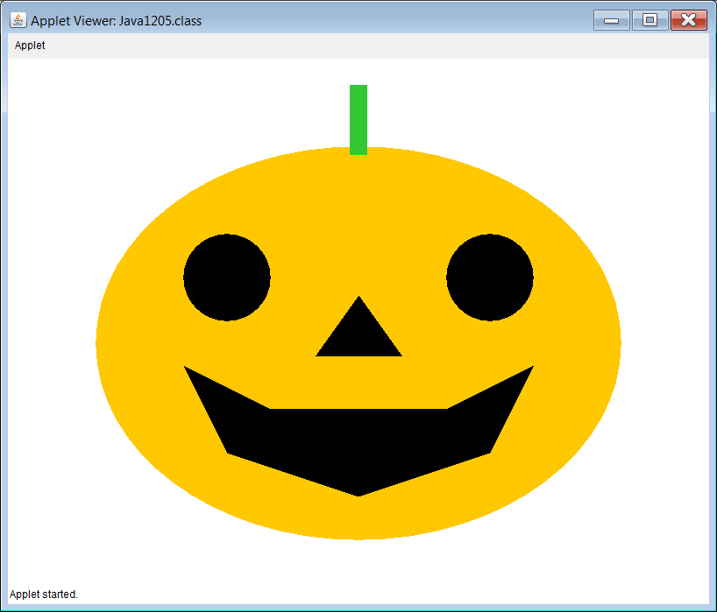
// Java1205.java // Jack O'lantern Case Study, Stage #3 // This program demonstrates composition. // The <Pumpkin> class now "has-a" // <Face> object attribute. public class Java1205 extends Applet { public void paint(Graphics g) { Pumpkin pumpkin = new Pumpkin(g); } } class Pumpkin { private Face face; public Pumpkin(Graphics g) { drawPumpkin(g); face = new Face(g); } public void drawPumpkin(Graphics g) { g.setColor(Color.orange); g.fillOval(100,100,600,450); g.setColor(new Color(50,200,50)); g.fillRect(390,30,20,80); } } | class Face { public Face(Graphics g) { drawFace(g); } public void drawFace(Graphics g) { // Draw eyes g.setColor(Color.black); g.fillOval(200,200,100,100); g.fillOval(500,200,100,100); // Draw nose Polygon nose = new Polygon(); nose.addPoint(350,340); nose.addPoint(450,340); nose.addPoint(400,270); g.fillPolygon(nose); // Draw mouth Polygon mouth = new Polygon(); mouth.addPoint(300,400); mouth.addPoint(200,350); mouth.addPoint(250,450); mouth.addPoint(400,500); mouth.addPoint(550,450); mouth.addPoint(600,350); mouth.addPoint(500,400); g.fillPolygon(mouth); } }

Slide 19
// Java1206.java // Jack O'lantern Case Study, Stage #4 // This program demonstrates both // inheritance and composition. public class Java1206 extends Applet { public void paint(Graphics g) { JackOLantern jack = new JackOLantern(g); } } class Pumpkin { public Pumpkin(Graphics g) { drawPumpkin(g); } public void drawPumpkin(Graphics g) { g.setColor(Color.orange); g.fillOval(100,100,600,450); g.setColor(new Color(50,200,50)); g.fillRect(390,30,20,80); } } | class Face { // same as the previous program } class JackOLantern extends Pumpkin { private Face f; public JackOLantern(Graphics g) { super(g); f = new Face(g); } }

Slide 20
Section 12.4
The Train
Case Study

Slide 21
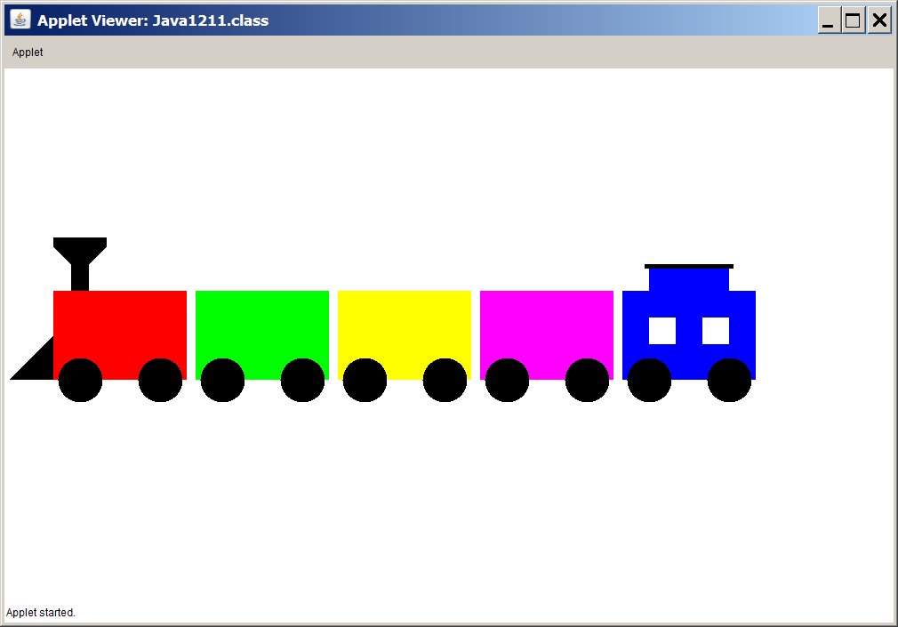
Train Case Study
We will now look at a 5-step Case Study that will ultimately draw a Train.
The end result is shown below:
Inspired by Greg Muzljakovich and Amy Ho – BHS students 2005

Slide 22
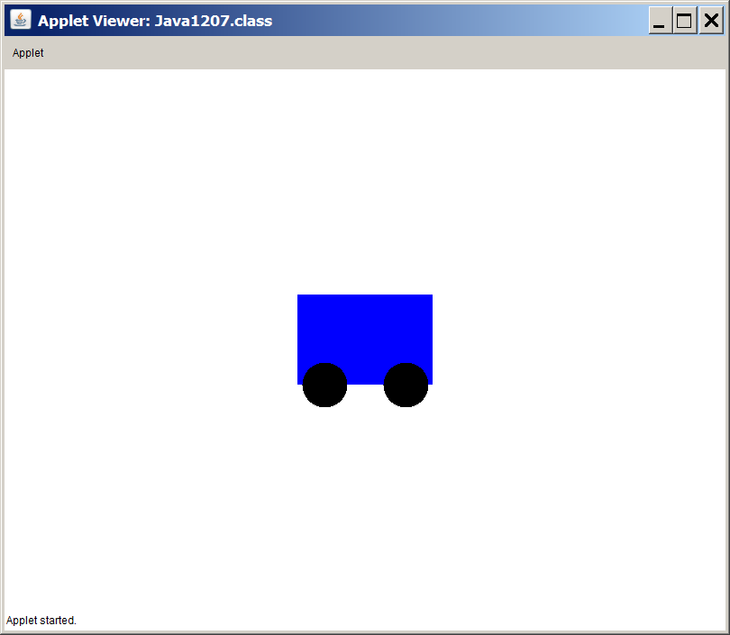
// Java1207.java Train case study, Stage #1
// The first stage starts with the <TrainCar> class.
public class Java1207 extends Applet
{
public void paint(Graphics g)
{
TrainCar tc = new TrainCar();
tc.drawTrainCar(g);
}
}
class TrainCar
{
private Color carColor;
public TrainCar() { carColor = Color.blue; }
public void drawTrainCar(Graphics g)
{
g.setColor(carColor);
g.fillRect(325,250,150,100);
g.setColor(Color.black);
g.fillOval(330,325,50,50);
g.fillOval(420,325,50,50);
}
}

Slide 23
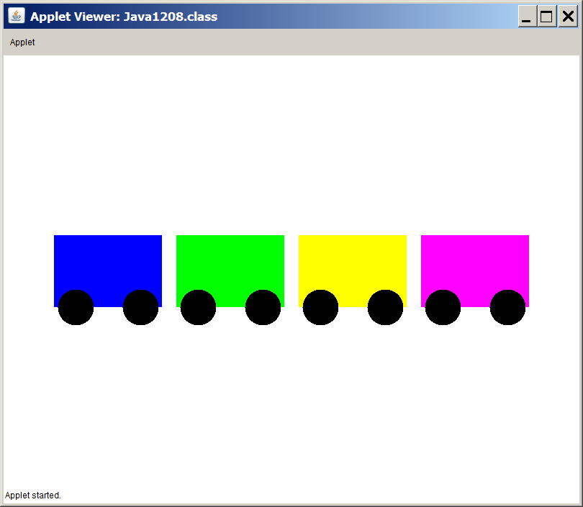
// Java1208.java // Train case study, Stage #2 // This program improves the <TrainCar> class by // constructing new objects with a specified color // and a specified location. import java.awt.*; import java.applet.*; public class Java1208 extends Applet { public void paint(Graphics g) { TrainCar tc1 = new TrainCar(Color.blue,70,250); TrainCar tc2 = new TrainCar(Color.green,240,250); TrainCar tc3 = new TrainCar(Color.yellow,410,250); TrainCar tc4 = new TrainCar(Color.magenta,580,250); tc1.drawTrainCar(g); tc2.drawTrainCar(g); tc3.drawTrainCar(g); tc4.drawTrainCar(g); } } | class TrainCar { private Color carColor; private int xPos; private int yPos; public TrainCar(Color cC, int xP, int yP) { carColor = cC; xPos = xP; yPos = yP; } public void drawTrainCar(Graphics g) { g.setColor(carColor); g.fillRect(xPos,yPos,150,100); g.setColor(Color.black); g.fillOval(xPos+5,yPos+80,50,50); g.fillOval(xPos+95,yPos+75,50,50); } }

Slide 24
// Java1209.java // Train case study, Stage #3 // This program adds the <Locomotive> class, // using inheritance, since a locomotive is-a // traincar. import java.awt.*; import java.applet.*; public class Java1209 extends Applet { public void paint(Graphics g) { Locomotive loc = new Locomotive(Color.blue,70,250); loc.drawTrainCar(g); } } | class TrainCar { private Color carColor; private int xPos; private int yPos; public TrainCar(Color cC, int xP, int yP) { carColor = cC; xPos = xP; yPos = yP; } public void drawTrainCar(Graphics g) { g.setColor(carColor); g.fillRect(xPos,yPos,150,100); g.setColor(Color.black); g.fillOval(xPos+5,yPos+80,50,50); g.fillOval(xPos+95,yPos+75,50,50); } }
The Locomotive class
and the output
are shown on the
next slide.

Slide 25
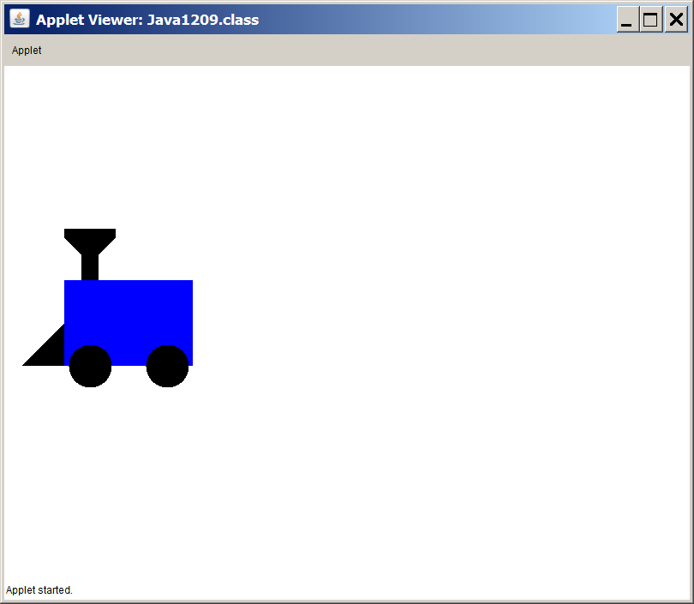
class Locomotive extends TrainCar { public Locomotive(Color cc, int xP, int yP) { super(cc,xP,yP); } public void drawTrainCar(Graphics g) { super.drawTrainCar(g); drawScoop(g); drawFunnel(g); } private void drawScoop(Graphics g) { Polygon scoop = new Polygon(); scoop.addPoint(xPos,yPos+50); scoop.addPoint(xPos,yPos+100); scoop.addPoint(xPos-50,yPos+100); g.setColor(Color.black); g.fillPolygon(scoop); } | private void drawFunnel(Graphics g) { Polygon funnel = new Polygon(); funnel.addPoint(xPos+20,yPos); funnel.addPoint(xPos+20,yPos-30); funnel.addPoint(xPos,yPos-50); funnel.addPoint(xPos,yPos-60); funnel.addPoint(xPos+60,yPos-60); funnel.addPoint(xPos+60,yPos-50); funnel.addPoint(xPos+40,yPos-30); funnel.addPoint(xPos+40,yPos); g.setColor(Color.black); g.fillPolygon(funnel); } }

Slide 26
// Java1210.java // Train case study, Stage #4 // This program adds the <Caboose> class, // using inheritance, since a caboose "is-a" // traincar. import java.awt.*; import java.applet.*; public class Java1210 extends Applet { public void paint(Graphics g) { Caboose cab = new Caboose(Color.red,580,250); cab.drawTrainCar(g); } } | class TrainCar { private Color carColor; private int xPos; private int yPos; public TrainCar(Color cC, int xP, int yP) { carColor = cC; xPos = xP; yPos = yP; } public void drawTrainCar(Graphics g) { g.setColor(carColor); g.fillRect(xPos,yPos,150,100); g.setColor(Color.black); g.fillOval(xPos+5,yPos+80,50,50); g.fillOval(xPos+95,yPos+75,50,50); } }
The Caboose class
and the output
are shown on the
next slide.

Slide 27
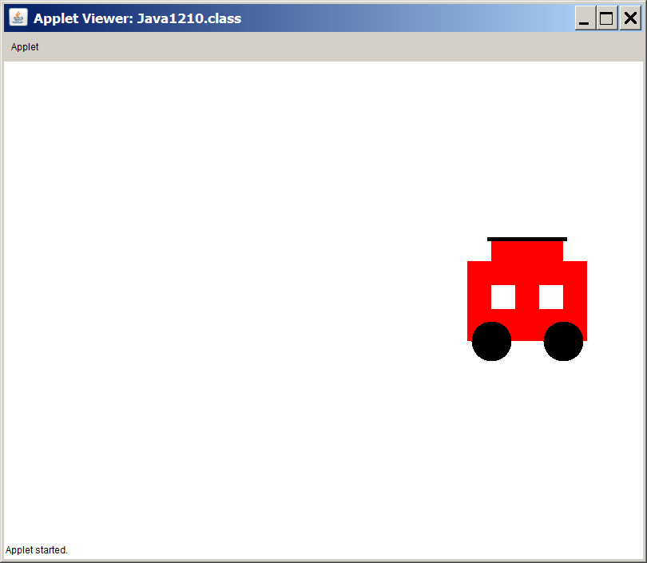
class Caboose extends TrainCar { public Caboose(Color cc, int xP, int yP) { super(cc,xP,yP); } public void drawTrainCar(Graphics g) { super.drawTrainCar(g); drawWindows(g); drawTop(g); } private void drawWindows(Graphics g) { g.setColor(Color.white); g.fillRect(xPos+30,yPos+30,30,30); g.fillRect(xPos+90,yPos+30,30,30); } | private void drawTop(Graphics g) { g.setColor(Color.red); g.fillRect(xPos+30,yPos-30,90,30); g.setColor(Color.black); g.fillRect(xPos+25,yPos-30,100,5); } }

Slide 28
// Java1211.java
// Train case study, Stage #5
// This program concludes by adding the <Train> class
// A train has train cars. The first train car is the locomotive.
// The last train car is the Caboose.
// This program now combines inheritance with composition.
public class Java1211 extends Applet
{
public void paint(Graphics g)
{
Train t = new Train(55,250);
t.drawTrain(g);
}
}
class Train
{
private Locomotive loc;
private TrainCar tc1;
private TrainCar tc2;
private TrainCar tc3;
private Caboose cab;
private int tlX;
private int tlY;
public Train(int tlX, int tlY)
{
this.tlX = tlX;
this.tlY = tlY;
loc = new Locomotive(Color.red,tlX,tlY);
tc1 = new TrainCar(Color.green,tlX+160,tlY);
tc2 = new TrainCar(Color.yellow,tlX+320,tlY);
tc3 = new TrainCar(Color.magenta,tlX+480,tlY);
cab = new Caboose(Color.blue,tlX+640,tlY);
}
public void drawTrain(Graphics g)
{
loc.drawCar(g);
tc1.drawCar(g);
tc2.drawCar(g);
tc3.drawCar(g);
cab.drawCar(g);
}
}

Slide 29
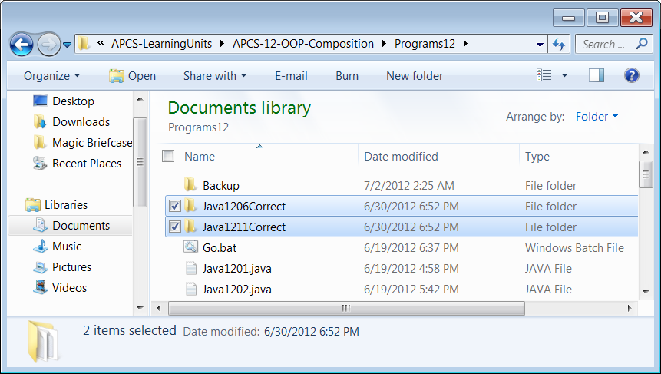
Proper Object Oriented Design
In the Programs12 folder are two folders called Java1206 and Java1211. Both folders end with Correct. The programs for the Jack O'Lantern and the Train case studies each were written for convenience of teaching. Every one of the classes was placed in a single file. The "Correct" folders show the correct style where each class is inside its own file ... that is, each public class should be inside its own file.

Slide 30
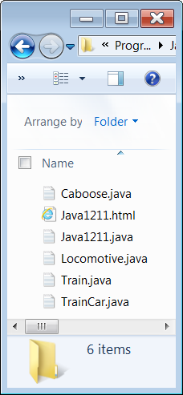
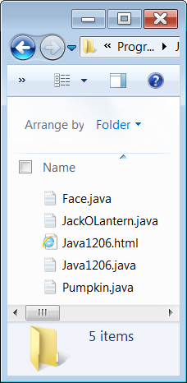
Proper Object Oriented Design

Slide 31
Section 12.5
Using Arrays
For Composition

Slide 32
// Java1212.java
// This program demonstrates composition by creating a class,
// which "has-an" array of objects of another class.
// In this program static arrays are used in the <School> class.
public class Java1212
{
public static void main(String args[])
{
System.out.println("\nJAVA1212\n");
String[] names = {"Tom","Sue","Joe","Meg","Bob","Ann","Dan","Jan","Ken","Kim"};
double[] gpas = {2.125,2.175,2.225,2.275,3.125,3.175,3.325,3.375,3.675,3.875};
School planoWest = new School(names.length);
planoWest.loadData(names, gpas);
planoWest.printStudents();
System.out.println();
}
}

Slide 33

class Student
{
private String name;
private double gpa;
public Student(String name, double gpa)
{
this.name = name;
this.gpa = gpa;
}
public void printStudent()
{
System.out.println("Name: " + name);
System.out.println("GPA: " + gpa);
}
}

Slide 34
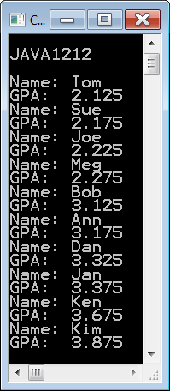

class School
{
private int count;
private Student[] students;
public School(int n)
{
count = n;
students = new Student[count];
}
public void loadData(String[] names, double[] gpas)
{
for (int k = 0; k < count; k++)
{
Student temp = new Student(names[k], gpas[k]);
students[k] = temp;
}
}
public void printStudents()
{
for (Student s: students)
s.printStudent();
}
}

Slide 35
// Java1213.java
// This program demonstrates composition by creating a class,
// which "has-an" array of objects of another class.
// In this program dynamic arrays are used in the <School> class.
import java.util.ArrayList;
public class Java1213
{
public static void main(String args[])
{
System.out.println("\nJAVA1213\n");
String[] names =
{"Tom","Sue","Joe","Meg","Bob","Ann","Dan","Jan","Ken","Kim"};
double[] gpas = {2.125,2.175,2.225,2.275,3.125,3.175,3.325,3.375,3.675,3.875};
School planoWest = new School();
planoWest.loadData(names,gpas);
planoWest.printStudents();
System.out.println();
}
}

Slide 36

class Student
{
private String name;
private double gpa;
public Student(String name, double gpa)
{
this.name = name;
this.gpa = gpa;
}
public void printStudent()
{
System.out.println("Name: " + name);
System.out.println("GPA: " + gpa);
}
}

Slide 37


class School
{
private ArrayList<Student> students;
public School()
{
students = new ArrayList<Student>();
}
public void loadData(String[] names, double[] gpas)
{
for (int k = 0; k < names.length; k++)
{
Student temp = new Student(names[k], gpas[k]);
students.add(temp);
}
}
public void printStudents()
{
for (Student s: students)
s.printStudent();
}
}

Slide 38
Section 12.6
GridWorld
& Composition

Slide 39
Composition with the Actor Class
public class Actor
{
private Grid<Actor> grid;
private Location location;
private int direction;
private Color color;
public Actor()
{
color = Color.BLUE;
direction = Location.NORTH;
grid = null;
location = null;
}
You may be tempted to say that with four attributes there must be four composition cases. After all the Actor class "has 4 data fields”.
Keep in mind that composition means one class contains an object of another class as an attribute.

Slide 40
Actor Class grid Attribute
public class Actor
{
private Grid<Actor> grid;
private Location location;
private int direction;
private Color color;
public Actor()
{
color = Color.BLUE;
direction = Location.NORTH;
grid = null;
location = null;
}
The attribute grid is an object of the Grid class and it is a member of the Actor class.
We can say that an Actor object
"has-a" Grid.
The grid field is an example of composition.

Slide 41
Actor Class location Attribute
public class Actor
{
private Grid<Actor> grid;
private Location location;
private int direction;
private Color color;
public Actor()
{
color = Color.BLUE;
direction = Location.NORTH;
grid = null;
location = null;
}
The attribute location is an object of the Location class and it is a member of the Actor class.
We can say that an Actor object
"has-a" Location.
The location field
is an example of composition.

Slide 42
Actor Class direction Attribute
public class Actor
{
private Grid<Actor> grid;
private Location location;
private int direction;
private Color color;
public Actor()
{
color = Color.BLUE;
direction = Location.NORTH;
grid = null;
location = null;
}
The attribute direction is a member of the Actor class, but it is not an object.
This is a primitive data type that does not demonstrate any type of relationship between two classes.
The direction field
is not composition.

Slide 43
Actor Class color Attribute
public class Actor
{
private Grid<Actor> grid;
private Location location;
private int direction;
private Color color;
public Actor()
{
color = Color.BLUE;
direction = Location.NORTH;
grid = null;
location = null;
}
The attribute color is an object of the Color class and it is a member of the Actor class.
We can say that an Actor object
"has-a" Color.
The color field
is an example of composition.

Slide 44
Generic BoundedGrid Class
public class BoundedGrid<E> extends AbstractGrid<E>
{
private Object[ ][ ] occupantArray;
public BoundedGrid(int rows, int cols)
{
if (rows <= 0)
throw new IllegalArgumentException("rows <= 0");
if (cols <= 0)
throw new IllegalArgumentException("cols <= 0");
occupantArray = new Object[rows][cols];
}
A BoundedGrid has-a 2D array of Object.

Slide 45
What is the <E> thing?
public class BoundedGrid<E> extends AbstractGrid<E>
{
private Object[ ][ ] occupantArray;
public BoundedGrid(int rows, int cols)
: : :
Grid<Actor> grid = new BoundedGrid<Actor>;
When you create an object of a generic class.
You essentially pass a class identifier
almost as if it were a parameter.
This is the same thing we do with ArrayList.
ArrayList<Student> school = new ArrayList<Student>;

Slide 46
Section 12.7
GWCS
Redefined or
Newly-Defined

Slide 47
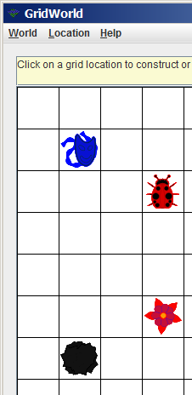
Redefined vs. Newly-Defined
The Bug, Flower and Rock classes are all three subclasses of the Actor class. This means that at a minimum they have all the methods that are already defined for Actor.
Now there are two possible changes. First, one or more methods defined in the Actor class is re-defined in one of its subclasses to provide new and improved - or desired - functionality.
Second, you may see one or more new methods in any of the subclasses that never existed in the Actor class.

Slide 48
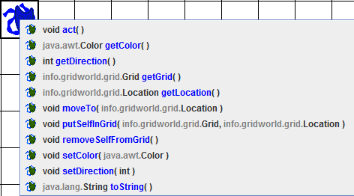
Actor Class Methods
These methods are available to all subclasses of Actor.

Slide 49
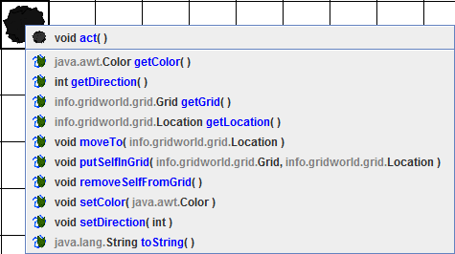
Flower Class Methods
Rock redefines the act method and inherits the rest.

Slide 50
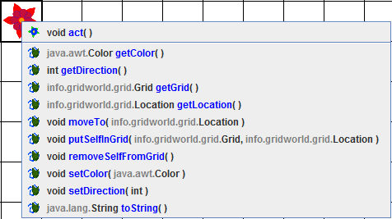
Flower Class Methods
Flower redefines the act method and inherits the rest.

Slide 51
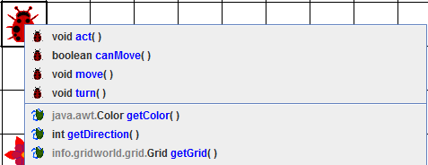
Bug Class Methods
Bug redefines the act method.
Bug also newly-defines the canMove,
move and turn methods.
The rest of the methods are inherited from Actor.

Slide 52
Section 12.8
The Humble
Rock Class

Slide 53
Class Headings with Inheritance
The class heading indicates an is-a inheritance relationship between two classes with the use of the keyword extends.
public class Rock extends Actor
The first class, Rock in this example,
is the subclass.
The second class, Actor following extends,
is the superclass.

Slide 54

public class Rock extends Actor
{
private static final Color DEFAULT_COLOR = Color.BLACK;
public Rock()
{
setColor(DEFAULT_COLOR);
}
public Rock(Color rockColor)
{
setColor(rockColor);
}
public void act()
{
}
}

Slide 55
Section 12.9
The Flower Class

Slide 56
public class Flower extends Actor
{
private static final Color DEFAULT_COLOR = Color.PINK;
private static final double DARKENING_FACTOR = 0.05;
public Flower() { setColor(DEFAULT_COLOR); }
public Flower(Color initialColor) { setColor(initialColor); }
public void act()
{
Color c = getColor();
int red = (int) (c.getRed() * (1 - DARKENING_FACTOR));
int green = (int) (c.getGreen() * (1 - DARKENING_FACTOR));
int blue = (int) (c.getBlue() * (1 - DARKENING_FACTOR));
setColor(new Color(red, green, blue));
}
}

Slide 57
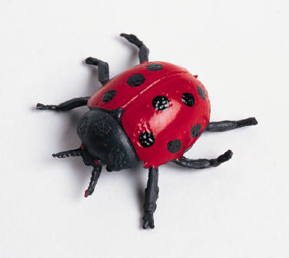
Section 12.10
The Bug Class

Slide 58
APCS Exam GridWorld Requirements
All the classes presented so far, meaning the Actor, Location, Rock and Flower classes, only test the API.
This means that you only need to know the behavior of the methods and you need to know how to call the methods with the correct parameter information.
The Bug class is the first class, which will
test the class code. In other words you are
responsible for every detail of the program
code found in the Bug class.
Initially, this is quite tricky since so many
GridWorld classes interact with each other.
Complete understanding will come steadily
as you study more classes.

Slide 59
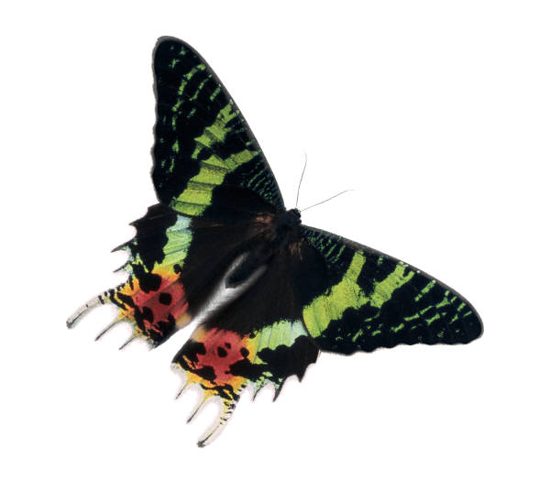
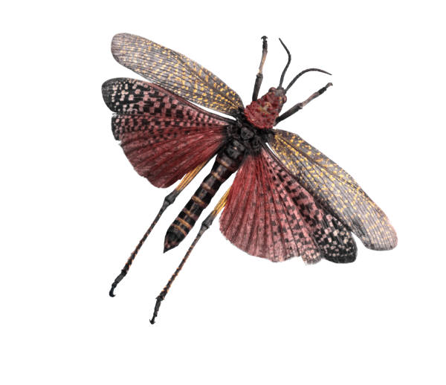
public class Bug extends Actor
{
public Bug()
{
setColor(Color.RED);
}
public Bug(Color bugColor)
{
setColor(bugColor);
}
public void act()
{
if (canMove())
move();
else
turn();
}
public void turn()
{
setDirection(getDirection() + Location.HALF_RIGHT);
}

Slide 60
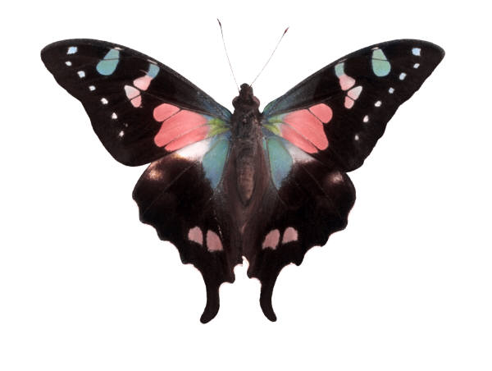
public void move()
{
Grid<Actor> gr = getGrid();
if (gr == null)
return;
Location loc = getLocation();
Location next = loc.getAdjacentLocation(getDirection());
if (gr.isValid(next))
moveTo(next);
else
removeSelfFromGrid();
Flower flower = new Flower(getColor());
flower.putSelfInGrid(gr, loc);
}
public boolean canMove()
{
Grid<Actor> gr = getGrid();
if (gr == null)
return false;
Location loc = getLocation();
Location next = loc.getAdjacentLocation(getDirection());
if (!gr.isValid(next))
return false;
Actor neighbor = gr.get(next);
return (neighbor == null) || (neighbor instanceof Flower);
}
}

