Slide 1


Exposure Java 2013
APCS Edition
Chapter 14 Slides
Focus on OOP:
Polymorphism and Abstractness
PowerPoint Presentation
created by:
Mr. John L. M. Schram
and Mr. Leon Schram
Authors of Exposure Java

Slide 2
Section 14.1
Introduction

Slide 3
OOP Review
Object Oriented Programming (OOP) is a style of programming that incorporates these 3 features:
Encapsulation
Polymorphism
Class Interaction

Slide 4
Polymorphism
Polymorphism allows something
to have many forms.
It aids reliability by making every object responsible for its own actions.

Slide 5
Abstractness
The opposite of abstract is concrete.
Concrete items can be detected with one or more of our senses.
Abstract items are not detectable with our senses.

Slide 6
Section 14.2
Overloaded
Operators
and Methods

Slide 7

Addition & Concatenation
100 + 200 = 300 (this is addition)
“100” + “200” = “100200” (this is concatenation)
This shows that the plus sign ( + ) is an overloaded operator.

Slide 8
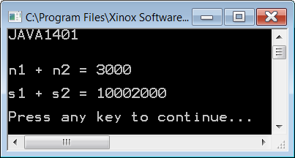
// Java1401.java
// The < + > operator in Java is overloaded.
// This program shows that the same operator can perform
// arithmetic addition and string concatenation.
public class Java1401
{
public static void main (String[] args)
{
System.out.println("JAVA1401\n\n");
int n1 = 1000;
int n2 = 2000;
int n3 = n1 + n2;
String s1 = "1000";
String s2 = "2000";
String s3 = s1 + s2;
System.out.println();
System.out.println("n1 + n2 = " + n3);
System.out.println();
System.out.println("s1 + s2 = " + s3);
System.out.println();
}
}

Slide 9
// Java1402.java
// This program draws four squares with four different
// <drawSquare> methods.
// There are no overloaded methods.
public class Java1402 extends Applet
{
public void paint(Graphics g)
{
drawSquare1(g);
drawSquare2(g,200,300);
drawSquare3(g,Color.blue,600,200);
drawSquare4(g,Color.green,500,400,200);
}
public void drawSquare1(Graphics g)
{
g.setColor(Color.red);
g.fillRect(100,100,150,150);
}

Slide 10
public void drawSquare2(Graphics g, int x, int y)
{
g.setColor(Color.red);
g.fillRect(x,y,150,150);
}
public void drawSquare3(Graphics g, Color color, int x, int y)
{
g.setColor(color);
g.fillRect(x,y,150,150);
}
public void drawSquare4(Graphics g, Color color, int x, int y, int side)
{
g.setColor(color);
g.fillRect(x,y,side,side);
}
}

Slide 11
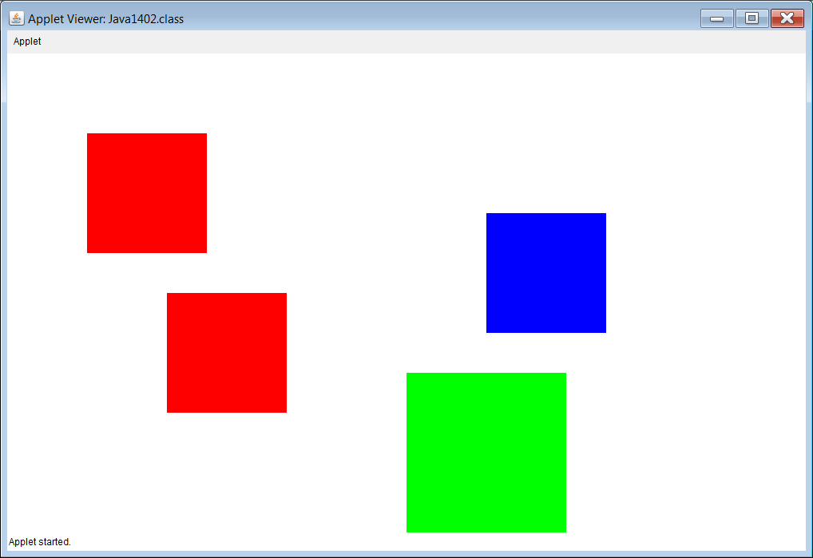

Slide 12
// Java1403.java
// This program draws four different squares with the
// same <drawSquare> method. Each method has a different
// parameter signature. They are overloaded methods.
public class Java1403 extends Applet
{
public void paint(Graphics g)
{
drawSquare(g);
drawSquare(g,200,300);
drawSquare(g,Color.blue,600,200);
drawSquare(g,Color.green,500,400,200);
}
public void drawSquare(Graphics g)
{
g.setColor(Color.red);
g.fillRect(100,100,150,150);
}

Slide 13
public void drawSquare(Graphics g, int x, int y)
{
g.setColor(Color.red);
g.fillRect(x,y,150,150);
}
public void drawSquare(Graphics g, Color color, int x, int y)
{
g.setColor(color);
g.fillRect(x,y,150,150);
}
public void drawSquare(Graphics g, Color color, int x, int y, int side)
{
g.setColor(color);
g.fillRect(x,y,side,side);
}
}

Slide 14


Slide 15

Section 14.3
Polymorphism and
Umbrella Classes

Slide 16

Umbrella Class Example 1
Actor obj1 = new Rock();
Actor obj2 = new Bug();
Actor obj3 = new Flower();

Slide 17
Umbrella Class Example 2
The following 4 separate announcements…
being made to 4 separate classes of students:
9th graders go to the gymnasium at 10:00am.
10th graders go to the gymnasium at 10:00am.
11th graders go to the gymnasium at 10:00am.
12th graders go to the gymnasium at 10:00am.
could be reduced to 1 announcement…
with 1 Umbrella class: students
All students go to the gymnasium at 10:00am.

Slide 18
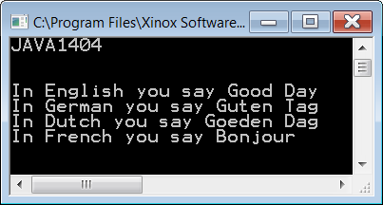
// Java1404.java
// This program displays the output of four different classes
// with the same <greeting> method.
// This program uses neither inheritance nor polymorphism.
import java.util.ArrayList;
public class Java1404
{
public static void main (String[] args)
{
System.out.println("JAVA1404\n");
English g1 = new English();
German g2 = new German();
Dutch g3 = new Dutch();
French g4 = new French();
g1.greeting();
g2.greeting();
g3.greeting();
g4.greeting();
System.out.println("\n\n");
}
}

Slide 19



class English
{
public void greeting()
{
System.out.println("In English you say Good Day");
}
}
class German
{
public void greeting()
{
System.out.println("In German you say Guten Tag");
}
}
class Dutch
{
public void greeting()
{
System.out.println("In Dutch you say Goeden Dag");
}
}
class French
{
public void greeting()
{
System.out.println("In French you say Bonjour");
}
}

Slide 20
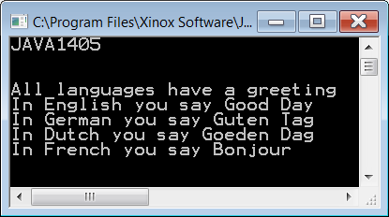
// Java1405.java
// This program displays the output of five different classes
// with the same <display> method using polymorphism.
import java.util.ArrayList;
public class Java1405
{
public static void main (String[] args)
{
System.out.println("JAVA1405\n\n");
ArrayList<Language> countries = new ArrayList<Language>();
countries.add(new Language());
countries.add(new English());
countries.add(new German());
countries.add(new Dutch());
countries.add(new French());
for (Language country: countries)
country.greeting();
System.out.println("\n\n");
}
}

Slide 21
class Language
{
public void greeting()
{
System.out.println("All languages have a greeting");
}
}
class English extends Language
{
public void greeting()
{
System.out.println("In English you say Good Day");
}
}
class German extends Language
{
public void greeting()
{
System.out.println("In German you say Guten Tag");
}
}
class Dutch extends Language
{
public void greeting()
{
System.out.println("In Dutch you say Goeden Dag");
}
}
class French extends Language
{
public void greeting()
{
System.out.println("In French you say Bonjour");
}
}

Slide 22

// Java1406.java
// This program was the final stage of the <Train> case study.
// It demonstrates the use of inheritance and composition.
// Every class is placed in its own file.
import java.awt.*;
import java.applet.*;
public class Java1406 extends Applet
{
public void paint(Graphics g)
{
Train t = new Train(55,250);
t.drawTrain(g);
}
}

Slide 23

// TrainCar.java
// This class is used by the <Java1406> program.
public class TrainCar
{
protected Color carColor;
protected int xPos;
protected int yPos;
public TrainCar(Color cC, int xP, int yP)
{
carColor = cC;
xPos = xP;
yPos = yP;
}
public void drawCar(Graphics g)
{
g.setColor(carColor);
g.fillRect(xPos,yPos,150,100);
g.setColor(Color.black);
g.fillOval(xPos+5,yPos+75,50,50);
g.fillOval(xPos+95,yPos+75,50,50);
}
}

Slide 24
// Locomotive.java
// This class is used by the <Java1406> program.
public class Locomotive extends TrainCar
{
public Locomotive(Color cc, int xP, int yP)
{
super(cc,xP,yP);
}
public void drawCar(Graphics g)
{
super.drawCar(g);
drawScoop(g);
drawFunnel(g);
}
private void drawScoop(Graphics g)
{
Polygon scoop = new Polygon();
scoop.addPoint(xPos,yPos+50);
scoop.addPoint(xPos,yPos+100);
scoop.addPoint(xPos-50,yPos+100);
g.setColor(Color.black);
g.fillPolygon(scoop);
}
private void drawFunnel(Graphics g)
{
Polygon funnel = new Polygon();
funnel.addPoint(xPos+20,yPos);
funnel.addPoint(xPos+20,yPos-30);
funnel.addPoint(xPos,yPos-50);
funnel.addPoint(xPos,yPos-60);
funnel.addPoint(xPos+60,yPos-60);
funnel.addPoint(xPos+60,yPos-50);
funnel.addPoint(xPos+40,yPos-30);
funnel.addPoint(xPos+40,yPos);
g.setColor(Color.black);
g.fillPolygon(funnel);
}
}

Slide 25
// Caboose.java
// This class is used by the <Java1406> program.
public class Caboose extends TrainCar
{
public Caboose(Color cc, int xP, int yP)
{
super(cc,xP,yP);
}
public void drawCar(Graphics g)
{
super.drawCar(g);
drawWindows(g);
drawTop(g);
}
private void drawWindows(Graphics g)
{
g.setColor(Color.white);
g.fillRect(xPos+30,yPos+30,30,30);
g.fillRect(xPos+90,yPos+30,30,30);
}
private void drawTop(Graphics g)
{
g.setColor(carColor);
g.fillRect(xPos+30,yPos-30,90,30);
g.setColor(Color.black);
g.fillRect(xPos+25,yPos-30,100,5);
}
}

Slide 26
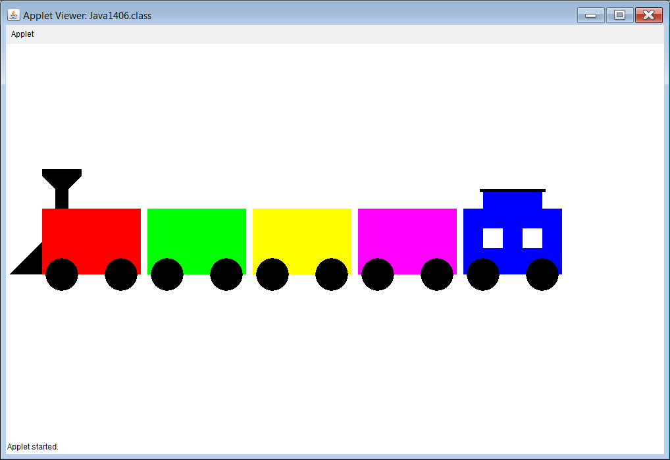

Slide 27
// Java1407.java
// This program uses "polymorphism" to display the train.
import java.awt.*;
import java.applet.*;
public class Java1407 extends Applet
{
public void paint(Graphics g)
{
Train t = new Train(55,250);
t.drawTrain(g);
}
}

Slide 28

// Train.java
// This class is used by the <Java1407> program.
public class Train
{
ArrayList<TrainCar> trainCars;
private int tlX;
private int tlY;
public Train(int tlX, int tlY)
{
trainCars = new ArrayList<TrainCar>();
this.tlX = tlX;
this.tlY = tlY;
trainCars.add(new Locomotive(Color.red,tlX,tlY));
trainCars.add(new TrainCar(Color.green,tlX+160,tlY));
trainCars.add(new TrainCar(Color.yellow,tlX+320,tlY));
trainCars.add(new TrainCar(Color.magenta,tlX+480,tlY));
trainCars.add(new Caboose(Color.blue,tlX+640,tlY));
}
public void drawTrain(Graphics g)
{
for (TrainCar tc: trainCars)
tc.drawCar(g);
}
}
Other classes are the same
as the last program.

Slide 29
Section 14.4
GridWorld and
Polymorphism

Slide 30
/* AP(r) Computer Science GridWorld Case Study:
* Copyright(c) 2002-2006 College Entrance Examination Board (http://www.collegeboard.com).
*
* This code is free software; you can redistribute it and/or modify it under the terms of the GNU
* General Public License as published by the Free Software Foundation.
* This code is distributed in the hope that it will be useful, but WITHOUT ANY WARRANTY;
* without even the implied warranty of MERCHANTABILITY or FITNESS FOR A PARTICULAR
* PURPOSE. See the GNU General Public License for more details.
*
* @author Alyce Brady
* @author APCS Development Committee
* @author Cay Horstmann
*/
// METHOD getOccupiedLocations is a member of the BoundedGrid class.
public ArrayList<Location> getOccupiedLocations() // 1
{
ArrayList<Location> theLocations = new ArrayList<Location>(); // 2
for (int r = 0; r < getNumRows(); r++) // 3
{
for (int c = 0; c < getNumCols(); c++) // 4
{
Location loc = new Location(r, c); // 5
if (get(loc) != null) // 6
theLocations.add(loc); // 7
}
}
return theLocations; // 8
}
Java1408.java

Slide 31
/* AP(r) Computer Science GridWorld Case Study:
* Copyright(c) 2002-2006 College Entrance Examination Board (http://www.collegeboard.com).
*
* This code is free software; you can redistribute it and/or modify it under the terms of the GNU
* General Public License as published by the Free Software Foundation.
* This code is distributed in the hope that it will be useful, but WITHOUT ANY WARRANTY;
* without even the implied warranty of MERCHANTABILITY or FITNESS FOR A PARTICULAR
* PURPOSE. See the GNU General Public License for more details.
*
* @author Cay Horstmann
*/
// METHOD step is a member of the ActorWorld class.
public void step()
{
Grid<Actor> gr = getGrid(); // 1
ArrayList<Actor> actors = new ArrayList<Actor>(); // 2
for (Location loc : gr.getOccupiedLocations()) // 3
actors.add(gr.get(loc)); // 4
for (Actor a : actors) // 5
{
if (a.getGrid() == gr) // 6
a.act(); // 7
}
}
Java1409.java

Slide 32
Polymorphism & Reliability
In a complex program with hundreds or more classes and many, many similar, but different actions it is very easy to get confused and instruct some object to behave incorrectly.
This will not happen if each object carries its own set of instructions and is told to act, to display, to compute, etc.

Slide 33
Cookies & Polymorphism
In a complex program with hundreds or more classes and many, many similar, but different actions it is very easy to get confused and instruct some object to behave incorrectly.
This will not happen if each object carries its own set of instructions and is told to act, to display, to compute, etc.

Slide 34
Section 14.5
Classes and
Interfaces

Slide 35
Java Collection Hierarchy
Collection
interface
List
interface
Set
interface
ArrayList
class
LinkedList
class
HashSet
class
TreeSet
class

Slide 36
Collections
A Collection is a group of objects.

Slide 37
Lists
A List is a Collection that allows access to any element in the list.
A List may have duplicate elements.
Examples of list data structures
are Java static arrays,
ArrayLists, Strings and Files.

Slide 38
Sets
A Set is an unordered collection without any duplicate elements.

Slide 39
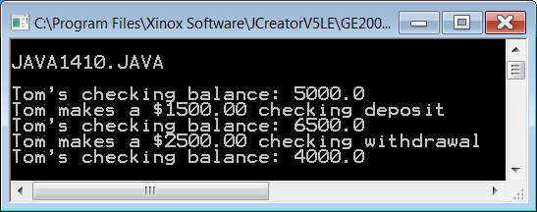
// Java1410.java
// This program uses a <Bank> class, which will be used for interface program examples in this chapter.
public class Java1410
{
public static void main (String args[])
{
System.out.println("\nJAVA1410.JAVA\n");
Bank tom = new Bank(5000.0);
System.out.println("Tom's checking balance: " + tom.getCheckingBalance());
System.out.println("Tom makes a $1500.00 checking deposit");
tom.makeCheckingDeposit(1500.0);
System.out.println("Tom's checking balance: " + tom.getCheckingBalance());
System.out.println("Tom makes a $2500.00 checking withdrawal");
tom.makeCheckingWithdrawal(2500.0);
System.out.println("Tom's checking balance: " + tom.getCheckingBalance());
System.out.println();
}
}
class Bank
{
private double checking;
public Bank(double c) { checking = c; }
public double getCheckingBalance() { return checking; }
public void makeCheckingDeposit(double amount) { checking += amount; }
public void makeCheckingWithdrawal(double amount) { checking -= amount; }
}

Slide 40
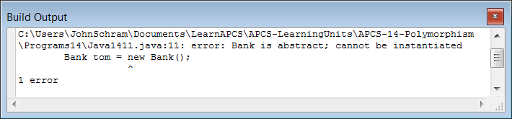
// Java1411.java
// The former <Bank> class is now a <Bank> interface.
// Only the method headings are shown. The program does not compile.
public class Java1411
{
public static void main (String args[])
{
System.out.println("\nJAVA1411.JAVA\n");
Bank tom = new Bank();
System.out.println();
}
}
interface Bank
{
public double getCheckingBalance();
public void makeCheckingDeposit(double amount);
public void makeCheckingWithdrawal(double amount);
}

Slide 41
Program Differences
Typical Program | Java1411.java
Uses class | Uses interface
Has methods with program statements | No statements, only method headings
Methods headings have no semi-colons | Method headings have semi-colons
Class has a constructor | There is no constructor
There are fields to store data | There are no fields

Slide 42
Java Interfaces
A Java Interface provides a group of method signatures that will be available for any client of a class that implements the interface.
Implementation details of the Interface methods are neither required nor desired at the Interface level.

Slide 43
Section 14.6
Implementing
Interfaces

Slide 44

// Java1412.java
// The <MyBank> class implements the <Bank> interface. The program now compiles and executes.
public class Java1412
{
public static void main (String args[])
{
System.out.println("\nJAVA1412.JAVA\n");
MyBank tom = new MyBank(5000.0);
System.out.println("Tom's checking balance: " + tom.getCheckingBalance());
System.out.println("Tom makes a $1500.00 checking deposit");
tom.makeCheckingDeposit(1500.0);
System.out.println("Tom's checking balance: " + tom.getCheckingBalance());
System.out.println("Tom makes a $2500.00 checking withdrawal");
tom.makeCheckingWithdrawal(2500.0);
System.out.println("Tom's checking balance: " + tom.getCheckingBalance());
System.out.println();
}
}
interface Bank
{
public double getCheckingBalance();
public void makeCheckingDeposit(double amount);
public void makeCheckingWithdrawal(double amount);
}
class MyBank implements Bank
{
private double checking;
public MyBank(double c) { checking = c; }
public double getCheckingBalance() { return checking; }
public void makeCheckingDeposit(double amount) { checking += amount; }
public void makeCheckingWithdrawal(double amount) { checking -= amount; }
}

Slide 45

// Java1413.java
// An interface is "abstract" and its methods are also "abstract". The <abstract> keyword is optional.
public class Java1413
{
public static void main (String args[])
{
System.out.println("\nJAVA1413.JAVA\n");
MyBank tom = new MyBank(5000.0);
System.out.println("Tom's checking balance: " + tom.getCheckingBalance());
System.out.println("Tom makes a $1500.00 checking deposit");
tom.makeCheckingDeposit(1500.0);
System.out.println("Tom's checking balance: " + tom.getCheckingBalance());
System.out.println("Tom makes a $2500.00 checking withdrawal");
tom.makeCheckingWithdrawal(2500.0);
System.out.println("Tom's checking balance: " + tom.getCheckingBalance());
System.out.println();
}
}
abstract interface Bank
{
public abstract double getCheckingBalance();
public abstract void makeCheckingDeposit(double amount);
public abstract void makeCheckingWithdrawal(double amount);
}
class MyBank implements Bank
{
private double checking;
public MyBank(double c) { checking = c; }
public double getCheckingBalance() { return checking; }
public void makeCheckingDeposit(double amount) { checking += amount; }
public void makeCheckingWithdrawal(double amount) { checking -= amount; }
}

Slide 46
Implementation Rule
A class, which implements an interface, must implement every method declared in the interface.

Slide 47
// Java1414.java
// This program partially implements the <Bank> class. Now the program does not compile.
public class Java1414
{
public static void main (String args[])
{
System.out.println("\nJAVA1414.JAVA\n");
MyBank tom = new MyBank(5000.0);
System.out.println("Tom's checking balance: " + tom.getCheckingBalance());
System.out.println("Tom makes a $1500.00 checking deposit");
tom.makeCheckingDeposit(1500.0);
System.out.println("Tom's checking balance: " + tom.getCheckingBalance());
System.out.println("Tom makes a $2500.00 checking withdrawal");
tom.makeCheckingWithdrawal(2500.0);
System.out.println("Tom's checking balance: " + tom.getCheckingBalance());
System.out.println();
}
}
abstract interface Bank
{
public abstract double getCheckingBalance();
public abstract void makeCheckingDeposit(double amount);
public abstract void makeCheckingWithdrawal(double amount);
}
class MyBank implements Bank
{
private double checking;
public MyBank(double c) { checking = c; }
public void makeCheckingDeposit(double amount) { checking += amount; }
public void makeCheckingWithdrawal(double amount) { checking -= amount; }
}

Slide 48
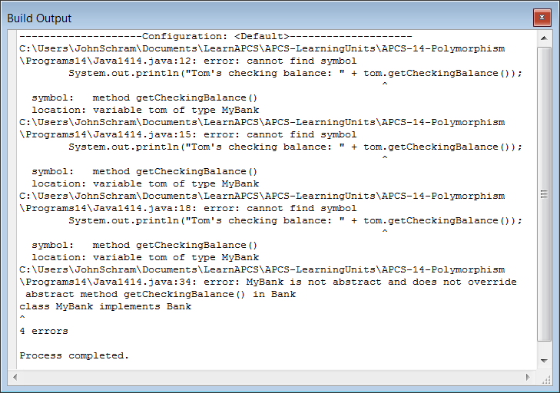

Slide 49
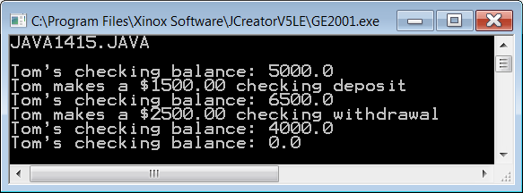
// Java1415.java This program demonstrates that it is possible to implement an interface
// and define additional methods that are not declared in the interface.
public class Java1415
{
public static void main (String args[])
{
System.out.println("\nJAVA1415.JAVA\n");
MyBank tom = new MyBank(5000.0);
System.out.println("Tom's checking balance: " + tom.getCheckingBalance());
System.out.println("Tom makes a $1500.00 checking deposit");
tom.makeCheckingDeposit(1500.0);
System.out.println("Tom's checking balance: " + tom.getCheckingBalance());
System.out.println("Tom makes a $2500.00 checking withdrawal");
tom.makeCheckingWithdrawal(2500.0);
System.out.println("Tom's checking balance: " + tom.getCheckingBalance());
tom.closeAccount();
System.out.println("Tom's checking balance: " + tom.getCheckingBalance());
System.out.println();
}
}
abstract interface Bank
{
public abstract double getCheckingBalance();
public abstract void makeCheckingDeposit(double amount);
public abstract void makeCheckingWithdrawal(double amount);
}
class MyBank implements Bank
{
private double checking;
public MyBank(double c) { checking = c; }
public double getCheckingBalance() { return checking; }
public void makeCheckingDeposit(double amount) { checking += amount; }
public void makeCheckingWithdrawal(double amount) { checking -= amount; }
public void closeAccount() { checking = 0; }
}

Slide 50
Section 14.7
Implementing
Multiple
Interfaces

Slide 51
// Java1416.java
// This program shows how one class, <BankAccounts> can implement two
// interfaces <Checking> and <Savings>.
public class Java1416
{
public static void main (String args[])
{
System.out.println("\nJAVA1416.JAVA\n");
BankAccounts tom = new BankAccounts(5000.0,7500.0);
System.out.println("Tom's checking balance: " + tom.getCheckingBalance());
System.out.println("Tom makes a $1500.00 checking deposit");
tom.makeCheckingDeposit(1500.0);
System.out.println("Tom's checking balance: " + tom.getCheckingBalance());
System.out.println("Tom makes a $2500.00 checking withdrawal");
tom.makeCheckingWithdrawal(2500.0);
System.out.println("Tom's checking balance: " + tom.getCheckingBalance());
System.out.println();
System.out.println("Tom's savings balance: " + tom.getSavingsBalance());
System.out.println("Tom makes a $1500.00 savings deposit");
tom.makeSavingsDeposit(1500.0);
System.out.println("Tom's savings balance: " + tom.getSavingsBalance());
System.out.println("Tom makes a $2500.00 savings withdrawal");
tom.makeSavingsWithdrawal(2500.0);
System.out.println("Tom's savings balance: " + tom.getSavingsBalance());
System.out.println();
}
}

Slide 52
abstract interface Checking
{
public abstract double getCheckingBalance();
public abstract void makeCheckingDeposit(double amount);
public abstract void makeCheckingWithdrawal(double amount);
}
abstract interface Savings
{
public abstract double getSavingsBalance();
public abstract void makeSavingsDeposit(double amount);
public abstract void makeSavingsWithdrawal(double amount);
}
class BankAccounts implements Checking, Savings
{
private double checking;
private double savings;
public BankAccounts(double c, double s) { checking = c; savings = s; }
public double getCheckingBalance() { return checking; }
public double getSavingsBalance() { return savings; }
public void makeCheckingDeposit(double amount) { checking += amount; }
public void makeSavingsDeposit(double amount) { savings += amount; }
public void makeCheckingWithdrawal(double amount) { checking -= amount; }
public void makeSavingsWithdrawal(double amount) { savings -= amount; }
}

Slide 53
Section 14.8
Using Fields in
an Interface

Slide 54
// Java1417.java
// This program shows that it is possible to have a field in an interface, but it
// must be final and initialized.
public class Java1417
{
public static void main (String args[])
{
System.out.println("\nJAVA1417.JAVA\n");
MyBank tom = new MyBank(5000.0);
System.out.println("Tom's checking balance: " + tom.getCheckingBalance());
System.out.println("Tom makes a $1500.00 checking deposit");
tom.makeCheckingDeposit(1500.0);
System.out.println("Tom's checking balance: " + tom.getCheckingBalance());
System.out.println("Tom makes a $2500.00 checking withdrawal");
tom.makeCheckingWithdrawal(2500.0);
System.out.println("Tom's checking balance: " + tom.getCheckingBalance());
System.out.println("Computing interest");
tom.computeInterest();
System.out.println("Tom's checking balance: " + tom.getCheckingBalance());
System.out.println();
}
}

Slide 55
abstract interface Bank
{
public final double rate = 0.05;
public abstract double getCheckingBalance();
public abstract void makeCheckingDeposit(double amount);
public abstract void makeCheckingWithdrawal(double amount);
public abstract void computeInterest();
}
class MyBank implements Bank
{
private double checking;
private double interest;
public MyBank(double c)
{
checking = c;
interest = 0.0;
}
public double getCheckingBalance() { return checking; }
public void makeCheckingDeposit(double amount) { checking += amount; }
public void makeCheckingWithdrawal(double amount) { checking -= amount; }
public void computeInterest()
{
interest = checking * rate;
checking += interest;
}
}

Slide 56
Using Fields in an Interface
Fields may be used in an interface declaration.
All fields must have an initialized value.
Field values are constant and cannot be changed.
The final keyword is optional. Final is implied.

Slide 57
Section 14.9
Interfaces and
Polymorphism

Slide 58
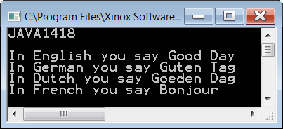
// Java1418.java
// This program works polymorphism correctly with an "umbrella"
// superclass that uses an empty <greeting> method.
public class Java1418
{
public static void main (String[] args)
{
System.out.println("JAVA1418\n");
ArrayList<Language> countries = new ArrayList<Language>();
countries.add(new English());
countries.add(new German());
countries.add(new Dutch());
countries.add(new French());
for (Language country: countries)
country.greeting();
System.out.println("\n\n");
}
}
class Language
{
public void greeting()
{
}
}

Slide 59
class English extends Language
{
public void greeting()
{
System.out.println("In English you say Good Day");
}
}
class German extends Language
{
public void greeting()
{
System.out.println("In German you say Guten Tag");
}
}
class Dutch extends Language
{
public void greeting()
{
System.out.println("In Dutch you say Goeden Dag");
}
}
class French extends Language
{
public void greeting()
{
System.out.println("In French you say Bonjour");
}
}

Slide 60

// Java1419.java
// This program also works polymorphism correctly with an
// interface that uses an abstract <greeting> method.
public class Java1419
{
public static void main (String[] args)
{
System.out.println("JAVA1419\n\n");
ArrayList<Language> countries = new ArrayList<Language>();
countries.add(new English());
countries.add(new German());
countries.add(new Dutch());
countries.add(new French());
for (Language country: countries)
country.greeting();
System.out.println("\n\n");
}
}
abstract interface Language
{
public abstract void greeting();
}

Slide 61
class English implements Language
{
public void greeting()
{
System.out.println("In English you say Good Day");
}
}
class German implements Language
{
public void greeting()
{
System.out.println("In German you say Guten Tag");
}
}
class Dutch implements Language
{
public void greeting()
{
System.out.println("In Dutch you say Goeden Dag");
}
}
class French implements Language
{
public void greeting()
{
System.out.println("In French you say Bonjour");
}
}

Slide 62


SuperClass vs. Interface
class Language { public void greeting() { } } | interface Language { public void greeting(); }

Slide 63
Section 14.10
Abstract
Classes

Slide 64
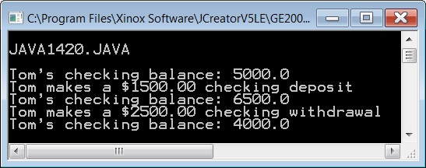
// Java1420.java
// This program uses an abstract <Bank> class, rather than a <Bank> interface.
// There appears no difference between an abstract class and an interface.
public class Java1420
{
public static void main (String args[])
{
System.out.println("\nJAVA1420.JAVA\n");
MyBank tom = new MyBank(5000.0);
System.out.println("Tom's checking balance: " + tom.getCheckingBalance());
System.out.println("Tom makes a $1500.00 checking deposit");
tom.makeCheckingDeposit(1500.0);
System.out.println("Tom's checking balance: " + tom.getCheckingBalance());
System.out.println("Tom makes a $2500.00 checking withdrawal");
tom.makeCheckingWithdrawal(2500.0);
System.out.println("Tom's checking balance: " + tom.getCheckingBalance());
System.out.println();
}
}
abstract class Bank
{
public abstract double getCheckingBalance();
public abstract void makeCheckingDeposit(double amount);
public abstract void makeCheckingWithdrawal(double amount);
}
class MyBank extends Bank
{
private double checking;
public MyBank(double c) { checking = c; }
public double getCheckingBalance() { return checking; }
public void makeCheckingDeposit(double amount) { checking += amount; }
public void makeCheckingWithdrawal(double amount) { checking -= amount; }
}

Slide 65
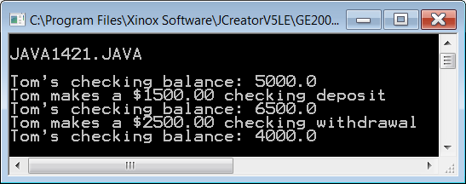
// Java1421.java
// An abstract class can have both abstract members and concrete members.
// An interface can only have abstract members.
public class Java1421
{
public static void main (String args[])
{
System.out.println("\nJAVA1421.JAVA\n");
MyBank tom = new MyBank(5000.0);
System.out.println("Tom's checking balance: " + tom.getCheckingBalance());
System.out.println("Tom makes a $1500.00 checking deposit");
tom.makeCheckingDeposit(1500.0);
System.out.println("Tom's checking balance: " + tom.getCheckingBalance());
System.out.println("Tom makes a $2500.00 checking withdrawal");
tom.makeCheckingWithdrawal(2500.0);
System.out.println("Tom's checking balance: " + tom.getCheckingBalance());
System.out.println();
}
}
abstract class Bank
{
protected double checking;
protected Bank(double c) { checking = c; }
public abstract double getCheckingBalance();
public abstract void makeCheckingDeposit(double amount);
public abstract void makeCheckingWithdrawal(double amount);
}
class MyBank extends Bank
{
protected MyBank(double c) { super(c); }
public double getCheckingBalance() { return checking; }
public void makeCheckingDeposit(double amount) { checking += amount; }
public void makeCheckingWithdrawal(double amount) { checking -= amount; }
}

Slide 66
Abstract Interfaces & Abstract Classes
All methods of an interface must be abstract.
Methods in an abstract class may be abstract or concrete.

Slide 67
Interfaces vs. Abstract Classes
Interface | Abstract Class
Abstract methods only | Abstract and concrete methods
No constructor allowed | Can have a constructor
Needs a class to implement the interface | Needs a subclass to implement the abstract methods
Only final attributes are allowed. | Any attribute is allowed.
Cannot instantiate an object | Cannot instantiate an object
The keyword abstract is implied. | The keyword abstract is required.
The keyword final is implied for all attributes. | The keyword final is required for all final attributes.
Can be used to facilitate polymorphism | Can be used to facilitate polymorphism

Slide 68
Polymorphism Steps
Use the following steps to use polymorphic methods:
1 | Create an umbrella interface or umbrella superclass.
2 | The umbrella interface or umbrella superclass must include the methods that are meant to be used polymorphically by other classes.
3 | Call every object - of different classes - using the umbrella and using the same method, like:
 | for (Actor a : actors) { if (a.getGrid() == gr) a.act(); }

Slide 69
Section 14.11
Interfaces
& Generics

Slide 70
// Java1422.java
// This is a not a runnable program.
// You see the <List> interface below, as it is described by the
// College Board AP Computer Science course description.
interface List<E>
{
public int Size(); // returns the number of elements in list
public boolean add(E obj); // appends obj to the end of list; returns true
public void add(int index, E obj);
// inserts obj at position index (0 <= index <= size),
// moving elements to the right (adds 1 to their indices) and adjusts size
public E get(int index); // returns element at position index
public E set(int index, E obj);
// replaces the element at position index with obj
// returns the element formerly at the specified position
public E remove(int index);
// removes element from position index, moving elements
// at position index+1 and higher to the left
// (subtracts 1 from their indices) and adjusts size
// returns the element formerly at the specified position
}
What
exactly is this E
thing?

Slide 71
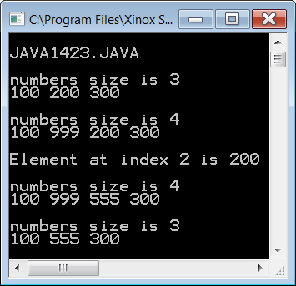
// Java1423.java
// This program implement the <IntList> interface.
// The interface and the implementation is intentionally not generic.
// Every method and storage is designed to work with <int> values only.
public class Java1423
{
public static void main (String args[])
{
System.out.println("\nJAVA1423.JAVA\n");
MyIntList numbers = new MyIntList();
numbers.add(100);
numbers.add(200);
numbers.add(300);
System.out.println("numbers size is " + numbers.Size());
numbers.display();
numbers.add(1,999);
System.out.println("numbers size is " + numbers.Size());
numbers.display();
System.out.println("Element at index 2 is " + numbers.get(2) + "\n");
numbers.set(2,555);
System.out.println("numbers size is " + numbers.Size());
numbers.display();
numbers.remove(1);
System.out.println("numbers size is " + numbers.Size());
numbers.display();
}
}
interface IntList
{
public int Size();
public boolean add(int num);
public void add(int index, int num);
public int get(int index);
public int set(int index, int num);
public int remove(int index);
}

Slide 72
class MyIntList implements IntList
{
private int intArray[];
private int size;
public MyIntList()
{
intArray = new int[10000];
size = 0;
}
public int Size()
{
return size;
}
public boolean add(int num)
{
intArray[size] = num;
size++;
return true;
}
public void add(int index, int num)
{
for (int k = size; k >= index; k--)
intArray[k] = intArray[k-1];
intArray[index] = num;
size++;
}
public int get(int index)
{
return intArray[index];
}
public int set(int index, int num)
{
int temp = intArray[index];
intArray[index] = num;
return temp;
}
public int remove(int index)
{
int temp = intArray[index];
for (int k = index; k < size-1; k++)
intArray[k] = intArray[k+1];
size--;
return temp;
}
public void display()
{
for (int k = 0; k < size; k++)
System.out.print(intArray[k] + " ");
System.out.println("\n");
}
}

Slide 73
class MyIntList implements IntList
{
private int intArray[];
private int size;
public MyIntList()
{
intArray = new int[10000];
size = 0;
}
public int Size()
{
return size;
}
public boolean add(int num)
{
intArray[size] = num;
size++;
return true;
}
public void add(int index, int num)
{
for (int k = size; k >= index; k--)
intArray[k] = intArray[k-1];
intArray[index] = num;
size++;
}
The reason the add method needs to return a boolean value is because it implements the Collection interface which is also used for Sets.
Returning true means a successful add.
In the case of a Set, duplicate elements are not allowed.
Trying to add a duplicate would cause false to be returned indicating it was not a successful add.

Slide 74
// Java1424.java
// This program implement the <List> interface.
// The interface and the implementation are now generic.
// In this program every instance of E will be replaced by String.
public class Java1424
{
public static void main (String args[])
{
System.out.println("\nJAVA1424.JAVA\n");
MyList<String> names = new MyList<String>();
names.add("Isolde");
names.add("John");
names.add("Greg");
System.out.println("names size is " + names.Size());
names.display();
names.add(1,"Maria");
System.out.println("names size is " + names.Size());
names.display();
System.out.println("Element at index 2 is " + names.get(2) + "\n");
names.set(2,"Heidi");
System.out.println("names size is " + names.Size());
names.display();
names.remove(1);
System.out.println("names size is " + names.Size());
names.display();
}
}
interface List<E>
{
public int Size();
public boolean add(E obj);
public void add(int index, E obj);
public E get(int index);
public E set(int index, E obj);
public E remove(int index);
}
NOTE: Not every int was changed to E. The size of the array and the indexes of each element are always integers, regardless of what the array stores.

Slide 75
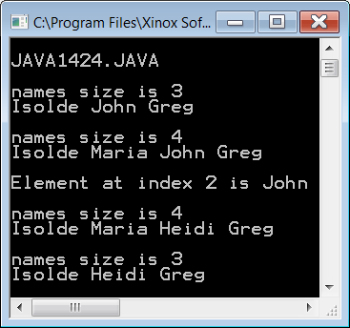
// Java1424.java
// This program implement the <List> interface.
// The interface and the implementation are now generic.
// In this program every instance of E will be replaced by String.
public class Java1424
{
public static void main (String args[])
{
System.out.println("\nJAVA1424.JAVA\n");
MyList<String> names = new MyList<String>();
names.add("Isolde");
names.add("John");
names.add("Greg");
System.out.println("names size is " + names.Size());
names.display();
names.add(1,"Maria");
System.out.println("names size is " + names.Size());
names.display();
System.out.println("Element at index 2 is " + names.get(2) + "\n");
names.set(2,"Heidi");
System.out.println("names size is " + names.Size());
names.display();
names.remove(1);
System.out.println("names size is " + names.Size());
names.display();
}
}
interface List<E>
{
public int Size();
public boolean add(E obj);
public void add(int index, E obj);
public E get(int index);
public E set(int index, E obj);
public E remove(int index);
}

Slide 76
class MyList<E> implements List<E>
{
private Object array[];
private int size;
public MyList()
{
array = new Object[10000];
size = 0;
}
public int Size()
{
return size;
}
public boolean add(E obj)
{
array[size] = obj;
size++;
return true;
}
public void add(int index, E obj)
{
for (int k = size; k >= index; k--)
array[k] = array[k-1];
array[index] = obj;
size++;
}
public E get(int index)
{
return (E) array[index];
}
public E set(int index, E obj)
{
E temp = (E) array[index];
array[index] = obj;
return temp;
}
public E remove(int index)
{
E temp = (E) array[index];
for (int k = index; k < size-1; k++)
array[k] = array[k+1];
size--;
return temp;
}
public void display()
{
for (int k = 0; k < size; k++)
System.out.print(array[k] + " ");
System.out.println("\n");
}
}

Slide 77
class MyList<E> implements List<E>
{
private Object array[];
private int size;
public MyList()
{
array = new Object[10000];
size = 0;
}
public int Size()
{
return size;
}
public boolean add(E obj)
{
array[size] = obj;
size++;
return true;
}
public void add(int index, E obj)
{
for (int k = size; k >= index; k--)
array[k] = array[k-1];
array[index] = obj;
size++;
}
public E get(int index)
{
return (E) array[index];
}
public E set(int index, E obj)
{
E temp = (E) array[index];
array[index] = obj;
return temp;
}
public E remove(int index)
{
E temp = (E) array[index];
for (int k = index; k < size-1; k++)
array[k] = array[k+1];
size--;
return temp;
}
public void display()
{
for (int k = 0; k < size; k++)
System.out.print(array[k] + " ");
System.out.println("\n");
}
}
Typecasting with Generics

Slide 78
MyList<String> names = new MyList<String>();
interface List<E>
{
public int size();
public boolean add(E obj);
public void add(int index, E obj);
public E get(int index);
public E set(int index, E obj);
public E remove(int index);
}
Working with Generics is like having the ability to pass a parameter – which is a datatype – to a class.

Slide 79
MyList<String> names = new MyList<String>();
interface List<String>
{
public int size();
public boolean add(String obj);
public void add(int index, String obj);
public String get(int index);
public String set(int index, String obj);
public String remove(int index);
}
It is as if all of the Es magically change to String which is the datatype you want to work with.

Slide 80
Section 14.12
GWCS Grid
Interface

Slide 81
/* AP(r) Computer Science GridWorld Case Study:
* Copyright(c) 2002-2006 College Entrance Examination Board
* (http://www.collegeboard.com).
*
* This code is free software; you can redistribute it and/or modify
* it under the terms of the GNU General Public License as published by
* the Free Software Foundation.
* This code is distributed in the hope that it will be useful,
* but WITHOUT ANY WARRANTY; without even the implied warranty of
* MERCHANTABILITY or FITNESS FOR A PARTICULAR PURPOSE. See the
* GNU General Public License for more details.
*
* @author Alyce Brady
* @author APCS Development Committee
* @author Cay Horstmann
*/
public interface Grid<E>
{
int getNumRows();
int getNumCols();
boolean isValid(Location loc);
E put(Location loc, E obj);
E remove(Location loc);
E get(Location loc);
ArrayList<Location> getOccupiedLocations();
ArrayList<Location> getValidAdjacentLocations(Location loc);
ArrayList<Location> getEmptyAdjacentLocations(Location loc);
ArrayList<Location> getOccupiedAdjacentLocations(Location loc);
ArrayList<E> getNeighbors(Location loc);
}
Grid.java in Java1425 folder

Slide 82
int getNumRows();
returns the number of rows in the grid,
if the grid is bounded
returns -1 if the grid is unbounded
int getNumCols();
returns the number of columns in the grid,
if the grid is bounded
returns -1 if the grid is unbounded

Slide 83
boolean isValid(Location loc);
Precondition: loc is not null
returns true if loc is a valid location in this grid
returns false if loc is not a valid location in this grid

Slide 84
E put(Location loc, E obj);
Precondition:
loc is valid in this grid and obj is not null
puts the obj at loc location in this grid
returns the previous object
returns null if location was previously not occupied

Slide 85
E remove(Location loc);
Precondition: loc is valid in this grid
removes the obj at loc location in this grid
returns the previous object
returns null if location was previously not occupied

Slide 86
ArrayList<Location> getOccupiedLocatons;
Precondition: loc is valid in this grid
removes the obj at loc location in this grid
returns the previous object
returns null if location was previously not occupied

Slide 87



ArrayList<Location> getValidAdjacentLocatons(Location loc);
Precondition: loc is valid in this grid
returns an ArrayList of the valid locations adjacent to loc in this grid, which means in the eight compass directions of loc
1 | 2 | 3
8 |  | 4
7 | 6 | 5

Slide 88
ArrayList<Location> getEmptyAdjacentLocatons(Location loc);
Precondition: loc is valid in this grid
returns an ArrayList of the valid empty locations adjacent to loc in this grid, which means in the eight compass directions of loc
1 | 2
5 |  | 3
 |  | 4

Slide 89
ArrayList<Location> getOccupiedAdjacentLocatons(Location loc);
Precondition: loc is valid in this grid
returns an ArrayList of the valid occupied locations adjacent to loc in this grid, which means in the eight compass directions of loc
 |  | 1
3 | 2

Slide 90
ArrayList<E> getNeighbors(Location loc);
Precondition: loc is valid in this grid
returns an ArrayList of the objects in the occupied locations adjacent to loc in this grid, which means in the 8 compass directions of loc
NOTE:
The previous
method returned an
array of locations.
 |  | 1
3 | 2
getNeighbors
returns an array of
objects at those
locations.

Slide 91
public class BoundedGrid<E> implements Grid<E> public class UnboundedGrid<E> implements Grid<E>

Slide 92
public class BoundedGrid<E> implements Grid<E> public class UnboundedGrid<E> implements Grid<E>
public abstract class AbstractGrid<E> implements Grid<E>
public class BoundedGrid<E> extends AbstractGrid<E> public class UnboundedGrid<E> extends AbstractGrid<E>

Slide 93
/* AP(r) Computer Science GridWorld Case Study:
* Copyright(c) 2005-2006 Cay S. Horstmann (http://horstmann.com)
*
* This code is free software; you can redistribute it and/or modify
* it under the terms of the GNU General Public License as published by
* the Free Software Foundation.
* This code is distributed in the hope that it will be useful,
* but WITHOUT ANY WARRANTY; without even the implied warranty of
* MERCHANTABILITY or FITNESS FOR A PARTICULAR PURPOSE. See the
* GNU General Public License for more details.
*
* @author Cay Horstmann
*/
package info.gridworld.grid;
import java.util.ArrayList;
public abstract class AbstractGrid<E> implements Grid<E>
{
public ArrayList<E> getNeighbors(Location loc)
{
ArrayList<E> neighbors = new ArrayList<E>();
for (Location neighborLoc : getOccupiedAdjacentLocations(loc))
neighbors.add(get(neighborLoc));
return neighbors;
}
AbstractGrid.java in Java1425 folder

Slide 94
public ArrayList<Location> getValidAdjacentLocations(Location loc)
{
ArrayList<Location> locs = new ArrayList<Location>();
int d = Location.NORTH;
for (int i = 0; i < Location.FULL_CIRCLE / Location.HALF_RIGHT; i++)
{
Location neighborLoc = loc.getAdjacentLocation(d);
if (isValid(neighborLoc))
locs.add(neighborLoc);
d = d + Location.HALF_RIGHT;
}
return locs;
}
public ArrayList<Location> getEmptyAdjacentLocations(Location loc)
{
ArrayList<Location> locs = new ArrayList<Location>();
for (Location neighborLoc : getValidAdjacentLocations(loc))
{
if (get(neighborLoc) == null)
locs.add(neighborLoc);
}
return locs;
}

Slide 95
public ArrayList<Location> getOccupiedAdjacentLocations(Location loc)
{
ArrayList<Location> locs = new ArrayList<Location>();
for (Location neighborLoc : getValidAdjacentLocations(loc))
{
if (get(neighborLoc) != null)
locs.add(neighborLoc);
}
return locs;
}
public String toString()
{
String s = "{";
for (Location loc : getOccupiedLocations())
{
if (s.length() > 1)
s += ", ";
s += loc + "=" + get(loc);
}
return s + "}";
}
}

Slide 96
/* AP(r) Computer Science GridWorld Case Study:
* Copyright(c) 2002-2006 College Entrance Examination Board
* (http://www.collegeboard.com).
*
* This code is free software; you can redistribute it and/or modify
* it under the terms of the GNU General Public License as published by
* the Free Software Foundation.
* This code is distributed in the hope that it will be useful,
* but WITHOUT ANY WARRANTY; without even the implied warranty of
* MERCHANTABILITY or FITNESS FOR A PARTICULAR PURPOSE. See the
* GNU General Public License for more details.
*
* @author Alyce Brady
* @author APCS Development Committee
* @author Cay Horstmann
*/
package info.gridworld.grid;
import java.util.ArrayList;
public class BoundedGrid<E> extends AbstractGrid<E>
{
private Object[][] occupantArray;
BoundedGrid.java in Java1425 folder

Slide 97
public BoundedGrid(int rows, int cols)
{
if (rows <= 0)
throw new IllegalArgumentException("rows <= 0");
if (cols <= 0)
throw new IllegalArgumentException("cols <= 0");
occupantArray = new Object[rows][cols];
}
public int getNumRows()
{
return occupantArray.length;
}
public int getNumCols()
{
return occupantArray[0].length;
}
public boolean isValid(Location loc)
{
return 0 <= loc.getRow() && loc.getRow() < getNumRows()
&& 0 <= loc.getCol() && loc.getCol() < getNumCols();
}

Slide 98
public ArrayList<Location> getOccupiedLocations()
{
ArrayList<Location> theLocations = new ArrayList<Location>();
for (int r = 0; r < getNumRows(); r++)
{
for (int c = 0; c < getNumCols(); c++)
{
Location loc = new Location(r, c);
if (get(loc) != null)
theLocations.add(loc);
}
}
return theLocations;
}
public E get(Location loc)
{
if (!isValid(loc))
throw new IllegalArgumentException("Location " + loc
+ " is not valid");
return (E) occupantArray[loc.getRow()][loc.getCol()];
// unavoidable warning
}

Slide 99
public E put(Location loc, E obj)
{
if (!isValid(loc))
throw new IllegalArgumentException("Location " + loc
+ " is not valid");
if (obj == null)
throw new NullPointerException("obj == null");
E oldOccupant = get(loc);
occupantArray[loc.getRow()][loc.getCol()] = obj;
return oldOccupant;
}
public E remove(Location loc)
{
if (!isValid(loc))
throw new IllegalArgumentException("Location " + loc
+ " is not valid");
E r = get(loc);
occupantArray[loc.getRow()][loc.getCol()] = null;
return r;
}
}

Slide 100
/* AP(r) Computer Science GridWorld Case Study:
* Copyright(c) 2002-2006 College Entrance Examination Board
* (http://www.collegeboard.com).
*
* This code is free software; you can redistribute it and/or modify
* it under the terms of the GNU General Public License as published by
* the Free Software Foundation.
* This code is distributed in the hope that it will be useful,
* but WITHOUT ANY WARRANTY; without even the implied warranty of
* MERCHANTABILITY or FITNESS FOR A PARTICULAR PURPOSE. See the
* GNU General Public License for more details.
*
* @author Alyce Brady
* @author APCS Development Committee
* @author Cay Horstmann
*/
public class UnboundedGrid<E> extends AbstractGrid<E>
{
private Map<Location, E> occupantMap;
public UnboundedGrid() { occupantMap = new HashMap<Location, E>(); }
public int getNumRows() { return -1; }
public int getNumCols() { return -1; }
public boolean isValid(Location loc) { return true; }
UnboundedGrid.java in Java1425 folder
NOTE: In an unbounded grid there are an infinite number of rows and columns. This makes all locations valid.

Slide 101
public ArrayList<Location> getOccupiedLocations()
{
ArrayList<Location> a = new ArrayList<Location>();
for (Location loc : occupantMap.keySet())
a.add(loc);
return a;
}
public E get(Location loc)
{
if (loc == null)
throw new NullPointerException("loc == null");
return occupantMap.get(loc);
}
public E put(Location loc, E obj)
{
if (loc == null)
throw new NullPointerException("loc == null");
if (obj == null)
throw new NullPointerException("obj == null");
return occupantMap.put(loc, obj);
}
public E remove(Location loc)
{
if (loc == null)
throw new NullPointerException("loc == null");
return occupantMap.remove(loc);
}
}

Slide 102
Grid interface
getNumRows
getNumCols
isValid
put
remove
get
getOccupiedLocations
getValidAdjacentLocations
getEmptyAdjacentLocations
getOccupiedAdjacentLocations
getNeighbors

Slide 103
AbstractGrid abstract class
getValidAdjacentLocations
getEmptyAdjacentLocations
getOccupiedAdjacentLocations
getNeighbors
These methods are implemented in
AbstractGrid, and inherited by both
BoundedGrid & UnboundedGrid.

Slide 104
BoundedGrid class | UnboundedGrid class
getNumRows
getNumCols
isValid
put
remove
get
getOccupiedLocations
getNumRows
getNumCols
isValid
put
remove
get
getOccupiedLocations
These methods are implemented
separately and differently by both
BoundedGrid & UnboundedGrid.

Slide 105
Grid Hierarchy
Grid
interface
AbstractGrid
abstract class
BoundedGrid
class
UnboundedGrid
class

