Slide 1


Exposure Java 2013
APCS Edition
Chapter 18 Slides
Algorithms
PowerPoint Presentation
created by:
Mr. John L. M. Schram
and Mr. Leon Schram
Authors of Exposure Java

Slide 2
Section 18.1
Introduction

Slide 3
Algorithm Definition
An algorithm is a step-by-step solution to a problem.

Slide 4
Niklaus Wirth’s Programming Language Definition
Niklaus Wirth, the creator of the programming language Pascal, made the following equation about data structures and algorithms.
Data Structures + Algorithms = Programs

Slide 5

Array Traversing Reminder
Use a single loop to traverse
a one-dimensional array.
Use two loops
(one nested inside the other)
to traverse a two-dimensional
array.

Slide 6
Section 18.2
The List
Case Study

Slide 7
The List Class Case Study
Back in Chapter 12, you saw that occasionally material is presented in the form of a Case Study like the Jack O’Lantern Case Study and the Train Case Study.
We will now start the List Case Study. The point is to show that Java static arrays can be a member of an object. Essentially, arrays can be used for composition. The creation of a List class allows storage of array elements along with the actions or methods that process the array. This OOP approach creates a neatly encapsulated package for list processing.
The algorithms that you will learn are independent of a programming language. The syntax implementation in sample programs may be specific to Java, but the algorithmic considerations carry across all program languages.
The List class will grow with each new algorithm. Program Java1801.java is the first stage.

Slide 8
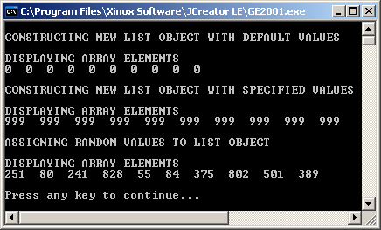
// Java1801.java
// List case study #1
// The first stage of the List case study in Chapter 18 is actually
// a review of the third stage of the List case study in Chapter 12.
import java.util.Random;
public class Java1801
{
public static void main(String args[])
{
List1 array1 = new List1(10);
array1.display();
List1 array2 = new List1(10,999);
array2.display();
array2.assign();
array2.display();
System.out.println();
}
}

Slide 9
class List1
{
private int intArray[]; // stores array elements
private int size; // number of elements in the array
public List1(int s)
{
System.out.println("\nCONSTRUCTING NEW LIST OBJECT WITH DEFAULT VALUES");
size = s;
intArray = new int[size];
}
public List1(int s, int n)
{
System.out.println("\nCONSTRUCTING NEW LIST OBJECT WITH SPECIFIED VALUES");
size = s;
intArray = new int[size];
for (int k = 0; k < size; k++)
intArray[k] = n;
}
public void assign()
{
System.out.println("\nASSIGNING RANDOM VALUES TO LIST OBJECT");
Random rndInt = new Random(12345);
for (int k = 0; k < size; k++)
intArray[k] = rndInt.nextInt(1000);
}
public void display()
{
System.out.println("\nDISPLAYING ARRAY ELEMENTS");
for (int k = 0; k < size; k++)
System.out.print(intArray[k] + " ");
}
}

Slide 10
// Java1802.java List case study #2
// This stage adds a third constructor, which instantiates an array object with
// a specified set of random numbers. Old methods, like the first two constructors,
// which are not tested are removed for better program brevity and clarity.
import java.util.Random;
public class Java1802
{
public static void main(String args[])
{
List2 array1 = new List2(15,0,100);
array1.display();
List2 array2 = new List2(15,100,999);
array2.display();
List2 array3 = new List2(15,0,1);
array3.display();
List2 array4 = new List2(15,500,505);
array4.display();
System.out.println();
}
}

Slide 11
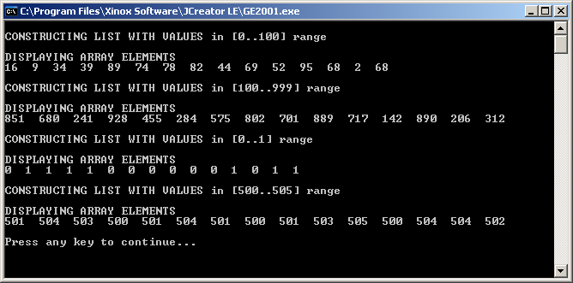
Java1802.java Output

Slide 12
class List2
{
private int intArray[ ]; // stores array elements
private int size; // number of elements in the array
private int minInt; // smallest random integer
private int maxInt; // largest random integer
public List2(int s, int min, int max)
{
Random rndInt = new Random(12345);
minInt = min;
maxInt = max;
size = s;
System.out.println("\nCONSTRUCTING LIST WITH VALUES in ["
+ minInt + ".." + maxInt + "] range");
intArray = new int[size];
int range = maxInt - minInt + 1;
for (int k = 0; k < size; k++)
intArray[k] = rndInt.nextInt(range) + minInt;
}
public void display()
{
System.out.println("\nDISPLAYING ARRAY ELEMENTS");
for (int k = 0; k < size; k++)
System.out.print(intArray[k] + " ");
System.out.println();
}
}

Slide 13
Section 18.3
Improving Input
and Output

Slide 14
// Java1803.java List case study #3
// This program adds the <pause> method, which freezes output display until
// the <Enter> key is pressed. This new method allows output viewing on the
// monitor when the display becomes too large.
import java.util.*;
public class Java1803
{
public static void main(String args[])
{
List3 array1 = new List3(60,100,200);
array1.display();
array1.pause();
List3 array2 = new List3(100,100,999);
array2.display();
array2.pause();
List3 array3 = new List3(200,10,19);
array3.display();
array3.pause();
List3 array4 = new List3(40,500,505);
array4.display();
array4.pause();
System.out.println();
}
}

Slide 15
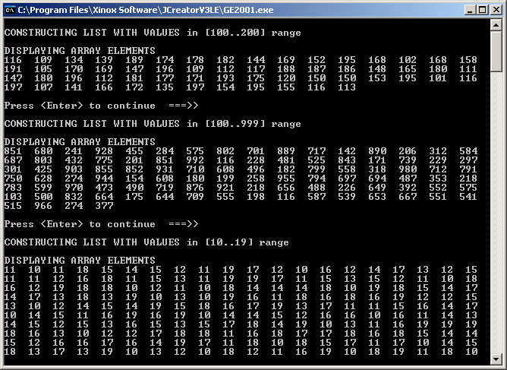
public void pause()
{
Scanner input = new Scanner(System.in);
String dummy;
System.out.print("\nPress <Enter> to continue ===>> ");
dummy = input.nextLine();
}

Slide 16
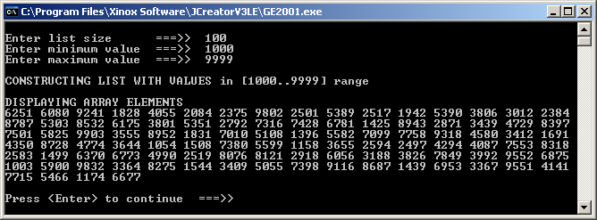
// Java1804.java List case study #4
// This program allows all list information to be entered at the keyboard
// before a list object is constructed.
import java.util.*;
public class Java1804
{
public static void main(String args[])
{
Scanner input = new Scanner(System.in);
System.out.print("\nEnter list size ===>> ");
int listSize = input.nextInt();
System.out.print("Enter minimum value ===>> ");
int listMin = input.nextInt();
System.out.print("Enter maximum value ===>> ");
int listMax = input.nextInt();
List4 array = new List4(listSize,listMin,listMax);
array.display();
array.pause();
System.out.println();
}
}

Slide 17
Section 18.4
Linear Search

Slide 18
// Java1805.java List case study #5
// This program introduces the "inefficient" Linear Search algorithm.
import java.util.*;
public class Java1805
{
public static void main(String args[])
{
Scanner input = new Scanner(System.in);
System.out.print("\nEnter list size ===>> ");
int listSize = input.nextInt();
System.out.print("Enter minimum value ===>> ");
int listMin = input.nextInt();
System.out.print("Enter maximum value ===>> ");
int listMax = input.nextInt();
List5 array = new List5(listSize,listMin,listMax);
array.display();
array.pause();
System.out.print("\nEnter search number ===>> ");
int searchNumber = input.nextInt();
if (array.linearSearch(searchNumber))
System.out.println(searchNumber + " is in the list");
else
System.out.println(searchNumber + " is not in the list");
System.out.println();
}
}

Slide 19
The Inefficient Linear Search
public boolean linearSearch(int sn)
{
boolean found = false;
for (int k = 0; k < size; k++)
if (intArray[k] == sn)
found = true;
return found;
}
There are 2 problems with this algorithm:
It will keep searching to the end even if it has already
found the desired item.
2) When an item is found, it does not tell you where it is.

Slide 20
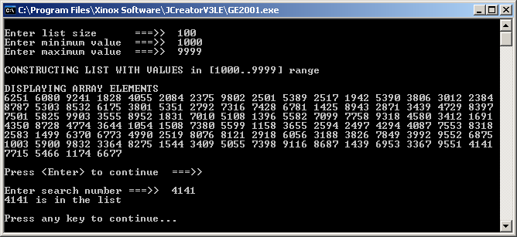
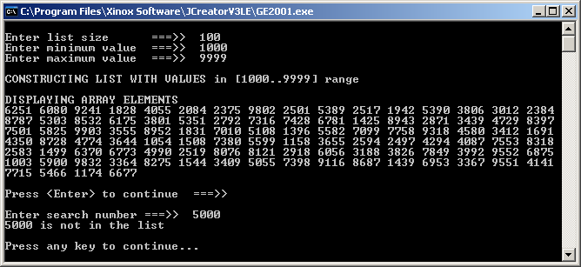
Outputs for
Java1805.java &
Java1806.java

Slide 21
// Java1806.java List case study #6
// The inefficient linear search is replaced with a conditional loop, which stops
// the repetition once the searchNumber is found.
import java.util.*;
public class Java1806
{
public static void main(String args[])
{
Scanner input = new Scanner(System.in);
System.out.print("\nEnter list size ===>> ");
int listSize = input.nextInt();
System.out.print("Enter minimum value ===>> ");
int listMin = input.nextInt();
System.out.print("Enter maximum value ===>> ");
int listMax = input.nextInt();
List6 array = new List6(listSize,listMin,listMax);
array.display();
array.pause();
System.out.print("\nEnter search number ===>> ");
int searchNumber = input.nextInt();
if (array.linearSearch(searchNumber))
System.out.println(searchNumber + " is in the list");
else
System.out.println(searchNumber + " is not in the list");
System.out.println();
}
}

Slide 22
An Efficient Linear Search
public boolean linearSearch(int sn)
{
boolean found = false;
int k = 0;
while (k < size && !found)
{
if (intArray[k] == sn)
found = true;
else
k++;
}
return found;
}
This algorithm does stop when the desired element is found, but still does not tell us where it is.

Slide 23
// Java1807.java List case study #7
// This program makes the Linear Search algorithm more practical
// by returning the index of the SearchNumber or -1 if not found.
import java.util.*;
public class Java1807
{
public static void main(String args[])
{
Scanner input = new Scanner(System.in);
System.out.print("\nEnter list size ===>> ");
int listSize = input.nextInt();
System.out.print("Enter minimum value ===>> ");
int listMin = input.nextInt();
System.out.print("Enter maximum value ===>> ");
int listMax = input.nextInt();
List7 array = new List7(listSize,listMin,listMax);
array.display();
array.pause();
System.out.print("\nEnter search number ===>> ");
int searchNumber = input.nextInt();
int index = array.linearSearch(searchNumber);
if (index == -1)
System.out.println(searchNumber + " is not in the list");
else
System.out.println(searchNumber + " is found at index " + index);
System.out.println();
}
}

Slide 24
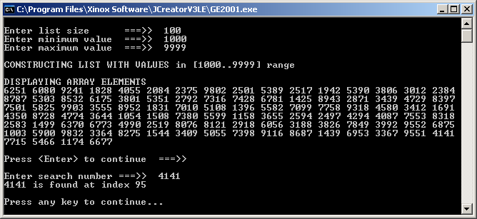
Outputs for
Java1807.java

Slide 25
An Efficient and Practical Linear Search
public int linearSearch(int sn)
{
boolean found = false;
int k = 0;
while (k < size && !found)
{
if (intArray[k] == sn)
found = true;
else
k++;
}
if (found)
return k;
else
return -1;
}
Like the last one, this algorithm does stop when the desired element is found.
However, instead of merely returning a boolean, which only told us if it was found, this algorithm returns an int, which tells us the index of where it was found.
It is a convention to return an index of -1 when the desired data is not found.

Slide 26
Section 18.5
Bubble Sort

Slide 27
Sorting: Why do we sort?
Sorting does not exist
in a vacuum.
The reason for sorting
is to allow more efficient
searching.

Slide 28

The Bubble Sort – 1st Pass
45 is greater than 32; the two numbers need to be swapped.
45 is greater than 28; the two numbers need to be swapped.
45 is not greater than 57; the numbers are left alone.
57 is greater than 38; the two numbers need to be swapped.
One pass is now complete.
The largest number, 57, is in the correct place.
45 | 32 | 28 | 57 | 38
32 | 45 | 28 | 57 | 38
32 | 28 | 45 | 57 | 38
32 | 28 | 45 | 38 | 57

Slide 29

The Bubble Sort – 2nd Pass
32 is greater than 28; the two numbers need to be swapped.
32 is not greater than 45; the numbers are left alone.
45 is greater than 38; the two numbers need to be swapped.
We can see that the list is now sorted.
Our current algorithm does not realize this.
All the computer knows is the last 2 numbers are in the correct place.
Because of this, it is not necessary to compare 45 and 57.
32 | 28 | 45 | 38 | 57
28 | 32 | 45 | 38 | 57
28 | 32 | 38 | 45 | 57

Slide 30

The Bubble Sort – 3rd & 4th Pass
28 is not greater than 32; the numbers are left alone.
32 is not greater than 38; the numbers are left alone.
The 3rd pass is complete, and 38 is “known” to be in the correct place.
The 4th pass begins.
28 is not greater than 32; the numbers are left alone.
The 4th pass is complete, and 32 is “known” to be in the correct place.
A 5th pass is not necessary. 28 is the only number left.
With 5 numbers there will be 4 comparison passes.
With N numbers there will be N-1 comparison passes.
28 | 32 | 38 | 45 | 57
28 | 32 | 38 | 45 | 57
28 | 32 | 38 | 45 | 57
28 | 32 | 38 | 45 | 57

Slide 31
Bubble Sort Logic
Compare adjacent array elements.
Swap the elements if they are not ordered correctly.
Continue this process until the largest element is in
the last element of the array.
Repeat the comparison process in the same manner.
During the second pass make one less comparison,
and place the second-largest number in the second-to-last element of the array.
Repeat these comparison passes with N elements,
N-1 times. Each pass makes one less comparison.

Slide 32
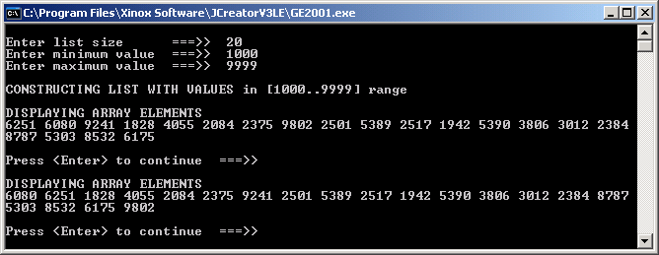
// Java1808.java List case study #8
// This program introduces a "partial-sort" algorithm.
// Only the largest number is places at the end of the list.
import java.util.*;
public class Java1808
{
public static void main(String args[])
{
Scanner input = new Scanner(System.in);
System.out.print("\nEnter list size ===>> ");
int listSize = input.nextInt();
System.out.print("Enter minimum value ===>> ");
int listMin = input.nextInt();
System.out.print("Enter maximum value ===>> ");
int listMax = input.nextInt();
List8 array = new List8(listSize,listMin,listMax);
array.display();
array.pause();
array.partialSort();
array.display();
array.pause();
System.out.println();
}
}
The largest # is now at the end.

Slide 33
The Partial Sort
public void partialSort()
{
int temp;
for (int q = 0; q < size-1; q++)
if (intArray[q] > intArray[q+1])
{
temp = intArray[q];
intArray[q] = intArray[q+1];
intArray[q+1] = temp;
}
}
The Partial Sort accomplishes the 1st Pass of the Bubble Sort.

Slide 34
// Java1809.java List case study #9
// This program sorts in ascending order using the BubbleSort.
import java.util.*;
public class Java1809
{
public static void main(String args[])
{
Scanner input = new Scanner(System.in);
System.out.print("\nEnter list size ===>> ");
int listSize = input.nextInt();
System.out.print("Enter minimum value ===>> ");
int listMin = input.nextInt();
System.out.print("Enter maximum value ===>> ");
int listMax = input.nextInt();
List9 array = new List9(listSize,listMin,listMax);
array.display();
array.pause();
array.bubbleSort();
array.display();
array.pause();
System.out.println();
}
}

Slide 35
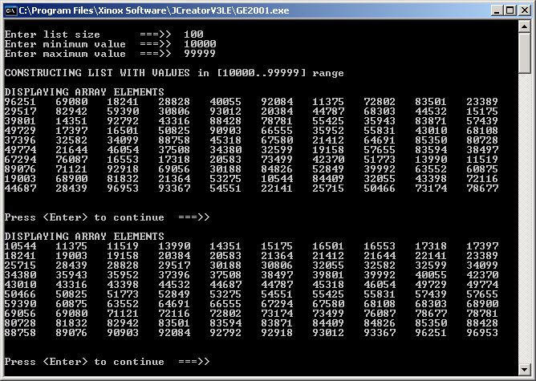
Java1809.java Output

Slide 36

The Bubble Sort
public void bubbleSort()
{
int temp;
for (int p = 1; p < size; p++)
for (int q = 0; q < size-1; q++)
if (intArray[q] > intArray[q+1])
{
temp = intArray[q];
intArray[q] = intArray[q+1];
intArray [q+1] = temp;
}
}
The Bubble Sort gets its name because the larger numbers seem to float to the top (or end) of the array like bubbles.

Slide 37
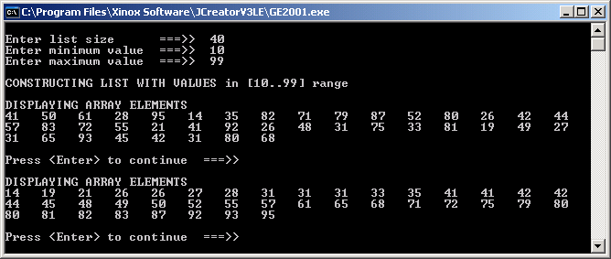
// Java1810.java List case study #10
// This program introduces the private <swap> method that is used by the
// <bubbleSort> and other methods. It also improves the bubbleSort by
// reducing the number of comparison made on each pass.
import java.util.*;
public class Java1810
{
public static void main(String args[])
{
Scanner input = new Scanner(System.in);
System.out.print("\nEnter list size ===>> ");
int listSize = input.nextInt();
System.out.print("Enter minimum value ===>> ");
int listMin = input.nextInt();
System.out.print("Enter maximum value ===>> ");
int listMax = input.nextInt();
List10 array = new List10(listSize,listMin,listMax);
array.display();
array.pause();
array.bubbleSort();
array.display();
array.pause();
System.out.println();
}
}

Slide 38
Improved Bubble Sort
private int intArray[ ]; // stores array elements
private void swap(int x, int y)
{
int temp = intArray[x];
intArray[x] = intArray[y];
intArray[y] = temp;
}
public void bubbleSort()
{
for (int p = 1; p < size; p++)
for (int q = 0; q < size-p; q++)
if (intArray[q] > intArray[q+1])
swap(q,q+1);
}
If you turn this operator around, it will sort in descending order.
While this sort may be improved, it still does not have the ability to stop if the list is already sorted.

Slide 39

// Java1811.java List case study #11
// This program makes the BubbleSort "smart" by adding a conditional
// loop structure to see if the list is sorted.
import java.util.*;
public class Java1811
{
public static void main(String args[])
{
Scanner input = new Scanner(System.in);
System.out.print("\nEnter list size ===>> ");
int listSize = input.nextInt();
System.out.print("Enter minimum value ===>> ");
int listMin = input.nextInt();
System.out.print("Enter maximum value ===>> ");
int listMax = input.nextInt();
List11 array = new List11(listSize,listMin,listMax);
array.display();
array.pause();
array.bubbleSort();
array.display();
array.pause();
System.out.println();
}
}

Slide 40

The Smart Bubble Sort
public void bubbleSort()
{
boolean sorted;
int p = 1;
do
{
sorted = true;
for (int q = 0; q < size-p; q++)
if (intArray[q] > intArray[q+1])
{
swap(q,q+1);
sorted = false;
}
p++;
}
while (!sorted);
}
If this sort makes no swaps during a pass, it knows the list is sorted and stops.

Slide 41
Section 18.6
Selection Sort

Slide 42
Selection Sort – 1st & 2nd Pass
We start by picking the first number, 45, as the smallest number.
Compare 45 with 32; 32 is smaller; make 32 the smallest number.
Compare 32 with 28; 28 is smaller; make 28 the smallest number.
Compare 28 with 57; 28 is smaller; keep 28 as the smallest number.
Compare 28 with 38; 28 is smaller; keep 28 as the smallest number.
Swap the smallest number, 28, with the first number, 45.
Repeat the comparison process for a 2nd pass; start with the second number.
Pick 32 as the smallest number.
Compare 32 with 45; 32 is smaller; keep 32 as the smallest number.
Compare 32 with 57; 32 is smaller; keep 32 as the smallest number.
Compare 32 with 38; 32 is smaller; keep 32 as the smallest number.
No swapping is required on this pass.
The smallest number is in the correct place.
45 | 32 | 28 | 57 | 38
28 | 32 | 45 | 57 | 38

Slide 43
Selection Sort – 3rd & 4th Pass
Repeat the comparison process a third time; start with the third number.
Pick 45 as the smallest number.
Compare 45 with 57; 45 is smaller; keep 45 as the smallest number.
Compare 45 with 38; 38 is smaller; make 38 as the smallest number.
Swap the smallest number, 38, with the starting number, 45.
Repeat the comparison process a fourth time; start with the fourth number.
Pick 57 as the smallest number.
Compare 57 with 45; 45 is smaller; make 45 the smallest number.
Swap the smallest number, 45, with the starting number, 57.
This is the fourth and final pass. The numbers are sorted.
28 | 32 | 45 | 57 | 38
28 | 32 | 38 | 57 | 45
28 | 32 | 38 | 45 | 57

Slide 44
Selection Sort Logic
Set the first number as the smallest number.
Compare the smallest number to each number in the list.
If any number is smaller, it becomes the smallest number.
After every number is compared, swap the smallest number with the first number.
The smallest number is now in the correct location.
Repeat the comparison process in the same manner.
During the second pass, start with the second numberand make it the smallest number. At the conclusionof the comparison pass swap the smallest number with the second number.
Repeat these comparison passes with N elements, N-1 times.
Each pass makes one less comparison.

Slide 45
// Java1812.java List case study #12
// This stage replaces the Bubble Sort with the Selection Sort.
import java.util.*;
public class Java1812
{
public static void main(String args[])
{
Scanner input = new Scanner(System.in);
System.out.print("\nEnter list size ===>> ");
int listSize = input.nextInt();
System.out.print("Enter minimum value ===>> ");
int listMin = input.nextInt();
System.out.print("Enter maximum value ===>> ");
int listMax = input.nextInt();
List12 array = new List12(listSize,listMin,listMax);
array.display();
array.pause();
array.selectionSort();
array.display();
array.pause();
System.out.println();
}
}

Slide 46
The Selection Sort
public void selectionSort()
{
int p,q;
int smallest;
for (p = 0; p < size-1; p++)
{
smallest = p;
for (q = p+1; q < size; q++)
if (intArray[q] < intArray[smallest])
smallest = q;
if (intArray[p] != intArray[smallest])
swap(p,smallest);
}
}

Slide 47
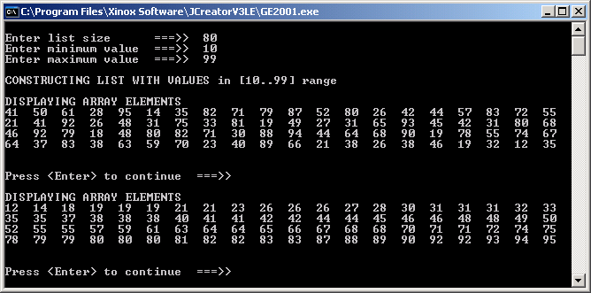
Java1812.java Output

Slide 48
Section 18.7
Insertion Sort

Slide 49
Insertion Sort – Part 1
Put the first number into the beginning of the small list.
83 is larger than 45. It will be inserted behind number 45
19 needs to be inserted at the very front.
98 needs to be inserted at the very end.
45 | 83 | 19 | 98 | 85 | 32 | 50 | 73
45
45 | 83 | 19 | 98 | 85 | 32 | 50 | 73
45 | 83
45 | 83 | 19 | 98 | 85 | 32 | 50 | 73
19 | 45 | 83
45 | 83 | 19 | 98 | 85 | 32 | 50 | 73
19 | 45 | 83 | 98

Slide 50
Insertion Sort – Part 2
85 is inserted between the 83 and the 98.
32 is inserted between the 19 and the 45.
50 is inserted between the 45 and the 83.
73 is inserted between the 50 and the 83.
45 | 83 | 19 | 98 | 85 | 32 | 50 | 73
19 | 45 | 83 | 85 | 98
45 | 83 | 19 | 98 | 85 | 32 | 50 | 73
19 | 32 | 45 | 83 | 85 | 98
45 | 83 | 19 | 98 | 85 | 32 | 50 | 73
19 | 32 | 45 | 50 | 83 | 85 | 98
45 | 83 | 19 | 98 | 85 | 32 | 50 | 73
19 | 32 | 45 | 50 | 73 | 83 | 85 | 98

Slide 51
Insertion Sort Steps
1. Use a search routine to find the proper
insertion location.
2. Move all array elements, starting with the
insertion index, to the next array location.
3. Insert the new array element in the "empty"
location.

Slide 52
// Java1813.java
// List case study #13
// This stage replaces the Selection Sort with the Insertion Sort.
import java.util.*;
public class Java1813
{
public static void main(String args[])
{
Scanner input = new Scanner(System.in);
System.out.print("\nEnter list size ===>> ");
int listSize = input.nextInt();
System.out.print("Enter minimum value ===>> ");
int listMin = input.nextInt();
System.out.print("Enter maximum value ===>> ");
int listMax = input.nextInt();
List13 array = new List13(listSize,listMin,listMax);
array.display();
array.pause();
array.insertionSort();
array.display();
array.pause();
System.out.println();
}
}

Slide 53
private int linearSearch(int searchNumber, int numElements)
{
int index = 0;
while (index < numElements && searchNumber > intArray[index])
index++;
return index;
}
private void insertItem(int searchNumber, int numElements, int index)
{
for (int k = numElements-1; k > index; k--)
intArray[k] = intArray[k-1];
intArray[index] = searchNumber;
}
public void insertionSort()
{
for (int k = 0; k < size; k++)
{
int numElements = k + 1;
int index = linearSearch(intArray[k], numElements);
insertItem(intArray[k], numElements,index);
}
}

Slide 54
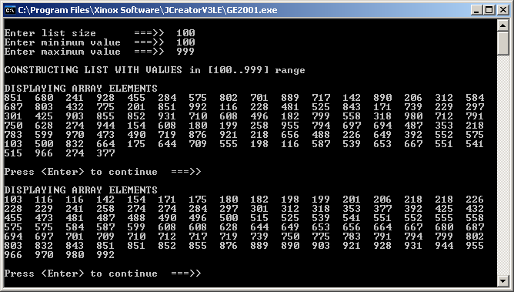
Java1813.java Output

Slide 55
Section 18.8
Binary Search

Slide 56
Binary Search with a Telephone Book
Start with a 2000 page telephone book.
Split in two, and ignore 1000 pages and search in the remaining 1000 pages.
Split in two, and ignore 500 pages and search in the remaining 500 pages.
Split in two, and ignore 250 pages and search in the remaining 250 pages.
Split in two, and ignore 125 pages and search in the remaining 125 pages.
Split in two, and ignore 62 pages and search in the remaining 62 pages.
Split in two, and ignore 31 pages and search in the remaining 31 pages.
Split in two, and ignore 15 pages and search in the remaining 15 pages.
Split in two, and ignore 7 pages and search in the remaining 7 pages.
Split in two, and ignore 3 pages and search in the remaining 3 pages.
Split in two, and ignore 1 page and search in the remaining 1 page.

Slide 57
Binary Search Logic
The Binary Search only works with sorted lists.
Start by making the smallest index small and the largest index large.
Find the midpoint index with (small + large) / 2
Compare the midpoint value with the search item.
If the value is found you are done.
Otherwise re-assign small or large.
If the search item is greater you have a new small,
otherwise you have a new large
Repeat the same process.
Continue the process until the search item is found or large becomes less than small.

Slide 58
Using the Binary Search to Find an Element in an Array Step 1
[0] | [1] | [2] | [3] | [4] | [5] | [6] | [7] | [8] | [9] | [10] | [11] | [12] | [13]
15 | 18 | 23 | 27 | 29 | 32 | 45 | 52 | 60 | 74 | 75 | 89 | 90 | 93
We are looking for the 60.

Slide 59
Using the Binary Search to Find an Element in an Array Step 2
[0] | [1] | [2] | [3] | [4] | [5] | [6] | [7] | [8] | [9] | [10] | [11] | [12] | [13]
15 | 18 | 23 | 27 | 29 | 32 | 45 | 52 | 60 | 74 | 75 | 89 | 90 | 93
small
large
Establish the large and small indexes.

Slide 60
Using the Binary Search to Find an Element in an Array Step 3
[0] | [1] | [2] | [3] | [4] | [5] | [6] | [7] | [8] | [9] | [10] | [11] | [12] | [13]
15 | 18 | 23 | 27 | 29 | 32 | 45 | 52 | 60 | 74 | 75 | 89 | 90 | 93
small
mid
large
Average the small and the large
to compute the midpoint.

Slide 61
Using the Binary Search to Find an Element in an Array Step 4
[0] | [1] | [2] | [3] | [4] | [5] | [6] | [7] | [8] | [9] | [10] | [11] | [12] | [13]
15 | 18 | 23 | 27 | 29 | 32 | 45 | 52 | 60 | 74 | 75 | 89 | 90 | 93
mid
small
large
60 > 45, therefore
small = mid + 1;

Slide 62
Using the Binary Search to Find an Element in an Array Step 5
[0] | [1] | [2] | [3] | [4] | [5] | [6] | [7] | [8] | [9] | [10] | [11] | [12] | [13]
15 | 18 | 23 | 27 | 29 | 32 | 45 | 52 | 60 | 74 | 75 | 89 | 90 | 93
small
mid
large
Average the small and the large
to compute the midpoint.

Slide 63
Using the Binary Search to Find an Element in an Array Step 6
[0] | [1] | [2] | [3] | [4] | [5] | [6] | [7] | [8] | [9] | [10] | [11] | [12] | [13]
15 | 18 | 23 | 27 | 29 | 32 | 45 | 52 | 60 | 74 | 75 | 89 | 90 | 93
mid
small
large
60 < 75, therefore
large = mid - 1;

Slide 64
Using the Binary Search to Find an Element in an Array Step 7
[0] | [1] | [2] | [3] | [4] | [5] | [6] | [7] | [8] | [9] | [10] | [11] | [12] | [13]
15 | 18 | 23 | 27 | 29 | 32 | 45 | 52 | 60 | 74 | 75 | 89 | 90 | 93
small
large
mid
Average the small and the large
to compute the midpoint.

Slide 65
Using the Binary Search to Find an Element in an Array Step 8
[0] | [1] | [2] | [3] | [4] | [5] | [6] | [7] | [8] | [9] | [10] | [11] | [12] | [13]
15 | 18 | 23 | 27 | 29 | 32 | 45 | 52 | 60 | 74 | 75 | 89 | 90 | 93
mid
We found 60!

Slide 66
// Java1814.java List case study #14
// This program introduces the "Binary Search" which searches a sorted list
// far more efficiently than a "Linear Search" can.
import java.util.*;
public class Java1814
{
public static void main(String args[])
{
Scanner input = new Scanner(System.in);
System.out.print("\nEnter list size ===>> ");
int listSize = input.nextInt();
System.out.print("Enter minimum value ===>> ");
int listMin = input.nextInt();
System.out.print("Enter maximum value ===>> ");
int listMax = input.nextInt();
List14 array = new List14(listSize,listMin,listMax);
array.display();
array.pause();
array.selectionSort();
array.display();
array.pause();
System.out.print("\nEnter search number ===>> ");
int searchNumber = input.nextInt();
if (array.binarySearch(searchNumber))
System.out.println(searchNumber + " is in the list");
else
System.out.println(searchNumber + " is not in the list");
}
}

Slide 67


The Binary Search
public int binarySearch(int sn)
{
boolean found = false;
int lo = 0;
int hi = size-1;
int mid = 0;
while (lo <= hi && !found)
{
mid = (lo + hi) / 2;
if (intArray[mid] == sn)
found = true;
else
{
if (sn > intArray[mid])
lo = mid + 1;
else
hi = mid - 1;
}
}
if (found)
return mid;
else
return -1;
}

Slide 68
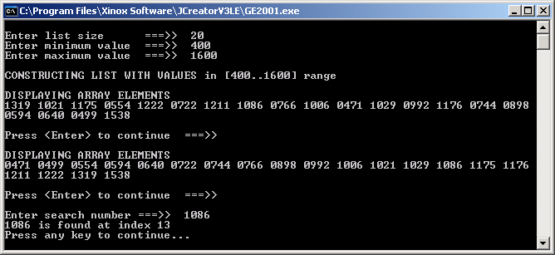

Outputs for
Java1814.java

Slide 69
Section 18.9
Merge Sort

Slide 70
Understanding The Merge Sort
List1
23
34
35
39
50
72
75
90
92
List2
17
18
29
46
61
82
85
23
34
35
39
50
72
75
90
92
17
18
29
46
61
82
85
17
18
23
29
34
35
39
46
50
61
72
75
82
85
90
92

Slide 71
Understanding the Merge Sort
456
143
678
342
179
809
751
500
Divide the List in Half
456
143
678
342
179
809
751
500

Slide 72
Divide the List in Half Again
456
143
678
342
179
809
751
500
And Again…
456
143
678
342
179
809
751
500

Slide 73
Important Merge Sort Facts
The merge sort works either by merging 2 sorted lists into a 3rd sorted list
or by merging 2 sorted sections of one list.
In either case, what is being merged must be sorted.
The merge sort will divide a list in half again and again until every sub-list has a size of 1.
It is also what makes it work since a list of only 1 element must be sorted.

Slide 74
All Lists Have a Size of 1
456
143
678
342
179
809
751
500
First Merge
143
456
342
678
179
809
500
751

Slide 75
Second Merge
143
342
456
678
179
500
751
809
Final Merge - List is Sorted
143
179
342
456
500
678
751
809

Slide 76
Section 18.10
Testing Algorithm Efficiency
with the TimeTest class

Slide 77
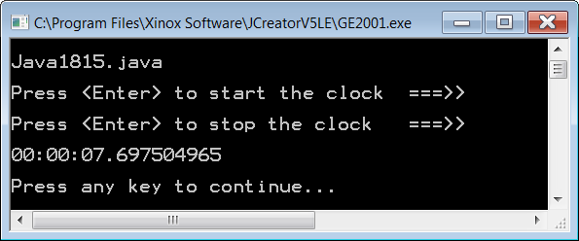
// Java1815.java
// This program uses a <TimeTest> class, which displays the elapsed time
// in hh:mm:ss.fractions for executing some program code.
import java.util.*;
import java.text.DecimalFormat;
public class Java1815
{
public static void main(String args[])
{
System.out.println("\nJava1815.java\n");
Scanner input = new Scanner(System.in);
TimeTest time = new TimeTest();
System.out.print("Press <Enter> to start the clock ===>> ");
input.nextLine();
time.startClock();
System.out.println();
System.out.print("Press <Enter> to stop the clock ===>> ");
input.nextLine();
time.stopClock();
System.out.println();
System.out.println(time);
System.out.println();
}
}

Slide 78
class TimeTest
{
private long startNanos; // tick count at the start of the test
private long endNanos; // tick count at the end of the test
private long nanos; // elapsed number of nano seconds
private long hours; // elapsed hours
private long minutes; // elapsed minutes
private long seconds; // elapsed seconds
private long fractions; // elapsed fractions of a second
Do not worry if you don’t understand the implementation of the Time Test class!
public TimeTest() { startNanos = 0; endNanos = 0; nanos = 0; hours = 0; minutes = 0; seconds = 0; fractions = 0; } public void startClock() { startNanos = System.nanoTime(); } public void stopClock() { endNanos = System.nanoTime(); computeTime(); } | private void computeTime() { nanos = endNanos - startNanos; hours = nanos / 3600000000000L; long leftOver = nanos % 3600000000000L; minutes = leftOver / 60000000000L; leftOver = leftOver % 60000000000L; seconds = leftOver / 1000000000L; fractions = leftOver % 1000000000L; } public String toString() { DecimalFormat twos = new DecimalFormat("00"); DecimalFormat nines = new DecimalFormat("000000000"); String temp = twos.format(hours) + ":"; temp = temp + twos.format(minutes) + ":"; temp = temp + twos.format(seconds) + "."; temp = temp + nines.format(fractions); return temp; }}

Slide 79
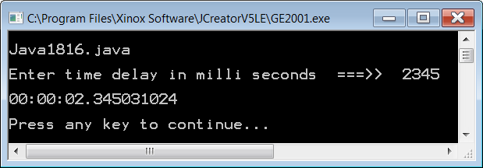
// Java1816.java
// This program demonstrates the <delay> method, which delays program execution
// an indicated number of milli seconds amount of time.
import java.util.*;
import java.text.DecimalFormat;
public class Java1816
{
public static void main(String args[])
{
System.out.println("\nJava1816.java\n");
Scanner input = new Scanner(System.in);
TimeTest time = new TimeTest();
System.out.print("Enter time delay in milli seconds ===>> ");
int delayTime = input.nextInt();
time.startClock();
time.delay(delayTime);
time.stopClock();
System.out.println();
System.out.println(time);
System.out.println();
}
}

Slide 80
Section 18.11
Informal
Algorithmic
Analysis

Slide 81
Algorithms and Methods
An algorithm is a step-by-step sequence of instructions to complete a desired process.
An algorithm can be written and explained in English.
An algorithm is NOT connected to any programming language.
A method is one implementation of an algorithm.
A method is written in a programming language.

Slide 82
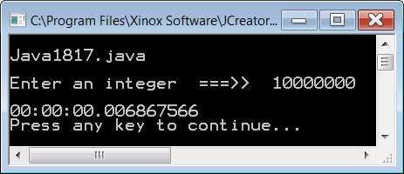

// Java1817.java
// This program measures the time necessary to count integers.
import java.util.*;
public class Java1817
{
public static void main(String args[])
{
System.out.println("\nJava1817.java\n");
Scanner input = new Scanner(System.in);
TimeTest time = new TimeTest();
System.out.print("Enter an integer ===>> ");
int count = input.nextInt();
time.startClock();
counter(count);
time.stopClock();
System.out.println();
System.out.println(time);
}
public static void counter (int n)
{
for (int k = 1; k <= n; k++)
System.out.print(k + "\t");
}
}

Slide 83
Counter Algorithm
Data Quantity | 10,000,000 | 20,000,000 | 40,000,000
Process Time | 0.006867566 | 0.013377309 | 0.026629965
Notice that as the Data Quantity doubles,
the Processing Time also doubles.
NOTE: Execution Times will vary on different computers.

Slide 84
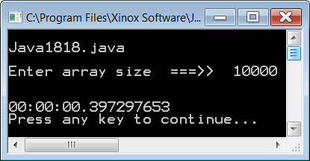
// Java1818.java
// This program tests the efficiency of a nested loop algorithm
// like the Bubble Sort.
import java.util.*;
public class Java1818
{
public static void main(String args[])
{
System.out.println("\nJava1818.java\n");
Scanner input = new Scanner(System.in);
TimeTest time = new TimeTest();
System.out.print("Enter array size ===>> ");
int size = input.nextInt();
int[] list = new int[size];
createList(list,size);
System.out.println();
// displayList(list);
time.startClock();
bubbleSort(list);
time.stopClock();
// displayList(list);
System.out.println();
System.out.println(time);
}

Slide 85
The Bubble Sort
This time when
the Data Quantity
doubles, the
Processing Time
QUADRUPLES.
This is because of
the nested loops.
public void bubbleSort()
{
int temp;
for (int p = 1; p < size; p++)
for (int q = 0; q < size-1; q++)
if (intArray[q] > intArray[q+1])
{
temp = intArray[q];
intArray[q] = intArray[q+1];
intArray [q+1] = temp;
}
}
Bubble Sort Algorithm
Data Quantity | 10,000 | 20,000 | 40,000
Process Time | 0.397297653 | 1.625597655 | 6.563557857

Slide 86
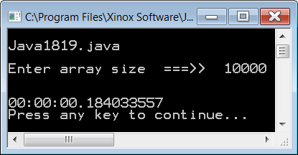
// Java1819.java
// This program tests the efficiency of a nested loop algorithm
// like the Selection Sort.
import java.util.*;
public class Java1819
{
public static void main(String args[])
{
System.out.println("\nJava1819.java\n");
Scanner input = new Scanner(System.in);
TimeTest time = new TimeTest();
System.out.print("Enter array size ===>> ");
int size = input.nextInt();
int[] list = new int[size];
createList(list,size);
System.out.println();
// displayList(list);
time.startClock();
selectionSort(list);
time.stopClock();
// displayList(list);
System.out.println();
System.out.println(time);
}

Slide 87
The Selection Sort
public static void selectionSort(int[] list)
{
int smallest = 0;
for (int p = 0; p < list.length; p++)
{
smallest = p;
for (int q = p+1; q < list.length; q++)
if (list[q] < list[smallest])
smallest = q;
if (list[p] != list[smallest])
{
int temp = list[p];
list[p] = list[smallest];
list[smallest] = temp;
}
}
}
The Selection Sort
is faster than the
Bubble Sort,
but the
Processing Time
still QUADRUPLES
as the data
quantity doubles.
Selection Sort Algorithm
Data Quantity | 10,000 | 20,000 | 40,000
Process Time | 0.184033557 | 0.708414663 | 2.887793585

Slide 88
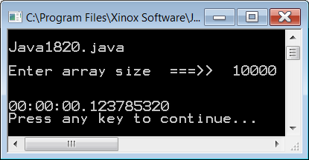
// Java1820.java
// This program demonstrates the efficiency of the Insertion Sort.
import java.util.*;
public class Java1820
{
public static void main(String args[])
{
System.out.println("\nJava1820.java\n");
Scanner input = new Scanner(System.in);
TimeTest time = new TimeTest();
System.out.print("Enter array size ===>> ");
int size = input.nextInt();
IntList x = new IntList(size);
// x.displayList();
time.startClock();
x.insertionSort();
time.stopClock();
// x.displayList();
System.out.println(time);
System.out.println();
}
}

Slide 89
The Insertion Sort
public void insertionSort()
{
for (int k = 0; k < size; k++)
{
int numElements = k + 1;
int index = linearSearch(intArray[k],numElements);
insertItem(intArray[k],numElements,index);
}
}
Remember that linearSearch and
insertItem both contains their own loops.
Insertion Sort Algorithm
Data Quantity | 10,000 | 20,000 | 40,000
Process Time | 0.123765320 | 0.679104445 | 2.19220818

Slide 90

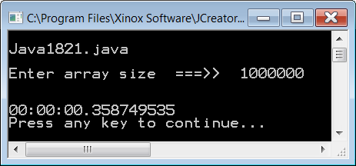
// Java1821.java
// This program demonstrates the efficiency of the Merge Sort.
import java.util.*;
public class Java1821
{
public static void main(String args[])
{
System.out.println("\nJava1821.java\n");
Scanner input = new Scanner(System.in);
TimeTest time = new TimeTest();
System.out.print("Enter array size ===>> ");
int size = input.nextInt();
IntList x = new IntList(size);
// x.displayList();
time.startClock();
x.mergeSort();
time.stopClock();
// x.displayList();
System.out.println(time);
System.out.println();
}
}
1 Million numbers sorted in less than ½ a second!

Slide 91
The Merge Sort
public void mergeSort(int first, int last)
{
if (first < last)
{
int mid = (first + last) / 2;
mergeSort(first,mid);
mergeSort(mid+1,last);
merge(first,mid,last);
}
}
This incredibly fast sort uses advanced features that will not be discussed at this time.
Merge Sort Algorithm
Data Quantity | 10,000 | 20,000 | 40,000
Process Time | 0.003742967 | 0.005322865 | 0.011318359

Slide 92
Multiple Sort Comparisons
Sort / List Size | 10,000 | 20,000 | 40,000 | 80,000
Bubble Sort | 0.3972977 | 1.6255977 | 6.5635579 | 25.8646338
Selection Sort | 0.1840336 | 0.7084147 | 2.8877936 | 12.3315687
Insertion Sort | 0.1237853 | 0.6791044 | 2.1912208 | 8.41794337
Merge Sort | 0.0037430 | 0.0053229 | 0.0113184 | 0.02298770
The Merge Sort is more efficient not just
because it is faster, but also because
the processing time does not QUADRUPLE
like the other sorts when the data doubles.

Slide 93
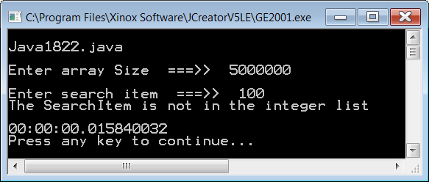
// Java1822.java
// This program measures the time necessary to find an element in an array of randomly arranged
// integers with a Linear Search algorithm.
import java.util.*;
public class Java1822
{
public static void main(String args[])
{
System.out.println("\nJava1822.java\n");
Scanner input = new Scanner(System.in);
TimeTest time = new TimeTest();
System.out.print("Enter array Size ===>> ");
int size = input.nextInt();
int[] list = new int[size];
createList(list,size);
System.out.println();
// displayList(list);
System.out.print("Enter search item ===>> ");
int searchItem = input.nextInt();
time.startClock();
int index = linearSearch(list,searchItem);
time.stopClock();
displayIndex(index);
System.out.println();
System.out.println(time);
}
In the search tests,
we will be looking
for a number
that we know
is not in the list.
This eliminates
the possibility of
finding the number
quickly by sheer luck.

Slide 94
The Linear Search
public static int linearSearch(int[] list, int searchItem)
{
boolean found = false;
int k = 0;
while (k < list.length && !found)
{
if (list[k] == searchItem)
found = true;
else
k++;
}
if (found)
return k;
else
return -1;
}
Linear Search Algorithm
Data Quantity | 5,000,000 | 10,000,000 | 20,000,000
Process Time | 0.015840032 | 0.032308698 | 0.071358354

Slide 95

// Java1823.java
// This program measures the time necessary to find an element in a sorted array with a
// Binary Search algorithm. This program uses the <delay> method intentionally.
import java.util.*;
public class Java1823
{
public static void main(String args[])
{
System.out.println("\nJava1823.java\n");
Scanner input = new Scanner(System.in);
TimeTest time = new TimeTest();
System.out.print("Enter array Size ===>> ");
int size = input.nextInt();
int[] list = new int[size];
createList(list,size);
System.out.println();
// displayList(list);
System.out.print("Enter search item ===>> ");
int searchItem = input.nextInt();
time.startClock();
int index = binarySearch(list,searchItem);
time.stopClock();
displayIndex(index);
System.out.println();
System.out.println(time);
}

Slide 96
The Binary Search
public static int binarySearch(int[] list, int searchItem)
{
int lo = 0;
int hi = list.length-1;
int mid = 0;
boolean found = false;
while (lo <= hi && !found)
{
mid = (lo + hi) / 2;
if (list[mid] == searchItem)
found = true;
else
if (list[mid] > searchItem)
hi = mid - 1;
else
lo = mid + 1;
}
if (found)
return mid;
else
return -1;
}
Binary Search Algorithm
Data Quantity | 5,000,000 | 10,000,000 | 20,000,000
Process Time | 0.000010754 | 0.000010754 | 0.000011244

Slide 97
Compare the Searches
Sort / List Size | 5,000,000 | 10,000,000 | 20,000,000 | 40,000,000
Linear Search | 0.0158400 | 0.0323087 | 0.0713584 | 0.14240728
Binary Search | 0.0000108 | 0.0000108 | 0.0000112 | 0.00001173
The Binary Search is more efficient
because doubling the list size only
adds 1 step to the processing time.

Slide 98
Section 18.12
Exact Calculation
of Execution Counts

Slide 99
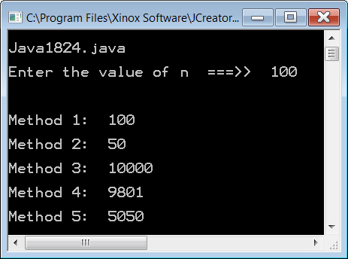
// Java1824.java
// This program demonstrates the exact calculation counts of five different
// methods based on the entered value of n.
import java.util.*;
public class Java1824
{
public static void main(String args[])
{
System.out.println("\nJava1824.java\n");
Scanner input = new Scanner(System.in);
System.out.print("Enter the value of n ===>> ");
int n = input.nextInt();
System.out.println("\n\n");
method1(n);
method2(n);
method3(n);
method4(n);
method5(n);
System.out.println("\n\n");
}
public static void method1(int n)
{
int count = 0;
for (int k = 1; k <= n; k++)
count++;
System.out.println("Method 1: " + count);
System.out.println();
}

Slide 100
public static void method2(int n) { int count = 0; for (int k = 1; k <= n/2; k++) count++; System.out.println( "Method 2: " + count); System.out.println(); } | public static void method4(int n) { int count = 0; for (int p = 1; p < n; p++) for (int q = 1; q < n; q++) count++; System.out.println( "Method 4: " + count); System.out.println(); }
public static void method3(int n) { int count = 0; for (int p = 1; p <= n; p++) for (int q = 1; q <= n; q++) count++; System.out.println( "Method 3: " + count); System.out.println(); } | public static void method5(int n) { int count = 0; for (int p = 0; p < n; p++) for (int q = 1; q <= n-p; q++) count++; System.out.println( "Method 5: " + count); System.out.println(); }

