Slide 1


Exposure Java 2013
APCS Edition
Chapter 19 Slides
Recursion
PowerPoint Presentation
created by:
Mr. John L. M. Schram
and Mr. Leon Schram
Authors of Exposure Java

Slide 2
Section 19.1
Introduction

Slide 3
Recursion Definition
Recursion is the computer programming process, whereby a method calls itself.
"Hello,
Am I there?"

Slide 4
APCS Exam Alert
Recursion is an important topic with frequent questions on the APCS Examination.
The APCS Examination requires that a student can understand and evaluate recursive methods.
The APCS Examination does NOT require that students generate free response recursive solutions.

Slide 5
Section 19.2
Pre-Recursion
Assignment

Slide 6
The Grid Problem
An image can be represented as a grid of black and white cells.
Two cells in an image are part of the same object if each is black and there is a sequence of moves from one cell to the other, where each move is either horizontal or vertical to an adjacent black cell.
For example, the diagram on the side represents an image that contains four separate objects, one of them consisting of a single cell.
 |  |  |  | 1

Slide 7
The Grid Problem
Complete method alterGrid using the header below, such that all cells in the same object as grid[row][col] are set to white; otherwise grid is unchanged.
grid is a two-dimensional array of boolean elements. An element value of true means a black cell and an element value of false means a white cell.
 |  |  |  | 1
public void alterGrid(boolean grid[ ][ ], int row, int col)

Slide 8
Section 19.3
Recursion
Requires an Exit

Slide 9
Recursion Requires an Exit
The original BASIC programming language makes frequent use of the GOTO control structure.
GOTO is very much frowned upon by computer scientists who do not like to see unconditional jumps in a program.
100 REM Program that counts integers starting at 0
110 K = 0
120 K = K + 1
130 PRINT K
140 GOTO 120

Slide 10
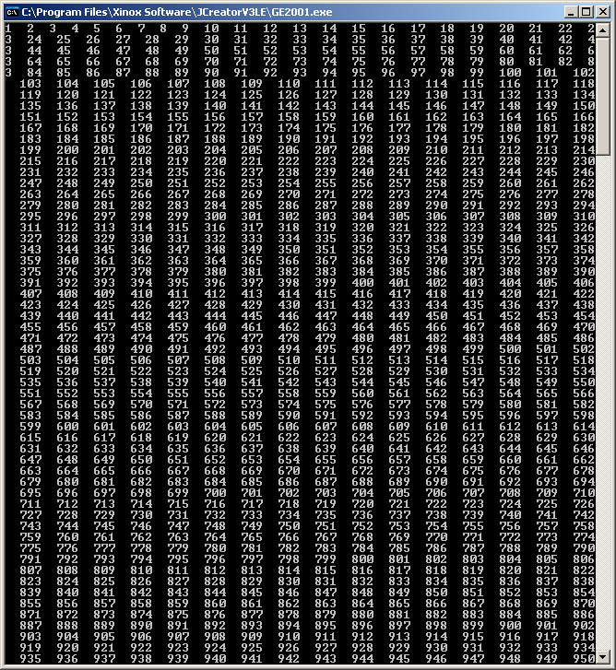
// Java1901.java
// This program demonstrates recursion without an exit.
// The recursive calls will continue until the program aborts
// with an error message.
public class Java1901
{
static int k = 0;
public static void main(String args[])
{
count();
}
public static void count()
{
k++;
System.out.print(k + " ");
count();
}
}
In theory,
this would continue forever.
In reality,
it continues until the
computer runs out of
memory and crashes.

Slide 11
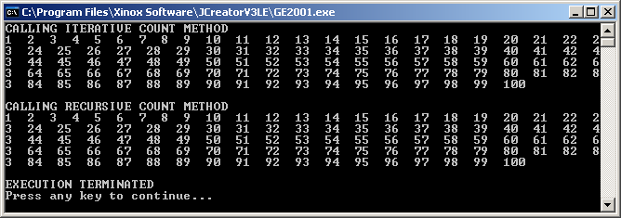
// Java1902.java
// This program demonstrates how to add an exit or base case to control recursive calls
public class Java1902
{
static int k = 0;
public static void main(String args[])
{
System.out.println("CALLING ITERATIVE COUNT METHOD");
count1();
System.out.println("\n\nCALLING RECURSIVE COUNT METHOD");
count2();
System.out.println("\n\nEXECUTION TERMINATED");
}
public static void count1() /***** ITERATIVE COUNT *****/
{
for (int k = 1; k <= 100; k++)
System.out.print(k + " ");
}
public static void count2() /***** RECURSIVE COUNT *****/
{
k++;
System.out.print(k + " ");
if (k < 100) count2();
}
}

Slide 12
Important Recursion Rule
All recursive methods must have an exit that stops the recursive process.
The special case or condition that stops the recursive calls is called the base case.

Slide 13
Section 19.4
Recursion
Fundamentals

Slide 14
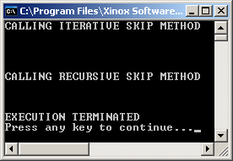
// Java1903.java This program demonstrates the <Skip> method.
public class Java1903
{
public static void main(String args[])
{
System.out.println("CALLING ITERATIVE SKIP METHOD");
skip1(4);
System.out.println("CALLING RECURSIVE SKIP METHOD");
skip2(3);
System.out.println("EXECUTION TERMINATED");
}
public static void skip1(int n) /***** ITERATIVE SKIP *****/
{
for (int k = 1; k <= n; k++)
System.out.println();
}
public static void skip2(int n) /***** RECURSIVE SKIP *****/
{
if ( n > 0)
{
System.out.println();
skip2(n-1);
}
}
}

Slide 15
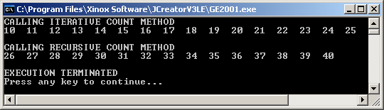
// Java1904.java
// This program demonstrates the <count(a,b)> method, which displays
// consecutive integers from a to b.
public class Java1904
{
public static void main(String args[])
{
System.out.println("CALLING ITERATIVE COUNT METHOD");
count1(10,25);
System.out.println("\n\nCALLING RECURSIVE COUNT METHOD");
count2(26,40);
System.out.println("\n\nEXECUTION TERMINATED");
}
public static void count1(int a, int b) /***** ITERATIVE COUNT *****/
{
for (int k = a; k <= b; k++)
System.out.print(k + " ");
}
public static void count2(int a, int b) /***** RECURSIVE COUNT *****/
{
if (a <= b)
{
System.out.print(a + " ");
count2(a+1,b);
}
}
}

Slide 16
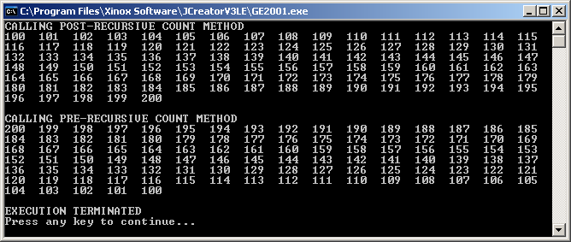
// Java1905.java
// This program compares the difference between "post-recursive" calls and "pre-recursive" calls.
public class Java1905
{
public static void main(String args[])
{
System.out.println("CALLING POST-RECURSIVE COUNT METHOD");
count1(100,200);
System.out.println("\n\nCALLING PRE-RECURSIVE COUNT METHOD");
count2(100,200);
System.out.println("\n\nEXECUTION TERMINATED");
}
public static void count1(int a, int b) /**** POST-RECURSIVE COUNT ****/
{
if (a <= b)
{
System.out.print(a + " ");
count1(a+1,b);
}
}
public static void count2(int a, int b) /**** PRE-RECURSIVE COUNT ****/
{
if (a <= b)
{
count2(a+1,b);
System.out.print(a + " ");
}
}
}

Slide 17
The Internal Stack & Recursion
Java has a special internal data structure, called a stack that is hidden from the programmer.
A stack is a data structure that will only access data from one end, usually called the top, in such a manner that it behaves like a LIFO.
Data is accessed Last In, First Out.
Program execution sequence is handled by something called an Index Pointer.
The Index Pointer, or IP for short, contains the next memory address of the line to be executed.
NOTE: An IP, which points to a memory address in a computer is in no way related to an Internet Protocol (IP) Address on the internet.

Slide 18
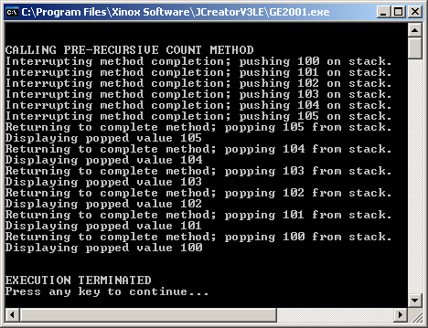
// Java1906.java
// This program demonstrates how recursion can display output in reverse order.
public class Java1906
{
public static void main(String args[])
{
System.out.println("\n\nCALLING PRE-RECURSIVE COUNT METHOD");
count2(100,105);
System.out.println("\n\nEXECUTION TERMINATED");
}
public static void count2(int a, int b)
{
if (a <= b)
{
System.out.println("Interrupting method completion; pushing " + a + " on stack.");
count2(a+1,b);
System.out.println("Returning to complete method; popping " + a + " from stack.");
System.out.println("Displaying popped value " + a);
}
}
}

Slide 19
Fundamental Recursion Concepts
All recursive methods require an or base case that stops the recursive process.
The stack controls recursion, since it controls the execution sequence of methods, and stores local method information.
Every method call requires the completion of the called method, even if the execution sequence is interrupted by another recursive method call.
Incomplete recursive calls result in a LIFO execution sequence.

Slide 20
Section 19.5
Recursive
Return Methods

Slide 21
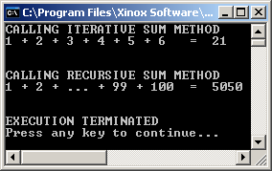
// Java1907.java This program demonstrates the <sum> method.
// It also demonstrates recursion with return methods.
public class Java1907
{
public static void main(String args[])
{
System.out.println("CALLING ITERATIVE SUM METHOD");
System.out.println("1 + 2 + 3 + 4 + 5 + 6 = " + sum1(6));
System.out.println("\n\nCALLING RECURSIVE SUM METHOD");
System.out.println("1 + 2 + ... + 99 + 100 = " + sum2(100));
System.out.println("\n\nEXECUTION TERMINATED");
}
public static int sum1(int n) /***** ITERATIVE SUM *****/
{
int sum = 0;
for (int k = 1; k <= n; k++)
sum += k;
return sum;
}
public static int sum2(int n) /***** RECURSIVE SUM *****/
{
if (n == 0)
return 0;
else
return n + sum2(n-1);
}
}

Slide 22
Stepping Through the Recursive Process with sum2(4)
CALL # | n | Method sum2 returns
1 2 3 4 5 | 4 3 2 1 0 | 4 + Sum2(3) 3 + Sum2(2) 2 + Sum2(1) 1 + Sum2(0) 0
sum2(4) = 4 + 3 + 2 + 1 + 0 = 10

Slide 23
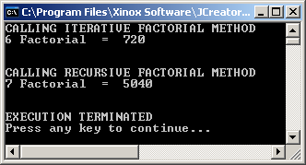
// Java1908.java
// This program demonstrates the <fact> method.
public class Java1908
{
public static void main(String args[])
{
System.out.println("CALLING ITERATIVE FACTORIAL METHOD");
System.out.println("6 Factorial = " + fact1(6));
System.out.println("\n\nCALLING RECURSIVE FACTORIAL METHOD");
System.out.println("7 Factorial = " + fact2(7));
System.out.println("\n\nEXECUTION TERMINATED");
}
public static int fact1(int n) /***** ITERATIVE FACT *****/
{
int temp = 1;
for (int k = n; k > 0; k--)
temp *= k;
return temp;
}
public static int fact2(int n) /***** RECURSIVE FACT *****/
{
if (n == 0)
return 1;
else
return n * fact2(n-1);
}
}
Doesn’t this look like the mathematical definition of factorial?

Slide 24
Stepping Through the Recursive Process with fact2(6)
CALL # | n | Method fact2 returns
1 2 3 4 5 6 7 | 6 5 4 3 2 1 0 | 6 * Fact2(5) 5 * Fact2(4) 4 * Fact2(3) 3 * Fact2(2) 2 * Fact2(1) 1 * Fact2(0) 1
sum2(4) = 6 * 5 * 4 * 3 * 2 * 1 * 1 = 720

Slide 25
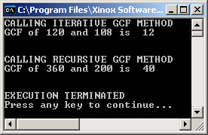
// Java1909.java This program demonstrates the <gcf> method.
public class Java1909
{
public static void main(String args[])
{
System.out.println("CALLING ITERATIVE GCF METHOD");
System.out.println("GCF of 120 and 108 is " + gcf1(120,108));
System.out.println("\n\nCALLING RECURSIVE GCF METHOD");
System.out.println("GCF of 360 and 200 is " + gcf2(360,200));
System.out.println("\n\nEXECUTION TERMINATED");
}
public static int gcf1(int n1, int n2) /***** ITERATIVE GCF *****/
{
int temp = 0; int rem = 0;
do
{
rem = n1 % n2;
if (rem == 0) temp = n2;
else
{
n1 = n2;
n2 = rem;
}
}
while (rem != 0);
return temp;
}

Slide 26
Stepping Through the Recursive Process with gcf2(360,200)
public static int gcf2(int n1, int n2)
{
int rem = n1 % n2;
if (rem == 0)
return n2;
else
return gcf2(n2,rem);
}
CALL# | n1 | n2 | rem | Method gcf2 returns
1 2 3 | 360 200 160 | 200 160 40 | 160 40 0 | gcf2(200,160) gcf2(160,40) 40
gcf2(360,200) = 40

Slide 27
Section 19.6
Fibonacci
A Recursive Nono

Slide 28

Fibonacci, a Recursive No-No
The Fibonacci Sequence is a sequence of numbers, starting with two ones, which is created by taking the sum of the two previous numbers.

Slide 29
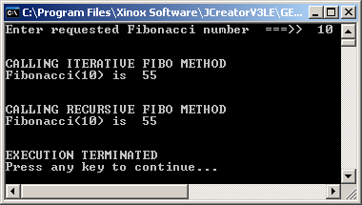
// Java1910.java
// This program demonstrates the <fibo> method. Note that this style of recursion becomes
// unacceptibly slow when the requested Fibonacci number becomes larger.
import java.util.*;
public class Java3210
{
public static void main(String args[])
{
Scanner input = new Scanner(System.in);
System.out.print("Enter requested Fibonacci number ===>> ");
int number = input.nextInt();
System.out.println("\n\nCALLING ITERATIVE FIBO METHOD");
System.out.println("Fibonacci(" + number + ") is " + fibo1(number));
System.out.println("\n\nCALLING RECURSIVE FIBO METHOD");
System.out.println("Fibonacci(" + number + ") is " + fibo2(number));
System.out.println("\n\nEXECUTION TERMINATED");
}

Slide 30
/***** ITERATIVE FIBO *****/
public static int fibo1(int n)
{
int n1 = 1;
int n2 = 1;
int n3 = 1;
if (n == 1 || n == 2)
return 1;
else
{
for (int k = 3; k <= n; k++)
{
n3 = n1 + n2;
n1 = n2;
n2 = n3;
}
}
return n3;
}

Slide 31
/***** RECURSIVE FIBO *****/
public static int fibo2(int n)
{
if (n == 1 || n == 2)
return 1;
else
return fibo2(n-1) + fibo2(n-2);
}
NOTE:
Times will vary on
different computers.
The problem with the recursive solution can be seen when you view how quickly the time to compute the Fibo numbers increases:
Fibo# | Time | Fibo# | Time
41 | 3 seconds | 51 | 1 hour
42 | 6 seconds | 58 | 4½ days
43 | 12 seconds | 61 | 1 month
44 | 24 seconds | 81 | 1,000,000 months

Slide 32
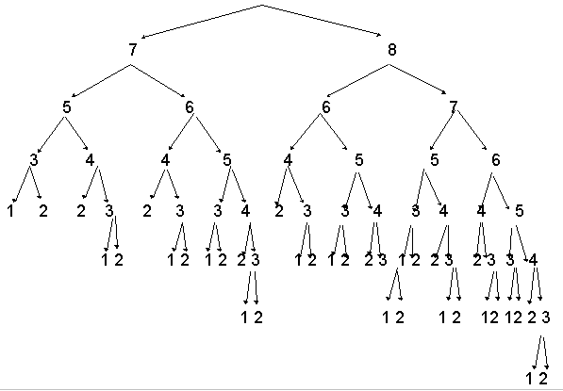
Fibonacci Problem Explained 9
The diagram is only for the 9th Fibonacci number. You see the large number of recursive calls, and you can also see how many times the same computation is performed.

Slide 33
Recursion Warning
Avoid recursive methods that have a single program statement with multiple recursive calls, like the Fibonacci Sequence:
return fibo(n-1) + fibo(n-2);

Slide 34
Section 19.7
Evaluating
Return Methods

Slide 35
APCS Exam Alert
Evaluating recursive method, like the examples that follow will be required for both the multiple choice part and the free response part of the examination.
Few students are comfortable with this type of problem at the first introduction.
Most students achieve excellent evaluation skills with repeated practice.

Slide 36
Exercise 01 Determine that m1(5) == 25.
public int m1(int n) { if (n == 1) return 25; else return m1(n-1); }
CALL # | n | Method m1 returns
1 2 3 4 5 | 5 4 3 2 1 | m1(4) m1(3) m1(2) m1(1) 25
m1(5) == 25
25 is returned
no matter what N is
as long as N >= 1

Slide 37
Exercise 02 Determine that m2(5) causes an error.
public int m2(int n) { if (n == 1) return 25; else return m2(n+1); }
CALL # | n | Method m2 returns
1 2 3 4 | 5 6 7 8 | m2(6) m2(7) m2(8) m2(9)
Error results because the base case cannot be reached.
It is not possible for N
to ever reach 1.
The method recursively calls itself until the
computer's stack runs out of memory.

Slide 38
Exercise 03 Determine that m3(5) == 39.
public int m3(int n) { if (n == 1) return 25; else return n + m3(n-1); }
CALL # | n | Method m3 returns
1 2 3 4 5 | 5 4 3 2 1 | 5 + m3(4) 4 + m3(3) 3 + m3(2) 2 + m3(1) 25
m3(5) == 5 + 4 + 3 + 2 + 25 == 39

Slide 39
Exercise 04 Determine that m4(1) == 10.
public int m4(int n) { if (n == 5) return 0; else return n + m4(n+1); }
CALL # | n | Method m4 returns
1 2 3 4 5 | 1 2 3 4 5 | 1 + m4(2) 2 + m4(3) 3 + m4(4) 4 + m4(5) 0
m4(1) == 1 + 2 + 3 + 4 + 0 = = 10

Slide 40
Exercise 05 Determine that m5(6) == 38
public int m5(int n) { if (n == 1 || n == 0) return 0; else return n + m5(n-1) + m5(n-2); }
CALL # | n | Method m5 returns
1 2 3 4 5 6 | 6 5 4 3 2 1 | 6 + m5(5) + m5(4) 5 + m5(4) + m5(3) 4 + m5(3) + m5(2) 3 + m5(2) + m5(1) 2 + m5(1) + m5(0) 0
m5(6) == 6 + 5 + 4 + 3 +2 + 0 == 20 ???
What?

Slide 41
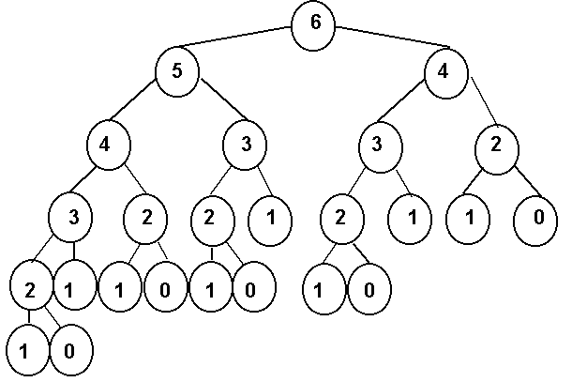
Exercise 05 Explained
Since anything less than 2 will return 0, we only add the numbers that are 2 or over. Now we have
6 + 5 + 4 + 4 + 3 + 3 + 2 + 3 + 2 + 2 + 2 + 2 = 38

Slide 42
Exercise 06 Determine that m6(5) == 120
public int m6(int n) { if (n == 1) return 1; else return n * m6(n-1); }
CALL # | n | Method m6 returns
1 2 3 4 5 | 5 4 3 2 1 | 5 * m6(4) 4 * m6(3) 3 * m6(2) 2 * m6(1) 1
m6(5) == 1 * 2 * 3 * 4 * 5 == 120
This is a recursive factorial method.

Slide 43
Exercise 07 Determine that m7(5,6) == 30
public int m7(int a, int b) { if (a == 0) return 0; else return b + m7(a-1,b); }
CALL # | a | b | Method m7 returns
1 2 3 4 5 6 | 5 4 3 2 1 0 | 6 6 6 6 6 6 | 6 + m7(4,6) 6 + m7(3,6) 6 + m7(2,6) 6 + m7(1,6) 6 + m7(0,6) 0
m7(5,6) = 6 + 6 + 6 + 6 + 6 + 0 = 30
This is a recursive way to multiply 2 numbers.
(Not that you would ever want to do it this way!)

Slide 44
Exercise 08 Determine that m8(4,3) == 81
public int m8(int a, int b) { if (a == 0) return 1; else return b * m8(a-1,b); }
CALL # | a | b | Method m8 returns
1 2 3 4 5 | 4 3 2 1 0 | 3 3 3 3 3 | 3 * m8(3,3) 3 * m8(2,3) 3 * m8(1,3) 3 * m8(0,3) 1
m8(4,3) == 3 * 3 * 3 * 3 * 1 == 81
This is a recursive power method.
It computes B^{A}.

Slide 45
Exercise 09 Determine that m9(4,3) == 64
public int m9(int a, int b) { if (b == 0) return 1; else return a * m9(a,b-1); }
CALL # | a | b | Method m9 returns
1 2 3 4 | 4 4 4 4 | 3 2 1 0 | 4 * m9(4,2) 4 * m9(4,1) 4 * m9(4,0) 1
m9(4,3) == 4 * 4 * 4 * 1 == 64
This is also a recursive power method.
But, it computes A^{B}.

Slide 46
Exercise 10 Determine that m10(7,3) == 17
public int m10(int a, int b) { if (a < b) return 5; else return b + m10(a-1,b+1); }
CALL # | a | b | Method m10 returns
1 2 3 4 | 7 6 5 4 | 3 4 5 6 | 3 + m10(6,4) 4 + m10(5,5) 5 + m10(4,6) 5
m10(7,3) == 3 + 4 + 5 + 5 == 17

Slide 47
Section 19.8
Manipulating
Parameters of
Return Methods

Slide 48
// Java1911.java
// This program demonstrates the <linear> method, which performs a Linear Search of a sorted array.
public class Java1911
{
public static void main(String args[])
{
int list[] = new int[100];
assign(list);
display(list);
System.out.println("\n\nCALLING ITERATIVE LINEAR SEARCH METHOD");
System.out.println("Number 425 is located at index " + linear1(list,425));
System.out.println("Number 211 is located at index " + linear1(list,211));
System.out.println("\n\nCALLING RECURSIVE LINEAR SEARCH METHOD");
System.out.println("Number 375 is located at index " + linear2(list,375,0));
System.out.println("Number 533 is located at index " + linear2(list,533,0));
System.out.println("\n\nEXECUTION TERMINATED");
}
public static void assign(int list[])
{
for (int k = 0; k < list.length; k++)
list[k] = 100 + k * 5;
}
public static void display(int list[])
{
for (int k = 0; k < list.length; k++)
System.out.print(list[k] + " ");
}
Both the iterative
and recursive linear
searches as well as
the program output
are shown on the
next few slides.

Slide 49
/***** ITERATIVE LINEAR SEARCH *****/
public static int linear1(int list[], int key)
{
boolean found = false;
int k = 0;
while (k < list.length && !found)
{
if (list[k] == key)
found = true;
else
k++;
}
if (found)
return k;
else
return -1;
}
First, we need to review the linearSearch method, implemented iteratively.
This implementation of the search algorithm returns the index (k) of the search item (key), or it returns k == -1 if the search is not successful.

Slide 50
/***** RECURSIVE LINEAR SEARCH *****/
public static int linear2(int list[], int key, int k)
{
if (k == list.length)
return -1;
else
if (list[k] == key)
return k;
else
return linear2(list,key,k+1);
}

Slide 51
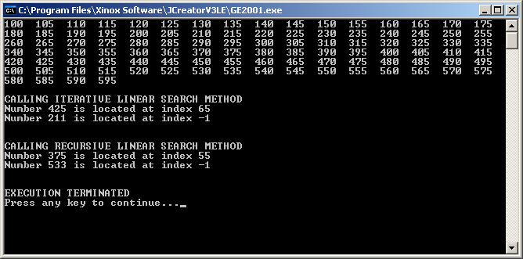
Program
Java1911.java
Output

Slide 52
// Java1912.java
// This program demonstrates the <binary> method, which performs
// a Binary Search of a sorted array.
public class Java1912
{
public static void main(String args[])
{
int list[] = new int[100];
assign(list);
display(list);
System.out.println("\n\nCALLING ITERATIVE BINARY SEARCH METHOD");
System.out.println("Number 425 is at index " + binary1(list,425));
System.out.println("Number 211 is at index " + binary1(list,211));
System.out.println("\n\nCALLING RECURSIVE BINARY SEARCH METHOD");
System.out.println("Number 375 is at index " + binary2(list,375,0,99));
System.out.println("Number 533 is at index " + binary2(list,533,0,99));
System.out.println("\n\nEXECUTION TERMINATED");
}

Slide 53
/***** ITERATIVE BINARY SEARCH *****/
public static int binary1(int list[], int key)
{
int lo = 0; int hi = list.length-1; int mid = 0;
boolean found = false;
while (lo <= hi && !found)
{
mid = (lo + hi) /2;
if (list[mid] == key)
found = true;
else
if (key > list[mid])
lo = mid + 1;
else
hi = mid - 1;
}
if (found)
return mid;
else
return -1;
}

Slide 54
/***** RECURSIVE BINARY SEARCH *****/
public static int binary2(int list[], int key, int lo, int hi)
{
int mid = 0;
if (lo > hi)
return -1;
else
{
mid = (lo + hi) /2;
if (list[mid] == key)
return mid;
else
if (key > list[mid])
return binary2(list,key,mid+1,hi);
else
return binary2(list,key,lo,mid-1);
}
}

Slide 55

Program
Java1912.java
Output

Slide 56
Recursion and Parameters
Changing existing iterative methods into recursive methods is an excellent exercise in obtaining proficiency with recursion.
Frequently it may be necessary to add parameters to the headings of the recursive methods.
Two examples of methods that require additional parameters in the recursive implementation are the Linear Search and the Binary Search.

Slide 57
Section 19.9
Multiple Recursive Calls
And the Tower of Hanoi

Slide 58
Multiple Recursive Calls and The Tower of Hanoi
Towers of Hanoi at the Start of the 5-Disk Problem
1
2
3
4
5
Peg A
Peg B
Peg C

Slide 59
Multiple Recursive Calls and The Tower of Hanoi
Towers of Hanoi at the End of the 5-Disk Problem
1
2
3
4
5
Peg A
Peg B
Peg C

Slide 60
The Trivial One-Disk Problem
Let us look at a variety of problems, starting with the simplest possible situation. Suppose that you only need to move one disk from peg A to peg C. Would that be any kind of problem?
1
Peg A
Peg B
Peg C

Slide 61
The Trivial One-Disk Problem
How do we solve the 1-Disk problem?
In exactly one step that be described with the single statement:
Move Disk1 from Peg A to Peg C
1
Peg A
Peg B
Peg C

Slide 62
The Easy Two-Disk Problem
Start
1
2
Peg A
Peg B
Peg C

Slide 63
The Easy Two-Disk Problem
Step 1
2
1
Peg A
Peg B
Peg C

Slide 64
The Easy Two-Disk Problem
Step 2
1
2
Peg A
Peg B
Peg C

Slide 65
The Easy Two-Disk Problem
Step 3 - Finished
1
2
Peg A
Peg B
Peg C

Slide 66
The Tower of Hanoi 5 Disk Demo
Start
1
2
3
4
5
Peg A
Peg B
Peg C

Slide 67
The Tower of Hanoi 5 Disk Demo
Step 1
2
3
4
5
1
Peg A
Peg B
Peg C

Slide 68
The Tower of Hanoi 5 Disk Demo
Step 2
3
4
5
2
1
Peg A
Peg B
Peg C

Slide 69
The Tower of Hanoi 5 Disk Demo
Step 3
3
4
1
5
2
Peg A
Peg B
Peg C

Slide 70
The Tower of Hanoi 5 Disk Demo
Step 4
4
1
5
2
3
Peg A
Peg B
Peg C

Slide 71
The Tower of Hanoi 5 Disk Demo
Step 5
1
4
5
2
3
Peg A
Peg B
Peg C

Slide 72
The Tower of Hanoi 5 Disk Demo
Step 6
1
4
2
5
3
Peg A
Peg B
Peg C

Slide 73
The Tower of Hanoi 5 Disk Demo
Step 7
1
4
2
5
3
Peg A
Peg B
Peg C

Slide 74
The Tower of Hanoi 5 Disk Demo
Step 8
1
2
5
4
3
Peg A
Peg B
Peg C

Slide 75
The Tower of Hanoi 5 Disk Demo
Step 9
1
2
5
4
3
Peg A
Peg B
Peg C

Slide 76
The Tower of Hanoi 5 Disk Demo
Step 10
2
1
5
4
3
Peg A
Peg B
Peg C

Slide 77
The Tower of Hanoi 5 Disk Demo
Step 11
1
2
5
4
3
Peg A
Peg B
Peg C

Slide 78
The Tower of Hanoi 5 Disk Demo
Step 12
1
2
3
5
4
Peg A
Peg B
Peg C

Slide 79
The Tower of Hanoi 5 Disk Demo
Step 13
2
3
5
4
1
Peg A
Peg B
Peg C

Slide 80
The Tower of Hanoi 5 Disk Demo
Step 14
2
3
5
4
1
Peg A
Peg B
Peg C

Slide 81
The Tower of Hanoi 5 Disk Demo
Step 15
1
2
3
5
4
Peg A
Peg B
Peg C

Slide 82
The Tower of Hanoi 5 Disk Demo
Step 16
1
2
3
4
5
Peg A
Peg B
Peg C

Slide 83
The Tower of Hanoi 5 Disk Demo
Step 17
2
3
1
4
5
Peg A
Peg B
Peg C

Slide 84
The Tower of Hanoi 5 Disk Demo
Step 18
3
2
1
4
5
Peg A
Peg B
Peg C

Slide 85
The Tower of Hanoi 5 Disk Demo
Step 19
1
3
2
4
5
Peg A
Peg B
Peg C

Slide 86
The Tower of Hanoi 5 Disk Demo
Step 20
1
2
3
4
5
Peg A
Peg B
Peg C

Slide 87
The Tower of Hanoi 5 Disk Demo
Step 21
1
2
3
4
5
Peg A
Peg B
Peg C

Slide 88
The Tower of Hanoi 5 Disk Demo
Step 22
2
1
3
4
5
Peg A
Peg B
Peg C

Slide 89
The Tower of Hanoi 5 Disk Demo
Step 23
1
2
3
4
5
Peg A
Peg B
Peg C

Slide 90
The Tower of Hanoi 5 Disk Demo
Step 24
1
2
4
3
5
Peg A
Peg B
Peg C

Slide 91
The Tower of Hanoi 5 Disk Demo
Step 25
1
2
4
3
5
Peg A
Peg B
Peg C

Slide 92
The Tower of Hanoi 5 Disk Demo
Step 26
1
4
3
2
5
Peg A
Peg B
Peg C

Slide 93
The Tower of Hanoi 5 Disk Demo
Step 27
1
4
3
2
5
Peg A
Peg B
Peg C

Slide 94
The Tower of Hanoi 5 Disk Demo
Step 28
3
1
4
2
5
Peg A
Peg B
Peg C

Slide 95
The Tower of Hanoi 5 Disk Demo
Step 29
3
4
1
2
5
Peg A
Peg B
Peg C

Slide 96
The Tower of Hanoi 5 Disk Demo
Step 30
2
3
4
1
5
Peg A
Peg B
Peg C

Slide 97
The Tower of Hanoi 5 Disk Demo
Step 31 - Finished
1
2
3
4
5
Peg A
Peg B
Peg C

Slide 98
Tower of Hanoi Formula
There is a pattern in the number of minimum moves to solve a given Tower of Hanoi problem.
With n the number of disks to be moved, the formula below computes the number or required moves.
2^{n} – 1

Slide 99
// Java3213.java This program solves the "Tower of Hanoi" puzzle.
import java.util.*;
public class Java3213
{
public static void main(String args[])
{
Scanner input = new Scanner(System.in);
System.out.print("\nHow many disks are in the tower ===>> ");
int disks = input.nextInt();
solveHanoi('A','B','C',disks);
System.out.println("\n\nEXECUTION TERMINATED");
}
public static void solveHanoi(char s, char t, char d, int n)
// s - source peg t - temporary peg d - destination peg n - number of disks
{
if (n != 0)
{
solveHanoi(s,d,t,n-1);
System.out.println("Move Disk "+n+" From Peg "+ s + " to Peg " + d);
solveHanoi(t,s,d,n-1);
}
}
}
YES! That’s it!

Slide 100
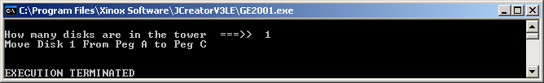
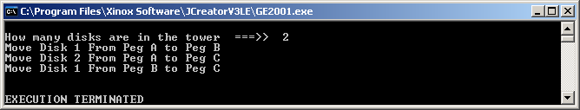
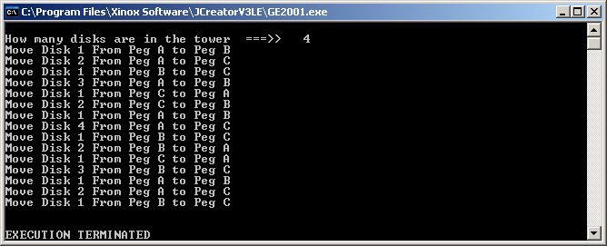
3 Outputs
for
Program
Java1912.java
Output

Slide 101
Tower of Hanoi General Solution
Move n-1 disks from Source Peg to Auxiliary Peg
Move the nth disk from Source Peg to Destination Peg
Move n-1 disks from Auxiliary Peg to Destination Peg

Slide 102
Tower of Hanoi Formula
Towers of Hanoi at Start of N-Disk Problem
1
2
N - 2
N - 1
N
Peg A
Peg B
Peg C

Slide 103
Tower of Hanoi Formula
Move N-1 Disks from Peg A to Peg B
1
2
N - 2
N
N - 1
Peg A
Peg B
Peg C

Slide 104
Tower of Hanoi Formula
Move Nth Disk from Peg A to Peg C
1
2
N - 2
N - 1
N
Peg A
Peg B
Peg C

Slide 105
Tower of Hanoi Formula
Move N-1 Disks from Peg B to Peg C
1
2
N - 2
N - 1
N
Peg A
Peg B
Peg C

Slide 106
Section 19.10
Why
Recursion?

Slide 107
Why Recursion?
Recursion is preferred over iteration when it is easier to write program code recursively.

Slide 108
The Grid Problem Revisited
Complete method alterGrid using the header below, such that all cells in the same object as grid[row][col] are set to white; otherwise grid is unchanged.
grid is a two-dimensional array of boolean elements. An element value of true means a black cell and an element value of false means a white cell.
 |  |  |  | 1
public void alterGrid(boolean grid[ ][ ], int row, int col)

Slide 109
// Java1914.java
// Recursive solution to the black/white "Grid" problem
public static void alter(boolean grid[][], int r, int c)
{
if ((r >= 1) && (r <= 10) &&
(c >= 1) && (c <= 10))
if (grid[r][c])
{
grid[r][c] = false;
alter(grid,r-1,c);
alter(grid,r+1,c);
alter(grid,r,c-1);
alter(grid,r,c+1);
}
}

Slide 110
Java1914.java Output #1
Enter row value ===>> 1
Enter col value ===>> 1
O X X O X X O X O X
O O X O X O O X X O
X O O X X O X X O X
O O O O X O O O X X
O X O X X O O O X X
O O X X O X X X O X
O X X O O O O X X X
X X O O X O O X O O
O O O X X X X X O X
O X O O O O X O O X
O X X O X X O X O X
O O X O X O O X X O
X O O X X O X X O X
O O O O X O O O X X
O X O X X O O O X X
O O X X O X X X O X
O X X O O O O X X X
X X O O X O O X O O
O O O X X X X X O X
O X O O O O X O O X
Since there is no “object” located
at index [1][1],
no change is made
to the grid.
NOTE:
This program does not use row 0 or column 0.

Slide 111
Java1914.java Output #2
Enter row value ===>> 2
Enter col value ===>> 2
X X X O X X O X X X
X X O O X X O X X O
X O O O O O O X X O
O O O O O O X O X X
X X X X X X X X O X
O X O X O X O O O X
X O O X O O X O O O
O O X O O O O X O X
O O O X X X O X O O
X X O O X X X O X O
O O O O X X O X X X
O O O O X X O X X O
O O O O O O O X X O
O O O O O O X O X X
X X X X X X X X O X
O X O X O X O O O X
X O O X O O X O O O
O O X O O O O X O X
O O O X X X O X O O
X X O O X X X O X O
public static void alter(boolean grid[][],
int r, int c)
{
if ((r >= 1) && (r <= 10) &&
(c >= 1) && (c <= 10))
if (grid[r][c])
{
grid[r][c] = false;
alter(grid,r-1,c);
alter(grid,r+1,c);
alter(grid,r,c-1);
alter(grid,r,c+1);
}
}

Slide 112
Java1914.java Output #3
Enter row value ===>> 5
Enter col value ===>> 5
X X X O X X X X X O
O X O X X O O X X X
X O X X X X O O O O
O O O O X O X O X O
O X O X X X X X X O
X O O X X O X O X O
X X O O O X O O X X
O X O X O X O X X O
X X X O X O X O X O
X O X X X O O O X O
X X X O O O O O O O
O X O O O O O O O O
X O O O O O O O O O
O O O O O O O O O O
O X O O O O O O O O
X O O O O O O O O O
X X O O O X O O O O
O X O X O X O O O O
X X X O X O X O O O
X O X X X O O O O O
public static void alter(boolean grid[][],
int r, int c)
{
if ((r >= 1) && (r <= 10) &&
(c >= 1) && (c <= 10))
if (grid[r][c])
{
grid[r][c] = false;
alter(grid,r-1,c);
alter(grid,r+1,c);
alter(grid,r,c-1);
alter(grid,r,c+1);
}
}

Slide 113
Something to think about…
The solution to the grid problem uses the same algorithm as a “floadfill” in a paint program.
Extra Credit
Write a program that solves the grid problem
ITERATIVELY.

