Slide 1
ANGULAR
A framework for single page website.

Slide 2
ANGULAR V/S ANGULAR JS
Angular is a TypeScript-based web Framework.
Angular JS is a JavaScript-based framework.

Slide 3
FEATURES
Open Source & Free
Cross Platform Support
Performance & Speed
Unit Testing
Built-in Component
Code Reusability

Slide 4
PREREQUISITES
Basics of TypeScript
Variable Declaration (let, const, public, private)
Ex: public data : number = 2;
If-else Condition
Basic loop (for-loop)
alert();
console.log()

Slide 5
SETUP ENVIRONMENT FOR ANGULAR
Download & Install Node.js
NPM (Node Package Manager) is installed with Node.js by default.
Install Angular CLI
npm install -g @angular/cli (Run this command in terminal)

Slide 6
CREATE FIRST PROJECT
Create a Workspace (Run this command)
ng new first-project
Run the application(Run this command)
ng serve –open

Slide 7
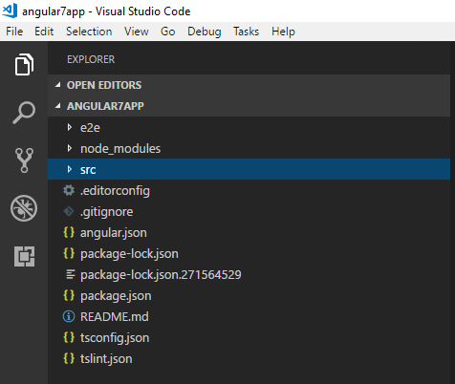
BASIC STRUCTURE

Slide 8
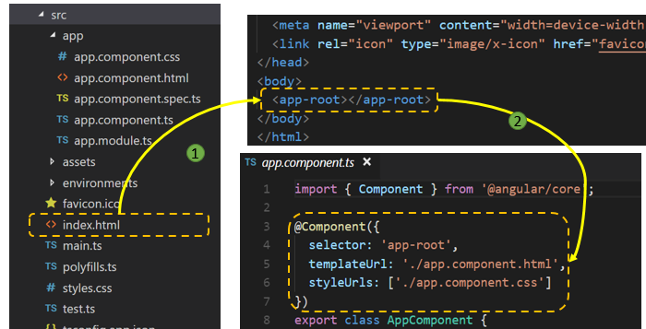
CALLING OF APP COMPONENT

