Slide 1


Beyond this meeting
A key aspect of CoFI is the flexibility provided for exploration and experimentation in inversion
Created examples and brought existing capabilities together
Making unique approaches accessible through the common interface and grow the set of examples
A FAIR example driven framework…
A conversation about CoFI over coffee is just the beginning…
www.inlab.au
Explore our examples
Setup your own inverse problem
Let us know what you think
Notes:
Horizon 1 – Overcomplete tomography represents a Horizon 1 concept in that it could in 3 years become part of established inversions method

Slide 2
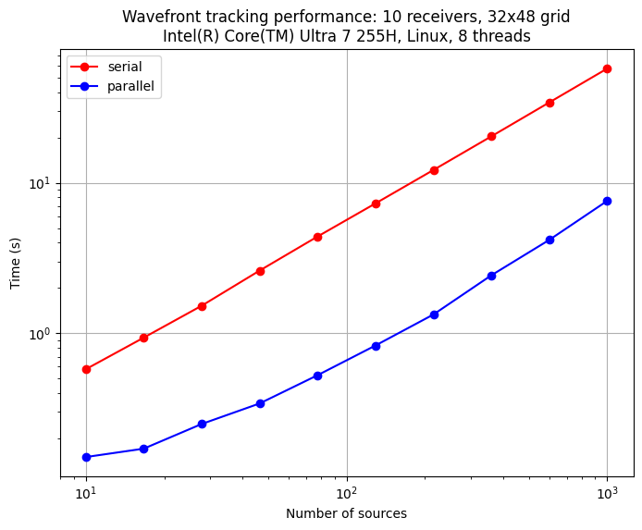
Scalable CoFI…
Forward problems are frequently the bottleneck in inverse problem workflows.
In many parameter estimation methods, communication typically occurs via linear algebra steps.
In contrast, ensemble methods often exhibit less communication between walkers, chains, or states

Slide 3
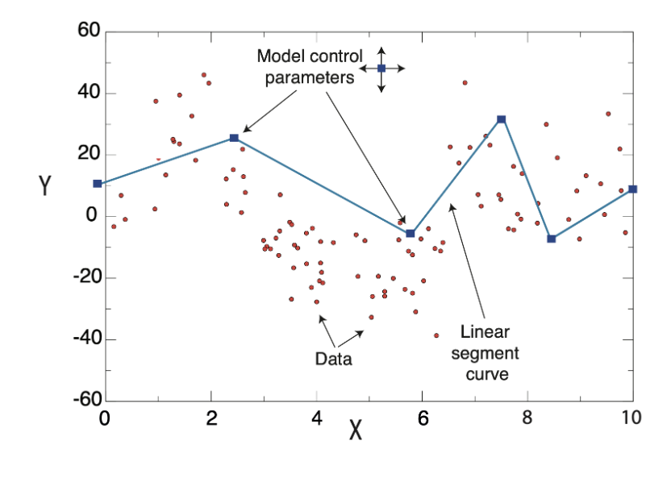
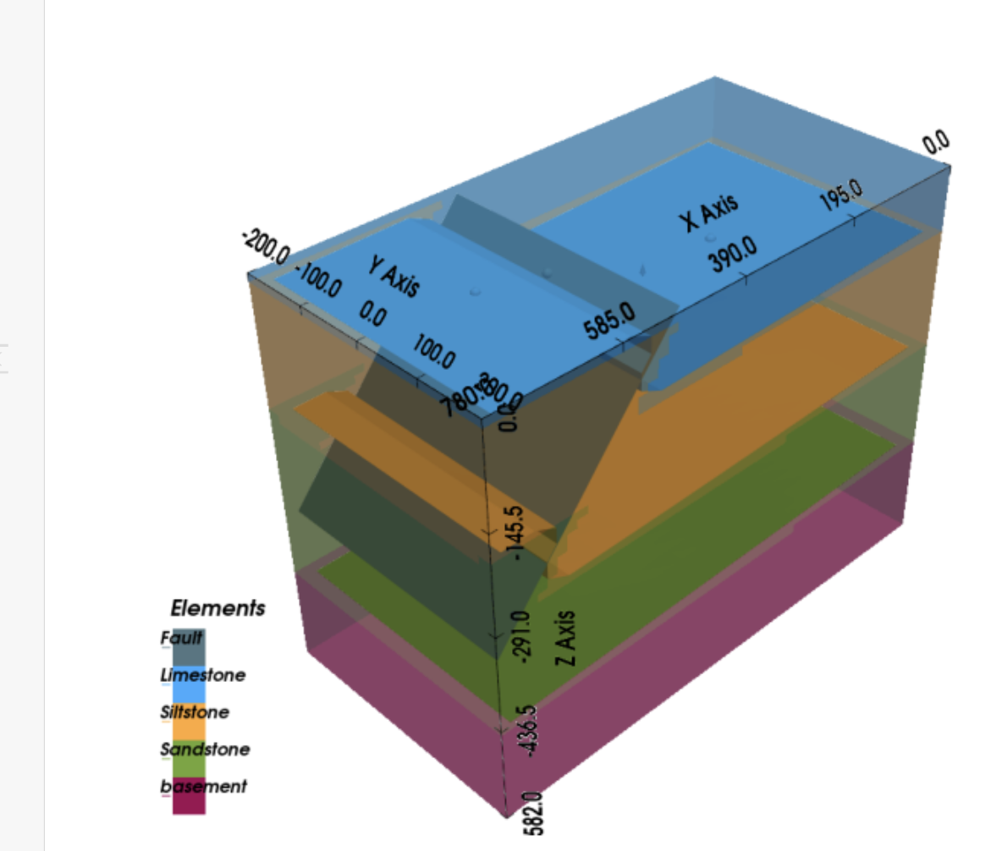
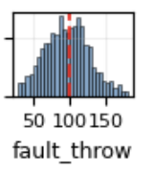
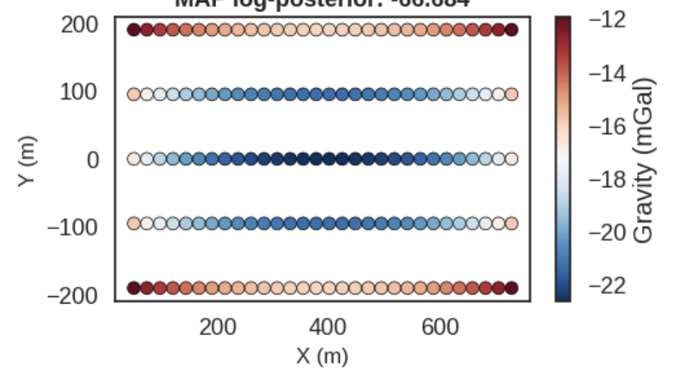
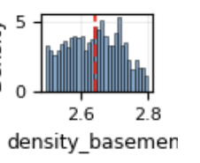
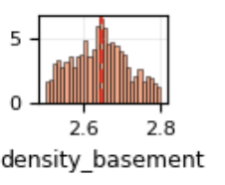
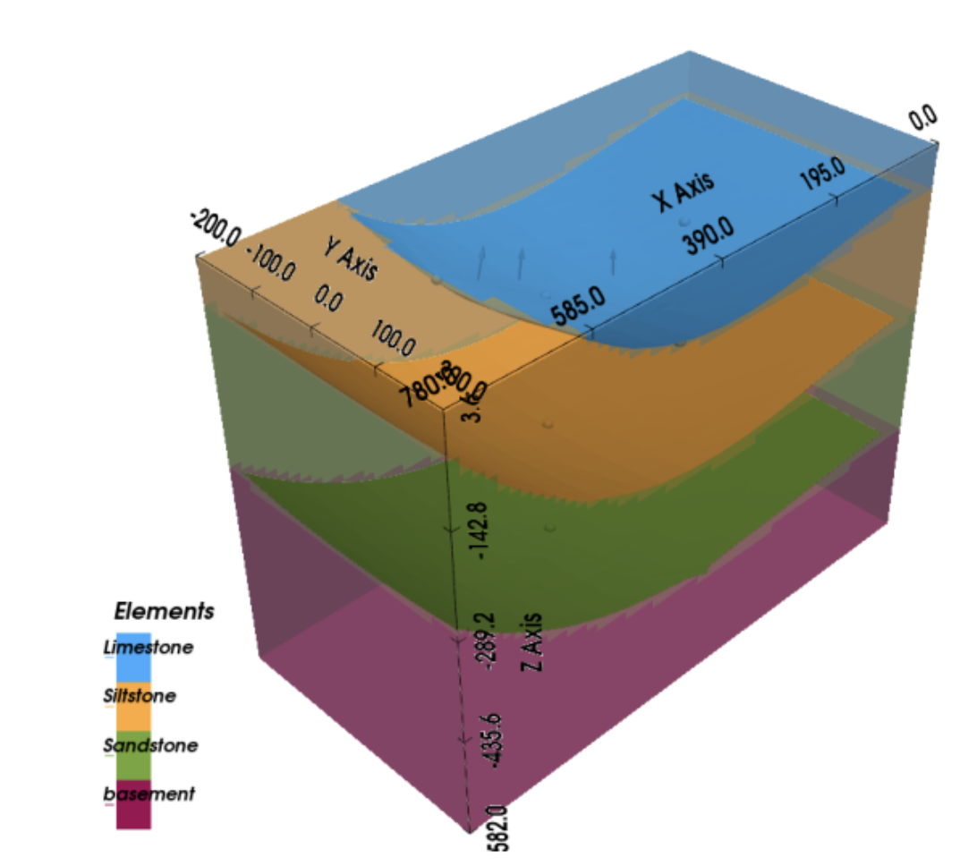
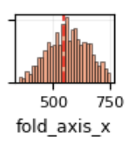
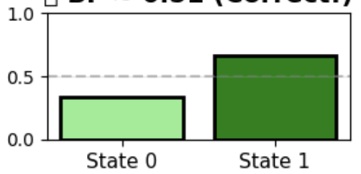
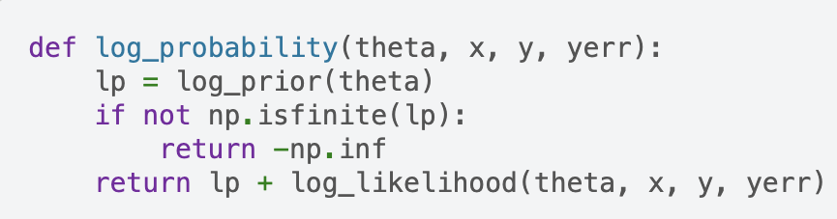
Beyond trans-dimensional sampling
Trans-conceptual sampling
0
fault
Both states can fit the gravity response of state/model 0
8 unknowns
…
github.com/fmagrini/bayes-bay
github.com/inlab-geo/pyrjmcmc
fold
1
Fits are equal – thus the
simpler model is preferred…
Unified Interface for ensemble methods
6 unknowns
…
emcee.readthedocs.io/en/stable/
github.com/gempy-project/gempy
github.com/inlab-geo/pyTransC
Notes:
Horizon 1 – Overcomplete tomography represents a Horizon 1 concept in that it could in 3 years become part of established inversions method

Slide 4

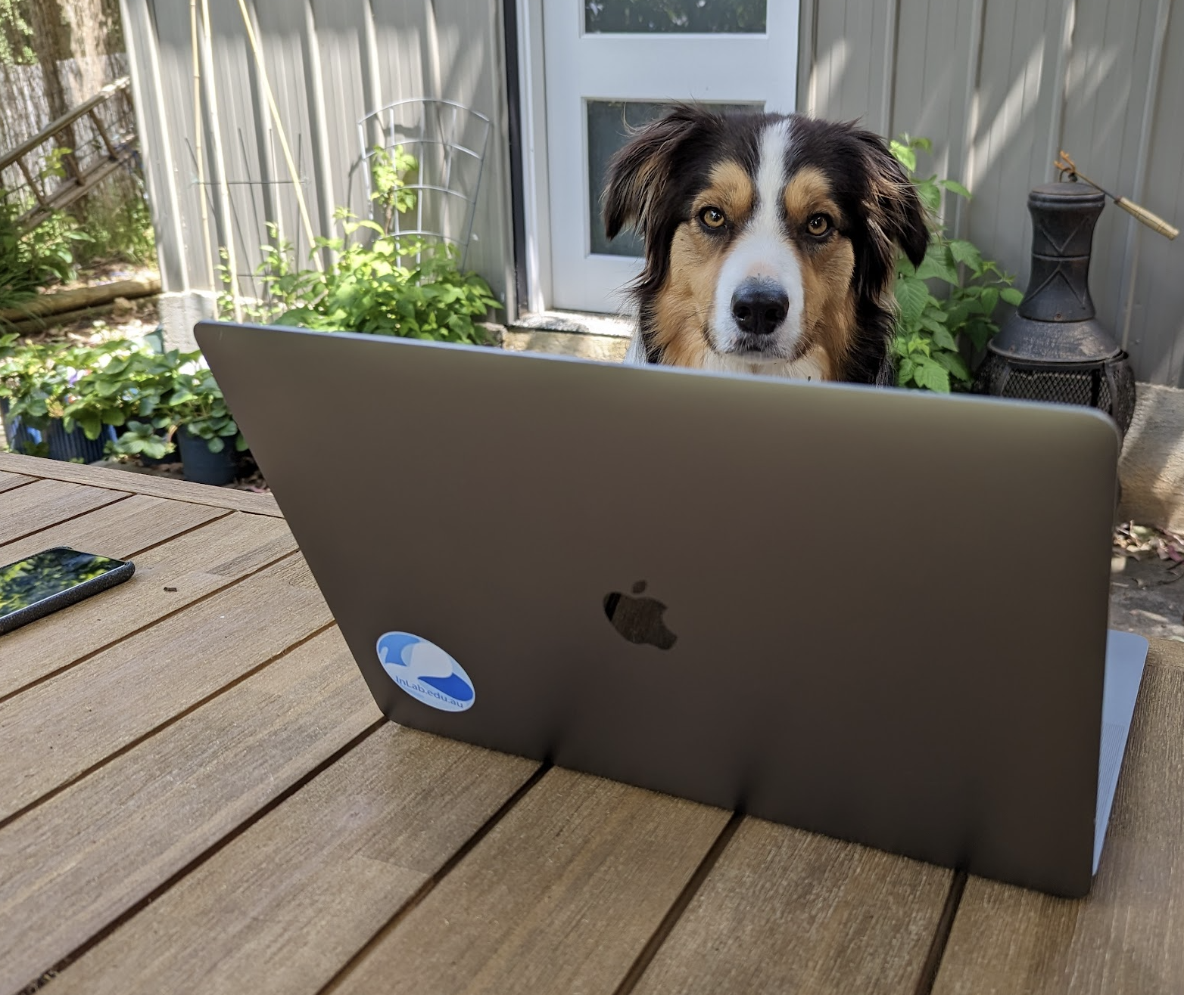
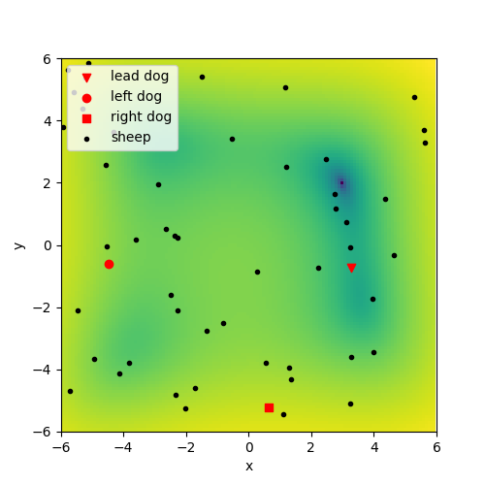

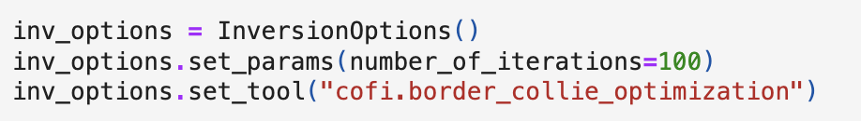
But what about my favourite metaheuristic optimiser?
Border Collie Optimization
Global minimum
www.inlab.au
Notes:
Horizon 1 – Overcomplete tomography represents a Horizon 1 concept in that it could in 3 years become part of established inversions method

Slide 5
Wrap up
This is an open source project
Feedback:
Choosing priorities: Expanding the methods; the examples, building a community;
Wishlist includes: scalability (HPC); new examples; automatic differentiation, Surrogate modelling. Link to new optimization and sampling packages…
Work with us & get involved:
creating an application example using CoFI
join our slack community: raise an issue on github:
http://inlab.au/community https://github.com/inlab-geo/cofi/issues
Notes:
Horizon 1 – Overcomplete tomography represents a Horizon 1 concept in that it could in 3 years become part of established inversions method

