Slide 1
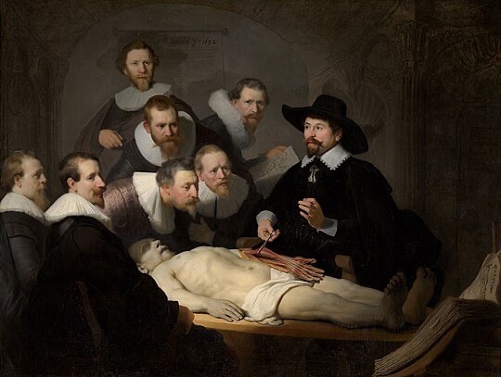



Using CoFI to experiment with geophysical inversion
A Common Framework for Inference
The Anatomy Lesson of Dr. Nicolaes Tulp
This will be an interactive session where participation is encouraged…

Slide 2
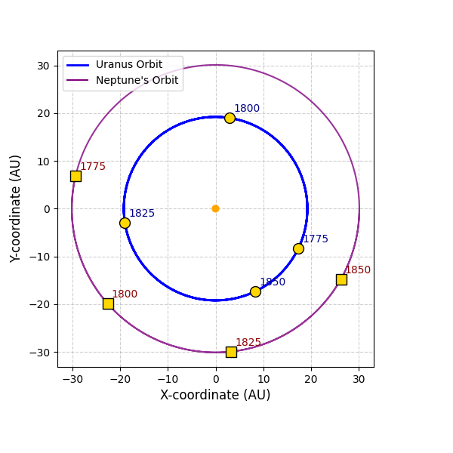
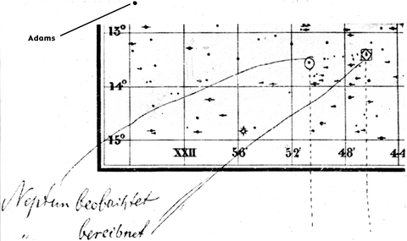
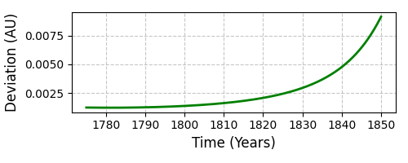
Discovery of Neptune
﻿﻿Le Verrier discovered a planet “with the tip of a pen, without any instruments other than the strength of his calculations alone.”…
Lequeux, J. (2013). Le Verrier--magnificent and detestable astronomer.
New York: Springer.
Use the observed data on Uranus and Newton's law of gravitation to deduce the mass, position, and orbit of a perturbing body - Neptune

Slide 3
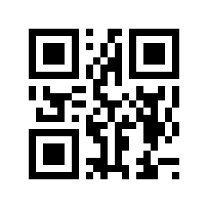
A Common Framework for Inference
Vision
CoFI provides industry, academia and government with a software platform underpinning research, training, and services in the application of inference methods to data.
Lower barriers in access to leading edge approaches
Reduce time in application of inference methods to data
Interactive education environment for training in inversion
“A good example is the best sermon”
– Benjamin Franklin
https://inlab.au/cofi/

Slide 4
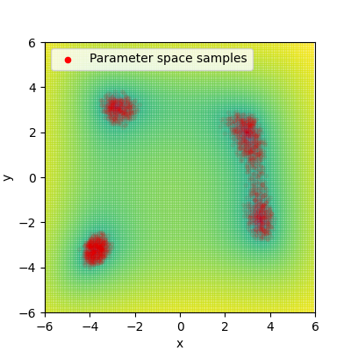
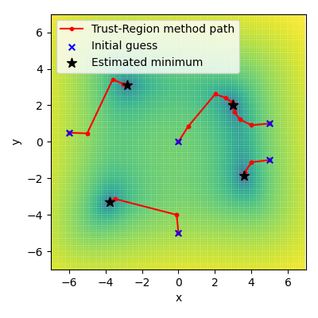
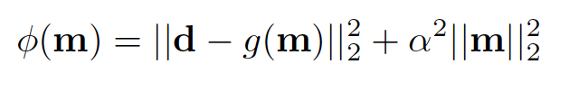

Two approaches to inversion
Parameter estimation
Ensemble method
Optimisation of a misfit function
Sample a target pdf

Slide 5
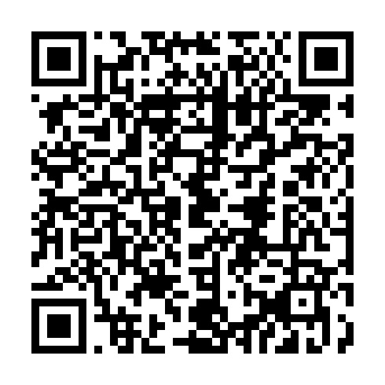
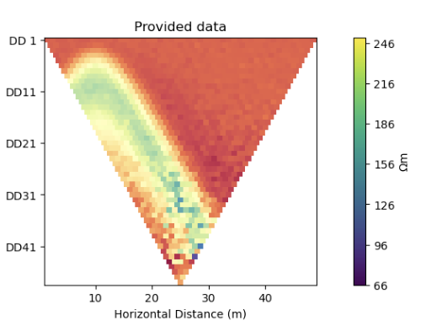
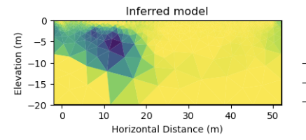
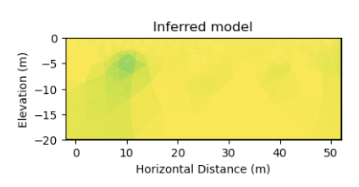
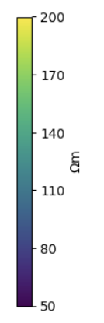
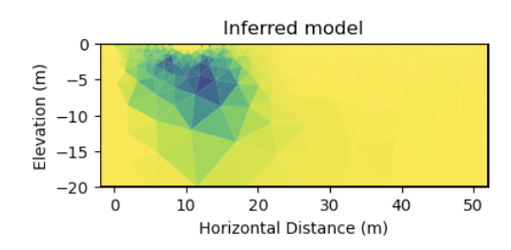
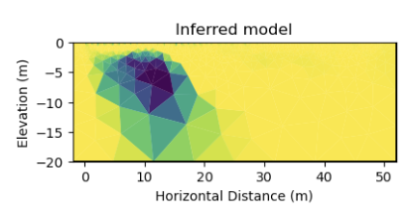
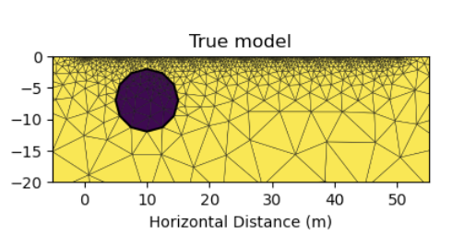
Exploration is about possibilities
CoFI - Common Framework for Inference
dogleg
Newton step
Electrical resistivity tomography
RAdam
trust-kyrlov
and so is finding an inference method using CoFI…

Slide 6

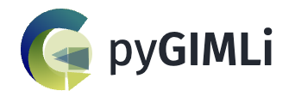


Momentum based optimisers
Vanilla iterative non-linear optimizers
only consider the objective function at
the current location
Machine learning methods are frequently applied to noisy data
Build inertia into the search direction to overcome local minima
trust-kyrlov
RAdam
https://pytorch.org/docs/stable/generated/torch.optim.RAdam.html
Notes:
Horizon 1 – Overcomplete tomography represents a Horizon 1 concept in that it could in 3 years become part of established inversions method

Slide 7
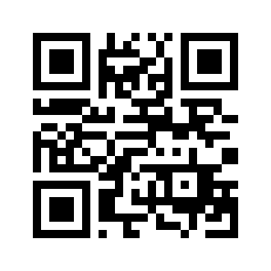
The CoFI explorer
www.inlab.au/inlab-explorer
Build on existing and emerging software packages
Example driven – we only add a method if there is an example that needs it
Findable, accessible, interoperable and reusable software

Slide 8
Capturing an inverse problem
An inverse method needs to only access a subset of features of a forward problem
Capturing a rich set of examples
Base Problem
inv_problem = BaseProblem()
inv_problem.set_objective( DEFINE ME)
inv_problem.set_jacobian(DEFINE ME)
inv_problem.set_initial_model(DEFINE ME)
Inversion Options
inv_options = InversionOptions()
inv_options.set_tool("scipy.linalg.lstsq")
Jacobian
Residuals
Log Likelihood
…
Proposal Strategy
Convergence Criteria
Number of iterations
…
Inversion
inv = Inversion(inv_problem, inv_options)
result = inv.run()

Slide 9
Take home messages…
What we hope you will take home today:
An understanding what CoFI can do.
Some familiarity with the design and philosophy of CoFI
Cognizance of the avenues to engage with CoFI and InLab
What we hope to take away today:
Priorities: Expanding the methods; the examples, building a community, other?
Wish lists: scalability; real data problems; automatic differentiation…

Slide 10
CoFI – A Common Framework for Inference
The application domain expert says:
What inference methods are suited to my data?
Where can I get access to them? What is required to make them talk to my forward problem/data?
How much work is that for me?
The research manager says:
How can my staff learn about state-of-the-art inference methods
How do we access the expertise?
Can we keep our design options open?
How long will it take?
The inference specialist says:
What other problems can my inference method solve?
Where can I get access to them?
How much work is that for me?
www.inlab.au

