Slide 1
Step size selection in Frank Wolf

Slide 2
Overview

Slide 3
Problem statement
Minimize $f(x)$
Subject to $x∈D$
$D$ - compact, convex set in a vector space
$f:D→R$ is a convex, $L$-smooth, function

Slide 4
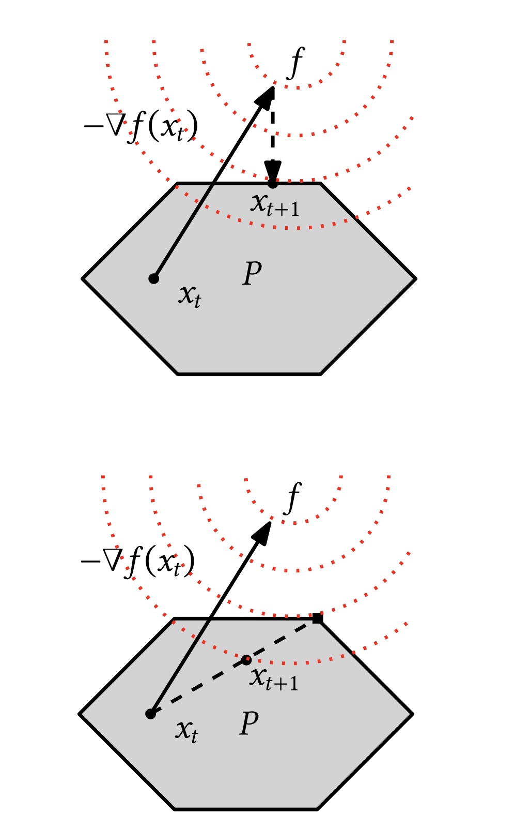
Linear Minimization Oracle
$$s=arg\min_{s∈D}s^{T}∇f(x_{k})$$
Finds a vector $s$ in feasible set $D$, which aligns most with $∇f(x_{k})$.
Vector $s$ has the largest projection on $-∇f(x_{k})$. Usually a vertex of the domain.

Slide 5
Algorithm
$$s_{k}=arg\min_{s∈D}s^{T}∇f(x_{k})$$
$$x_{k+1}=(1-γ_{k})x_{k}+γ_{k}s_{k}$$
, where $γ_{k}∈[0,1]$ is a step-size.
Both $x_{k},s_{k}∈D$. Convex combination of them is going to remain in the set. $x_{k+1}∈D$

Slide 6
Properties
Convergence rate $O(1/k)$
No need to do projection step (linear optimization vs. quadratic)
Solve high dimensional problems
Sparse solutions
Designed for smooth, convex $f$
Poor performance near optimum
Complex, non-linear boundaries increase computation costs.

Slide 7
Step size

Slide 8
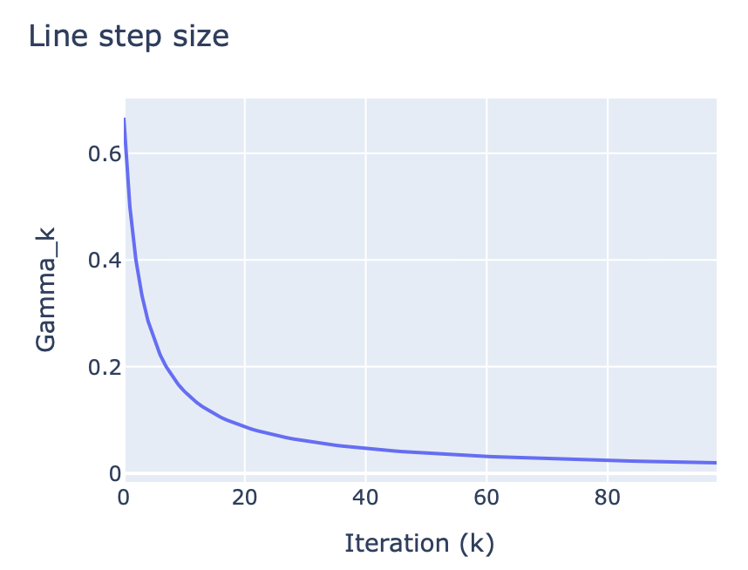
Line step size
$$γ_{k}=\frac{2}{k+2}$$
Straightforward and cheap to compute.
Slow convergence near optimum
No function adaptation

Slide 9
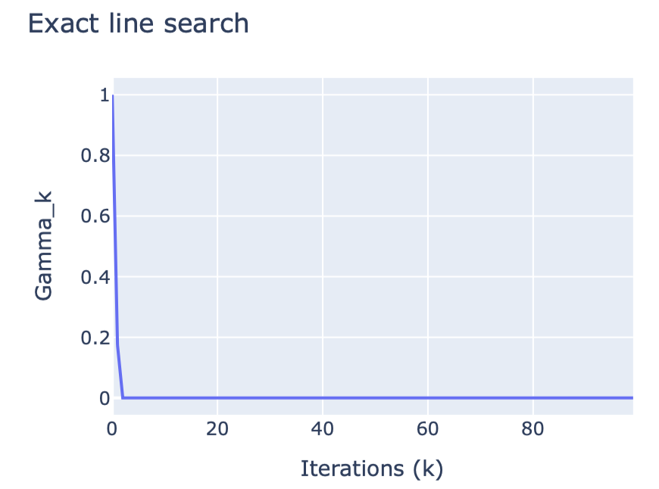
Exact line-search
$$γ_{k}=argminf((x_{k}+γ_{k}(s_{k}-x_{k}))$$
Ensures highest decrease per iteration
Costly optimization problem

Slide 10
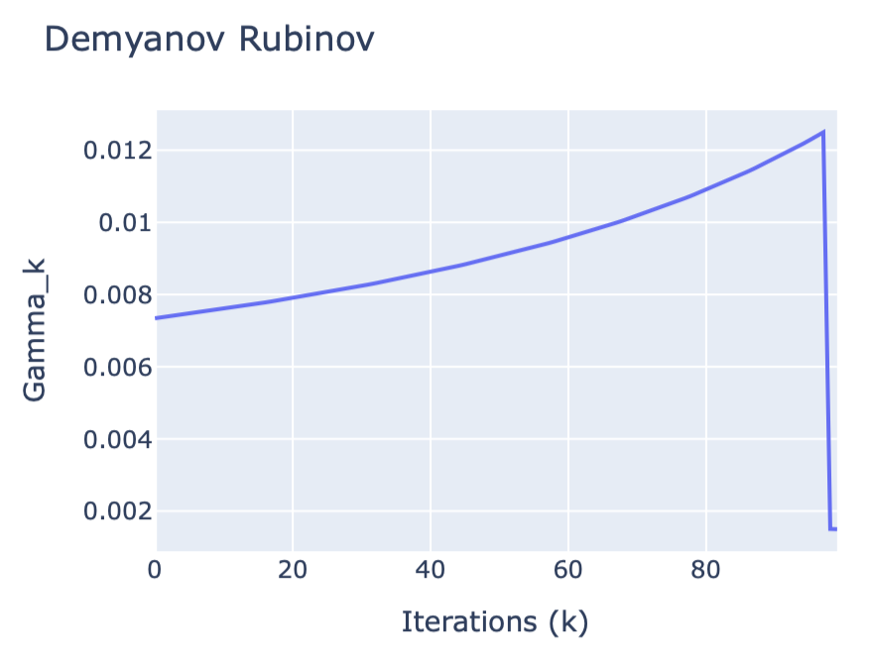
Demyanov-Rubinov
$$γ_{k}=min\{\frac{-∇f(x)^{T}(s_{k}-x_{k})}{L∥s_{k}-x_{k}∥^{2}},1\}$$
Goes to zero as we approach the optimum
Responsive for geometry of $f$
Require access to $L$
Unstable for small denominator (near optimum)

Slide 11
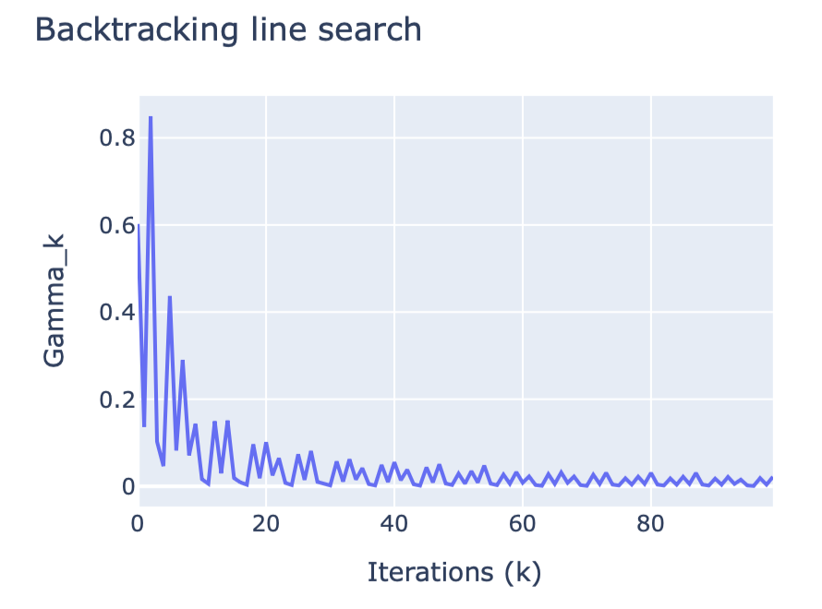
Backtracking line search
$$γ_{k}=min\{\frac{-∇f(x)^{T}(s_{k}-x_{k})}{M∥s_{k}-x_{k}∥^{2}},1\}$$
$M_{t}$ is approximation of $L$
Doesn’t require $L$
Adaptive and stable progress
Require multiple evaluation of $f$

Slide 12
Experiments

Slide 13
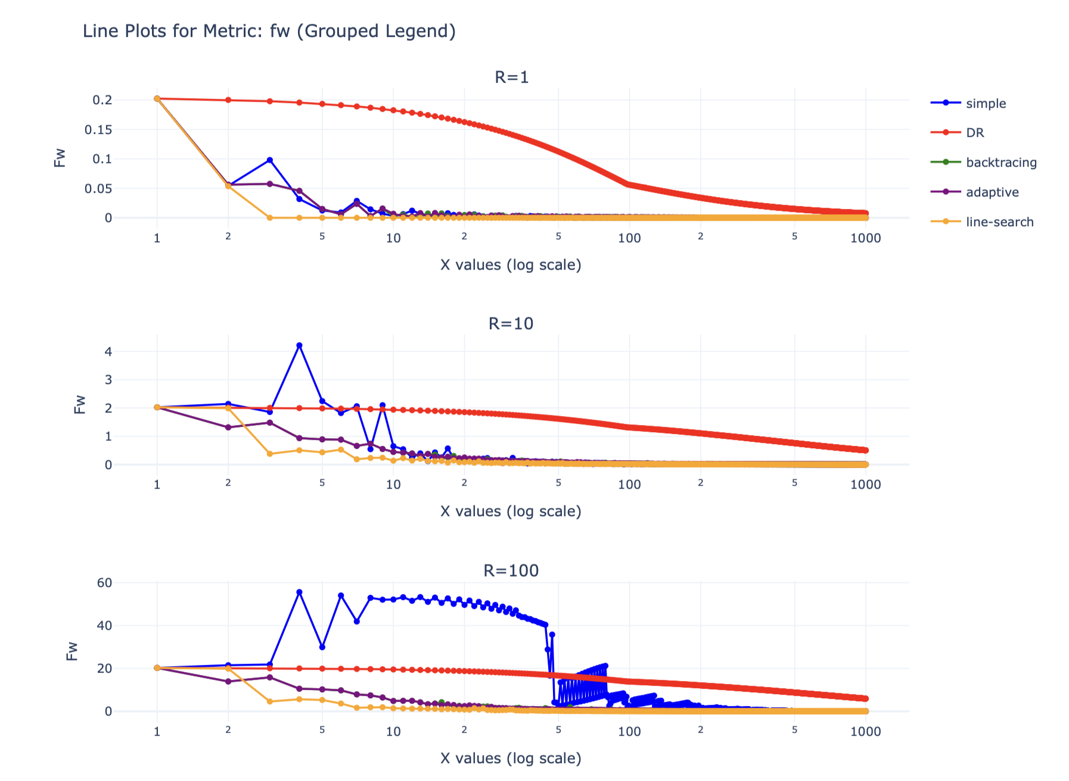
HW (Mushrooms)

Slide 14
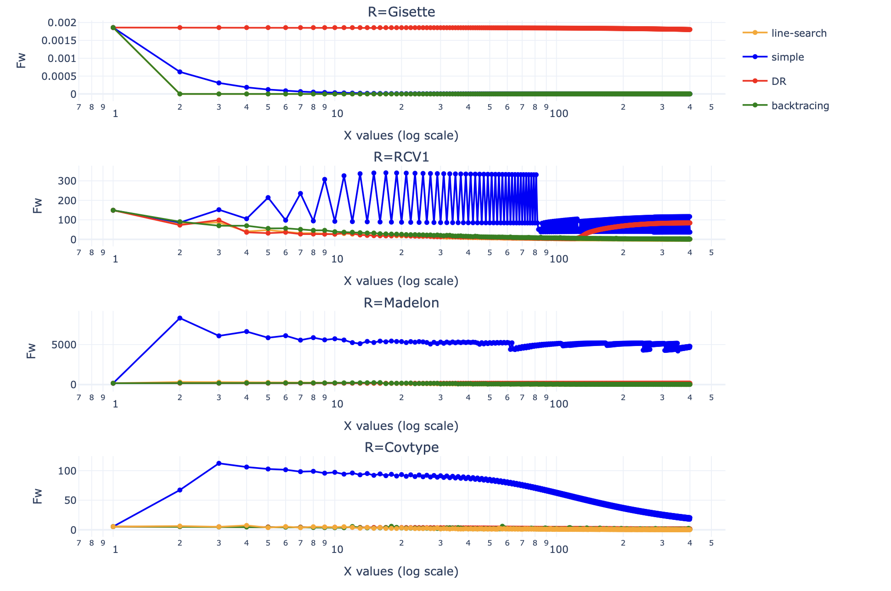
Benchmark
Gisette: Binary classification on 5000 features $R=6e^{-}3$
RCV1: Binary classification on 47236 features $R=2e^{4}$
Madelon: Binary classification on 500 features $R=20$
Covtype: Binary classification on 54 features $R=200$
Notes:
Gisette: The small radius R severely limits the feasible step size. DR and line-search methods fail to adapt to this constrained optimization region.
RCV1: The high dimensionality combined with a large R leads to instability in the simple step size. The erratic oscillations indicate that the gradient directions and feasible step sizes do not align well.
Madelon:
The moderate radius R allows for feasible progress, but simple step size cannot adapt to the curvature of the function. Line-search suffers because its fixed tolerance or numerical precision prevents fine-tuned steps.
Covtype: he smaller number of features and a larger feasible region R allow more flexibility for step sizes. Here, line-search and backtracking benefit from being able to explore better directions adaptively, while the simple step size is too conservative.

Slide 15
Performance
 | Simple | DR | Backtracking | Line-Search
Gisette | 1:16 5.24 it/s | 1:15 5.27 it/s | 1:49 3.66 it/s | 1:49 3.67 it/s
RCV1 | 1:43 3.87 it/s | 1:41 3.94 it/s | 2:25 2.75 it/s | 6:41 1 it/s
Madelon | 0:02 157.22 it/s | 0:02 159 it/s | 0:03 107 it/s | 0:11 35.84 it/s
Covtype | 0:21 18.84 it/s | 0:21 18.67 it/s | 0:30 13.02 it/s | 1:39 4.02 it/s

Slide 16
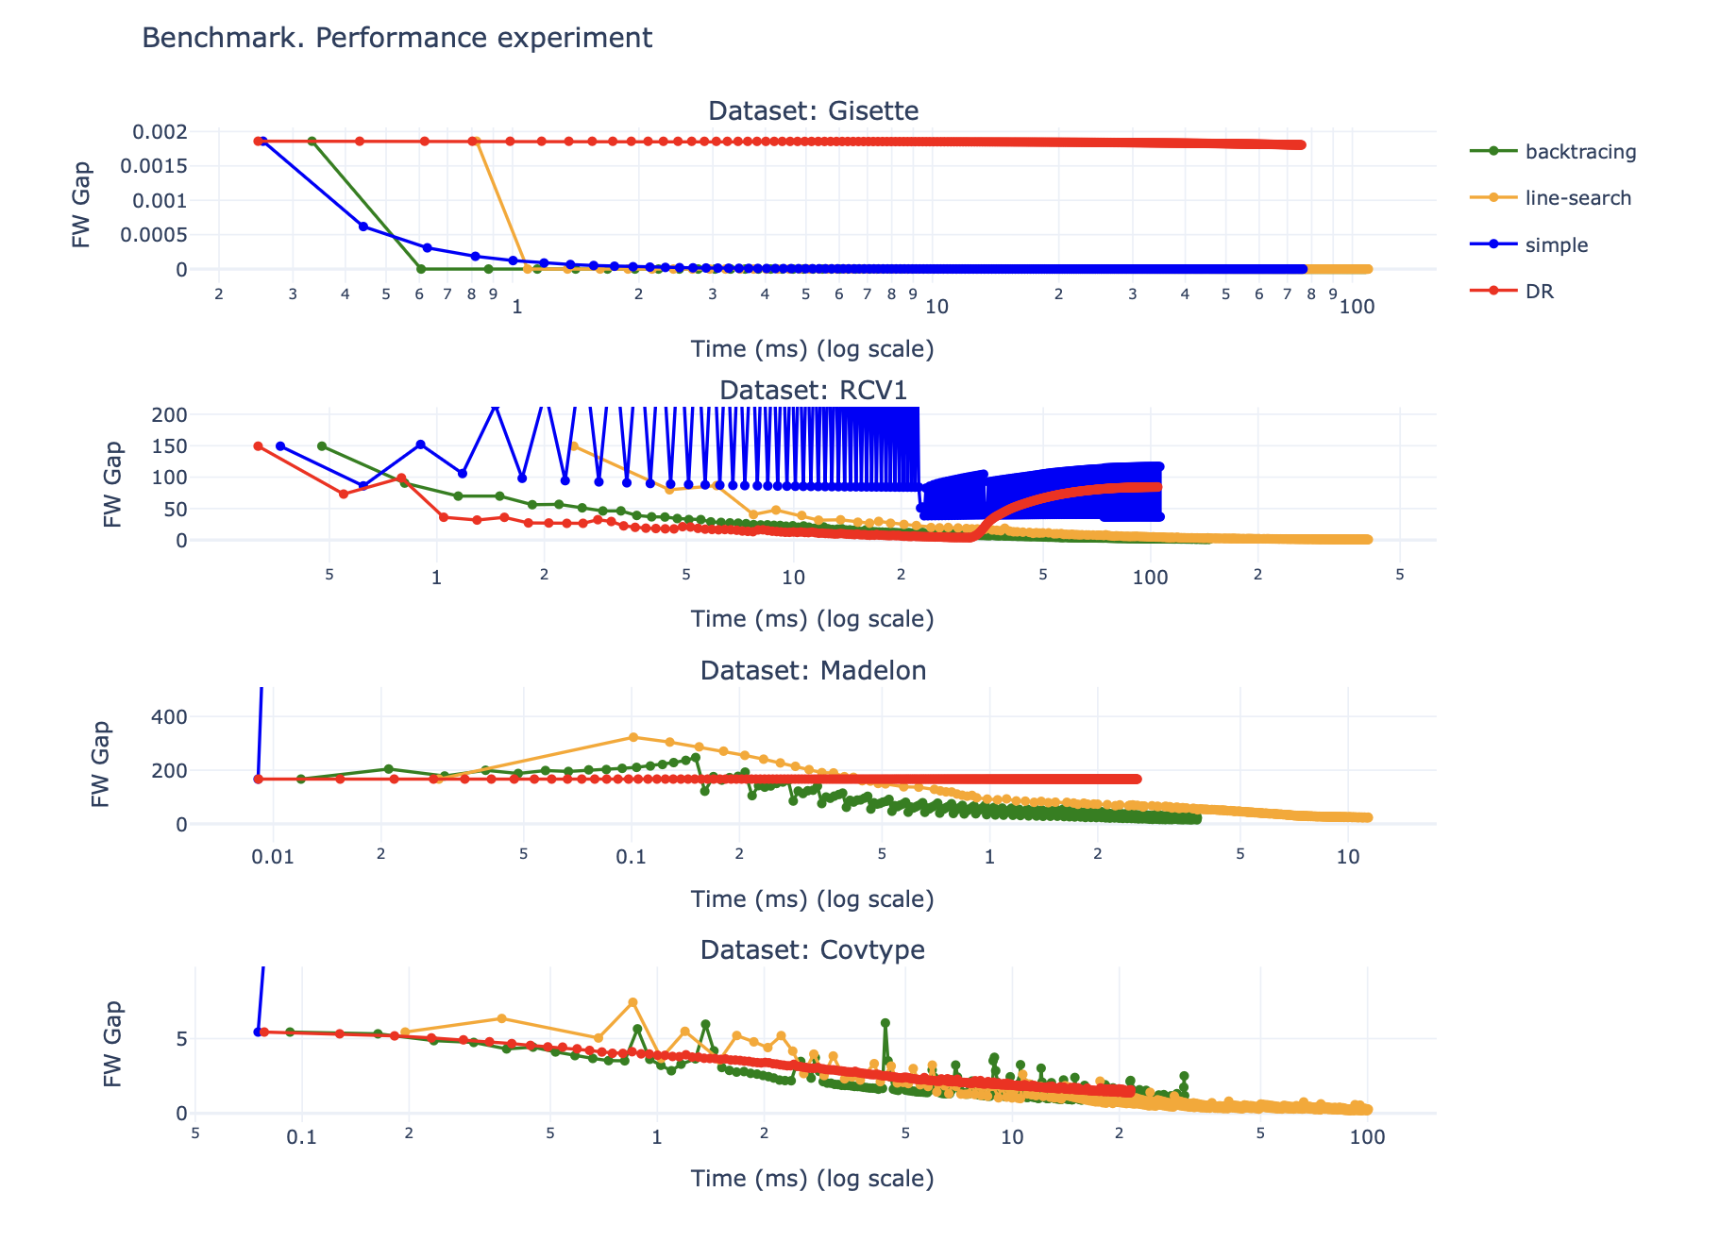

Slide 17
Results
Linear step: OK
Demyanov-Rubinov: Sucks
Backtracking: Best tradeoff
Line-Search: Best result at cost of high computations

Slide 18
References
https://fa.bianp.net/blog/2022/adaptive_fw/
https://proceedings.mlr.press/v206/wirth23a/wirth23a.pdf
https://www.researchgate.net/publication/259758847
https://arxiv.org/abs/2311.05313
https://arxiv.org/abs/2002.04756
https://arxiv.org/abs/1511.05932

Slide 19
Appendix

Slide 20
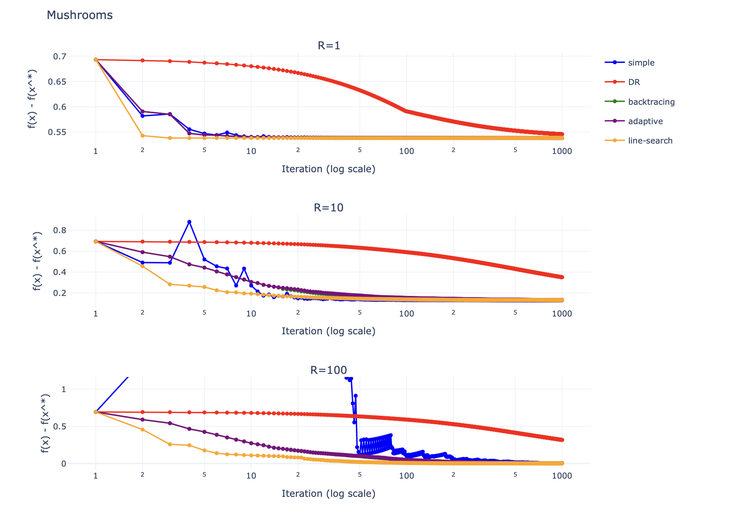

Slide 21
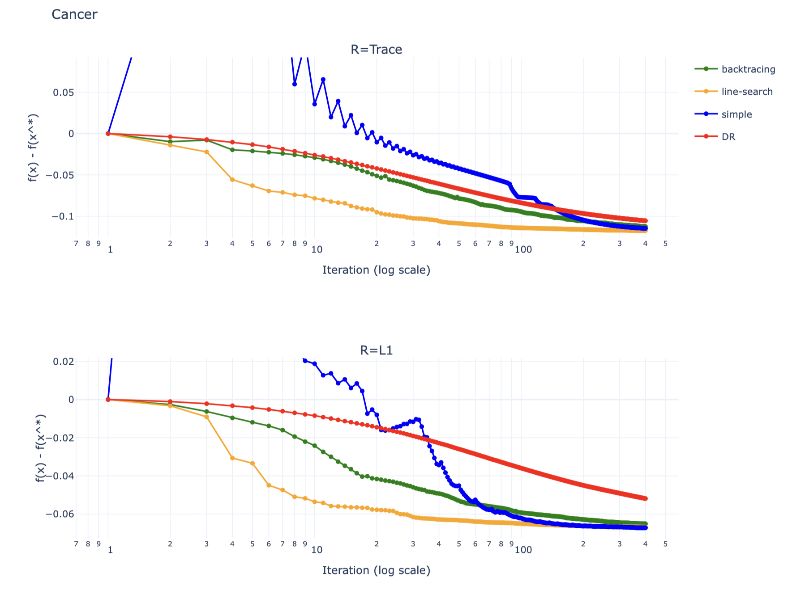

Slide 22
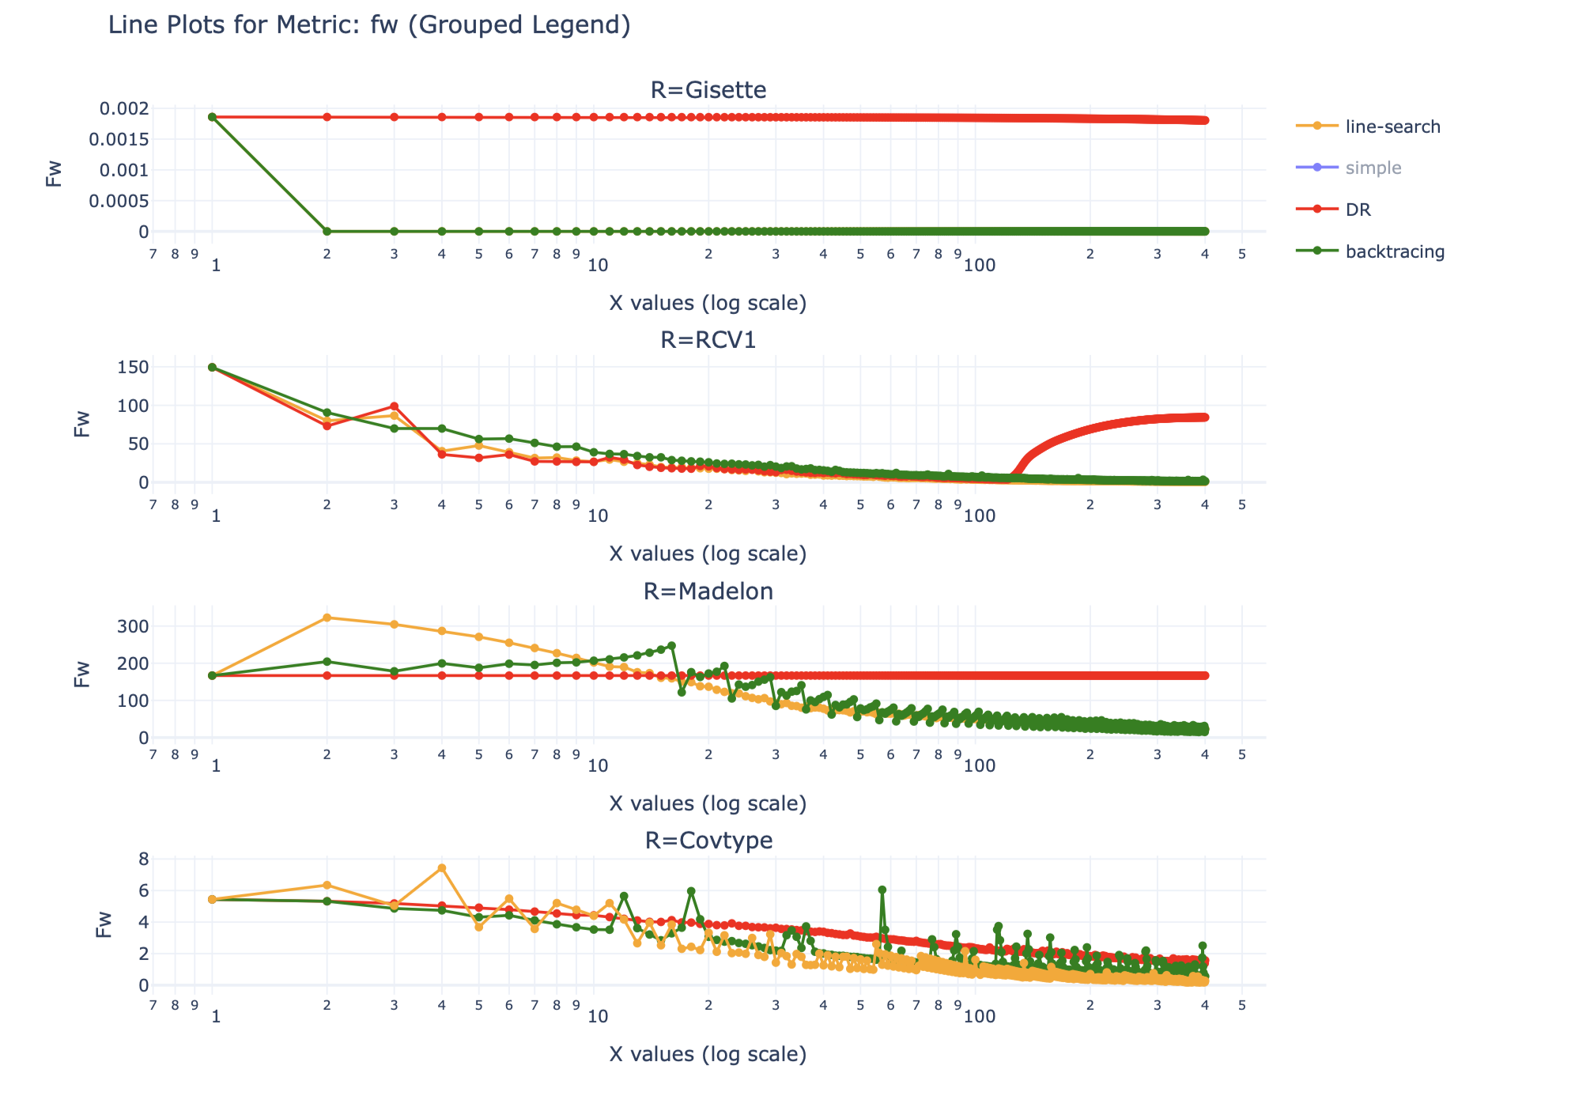

Slide 23
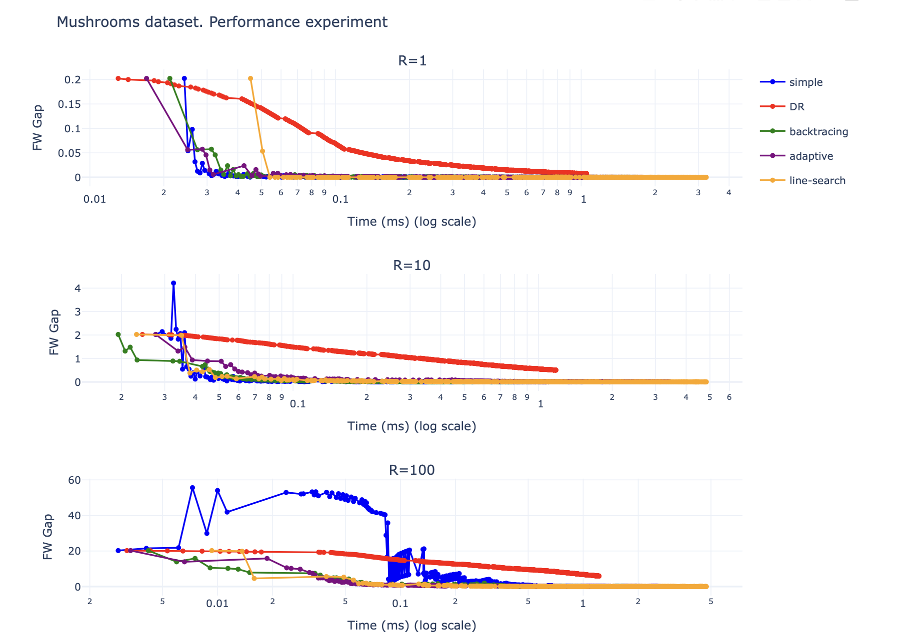

Slide 24
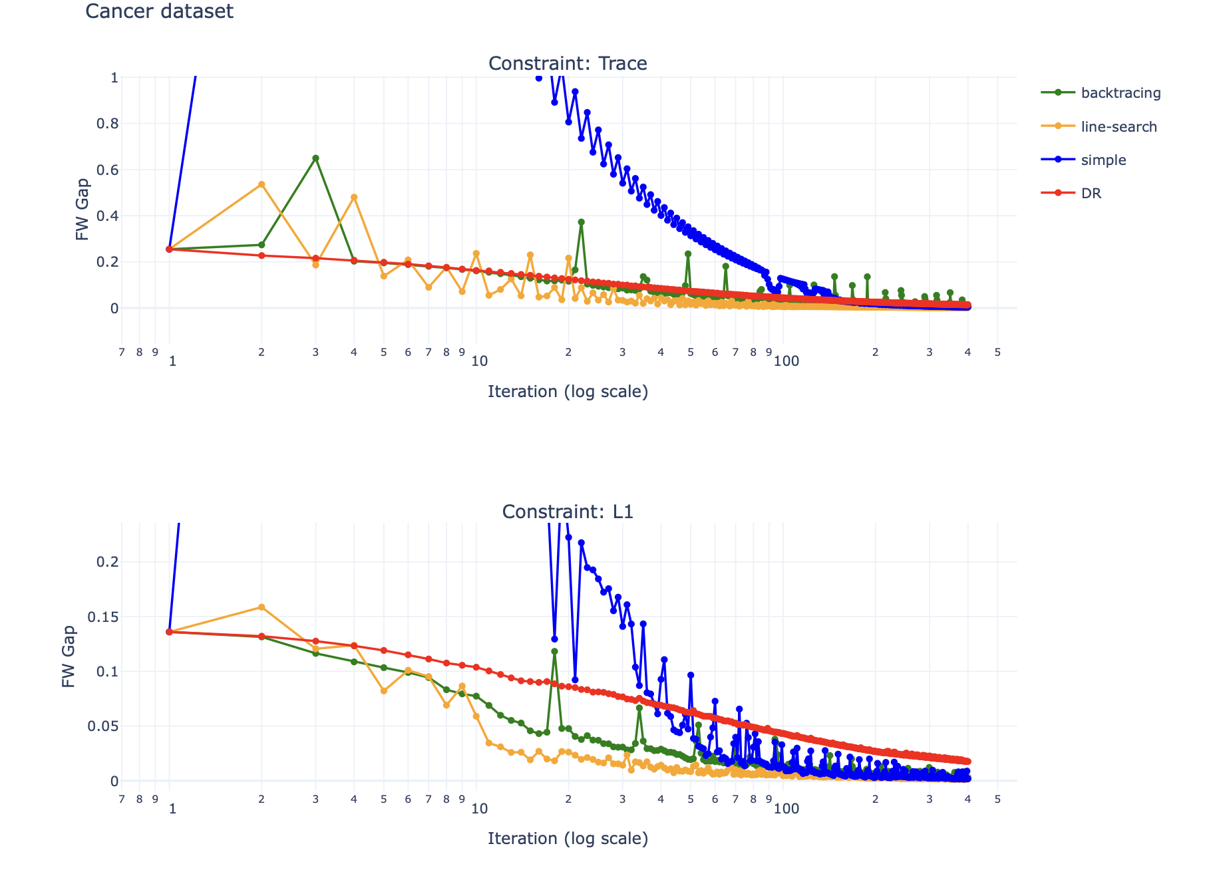
Cancer
Breast Cancer:

