Slide 1


Customer Segmentation for
BL04 and Bl01
A client segmentation model that identifies the behaviour of BL04 and BL01 from transactional data
- Advanced Analytics, March 2023

Slide 2
PRESENTATION OUTLINE
1:
Introduction
2:
Bank Customers Profile Comparison
4:
Executive Summary
5:
Clustering Approach
6:
Findings
7:
Recommendations
2

Slide 3
INTRODUCTION
Corporate & Institutional Banking is a branch of I&M that specializes in the management of company corporate customers (BL01 AND BL04) who are offered value added investment banking and cash management products
- The loans past due are grouped into three categories:0-30 days,30-79 days and greater than 80 days with the labels Late, Watch and defaulted (Non-Performing loans) respectively.
Data used for this analysis include:
- Demographics data
- Transactional data
- Loans data
- Revenue data
This analysis was undertaken to
- Identify the different customer segments inherent in the BL01 and BL04 customer base.
CIB
OBJECTIVE
ASSUMPTIONS
DATA
FINACLE / BUSINESS

Slide 4

BANK PROFILE COMPARISON
HIGH VALUE CUSTOMERS
MEDIUM VALUE CUSTOMERS
LOW VALUE CUSTOMERS
636 CUSTOMERS
TOTAL NUMBER
993 CUSTOMERS
TOTAL NUMBER
783 CUSTOMERS
KES 5,191,837,504
REVENUE VALUE
KES 2,627,140,862
KES 341,828,486
REVENUE VALUE
161 LOANS TAKEN OF TOTAL VALUE 27,984,024,827
144 LOANS TAKEN OF TOTAL VALUE 13,651,788,746
29 LOANS TAKEN OF TOTAL VALUE 1,304,639,042
LOANS TAKEN
LOANS TAKEN
131 LATE
16 WATCH
14 NPL
LOAN PERFOMANCE
87 LATE
17 WATCH
13 NPL
LOAN PERFOMANCE
23 LATE
7 WATCH
1 NPL

Slide 5
EXECUTIVE SUMMARY
This report presents a comprehensive analysis of the BL01 & BL04 corporate customer base, aiming to segment clients into distinct groups based on their financial behavior and relationship with the bank. By examining transactional, demographic, revenue, and loan data for the year 2022, we have identified three main clusters: High, Medium, and Low value customers.
High value customers represent the most financially active and loyal segment, with the longest average relationship with the bank (10 years) and the highest average transactional values for both credit and debit transactions. Although they comprise the smallest group with a total population of 636, they maintain the highest average monthly balance and account for the largest loan uptake in terms of total loan amount.
Medium value customers form the largest segment with a total population of 993. They exhibit moderate financial activity and maintain a relatively shorter average relationship with the bank (8.2 years). These customers have a significant presence in the bank's loan books and represent a substantial portion of the bank's revenue.
Low value customers, while accounting for a moderate share of the customer base with a total population of 783, demonstrate the least financial activity and have the shortest average relationship with the bank (6.9 years). They maintain the lowest average monthly balance and have the lowest loan uptake among the three groups
 | HIGH VALUE CUSTOMERS | MEDIUM VALUE CUSTOMERS | LOW VALUE CUSTOMERS
TOTAL POPULATION (COUNT) | 636 | 993 | 783
RELATIONSHIP WITH BANK (YRS) (AVG) | 10 | 8.2 | 6.9
COMPANY AVERAGE AGE (YRS) | 24 | 19.5 | 19.19
AVERAGE TRANSACTIONAL VALUE (CR) | Ksh 2,281,963,811 | Ksh 465,003,116 | Ksh 63,200,804
AVERAGE MONTHLY BALANCE | Ksh 8,681,393 | Ksh 2,318,157 | Ksh 1,357,368
AVERAGE TRANSACTIONAL VALUE (DR) | Ksh 2,323,522,982 | Ksh 482,992,269 | Ksh 53,706,147
LOAN UPTAKE (HAS LOANS) | 161 | 144 | 29
LOAN AMOUNT (IN ONE YEAR) | Ksh 27,984,024,827 | Ksh 13,651,788,746 | Ksh 1,304,639,042

Slide 6







CLUSTERING APPROACH
Identify BL01 & BL04 Bank Customers
Data Extraction from Finacle & EDW
(Demographics, Transactions, Revenue, Loans)
Data Cleaning and Exploratory Data Analysis
Feature Engineering
Preprocessing
- Scaling data
- Scoring and ranking
Machine learning model using Kmeans
Cluster profiling
And EDA
Variable Selection
(4 features selected)

Slide 7
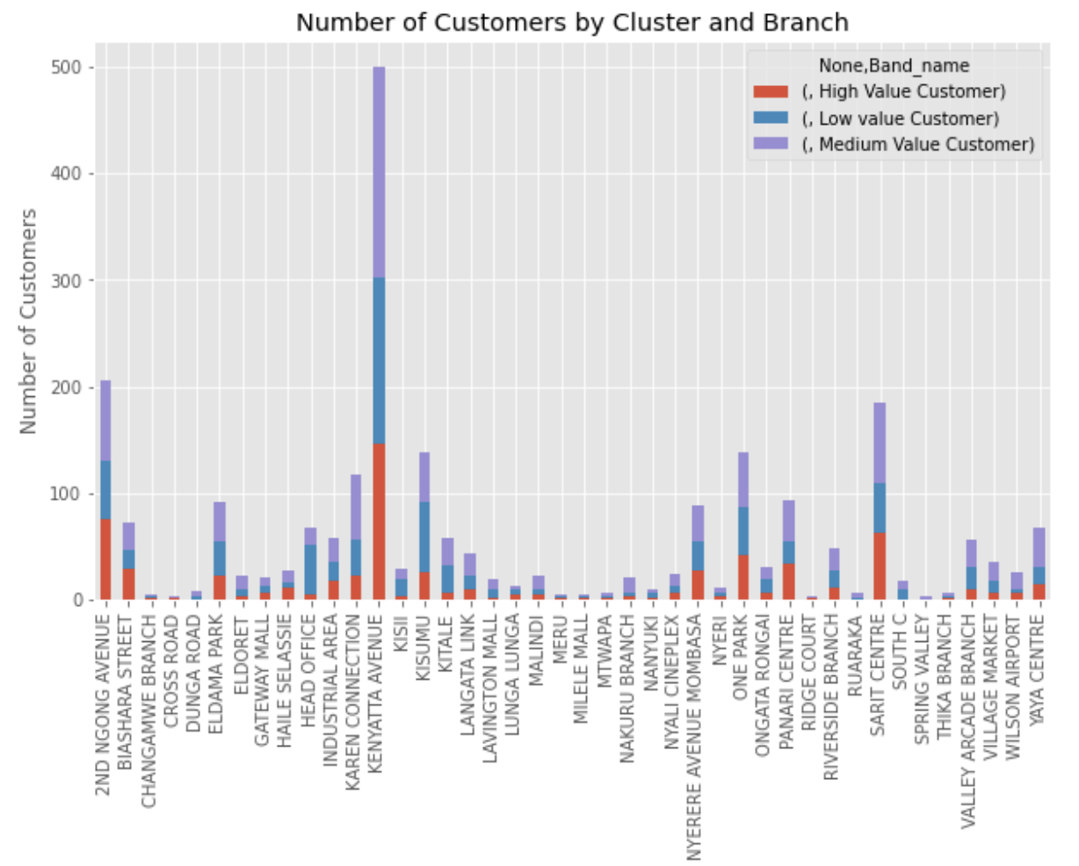

BRANCH COMPARISON
Deductions
Kenyatta Avenue has the highest number of customers .
It also has the highest number of High value and medium value customers followed by 2nd Ngong Avenue.

Slide 8
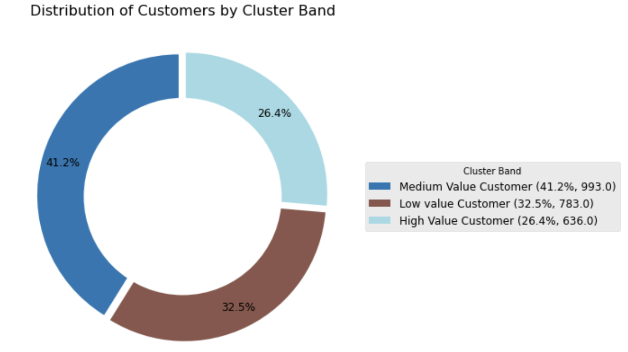
CLUSTER DISTRIBUTION

Slide 9
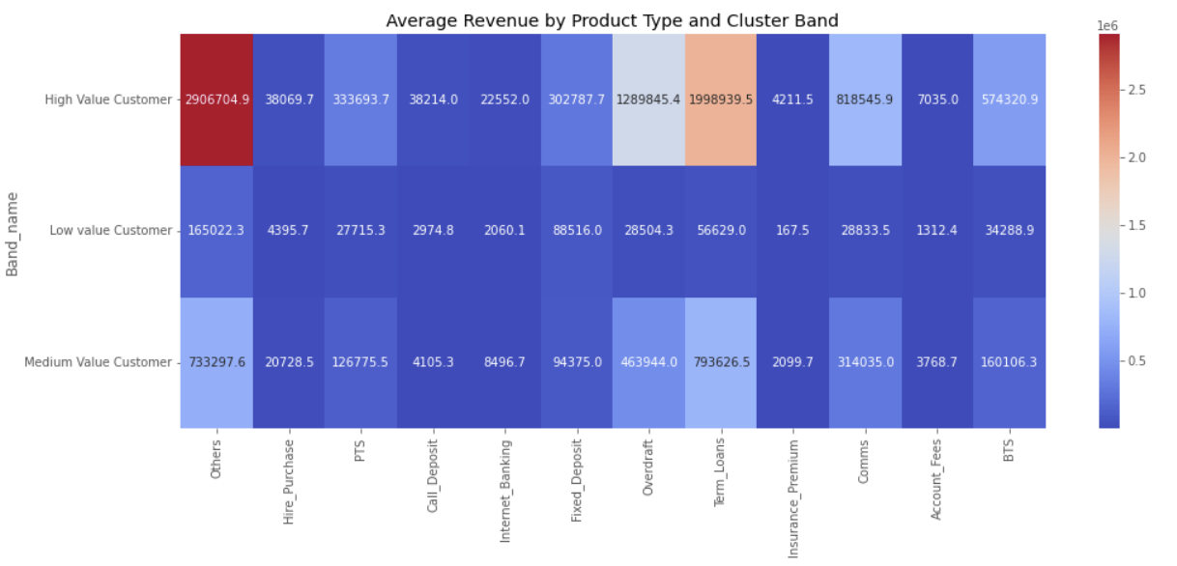
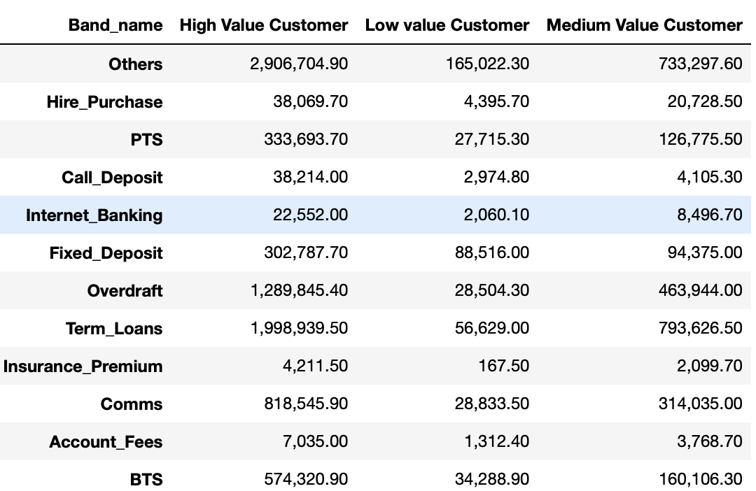
REVENUE DISTRIBUTION PER PRODUCT
Deductions
High Value Customers contribute significantly to the bank's revenue across various products, while Medium Value Customers present opportunities for growth. Low Value Customers demonstrate limited engagement
High Value Customers generate the highest revenue across the combination of other products (Ksh 2,906,704.90)

Slide 10
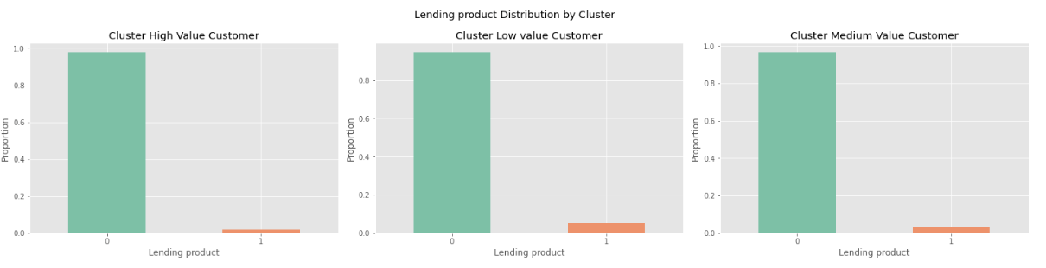
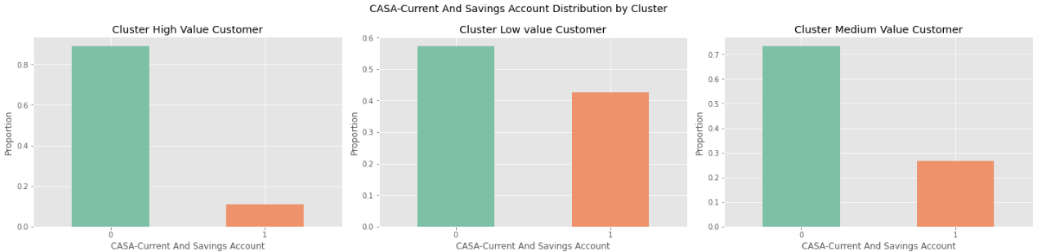
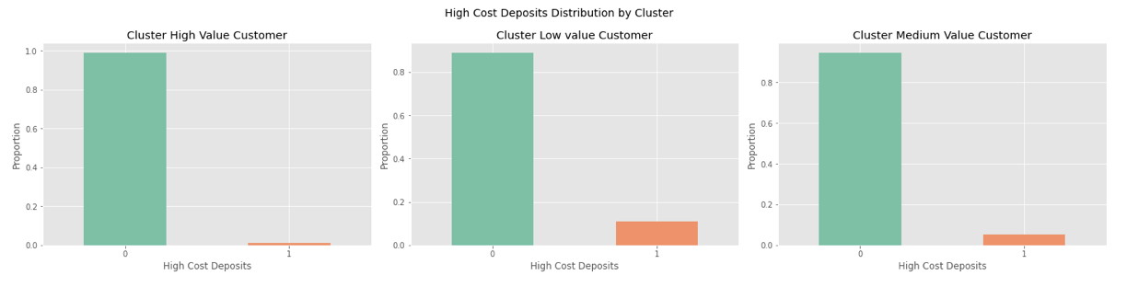
PRODUCT USAGE BY CLUSTER
Deductions
High Value Customers have lower engagement with Lending products, CASA (Current and Savings Account), and High-Cost Deposits compared to Medium and Low Value Customers

Slide 11
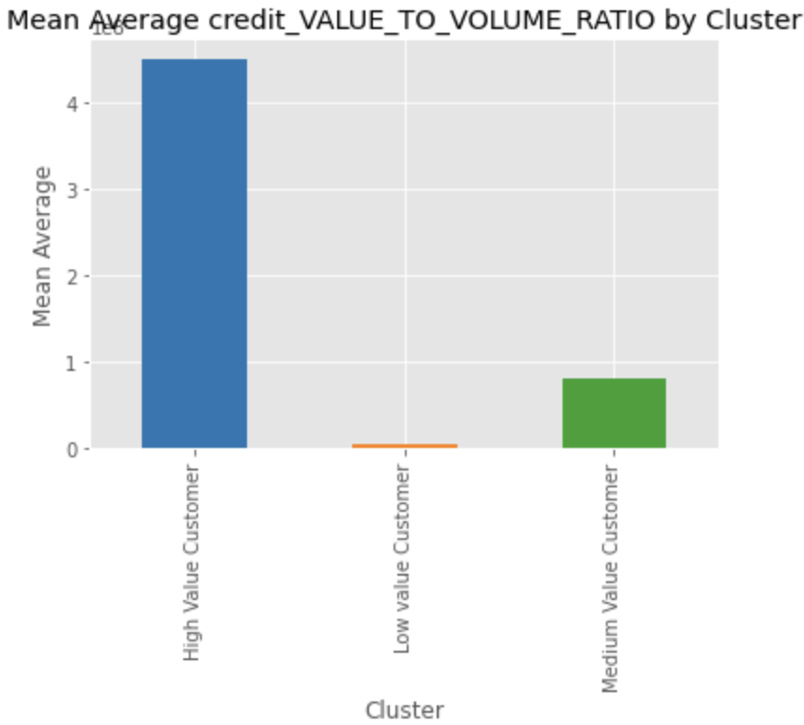
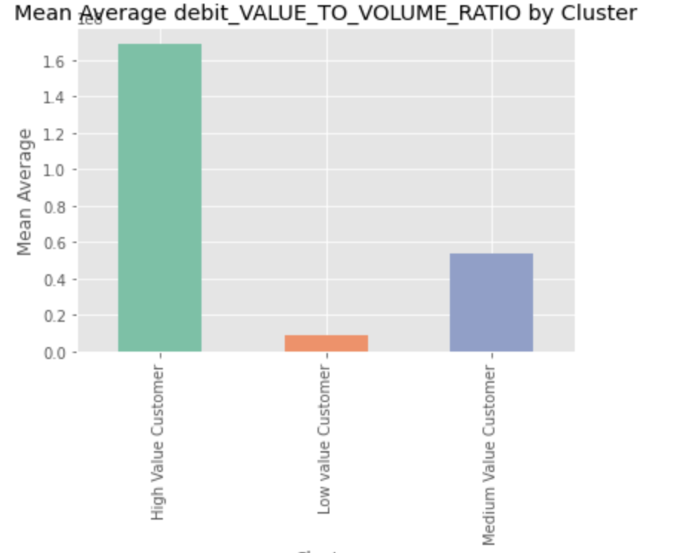
CREDIT/DEBIT VALUE PER CLUSTER
Deductions
The High Value Customer segment seems to be having the highest credit value to volume ratio as well as average debit value to volume ratio, the medium have higher average debit value to volume ratio than credit value to volume ratio. This means that the High Value Customer segment deposits the largest value in the shortest time compared to the other clusters
*units of chart -Millions

Slide 12
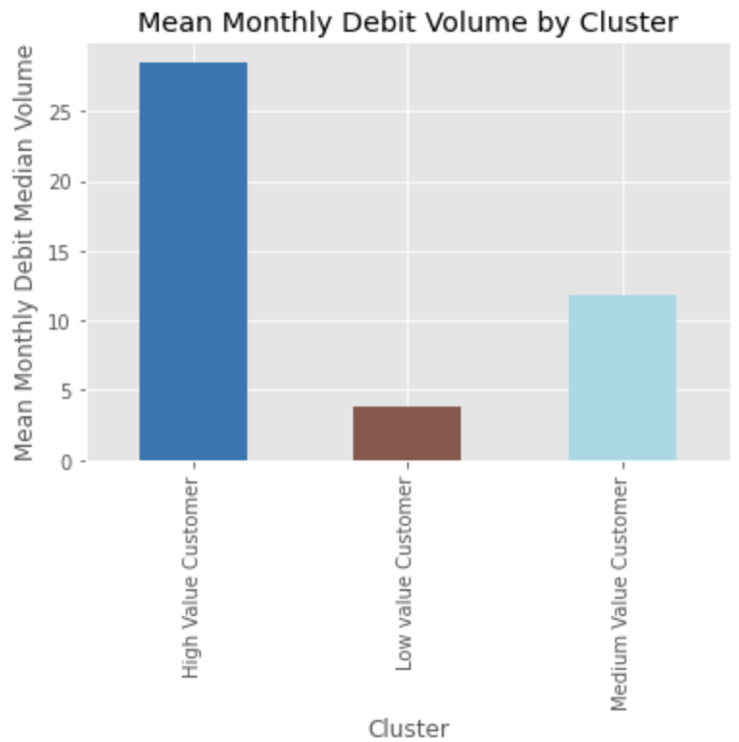
DEBIT VOLUME PER CLUSTER
Deductions
Higher transacting segments are considered more sticky as more transactions indicate significant account activities. As seen in the chart, High Valued Customer segment also tops this area. This further validates the need for sticky products across all segments.

Slide 13
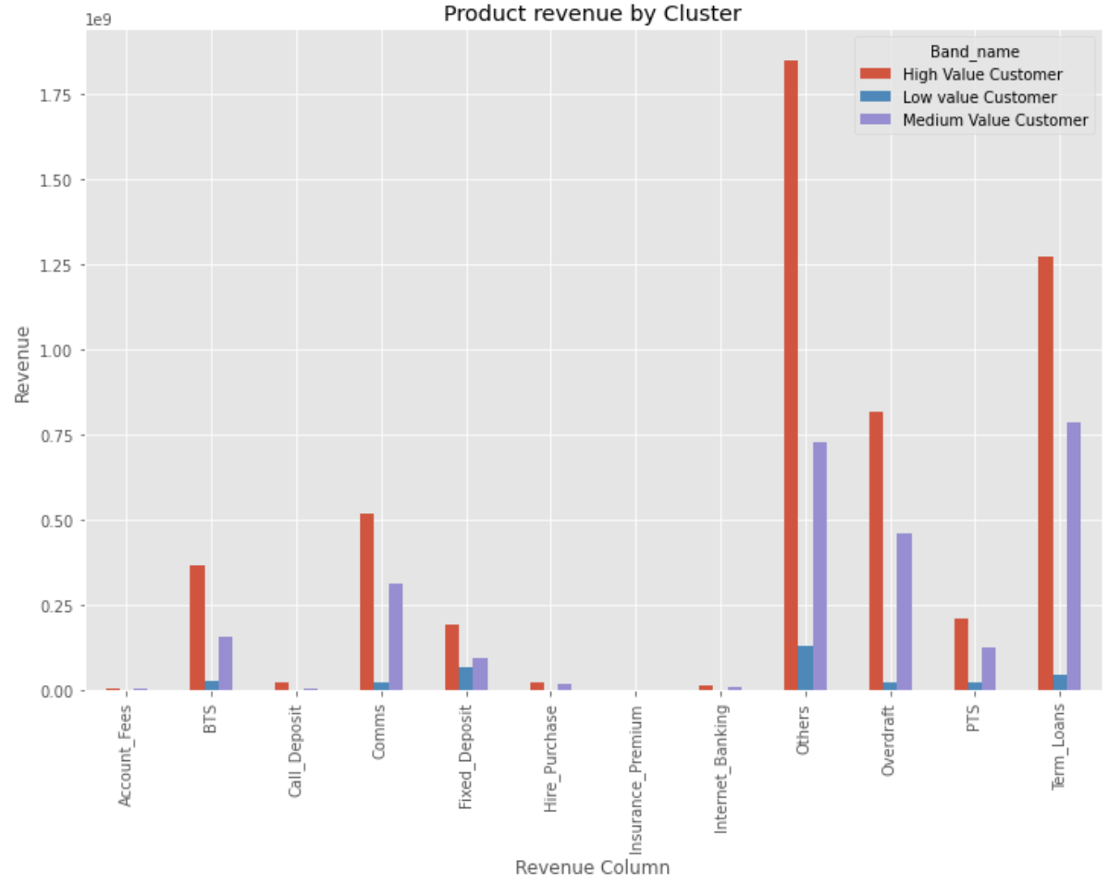
REVENUE PER PRODUCT PER CLUSTER
*units-billions
Deductions
High Value Customers contribute the most revenue across all product categories, with the highest revenues in Others, Term Loans, and Comms. Medium Value Customers follow, generating notable revenue in Others, Term Loans, and Comms as well, albeit at lower levels than High Value Customers. Low Value Customers contribute the least revenue across all product categories, with their highest revenues in Others, Fixed Deposit, and BTS. This highlights the importance of High Value Customers as the main revenue drivers for the bank with significant revenue being seen in term loans.

Slide 14
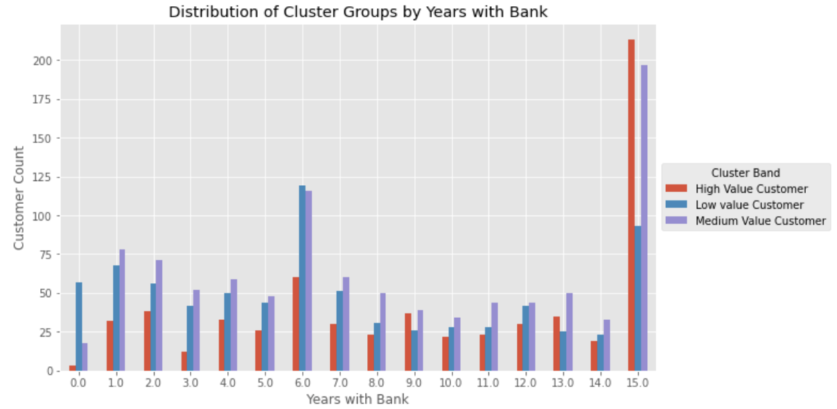
STRENGTH OF RELATIONSHIP WITH BANK PER CLUSTER
Deductions
The High Value Customer segment have stayed longest with the bank with an average of 10 years being with the bank. This behavior explains profitability tied to loyalty and stickiness.

Slide 15
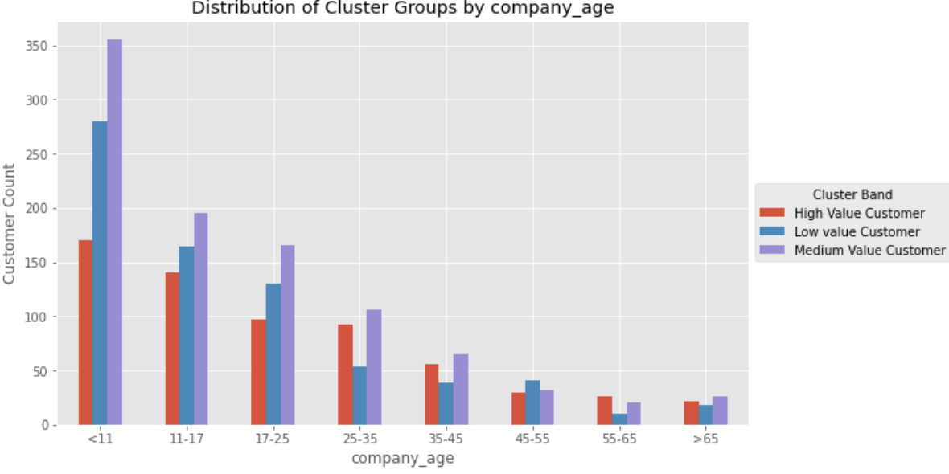
COMPANY AGE PER CLUSTER
Deductions
The High Value Customer segment have also been in business longer than other segments with an average of 24 years being in business.

Slide 16
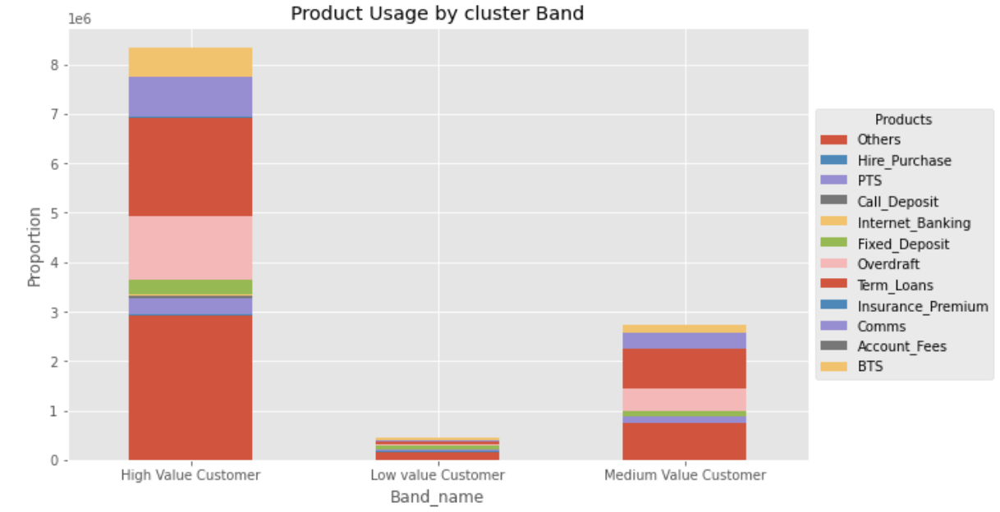
REVENUE DISTRIBUTION PER PRODUCT
Deductions
Although, the High Value Customer segment has the least number of customers, they seem to dominate in the revenue per product category. The low value customers seem to generate the least revenue across all products within CIB. It is recommended that sticky products will drive more loyal behaviour/ transactional activity within the respective segments. Some product recommendations for Low Value Customer segment are: - Fixed Deposit
- Overdraft

Slide 17
RECOMMENDATIONS
1
Increase Loan Uptake
Push loan products to more High Value customers as they have demonstrated capability for repayment.
RECOMMENDATIONS
More sticky products should be pushed to the Low Value Customer segment. Products like Fixed Deposit and Overdraft should be considered for this cluster of customers.
2
Product Offerings
Furthermore, there is a demonstration to handle more products seen within the High and Medium Value segments, it is recommended to push CASA to these customers as they seem to record a low volume compared to Low Value Customers.
Create a stand-alone model to identify customers within CIB that have the propensity to be High Value Customers
Leverage alternative/additional data e.g., Interactions, digital channel usage for more robust analysis
FUTURE CONSIDERATIONS

Slide 18
Thank you
I&M is regulated by the Central Bank of Kenya

