Slide 1
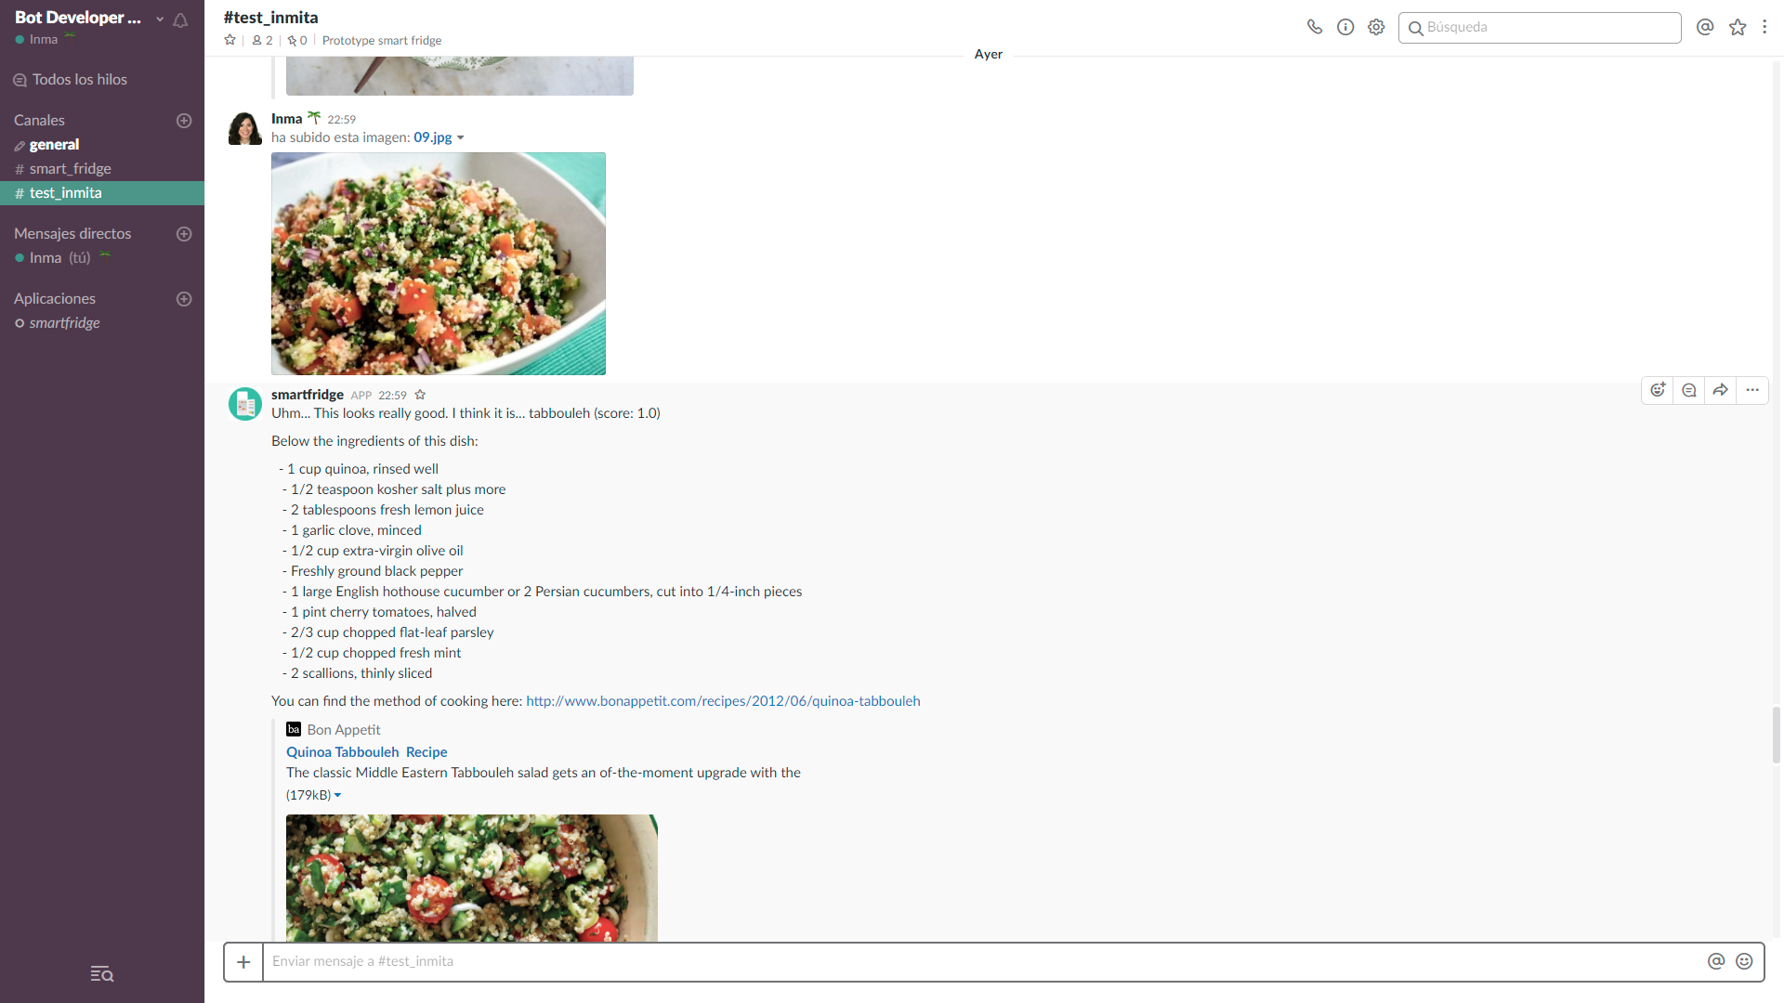

Slide 2











ORCHESTRATION
ENGINE
Visual
recognition
Conversation
Users
Slack
Information sources
Recipe service

Slide 3


IBM WATSON SERVICES
ORCHESTRATION
ENGINE
USERS
USER INTERFACE
Visual recognition
Slack
Conversation
DATA SOURCES
Recipe service
Databases

Slide 4


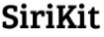
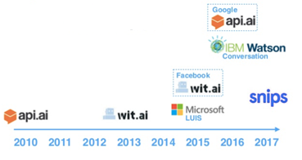



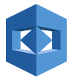
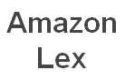







Conversation
LUIS
Facebook
Google
2010
2011
2012
2013
2014
2015
2016
2017

Slide 5
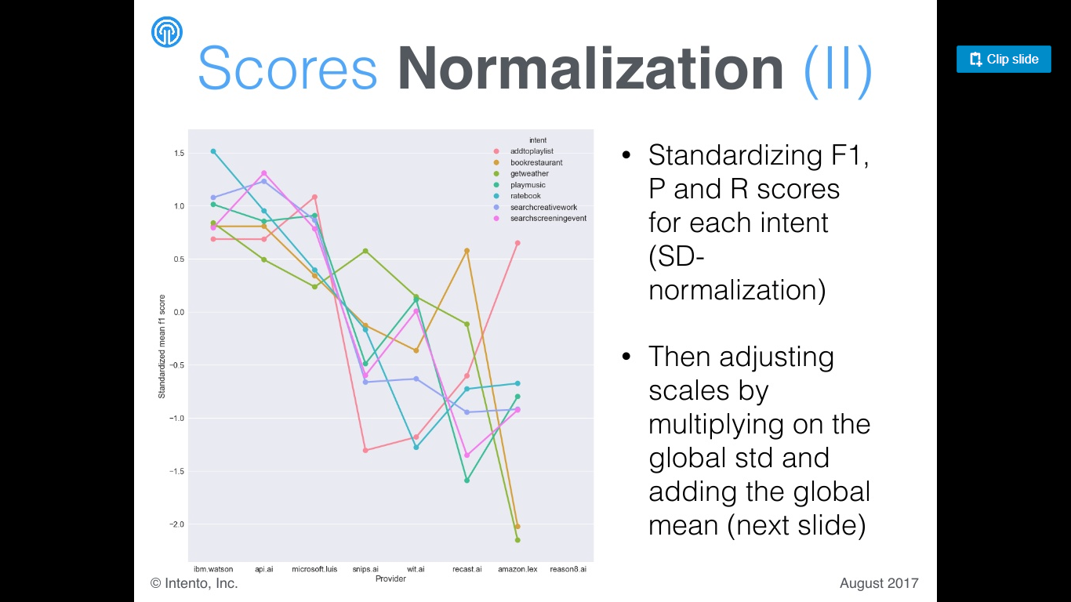
WATSON
API.ai
LUIS
WIT.ai
LEX

Slide 6
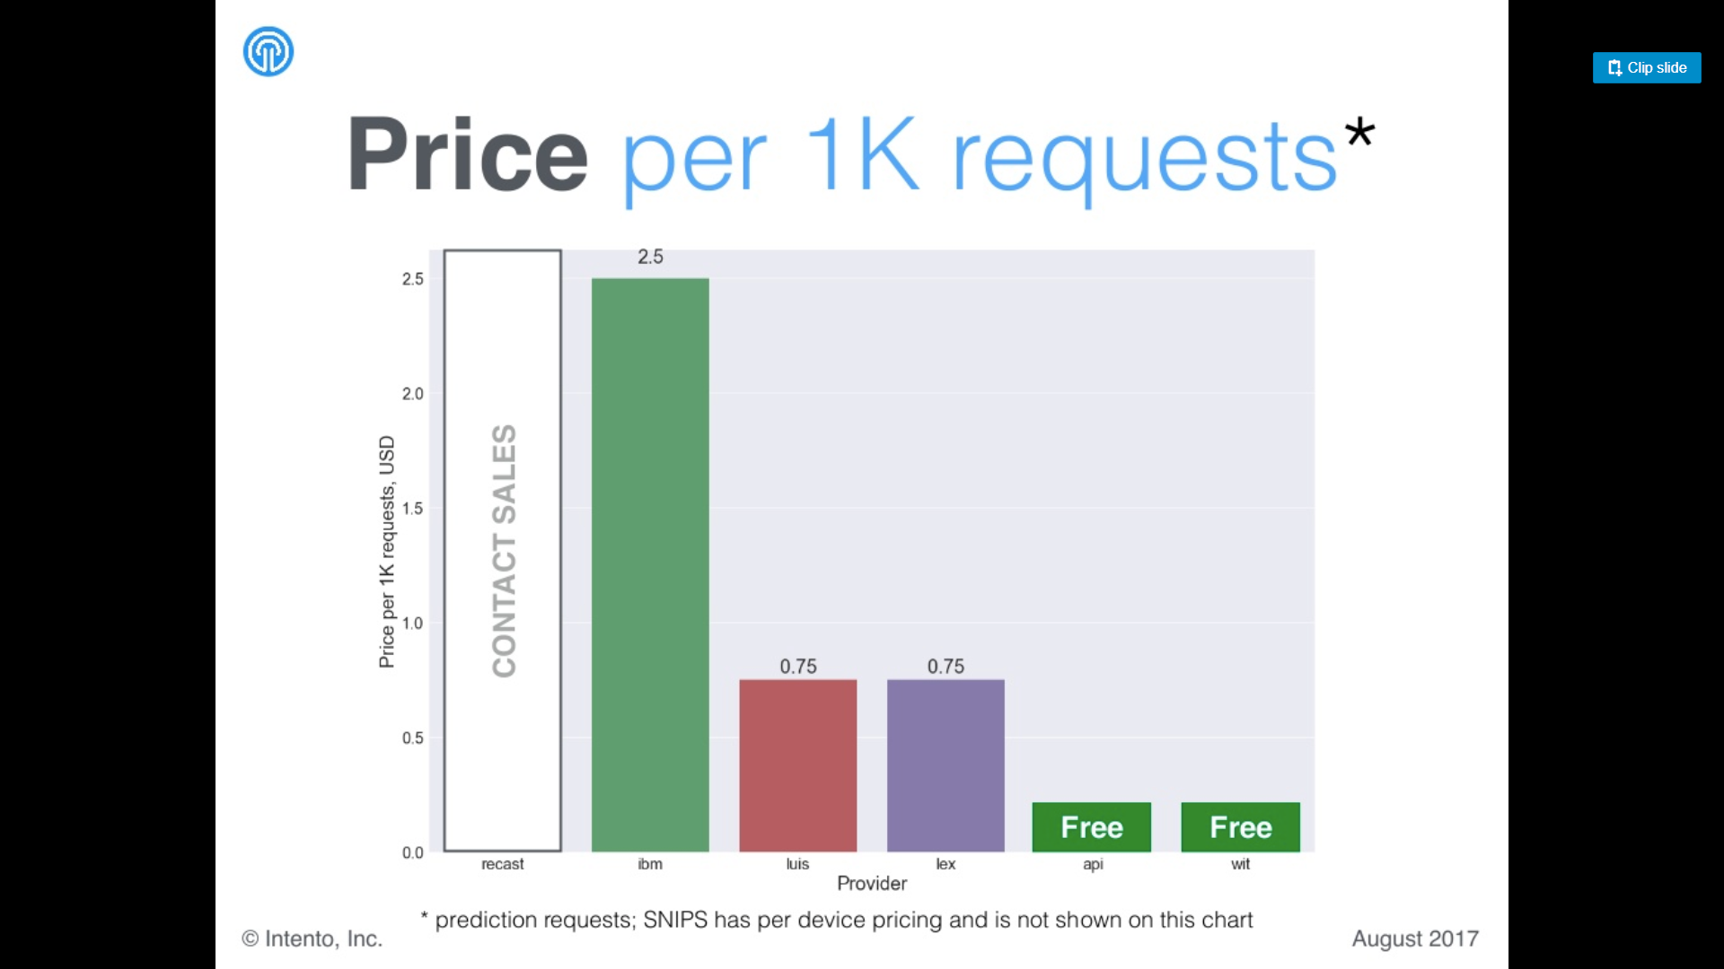
2,5 USD
0,63 USD
0,75 USD
WATSON
LUIS
LEX
API
WIT

Slide 7
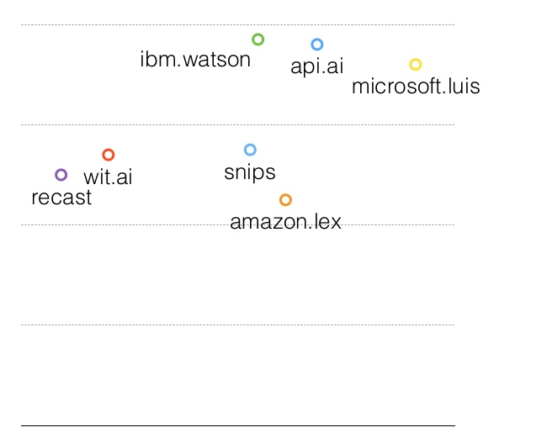
Rendimiento
Velocidad = 1/Latencia

Slide 8
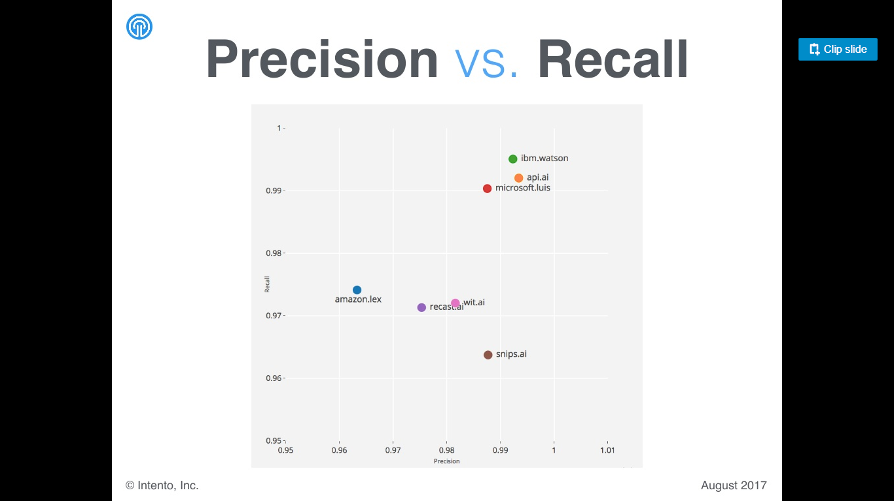
Sensibilidad
wit.ai
Precisión

Slide 9
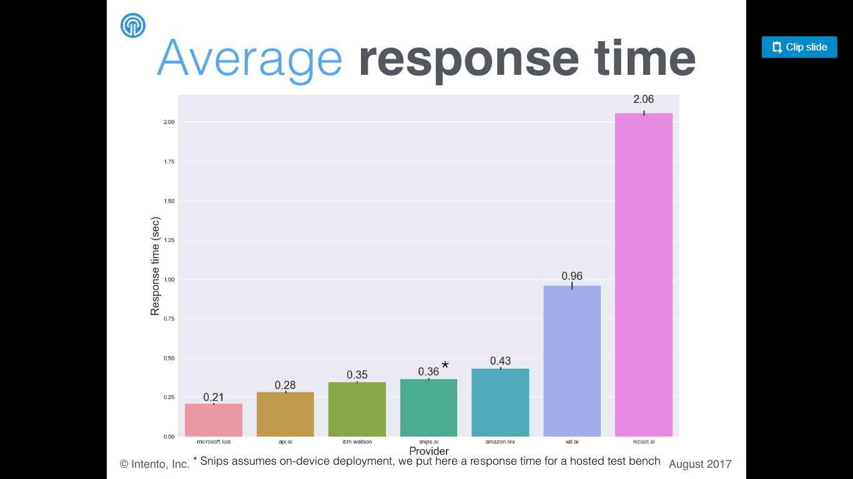
Tiempo de respuesta (sec)
LUIS
API.ai
WATSON
LEX
WIT

Slide 10
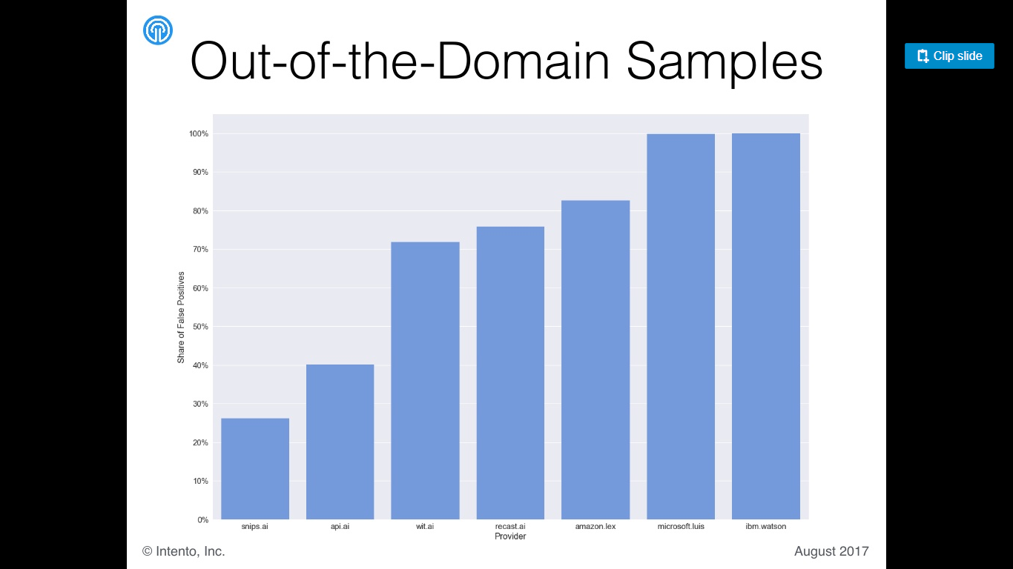
Falsos positivos
API.ai
WIT
LEX
LUIS
WATSON

Slide 11
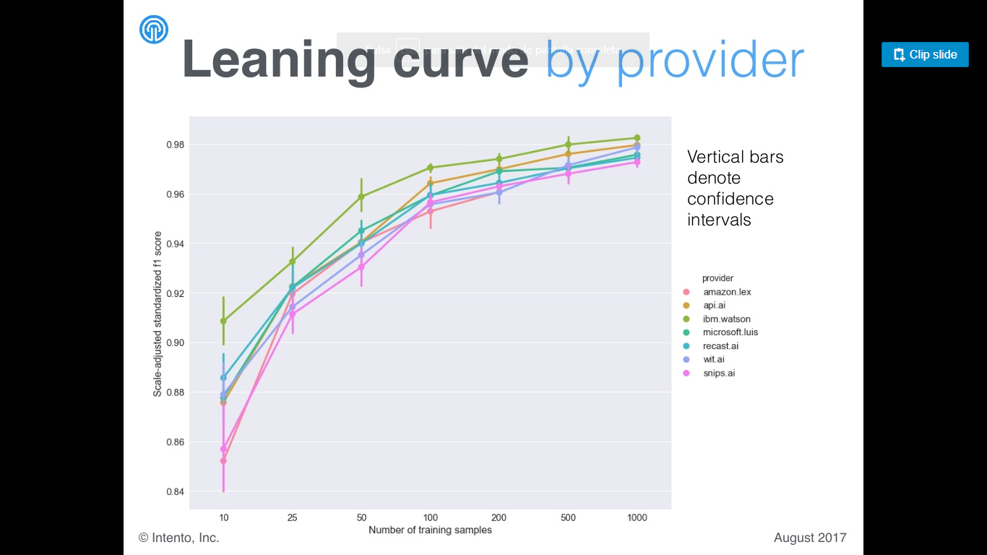
F1 score estandarizado
Número de muestras de aprendizaje

Slide 12
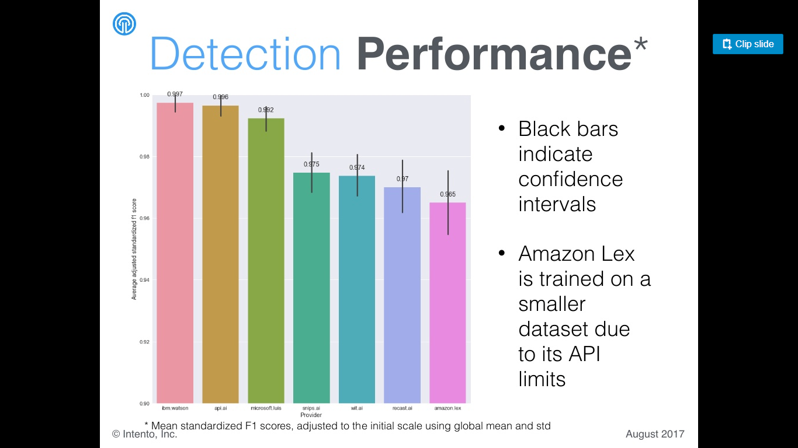
Media F1 score estandarizado
WATSON
API.ai
LUIS
WIT
LEX

Slide 13

CHECK
@DISH
Yes
Yes
( $dish)
SEARCH
RECIPE
RESPONSE
CHECK
#GET_RECIPE
START
Yes
No / Unknown
CHECK
$IMAGE
FILE
RECIPE SERVICES
Yes
Yes
( $image_file )
IMAGE
RECOGNITION
No / Unknown
ASK FOR
@DISH
OR
IMAGE FILE
IBM WATSON SERVICES
Visual recognition

Slide 14
CHECK
@CUISINE_TYPE
Yes
Yes
( $cuisine_type)
CHECK
#SUGEST_DISH
START
Yes
No / Unknown
( $yum_sugest=TRUE
$cuisine_type
$ingredients
$intolerances )
CHECK
@INTOLERANCES
CHECK
@INGREDIENTS
Yes
SEARCH
DISHES
Yes
( $ingredients)
Yes / No
No / Unknown
Unknown
RECIPE SERVICES
SHOW
OPTIONS
FIRST
TIME
YUM YUM
SUGEST
ASK FOR
@INTOLERANCES
No
( $yum_sugest)
Yes
CHECK
OPTIONS
Unknown
Yes / No
SEARCH
RECIPE
RESPONSE
ASK FOR
@CUISINE_TYPE
OR
INGREDIENTS
DATABASE

Slide 15
CHECK
#AVAILABLE_
INGREDIENTS
START
Yes
FETCH CONTENT
ANALIZE CONTENT
RESPONSE
DATABASE

Slide 16
#get_recipe
#interface
#negative_
reactions
#sugest_
dish
#greetings
#capabilities
#goodbyes
START
#positive_
reactions
END
#about_
yumyum
#available_
ingredients
#not_
specified
Yes
FETCH CONTENT

Slide 17
IBM WATSON SERVICES
RECIPE SERVICES
Visual recognition
CHECK
#GET_RECIPE
CHECK
$IMAGE
FILE
START
IMAGE
RECOGNITION
SEARCH
RECIPE
RESPONSE
Yes
Yes
( $image_file )
No / Unknown
CHECK
@DISH
Yes
( $dish)
No / Unknown
Yes
( $yum_sugest)
COUNTER < = 3
ASK FOR
@DISH
OR
IMAGE FILE
No
YUM YUM
SUGEST
DATABASE

Slide 18
V2
CHECK
#SUGEST_DISH
START
CHECK
@CUISINE_TYPE
Yes
Yes
RECIPE SERVICES
$yum_sugest= False
$sugest_dish = False
$cuisine_type = None
$ingredients = None
$intolerances = None
$cuisine_type
No / Unknown
CHECK
@INGREDIENTS
CHECK
@INTOLERANCES
Yes
Yes / No
SEARCH
RECIPE
RESPONSE
$ingredients
$intolerances
$sugest_dish = True
Unknown
ASK FOR
@INTOLERANCES
No / Unknown
FIRST
TIME
No
YUM YUM
SUGEST
$yum_sugest =TRUE
Yes
ORCHESTRATION ENGINE
ASK FOR
@CUISINE_TYPE
OR
INGREDIENTS
DATABASE
WATSON CONVERSATION

Slide 19
V2
IBM WATSON SERVICES
RECIPE SERVICES
Visual recognition
$yum_sugest = false
$image_recipe = false
$search_recipe=false
$dish= null
$counter= 0
CHECK
#GET_RECIPE
CHECK
$IMAGE
FILE
START
IMAGE
RECOGNITION
SEARCH
RECIPE
RESPONSE
Yes
Yes
$image_recipe=true
No / Unknown
CHECK
@DISH
Yes
$dish
$search_recipe=true
No / Unknown
Yes
COUNTER < = 3
ASK FOR
@DISH
OR
IMAGE FILE
No
YUM YUM
SUGEST
$yum_sugest=True
WATSON CONVERSATION
ORCHESTRATION ENGINE
DATABASE

Slide 20
ULTIMA
VERSIÓN

Slide 21
V2
IBM WATSON SERVICES
RECIPE SERVICES
Visual recognition
$yum_sugest = False
$image_recipe = False
$search_recipe = False
$dish= None
$counter= 0
CHECK
#GET_RECIPE
CHECK
$IMAGE_RECIPE
START
IMAGE
RECOGNITION
SEARCH
RECIPE
RESPONSE
Yes
True
$image_recipe=True
False / Unknown
CHECK
@DISH
! None
$dish
$search_recipe=true
None / Unknown
Yes
COUNTER < = 3
ASK FOR
@DISH
OR
IMAGE FILE
No
YUM YUM
SUGEST
$yum_sugest=True
WATSON CONVERSATION
ORCHESTRATION ENGINE
DATABASE

Slide 22
V3
CHECK
#SUGEST_DISH
RECIPE SERVICES
START
CHECK
@CUISINE_TYPE
Yes
! None
$yum_sugest= False
$suggest_dish = False
$cuisine_type = None
$ingredients = None
$intolerances = None
$cuisine_type
None / Unknown
CHECK
@INTOLERANCES
CHECK
@INGREDIENTS
! None
Yes / No
SUGGEST
A
RECIPE
RESPONSE
$ingredients
$intolerances
$suggest_dish = True
Unknown
None / Unknown
ASK FOR
@INTOLERANCES
FIRST
TIME
No
YUM YUM
SUGEST
DATABASE
$yum_sugest =True
Yes
CHECK
@RESPONSE_
TYPE
Negative / Uncertain / Unknown
$yum_sugest =True
ORCHESTRATION ENGINE
Positive
ASK FOR
@CUISINE_TYPE
OR
INGREDIENTS
WATSON CONVERSATION

Slide 23
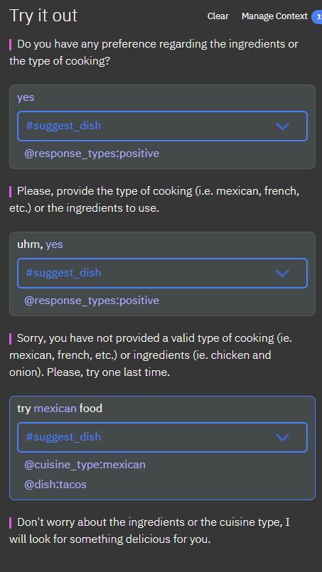


Slide 24
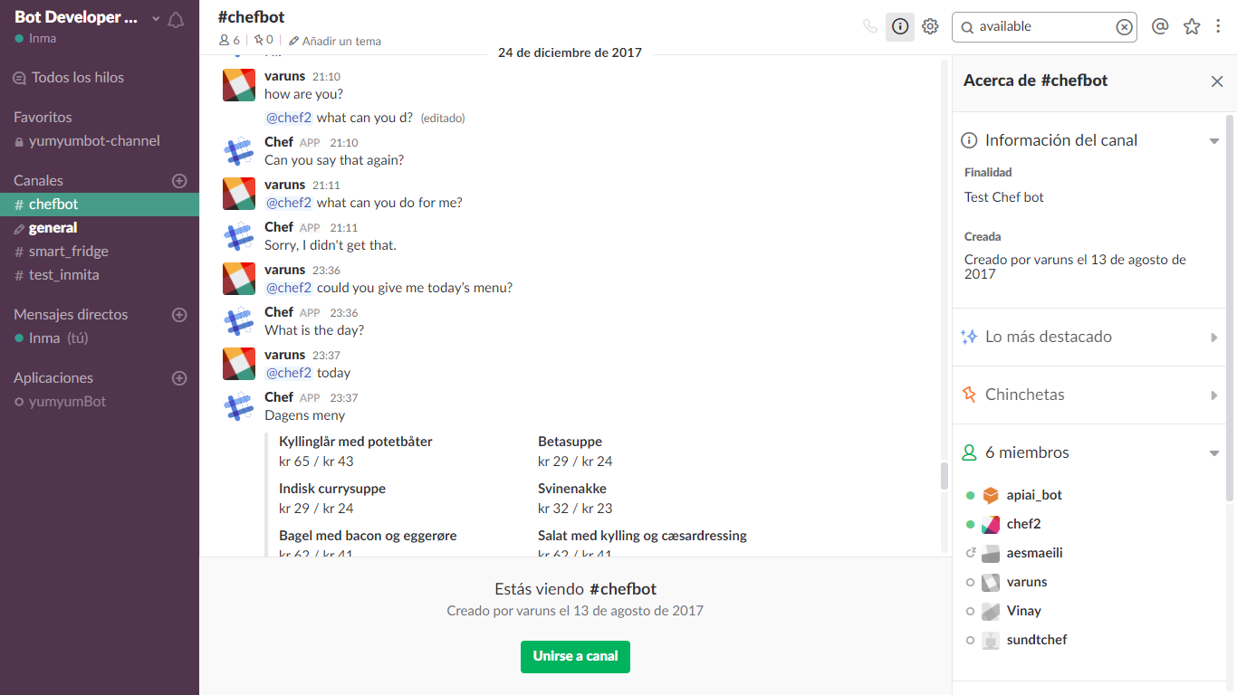

Slide 25
ULTIMA
VERSIÓN

Slide 26
CHECK
#AVAILABLE_
INGREDIENTS
CHECK
@INGREDIENTS
START
GET
INGREDIENTS
INFORMATION
RESPONSE
Yes
! None
$ingredients=None
$ingredients
None
DATABASE
GET
DATABASE SUMMARY
WATSON CONVERSATION
ORCHESTRATION ENGINE

Slide 27


DATABASE
ORCHESTRATION ENGINE
GET
DATABASE SUMMARY
SUMMARY
Yes
$Summary=True
CHECK
#NEEDED_
INGREDIENTS
CHECK
@RESPONSE_
TYPES
START
Yes
No / Uncertain
END
SUMMARY?
ANYTHING ELSE?
$counter=0
$Summary=False
Unknown
FIRST
TIME
Yes
No
$counter=1
$counter=0
WATSON CONVERSATION

Slide 28
WATSON CONVERSATION
CHECK
#NEGATIVE_
REACTION
CHECK
$INSULT_
COUNTER
>= 3
#BYE
START
RESPONSE
Yes
Yes
$insult_counter++
$insult_counter=0

Slide 29
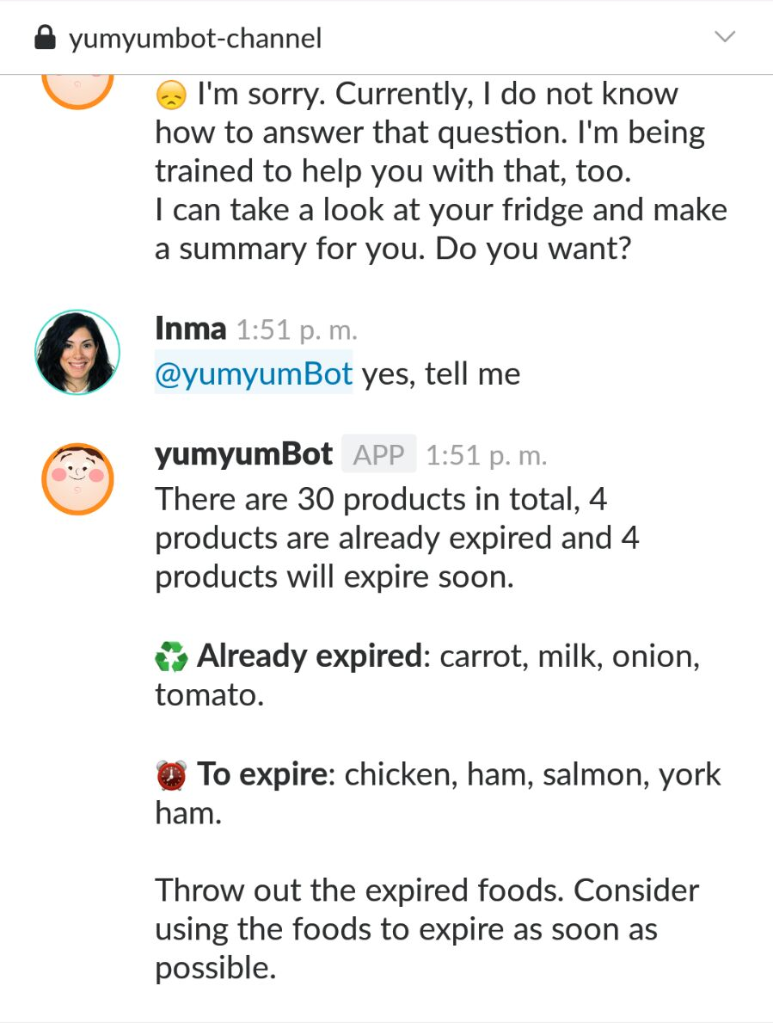
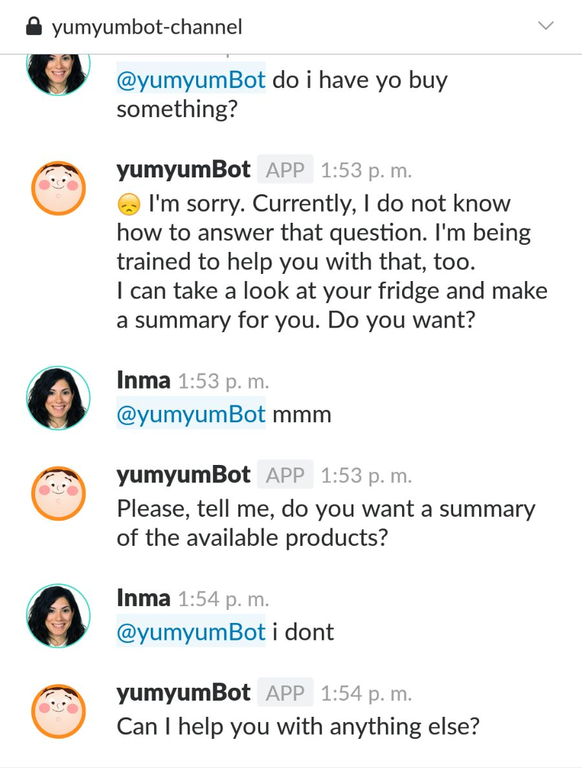
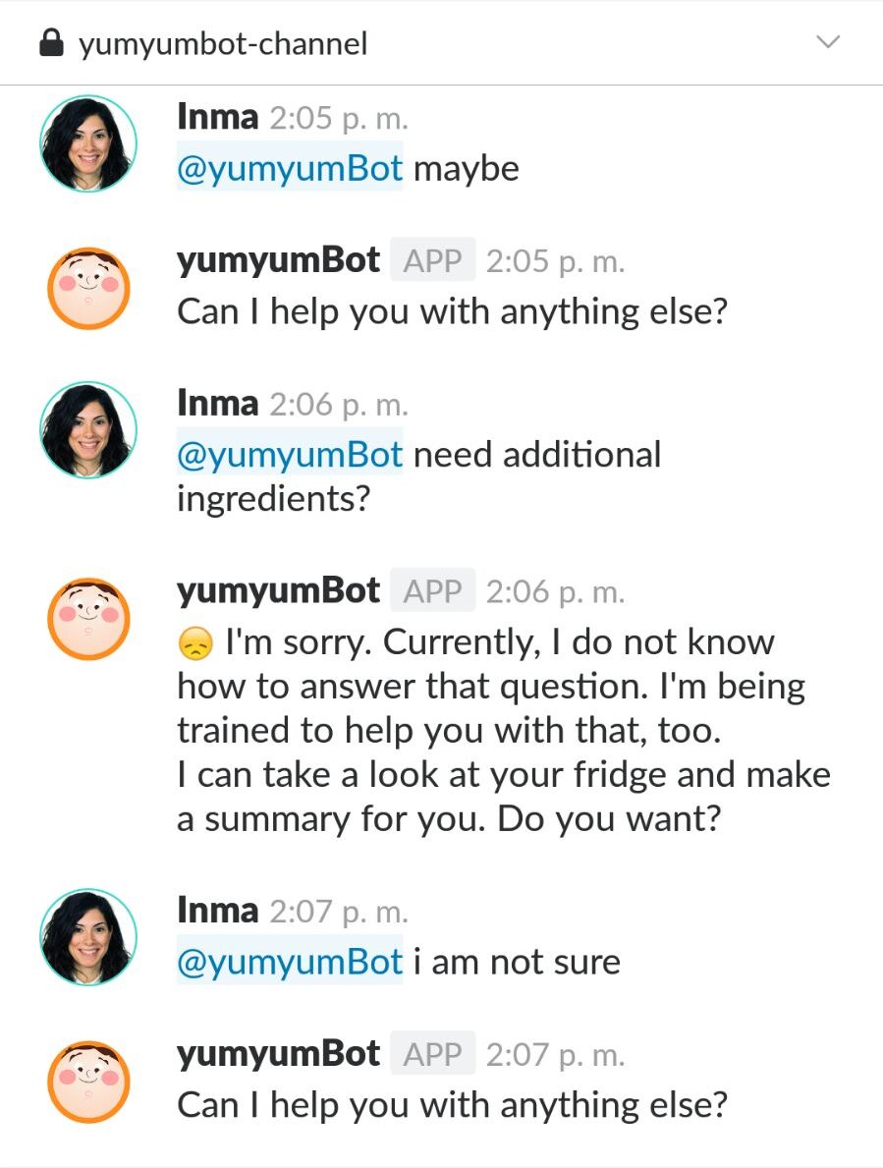
POSITIVE
UNKNOWN + NEGATIVE
UNCERTAIN

