Slide 1
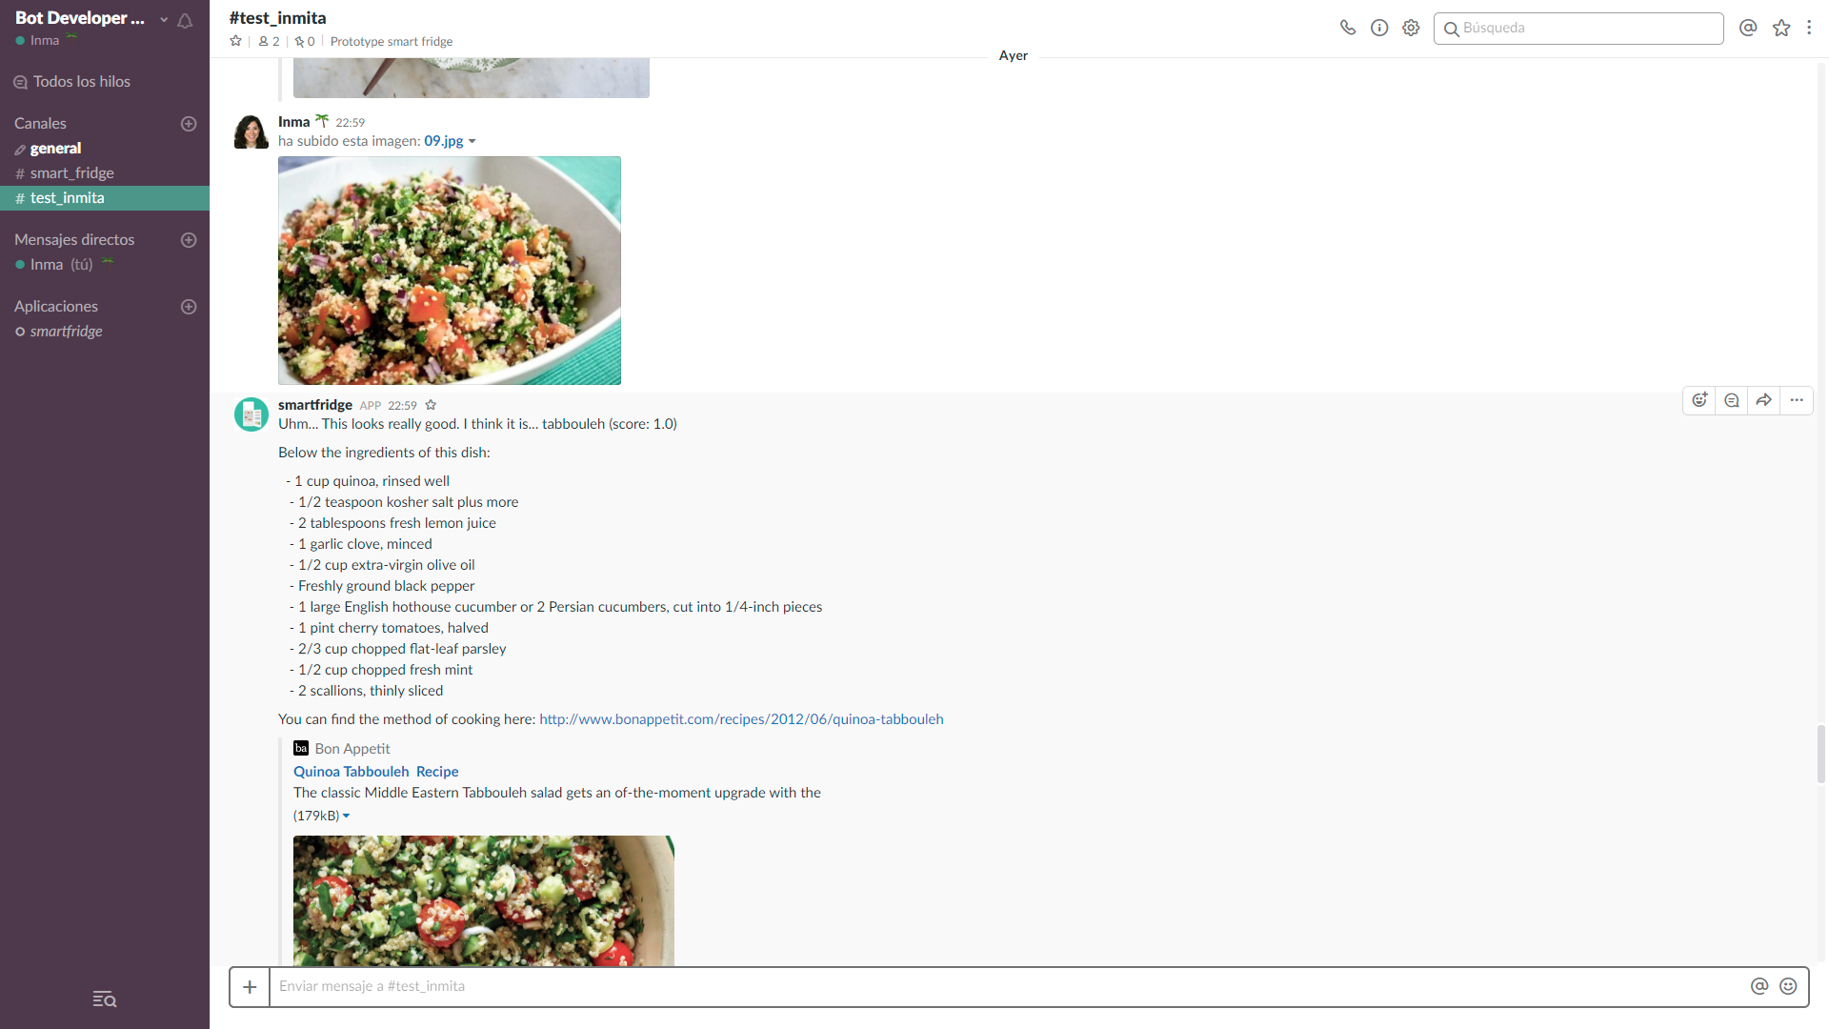

Slide 2











ORCHESTRATION
ENGINE
Visual
recognition
Conversation
Users
Slack
Information sources
Recipe service

Slide 3


IBM WATSON SERVICES
ORCHESTRATION
ENGINE
USERS
USER INTERFACE
Visual recognition
Slack
Conversation
DATA SOURCES
Recipe service
Databases

Slide 4


