Slide 1
Correlation Analysis in QEC
20240418
Yiming Zhang

Slide 2
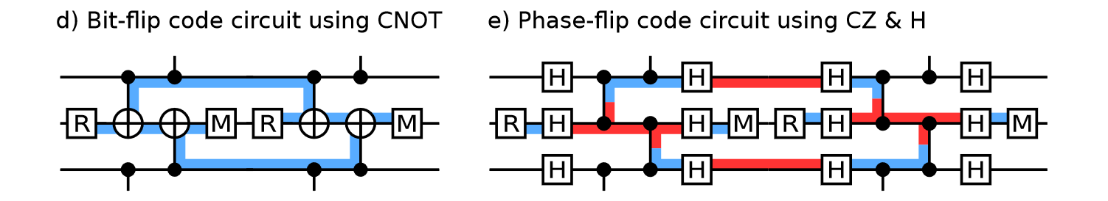
Background
Detector
Deterministic parity of measurement(s) result. Prior knowledge about the circuit/code structure.

Slide 3
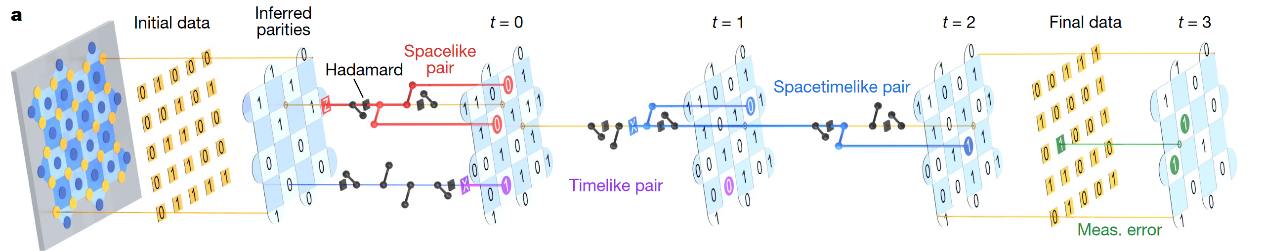
Background
Detection Event
Excited detector which reveals the underlying error mechanism.

Slide 4
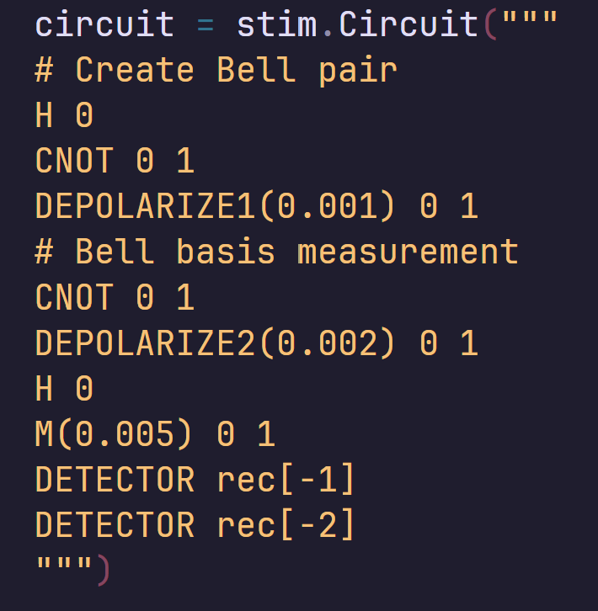
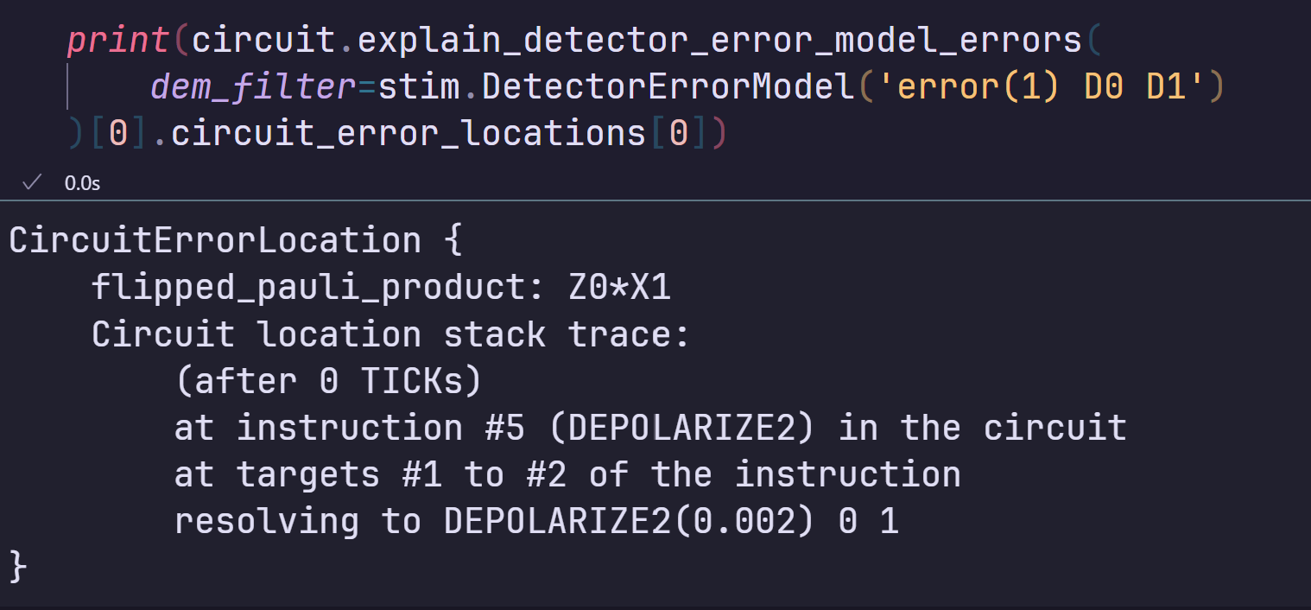
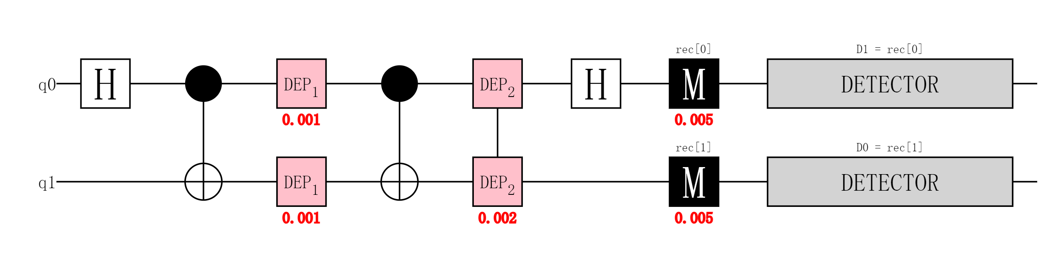
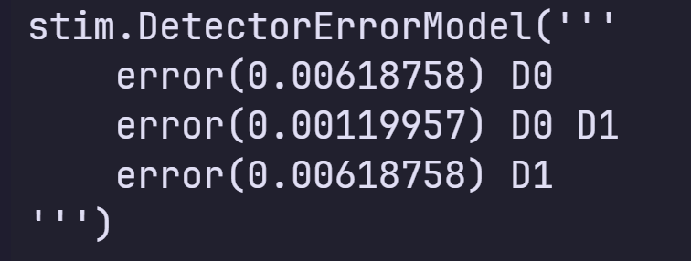
Background
Detector error model
What we know about the error mechanism and QEC circuit.
Error Mechanism
Circuit With Noise Prior Knowledge
Detector Error Model

Slide 5
Correlation Analysis
sample
Detector Error Model
Detection Events
Correlation analysis

Slide 6
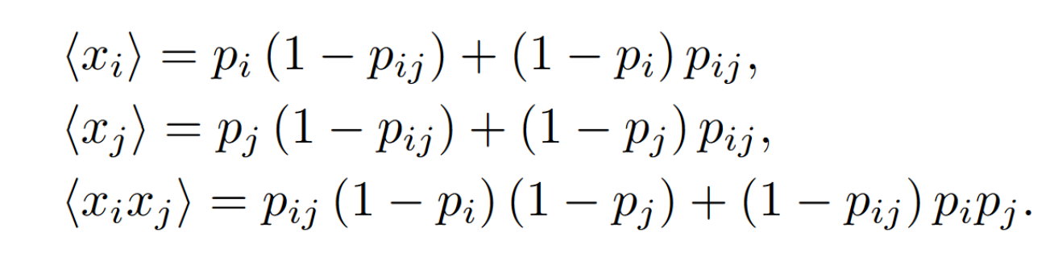
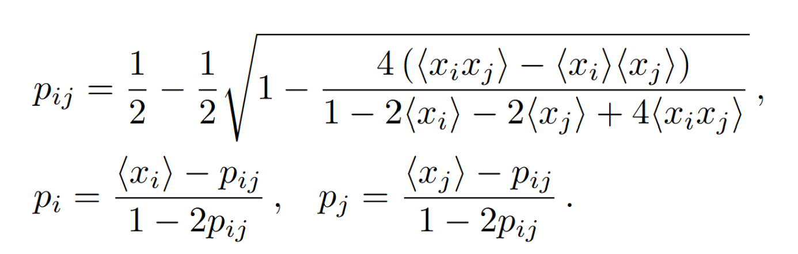
2-point analysis
Analytical Solution:
D0^D1
D0
D1
Pij
Pi
Pj

Slide 7









2-point analysis
$$P_{0}^{01}$$
$$P_{1}^{01}$$
$$P_{01}$$
$$P_{0}$$
D0
D1
D0
D1
$$P_{0}^{01}=P_{0}\left(1−P_{0}^{02}\right)+\left(1−P_{0}\right)P_{0}^{02}$$
$$P_{0}^{02}$$
D0
D2
$$P_{0}=\frac{<x_{i}>−P_{01}−P_{02}+2P_{01}P_{02}}{(1−2P_{01})(1−2P_{02})}$$
$$P_{02}$$
$$P_{2}^{02}$$
D2

Slide 8
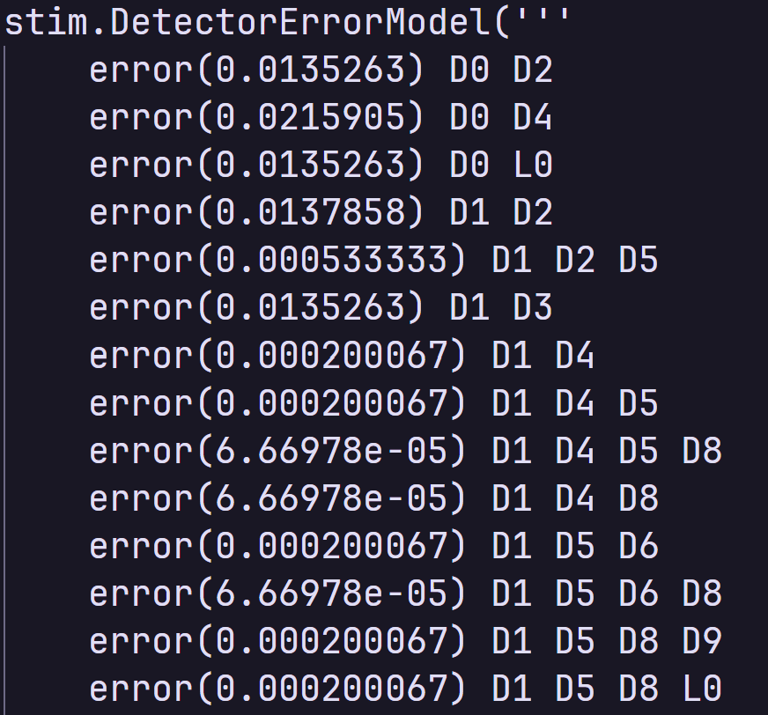
2-point analysis
What about hyperedges?
Inherent Correlation
D0
D1
D2
error(0.005) D0 D1 D2

Slide 9
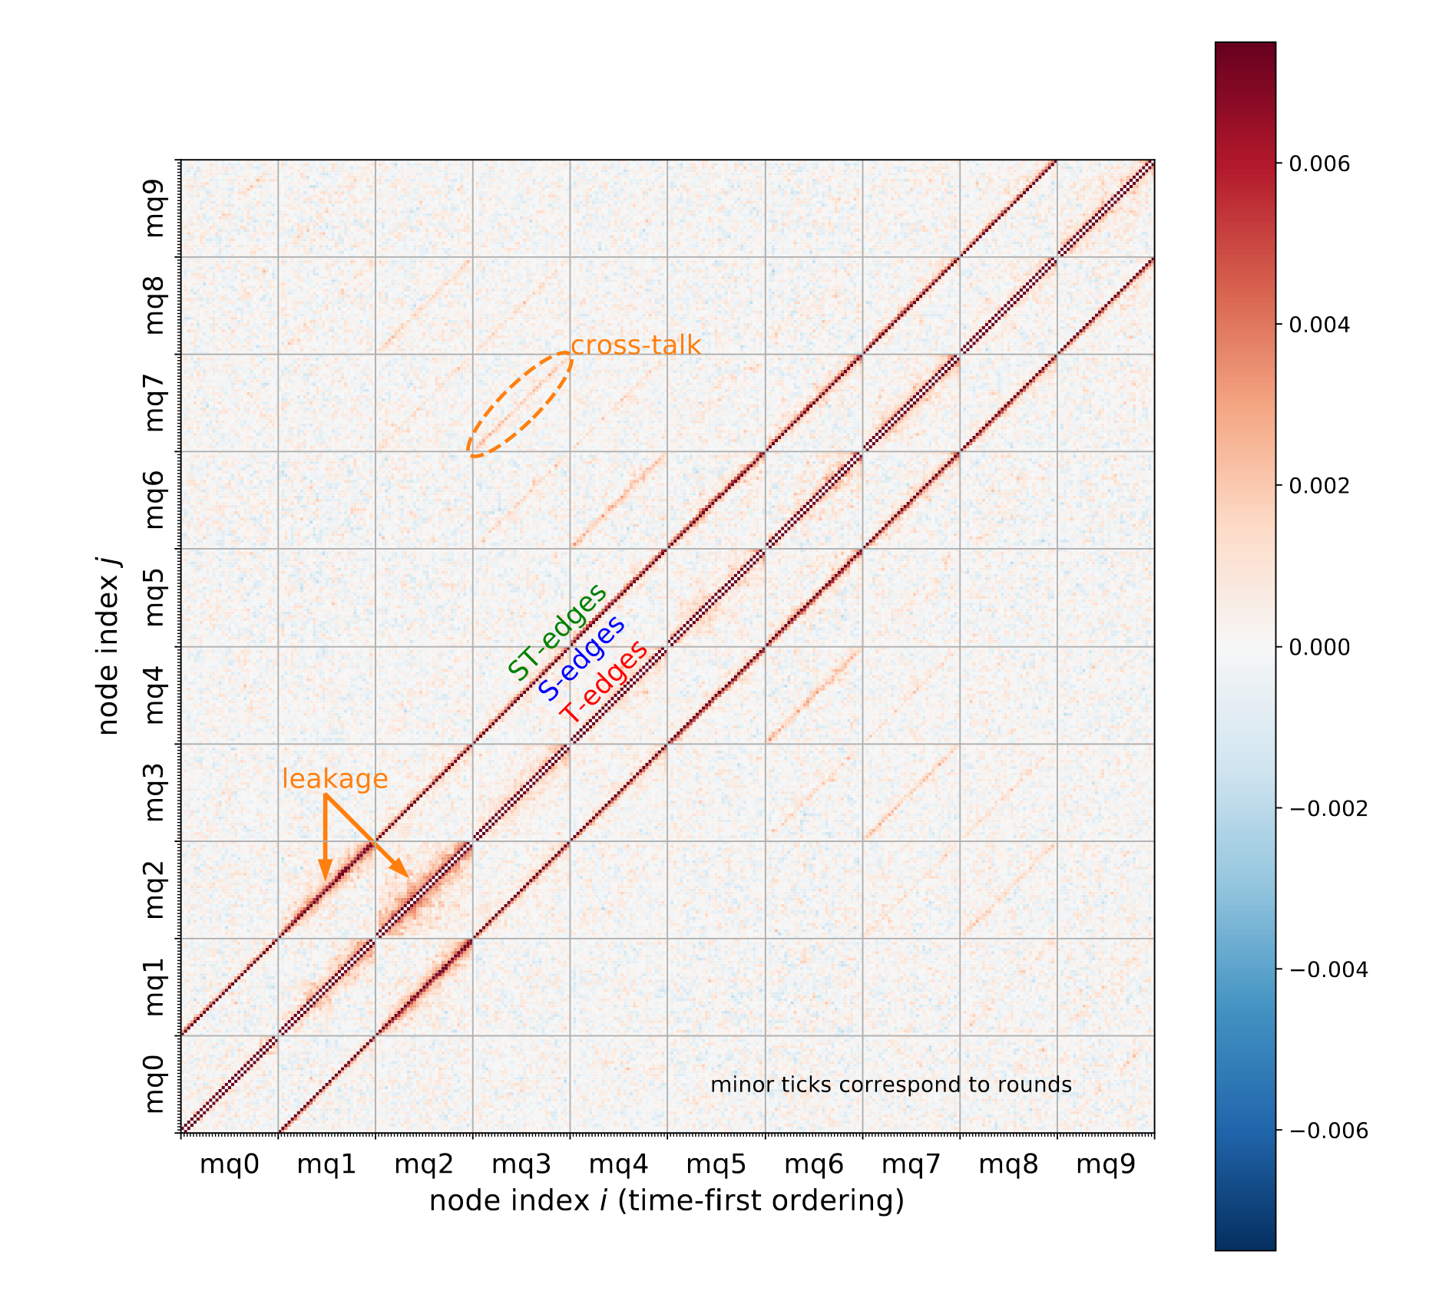
2-point analysis
Repetition Code
Experimental Correlation Error
D0
D1
Edge probabilities go up
Probabilities of adjusted boundary edge go down（negative prob might appear）
D2
error(0.005) D0 D1 D2

Slide 10
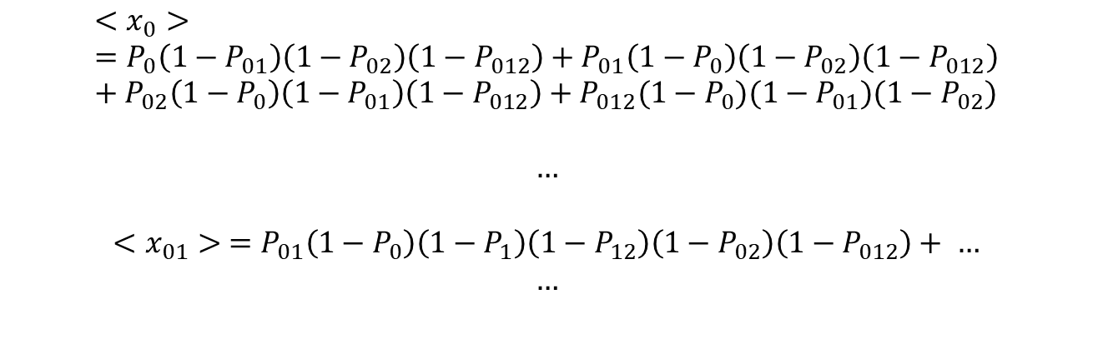
High order correlation
Solution: Take high order correlation into account
Cluster Method
$$<x_{0}> =P_{0}\left(1−P_{01}\right)\left(1−P_{02}\right)\left(1−P_{012}\right)+P_{01}\left(1−P_{0}\right)\left(1−P_{02}\right)\left(1−P_{012}\right)+P_{02}\left(1−P_{0}\right)\left(1−P_{01}\right)\left(1−P_{012}\right)+P_{012}(1−P_{0})(1−P_{01})(1−P_{02})$$
$$…$$
$$<x_{01}> =P_{01}\left(1−P_{0}\right)\left(1−P_{1}\right)\left(1−P_{12}\right)\left(1−P_{02}\right)\left(1−P_{012}\right)+ …$$
$$…$$
D0
D1
D2
Size-N cluster: $2^{N}−1$ variables with $2^{N}−1$ non-linear equations
Can be solved numerically

Slide 11
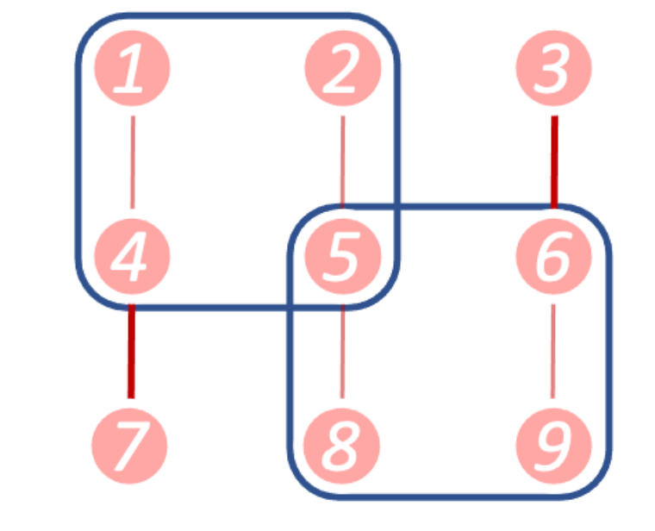
High order correlation
Put all things together
We approximate the probabilities of the hyperedges within each cluster by assuming these are the only hyperedges exist.
We need to adjust the probabilities with the method similar to that for boundary edges.
Overlap between clusters

Slide 12
High order correlation
Implementation
https://github.com/inmzhang/correlation (Python)
https://github.com/inmzhang/correlation-rs (Rust port with python binding)

Slide 13
Limitation
The number of cluster equals to the number of largest hyperedges in the error graph, which will scale with the code size and number of error correction rounds(linearly).
Solving the non-linear equation system is not cheap.
Currently we use the hyperedges appeared in the circuit-error-based depolarizing error model for high order correlation analysis. Experimental heuristic hyperedges are not easy and straightforward to locate and expensive to search by brute-force approach.

Slide 14
Reference
Calibrated Decoders for Experimental Quantum Error Correction. Physical Review Letters, 128(11), 110504.
Exponential suppression of bit or phase errors with cyclic error correction. Nature, 595(7867), Article
Suppressing quantum errors by scaling a surface code logical qubit. Nature, 614(7949), 676–681

