Slide 1
XEB Simulation

Slide 2
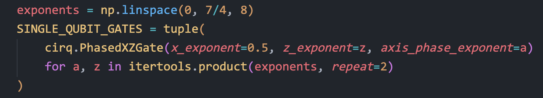
Dynamical phase transition
Random single qubit rotations:
Two qubit entangling gate: $\sqrt{ISWAP}$
Noise model: depolarize each qubit after every operation

Slide 3
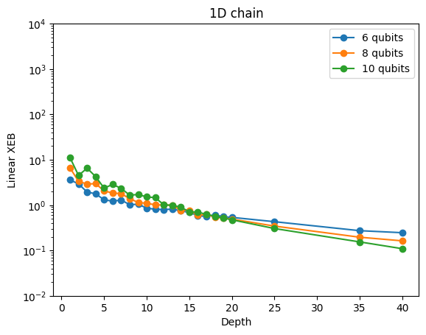
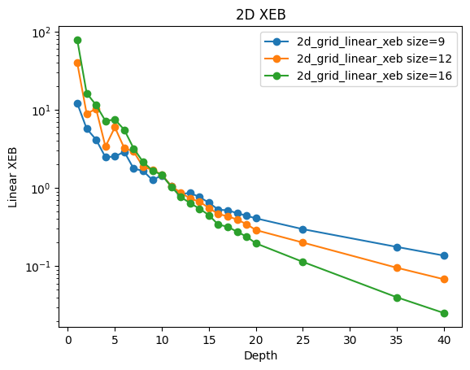
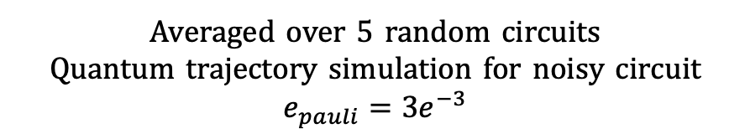
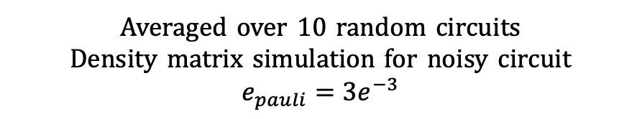
Dynamical phase transition
Averaged over 10 random circuits
Density matrix simulation for noisy circuit
$$e_{pauli}=3e^{−3}$$
Averaged over 5 random circuits
Quantum trajectory simulation for noisy circuit
$$e_{pauli}=3e^{−3}$$

Slide 4
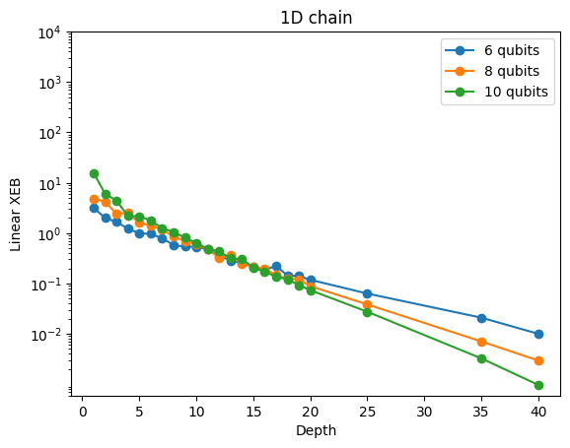
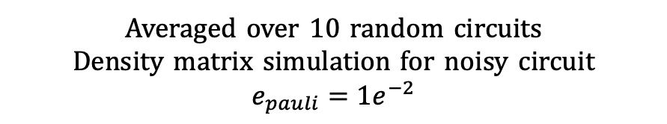
Dynamical phase transition
Averaged over 10 random circuits
Density matrix simulation for noisy circuit
$$e_{pauli}=3e^{−3}$$
Averaged over 10 random circuits
Density matrix simulation for noisy circuit
$$e_{pauli}=1e^{−2}$$

Slide 5
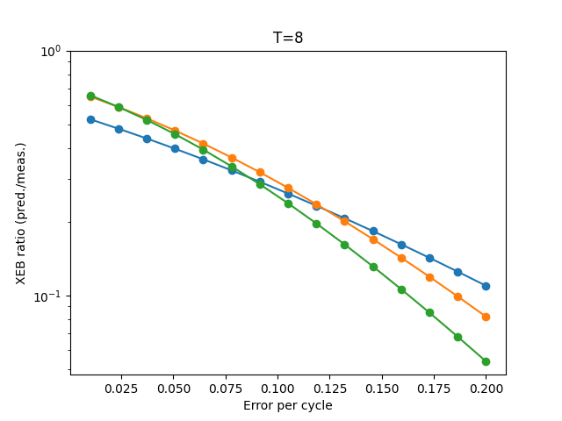
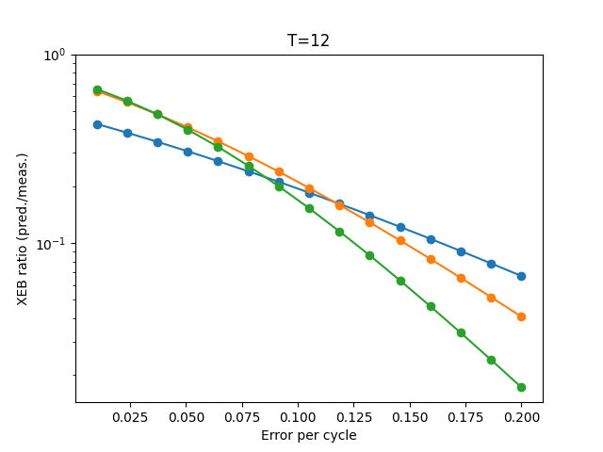
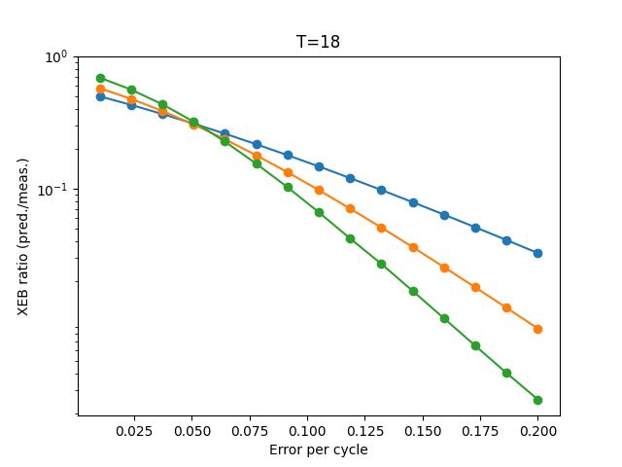
Noise induced phase transition
N=10 1D-chain
Averaged over 5 random circuits
Density matrix simulation for noisy circuit

Slide 6
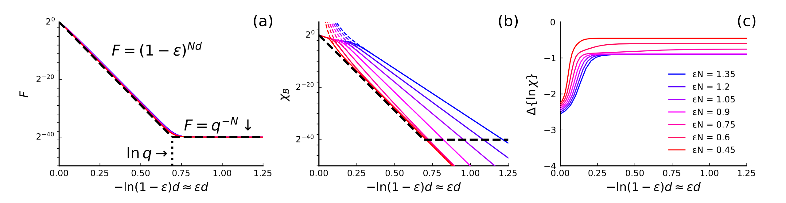
Noise induced phase transition(Slope)

Slide 7
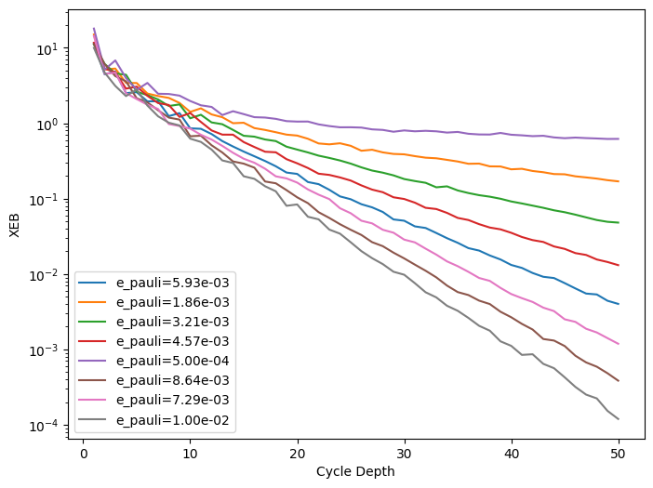
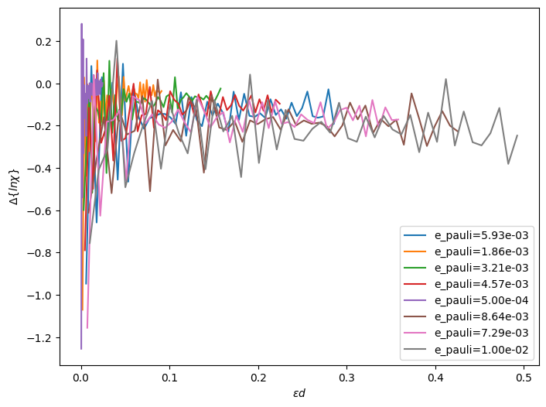
Noise induced phase transition(Slope)
N=10 1D-chain
Averaged over 10 random circuits
Density matrix simulation for noisy circuit

Slide 8
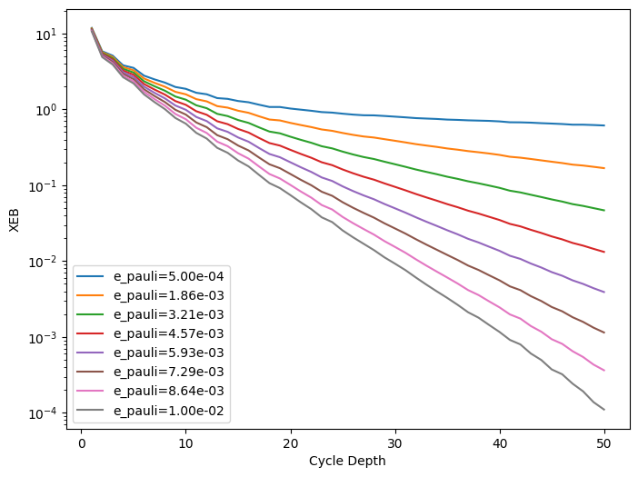
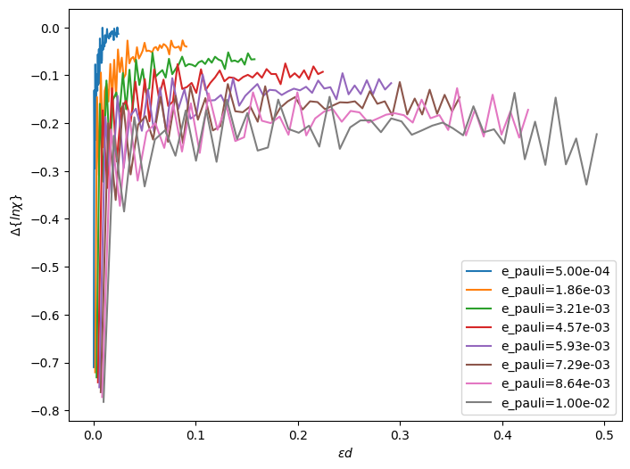
Noise induced phase transition(Slope)
N=10 1D-chain
Averaged over 100 random circuits
Density matrix simulation for noisy circuit

Slide 9
实验links怎么定义的：links-per-4-cycles=(total_links_in_4_cycles) / 4，即每新增一个连接的coupler +0.25，实验对应的结构在切线处有10个couplers，则对应links-per-4-cycles=2.5
验算epsilon n是否是图上的值（～ 0.2214）：实验拟合值，文章中点数太少拟合效果不佳
跑更多的随机线路看曲线会不会平滑：见jl
随机数生成 15比特4深度，20深度 NIST

