Slide 1
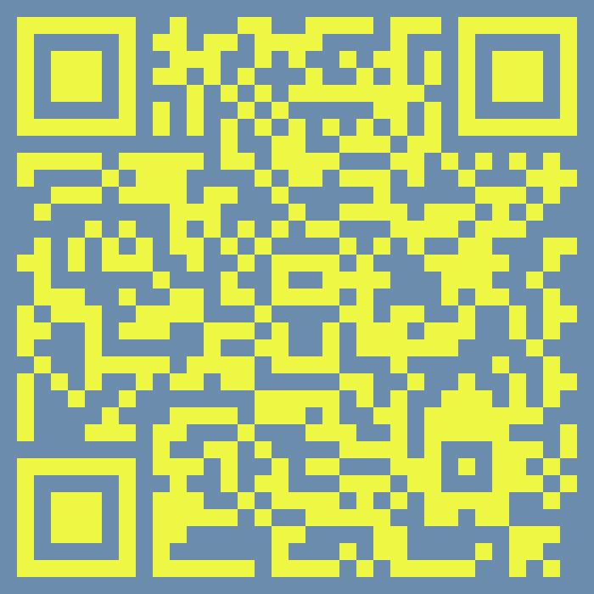
Data analysis
Lecture 2
Metalog data
Kateryna Pantiukh
pantiukh@ut.ee
GitHub
bi534-metagenomics
Code 01
Notes:
Hello, my name is K. Thank you for joining me today for this microbiome test lesson. Today’s topic will be XX, and I must say I am very glad to have the opportunity to promote the microbiome to students. A few words about myself: Here in Est we have a biobank and … I am a specialist in reconstruction of bacterial genomes, and my research is dedicated to understanding how MB relates to different diseases.

Slide 2
GitHub https://github.com
Visual Studio Code https://code.visualstudio.com
Please set up your GitHub repository and code editor (Visual Studio Code)
bi534-metagenomics
Code 01
Notes:
Hello, my name is K. Thank you for joining me today for this microbiome test lesson. Today’s topic will be XX, and I must say I am very glad to have the opportunity to promote the microbiome to students. A few words about myself: Here in Est we have a biobank and … I am a specialist in reconstruction of bacterial genomes, and my research is dedicated to understanding how MB relates to different diseases.

Slide 3
GitHub https://github.com/Chartiza/KSE_microbiome
Please clone our working directory from GitHub
bi534-metagenomics
Code 01
Notes:
Hello, my name is K. Thank you for joining me today for this microbiome test lesson. Today’s topic will be XX, and I must say I am very glad to have the opportunity to promote the microbiome to students. A few words about myself: Here in Est we have a biobank and … I am a specialist in reconstruction of bacterial genomes, and my research is dedicated to understanding how MB relates to different diseases.

Slide 4

Feedback
Please write in the chat how much time you spent on your homework.
bi534-metagenomics
Code 01
Notes:
Hello, my name is K. Thank you for joining me today for this microbiome test lesson. Today’s topic will be XX, and I must say I am very glad to have the opportunity to promote the microbiome to students. A few words about myself: Here in Est we have a biobank and … I am a specialist in reconstruction of bacterial genomes, and my research is dedicated to understanding how MB relates to different diseases.

Slide 5

Metalog. Open-source data
https://metalog.embl.de
Metalog is a repository of manually curated metadata for metagenomic samples
It is being developed in the Bork Group at EMBL Heidelberg
With support from more than 30 countries, the European Molecular Biology Laboratory (EMBL) has more than 110 independent research groups and service teams covering the spectrum of molecular biology at six sites in Barcelona, Grenoble, Hamburg, Heidelberg, EMBL-EBI Hinxton, and Rome.
bi534-metagenomics
Code 01
Notes:
Hello, my name is K. Thank you for joining me today for this microbiome test lesson. Today’s topic will be XX, and I must say I am very glad to have the opportunity to promote the microbiome to students. A few words about myself: Here in Est we have a biobank and … I am a specialist in reconstruction of bacterial genomes, and my research is dedicated to understanding how MB relates to different diseases.

Slide 6
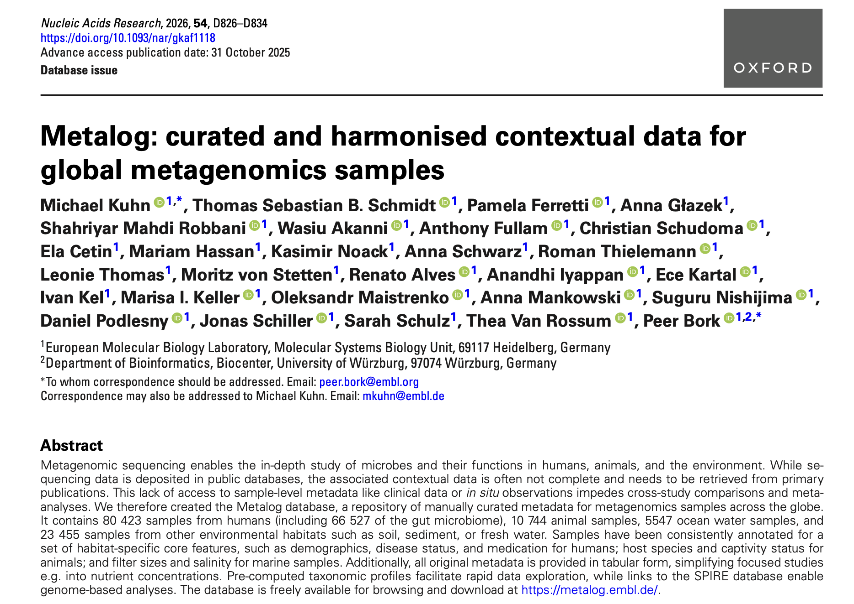
Metalog. Open-source data
Database:
https://metalog.embl.de
Paper:
https://academic.oup.com/nar/article/54/D1/D826/8307355
bi534-metagenomics
Code 01
Notes:
Hello, my name is K. Thank you for joining me today for this microbiome test lesson. Today’s topic will be XX, and I must say I am very glad to have the opportunity to promote the microbiome to students. A few words about myself: Here in Est we have a biobank and … I am a specialist in reconstruction of bacterial genomes, and my research is dedicated to understanding how MB relates to different diseases.

Slide 7
Metalog. Open-source data
Metadata + Taxonomic profile
(MetaPlAn 4.0)
https://metalog.embl.de
bi534-metagenomics
Code 01
Notes:
Hello, my name is K. Thank you for joining me today for this microbiome test lesson. Today’s topic will be XX, and I must say I am very glad to have the opportunity to promote the microbiome to students. A few words about myself: Here in Est we have a biobank and … I am a specialist in reconstruction of bacterial genomes, and my research is dedicated to understanding how MB relates to different diseases.

Slide 8
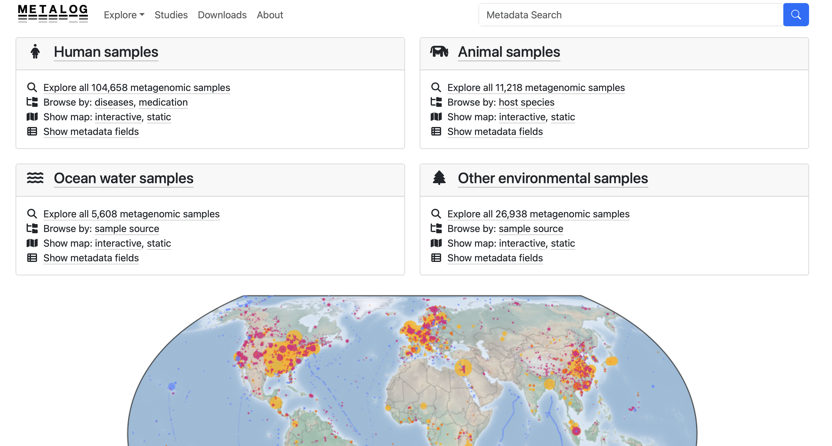
Metalog. Open-source data
https://metalog.embl.de
bi534-metagenomics
Code 01
Notes:
Hello, my name is K. Thank you for joining me today for this microbiome test lesson. Today’s topic will be XX, and I must say I am very glad to have the opportunity to promote the microbiome to students. A few words about myself: Here in Est we have a biobank and … I am a specialist in reconstruction of bacterial genomes, and my research is dedicated to understanding how MB relates to different diseases.

Slide 9
Metalog. Open-source data
Please choose which environment you want to analyse.
Write your choice in the chat. If you see that three people have already selected the same environment, please choose a different one.
Options:
Human, ocean, animal, environmental
https://metalog.embl.de
bi534-metagenomics
Code 01
Notes:
Hello, my name is K. Thank you for joining me today for this microbiome test lesson. Today’s topic will be XX, and I must say I am very glad to have the opportunity to promote the microbiome to students. A few words about myself: Here in Est we have a biobank and … I am a specialist in reconstruction of bacterial genomes, and my research is dedicated to understanding how MB relates to different diseases.

Slide 10

Metalog. Open-source data
Task 1. Exploratory analysis of the selected dataset
Please write your ideas in the chat about what you can check to understand your dataset better …
https://metalog.embl.de
bi534-metagenomics
Code 01
Notes:
Hello, my name is K. Thank you for joining me today for this microbiome test lesson. Today’s topic will be XX, and I must say I am very glad to have the opportunity to promote the microbiome to students. A few words about myself: Here in Est we have a biobank and … I am a specialist in reconstruction of bacterial genomes, and my research is dedicated to understanding how MB relates to different diseases.

Slide 11
Metalog. Open-source data
Task 1. Exploratory analysis of the selected dataset
General. How many samples are included in the dataset? How many studies does the dataset contain? What are the minimum, maximum, and average numbers of samples per study?
Dataset balance and bias & missing data structure. Which metadata fields are available, and are they consistently present across all samples and studies? …
Are any metadata variables strongly correlated or effectively duplicating the same information?
Temporal coverage. Do we have studies with multiple time points for the same samples?
Technical heterogeneity. Assess whether sequencing platform, library preparation, or read length vary across studies.
Redundancy at the sample level. Assess whether the dataset contains duplicate samples.
https://metalog.embl.de
bi534-metagenomics
Code 01
Notes:
Hello, my name is K. Thank you for joining me today for this microbiome test lesson. Today’s topic will be XX, and I must say I am very glad to have the opportunity to promote the microbiome to students. A few words about myself: Here in Est we have a biobank and … I am a specialist in reconstruction of bacterial genomes, and my research is dedicated to understanding how MB relates to different diseases.

Slide 12
Metalog. Open-source data
Task 2. Formulate a question that can be answered with the data
Please write your ideas in the chat …
For each selected question, clearly specify the response variables, the explanatory variables of interest, and any covariates or confounders that need to be controlled for.
https://metalog.embl.de
bi534-metagenomics
Code 01
Notes:
Hello, my name is K. Thank you for joining me today for this microbiome test lesson. Today’s topic will be XX, and I must say I am very glad to have the opportunity to promote the microbiome to students. A few words about myself: Here in Est we have a biobank and … I am a specialist in reconstruction of bacterial genomes, and my research is dedicated to understanding how MB relates to different diseases.

Slide 13
Metalog. Open-source data
Task 2. Formulate a question that can be answered with the data
Does microbiome community composition differ between sampling locations, different geographic regions, different body sites?
Is there a relationship between environmental conditions such as temperature, salinity, or oxygen concentration and the observed microbiome structure?
Do samples collected in different seasons or months show systematic differences, suggesting temporal or seasonal effects on the microbiome?
Does microbiome community composition differ between sampling protocols?
https://metalog.embl.de
bi534-metagenomics
Code 01
Notes:
Hello, my name is K. Thank you for joining me today for this microbiome test lesson. Today’s topic will be XX, and I must say I am very glad to have the opportunity to promote the microbiome to students. A few words about myself: Here in Est we have a biobank and … I am a specialist in reconstruction of bacterial genomes, and my research is dedicated to understanding how MB relates to different diseases.

Slide 14
Metalog. Open-source data
Task 3. Select a subset of data for your analysis
Select one study or a small set of studies that contain the metadata required to answer your question.
Aim for a balanced dataset to avoid confounding signals. For example, if you include multiple studies, they should have comparable structure (such as age, gender distribution, or other relevant variables).
Define case and control groups. Verify that these groups have similar structures, or construct matched case–control pairs where appropriate.
https://metalog.embl.de
bi534-metagenomics
Code 01
Notes:
Hello, my name is K. Thank you for joining me today for this microbiome test lesson. Today’s topic will be XX, and I must say I am very glad to have the opportunity to promote the microbiome to students. A few words about myself: Here in Est we have a biobank and … I am a specialist in reconstruction of bacterial genomes, and my research is dedicated to understanding how MB relates to different diseases.

Slide 15
Metalog. Open-source data
Task 4. Answer your question
Compare samples from the case and control groups.
Analyse and compare alpha-diversity distributions between the groups.
Calculate beta diversity and perform a PCA to determine whether the groups differ.
https://metalog.embl.de
bi534-metagenomics
Code 01
Notes:
Hello, my name is K. Thank you for joining me today for this microbiome test lesson. Today’s topic will be XX, and I must say I am very glad to have the opportunity to promote the microbiome to students. A few words about myself: Here in Est we have a biobank and … I am a specialist in reconstruction of bacterial genomes, and my research is dedicated to understanding how MB relates to different diseases.

Slide 16
Metalog. Open-source data
Task 1. Exploratory analysis of the selected dataset
Dataset:
https://metalog.embl.de
HW
Well-documented and reproducible code, including clear variable names and informative comments
A concise written report summarizing your analyses, key results, biological interpretations, and limitations of the dataset
Deadline: 12-02-26
Task 2. Formulate a question that can be answered with the data
Task 3. Select a subset of data for your analysis
Task 4. Answer your question
bi534-metagenomics
Code 01
Notes:
Hello, my name is K. Thank you for joining me today for this microbiome test lesson. Today’s topic will be XX, and I must say I am very glad to have the opportunity to promote the microbiome to students. A few words about myself: Here in Est we have a biobank and … I am a specialist in reconstruction of bacterial genomes, and my research is dedicated to understanding how MB relates to different diseases.

