Slide 1
Code is usually color coded. In the below example JavaScript key worlds are pink. Being pink doesn’t make it a key word, it is pink because it is a key word.
Think of it like taxi cabs in New York which are yellow. They are not taxi cabs because they are yellow. They are yellow because they are taxi cabs.
Here are the colors for this presentation.
Legend {
JavaScript Key Word
function
variable name
string
number
operator
}
function functionName(num1, num2, num3) {
let x = num1 * num2 * num3
return ‘the product is’ + 10
}

Slide 2
Function Syntax
function with no parameters
function with parameters
function name
set of parenthesis
2 parameters
‘function’ key word
function colorMyName() {
// function body
}
function colorIt(name, color) {
// function body
}
curly braces mark the start
& end of the function body

Slide 3
Calling a Function
Call function with no parameters
Call function with 3 parameter
function oneMoreFunction(first, last, grade) {
// function body
}
function nameOfFunction() {
// function body
}
oneMoreFunction(‘joe’, ‘smith’, 7)
nameOfFunction()
Function name followed by ()
Call function with 1 parameter
function anotherFunction(name) {
// function body
}
anotherFunction(‘joe’)

Slide 4
Function Body
function anotherFunction(num1, num2, num3) {
let x = num1 * num2 * num3
let y = num1 + num2 + num3
let z = x + y
return z
}
These 4 lines are in the ‘function body’
Who knows the value of ‘a’?
let a = anotherFunction(2, 5, 7)
a = 84

Slide 5
Arguments & Parameters
3 ‘parameters’
Functions have ‘parameters’
When you call a function you pass it ‘arguments’
Arguments become the value of the parameters
So …
first will be ‘joe’
last will be ‘smith’
grade will be 7
function anotherFunction(first, last, grade) {
// function body
}
anotherFunction(‘joe’, ‘smith’, 7)
3 ‘arguments’

Slide 6
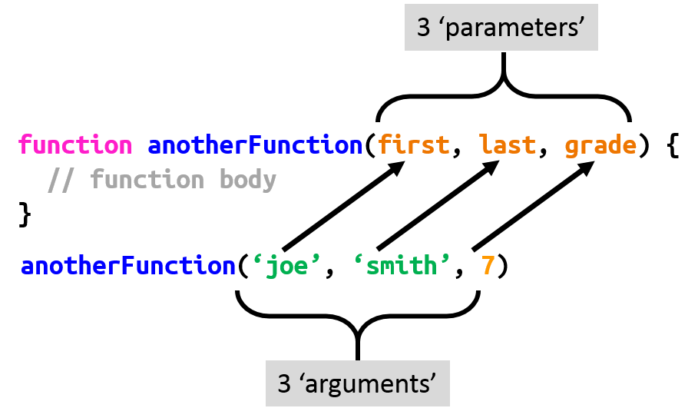
What Are
Arguments & Parameters
Arguments are values like strings and numbers
Parameters are like variables, they are a name for a value.
When we see let x = 10 we say, ‘let x equal 10’, or ‘x equals 10’, but it doesn’t.
x is a name for a space in the computers memory that holds the number 10.
So the technically correct way to say it is, ‘x is the name for a space in memory that holds the value 10’.
But that is too long. So we say, ‘x = 10’
You can think of the space in memory like a box that holds something.
first =
‘joe’
x
10
last =
‘smith’
grade =
7

Slide 7

Passing Parameters to a Function (Part I)
function anotherFunction(first, last, grade) {
p(first)
p(last)
p(grade)
}
joe
smith
7
nameOfFunction(‘joe’, ‘smith’, 7)

Slide 8
function colorMyName(name) {
colorIt(name, ‘blue’)
}
function colorIt (name, color) {
return ‘color ’ + name + ‘ ’ + color
}
let x = colorMyName(‘joe’)
x = ‘color joe blue’
x = ?

