Slide 1
Web Development
And The JavaScript Universe
Notes:
Although this is a talk about JavaScript, JavaScript isn’t much by itself
I’ll be talking about JavaScript in the context of Web Development
This is a talk about JavaScript and the ecosystem it lives in
That ecosystem huge and often referred to as a universe

Slide 2
JavaScript?
Notes:
JavaScript doesn’t do much by itself, it needs the ecosystem it lives in to be useful
While JavaScript may be a given programmers primary language, all JS programmers need to know its ecosystem
I’m going to talk about JavaScript in the context of making web applications, and give you a brief introduction to the JS ecosystem

Slide 3
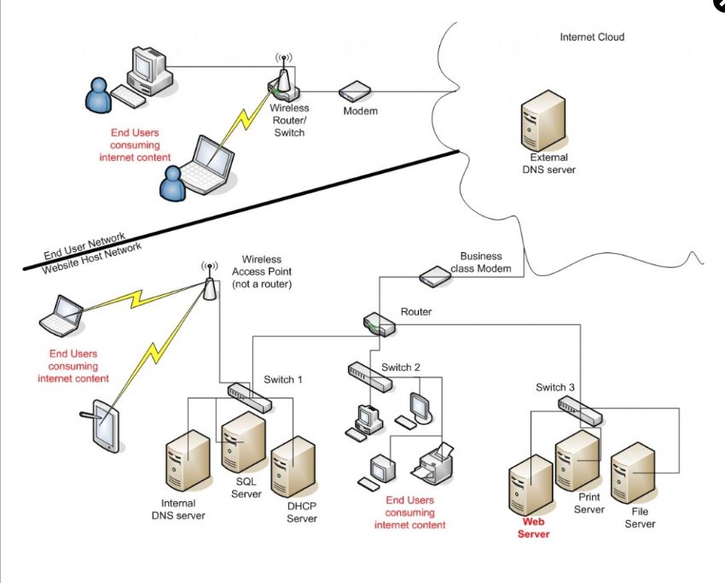
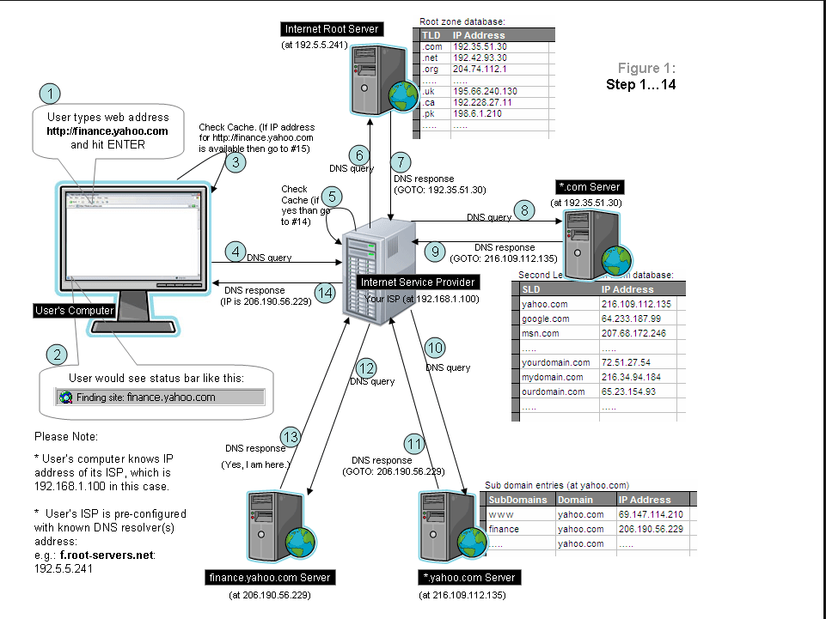
Systems are Complex
Notes:
First a note about system diagrams
Systems are complex but effective diagrams are as simple as possible
I’ll be using simple and well focused diagrams to illustrate several key points

Slide 4
Web Application
In computing, a web application or web app is a client–server computer program in which the client runs in a web browser.
-- Wikipedia
Notes:
Read out loud

Slide 5
Web Application
In computing, a web application or web app is a client–server computer program in which the client runs in a web browser.
-- Wikipedia
Notes:
I think there are two key points in the definition.
First, web applications always have a client and a server
And second, they run in a web browser

Slide 6
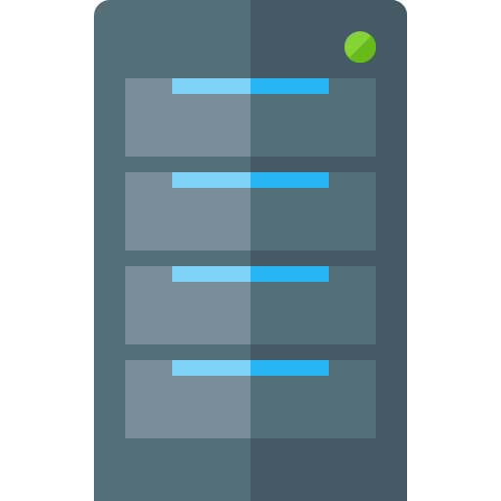

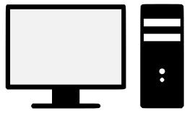

Web Apps: Clients & Servers
Servers
Clients
Notes:
Here is a typical client server diagram
You have clients, which we usually think of as devices like a phone, a desktop or a laptop
And servers which the clients talk to

Slide 7
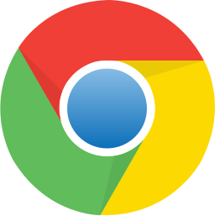



Clients
Notes:
So, here again are the clients we all know
We sit in front of them or hold them in our hands
However, for a web application, the device is not really the client
Web applications run in a browser so the real clients are browsers

Slide 8
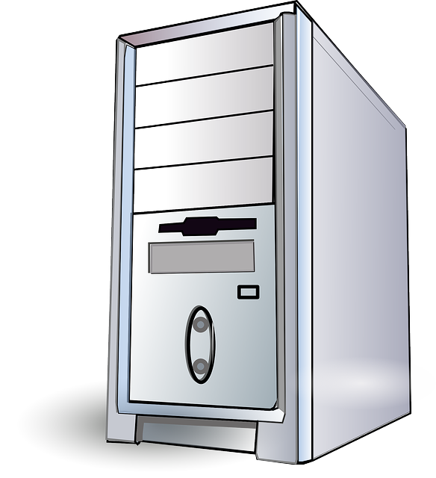
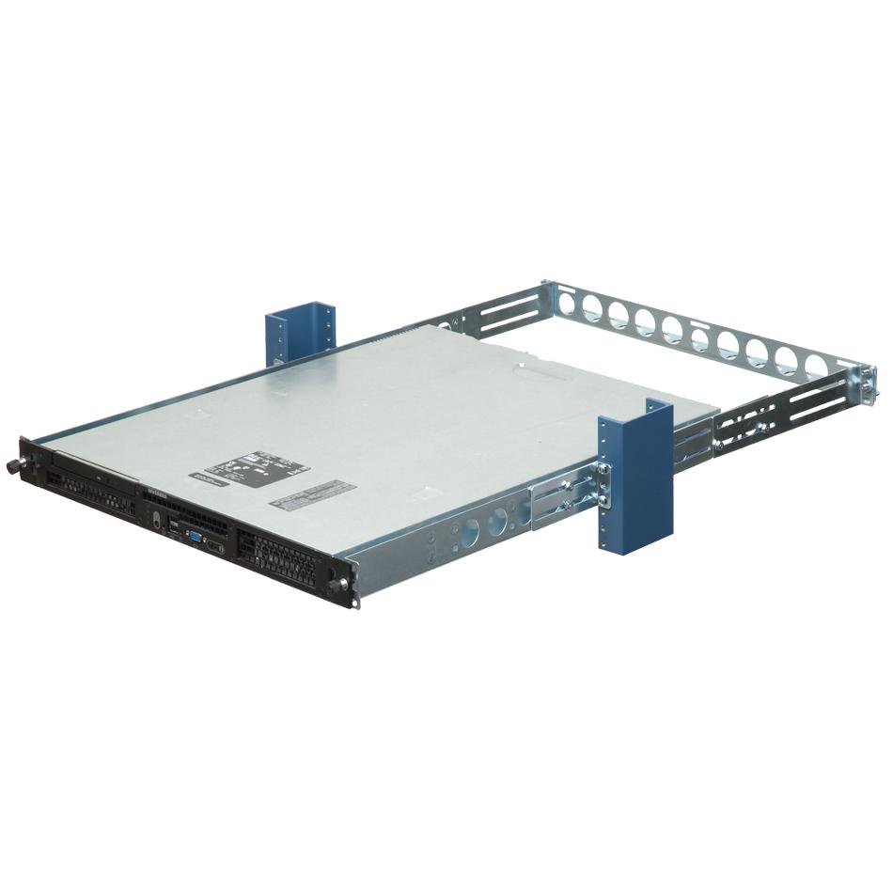
Servers – this could be a server
Notes:
Here we have a simple desktop computer
I could use this as a server
All I need to do is put the necessary server software on it, say a web server, and I could host my web site on it.
So a server is just a computer with the necessary software
However, servers look like this
They are made to mount into a rack
NEXT

Slide 9
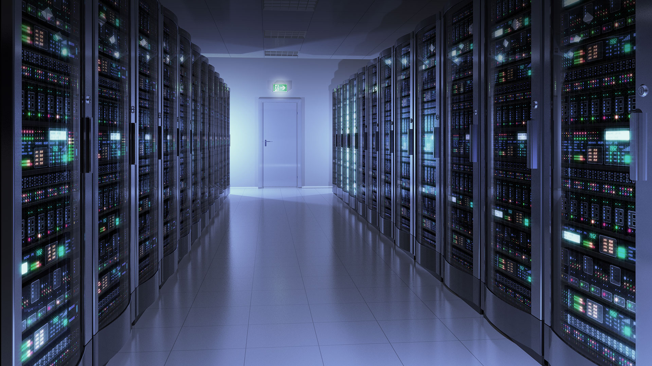
But servers are more like this
Notes:
And they live in racks arranged in rows like a supermarket
They share the racks with other network components like routers and switches and storage
There are rooms and there are server farms which can be huge

Slide 10
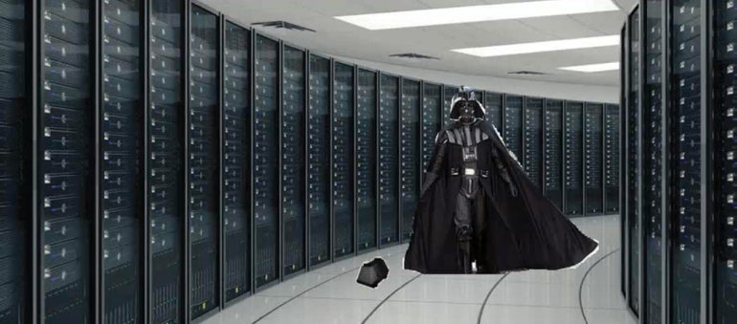
Server Room Security
Notes:
Server room security is very tight
As a software developer I have only been in a large server room once
And I hear, just in case an unauthorized person does get in, they are often patrolled by guys like this

Slide 11
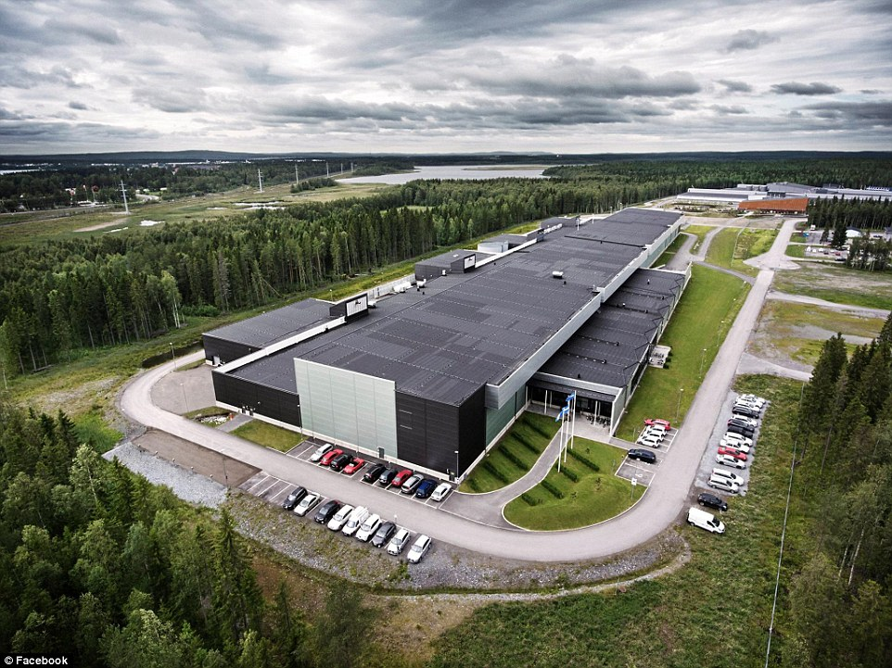
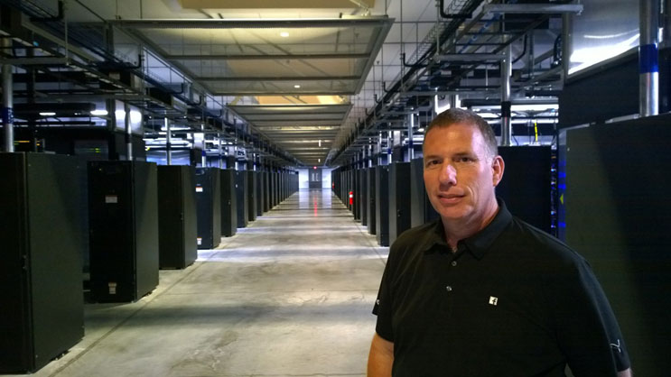
Server Farms are Huge
Notes:
Building is the size of 6 football fields

Slide 12
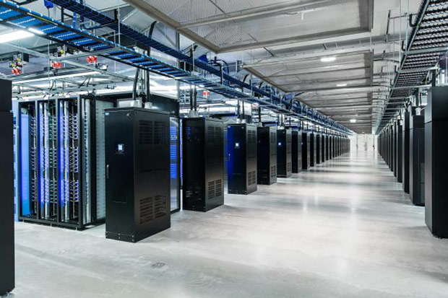
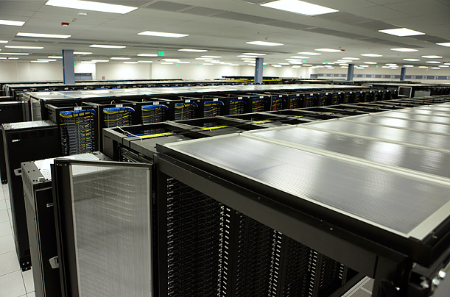
More views of Facebook’s server farm

Slide 13
Web Apps
Just a little bit on how they work
Notes:
Just a little bit

Slide 14
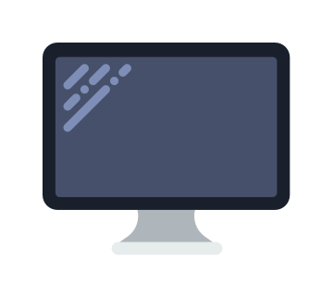
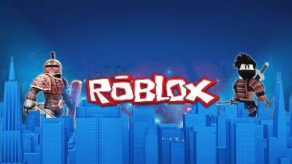
A Simple View?
Request / Response
roblox.com
Client
Request
Client asks for a page: www.roblox.com
Response
HTML, CSS & JavaScript, images, etc.
Server
Notes:
Clients and servers have a conversation
The client asks for a page named roblox.com
The roblox.com server sends back the resources, HTML … needed to display the site and allow the user to interact with it
BUT with millions of servers all over the world, how does the client find the server?

Slide 15
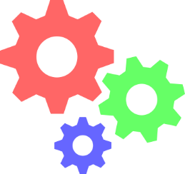

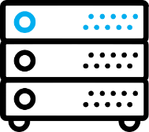
Layers of a Web Application
Presentation Tier
Business Logic
(API)
Data Tier
Get customer
select * from …
Joe Eng
21 Elm St
San Ramon, CA
Customer data
{id: 1, address: …}
Storage
Database
Front-end
(client)
Back-end
(server)

Slide 16
How does the client find the server?
IP Addresses

Slide 17
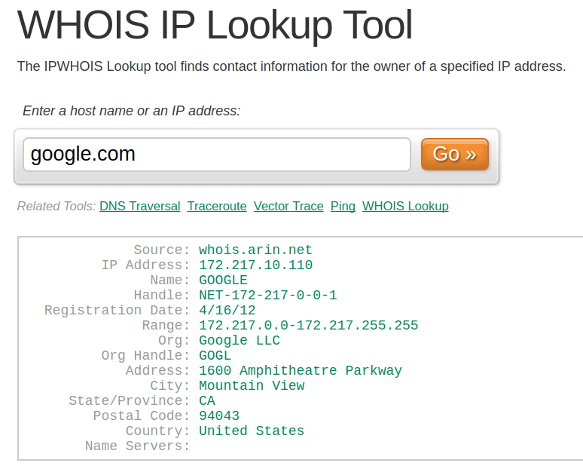
https://www.ultratools.com/tools/ipWhoisLookup
Notes:
Enter the IP Address

Slide 18
Domain Name Server (DNS)
URL | IP Address
roblox.com | 69.172.201.47
google.com | 172.217.10.110
schooloop.com | 184.168.221.9
Client
70.168.374.22
roblox.com
Server
69.172.201.47
Server
Notes:
The client’s request first finds a domain name server or DNS
The DNS maps URLs to IP Address, which work something like phone numbers

Slide 19
A JavaScript Project
Software is made of components
Notes:
Components are code that is writing and packaged up in a way that other people can use without having to look inside the package at the code itself.
So, how extensively are packages used?

Slide 20
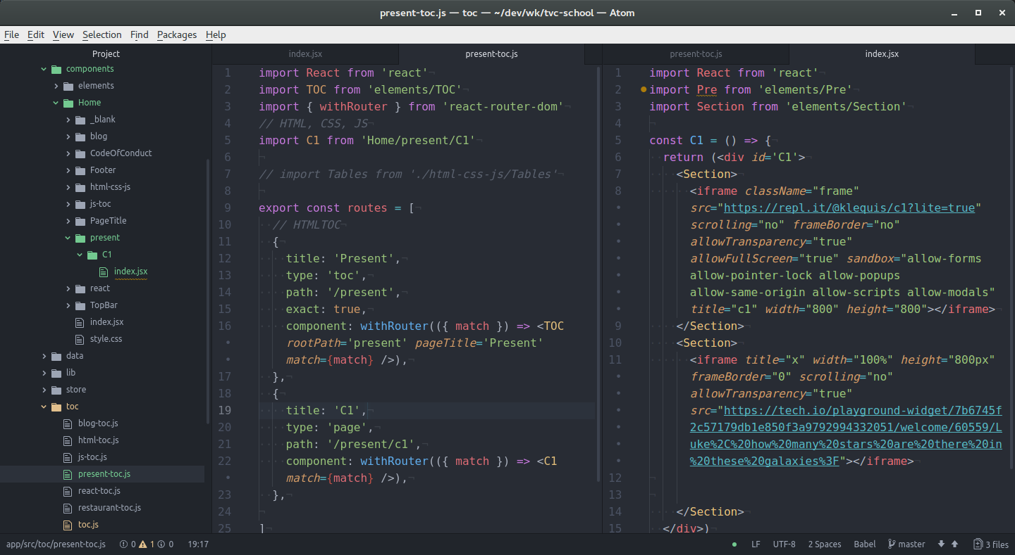
Notes:
This is a view of a JS project I’m working on
It has many ‘components’ made by other people
They are also called libraries or packages
When I add a package to my project it often adds many others which are called dependencies.
This project has 49 main packages, i.e., the ones I added
These 49 packages brought in 865 packages

Slide 21
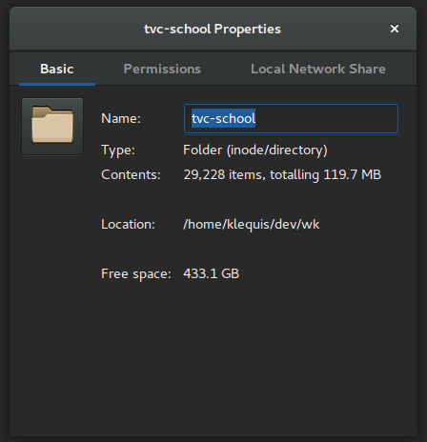
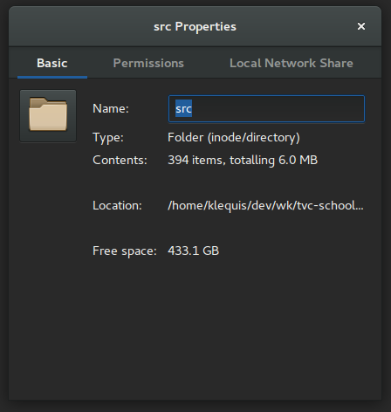
394 / 29,228 = 0.0134 (1.3%)
Notes:
To give you a little perspective on the extent to which software is made of reusable components, lets compare the total number of files in the project to the number of files I created for my code.
So a big part of the job of web developer is knowing which components to use and how to use them

Slide 22
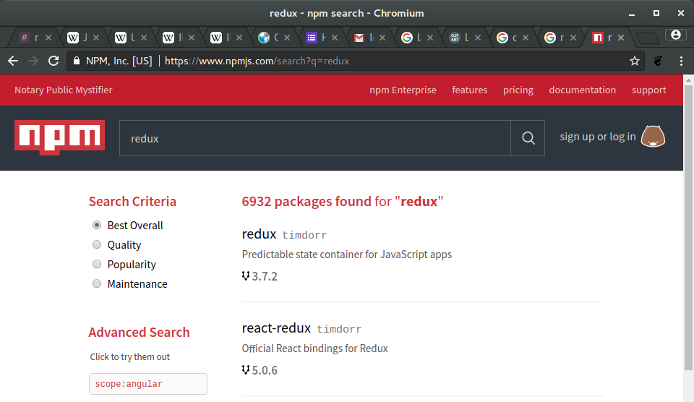
NPM - > 350,000 packages
Notes:
Another take on the same idea
For my projects I get my components from the npm repository

Slide 23
Resources
What is the Internet? https://youtu.be/Dxcc6ycZ73M?list=PLzdnOPI1iJNfMRZm5DDxco3UdsFegvuB7

Slide 24
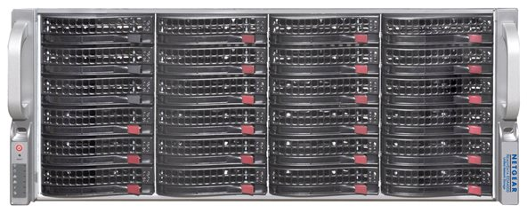
Database Database Management System (DBMS)
Your Computer
The Internet
Servers
Hard Drive Array
Server

