Slide 1
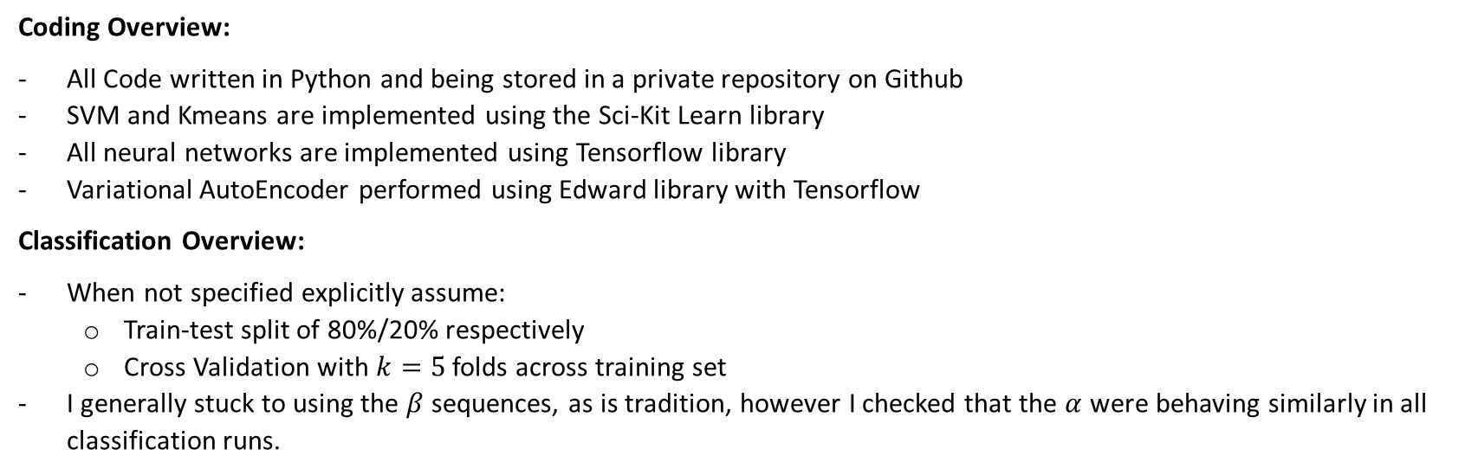
Overview:
Aim: Build an accurate binary classifier to distinguish if the origin of a CDR3 sequence is from a CD4 or CD8 cell
Coding Overview:
All Code written in Python and being stored in a private repository on Github
SVM and Kmeans are implemented using the Sci-Kit Learn library
All neural networks are implemented using Tensorflow library
Variational AutoEncoder performed using Edward library with Tensorflow
Classification Overview:
When not specified explicitly assume:
Train-test split of 80%/20% respectively
Cross Validation with $k=5$ folds across training set
I generally stuck to using the $β$ sequences, as is tradition, however I checked that the $α$ were behaving similarly in all classification runs.

Slide 2
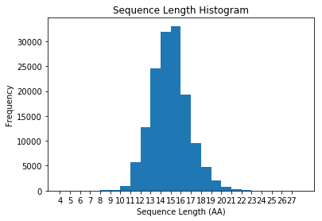
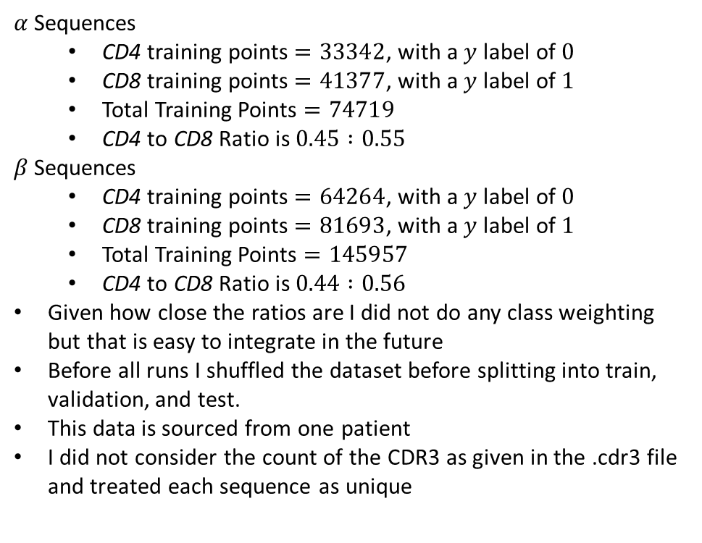

Dataset Overview:
$α$ Sequences
CD4 training points $=33342$, with a $y$ label of $0$
CD8 training points $=41377$, with a $y$ label of $1$
Total Training Points $=74719$
CD4 to CD8 Ratio is $0.45 :0.55$
$β$ Sequences
CD4 training points $=64264$, with a $y$ label of $0$
CD8 training points $=81693$, with a $y$ label of $1$
Total Training Points $=145957$
CD4 to CD8 Ratio is $0.44 :0.56$
Given how close the ratios are I did not do any class weighting but that is easy to integrate in the future
Before all runs I shuffled the dataset before splitting into train, validation, and test.
This data is sourced from one patient
I did not consider the count of the CDR3 as given in the .cdr3 file and treated each sequence as unique
Distribution of the length of sequences for$β$ sequences

Slide 3
Notes on Li et al.:
They had a 80/20 split of CD4:CD8 which is immediately suspicious
CD4 had higher percentages of
K, R, T
CD4 had lower percentages of
D, C, V
Generally CD4 was more associated with positive AAs and CD8 with negatives e.g. D
The only thing we see in our Data set is that the R is slightly higher in CD4s like above, but its quite weak.
For 13 long sequences (not they ignored C and F on the ends)
CD4
Preferred lysine in position 3
Preferred valine in position 3 and 11
Preferred asparagine in position 7
CD8
Preferred cysteine position 9
Preferred proline position 9
Preferred isoleucine position 5
Preferred tyrosine position 5

Slide 4
Notes on Li et al.:
What did WE see
For 13 long sequences (ignoring C and F on the ends)
CD4
Preferred arginine in position 4,5,6
Preferred asparagine in position 7
CD8
Preferred serine in position 7

Slide 5
Amino Acid Usage in CD4/CD8 Globally:
CD4:
['S‘ 15.2%]
['F' 10.3%]
['A' 10.2%]
['G' 9.1%]
['C' 7.1%]
['Q' 6.9%]
['T' 6.7%]
['Y' 6.0%]
['E' 5.3%]
['R' 4.2%]
['L' 4.0%]
['P' 3.3%]
['N' 3.0%]
['D' 2.6%]
['V' 2.0%]
['H' 1.3%]
['I' 1.1%]
['K' 0.9%]
['W‘ 0.5%]
['M' 0.3%]
CD8:
['S' 15.4%]
['F' 10.7%]
['A' 10.3%]
['G' 8.8%]
['C' 7.1%]
['Q' 7.1%]
['T' 6.5%]
['Y' 6.3%]
['E' 6.2%]
['L' 4.0%]
['D' 3.3%]
['P' 3.0%]
['R' 3.0%]
['N' 2.8%]
['V' 1.9%]
['H' 1.1%]
['I' 0.9%]
['K' 0.6%]
['W' 0.6%]
['M' 0.2%]

Slide 6
Classification using Amino Acid Position Probability:
I calculated the probabilities of a given AA being present in a given position for 14 long amino acids, for CD4 and CD8 populations.
For each sequence I made a vector of those individual probabilities, so two 14 long vectors for each sequence.
Both of the two vectors had their log products of all elements taken, leaving us with two values put into one vector
Classifying on this was no better than random

Slide 7
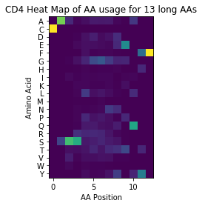
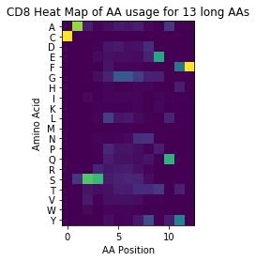
Amino Acid Usage in CD4/CD8:

Slide 8
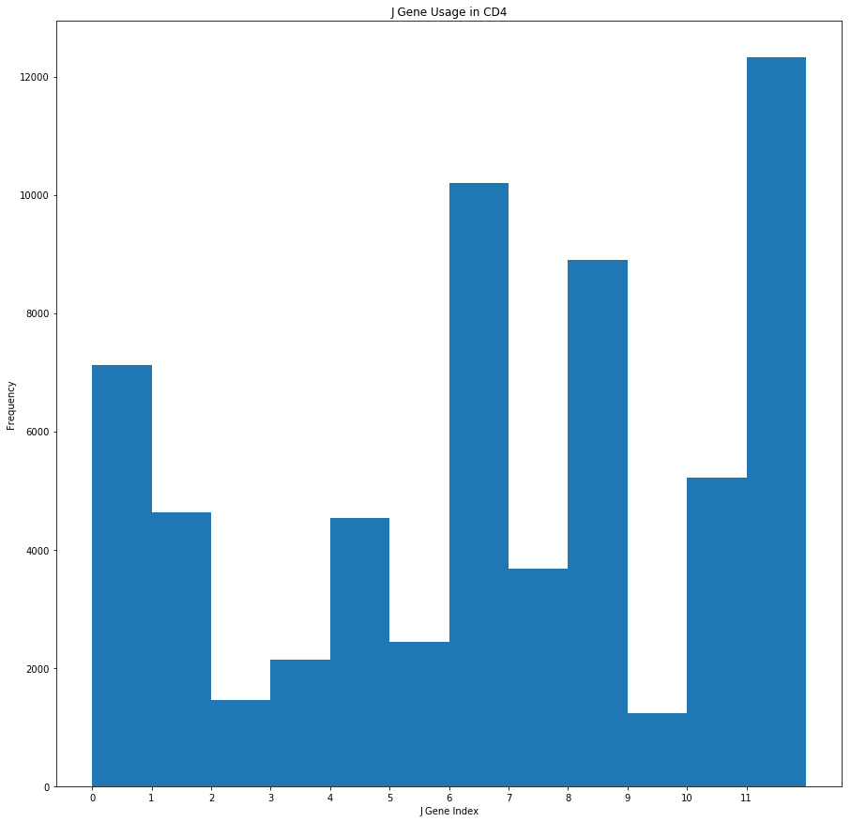
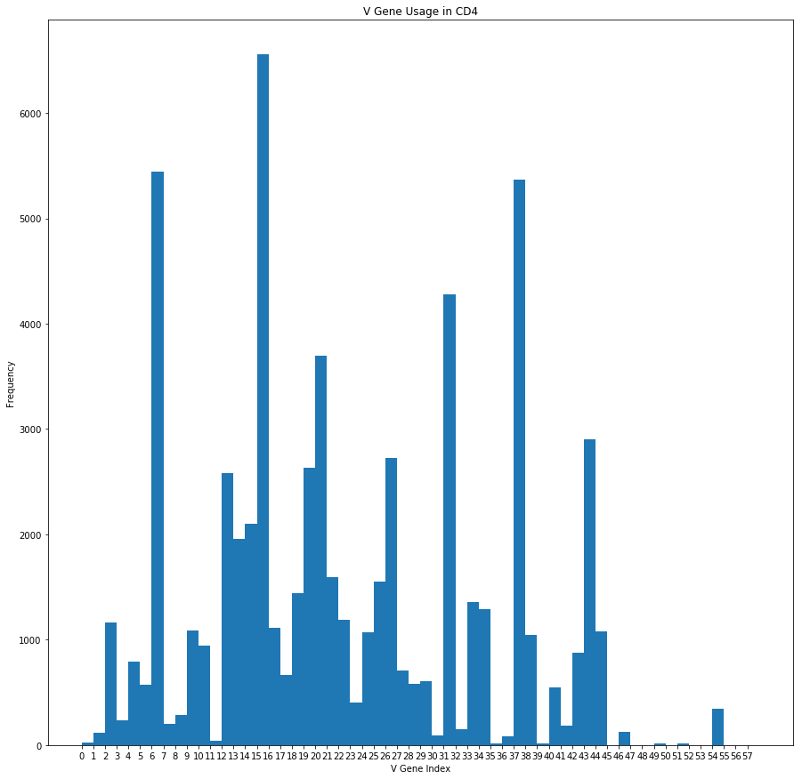
V and J Gene Usage in CD4 for EG10:

Slide 9
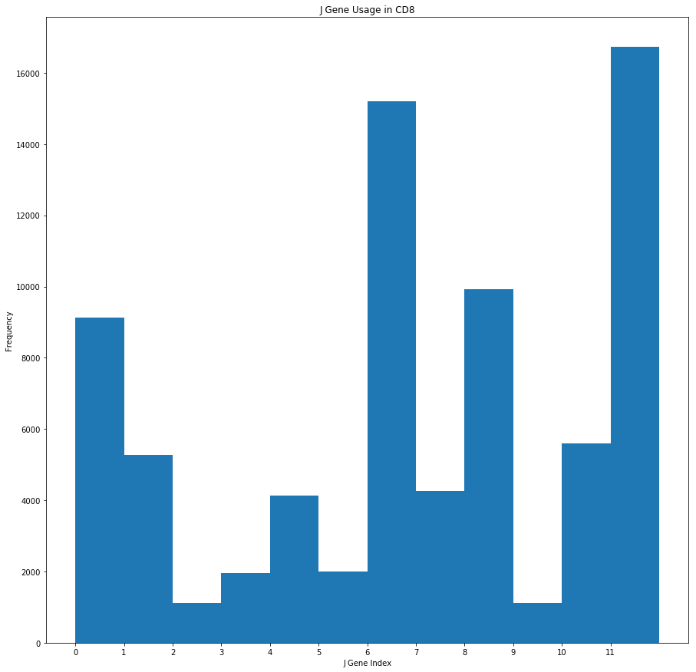
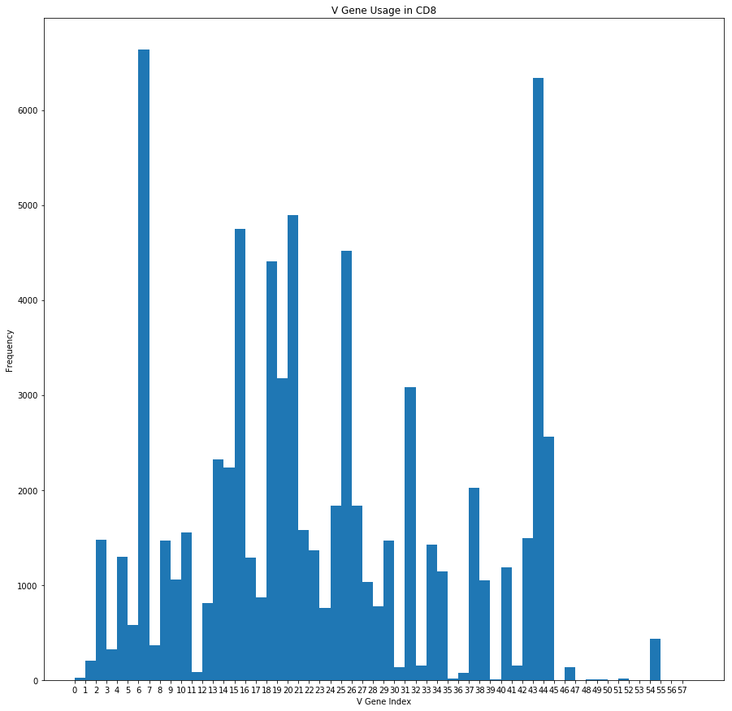
V and J Gene Usage in CD8 for EG10:

Slide 10
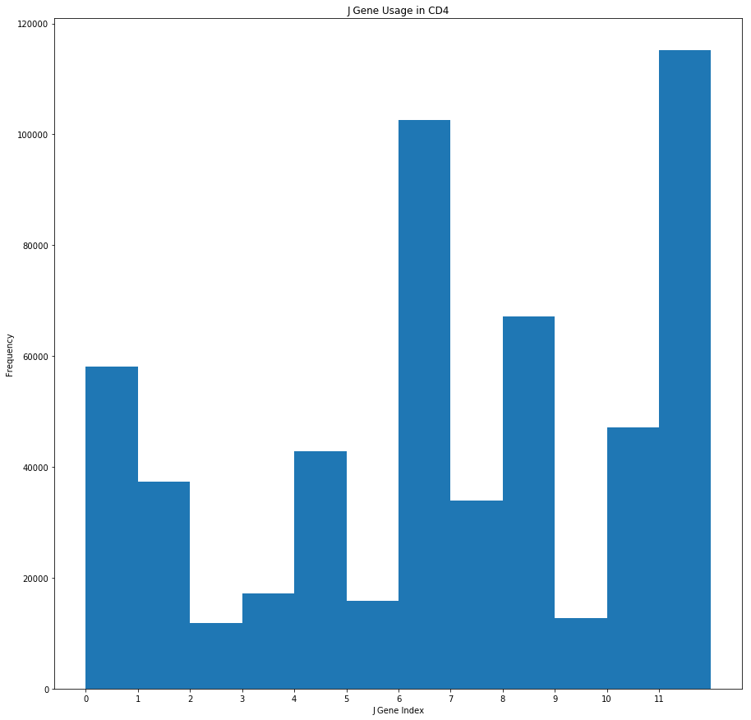
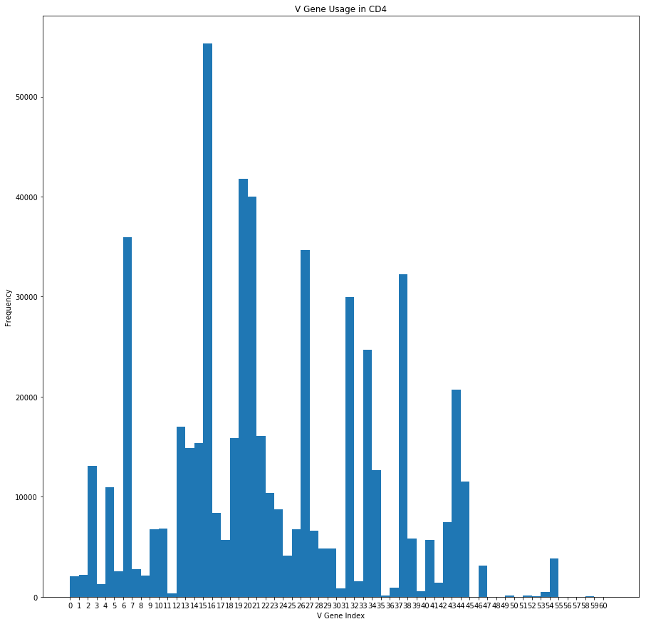
V and J Gene Usage in CD4
For SK11, KS07, EG10:

Slide 11
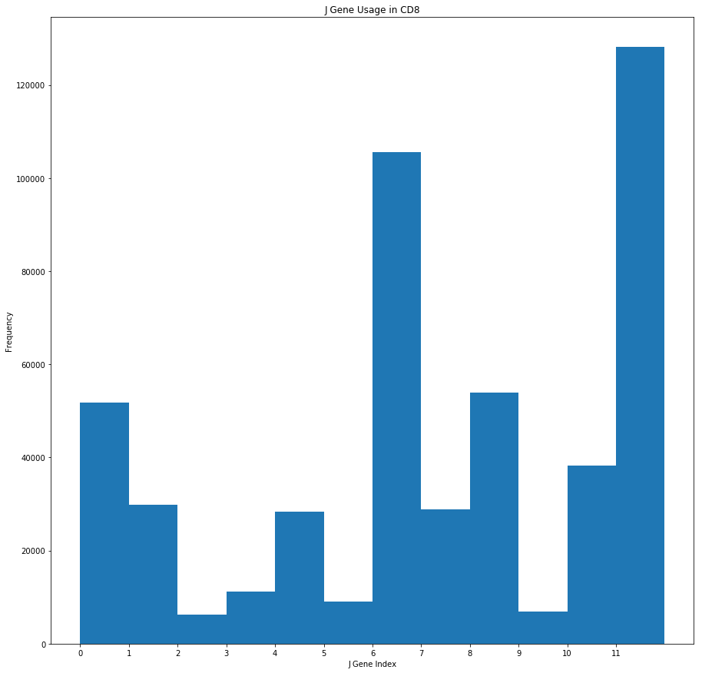
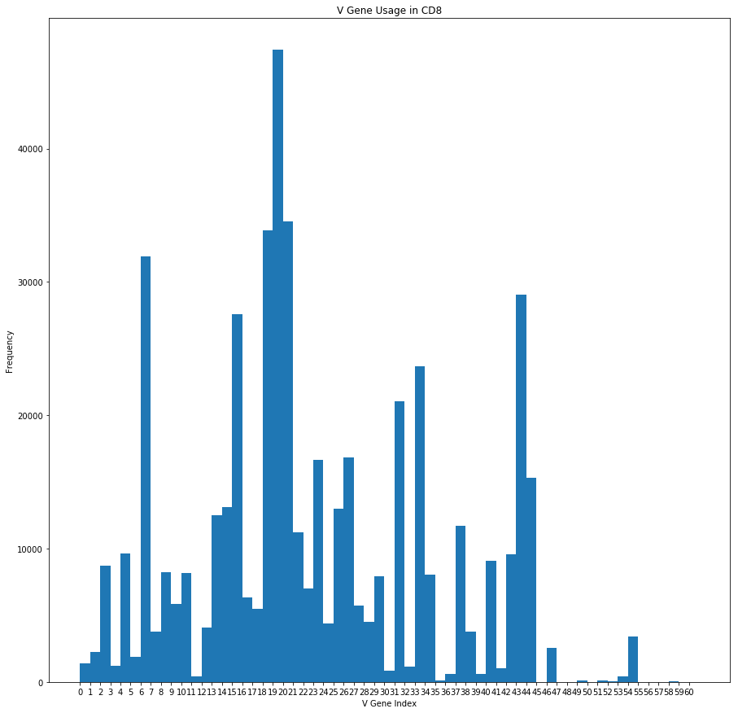
V and J Gene Usage in CD8
For SK11, KS07, EG10:

Slide 12
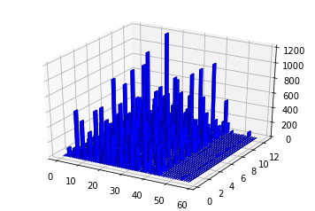
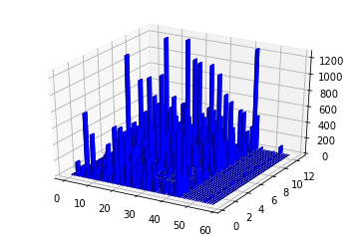
V-J Gene Usage in CD4/CD8:
CD4
CD8
Freq.
Freq.
J Gene
J Gene
V Gene
V Gene

Slide 13
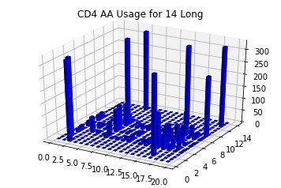
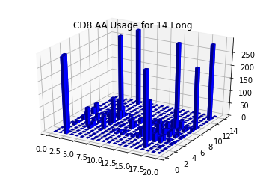
Amino Acid Usage in CD4/CD8 for V-J 15-12:
Freq.
Freq.
Position
Amino Acid Index (Alpha.)
Position
Amino Acid Index (Alpha.)

Slide 14
Conclusions: Amino Acid Usage in CD4/CD8 for V-J 15-12:
Looking at just the sequences its pretty clear that the preference for the beginning and ending amino acids is clearly dependent on the V-J combination. For example this combo almost always begins with CSA and almost always ends with EQYF. This makes sense biologically.
The J region usage is consistent not only across CD4 and CD8 but also across patient populations
The V region is different across the board

Slide 15
Dataset Overview: Short Motifs
Separated out the sequences with the five most common lengths, for beta is 12:16 amino acids long
From there started looking at most common short motifs of different lengths
Most common by frequency and descending for different lengths are below
CD4, p=2
['CA' '59428']
['AS' '55688']
['SS' '53366']
['YF' '30222']
['QY' '29394']
['FF' '26890']
['EQ' '26743']
['TQ' '14521']
['SL' '14077']
['GG' '12890']
CD4, p=1
['S' '116040']
['F' '78288']
['A' '78162']
['G' '69653']
['C' '53956']
['Q' '52980']
['T' '50938']
['Y' '45831']
['E' '40722']
['R' '32186']
CD8, p=1
['S' '148365']
['F' '102848']
['A' '99065']
['G' '84602']
['C' '68651']
['Q' '67877']
['T' '62005']
['Y' '60879']
['E' '59242']
['L' '38250']]
CD8, p=2
['CA' '44839']
['AS' '43010']
['SS' '39159']
['YF' '23608']
['QY' '22398']
['FF' '19217']
['EQ' '17410']
['TQ' '12114']
['GG' '10579']
['SL' '10317']
CD4, p=3
['CAS' '40501']
['ASS' '33743']
['QYF' '22218']
['TQY' '11561']
['SSL' '9350']
['EQY' '9334']
['QFF' '7979']
['EQF' '7767']
['YEQ' '7004']
['DTQ' '6786']]
CD8, p=3
['CAS' '53065']
['ASS' '46222']
['QYF' '29119']
['TQY' '13997']
['EQY' '13926']
['SSL' '12811']
['QFF' '12635']
['EQF' '12429']
['YEQ' '10607']
['NEQ' '9871']
CD4, p=4
['CASS' '33507']
['TQYF' '11554']
['EQYF' '9331']
['ASSL' '9125']
['EQFF' '7766']
['YEQY' '6789']
['DTQY' '6768']
['NEQF' '5872']
['EAFF' '5823']
['ASSP' '5070']]
CD8, p=4
['CASS' '45925']
['TQYF' '13982']
['EQYF' '13917']
['ASSL' '12462']
['EQFF' '12425']
['YEQY' '10353']
['NEQF' '9458']
['DTQY' '8890']
['EAFF' '8403']
['TEAF' '6856']]
CD4, p=5
['CASSL' '9118']
['YEQYF' '6789']
['DTQYF' '6768']
['NEQFF' '5872']
['CASSP' '5059']
['TEAFF' '4901']
['TDTQY' '4220']
['ETQYF' '3939']
CD8, p=5
['CASSL' '12457']
['YEQYF' '10353']
['NEQFF' '9457']
['DTQYF' '8890']
['TEAFF' '6856']
['CASSQ' '6779']
['CASSP' '6055']
['TDTQY' '5838']
CD4, p=7
['STDTQYF' '1454']
['SYNEQFF' '1184']
['NTGELFF' '928']
CD8, p=7
['SYNEQFF' '1950']
['STDTQYF' '1463']
['NTGELFF' '1049']
Notes:
Should look up if there are any well known short structural motifs just based on primary structure

Slide 16
Dataset Overview: Short Motifs
As can be seen on the past slide it seems like the most informative tuple size is p=4
A lot of the smaller sets and subsets of the common p=4 sets
large p values result in much less common tuples that are larger variants on p=4 tuples
The next question that arises is where do these motifs show up in a sequence
“CASS” always shows up at the beginning of a sequence and “TQYF” & “EQYF” always shows up at the end of a sequence, regardless of length. “ASSL” often shows up in the second and third positions likely due to “CASSL” being reasonably common. These quasi-rules are consistent across both CD4 and CD8 populations.
This would tend to suggest that there is definitely some underlying logic to the sequence. Obviously this goes without saying however this confirms that the sequences can be in some way generalized based on the short motifs.
Considering that the most common motifs are at the beginning and end of the sequence, and are consistent across populations, this tends to suggest that the motifs are adding noise to finding distinct differences in populations.
Furthermore this would suggest that the CDR3 loop itself is not uniformly hypervariable, the ends of the loop being less random and more common across populations. This could be due to having some consistent structure in establishing the loop so it presents better to the antigen.
Focusing on the center of the sequence will focus on the antigen binding and furthermore the region that likely contains areas relevant to separation.
This leads to a needing to do the character usage at different positions. We need to normalize the positions though as we’ve seen that the beginning and end regardless of length contain common features.
Notes:
Should look up if there are any well known short structural motifs just based on primary structure

Slide 17
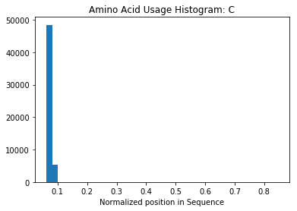
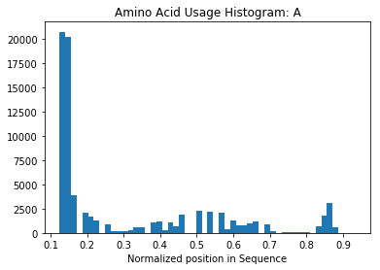
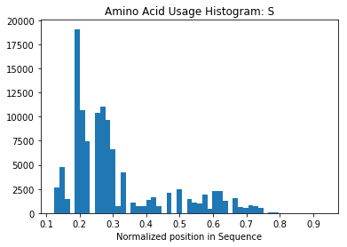
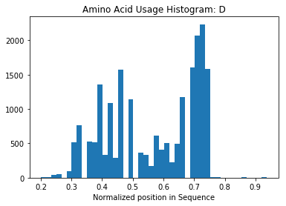
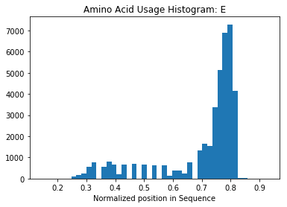
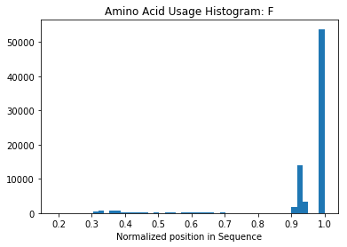
Dataset Overview: Amino Acid Usage CD4
Notes:
Should look up if there are any well known short structural motifs just based on primary structure

Slide 18
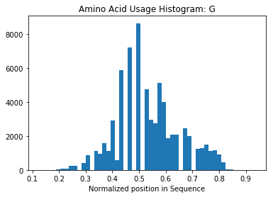
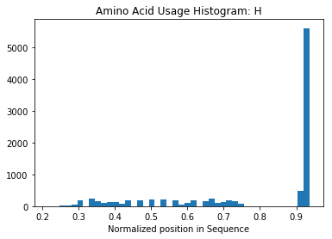
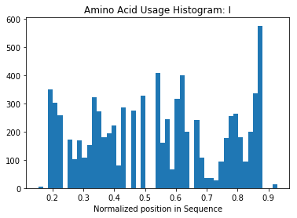
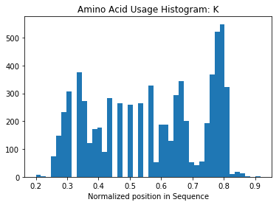
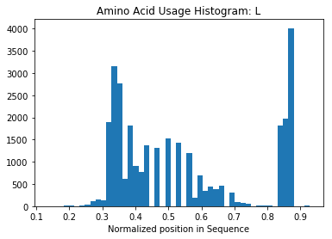
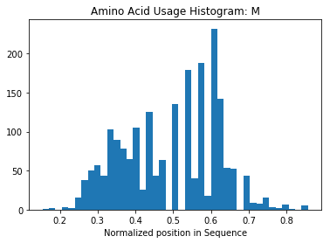
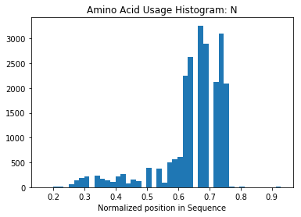
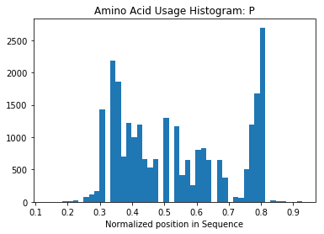
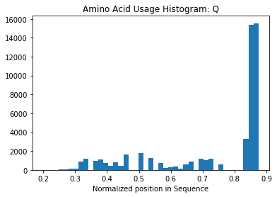
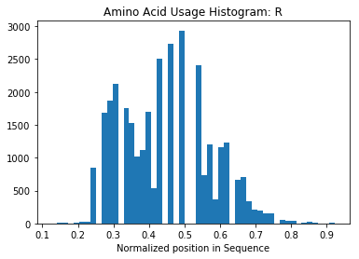
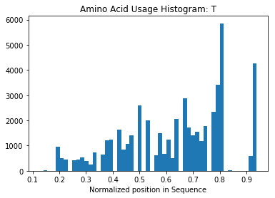
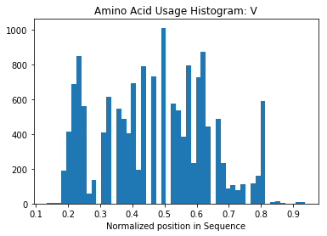

Slide 19
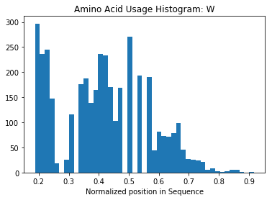
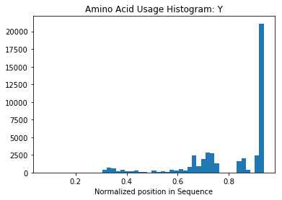

Slide 20
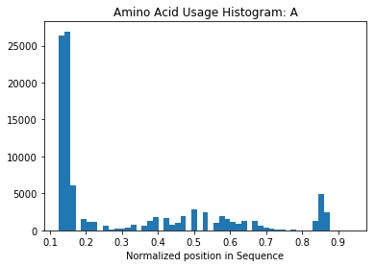
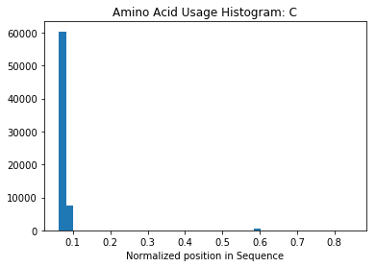
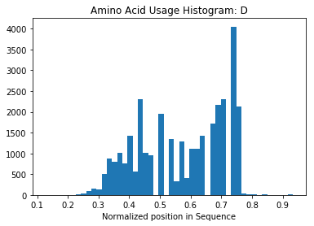
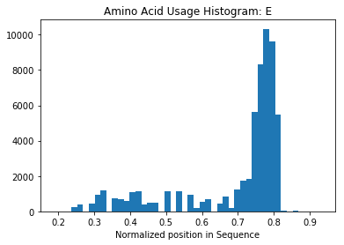
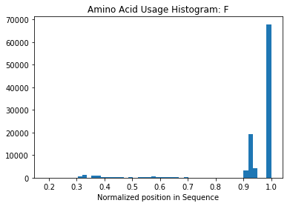
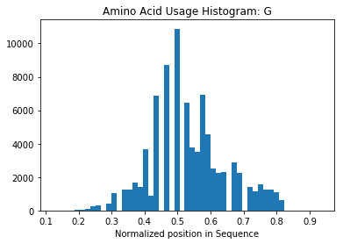
Dataset Overview: Amino Acid Usage CD8
Notes:
Should look up if there are any well known short structural motifs just based on primary structure

Slide 21
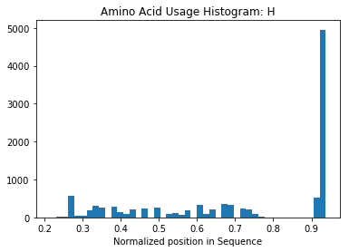
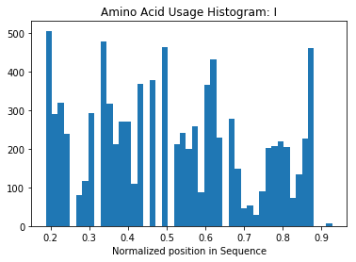
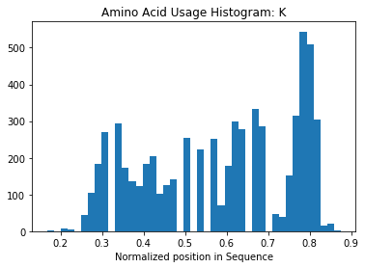
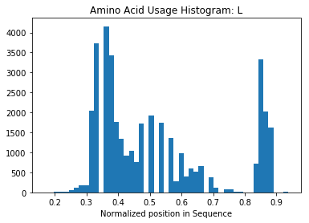
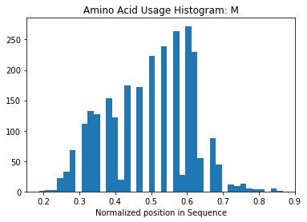
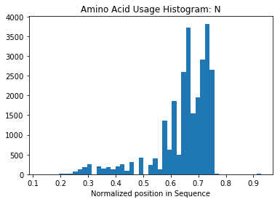
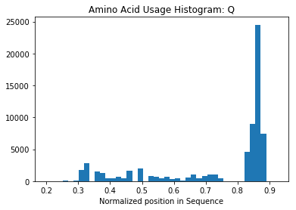



Slide 22






Slide 23
Dataset Overview: Amino Acid Usage CD8 and CD4
A: same, sits heavily at the beginning then spread across
C: same, always at the beginning of sequence
D: same, more towards end but spread, not at beginning or end
E: same, peaks heavily around 0.8
F: same, peaks massively at the end of the sequence
G: same, not start or end but bell curve around 0.5
H: same, peaks massively around the end
I: same , not start/end, uniform spread around center
K: same , not start/end, uniform spread around center
L: same , not start/end, uniform spread around center
M: same , not start/end, uniform spread around center
N: same
P: same
Q: same
R: same
S: same
T: same
V: same
W: same
Y: same
Notes:
Should look up if there are any well known short structural motifs just based on primary structure

Slide 24
Dataset Overview: Amino Acid Usage CD8 and CD4
Killing the first 2 aa’s doesn’t really affect the accuracy, likewise with removing the last 4 (14 long)
I used K-NN to test this as the results sit around 60% on a 50/50 class split.
First two makes sense as its so often ‘CA’
Last four also makes sense as its often one of the common tuples which don’t help in separation
This means that they’re not contributing noise but aren’t helping the separation
This follows as we knew that the common tuples were consistent across classes i.e. they’re not contributing
So do we remove them some how from the classification
This is exactly Chothia analysis from Antibody studies
Can we take advantage of homology modelling to get some version of the structures and then create a context free grammar – and shove that through a classification scheme
This means the classification is essentially taking place on a 8 long window.
Notes:
Should look up if there are any well known short structural motifs just based on primary structure

Slide 25
General Structure of Algorithm:
Input
Binary Classification
CD4
String to Numeric Data
CDR3 Sequence:
[“CAFMKRY…”]
Feature Engineering
Classifier
CD8
Optional:
Dimensionality Reduction

Slide 26
Feature Engineering Methods:
Dim. Reduction Methods:
p-Tuple Frequency
p-Tuple Frequency with CDR1/2
Thomas et al. 2014
Li et al. 2015
Prot2Vec
Deep Autoencoder
Classification Methods:
SVM
Linear Kernel
Polynomial Kernel
RBF
Deep Feed Forward Neural Network
Recurrent Neural Network (only used with Unsupervised feature extraction)

Slide 27
Feature Engineering:
Li et al. 2015 Method
Li Method, using length 14 as example
CDR3 Sequence:
[“CAFMKRY…”]
CDR3 of Length 14:
[“CAFMKRY…”]
Atchley Vectors:
[1.4,-1.3,0.2,2.0,-1.8…]
[1 x N]
[1 x 14]
[1 x 70]
This method is essentially binning sequences by length for ease
Then replacing each amino acid with its corresponding 5-dim Atchley Vector and flattening it to length by five dimensions

Slide 28
Feature Engineering:
Li et al. 2015 Method
Li Method including CDR1, CDR2, using CDR3 length 14 as example
CDR3 Sequence:
[“CAFMKRY…”]
CDR1/2/3:
[“EFFYA”]
Atchley Vectors:
[1.4,-1.3,0.2,2.0,-1.8…]
[1 x 5]
[“VEFANN”]
[1 x 6]
[1 x N]
[“CAFMKRY…”]
[1 x 14]
[1 x 125]

Slide 29
Feature Engineering:
Li et al. 2015 Method
AA Pos. Prob. Method using length 14 as example
CDR3 Sequence:
[“CAFMKRY…”]
CDR3 of Length 14:
[“CAFMKRY…”]
Probabilities of CD4 & CD8:
[0.1, 0.032, 0.02…]
[1 x N]
[1 x 14]
[1 x 28]

Slide 30
Ensemble Network
CDR3 of Length 14:
[“CAFMKRY…”]
Dense Layer
2 units
Softmax Activation
x2 Dense Layer
128, 64 units
ELU Activation
[1 x 14]
Concatenated
CDR2 of Length 6:
[“VEFANN”]
Dense Layer
2 units
Softmax Activation
x2 Dense Layer
64, 64 units
ELU Activation
[1 x 6]
Dense Layer
64 units
ELU Activation
CDR1 of Length 5:
[“EFFYA”]
Dense Layer
2 units
Softmax Activation
x2 Dense Layer
64, 64 units
ELU Activation
[1 x 6]
Dense Layer
2 units
Softmax Activation
V Gene Index:
[6]
Dense Layer
2 units
Softmax Activation
x2 Dense Layer
64, 64 units
ELU Activation
[1 x 1]
Prediction

Slide 31




Bi-Directional Recurrent Neural Network – using one-hot encoding as an example
Dense Layer
1 unit
Sigmoid Activation
Prediction
x2 Dense Layer
512, 128 units
ELU Activation
Concatenated
LSTM Cell
128 units
LSTM Cell
128 units
LSTM Cell
128 units
LSTM Cell
128 units
…
$$\left[\begin{matrix}0 \\ 0 \\ \begin{aligned}1 \\ 0\end{aligned}\end{matrix}\right]$$
$$\left[\begin{matrix}0 \\ 0 \\ \begin{aligned}0 \\ 1\end{aligned}\end{matrix}\right]$$
$$\left[\begin{matrix}1 \\ 0 \\ \begin{aligned}0 \\ 0\end{aligned}\end{matrix}\right]$$
$$\left[\begin{matrix}0 \\ 1 \\ \begin{aligned}0 \\ 0\end{aligned}\end{matrix}\right]$$
Input [1 x 20]

Slide 32
Li et al. SVM Classification
Tried the three different kernels mentioned previously and optimized with grid search or line search depending. The following are the search parameters where gamma is the width of the RBF:
C: [0.01, 0.1, 1, 10, 100]
gamma:[1e-5, 1e-4, 1e-3, 1e-2, 1e-1]
Depending on results these were altered
Length 14 Sequences are almost 1:1 in terms of class ratios
Seq. Length | Method/Kernel | Best Parameters | Test Accuracy
14 | Linear | C=10 | 59.6%
14 | Poly, n=3 | C=1, gamma=0.05 | 58.8%
14 | RBF | C=10, gamma =0.001 | 60.5%
14 | Deep NN | Batch=64, Learning Rate=0.001 | 63.2%

Slide 33
Li et al. NN Classification
Higher accuracy due to more CD8 examples
Four layers of sizes 48, 24, 12, 6 and finally one output node
Weights are Xavier initialized and Bias’ are zero initialized
Each layer has an ELU non-linearity and the output node is a sigmoid
Uses an Adam Optimizer with Cross Entropy loss
Gradient clipping to norm of 5 and an exponential decay of learning rate of 0.99 every epoch
Early stopping was performed based on manual heuristics
Seq. Length | Method/Kernel | Best Parameters | Test Accuracy
10 | Deep NN | Batch=64, Learning Rate=0.01 | 69.6%
11 | Deep NN | Batch=64, Learning Rate=0.01 | 68.9%
12 | Deep NN | Batch=64, Learning Rate=0.01 | 62.8%
13 | Deep NN | Batch=64, Learning Rate=0.01 | 62.1%
14 | Deep NN | Batch=64, Learning Rate=0.01 | 63.2%

Slide 34
Li et al. Extraneous Classification Methods
Using a nearest neighbor classifier to get a better background
Seq. Length | Method/Kernel | Best Parameters | Test Accuracy
14 | K-NN | N = 1 | 61.8%

Slide 35
Li et al. + AutoEncoder-SVM Classification
AutoEncoder used a layers of sizes 64, 32, 16, 32, 64, input_size
The layer of size 16 is the bottleneck that will produce the final layer of the encoder
All layers except the last with sigmoid non-linearities
After training the AutoEncoder with an Adam optimizer around squared loss it is run through an SVM
After 500 epochs it can generally reduce squared error to 0.109 and the decoded outputs look very similar to the inputs suggesting that the AutoEncoder compression is effective.
AE used batch of 128 and a learning rate of 0.001. The SVM used a C value of and gamma value of
Input size is Seq. Length times five so it is interesting how compressible this is.
Seq. Length | Method/Kernel | Parameters | Test Accuracy
10 | AE-SVM (RBF) | C = 100, gamma = 100 | 63.0%
11 | AE-SVM (RBF) | C = 10, gamma = 100 | 63.8%
12 | AE-SVM (RBF) | C = 1000, gamma = 1 | 58.2%
13 | AE-SVM (RBF) | C = 1000, gamma = 0.01 | 58.1%
14 | AE-SVM (RBF) | C = 100, gamma = 0.01 | 57.0%

Slide 36
Li et al. + AutoEncoder-SVM Classification
The obvious reason this appears to be working is that the repetition of Atchley vectors is very easy to learn and thus represent in some latent space as long as the latent space is larger than the size of the protein sequence primary structure.
Decreasing the latent space to below the size of the sequence is when the AutoEncoder is not only compressing but also trying to denoise.
After 2000 epochs, dropping the latent space size to 8 for sequences 14 AA long gets a loss of 0.198 and the outputs were looking pretty good. It was also still converging so could train longer.
Need to get a Variational AutoEncoder working then using tSNE we can visualize the space in 2D
This would give us more info about how it is separating
I believe the Keras documentation has a method for this
Actually shows an improvement from the original which suggests that the AE is de-noising to an extent
Seq. Length | Method/Kernel | Parameters | Test Accuracy
14 | AE(small)-SVM (RBF) | C = 100, gamma = 1.0 | 60.1%
Example of Compression:
Input = [-1.343 0.465 -0.862 ..., 1.891 -0.397 0.412]
Prediction = [-1.332 0.463 -0.858 ..., 1.684 -0.645 0.312]

Slide 37

Li et al. t-SNE Visualization
t-SNE runs on perplexity of 30, 2 principal components, a base method of PCA, and 5000 iterations
Blue = CD4
Red = CD8

Slide 38

Three Patient CD4/CD8 Dataset
Map each tuple in a sequence to a codeword cluster and generate a frequency entry for each cluster
Both p=3 and p=2 where tested
Using triplets as an example, all possible triplet Atchley vectors are clustered into k clusters. Every sequence is broken down into triplets and then each triplet is mapped to a cluster. The number of triplets mapped into each cluster is represented in a k-dimensional vector.
This process is performed for all sequences
I used k=100 and k=1000 with close to the same results
Feature Engineering: Thomas et al. 2014 Method

Slide 39
Thomas et al. 2014 SVM Classification
Results given are over
Tried the three different kernels mentioned previously and optimized with grid search or line search depending. The following are the search parameters where gamma is the width of the RBF:
C: [0.1, 1, 10, 100, 1000]
gamma:[1e-4, 1e-3, 1e-2, 1e-1, 1e0, 1e1, 1e2]
n clusters: 100
K samples: 10,000
Depending on results these were altered
Need to re-run as page I wrote params on is missing
p Value | Kernel | Best Parameters | Test Accuracy
2 | RBF | C = 10, gamma = 1 | 58.2%
3 | RBF | - | 59.9%

Slide 40
Feature Engineering: p-Tuple Frequency
Basic Method
CDR3 Sequence:
[“CAFMKRY…”]
CDR3 Sequence p-Tuples:
[“CAF”, “AFM”, “FMK”, …]
p-Tuples Frequency:
[0,1,0,0,0,0,0,0, …]
[1 x N]
[1 x (N-2) x p]
[1 x 20^{p}]
Both p=3 and p=2 where tested, thus each point/sequence had 400 dimensions or 8000 dimensions respectively
These were not binary features, that is to say it was a frequency count of a p-Tuple being present in a sequence, but in practice counts above one are rare and the vectors are quite sparse.
Note that this is length invariant as a method so it doesn’t require separation of sequences by length

Slide 41
p-Tuple Frequency SVM Classification
Results given are over
Tried the three different kernels mentioned previously and optimized with grid search or line search depending. The following are the search parameters where gamma is the width of the RBF:
C: [0.1,1,10,100]
gamma:[1e-4,1e-3,1e-2]
Depending on results these were altered
p Value | Kernel | Best Parameters | Test Accuracy
2 | Linear | C = 1, gamma = 1 | 61.0%
2 | Poly, n=3 | C = 100, gamma = 0.01 | 60.8%
2 | RBF | C = 10, gamma = 0.01 | 62.0%
3 | Linear | C = 1, gamma = 0.01 | 60.1%
3 | Poly, n=3 | C = 1, gamma = 1 | 61.0%
3 | RBF | C = 10, gamma = 0.01 | 62.2%

Slide 42
Feature Engineering:
p-Tuple Frequency with CDR1/2
CDR1 and CDR2 Included Method
CDR Sequences:
[“CAFMKRY…”]
[“VASNS…”]
[“VSAKL…”]
CDR3 Sequence p-Tuples:
[“CAF”, “AFM”, “FMK”, …]
[“VAS”, “ASN”, “SNS”, …]
[“VSA”, “SAK”, “AKL”, …]
p-Tuples Frequency:
[0,1,0,0,0,0,0,0, …]
[0,0,0,0,1,0,0,0, …]
[0,0,0,0,0,1,0,0, …]
p-Tuples Frequency:
[0,1,0,0,0,0,0,0, …]
3 x [1 x N]
3 x[1 x (N-2) x p]
3 x[1 x 20^{p}]
[1 x (20^{p} x 3)]
Both p=3 and p=2 where tested, thus each point/sequence had 400 dimensions or 8000 dimensions respectively
The last step flattens/concatenates the three CDRs together

Slide 43

Feature Engineering:
ProtVec Method
This method is based on BioVec from Asgari & Mofrad (2015).
Will train our own embeddings and use those trained on SwissProt
They implemented a pretty simple Word2Vec method, so I’m going to implement the GloVe from Pennington et al. (the big brother embedding)
Limited vocab size to 6500
Did the splittings like Asgari
Ran in self enclosed ProVec.py
Trained a 192 dimension embedding for each pTuple (just p=3)
Should use Lipshitz constant to calculate smoothness
Sum of embeddings for a protein is its feature representation.
This is then put through a four layer NN (128/64/32/16)
58.65% Accuracy on Custom Embeddings with an NN classifier
Accuracy on Custom Embeddings with an NN classifier
Notes:
http://journals.plos.org/plosone/article/metrics?id=10.1371/journal.pone.0141287
https://cs224d.stanford.edu/reports/LeeNguyen.pdf
https://github.com/ehsanasgari/Deep-Proteomics
https://arxiv.org/abs/1608.05949
https://arxiv.org/abs/1604.07176
https://nlp.stanford.edu/pubs/glove.pdf

Slide 44


Feature Engineering:
ProtVec Method tSNE plots 192 dim custom
Common Triples
Rare Triples
Notes:
http://journals.plos.org/plosone/article/metrics?id=10.1371/journal.pone.0141287
https://cs224d.stanford.edu/reports/LeeNguyen.pdf
https://github.com/ehsanasgari/Deep-Proteomics
https://arxiv.org/abs/1608.05949
https://arxiv.org/abs/1604.07176
https://nlp.stanford.edu/pubs/glove.pdf

Slide 45

Feature Engineering:
ProtVec Method tSNE plots 150 dim training set 10,000 examples
Blue = CD4
Red = CD8
Notes:
http://journals.plos.org/plosone/article/metrics?id=10.1371/journal.pone.0141287
https://cs224d.stanford.edu/reports/LeeNguyen.pdf
https://github.com/ehsanasgari/Deep-Proteomics
https://arxiv.org/abs/1608.05949
https://arxiv.org/abs/1604.07176
https://nlp.stanford.edu/pubs/glove.pdf

Slide 46

Feature Engineering:
Probability Position tSNE training set 10,000 examples
Notes:
http://journals.plos.org/plosone/article/metrics?id=10.1371/journal.pone.0141287
https://cs224d.stanford.edu/reports/LeeNguyen.pdf
https://github.com/ehsanasgari/Deep-Proteomics
https://arxiv.org/abs/1608.05949
https://arxiv.org/abs/1604.07176
https://nlp.stanford.edu/pubs/glove.pdf

Slide 47
Larger Dataset
Chucking everything in didn’t work
Only looked at beta initially
Next used only the beta naïve cells about 10 off random
The same relative results for models trained on individual patients
Right now we have three, EG10, SK11, KS07
Trained an individual model for each patient and when combining them by multiplying the log likelihoods it didn’t go very well and actually decreased things. This makes it look like the only way is to include the prior of the V and go from there
The predication probability differences are really low which suggests the V prior will have a big effect.
Another thing is to include the v and j regions as features
Also need to run the one hot version
Also need to run the one hot version with v
Also need to classify only the CDR1 and CDR2 separately
Just on V and J got EG10 61% (55/45) using Adaboost
This suggest knowing the v and j is valuable; the deletions are not
This is entirely derived from the v region: v region is used preferably by cd4/8
Notes:
http://journals.plos.org/plosone/article/metrics?id=10.1371/journal.pone.0141287
https://cs224d.stanford.edu/reports/LeeNguyen.pdf
https://github.com/ehsanasgari/Deep-Proteomics
https://arxiv.org/abs/1608.05949
https://arxiv.org/abs/1604.07176
https://nlp.stanford.edu/pubs/glove.pdf

Slide 48
Larger Dataset
Including V region with Li et al. method leads to 5% bump to around 66% using adaboost
Multiplying the V region probability after the fact bumps it by only 1 to 2%
Almost all CDR1s are 5 long; can classify them at get a 5% gain on random at 60%
Appears the same with CDR2s but they’re 6 long; 61%
Concatenating them makes 61%
Classifier on each then concat the log probs then ensemble on the data with an svm gets
Notes:
http://journals.plos.org/plosone/article/metrics?id=10.1371/journal.pone.0141287
https://cs224d.stanford.edu/reports/LeeNguyen.pdf
https://github.com/ehsanasgari/Deep-Proteomics
https://arxiv.org/abs/1608.05949
https://arxiv.org/abs/1604.07176
https://nlp.stanford.edu/pubs/glove.pdf

Slide 49
Boosting
Adaboost and XGBoost are getting around the same results
The single patient data vs 3 patient data is an order of magnitude of more points and it gets almost the same results
With Li et al. plus V region integer value gets around 64-66%
Notes:
http://journals.plos.org/plosone/article/metrics?id=10.1371/journal.pone.0141287
https://cs224d.stanford.edu/reports/LeeNguyen.pdf
https://github.com/ehsanasgari/Deep-Proteomics
https://arxiv.org/abs/1608.05949
https://arxiv.org/abs/1604.07176
https://nlp.stanford.edu/pubs/glove.pdf

Slide 50
Feature selection using EG10 only
Baseline: Removing features with low variance (80% threshold): 65%
No effect at 80%
Started to decrease at 5%
This suggest out data set has really low variance
Basically the first and last AAs obviously have low variance so they’re turfed and that’s it
Select K Best Features
Chi Squared
Cant use as Negative Values
Mutual Information
At k=2 it could get to 62%
This was carried by the v region and one attribute of an amino acid in the center
F-Score ANOVA
K=50 is about when it starts to drop values
This is again confirming we have a lack of distinct features apart from v value
Adaboost assigns weights in a similar way as Mutual Info
Last two and first two amino acids are useless
Most important is the v region
Without v the most important is spread across the middle Aas
Notes:
http://journals.plos.org/plosone/article/metrics?id=10.1371/journal.pone.0141287
https://cs224d.stanford.edu/reports/LeeNguyen.pdf
https://github.com/ehsanasgari/Deep-Proteomics
https://arxiv.org/abs/1608.05949
https://arxiv.org/abs/1604.07176
https://nlp.stanford.edu/pubs/glove.pdf

Slide 51
Adding CDR1 and CDR2
Need to
add CDR1 and CDR2 with boosting model
Remove repeats from both sequences
Remove Repeats
About 1900 in EG10 and doesn’t have any noticeable effect on the separation
Same with all three patients – no effect
This was with and without including the v region as a delimiter of what is unique
1.5% of sequences are shared which is reasonable
Still more than Li et al.
CDR1/2
Noticed that there is a weird 3aa artifact at the end of each sequence that I need to turf to match up
Only one failure when removing the extra artifact
Added the v region and concatenated the atchley of all three
Adaboost on CDR3/1/2/v got 66% flat and XGBoost was getting same if not a touch higher
That’s 126 features – weirdly v not as important
With feature reduction based on mutual information to 100 best features reduced accuracy down to 64%
110 was 65%
Given that this split is essentially 55/45 it means it still a 10% gain on random
Notes:
http://journals.plos.org/plosone/article/metrics?id=10.1371/journal.pone.0141287
https://cs224d.stanford.edu/reports/LeeNguyen.pdf
https://github.com/ehsanasgari/Deep-Proteomics
https://arxiv.org/abs/1608.05949
https://arxiv.org/abs/1604.07176
https://nlp.stanford.edu/pubs/glove.pdf

Slide 52
Focusing on V(D)J data
Got the families and subfamilies and added them to the data set of [v, j, v deletions, j deletions]
Baseline of 61%
With the families and sub families it was just 0.5% more
This is when you keep in the v and j indexes
AdaBoost feature importance
array([ 0.62, 0.02, 0.04, 0.03, 0.18, 0.09, 0. , 0.02])
Its heavily relying on V as expected but the rest is still helping
V family (sub) didn’t help with the overall classifier
Notes:
http://journals.plos.org/plosone/article/metrics?id=10.1371/journal.pone.0141287
https://cs224d.stanford.edu/reports/LeeNguyen.pdf
https://github.com/ehsanasgari/Deep-Proteomics
https://arxiv.org/abs/1608.05949
https://arxiv.org/abs/1604.07176
https://nlp.stanford.edu/pubs/glove.pdf

Slide 53
InfoGAN
Examples after one epoch of simple set up
Notes:
http://journals.plos.org/plosone/article/metrics?id=10.1371/journal.pone.0141287
https://cs224d.stanford.edu/reports/LeeNguyen.pdf
https://github.com/ehsanasgari/Deep-Proteomics
https://arxiv.org/abs/1608.05949
https://arxiv.org/abs/1604.07176
https://nlp.stanford.edu/pubs/glove.pdf

