Slide 1
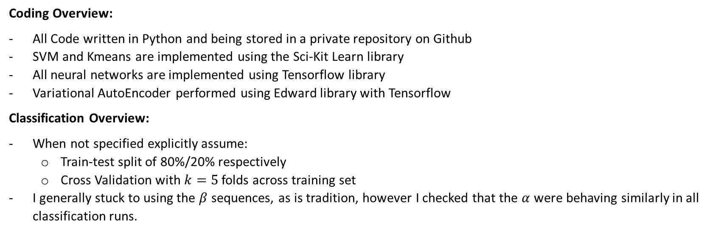
Overview:
Aim: Build an accurate binary classifier to distinguish if the origin of a CDR3 sequence is from a CD4 or CD8 cell
Coding Overview:
All Code written in Python and being stored in a private repository on Github
SVM and Kmeans are implemented using the Sci-Kit Learn library
All neural networks are implemented using Tensorflow library
Variational AutoEncoder performed using Edward library with Tensorflow
Classification Overview:
When not specified explicitly assume:
Train-test split of 80%/20% respectively
Cross Validation with $k=5$ folds across training set
I generally stuck to using the $β$ sequences, as is tradition, however I checked that the $α$ were behaving similarly in all classification runs.

Slide 2
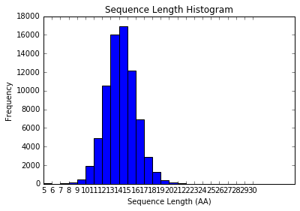
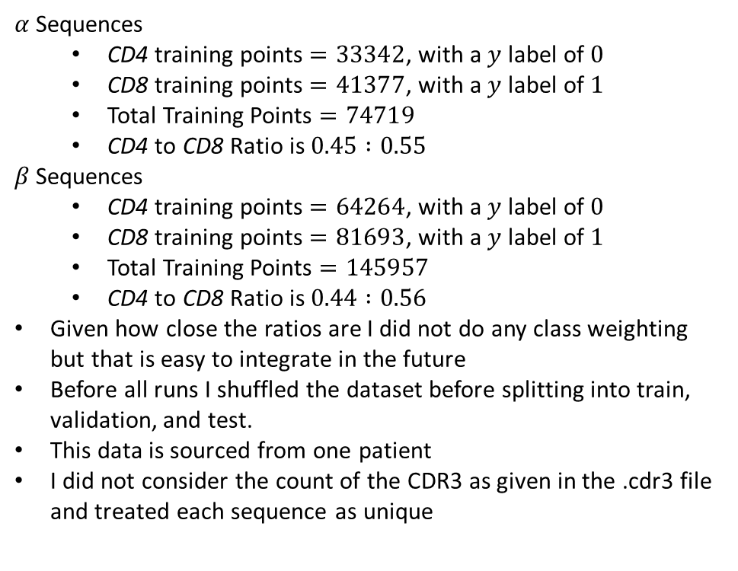

Dataset Overview:
$α$ Sequences
CD4 training points $=33342$, with a $y$ label of $0$
CD8 training points $=41377$, with a $y$ label of $1$
Total Training Points $=74719$
CD4 to CD8 Ratio is $0.45 :0.55$
$β$ Sequences
CD4 training points $=64264$, with a $y$ label of $0$
CD8 training points $=81693$, with a $y$ label of $1$
Total Training Points $=145957$
CD4 to CD8 Ratio is $0.44 :0.56$
Given how close the ratios are I did not do any class weighting but that is easy to integrate in the future
Before all runs I shuffled the dataset before splitting into train, validation, and test.
This data is sourced from one patient
I did not consider the count of the CDR3 as given in the .cdr3 file and treated each sequence as unique
Distribution of the length of sequences for$β$ sequences

Slide 3
General Structure of Algorithm:
Input
Binary Classification
CD4
String to Numeric Data
CDR3 Sequence:
[“CAFMKRY…”]
Feature Engineering
Classifier
CD8
Optional:
Dimensionality Reduction

Slide 4
Feature Engineering Methods:
Dim. Reduction Methods:
p-Tuple Frequency
p-Tuple Frequency with CDR1/2
Thomas et al. 2014
Li et al. 2015
Aa2Vec
Deep Autoencoder
Classification Methods:
SVM
Linear Kernel
Polynomial Kernel
RBF
Deep Feed Forward Neural Network
Recurrent Neural Network (only used with Unsupervised feature extraction)

Slide 5
Feature Engineering:
Li et al. 2015 Method
Li Method, using length 14 as example
CDR3 Sequence:
[“CAFMKRY…”]
CDR3 of Length 14:
[“CAFMKRY…”]
Atchley Vectors:
[1.4,-1.3,0.2,2.0,-1.8…]
[1 x N]
[1 x 14]
[1 x 70]
This method is essentially binning sequences by length for ease
Then replacing each amino acid with its corresponding 5-dim Atchley Vector and flattening it to length by five dimensions

Slide 6
Li et al. SVM Classification
Tried the three different kernels mentioned previously and optimized with grid search or line search depending. The following are the search parameters where gamma is the width of the RBF:
C: [0.01, 0.1, 1, 10, 100]
gamma:[1e-5, 1e-4, 1e-3, 1e-2, 1e-1]
Depending on results these were altered
Length 14 Sequences are almost 1:1 in terms of class ratios
Seq. Length | Method/Kernel | Best Parameters | Test Accuracy
14 | Linear | C=10 | 59.6%
14 | Poly, n=3 | C=1, gamma=0.05 | 58.8%
14 | RBF | C=10, gamma =0.001 | 60.5%
14 | Deep NN | Batch=64, Learning Rate=0.001 | 63.2%

Slide 7
Li et al. NN Classification
Four layers of sizes 48, 24, 12, 6 and finally one output node
Weights are Xavier initialized and Bias’ are zero initialized
Each layer has an ELU non-linearity and the output node is a sigmoid
Uses an Adam Optimizer with Cross Entropy loss
Gradient clipping to norm of 5 and an exponential decay of learning rate of 0.99 every epoch
Early stopping was performed based on manual heuristics
Seq. Length | Method/Kernel | Best Parameters | Test Accuracy
10 | Deep NN | Batch=64, Learning Rate=0.01 | 69.6%
11 | Deep NN | Batch=64, Learning Rate=0.01 | 68.9%
12 | Deep NN | Batch=64, Learning Rate=0.01 | 62.8%
13 | Deep NN | Batch=64, Learning Rate=0.01 | 62.1%
14 | Deep NN | Batch=64, Learning Rate=0.01 | 63.2%

Slide 8
Li et al. + AutoEncoder-SVM Classification
AutoEncoder used a layers of sizes 64, 32, 16, 32, 64, input_size
The layer of size 16 is the bottleneck that will produce the final layer of the encoder
All layers except the last with sigmoid non-linearities
After training the AutoEncoder with an Adam optimizer around squared loss it is run through an SVM
After 500 epochs it can generally reduce squared error to 0.109 and the decoded outputs look very similar to the inputs suggesting that the AutoEncoder compression is effective.
AE used batch of 128 and a learning rate of 0.001. The SVM used a C value of and gamma value of
Input size is Seq. Length times five so it is interesting how compressible this is.
Seq. Length | Method/Kernel | Parameters | Test Accuracy
10 | AE-SVM (RBF) | C = 100, gamma = 100 | 63.0%
11 | AE-SVM (RBF) | C = 10, gamma = 100 | 63.8%
12 | AE-SVM (RBF) | C = 1000, gamma = 1 | 58.2%
13 | AE-SVM (RBF) | C = 1000, gamma = 0.01 | 58.1%
14 | AE-SVM (RBF) | C = 100, gamma = 0.01 | 57.0%

Slide 9
Li et al. + AutoEncoder-SVM Classification
The obvious reason this appears to be working is that the repetition of Atchley vectors is very easy to learn and thus represent in some latent space as long as the latent space is larger than the size of the protein sequence primary structure.
Decreasing the latent space to below the size of the sequence is when the AutoEncoder is not only compressing but also trying to denoise.
After 2000 epochs, dropping the latent space size to 8 for sequences 14 AA long gets a loss of 0.198 and the outputs were looking pretty good. It was also still converging so could train longer.
Need to get a Variational AutoEncoder working then using tSNE we can visualize the space in 2D
This would give us more info about how it is separating
I believe the Keras documentation has a method for this
Actually shows an improvement from the original which suggests that the AE is de-noising to an extent
Seq. Length | Method/Kernel | Parameters | Test Accuracy
14 | AE(small)-SVM (RBF) | C = 100, gamma = 1.0 | 60.1%
Example of Compression:
Input = [-1.343 0.465 -0.862 ..., 1.891 -0.397 0.412]
Prediction = [-1.332 0.463 -0.858 ..., 1.684 -0.645 0.312]

Slide 10
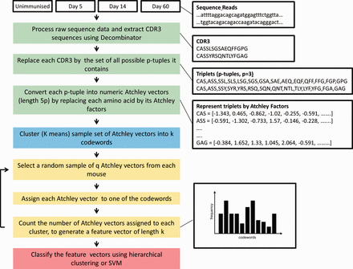
Feature Engineering: Thomas et al. 2014 Method
dataset
These steps not needed
Both p=3 and p=2 where tested
Using triplets as an example, all possible triplet Atchley vectors are clustered into k clusters. Every sequence is broken down into triplets and then each triplet is mapped to a cluster. The number of triplets mapped into each cluster is represented in a k-dimensional vector.
This process is performed for all sequences
I used k=100 and k=1000 with close to the same results

Slide 11
Thomas et al. 2014 SVM Classification
Results given are over
Tried the three different kernels mentioned previously and optimized with grid search or line search depending. The following are the search parameters where gamma is the width of the RBF:
C: [0.1, 1, 10, 100, 1000]
gamma:[1e-4, 1e-3, 1e-2, 1e-1, 1e0, 1e1, 1e2]
n clusters: 100
K samples: 10,000
Depending on results these were altered
Need to re-run as page I wrote params on is missing
p Value | Kernel | Best Parameters | Test Accuracy
2 | RBF | C = 10, gamma = 1 | 58.2%
3 | RBF | - | 59.9%

Slide 12
Feature Engineering: p-Tuple Frequency
Basic Method
CDR3 Sequence:
[“CAFMKRY…”]
CDR3 Sequence p-Tuples:
[“CAF”, “AFM”, “FMK”, …]
p-Tuples Frequency:
[0,1,0,0,0,0,0,0, …]
[1 x N]
[1 x (N-2) x p]
[1 x 20^{p}]
Both p=3 and p=2 where tested, thus each point/sequence had 400 dimensions or 8000 dimensions respectively
These were not binary features, that is to say it was a frequency count of a p-Tuple being present in a sequence, but in practice counts above one are rare and the vectors are quite sparse.
Note that this is length invariant as a method so it doesn’t require separation of sequences by length

Slide 13
p-Tuple Frequency SVM Classification
Results given are over
Tried the three different kernels mentioned previously and optimized with grid search or line search depending. The following are the search parameters where gamma is the width of the RBF:
C: [0.1,1,10,100]
gamma:[1e-4,1e-3,1e-2]
Depending on results these were altered
p Value | Kernel | Best Parameters | Test Accuracy
2 | Linear | C = 1, gamma = 1 | 61.0%
2 | Poly, n=3 | C = 100, gamma = 0.01 | 60.8%
2 | RBF | C = 10, gamma = 0.01 | 62.0%
3 | Linear | C = 1, gamma = 0.01 | 60.1%
3 | Poly, n=3 | C = 1, gamma = 1 | 61.0%
3 | RBF | C = 10, gamma = 0.01 | 62.2%

Slide 14
Feature Engineering:
p-Tuple Frequency with CDR1/2
CDR1 and CDR2 Included Method
CDR Sequences:
[“CAFMKRY…”]
[“VASNS…”]
[“VSAKL…”]
CDR3 Sequence p-Tuples:
[“CAF”, “AFM”, “FMK”, …]
[“VAS”, “ASN”, “SNS”, …]
[“VSA”, “SAK”, “AKL”, …]
p-Tuples Frequency:
[0,1,0,0,0,0,0,0, …]
[0,1,0,0,0,0,0,0, …]
[0,1,0,0,0,0,0,0, …]
p-Tuples Frequency:
[0,1,0,0,0,0,0,0, …]
3 x [1 x N]
3 x[1 x (N-2) x p]
3 x[1 x 20^{p}]
[1 x (20^{p} x 3)]
Both p=3 and p=2 where tested, thus each point/sequence had 400 dimensions or 8000 dimensions respectively
The last step flattens/concatenates the three CDRs together

Slide 15
Feature Engineering:
ProtVec Method
This method is based on BioVec from Asgari & Mofrad (2015).
This is still a work in progress
Notes:
http://journals.plos.org/plosone/article/metrics?id=10.1371/journal.pone.0141287
https://cs224d.stanford.edu/reports/LeeNguyen.pdf
https://arxiv.org/abs/1608.05949
https://arxiv.org/abs/1604.07176

