Slide 1
DS 200 Lab1 Install Python and Datascience Module
Instructor: John Yen
TA: Yang Xu

Slide 2
Instructions for Installing Python
Installing Python on Windows (starting at slide 4)
Installing Python on Mac/Linux (starting at slide 8)
After completing one of the first two parts, proceed to install datascience module needed for this course (starting at slide 9)

Slide 3
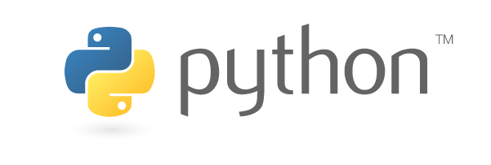
Resources
Python website
https://www.python.org/
Official documentation
https://www.python.org/doc/
Python 3.x
Python 2.x
Python setup and usage
https://docs.python.org/3/using/index.html

Slide 4
Install Python on Windows – Step 1
Download the latest release of installer for Python 3.6.2
https://www.python.org/downloads/windows/
If your machine runs 64 bit Windows, choose “Windows x86-64 executable installer”
If your machine runs 32 bit Windows, choose “Windows x86 executable installer”

Slide 5
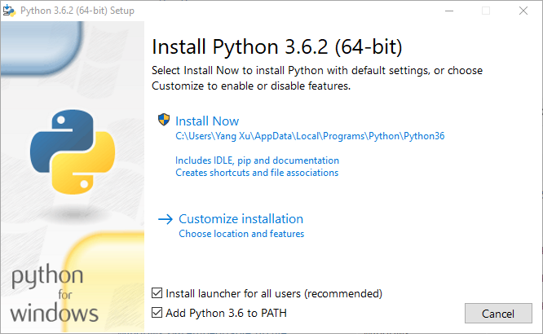
Install Python on Windows – Step 2
Go to the “Downloads” directory, double click on the python-3.6.2 file you downloaded.
Check both boxes (as shown below). Double click “Install Now”
Check the two boxes

Slide 6
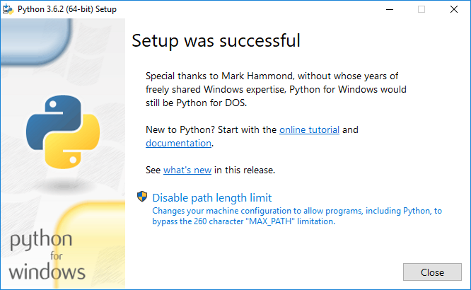
Install Python on Windows – Step 3
Disable path length limit

Slide 7
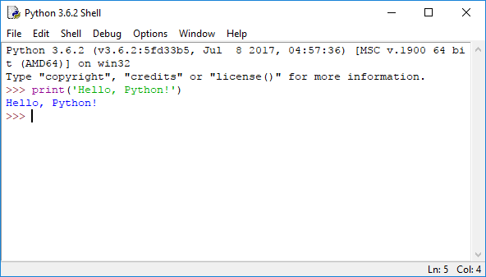
Install Python on Windows – Invoke Python
Click on “IDLE Python 3.6 shell” in the Start menu
You will see a prompt for entering Python code such as >>>
Type “print(‘Hello, Python!’)” to the prompt, you should see Python’s output
Proceed to slide No. 9.

Slide 8
Part 2: Install Python on Mac/Linux
MacOS
Mac has Python 2.7 installed by default, but not Python 3
Install opensource homebrew, free for download from the link below. This is also known as “the missing package manager for macOS” https://brew.sh/
After you install brew, invoke terminal window (you can use Spotlight search to find terminal)
In terminal, run: brew install python python3
Ubuntu Linux
Ubuntu 16.04 comes with Python 2.7 and Python 3.5 by default

Slide 9
Part 3: Installing datascience module
The key module needed for DS 200 is the datascience module (developed by the instructors of ds-8 Data Science course at University of California, Berkeley)
You will use pip to install packages from PyPI (Python Package Index)
3A: Installing datascience module and related packages on Mac or Linux (go to next slide)
3B: Installing datascience module and related packages on Windows (go to slide 11)

Slide 10
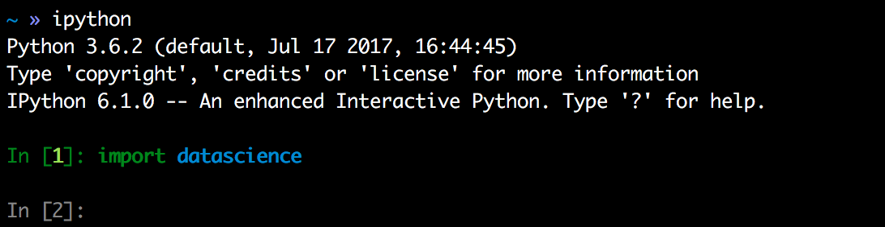
3A Install packages on Mac/Linux
Open terminal
Run: pip3 install -U numpy scipy matplotlib pandas ipython jupyter datascience
To check if the installation is successful
Type ipython (or python) in terminal.
Type ”import datascience” to the Python prompt

Slide 11
3B Install the datascience package for Windows 10
Step 1, install some required packages in terminal (Command Prompt) pip install -U datascience matplotlib pandas ipython jupyter
Step 2, Download numpy and scipy for windows
Go to URL: http://www.lfd.uci.edu/~gohlke/pythonlibs/ Search for numpy and scipy
http://www.lfd.uci.edu/~gohlke/pythonlibs/#numpy
For 64-bit Windows, download numpy‑1.13.1+mkl‑cp36‑cp36m‑win_amd64.whl
For 32-bit Windows, download numpy‑1.13.1+mkl‑cp36‑cp36m‑win32.whl
http://www.lfd.uci.edu/~gohlke/pythonlibs/#SciPy
For 64-bit Windows, download scipy‑0.19.1‑cp36‑cp36m‑win_amd64.whl For 32-bit Windows, download scipy‑0.19.1‑cp36‑cp36m‑win32.whl

Slide 12
Install the datascience package for Windows 10
Step 3, open command Terminal, “cd Downloads” to change your directory to “C:\Users\<YourUserName>\Downloads” Type the following line to the command prompt
pip install numpy‑1.13.1+mkl‑cp36‑cp36m‑win_amd64.whl
(unless you download the Win 32 version)
After you see “Sucessfully installed numpy-1.13.1+mkl”, type the following to the command prompt pip install scipy‑0.19.1‑cp36‑cp36m‑win_amd64.whl
(unless you download the Win 32 version)
Invoke python
Type “import datascience” to Python prompt
If you see the Python prompt again without error message, Congratulations! You have completed the installation of datascience module and associated packages.

Slide 13
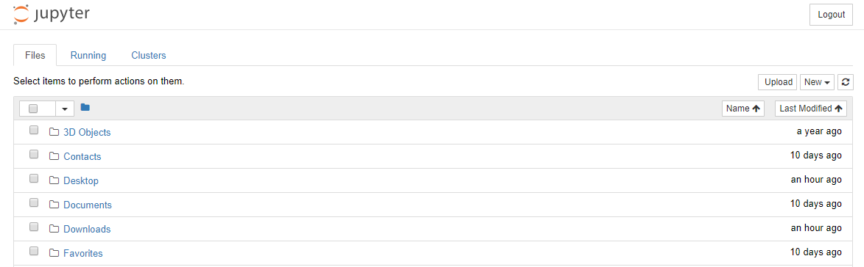
Use Jupyter notebook
In terminal/command, type “jupyter notebook”
You will see a browser with jupyter logo

Slide 14
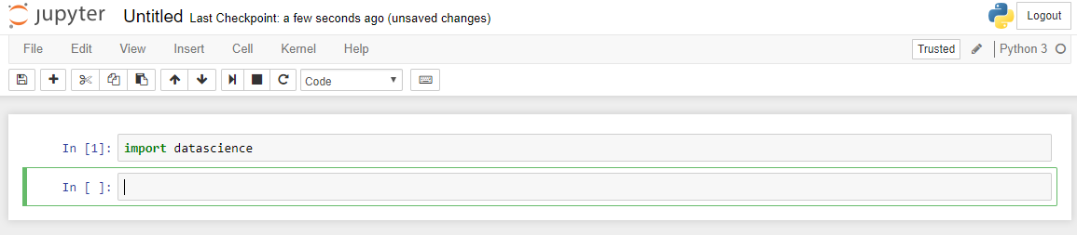
Use Jupyter notebook
On the upper righthand corner, click on New, select Python3
Type “import datascience”

