Slide 1
DS200 Lab10 Tweets Gathering Pipeline
Instructor: John Yen
TA: Yang Xu

Slide 2
For previous labs (lab 4, 5, 6, 7, 8)
Use get_tweets.py to download raw tweets data
Input: your key words → Output: a JSON file
Use json_to_csv.py to extract fields from JSON and save to CSV file
Input: JSON file → CSV file
Use remove_nonASCII.py to remove special characters in CSV file
Input: old CSV file → new CSV file

Slide 3
One pipeline
It would be great if we have just one integrated pipeline that do all these steps in one shot.
Pipeline
Input: your parameters including “key words”, “number of tweets” etc.
Output: one CSV file

Slide 4
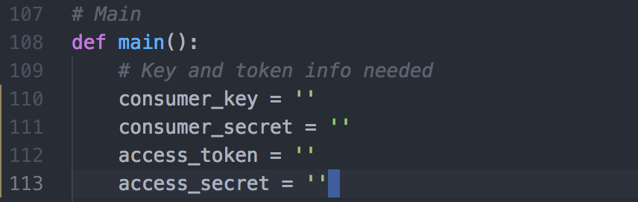
Edit pipeline file
Put gather_tweets_pipeline.py in a directory
Open gather_tweets_pipeline.py with a text editor (e.g., Atom, vim etc.)
Put your own consumer key, consumer secret, access token, access secret into Line 110 to 113 between the single quotes

Slide 5
Run pipeline
Open terminal/command and enter that directory using “cd” command
Type python gather_tweets_pipeline.py (For Windows) python3 gather_tweets_pipeline.py (For MacOS/Linux)

Slide 6
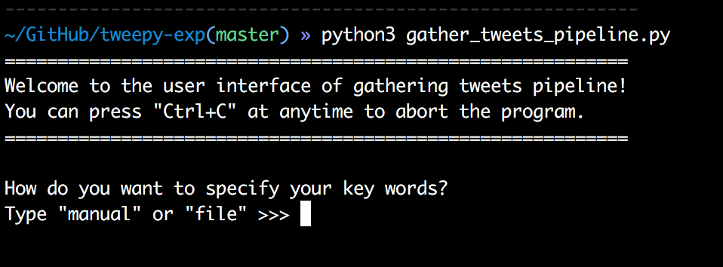
Step 1
Choose the way to specify your key words
Choose between “manual” or “file”

Slide 7
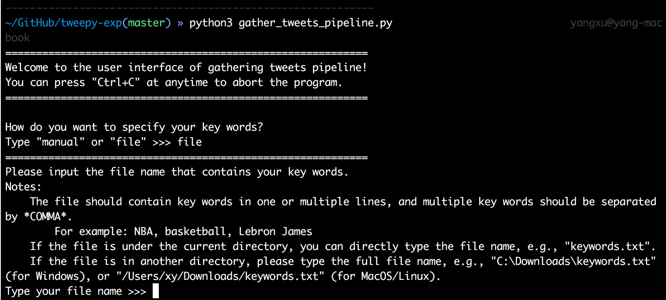
Step 1.1
If I choose “file”, prompt will ask for the file name

Slide 8
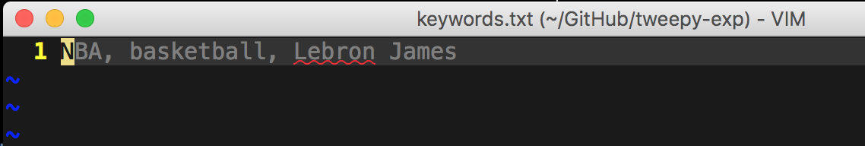
Step 1.1
How a key word file looks like
Multiple key words allowed
Multiple lines allowed
For MacOS/Linux:

Slide 9
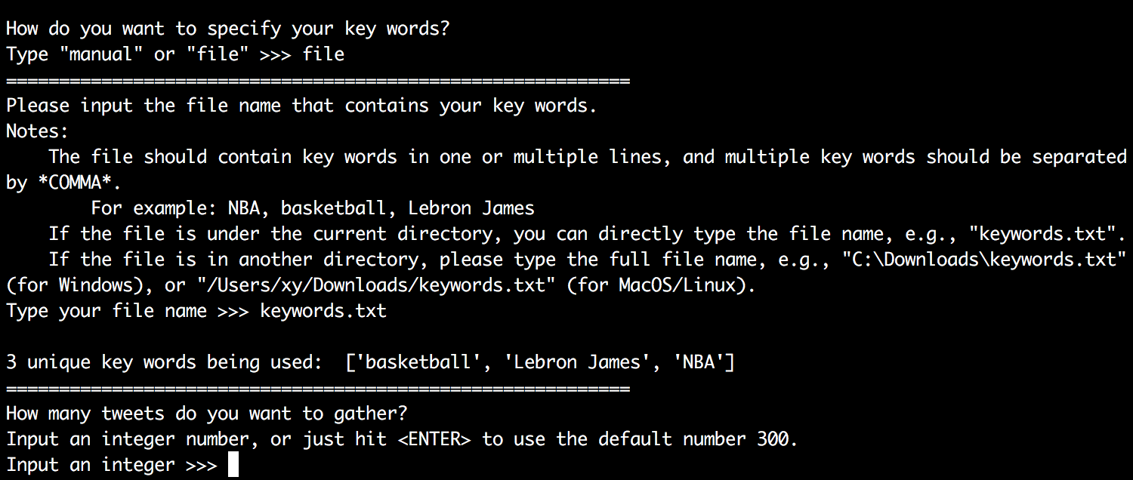
Step 1.1
Type in the file name directly, if the key word file is at the same directory with gather_tweets_pipeline.py

Slide 10
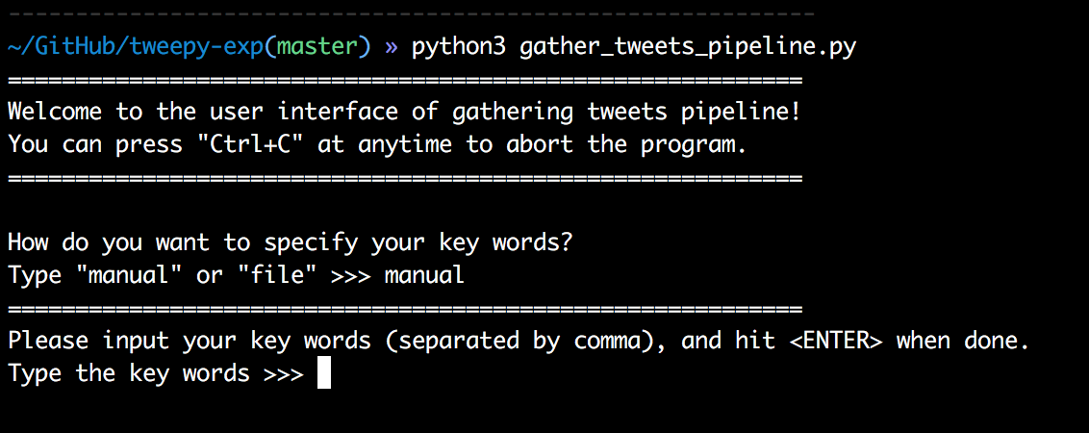
Step 1.2
Alternatively, you can input key words manually
Type in your key words, separated by comma

Slide 11
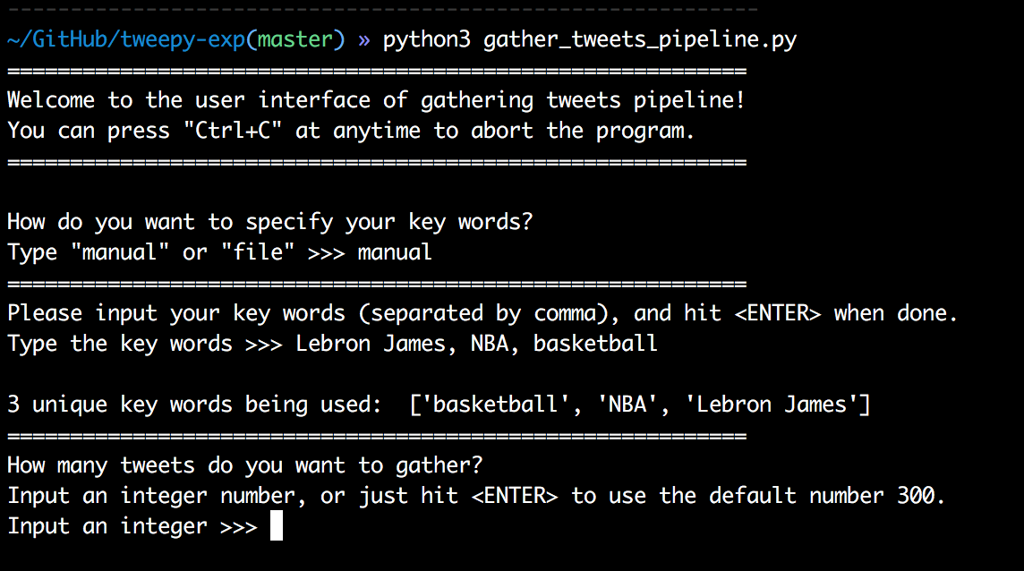
Step 1.2
Manual input of key words

Slide 12
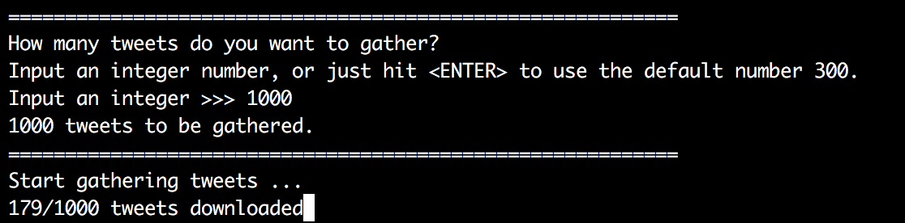
Step 2
Decide how many tweets to gather

Slide 13
Step 3
Wait until all tweets to be gathered, or press “Ctrl+C” to early stop.
Three files will be generated in the same directory for each run
raw_YYYY-MM-DD-HH-MM-SS.json
data_YYYY-MM-DD-HH-MM-SS.csv
text_YYYY-MM-DD-HH-MM-SS.csv

Slide 14
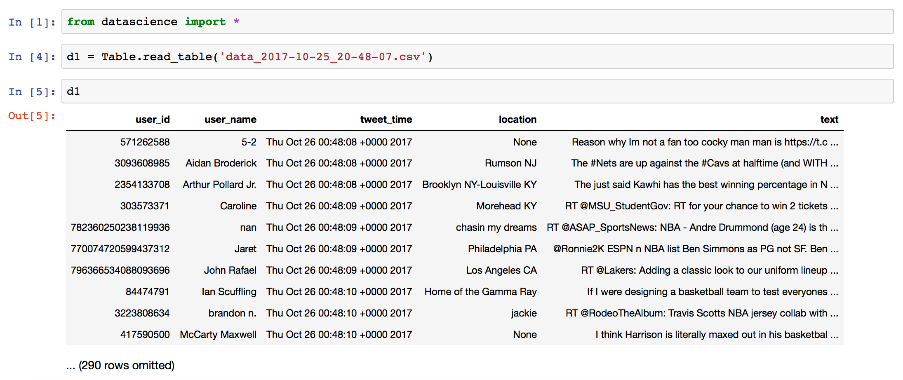
Load data in Jupyter Notebook

Slide 15
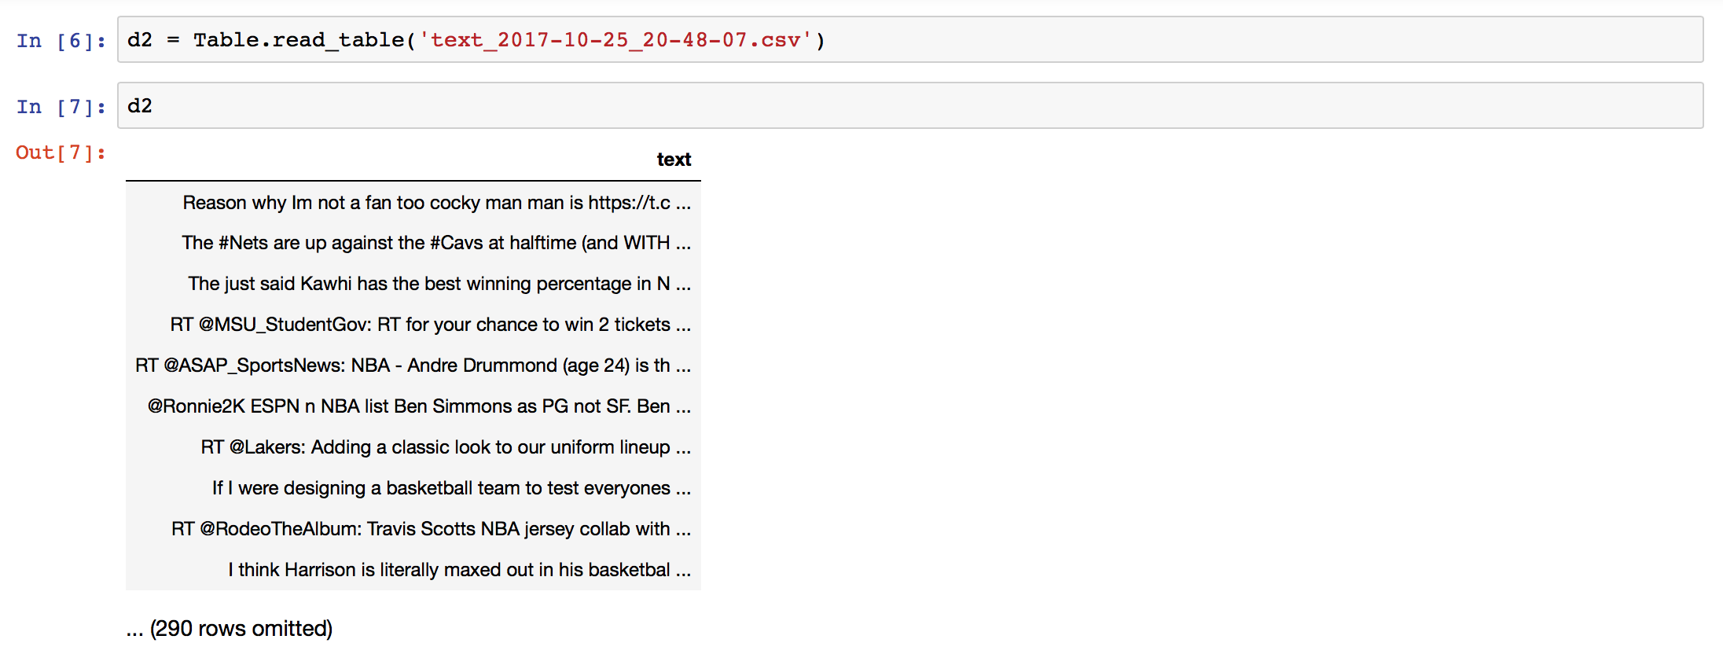
Load data in Jupyter Notebook

