Slide 1
DS200 Lab 11 Decision Tree Visualization and Interpretation
Instructor: John Yen
TA: Yang Xu

Slide 2
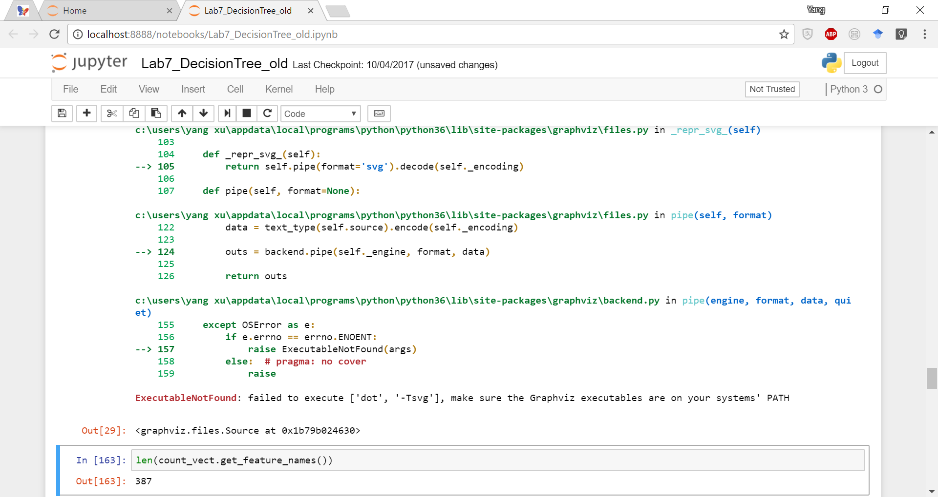
Graphiz error message

Slide 3
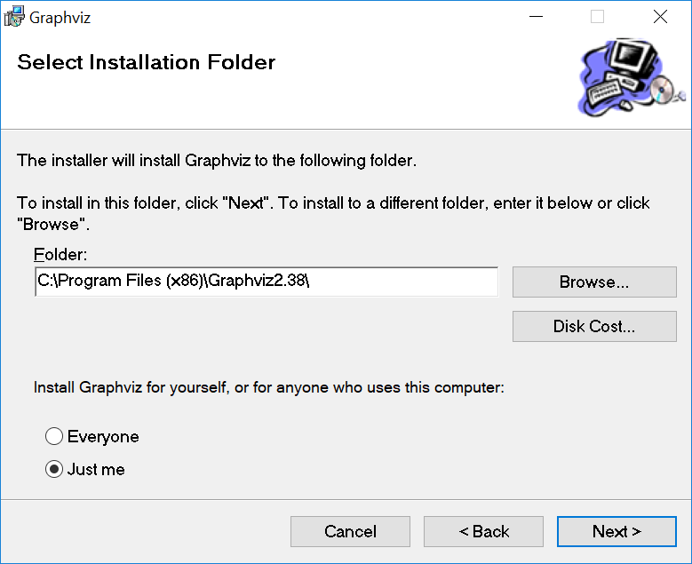
Fix for Windows
Step 1. Install the third-party software Graphiz
http://www.graphviz.org/Download_windows.php

Slide 4
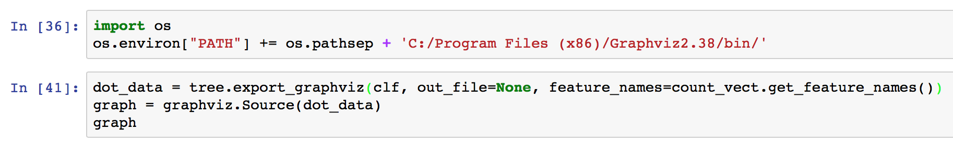
Fix for Windows
Step 2. Add a cell in Jupyter Notebook

Slide 5
Full decision tree
A huge tree: 11 levels
Problem?
Overfitting
The model fits the current data so well
that it lacks generalization.

Slide 6
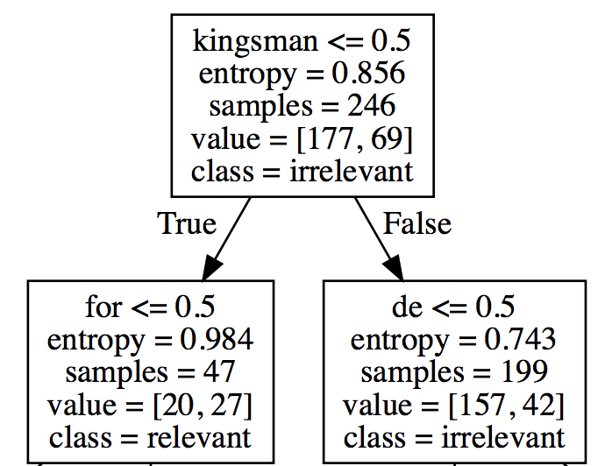
Zoom in
Root node: first split
Split criterion: kingsman <= 0.5 (“kingsman” does not appear)
Total # of samples: 246
After the split
47 samples fall into the left branch (classified as “relevant”)
199 samples fall into the right branch (classified as “irrelevant”)
Information gain of this split: entropy = 0.856
(another measurement, gini impority)

Slide 7
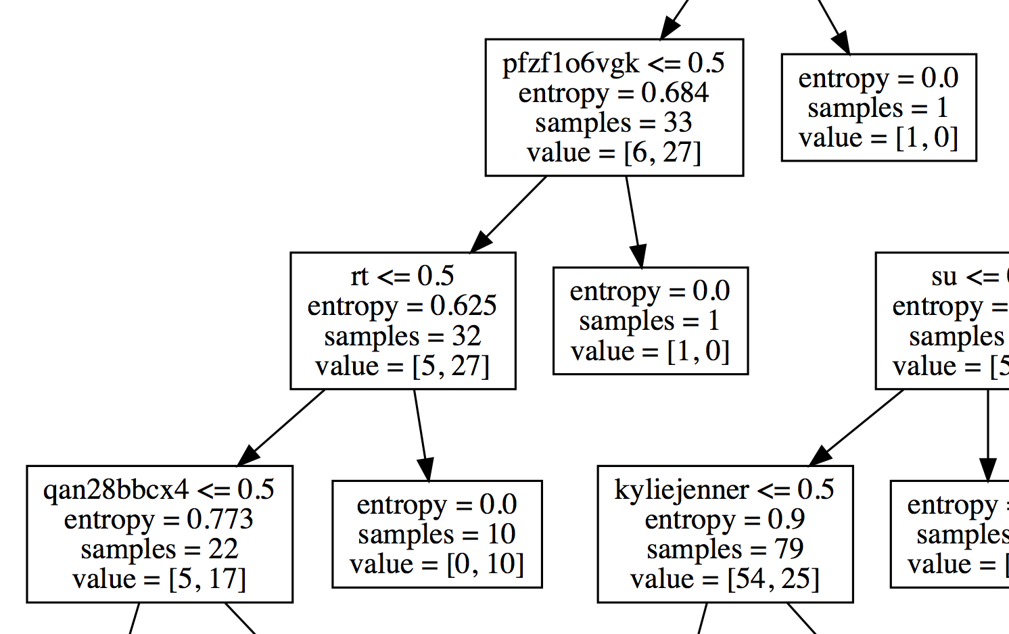
Overfitting
Very uncommon words are used as
split criteria.
This model does not generalizes well
to data that do not contain these words
In other words:
The model simply remembers the
current data.
We need a shallower tree

Slide 8
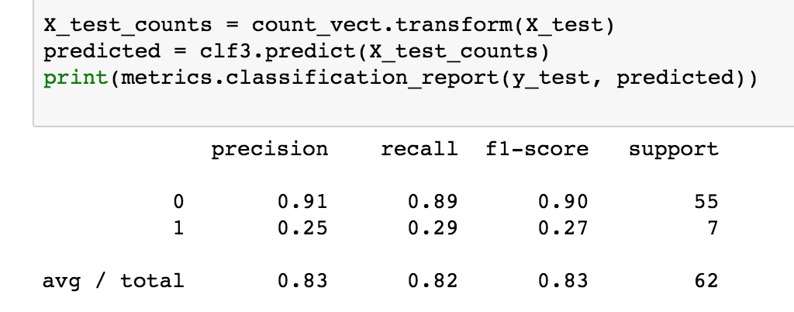
Counter overfitting
Method1: Limiting the tree depth
F1-score = 0.83
Already pretty good performance!

Slide 9
Find the best tree depth
Try different max_depth values
max_depth = 2
F1-score = 0.92
max_depth = 3
F1-score = 0.90

Slide 10
Counter overfitting
Other methods: set min_samples_leaf, or min_sample_split etc.
max_depth = 2
min_samples_leaf = 5
F1-score = 0.92

Slide 11
Note
Decision Tree is not the best option for text classification
Naïve Bayesian, Support Vector Machine (SVM), Deep Neural Network (RNN, CNN) models usually have better performance
Advantage of Decision Tree: Easy to interpret

Slide 12
Lab 11 assigment
Use Lab11_DecisionTreeVisualize_template.ipynb (assuming you have a dataset of two columns, with “text” and “label” as column names)
Find the best tree depth by tuning max_depth, and the corresponding F1-score.
Plot the full Decision Tree, and the optimal tree
Report Step 1 & 2 in a document, and also interpret the root node (See slide 6).

