Slide 1
DS200 Lab12 Advanced Text Preprocessing
Instructor: John Yen
TA: Yang Xu

Slide 2
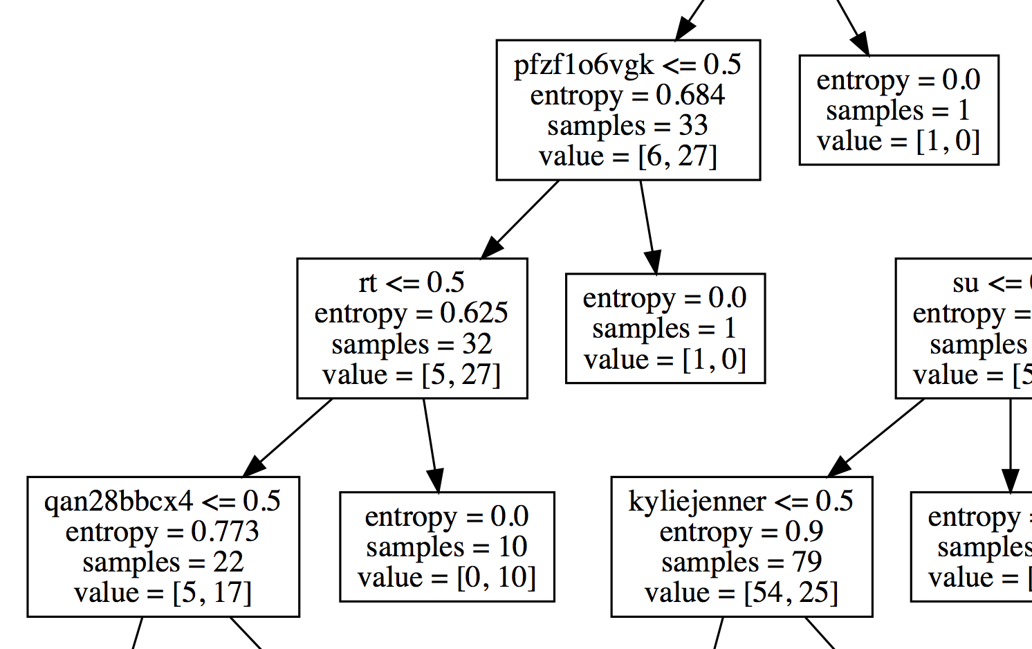
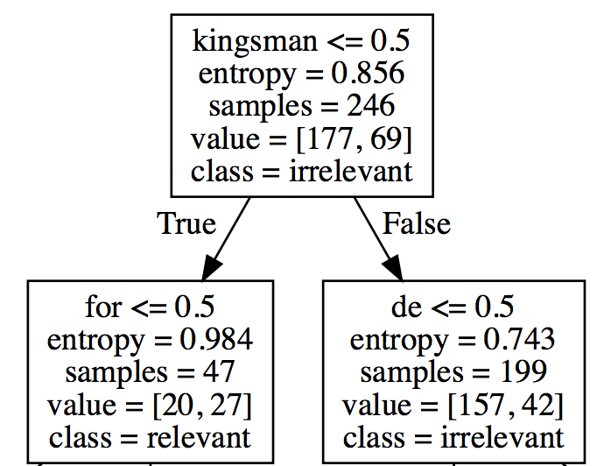
Unwanted nodes in decision tree
Stop words
URLs, Twitter user name (“@...”)

Slide 3
Remove stop words
Stop words are words which are filtered out before or after processing of natural language data (text)
They usually refer to the most common words in a language, there is no single universal list of stop words
The nltk package provides a list of 127 stop words
['i', 'me', 'my', 'myself', 'we', 'our', 'ours', 'ourselves',…]

Slide 4
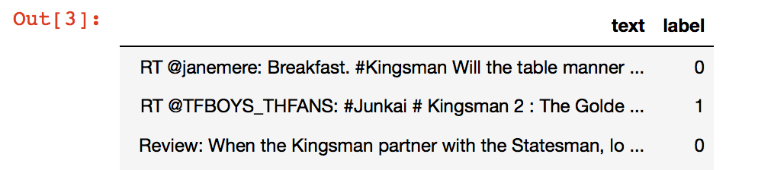
Remove stop words
Download remove_stopwords.py
Prepare your two-column data file
In terminal/command
Run: python remove_stopwords.py YOUR_DATA.csv or python3 remove_stopwords.py YOUR_DATA.csv
Then a new YOUR_DATA_stopwords_removed.csv will be saved in the same directory.

Slide 5
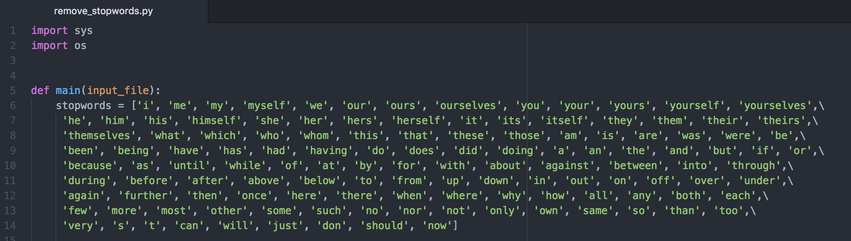
A glimpse of remove_stopwords.py
This list is from nltk, and you can edit it by adding or removing words from it,
which depends on your task

Slide 6
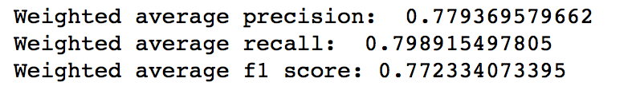
Comparing with original decision tree
Original tree (with stopwords)
5-fold cross-validation results

Slide 7
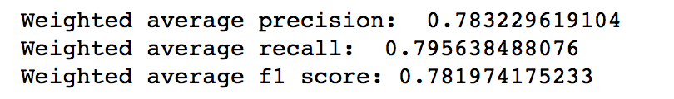
After stopwords are removed
Extending stopwords list with “9gag” and “que”
5-fold cross-validation results

Slide 8
Handling URLs and mentions (@)
Download replace_URLs.py
Prerequisite: you have already run remove_stopwords.py, and have the output file ready, e.g., YOUR_DATA_stopwords_removed.csv
In terminal/command
Run: python replace_URLs.py YOUR_DATA_stopwords_removed.csv or python3 replace_URLs.py YOUR_DATA_stopwords_removed.csv
Then a new YOUR_DATA_stopwords_removed_URLs_replaced.csv file will be saved to the same directory

Slide 9
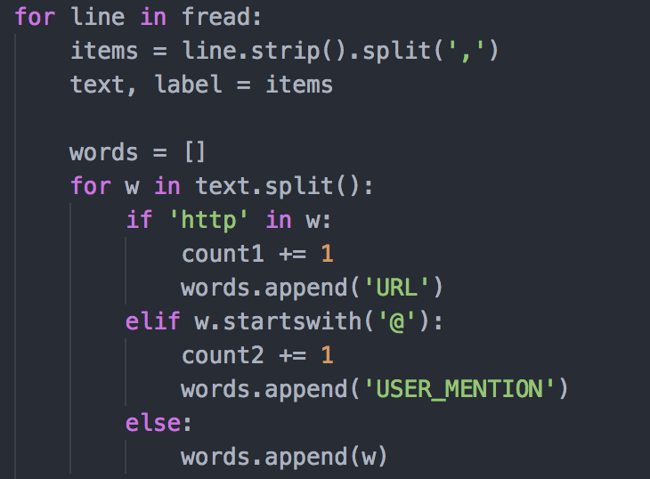
A glimpse of replace_URLs.py
You can design more accurate replace patterns
using regular expressions

Slide 10
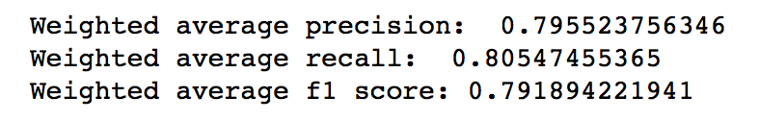
After URLs and user mentions are replaced
5-fold cross-validation results
Improvement of f1 score:
Original | Stopwords removed | Stopwords removed & URLs replaced
0.77 | 0.78 | 0.79

Slide 11
Lab 12 assignment
Run remove_stopwords.py on your data. Use the output data to build a decision tree model and obtain performance report via cross-validation.
Run replace_URLs.py on the output data of Step 1, and use the second output data to build a new decision tree model, with performance report via CV.
Compare the two performances with the original decision tree without applying remove_stopwords.py or replace_URLs.py.
You may use Lab12_stopwords_URL_template.ipynb to help you accomplish this assignment. Submit a document describing Step 1 through 3.

