Slide 1
DS200 Supplementary Material Save and Load Models
Instructor: John Yen
TA: Yang Xu

Slide 2
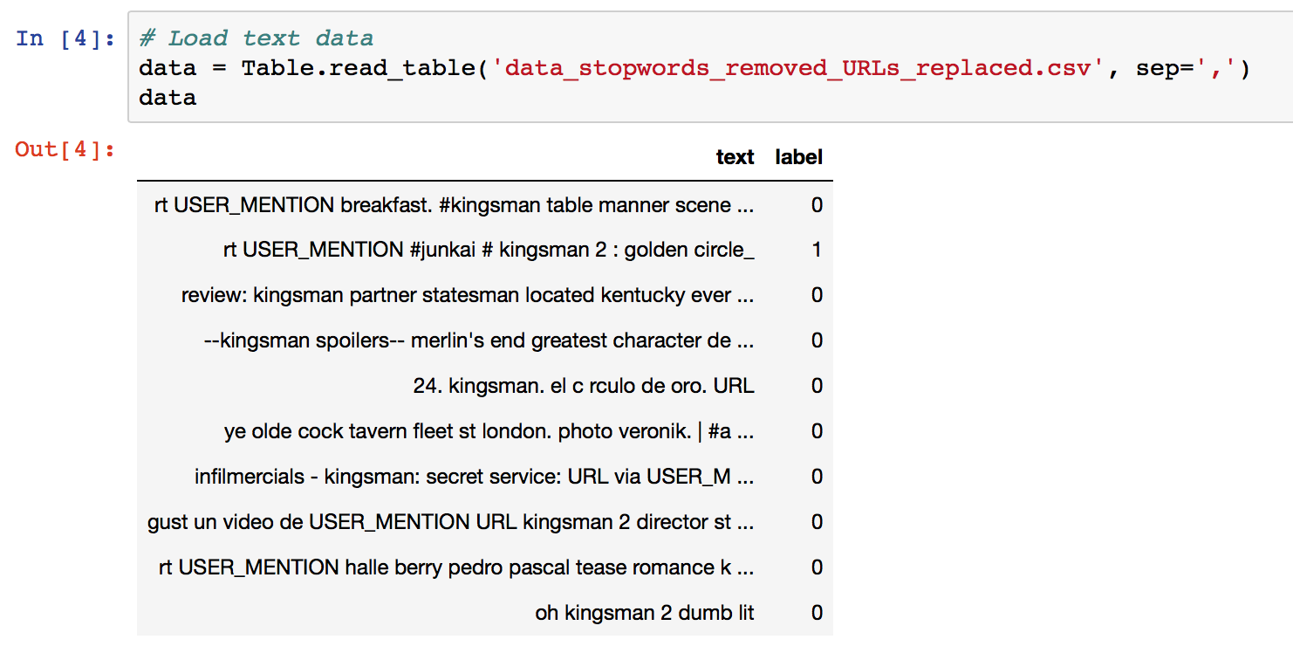
Example 1: Save and reuse text classification model
Load data

Slide 3
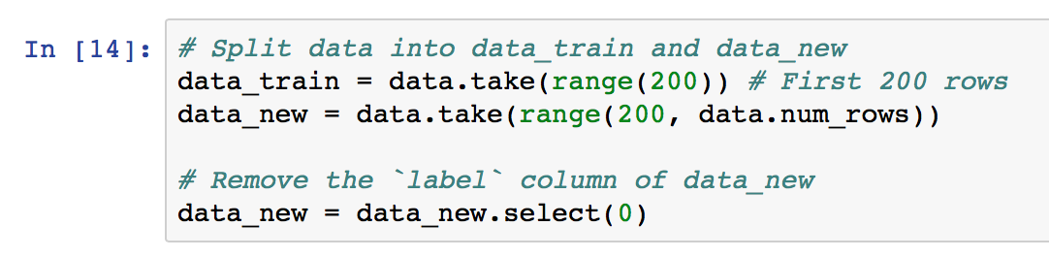
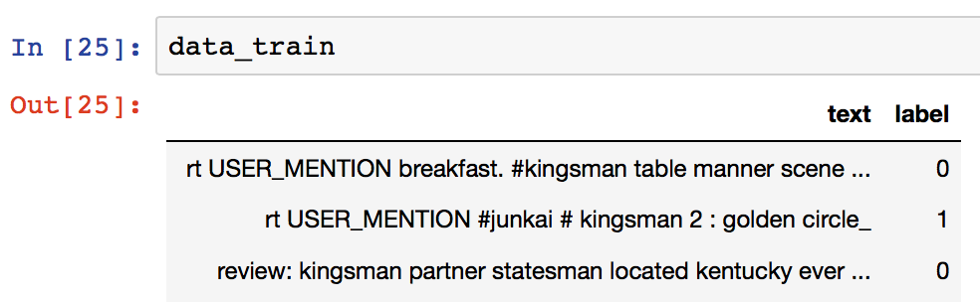
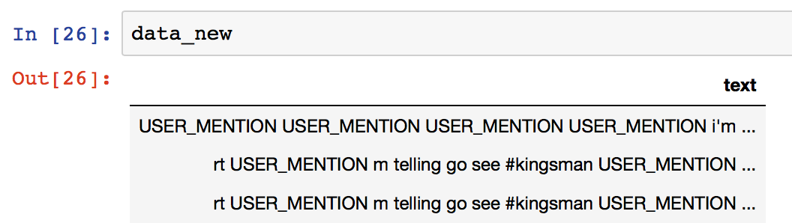
Split data
We pretend data_train is our training data (manually tagged)
and data_new is the untagged new data

Slide 4
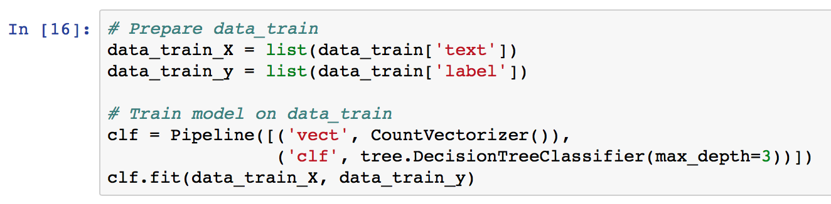
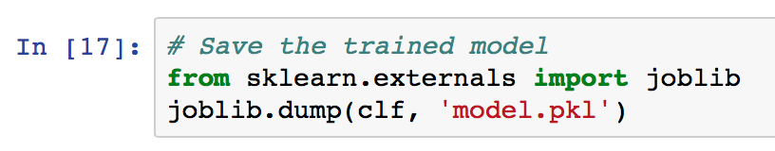
Train and save model
Train
Save

Slide 5
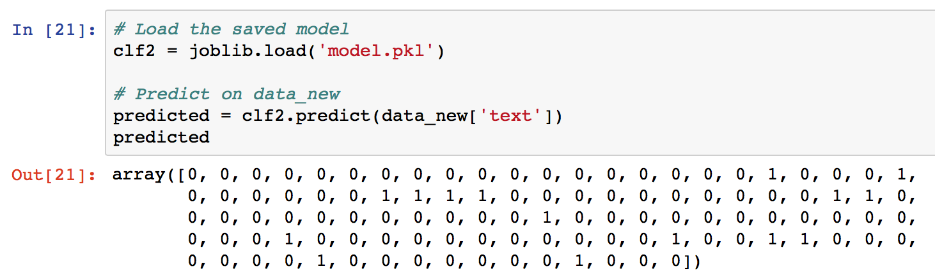
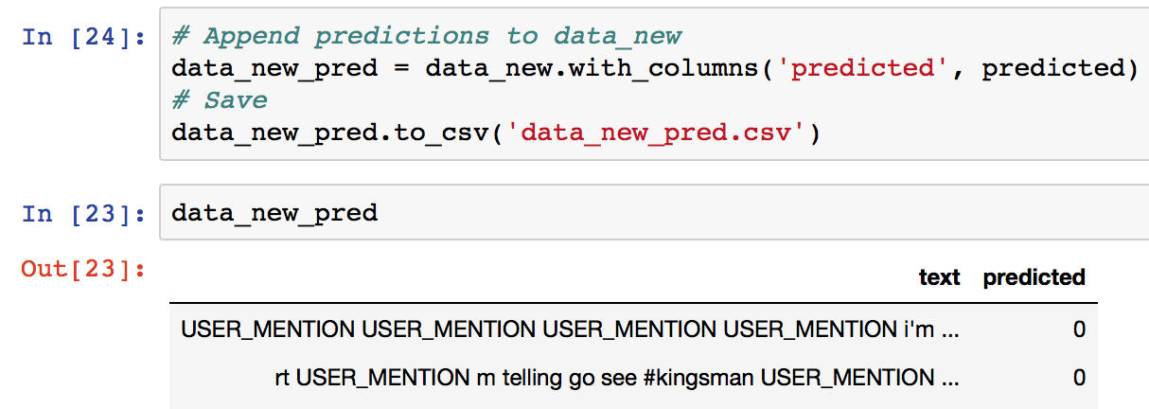
Load and reuse model on new data
Fairly simple!
Append the predictions to data_new and save

Slide 6
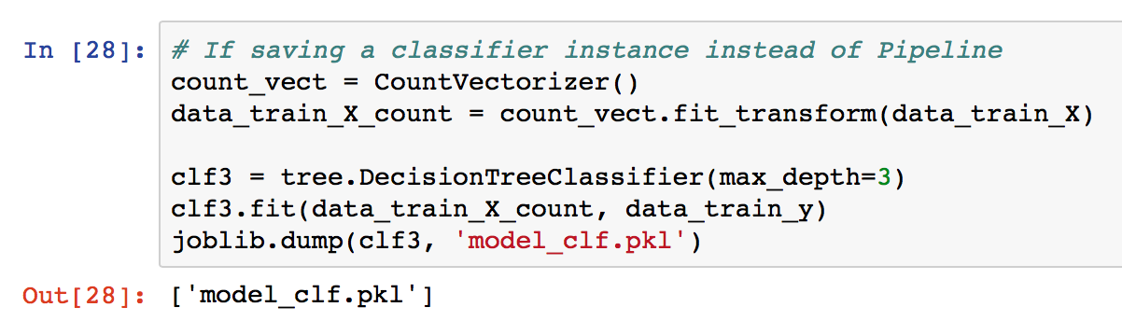
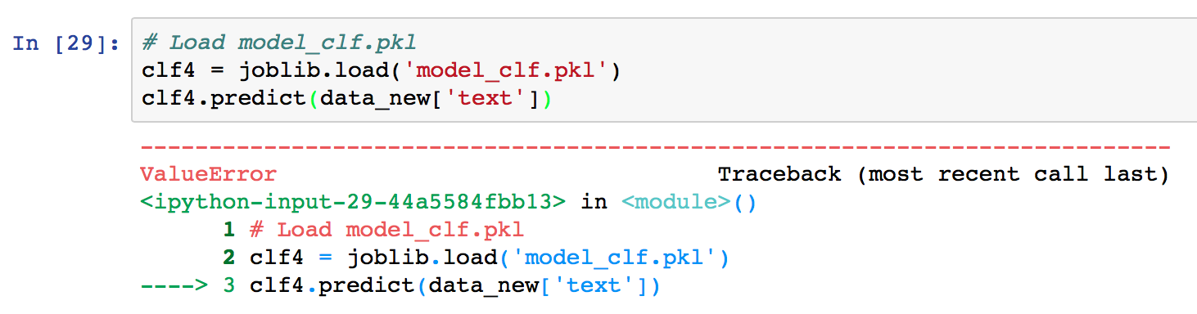
Note
clf is a Pipeline instance
What if clf is a instance of classifier?
Error because data_new[‘text’]
are strings but not word vectors

Slide 7
Note
Pipeline instance reserves more complete information of the model

Slide 8
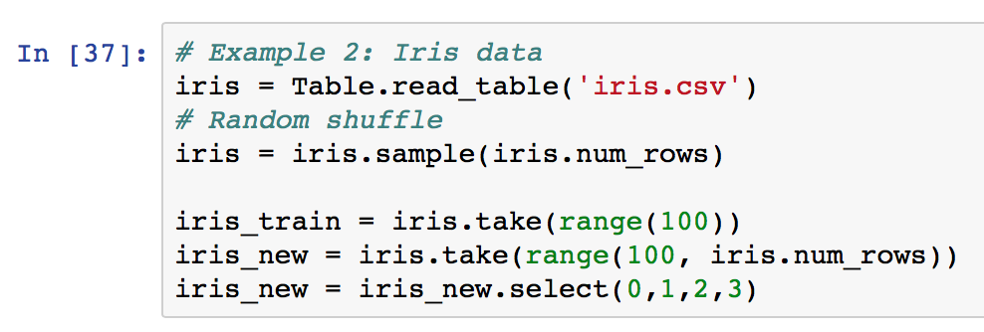
Example 2: Iris data
Load and split data

Slide 9
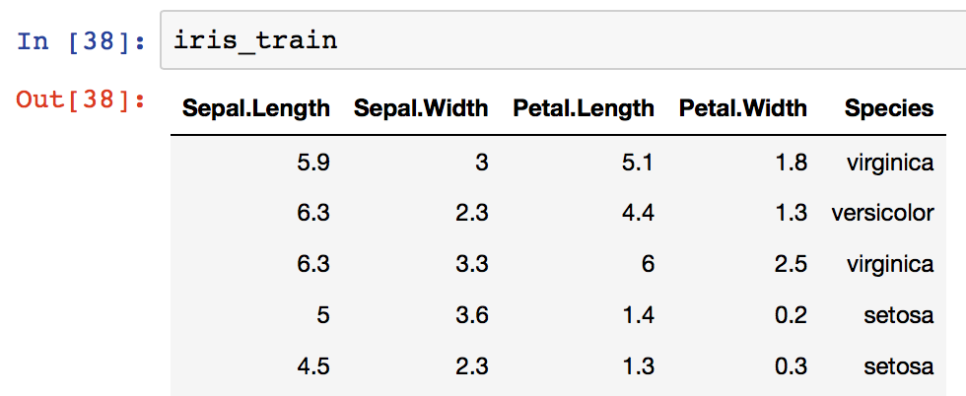
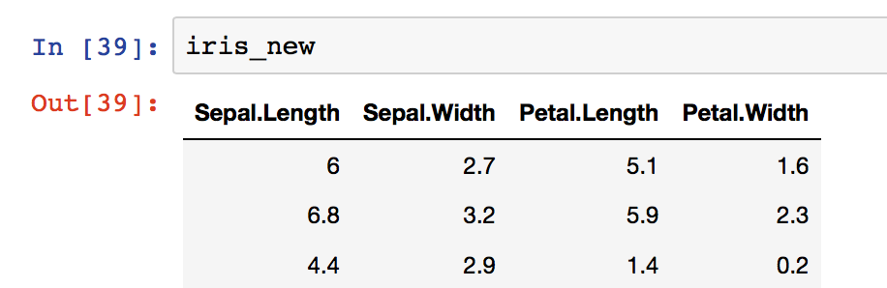
Train data and “new” data

Slide 10
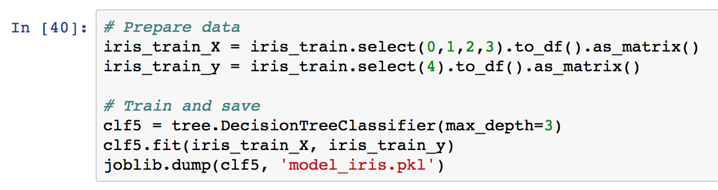
Train and save model

Slide 11
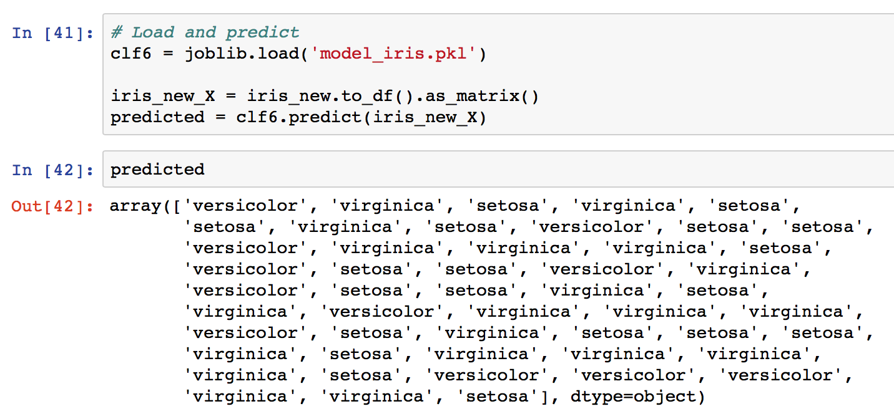
Load and predict

