Slide 1
DS200 Supplementary Material Decision Tree on Iris data
Instructor: John Yen
TA: Yang Xu

Slide 2
Background
The Iris flower dataset is a multivariate dataset introduced by the British statistician and biologist Ronald Fisher in 1936
The data set consists of 50 samples from each of three species of Iris (setosa, virginica and versicolor), thus 150 rows
Four features were measured from each sample: the length and the width of the sepals and petals, in centimetres

Slide 3
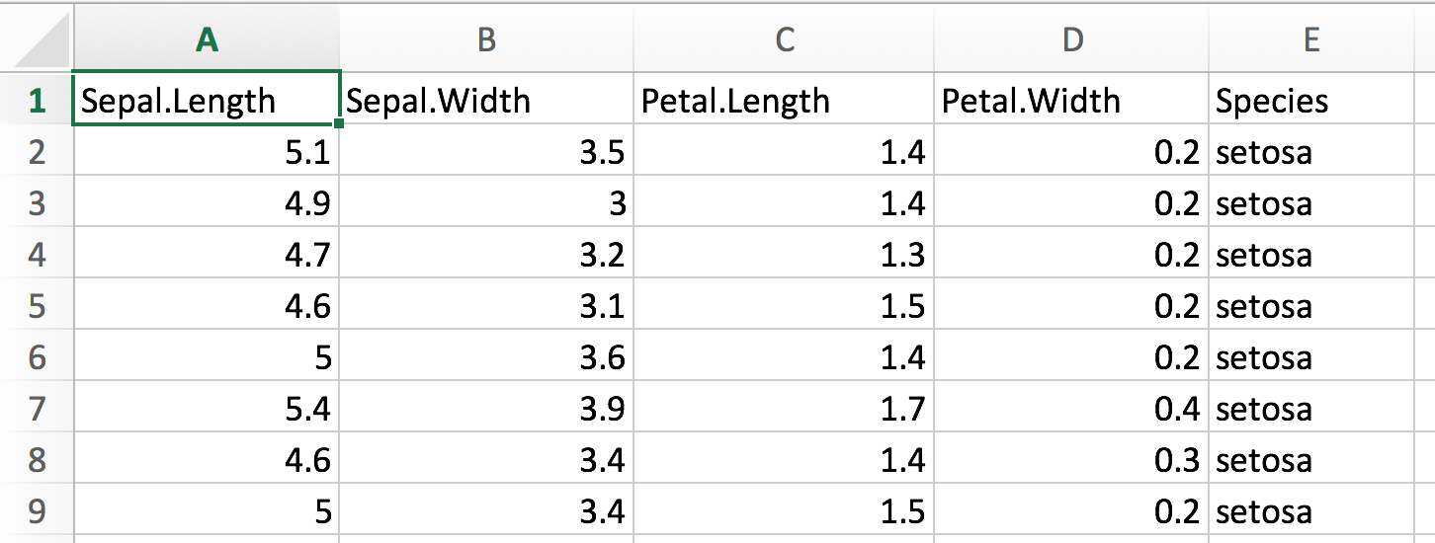
Background

Slide 4
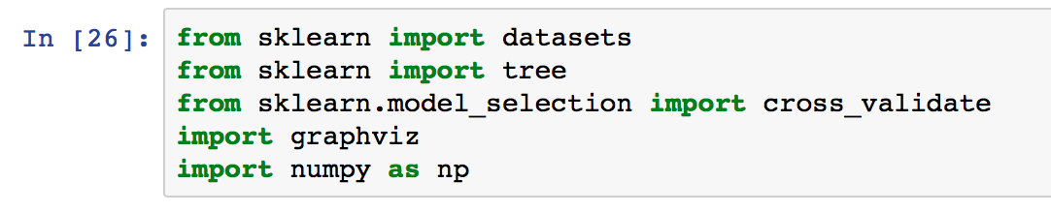

Method 1: Use the Iris dataset provided by scikit-learn

Slide 5
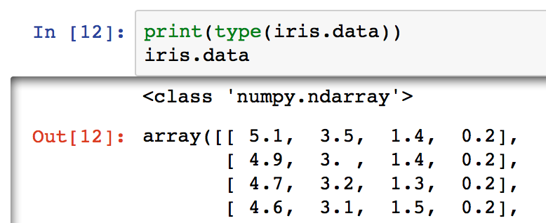
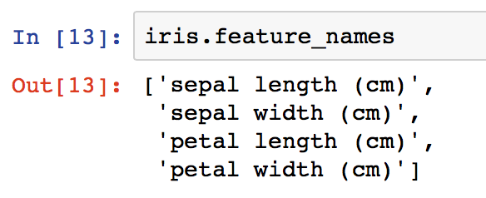
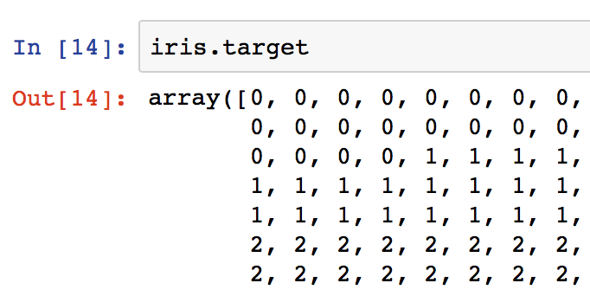
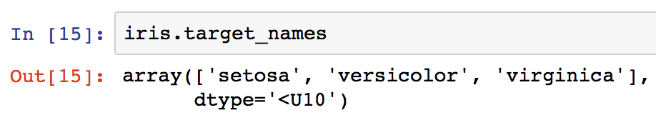
Structure of Iris data

Slide 6
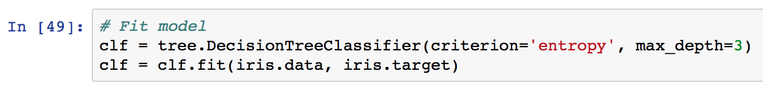
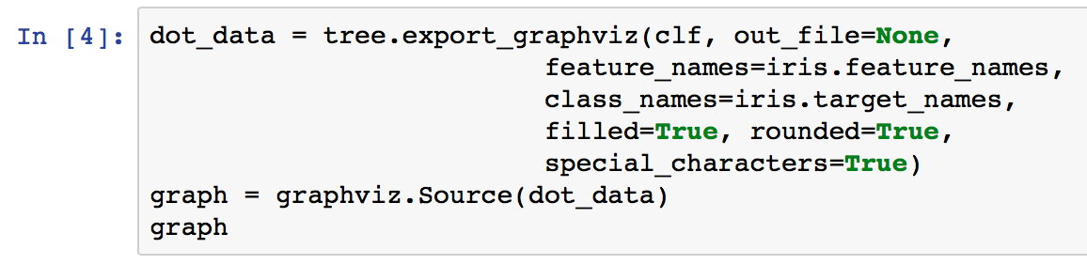
Fit the decision tree model & visualize

Slide 7
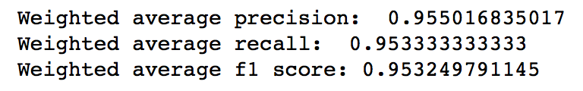
Full decision tree

Slide 8
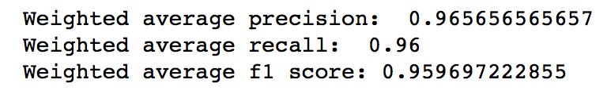
Decision tree with max_depth=3

Slide 9
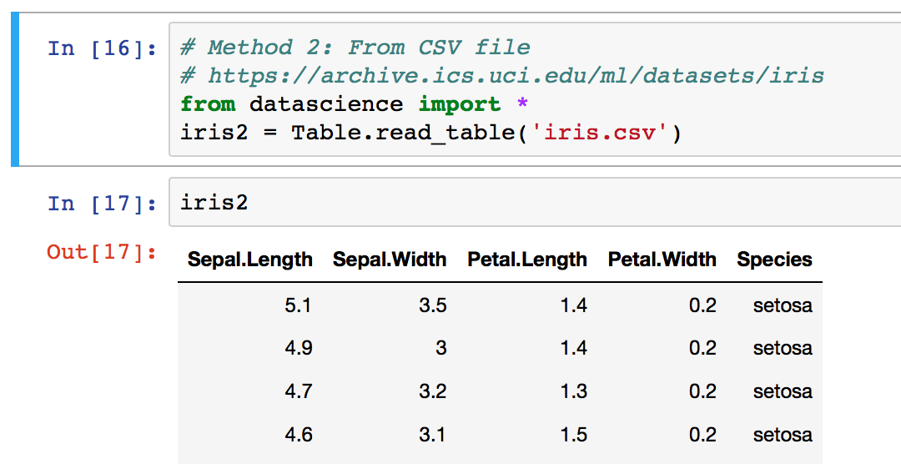
Method 2: Load Iris data from CSV file
Sources:
https://archive.ics.uci.edu/ml/machine-learning-databases/iris/iris.data
https://github.com/pandas-dev/pandas/blob/master/pandas/tests/data/iris.csv
Use datascience package

Slide 10
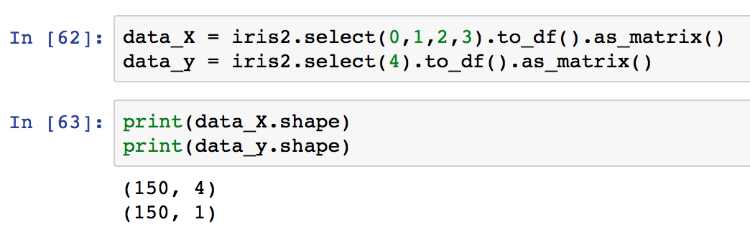
Prepare data
Separate features and target
Convert data in Table object to numpy arrays.

Slide 11
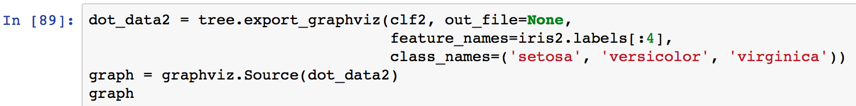
Train the model

