Slide 1
DS 200 Lab2 Python Basics and String Processing
Instructor: John Yen
TA: Yang Xu
August 31, 2017

Slide 2
Table of content
Variable and assignment & Built-in data types (Slide 4 -- 6)
Common operations on built-in types (Slide 7 -- 15)
Simple control flow statement (Slide 16 -- 20)
Experiment of word frequency (Slide 21 -- 30)

Slide 3
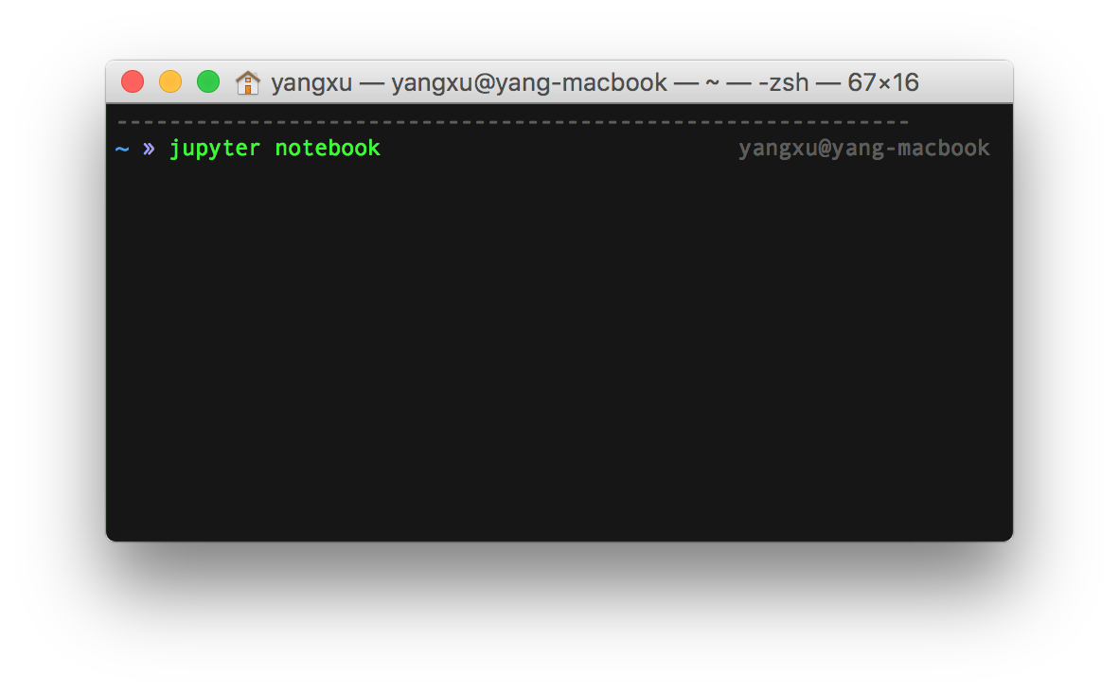
Before you start
Start jupyter notebook in terminal (Mac/Linux), or command (Windows)

Slide 4
Variables and Assignment
Name of places to hold data (temporarily) for processing.
Name of variables are Unique
Same name refers to the same place
Different name refers to different places for holding data
The “assignment” statement assigns data to a variable as its “value”.
Each variable takes only one value.
Each assignment replaces the old value of the variable with the new value.

Slide 5
Variables and Assignment
a = 10
b = 20
c = a + b
s1 = ‘I’
s2 = ‘love’
s3 = s1 + s2
Variables names must start with a letter or an underscore, e.g., a, _a
The remainder may consist of letters, numbers and underscores, e.g., a_1
Variable Names in Python are case sensitive, (i.e., my_var, My_Var, MY_VAR are all DIFFERENT in Python).

Slide 6
Types of Variables
Different types of data require different ways to “code” them in binary form.
Characters can be represented by “ASCII” code
Integer and real number also need to be represented differently.
“Types” of data supported by a programming language are called “built-in” types.

Slide 7
Built-in Data Types of Python
int: Integers, e.g., 1, 2, 3, 100
float: Floating-point numbers, e.g., 1.5, 2.6, 3.1416, 2000.2
boolean: True, or False
str: (String data type) A sequence of Unicode characters (in the range of U+0000 - U+10FFFF) in Python 3.x E.g., ‘I love Python!’, ‘我爱Python!’, ‘私はPythonが大好き’

Slide 8
Mutable vs Immutable
A type is mutable if it can be modified in-place (at the same location).
A type is not immutable if it can NOT be modified in-place.
Example:

Slide 9
Built-in Data Types
list: A sequence of objects (of same or different types) E.g., list1 = [1, 2, 3, 4] list2 = [‘I’, ‘love’, ‘Python’] list3 = [‘I’, ‘love’, ‘Python’, 3]
List is mutable, e.g., list1.append(5) changes list1 to [1, 2, 3, 4, 5]
tuple: a sequence of immutable objects E.g., tup1 = (1, 2, 3, 4), tup2 = (‘I’, ‘love’, ‘Python’, 3)
“append” cannot be applied to tup1 or tup2
Operations on tuple are ALL FUNCTIONS

Slide 10
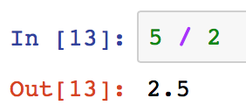
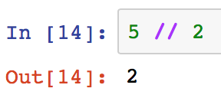
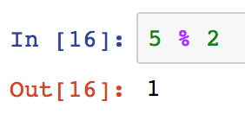
Common operations on built-in types
Numeric and arithmetic operations on int and float types
x + y, x - y, x * y, x / y
x // y floored quotient of x and y
x % y remainder of x / y
x ** y, or pow(x, y) x to the power of y

Slide 11
Common operations on built-in types
Comparison of int and float types
x < y strictly less than
x <= y less than or equal
x > y strictly greater than
x >= y greater than or equal
x != y not equal
x == y equal

Slide 12
Common operations on built-in types
Boolean operations
x or y if x is false, then y, else x
x and y if x is false, then x, else y
not x if x is false, then True, else False

Slide 13
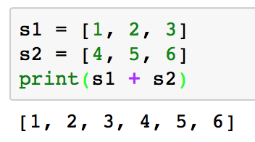
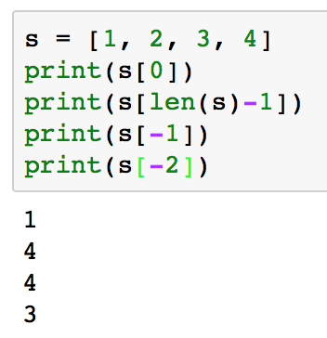
Common operations on built-in types
Common sequence operations, on str, list, and tuple
x in s True if an item of s is equal to x, else False
x not in s False if an item of s is equal to x, else True
s + t the concatenation of s and t
len(s) the length of s
s[i] the ith element of s, start from 0

Slide 14
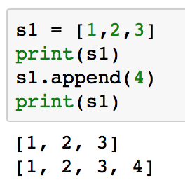
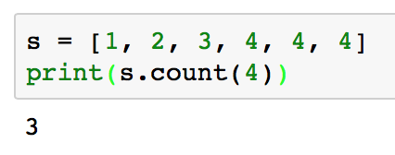
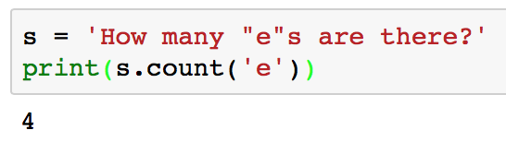
Common operations on built-in types
Common sequence operations (cont.)
s = [1, 2, 3, 4, 5]
s[i:j] slice of s from i to j, i is included and j is not E.g., s[0:3] = [1,2,3], s[1:4] = [2,3,4]
s[i:] slice of s from i to the end E.g., s[2:] = [3,4,5]
s.append(x) append x to the end of s
s.count(x) total number of occurrences of x in s

Slide 15
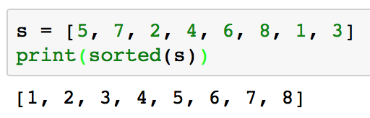
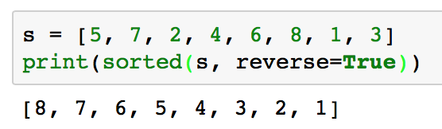
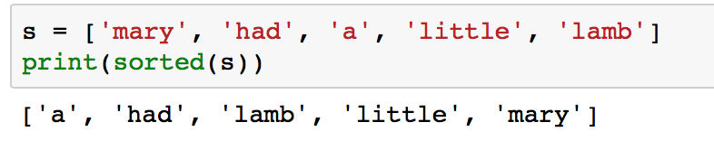
Common operations on built-in types
Common sequence operations (cont.)
sorted(iterable) Return a new sorted list from iterable

Slide 16
Common operations on String (str)
str.split(sep) Return a list of substrings (e.g., words) in the string, resulted from using sep as the delimiter. The default separator is space ‘ ‘. E.g., ‘I love Python’.split() = ['I', 'love', 'Python']
‘I love Python’.split(‘ ‘) = ['I', 'love', 'Python'] ‘144.182.67.1’.split(‘.’) = [‘144', ‘182', ‘67‘, ‘1’]
str.upper() Return a copy of the string with all the cased characters converted to uppercase
str.lower() Return a copy of the string with all the cased characters converted to lowercase

Slide 17
String is Immutable
Operations on string do NOT change the value of the string.
S1= “WE ARE! PENN STATE!”
S1.split(‘ ‘)
What does Python return?
What is the value of S1 now?
S2=S1.split(‘ ‘)
What is the value of S1 now?
What is the value of S2 now?
S1=S1.split(‘ ‘)
What is the value of S1 now?

Slide 18
Common operations on String (str)
str.strip() Returns a copy of the string with the leading and trailing characters removed E.g., ‘ hello\n ’.strip() = ‘hello’
str.startswith(prefix) Returns True if string starts with the prefix E.g., ‘Python’.startswith(‘P’) = True
str.endswith(suffix)

Slide 19
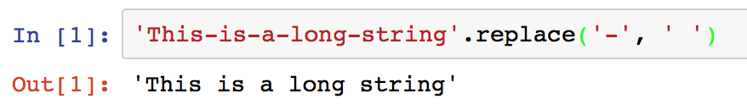
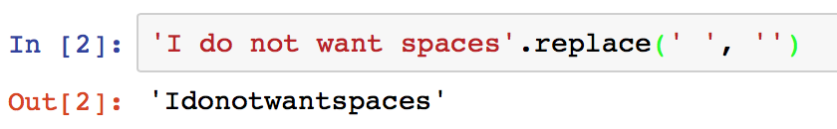
Common operations on String
str.replace(old, new) Return a copy of the string with all occurrences of substring old replaced by new

Slide 20
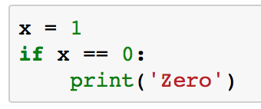
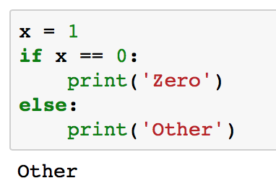
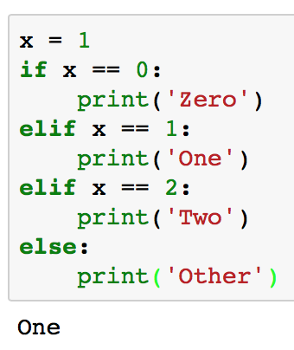
Control Statement: If-then-else
if statement: executes “then” part if the “if condition” is TRUE, otherwise execute “else” part.
else part is optional
elif is short for “else if”, and there can be zero or more elif parts

Slide 21
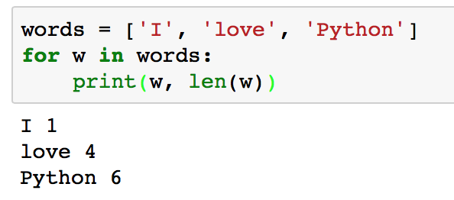
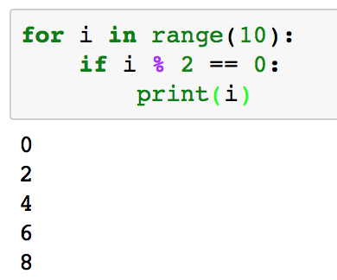
Control Statement: Iteration
for statement
Iterates over the items of any sequence (a list, tuple, or str), in the order that they appear in the sequence
Arbitrary name
Do whatever you want in a for statement

Slide 22
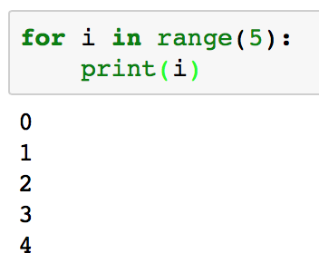
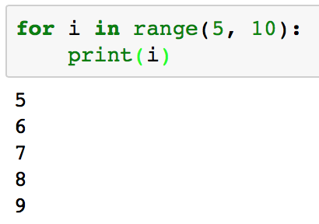
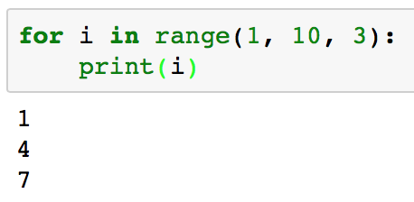
Simple control flow statement
More about range function: iterate over the value of index variable (e.g., i) from “start” to “end”, increase by “step”.
It generates arithmetic progressions to iterate over a sequence of numbers
start
end
step

Slide 23
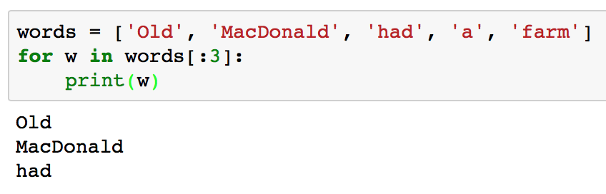
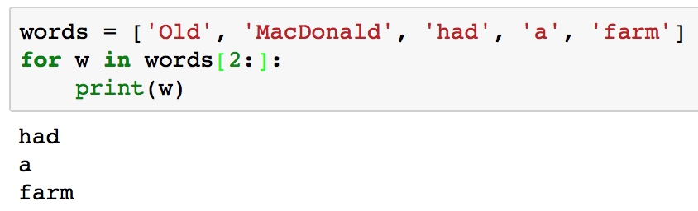
Iterate over the First n or the Last n of a Sequence
Iterate over the first n elements of a sequence [:n]
Iterate over the last n element of a sequence [n:]

Slide 24
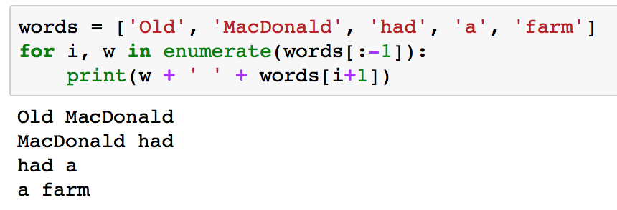
Simple control flow statement
enumerate function
To retrieve the position index and corresponding value at the same time when iterating over a sequence
i is the position index
w is the value
-1 is the position index of the last element in the sequence
Short for: len(s) - 1

Slide 25
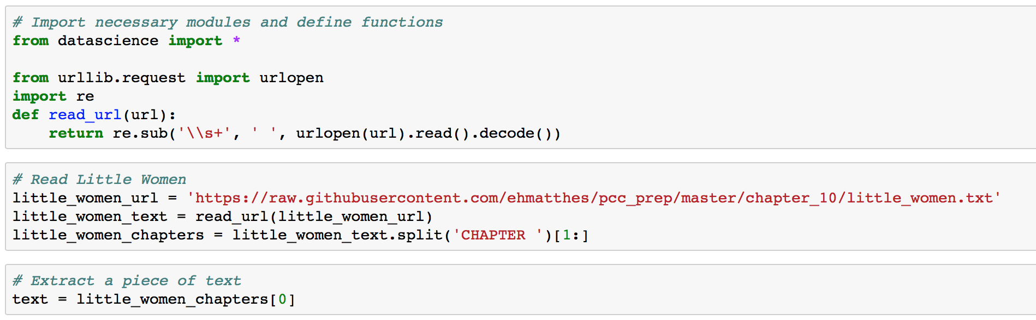
Experiment of word frequency in text
Task: Count the frequencies of all the words in a piece of text
Step 1. Use the code from lab 1 to get some text

Slide 26
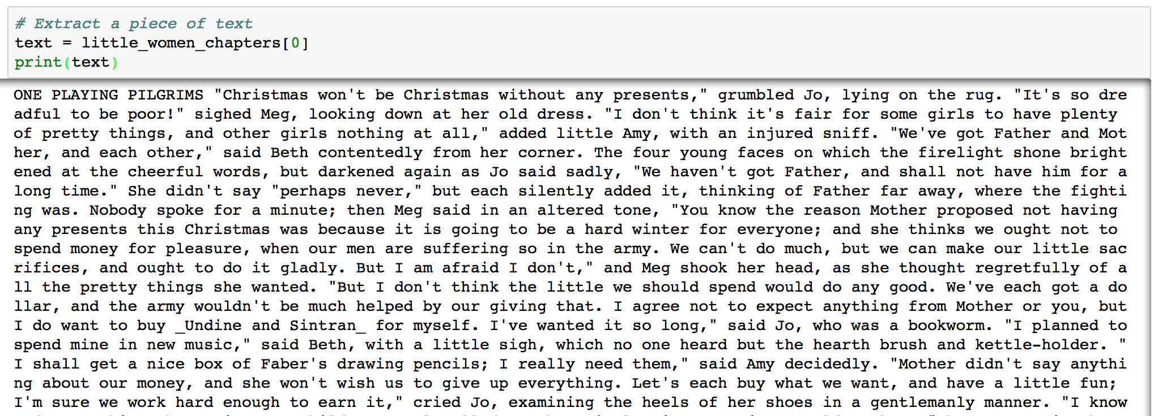
Lab 2: Computing word frequency in text
A glance of text

Slide 27
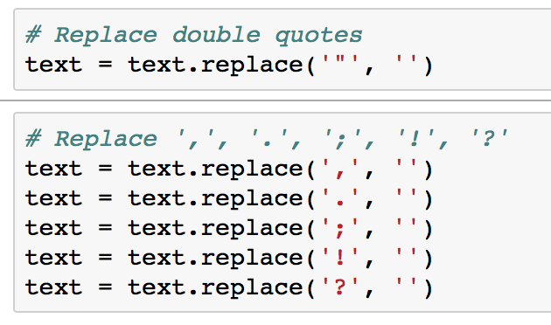
Lab 2: Preprocessing of Text: Remove punctuations
Preprocessing of text remove things not needed for later processing. Ex: Punctuations are not needed for counting frequency of words.
(Exception: short text such as tweets)
Step 2. Remove punctuations, including “ ” , . ; ! ?
Here, we use replace function
An alternative way is using regular expressions

Slide 28
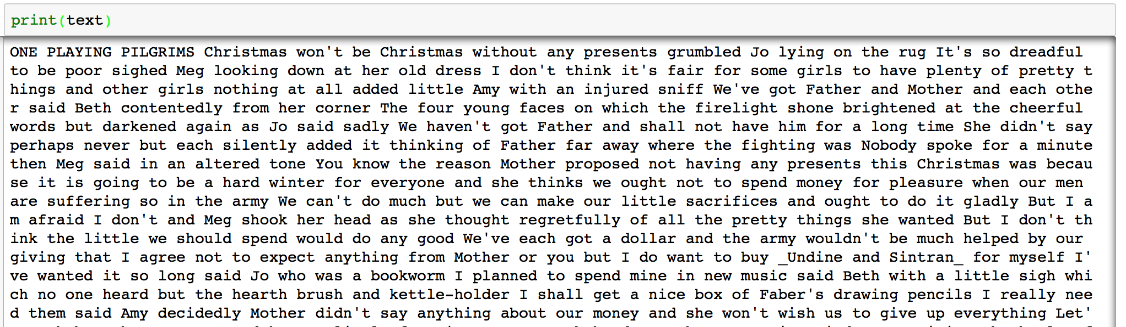
Experiment of word frequency in text
Now, the cleaned text looks like:
Q: What will be the value of variable text after the following Python statement?
text.replace(‘”’, ‘ ‘)

Slide 29
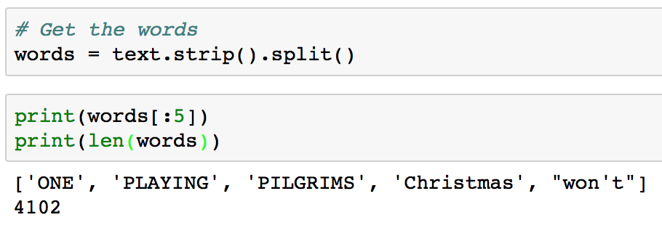
Preprocessing: Extracting Terms/Words
Remove punctuation
Step 3. Get the words
Now, all the 4102 words are stored in the words list

Slide 30
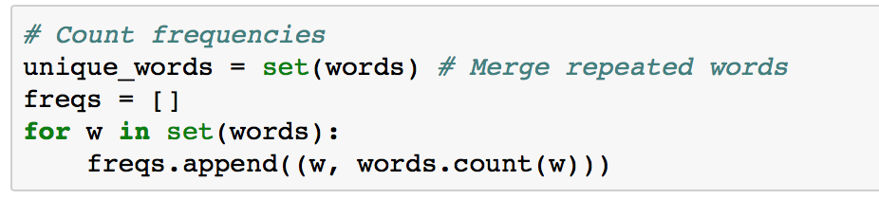
Experiment of word frequency in text
Step 4. Count the frequencies of words
First, convert the list into a set, an unordered collection with no duplicate elements
Then, create an empty list, and for each word in the set, append its number of occurrences in the original word list.
More advanced tricks:
Use dict or Counter class from collections module

Slide 31
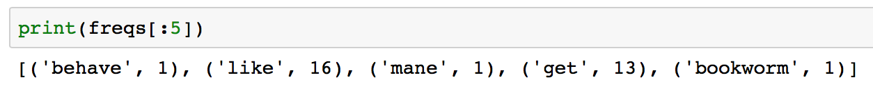
Experiment of word frequency in text
Now, the frequency information of all the words are stored in freqs, an unordered list of tuples:
Lab 2: Submit your execution result (screen shot) of counting the word frequency of a chapter of “Little Woman”.

