Slide 1
DS200 Lab4 Table Manipulation - Part 1
Instructor: John Yen
TA: Yang Xu

Slide 2
What are Tables?
Tables can be used to store relations in a database (as discussed on Tu)
Table is also a common object type (data structure) for representing data sets (in memory) for processing/analyzing the data
Two ways of viewing a Table:
A sequence of named columns
Each column describes a single aspect/attribute of all entries in a data set
A sequence of rows
Each row is a single entry (of all attributes) in a data set

Slide 3
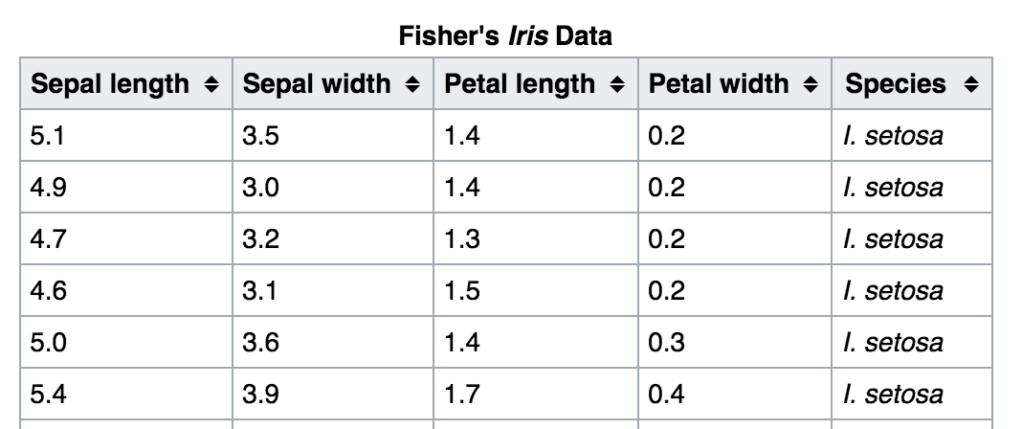
An Example of Table
Row
Column

Slide 4
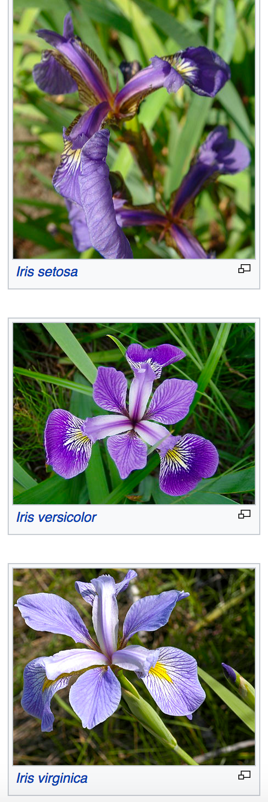
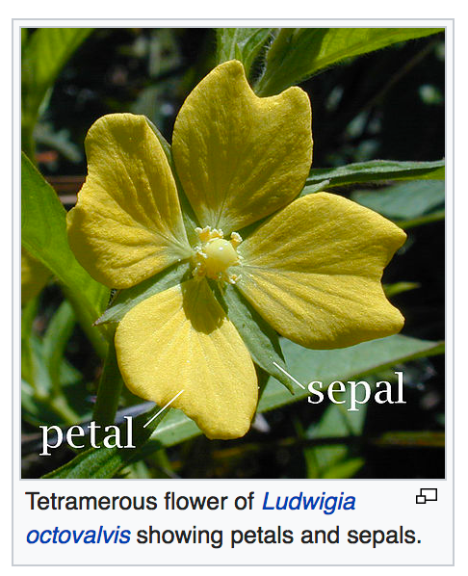
Background of the Iris Data Set
The data was introduced by biologist/statistician Ronald Fisher (1936) to classify three types of iris.
Each flower is represented by four attributes/features:
Sepal length
Sepal width
Petal length
Petal width

Slide 5
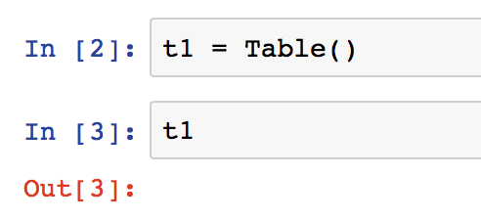
Table class in datascience package
Open jupyter notebook
from datascience import *
Create an empty Table by calling Table()

Slide 6
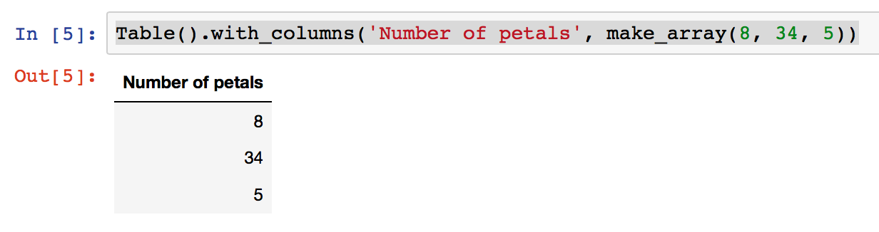
Create Table
Use with_columns method to add columns to Table
Call with_columns with a label and an array
make_array function creates an array
Table().with_columns('Number of petals', make_array(8, 34, 5))

Slide 7
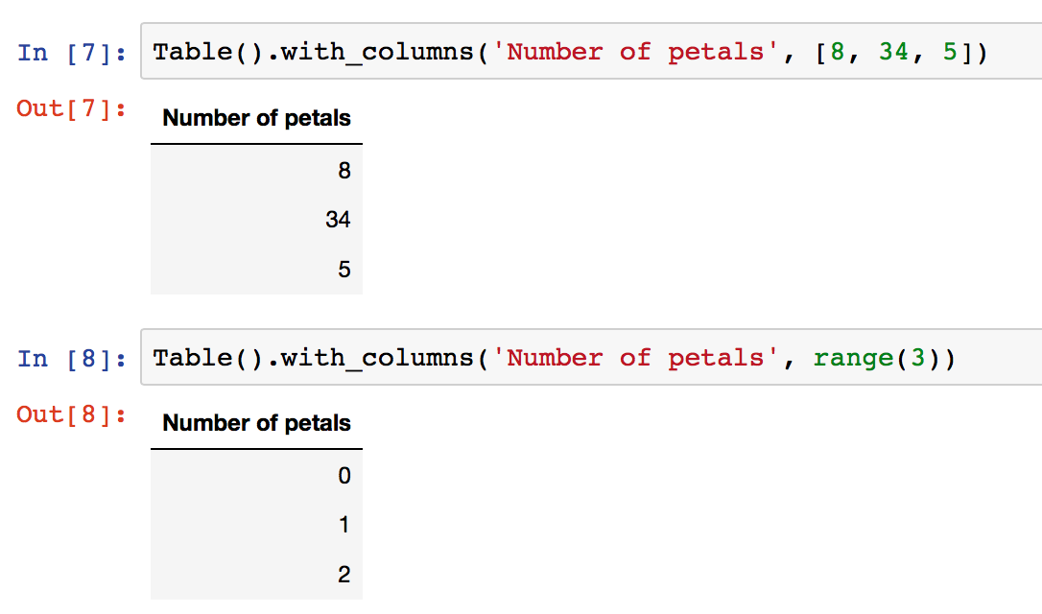
Create Table
Using list or range() also works

Slide 8
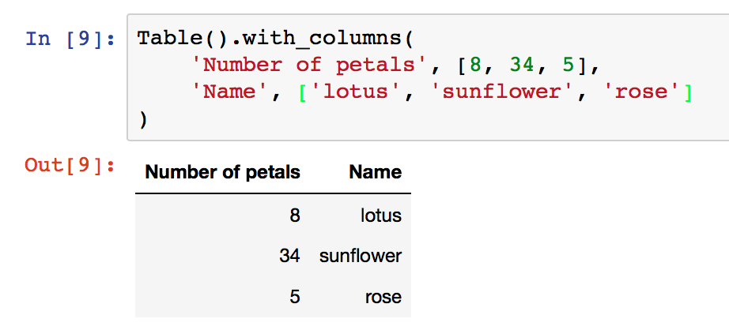
Create Table
Add multiple new columns

Slide 9
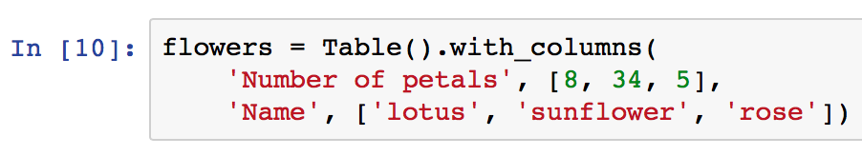
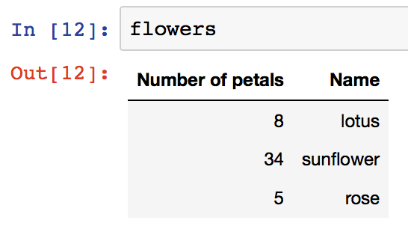
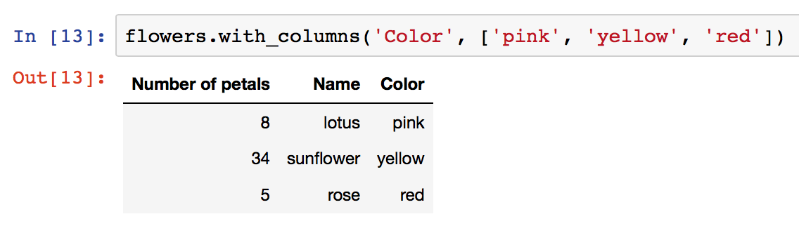
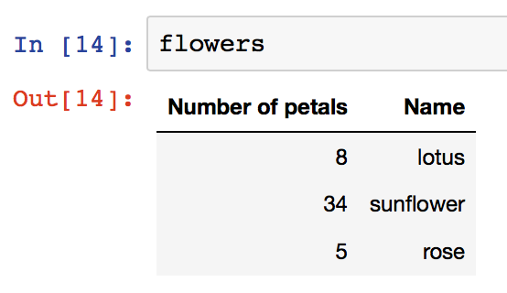
Create Table
Assign new Table to a variable, and extend it with new columns later
1
2
The original Table, flowers, is not changed!
4
3

Slide 10
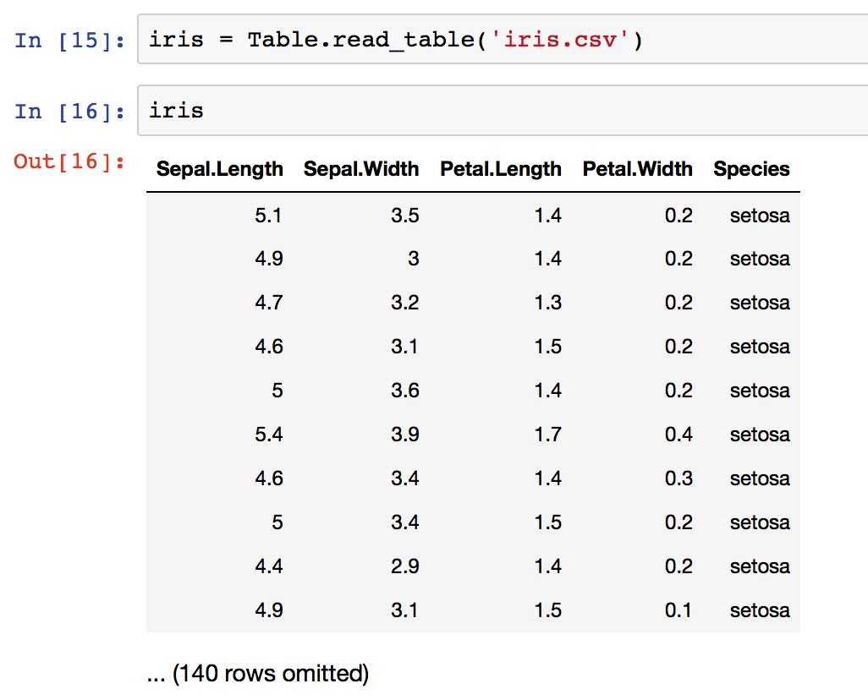
Create Table
User read_table method to read data from a file
Note: you should first download the “iris.csv”
file and put it in the same folder as your current
jupyter notebook

Slide 11
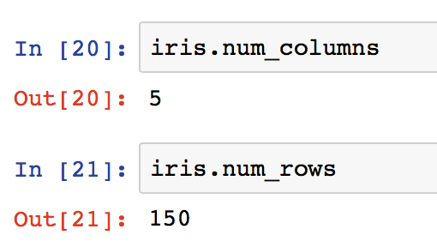
Table attributes
Use num_columns and num_rows to access the size of Tables
Use labels method to list the labels of all the columns

Slide 12
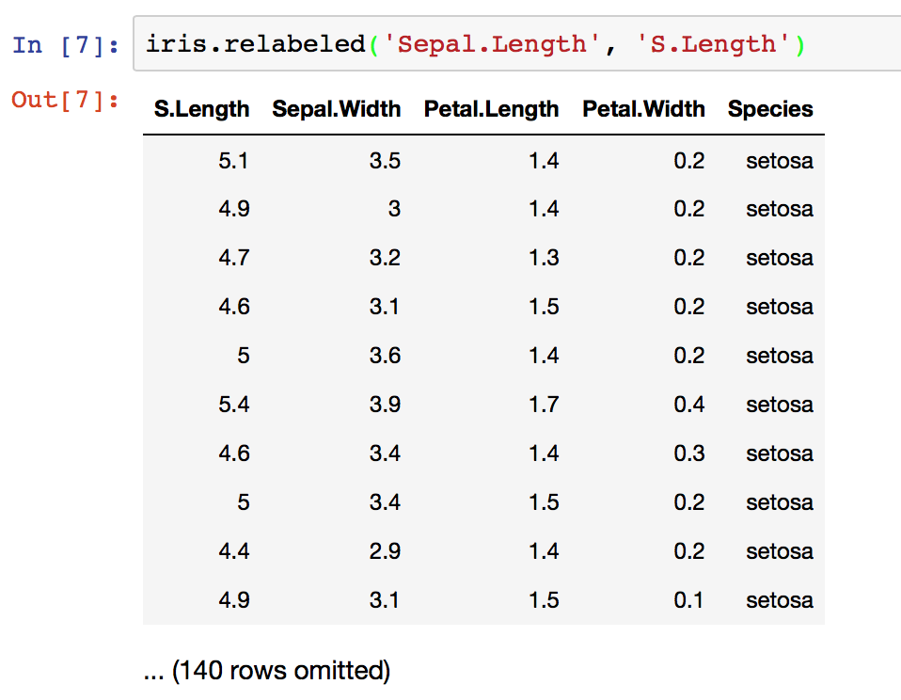
Table attributes
Use relabeled method to change column labels (Note: It creates a new Table and leaves the the original one unchanged)
Usage:
Table.relabeled(Old_label, New_label)

Slide 13
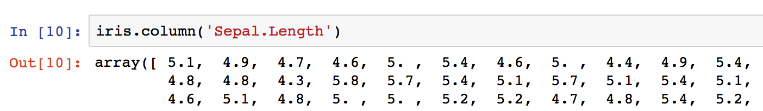
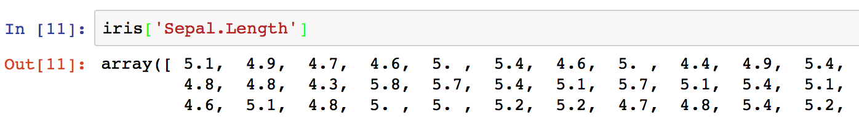
Accessing data in a column
Use a column’s label to access the array of data in the column
Easier way:

Slide 14
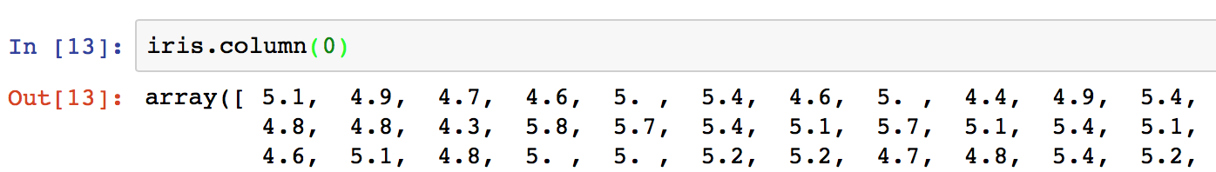
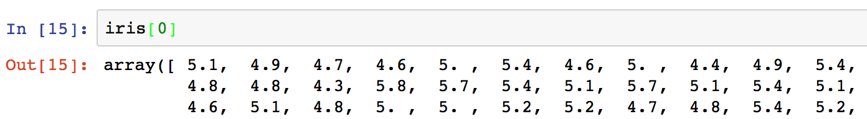
Accessing data in a column
Or, accessing column data using its column index
5 columns are indexed 0, 1, 2, 3, and 4.

Slide 15
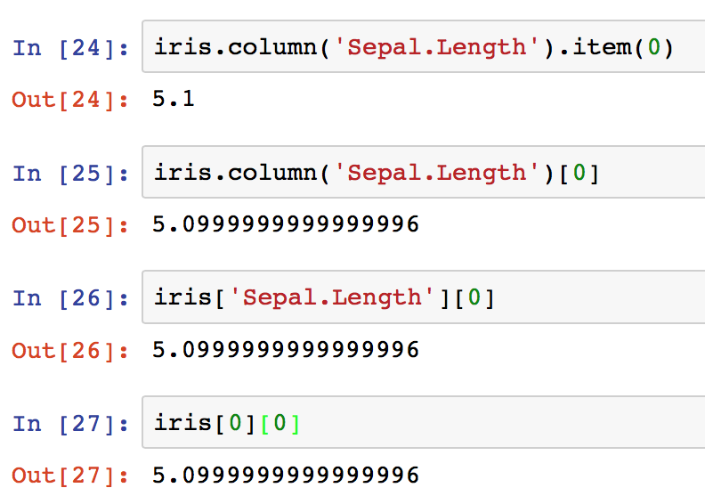
Accessing data in a column
How to access data points in a column?
item method, or second level []
float type returned
numpy.float64 type returned
(higher precision)

Slide 16
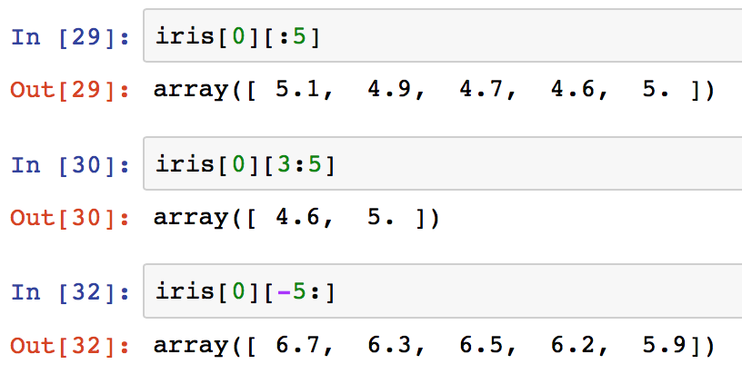
Accessing data in a column
Accessing a slice of data in a column
Similar to slicing a Python list

Slide 17
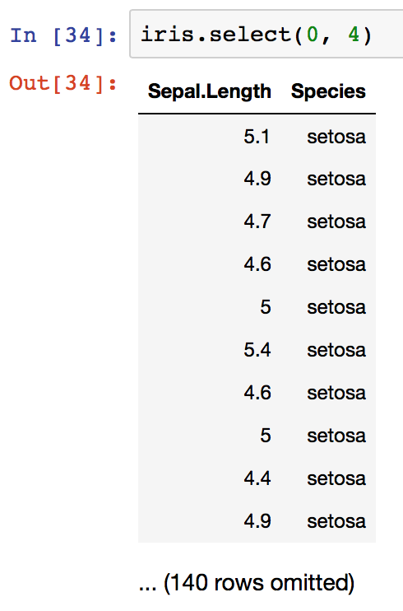
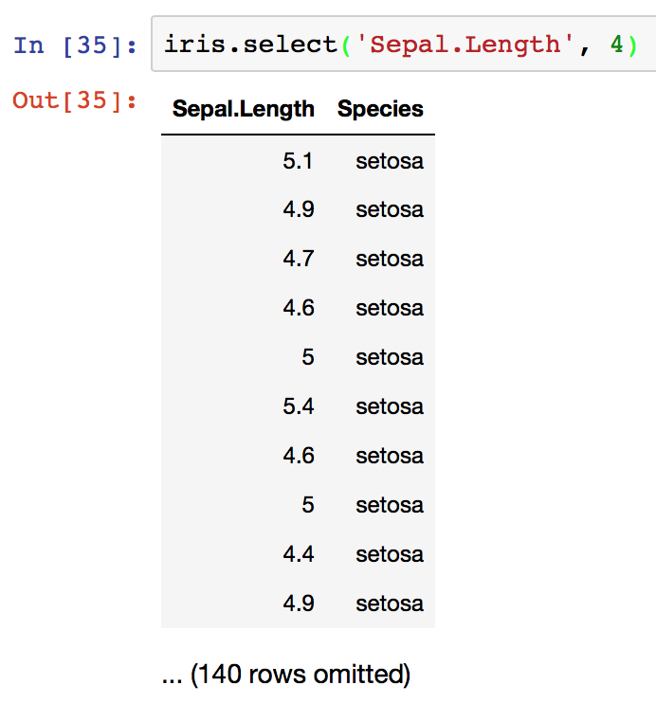
Choosing sets of columns
Use select method to create a new Table with specified columns
Same results

Slide 18
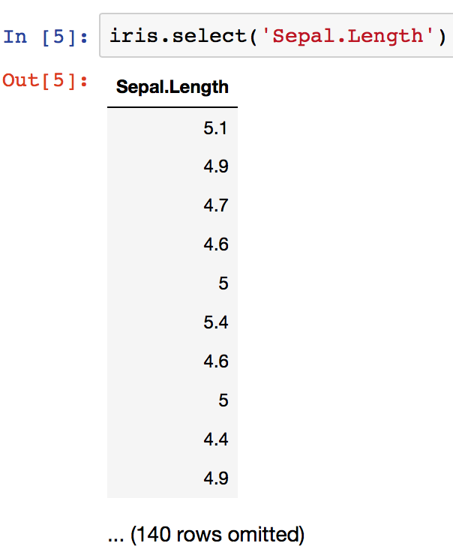
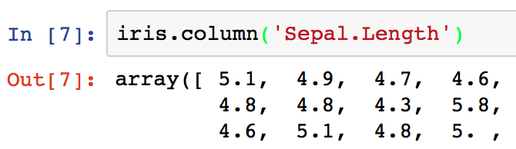
Choosing sets of columns
What about just choosing one column?
Important:
select method returns a Table, in this case, a Table of one column
Unlike column method, which returns an array:

Slide 19
Lab 4: Convert tweeter data into a Table
You will convert JSON file to CSV file
Download the new json_to_csv.py (bug fixed for Windows)
In terminal (command), type On macOS: python3 json_to_csv.py my_tweets_*.json On Windows: python json_to_csv.py my_tweets_*.json

Slide 20
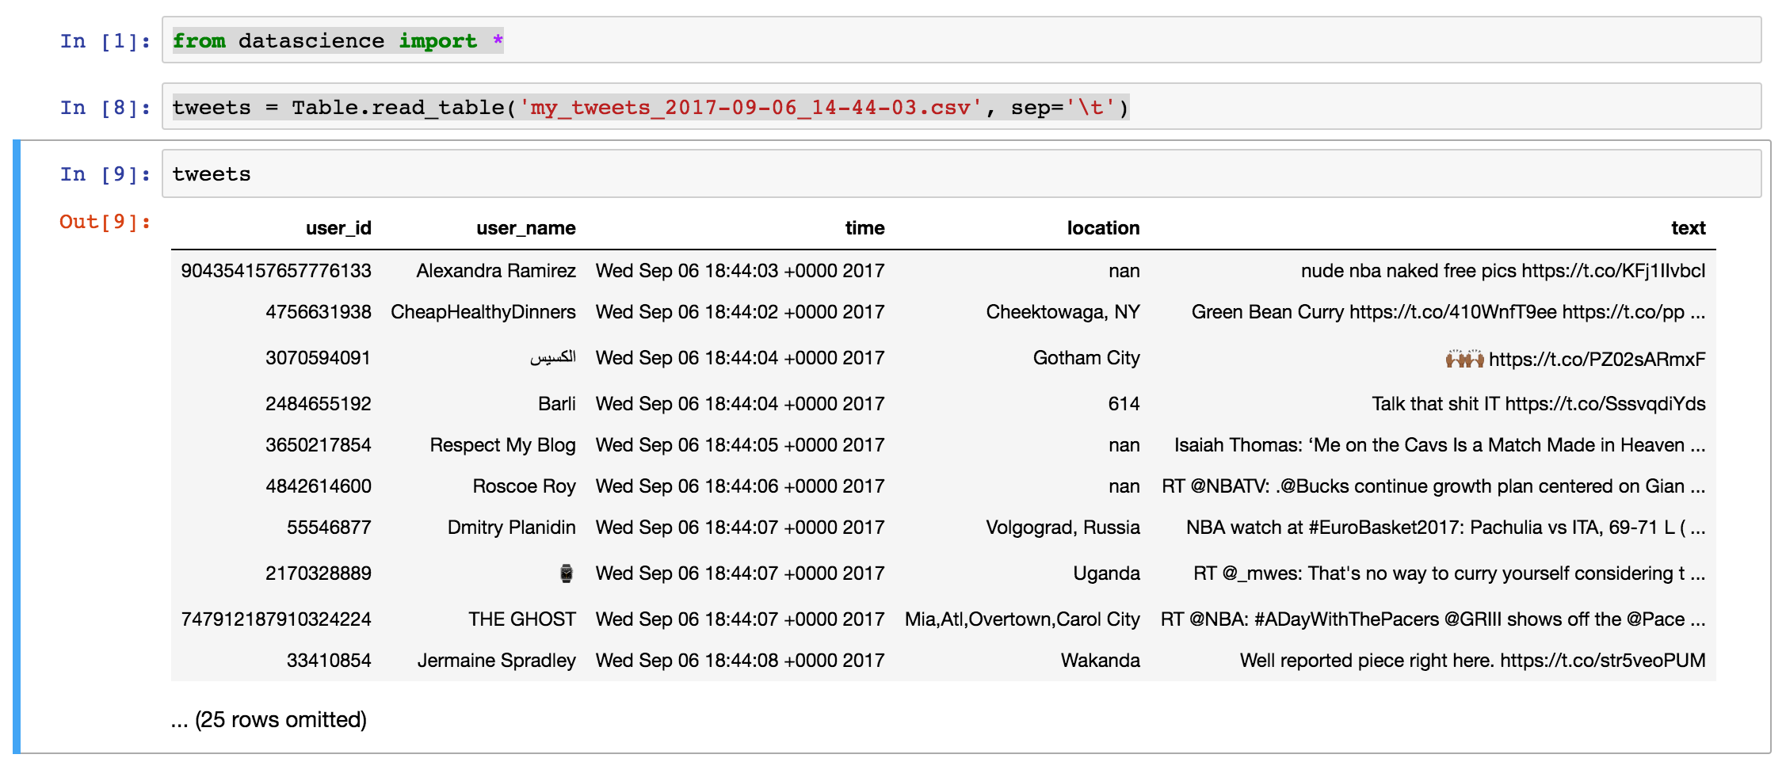
Experiment: Convert tweeter data to a Table
Open jupyter notebook in the same directory
Load “my_tweets_*.csv” into a Table

Slide 21
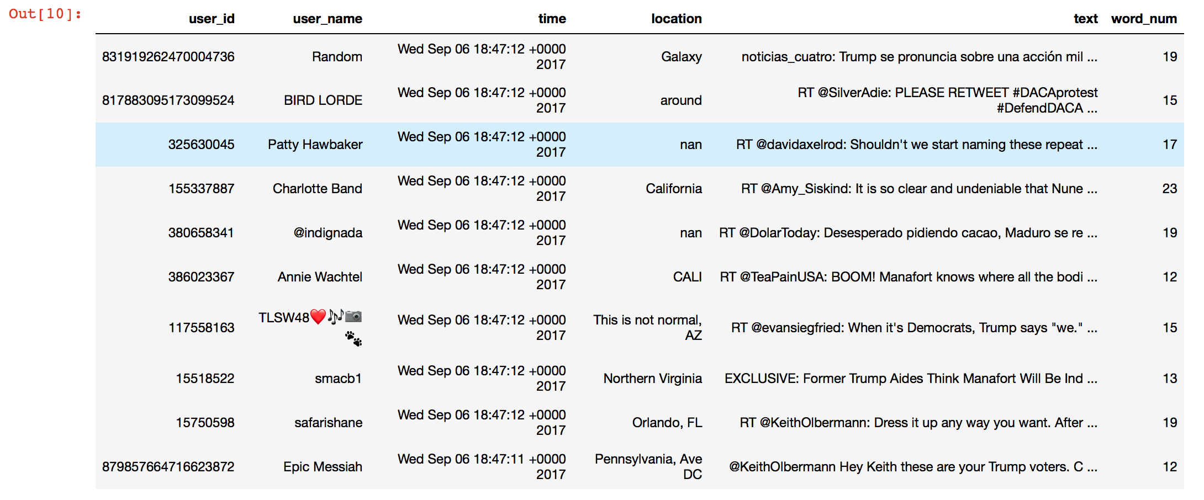
Experiment: Adding word count to the Tweet Table
We will add a word_num column, representing the number of words in the corresponding text column of the same row (a rough count)

Slide 22
Experiment: How to
Download “lab4_tweets_Table.ipynb”
Put it in the same directory with your “my_tweets_*.csv” file
Open jupyter notebook in the same directory
Do not “New” a python3 notebook, but click on the “lab4_tweets_Table.ipynb” you have just downloaded

Slide 23
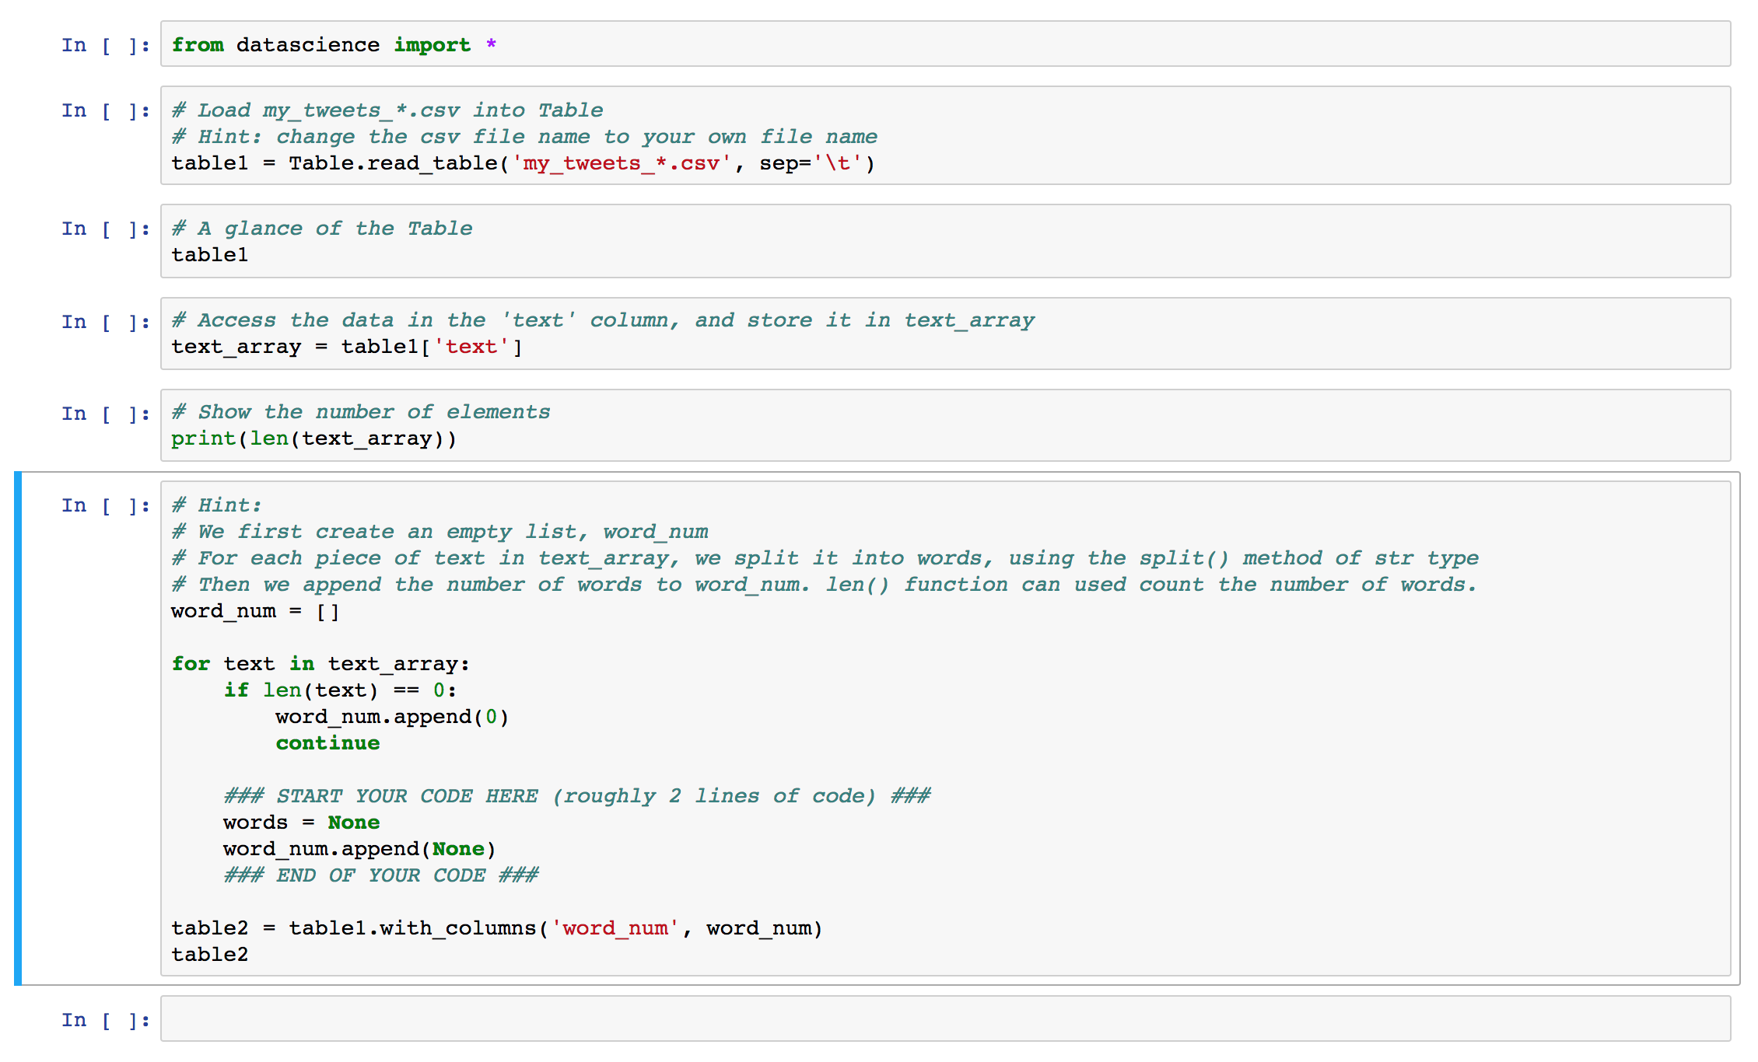
Experiment: Executing Python Code
Specify your csv
file name
Put your code Here

Slide 24
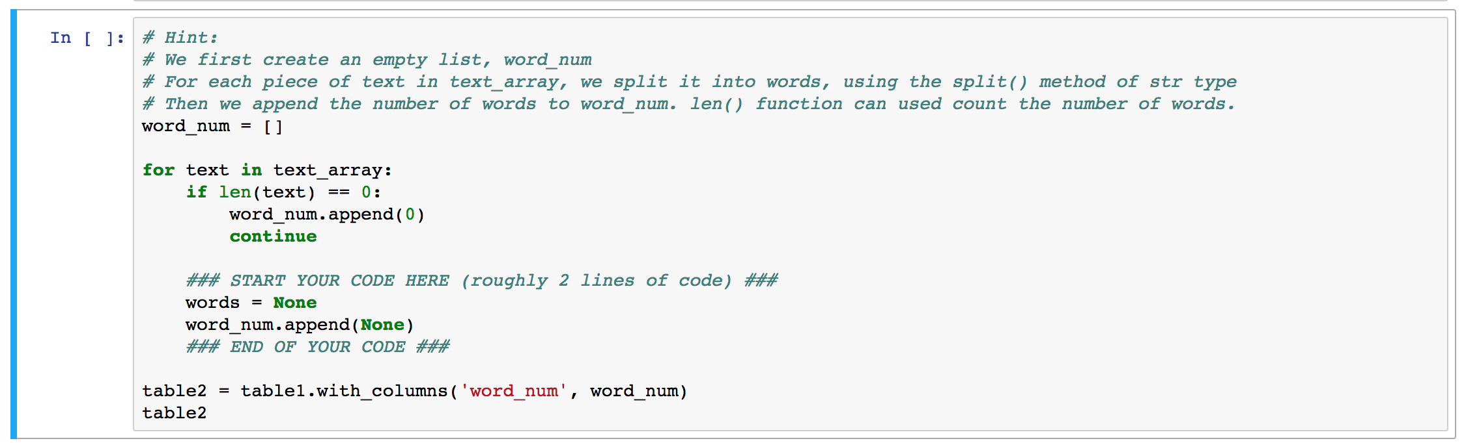
Experiment: How to
Run the cells one by one from top down
Hint:
words = text.split()
word_num.append(len(words))

Slide 25
Experiment: How to
Expected output of the last cell (Submit the screen shot of this cell and your code in the previous cell)

