Slide 1
DS 200
Lab5
Predictive Modeling Labs – Part 1
Tweets Tagging
Instructor: John Yen
TA: Yang Xu
September 20, 2017

Slide 2
What did we learn on Tuesday?
Predictive modeling is an important component of Data Sciences
The foundation of predictive modeling is induction
  From specifics (data) to general (model)
Supervised machine learning is a technique for constructing predictive model
Construction of predictive model involves
  Choosing a suitable representation for the data
  Choosing a suitable representation for the model (to be covered later)

Slide 3
What will we learn today?
Three additional tasks for constructing predictive models from data
Task 1: Decide what to predict? (What questions we hope to answer?)
Task 2: What data to use as model inputs
Task 3: Prepare “training data” through tagging

Slide 4
Task 1: What to predict?
We may start with a broad question, then refine the question to identify things we need to predict.
Examples
A. Question: Can we use social media to predict the sales record of new releases?
  A refined question: Can we use twitter “sentiment” about new release movies to predict their sales record?
  This question requires us to construct a predictive model of tweet sentiment from its content.

Slide 5
Another Example
Question: Can we use social media to predict the outcome of a presidential election?
A refined question: Can we use Twitter to predict people’s opinion about presidential candidates?
This question requires us to construct a predictive model about whether a tweet supports (or does not support) a presidential candidate.
We can then use the model to
  Compare the prediction result with the voting outcome
  Compare the prediction result in different time (e.g., after 1st, 2nd, 3rd debates)

Slide 6
Task 2: What Data to Use as Model Inputs
Existing Data
  Public Available Data
  Data gathered by others, but can be made available (through data usage agreement, suitable data sharing infrastructure)
New Data
  Data gathered through Streaming API (e.g., Twitter API)
  Data gathered through new sensors (e.g., wearables, IoTs)
  Data gathered through IRB-approved study protocols.

Slide 7
Task 3: Prepare Training Data through Tagging
Training Data: Data that includes desired “output” of predictive models (which we call “labels” of the data)
As discussed on Tu, training data is needed by all supervised machine learning methods to build predictive models.
We have seen an example of training data: the Iris data set.
For IRIS data set, the “outputs” of predictive model (i.e., the label) is the correct Iris subtype for each flower, provided by a biologist.
For Twitter data, the “output” of predictive model (i.e., the label) for each tweet is generated by multiple people (taggers) reading the tweets and providing the best “label” based on their interpretation of the tweet.

Slide 8
Opinion Tagging
Tagging whether a tweet “support” or “is against” an opinion.
X can be
  A policy (e.g., a healthcare reform bill)
  A presidential candidate
  An opinion expressed by someone ( a celebrity, a politician, etc)
  An event (e.g., a fund raising event)
  …

Slide 9
Sentiment tagging
Tagging the sentiment of a tweet that is relevant to a certain key word
E.g., key words: “iPhone X”, “iPhone 8”
Positive: “I can't wait to unlock your iPhone X with my face”
Negative: “RT @Cvchie: fuck the iphone 8, i need my kitty 8 🐱🤕”
Neutral: “RT @Apple: iPhone 8 and iPhone 8 Plus. A new generation of iPhone. Available for pre-order now.”
Irrelevant: “Wow! I just entered for a chance to win ""Yoobao Case for Apple iPhone 7 Plus/ iPhone 8 Plus...”

Slide 10
An Important Issue about Tagging
Due to subjective nature of the tagging, we need to have more than one people performing the tagging independently.
After they have each performed their tagging of the entire data set, we use “inter-tagger” agreement to evaluate the degree tagging results by these independent taggers agree with each other.
Tagging result is “acceptable” if the inter-tagging result is higher than a threshold.

Slide 11
Inter-rater Agreement
Given a well-defined rating rule, inter-rater agreement shows the degree of agreement among taggers
If various taggers do not agree on a large proportion of the instances, the rating rule needs to be refined
https://en.wikipedia.org/wiki/Inter-rater_reliability
Inter-rater agreement between two raters: Cohen’s kappa https://en.wikipedia.org/wiki/Cohen%27s_kappa

Slide 12
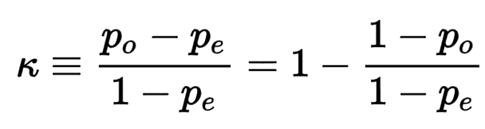

Cohen’s Kappa
Definition:
where $p_{o}$ is the proportion of agreement among raters, and $p_{e}$ is the hypothetical probability of chance agreement

Slide 13
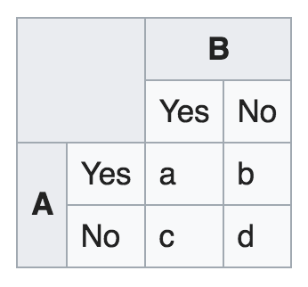
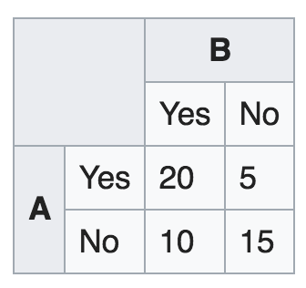
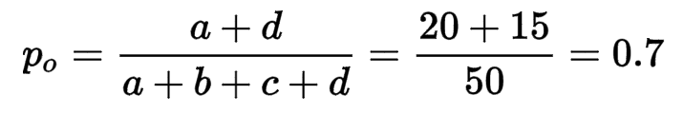
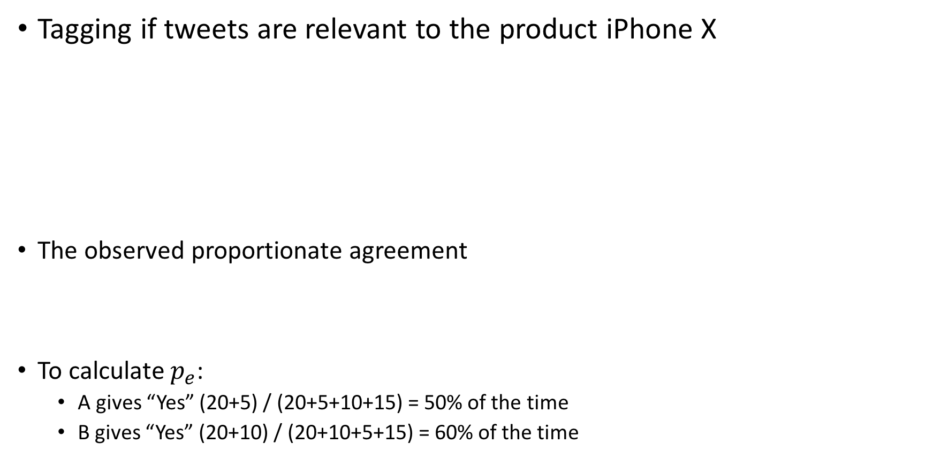
Cohen’s Kappa (example)
Tagging if tweets are relevant to the product iPhone X
The observed proportionate agreement
To calculate $p_{e}$:
  A gives “Yes” (20+5) / (20+5+10+15) = 50% of the time
  B gives “Yes” (20+10) / (20+10+5+15) = 60% of the time

Slide 14
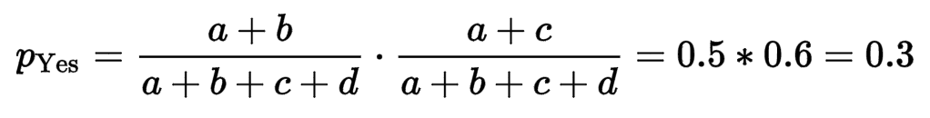
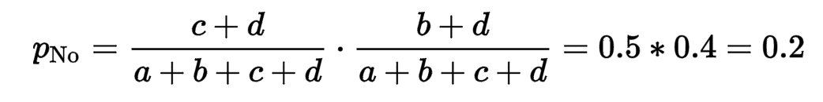

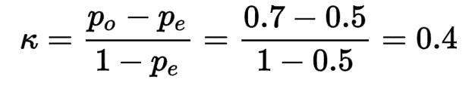
Cohen’s Kappa (example)
The probability that both taggers label a tweet “Yes” (by chance) is
Similarly, the probability that both say “No” (by chance) is
Overall agreement probability by chance is
Cohen’s Kappa is

Slide 15

Cohen’s Kappa
What if I have more than two categories of labels
$p_{o}$= (10+16+8) / Total
$p_{e}=p_{\text{Negative}}+p_{\text{Positive}}+p_{\text{Neutral}}$
Ref: http://www.real-statistics.com/reliability/cohens-kappa/
 |  | Rater A
 |  | Negative | Positive | Neutral
Rater B | Negative | 10 | 4 | 1
 | Positive | 6 | 16 | 2
 | Neutral | 0 | 3 | 8

Slide 16
What Cohen’s Kappa value means good?
One possible interpretation of Cohen’s Kappa.
  Poor agreement = Less than 0.20
  Fair agreement = 0.20 to 0.40
  Moderate agreement = 0.40 to 0.60
  Good agreement = 0.60 to 0.80
  Very good agreement = 0.80 to 1.00
Ref: http://www.pmean.com/definitions/kappa.htm

Slide 17
Lab 5 assignment
Discuss and describe a tagging schema for the tweets you gathered.
Analyze each tweet, and decide whether it is relevant.
Among relevant tweets, determine the “label” of each tweet (e.g., positive vs. negative sentiment; or support vs against an opinion/politician/policy), record them manually using Excel.
Tag your tweets *individually*.
Combine two independent tagging results and compute the Cohen’s Kappa score. Describe how do you compute the Cohen’s Kappa.
Submit:
  The CSV file of your collected tweets with two tagging results (from two taggers).
  A word or pdf document describe (1) the criteria of step 1, 2, and 3, and (2) the Cohen’s Kappa score for your tagging results.

