Slide 1
DS200 Lab6 Data Balancing Check
Instructor: John Yen
TA: Yang Xu

Slide 2
Unbalanced data
Sample of tagged tweets data
Text | Relevance | Sentiment
Dual Layer Credit card anti drop case for iPhone X … | Irrelevant
technews_today: We got our hands on the iPhone 8 … | Relevant | Positive
Y'all think I can buy me some storage to hold me off … | Relevant | Positive
Apple and Best Buy stop spamming … | Relevant | Negative
Can I enjoy my 7 … | Irrelevant
⋮ | ⋮ | ⋮
# of total tweets: 1000
# of “Irrelevant” tweets: 800 out of 1000
# of “Relevant” tweets: 200 out of 1000
# of “Positive” tweets: 150 out of 200
# of “Negative” tweets: 50 out of 200
800 vs. 200
Unbalanced
150 vs. 50

Slide 3
Why unbalanced data is bad
When data is highly unbalanced:
Data mining algorithms tend to degenerate by assigning all cases to the most common outcomes (Olson, 2005)
Naïve Bayesian classifier example
Two classes: Postive (90/100) vs. Negative (10/100)
New data point: X
Pr(Postive|X) ∝ Pr(X|Positive) * Pr(Positive)
Pr(Negative|X) ∝ Pr(X|Negative) * Pr(Negative)
Prior probability Pr(Positive) is naturally higher than Pr(Negative) → Bias!

Slide 4
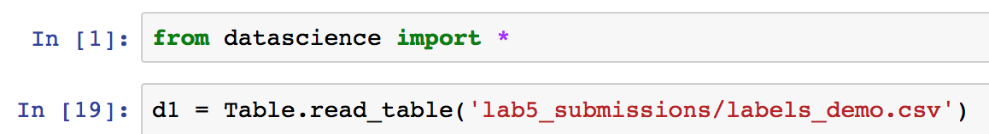
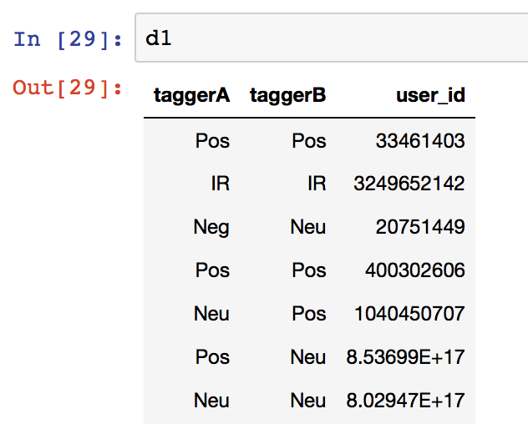
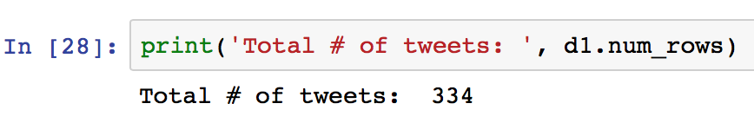
Check your data
Open Jupyter Notebook, and load the tagged tweets data (.csv file)

Slide 5
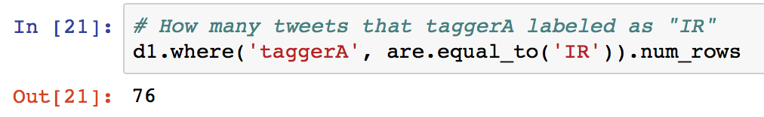
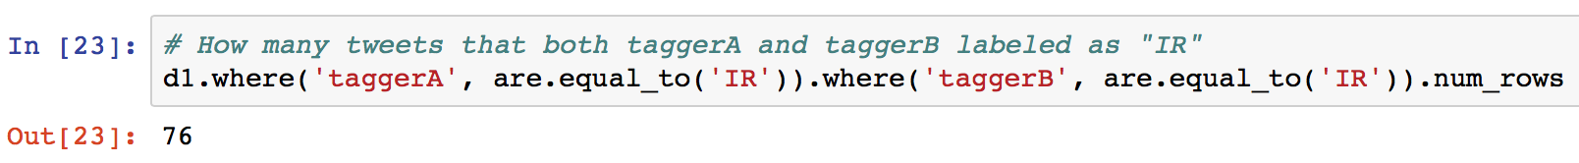
Count tags (by row selection)
We want to count how many “Pos”, “Neg”, and “Neu” tags each tagger gives
Use where method on Table object
76 out of 334 tweets are irrelevant.

Slide 6
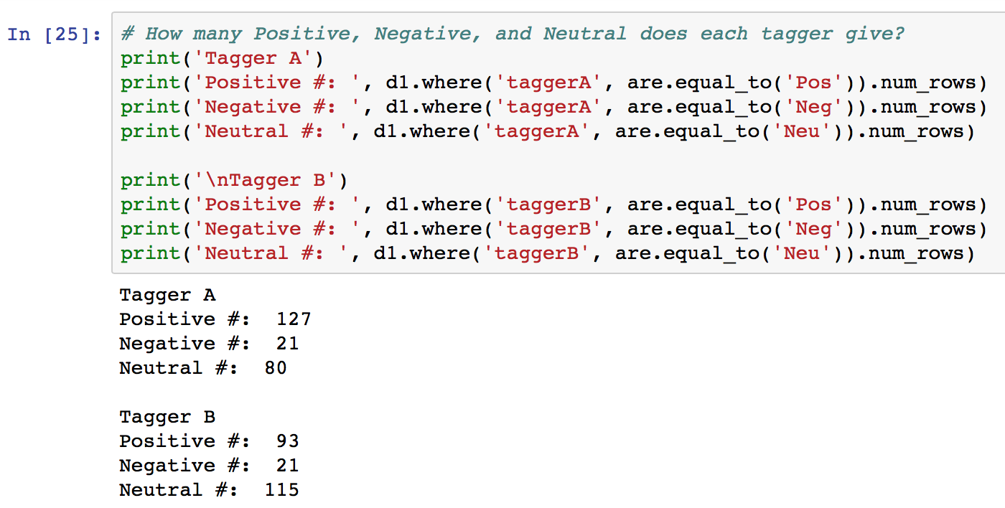
Count sentiment tags
The number of “Negative” tweets is relatively small
Maybe 50 to 60 more tweets in this class is needed.

Slide 7
Pipeline concept
Predictive model (future work)
Irrelevant tweet
Input:
New tweet
Filter
Predictive Model
Positive tweet
Sentiment/Opinion
Predictive Model
Negative tweet

Slide 8
Lab 6 assignment
Count how many “Irrelevant”, “Positive”, and “Negative” tags you have on your data.
Decide whether you need to collect more tweets, and for which tag particularly.
If needed, collect and tag more tweets data, until your data is sufficiently balanced.

