Slide 1
DS 200 Lab7 Building A Decision Tree Predictive Model Using Python
TA: Yang Xu
Instructor: John Yen
October 5, 2017

Slide 2
In this lab, you will learn to
Pre-process your twitter data to remove non ASCII characters. (slide 3-6)
Create training and testing data set from your tagged twitter data. (slide 7-11)
Build a decision-tree classifier from training set (using scikit-learn package) for filtering tweets (i.e., classifying tweets into Relevant vs Irrelevant). (slide 12-16)
Evaluate the predictive model on the testing data set. (13-16)
Visualize the decision-tree predictive model (17-19)

Slide 3
Data pre-processing
Remove non-ASCII characters in tweets
Remove empty or irregular rows
…
Open terminal or command
Windows, run: python remove_nonASCII.py YOUR_FILE_NAME
macOS/Linux, run: python3 remove_nonASCII.py YOUR_FILE_NAME
A new file “YOUR_FILE_NAME_nonASCII_removed.csv” will be generated

Slide 4
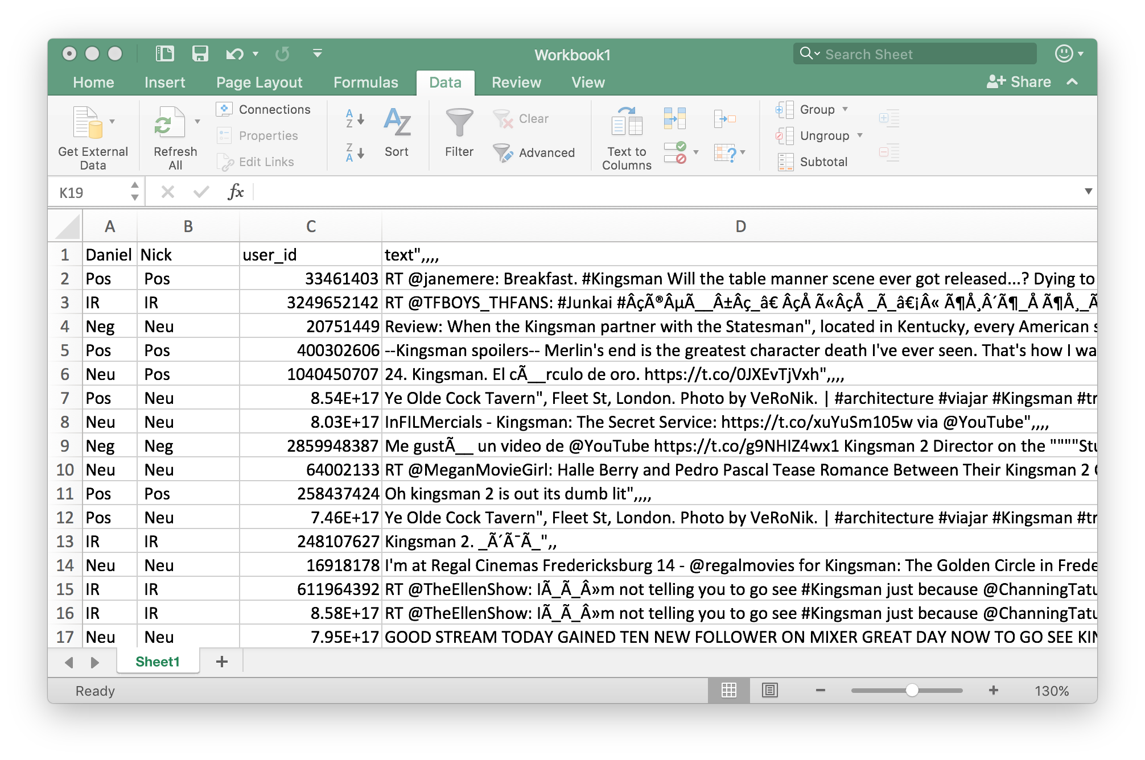
Data preprocessing
Raw data

Slide 5
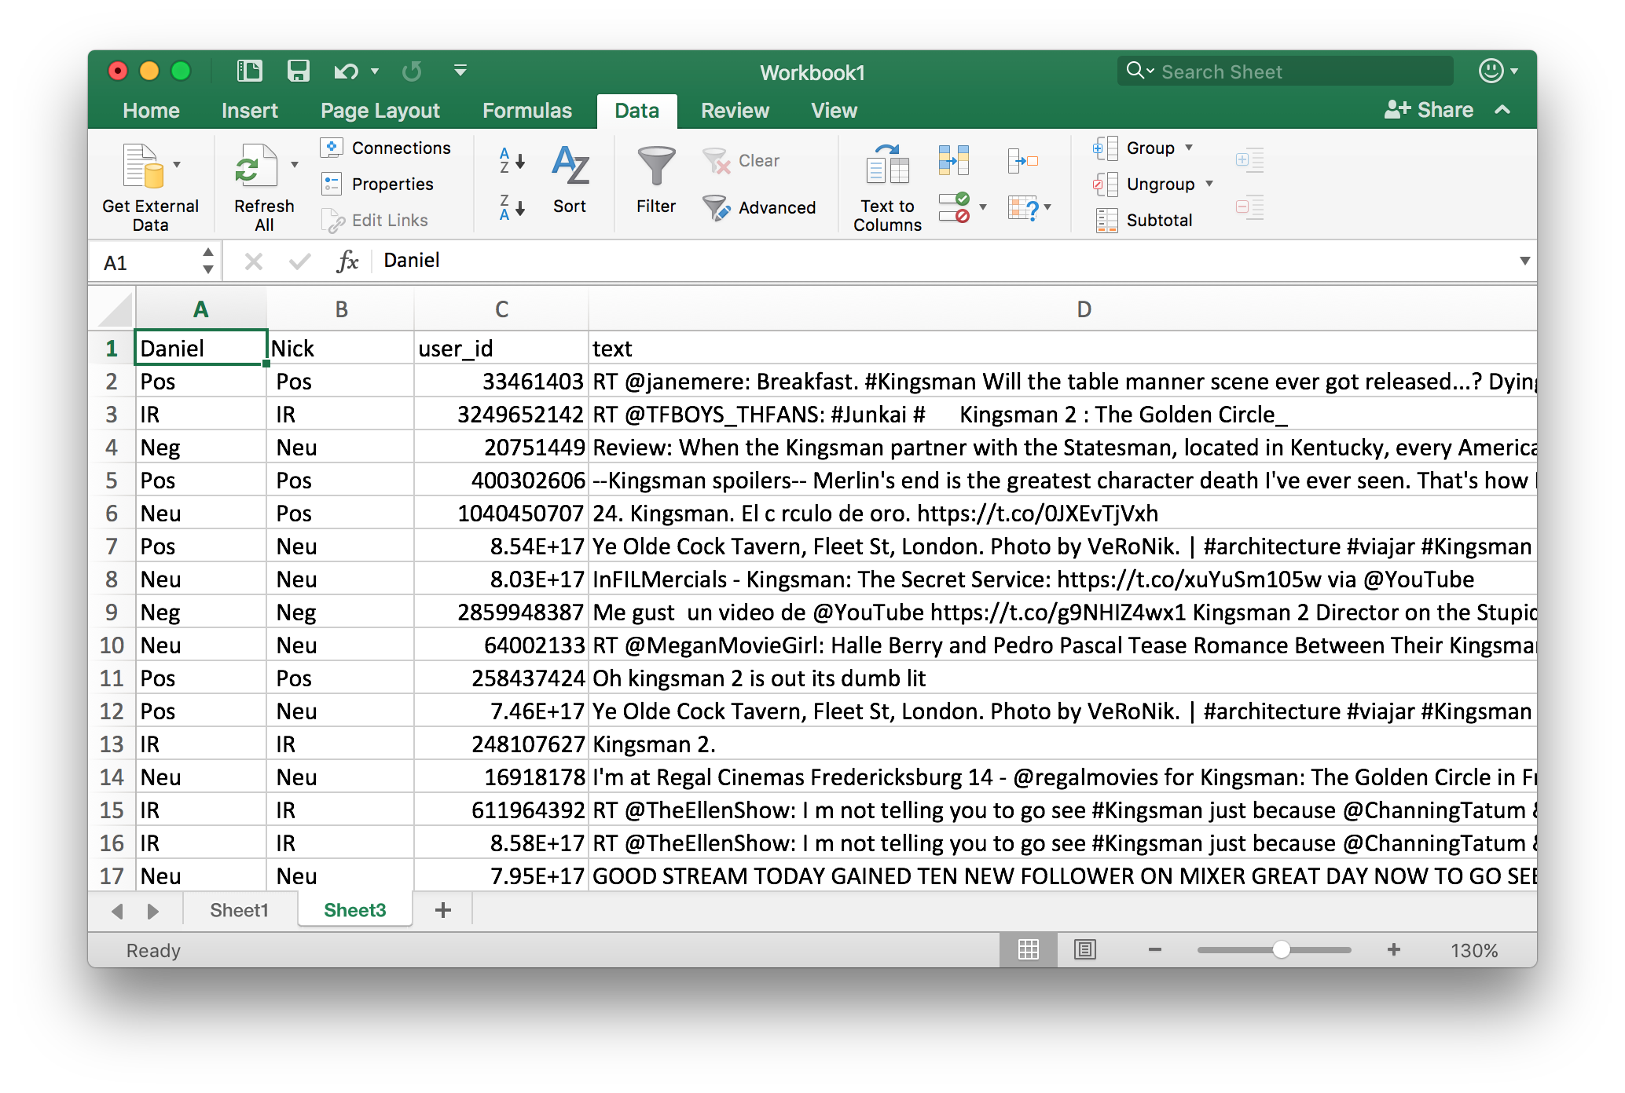
Data preprocessing
Cleaned data after removing non-ASCII characters

Slide 6
Install necessary packages
Open terminal or command
Windows, run: pip install -U scikit-learn graphviz
macOS/Linux, run: pip3 install -U scikit-learn graphviz
graphviz package is for later use to visualize decision trees

Slide 7
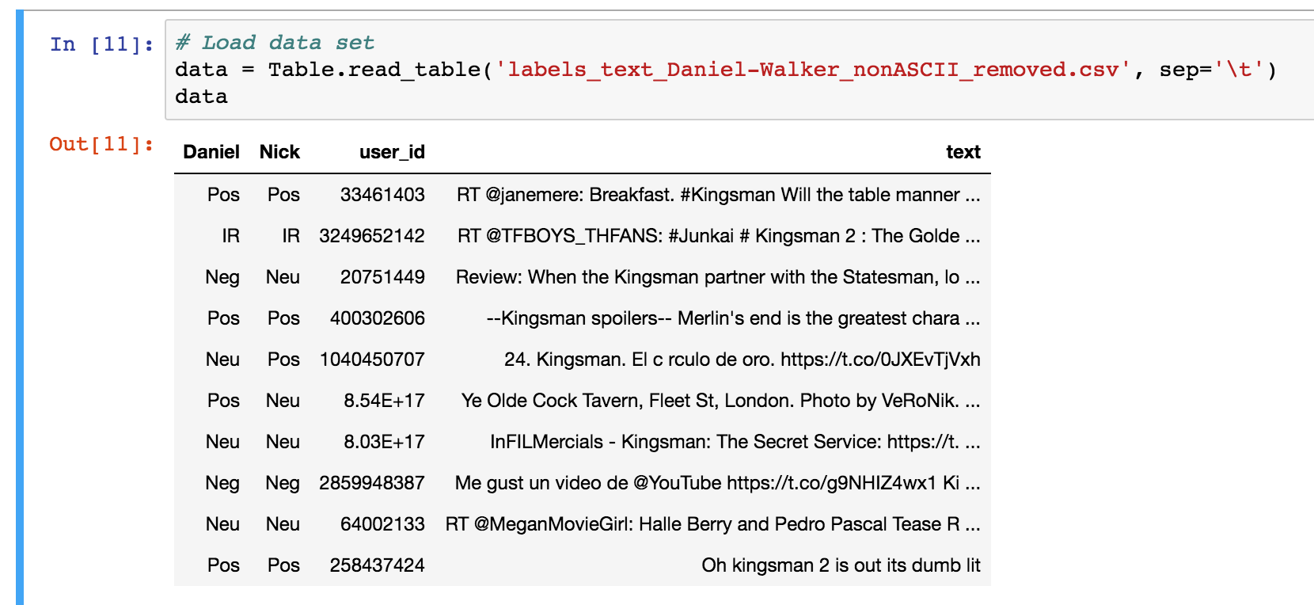
Step 2: Divide Tagged Data into Training and Testing sets
1. Load cleaned data

Slide 8
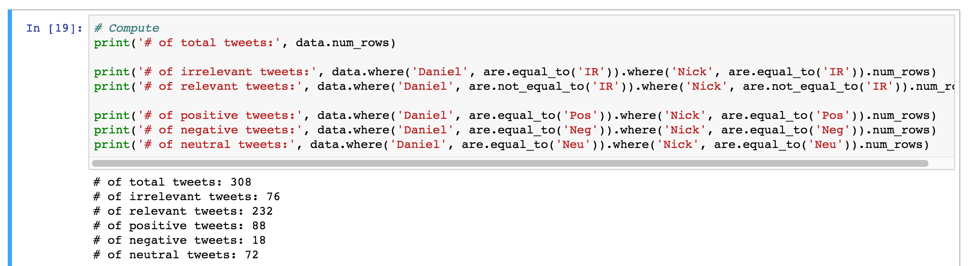
Create train and test sets
2. Focus on labels that are agreed by both taggers

Slide 9
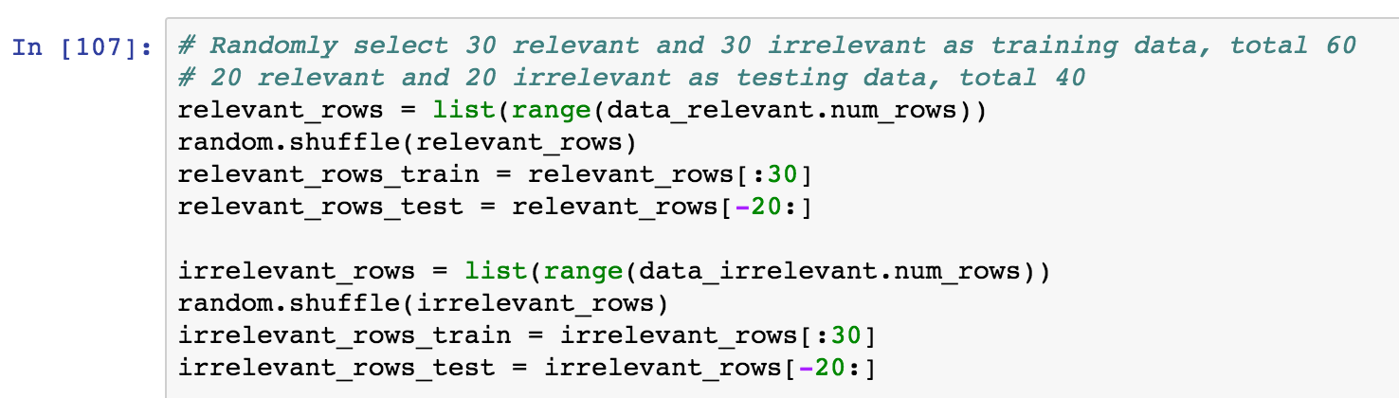
Create train and test sets
3. Separate data by relevant vs. irrelevant
4. Randomly select subsets (in a balanced way)
Row indices for
data_relevant
Row indices for
data_irrelevant

Slide 10
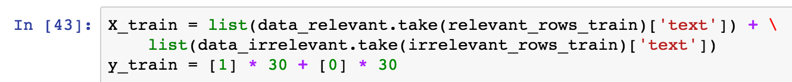
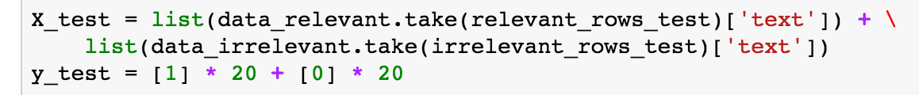
Create train and test sets
5. Create actual train and test data
take method of Table object takes a specified set of rows (by a row index or array of indices), and return a new Table

Slide 11
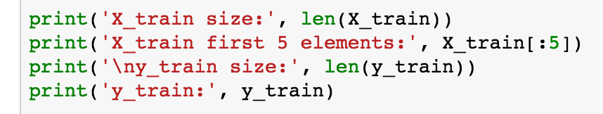
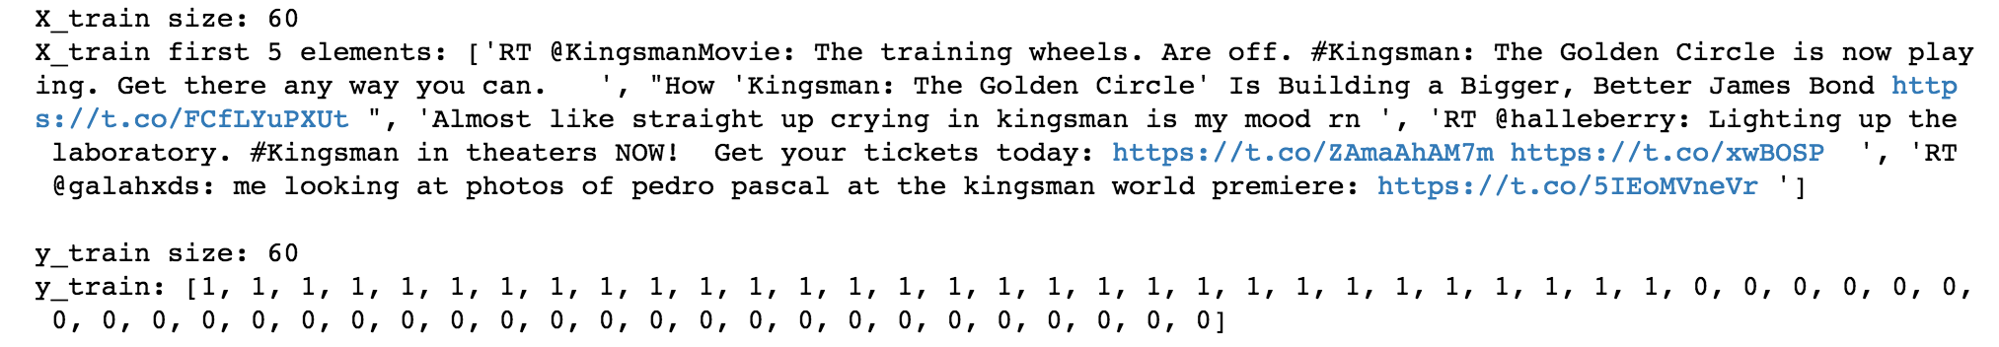
A glance of train and test sets
X_train is a list of str type
y_train is a list of int type

Slide 12
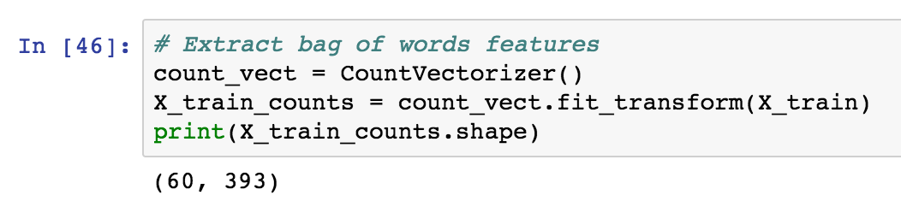
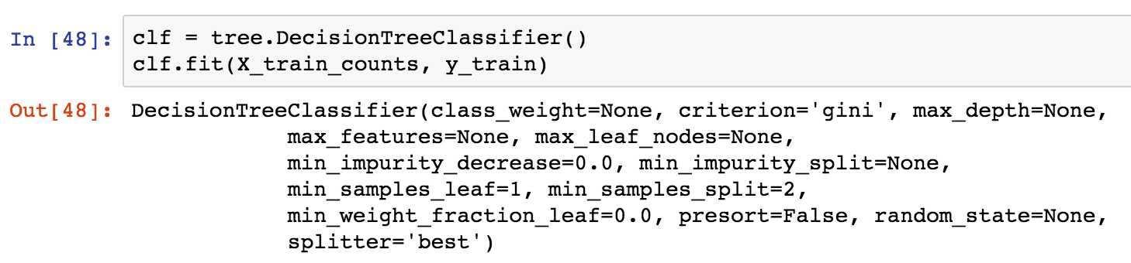
Build a decision tree classifier
Use a step-wise method
1. Extract bag-of-words features
2. Create and fit (train) a decision tree classifier

Slide 13
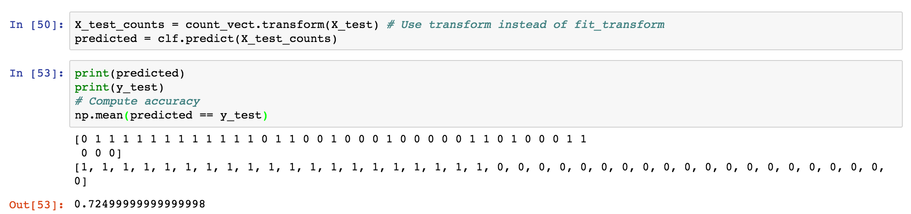
Build a decision tree classifier
Evaluate on test set
It reaches 72.5% accuracy, not bad!

Slide 14
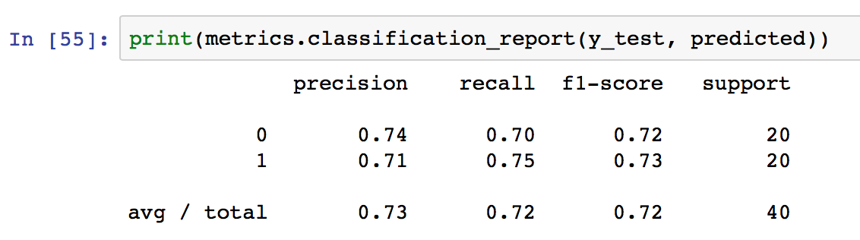
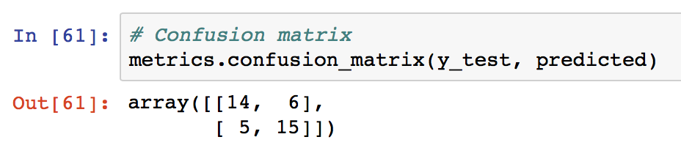
Build a decision tree classifier
More advanced evaluation

Slide 15
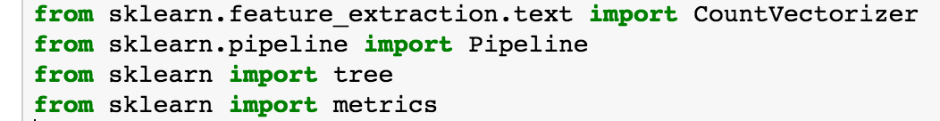
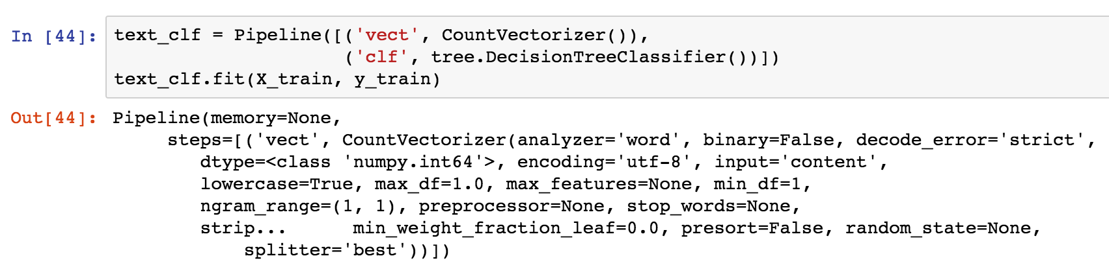
Build a decision tree classifier (alternative)
Alternatively, use the pipeline method provided by scikit-learn
Build and fit
Directly use X_train

Slide 16
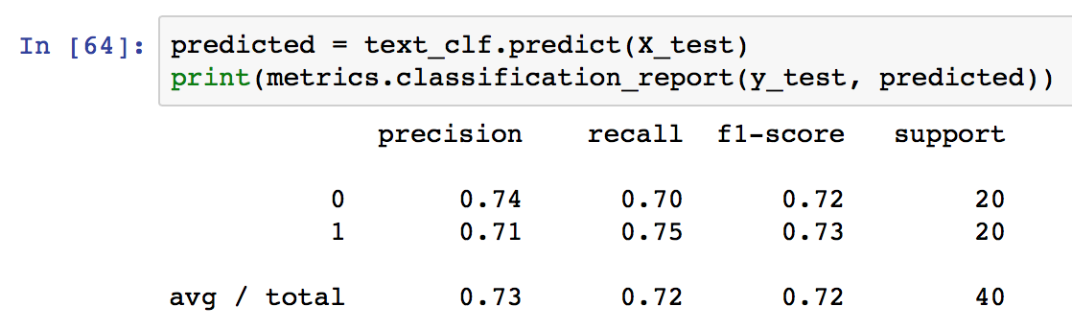
Build a decision tree classifier (alternative)
Directly use X_test
Evaluate

Slide 17
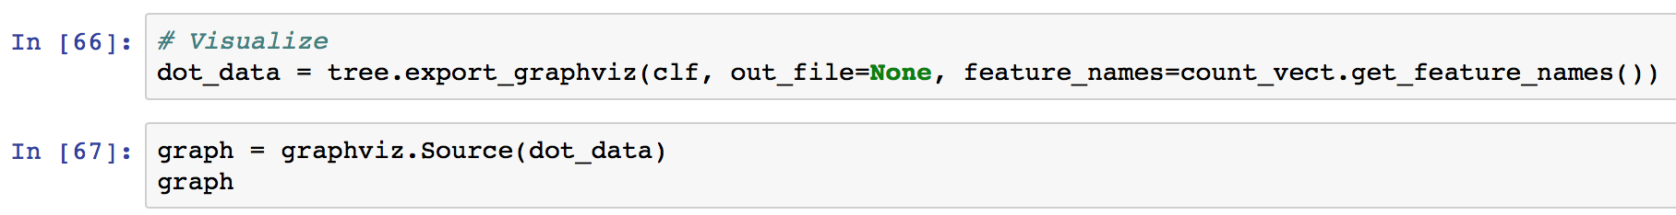
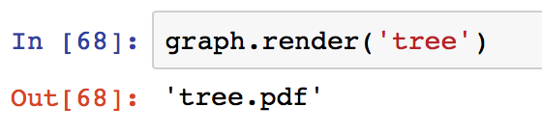
Visualize decision tree
Use graphviz package
Inline plot in Jupyter Notebook
Save as .pdf file

Slide 18
Visualize decision tree

Slide 19
Lab7 Assignment (due next Thursday 9 am)
Build a Decision Tree classifier that classify “relevant” (1) vs. “irrelevant” (0) tweets.
Submit:
A doc, docx, or PDF file containing the following information:
Screenshot showing tweets data loaded into Jupyter Notebook as Table object.
Screenshots showing the sizes of your train and test sets (X_train, y_train, X_test, y_test).
Screenshots showing the detailed evaluation of your Decision Tree classifier, including precision, recall, and f1-score.
Discussion about the evaluation result of your Decision Tree.
A pdf file showing the visualized decision tree.

