Slide 1
DS200 Lab 8 Cross-validation
Instructor: John Yen
TA: Yang Xu

Slide 2
In this lab, you will do
Use cross-validation (CV) to evaluate the performance of classifiers.
Compare the Precision, Recall, and F-measure resulted from CV with those from simple train-test split method.

Slide 3
Cross-validation
k-fold cross-validation
The original dataset is randomly partitioned into k equal size sub-datasets
Of the k sub-datasets, one single sub-dataset is retained as the testing data, and the remaining k-1 sub-datasets are used as training data.
The process is repeated k times, with each of the k sub-datasets used exactly once as testing data.
The k results are averaged (or combined) to produce a single estimation.

Slide 4
Demonstration of CV
Example: 5-fold CV
In practice, 10-fold CV is more common

Slide 5
Purpose of cross-validation
Give an indication of how well the model (classifier) will do when it is asked to make new predictions for data it has not already seen
Advantage over simple one time train-test split The evaluation of train-test division may depend heavily on which data points end up in the training set and which end up in the test set, and thus the evaluation may be significantly different depending on how the division is made.

Slide 6
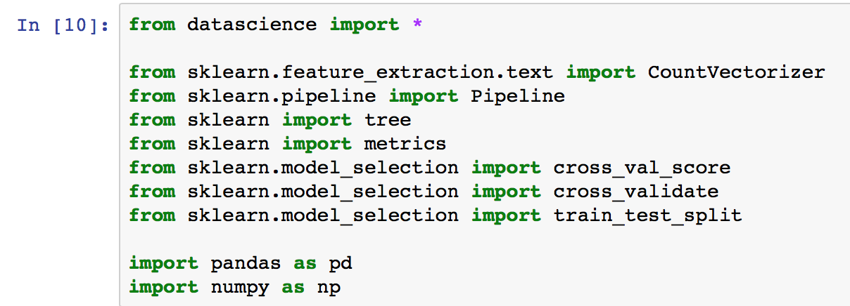
Cross-validation in scikit-learn

Slide 7
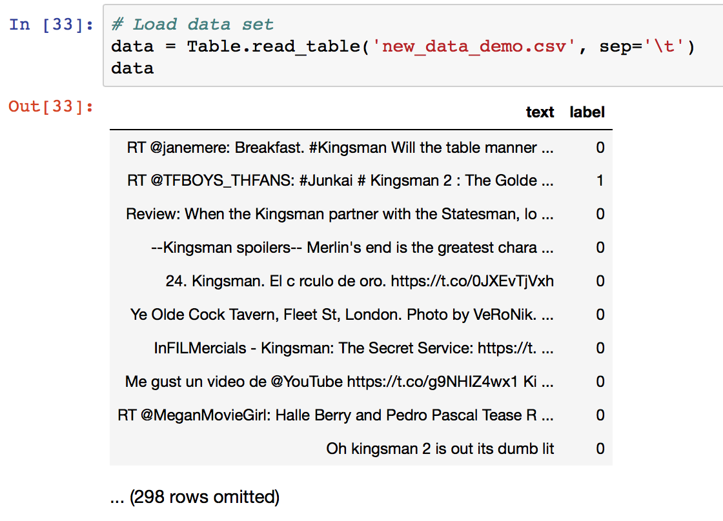
Cross-validation in scikit-learn
Load dataset

Slide 8
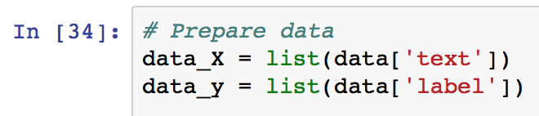
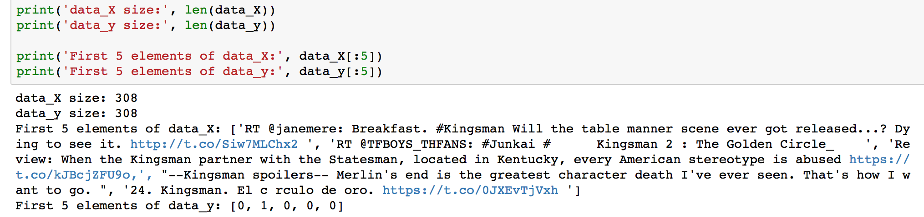
Cross-validation in scikit-learn
Prepare data
A glance

Slide 9
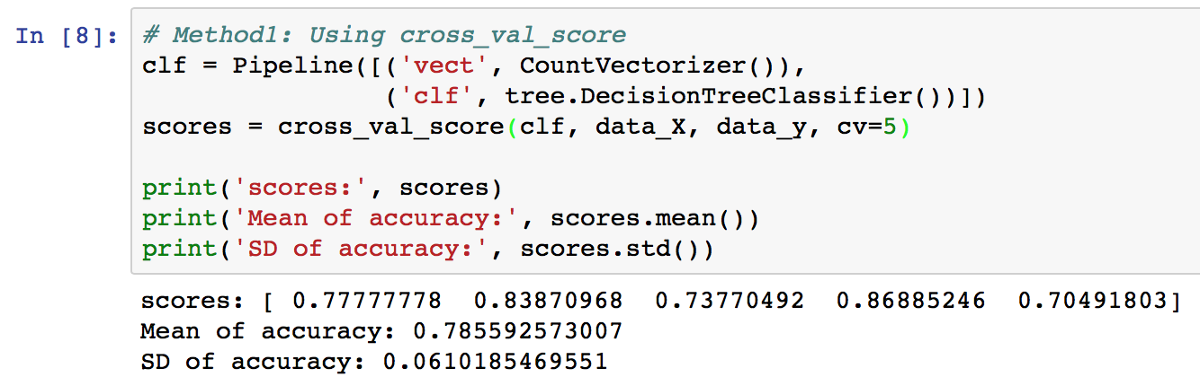
Cross-validation in scikit-learn
Method1: use cross_val_score method
Number of folds, i.e., k

Slide 10
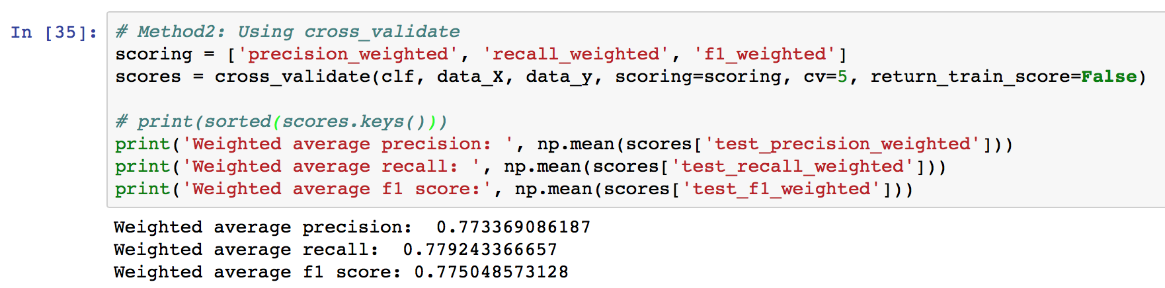
Cross-validation in scikit-learn
Method2: use cross_validate method for more detailed report

Slide 11
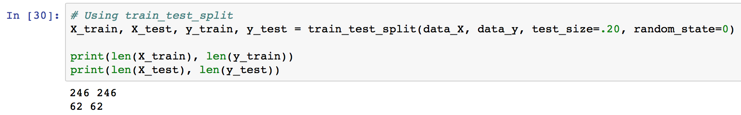
Compare CV with simple train-test split
Use 20% as testing data, and the rest 80% as training data (To compare with 10-fold CV, the percentages are 10% and 90%)

Slide 12
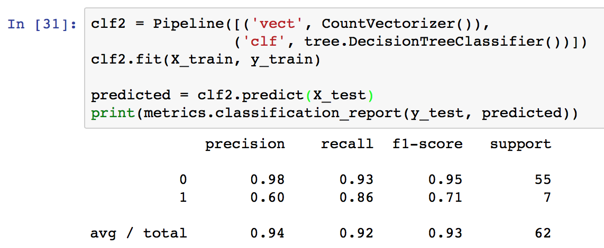
Compare CV with simple train-test split
Performance
Better performance than CV. Why?

Slide 13
Lab 8 assignment
Use Lab8_CrossValidation_template.ipynb to finish this assignment
Load the dataset (containing at least two columns: “text” and “label”)
Run CV using cross_val_score (specify your own fold number, k, 5 or 10)
Run CV using cross_validate
Run simple train-test split (use 20% or 10% data as test data)
Compare the performance of simple train-test split with CV, and explain why in your own language
Submit a word document or pdf that contains screenshots for step 1 to 4, and some text for step 5.
This is an individual assignment.

Slide 14
Appendix
How to create a two-column dataset?
Code can be found in the last two cells of Lab8_CrossValidation_template.ipynb

Slide 15
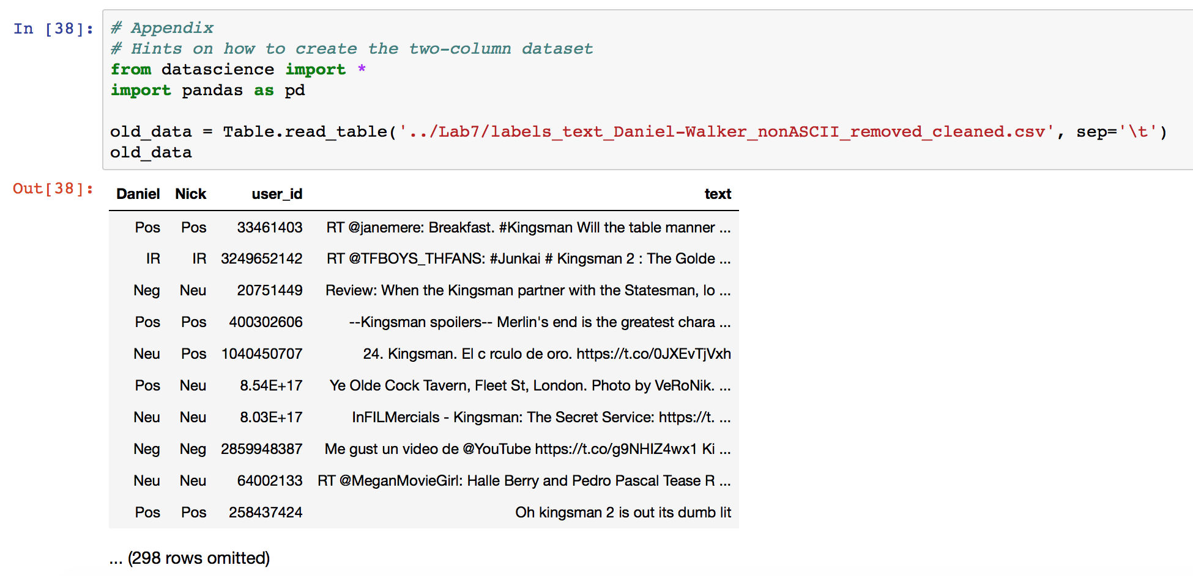

Slide 16
