Slide 1
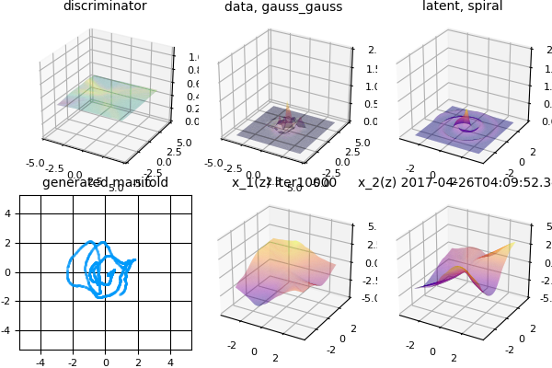
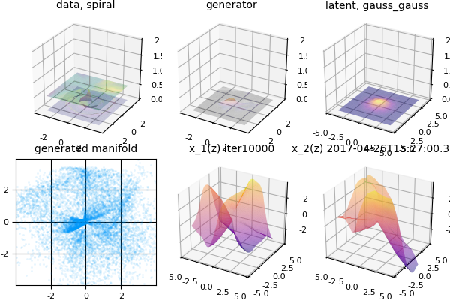
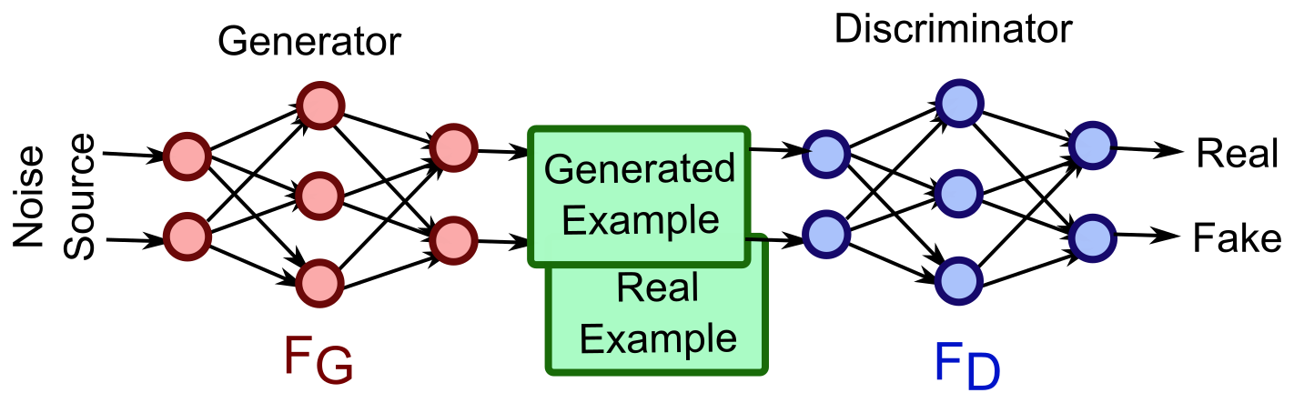
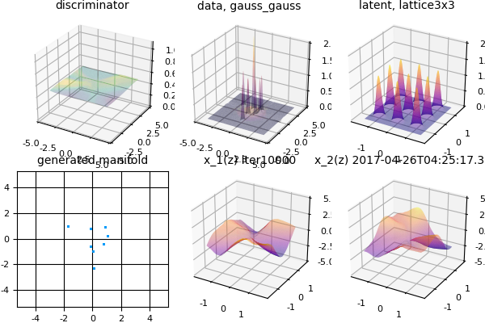
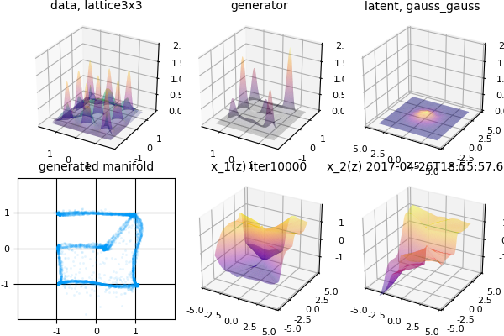
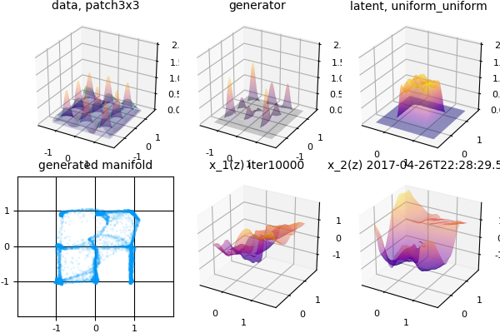
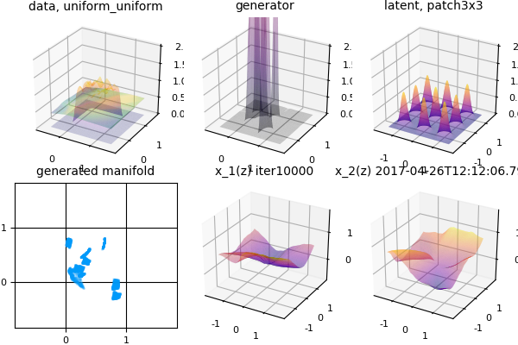
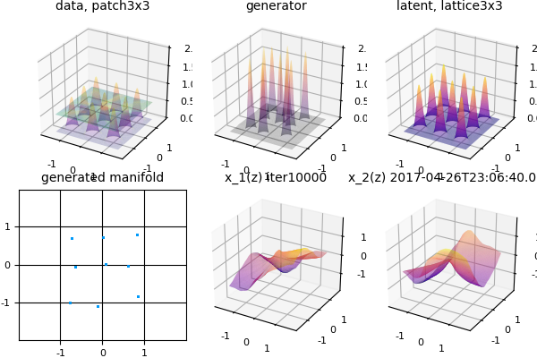
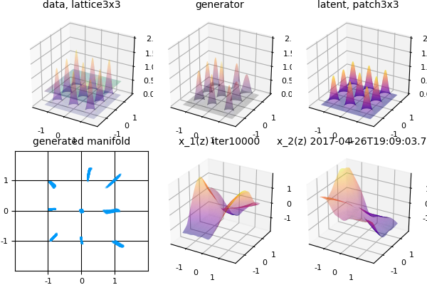
Geometric View of GAN and Visualization
Zhizhong Li | 1155070507 | Department of Information Engineering
GAN
Generative Adversarial Network (GAN), is a powerful generative model and also a hot topic
It contains two components: a Generator and a Discriminator
They compete with each other in the as in game theory
Visualization
Dimensionality
Connectivity
1d spiral → 2d Gaussian
2d Gaussian → 1d spiral
Geometric View
GAN is to learn a data manifold
  Data lie in a manifold
  Noise is not noise
  it is coordinate space
  Decouple Geometry & Distribution
Impact of geometric property
  Dimensionality
  Connectivity
0d lattice → 2d Gaussian
2d Gaussian → 0d lattice
1 square → 9 patches
9 patches → 1 square
Experiment
Use fully connected networks with BN and Elu activation.
Number of neurons are
20−40−100−200−200−100−40−20
9 points → 9 patches
9 patches → 9 points
TA-in-charge: Xiao Chu

