Slide 1

Example of text inputs linked to a variable
Variable type | Text inputs linked to a variable
MAC | 00-00-00-00-00-00
UUID | 00000000-0000-0000-0000-000000000000
HOSTNAME | dmb400
FIELD1 | Field1_value
FIELD2 | Field2_value
FIELD3 | Field3_value
FIELD4 | Field4_value
FIELD5 | Field5_value
custom variable City (for example) | Paris

Slide 2
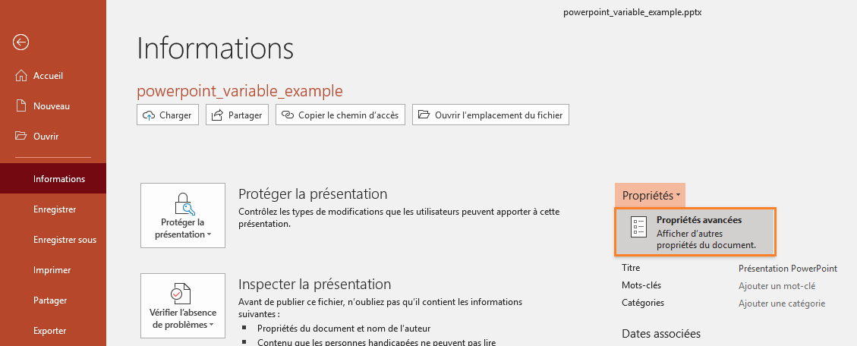
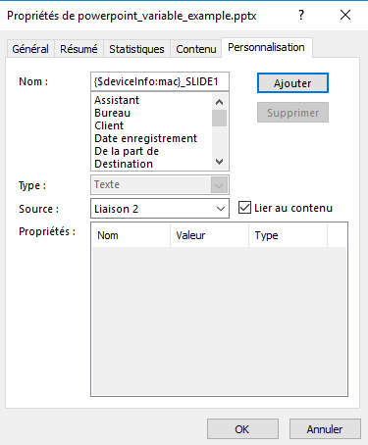
Create a link to a device variable in MS-PowerPoint
Select a text input value and open the screen
File > Information > Properties > Advanced properties
In the Customization tab, enter a link name with
the appropriate format according to your need:
{$deviceInfo:mac}_suffix or
{$deviceInfo:uuid}_suffix or
{$deviceInfo:hostname}_suffix or
{$deviceInfo:field1}_suffix or
{$custom:<variable_name>}_suffix
To finalize the link,
check on Link to content then press on the Add button
To just read your final advanced property configuration, don’t forget to unselect your text input else your links could be broken and would need to be created again !

Slide 3
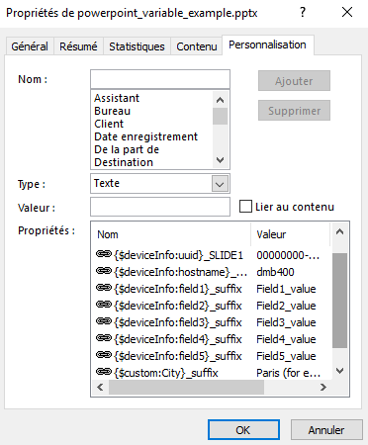
Summary of the links created
To just read your final advanced property configuration, don’t forget to unselect your text input else your link will be broken !

Slide 4
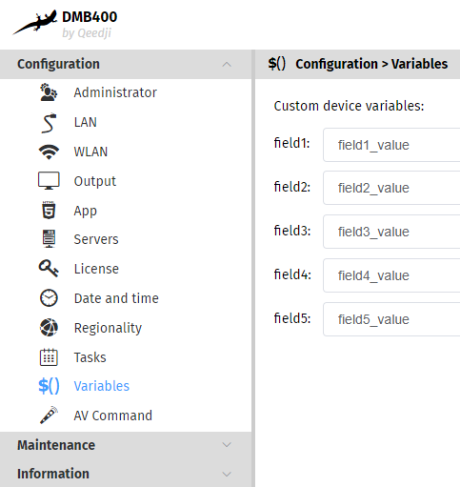
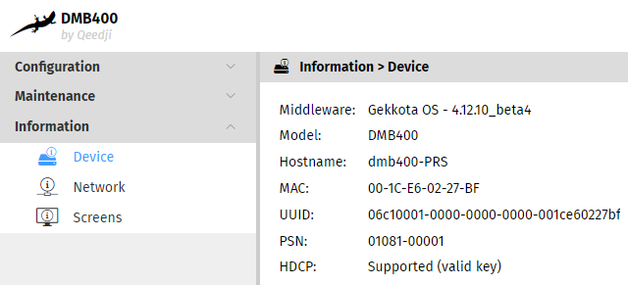
Variable values in the device Web UI
Field<i> variable values
MAC, UUID, Hostname values

Slide 5
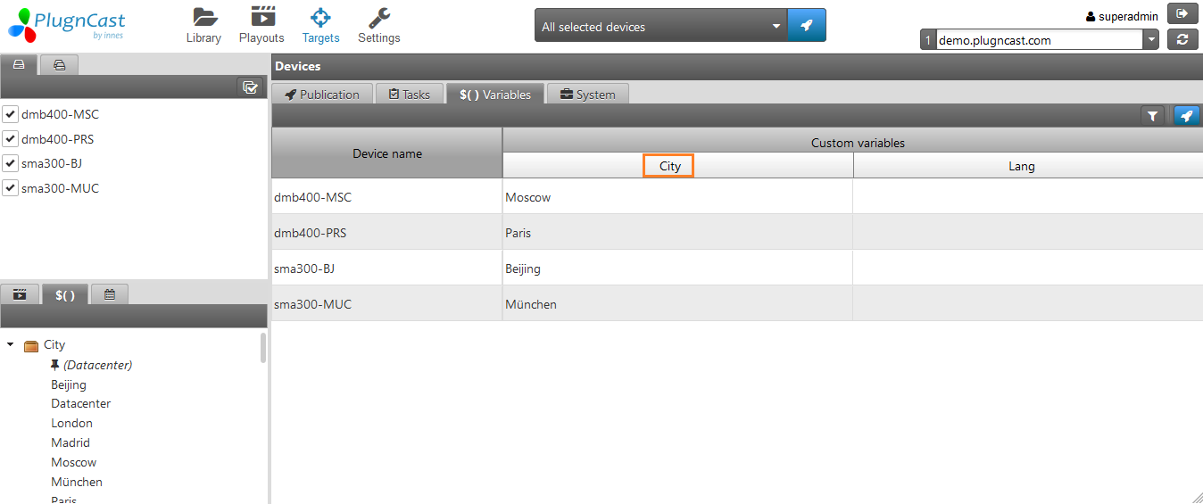
Create a custom variable name with your CMS PlugnCast (for example the localized variable name City)
and publish a value in your devices (for example the value Paris for the device named dmb400-PRS

Slide 6
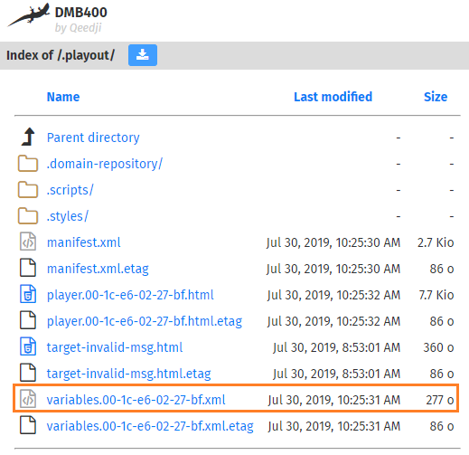
Custom devices variable values in the device Web UI
Variables<>.xml

