Slide 1
Example of text inputs linked to a variable
Variable type | Text inputs linked to a variable
MAC | 00-00-00-00-00-00
UUID | 00000000-0000-0000-0000-000000000000
HOSTNAME | dmb400
FIELD1 | Field1_value
FIELD2 | Field2_value
FIELD3 | Field3_value
FIELD4 | Field4_value
FIELD5 | Field5_value
custom variable City (for example) | Paris
custom variable City (2th using) | Paris

Slide 2
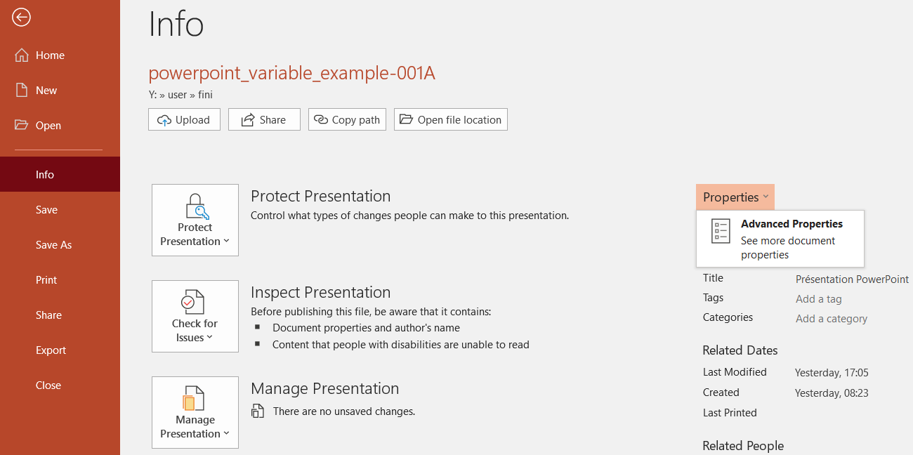
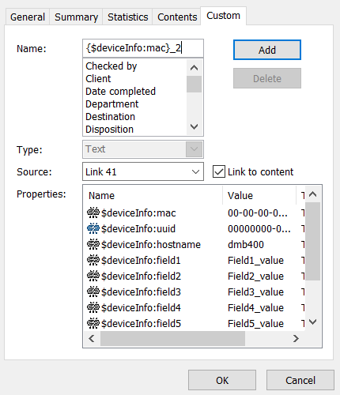
To create a link to a variable in MS-PowerPoint
Select a text input value and open the screen
File > Information > Properties > Advanced Properties
In the Custom tab, enter a link name with
the appropriate format according to your need:
$deviceInfo:mac
$deviceInfo:uuid
$deviceInfo:hostname
$deviceInfo:field1
$custom:<variable_name>
{$custom:<variable_name>}_1
To finalize the link,
check on Link to content then press on the Add button

Slide 3
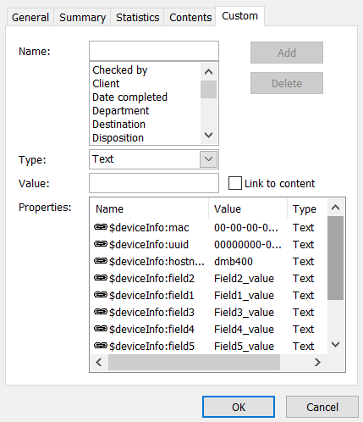
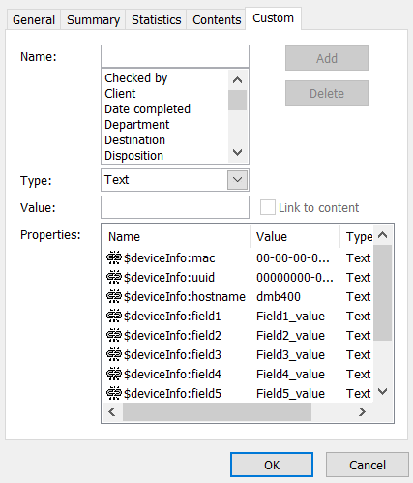
Summary of the links created: OK
Summary of the links broken: KO
Due to MS-PowerPoint issue, at the reopening of the MS-PowerPoint media, all the links are broken.
To work around, create again the links, save and just close the MS-PowerPoint and publish

Slide 4
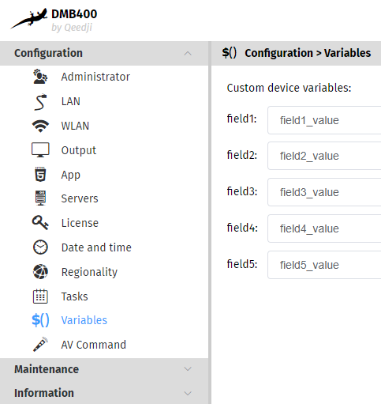
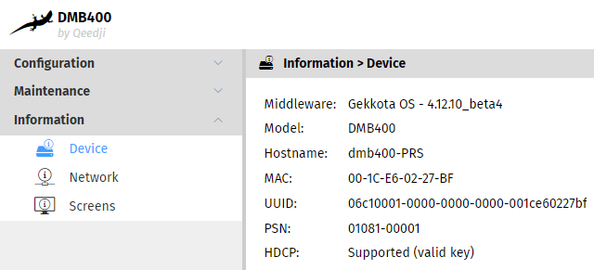
Device Web UI Field<i> variable values
Device Web UI: MAC, UUID, Hostname values

Slide 5
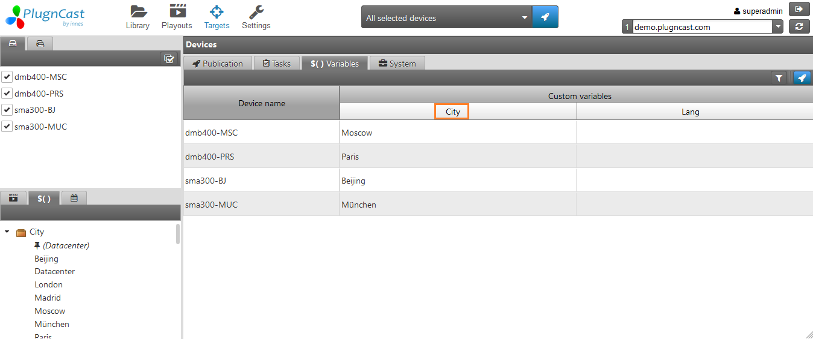
Publish a City custom variable value in your devices

Slide 6
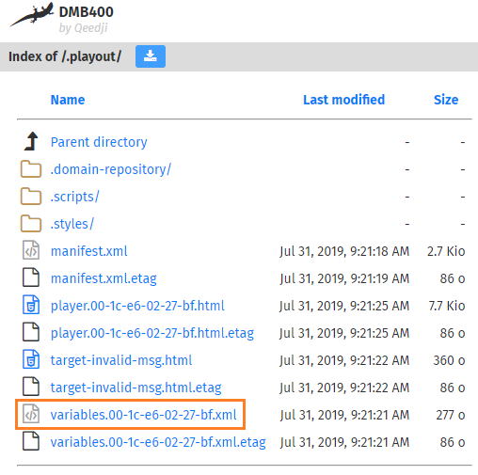
View custom variable on the device
HEADER AND FOOTER / MS-POWERPOINT DATE 31/07/2019 11:13:33

