Slide 1
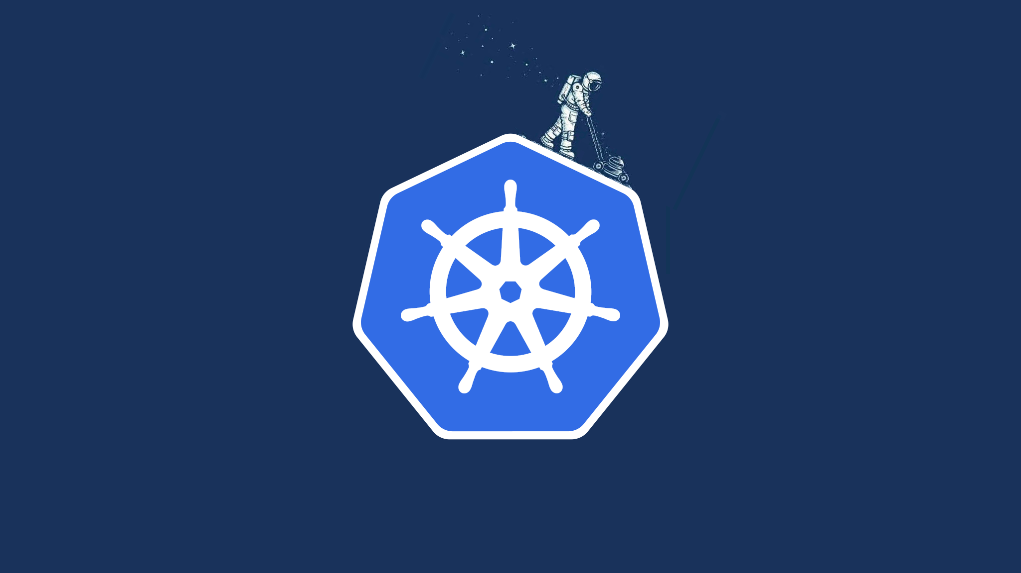
Kubernetes Hands-on
https://github.com/innfocco/hands-on-kubernetes

Slide 2
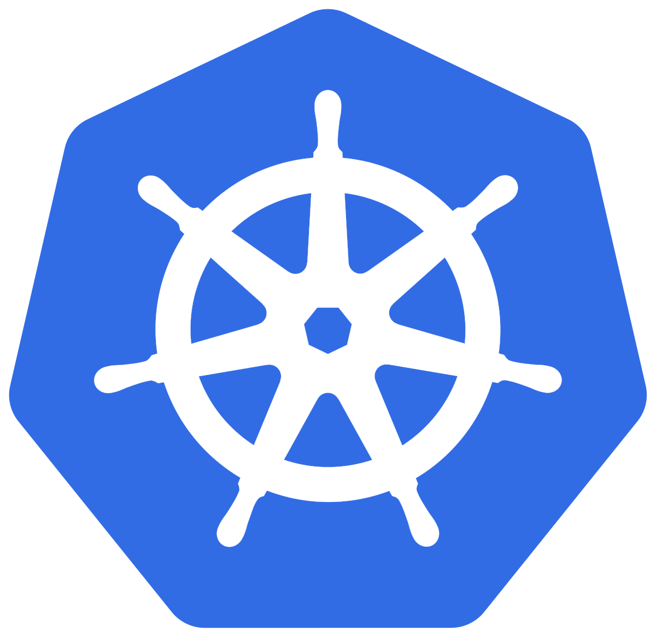
Roadmap

Slide 3
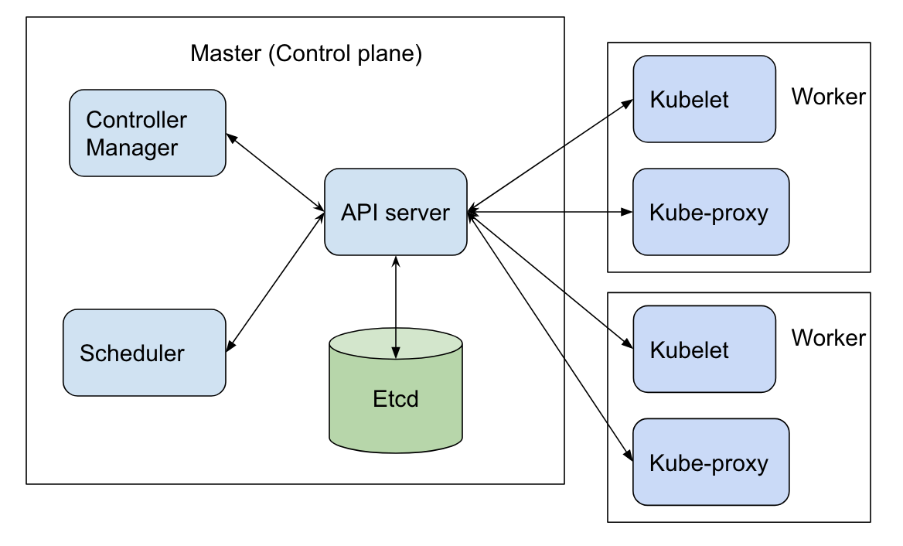
Architecture
Notes:
Kube-controller-manager
Loop principal do cluster, propaga as info
Kube-scheduler
For every newly created pod or other unscheduled pods, kube-scheduler selects an optimal node for them to run on.

Slide 4
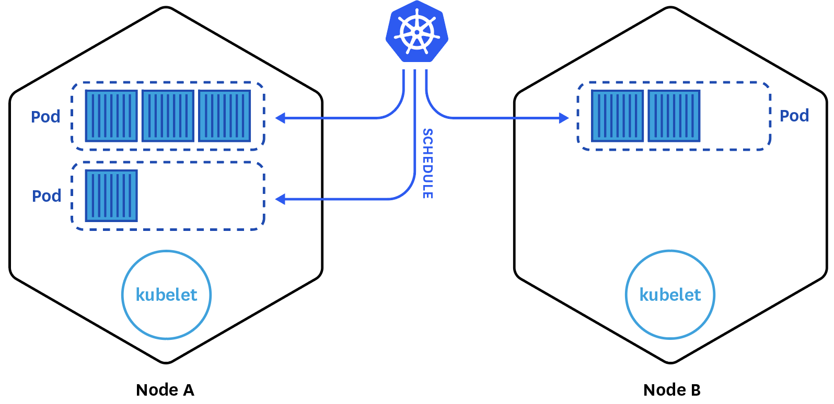
Pod’s
Menor unidade de deploy no k8s (pode ter 1 ou mais containers)

Slide 5




Ingress-Controller
Ingress exposes HTTP and HTTPS routes from outside the cluster to services within the cluster. Traffic routing is controlled by rules defined on the Ingress resource.

Slide 6
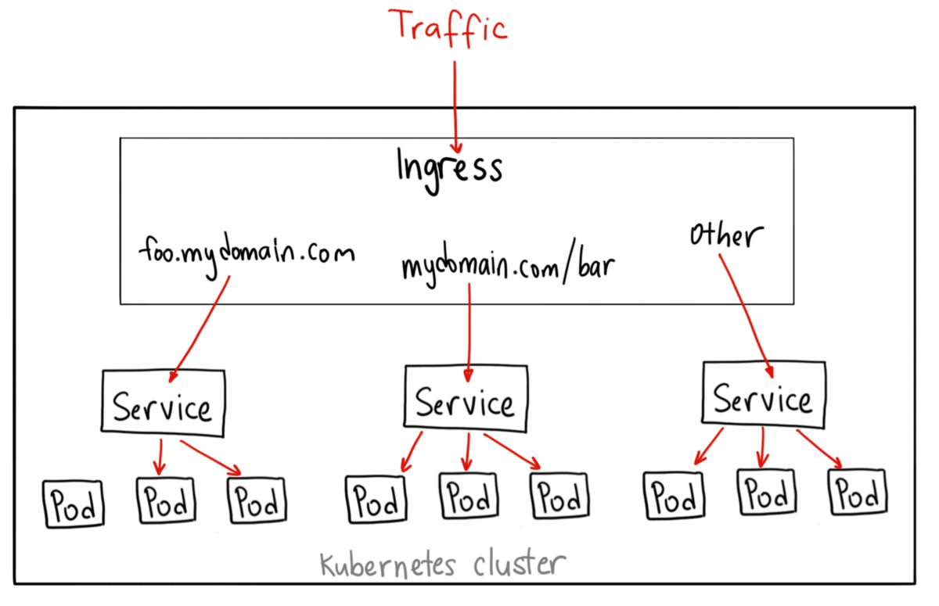
Services
An abstract way to expose an application running on a set of Pods as a network service.

Slide 7
Deployments
A Deployment provides declarative updates for Pods and ReplicaSets.
You describe a desired state in a Deployment, and the Deployment Controller changes the actual state to the desired state at a controlled rate.

Slide 8
