Slide 1

Lets talk about!
Basics and Beyond!

Slide 2
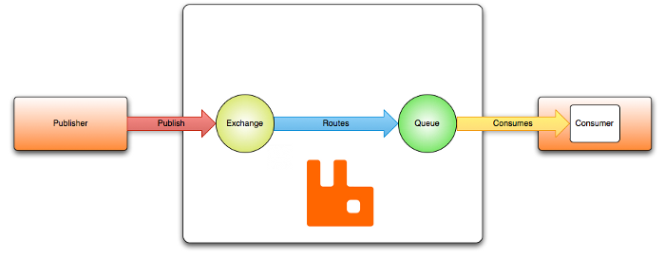
AMQP
Basics and Beyond!
https://www.rabbitmq.com/tutorials/amqp-concepts.html

Slide 3
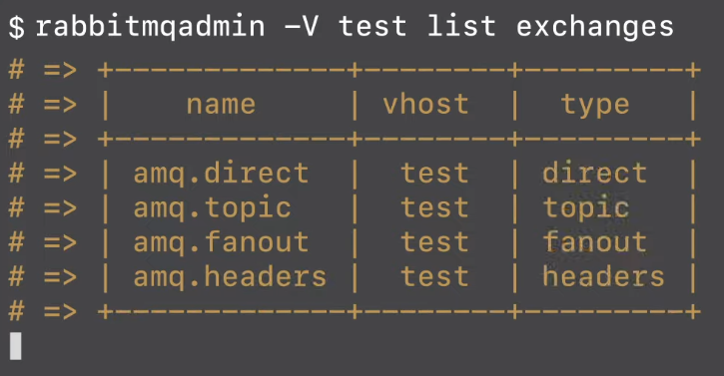
AMQP
US Mail
Postman
Your Address
Me
Mailbox
Basics and Beyond!
https://www.rabbitmq.com/tutorials/amqp-concepts.html

Slide 4
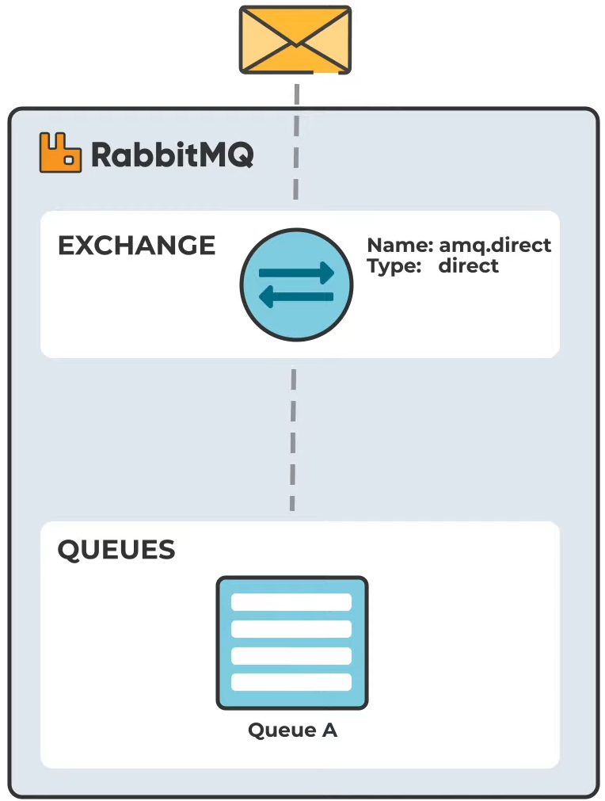
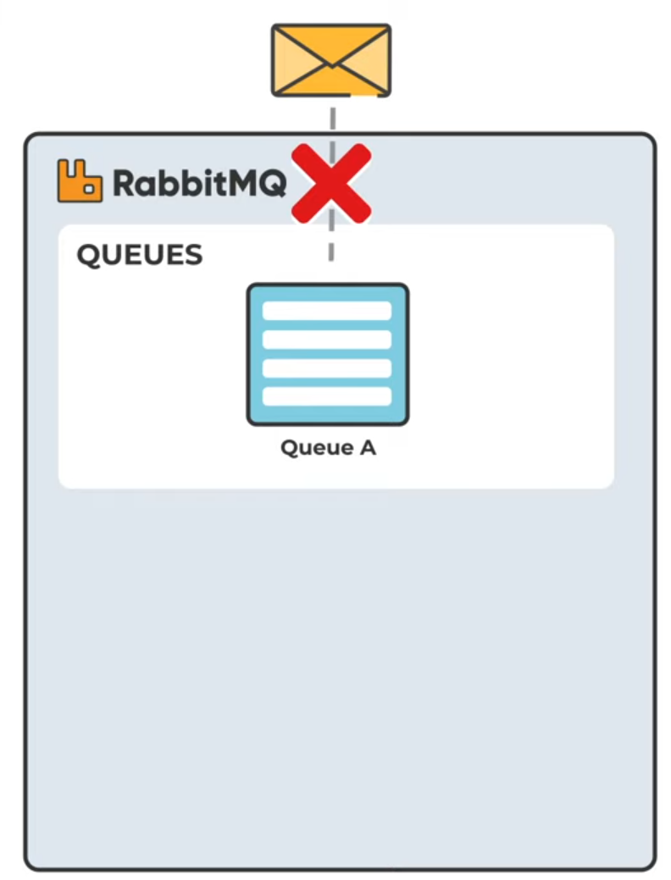
Exchanges
Bindings
https://www.rabbitmq.com/tutorials/amqp-concepts.html

Slide 5
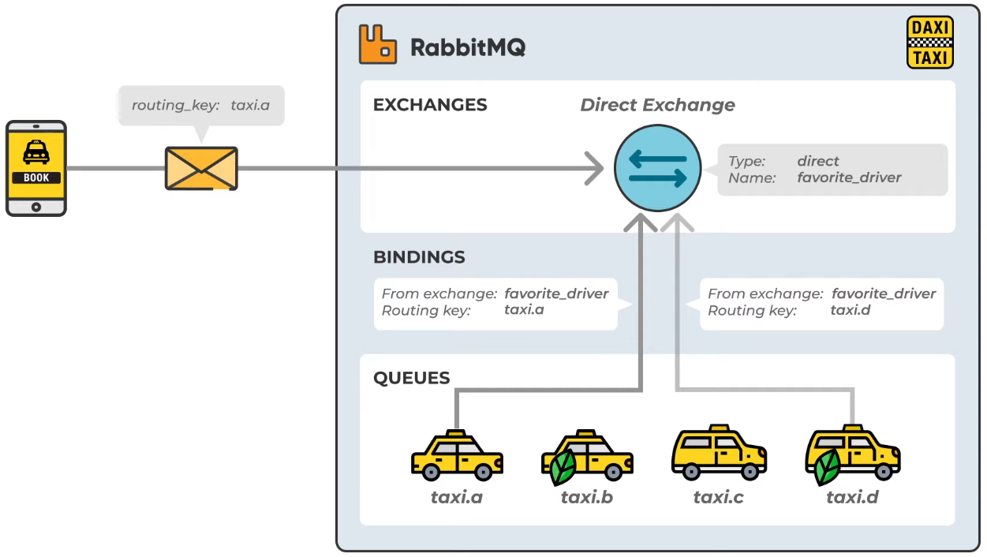
Exchanges
Direct exchange point to binding favorite_driver will reach A and D
https://www.rabbitmq.com/tutorials/amqp-concepts.html

Slide 6
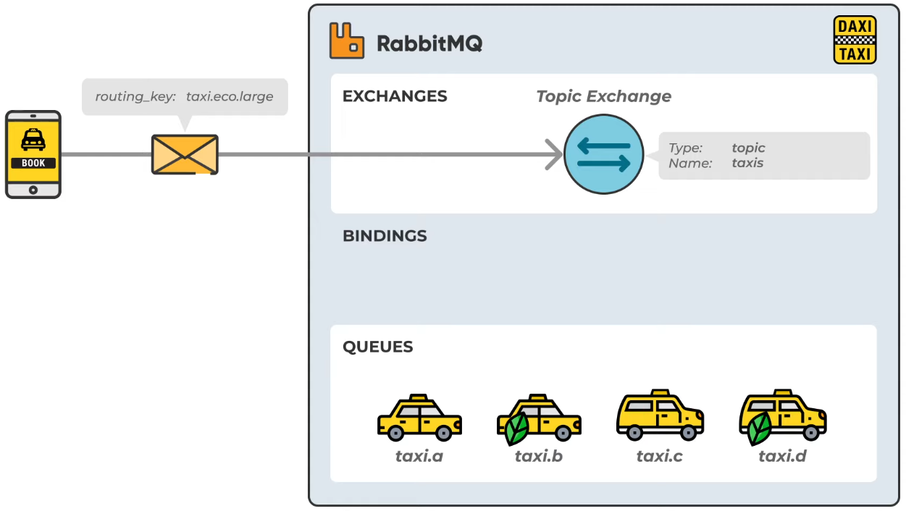
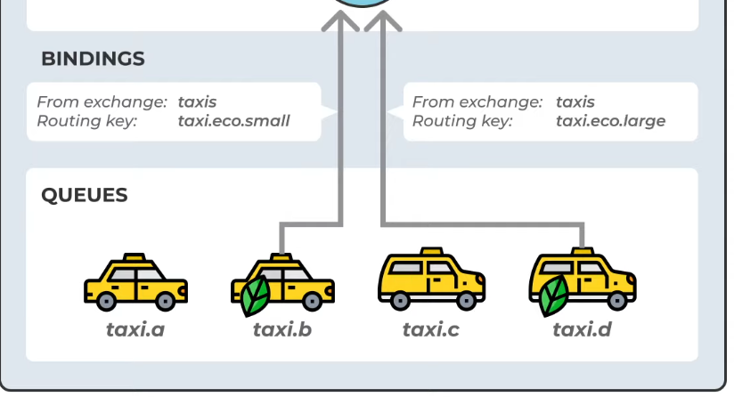
Exchanges
Topic Exchanges will route message to all RK associated with that exchange.
You can also use wildcards in your routing key like taxi.*.large.
https://www.rabbitmq.com/tutorials/amqp-concepts.html

Slide 7
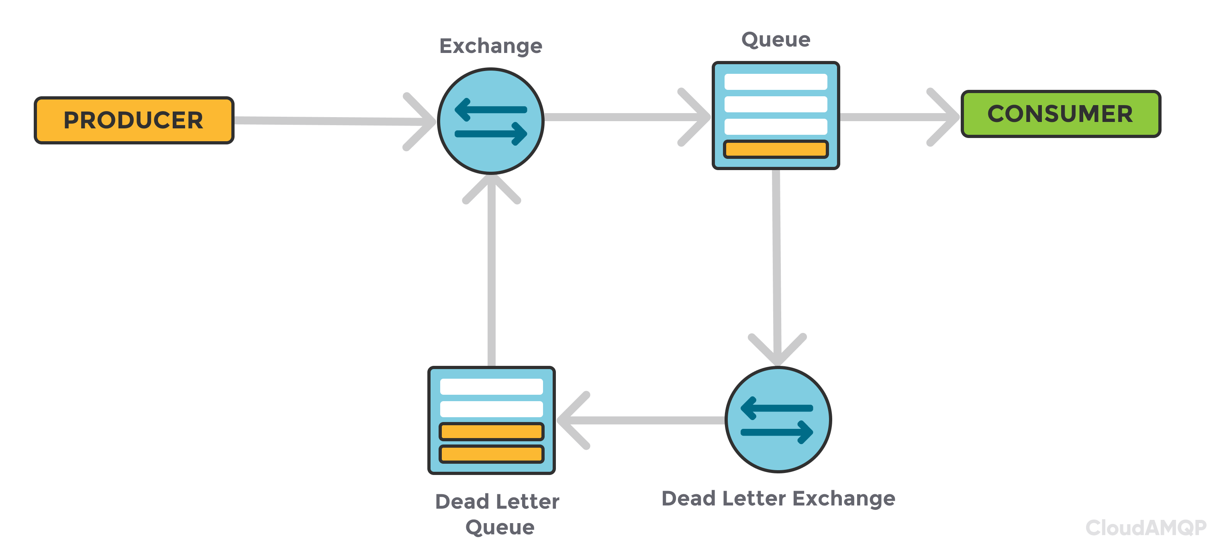
DLE (Dead Letter Exchanges)
Retry?
https://www.rabbitmq.com/tutorials/amqp-concepts.html

Slide 8
