Slide 1

Pamomo
Securemomo
SECURE DIGITAL WALLET

Slide 2

SecureMoMo - Pamomo
PITCH DECK PRESENTATION
Team Introduction
The
Team

Slide 3
Team Name: SecureMomo
Country: Malawi
PITCH DECK PRESENTATION
Institution: University Of Malawi
Team Members:
Innocent Waluza - Computer Network Engineering
Vincent Banda - Computer Science
Madalitso Ritch - Computer Science

Slide 4
SecureMoMo - Pamomo
PITCH DECK PRESENTATION
Problem
Background
problem

Slide 5
Problem Background
In many regions, mobile money operators and fintech applications rely on physical identification documents (IDs) to register users. While this method provides a basic level of security, it has significant vulnerabilities:
Limited Financial Inclusion – Many potential users lack access to their physical IDs at all times(lost or stolen), preventing them from registering for digital financial services.
Identity Fraud & Misuse – Fraudsters exploit the system by using stolen or borrowed IDs to create accounts, making it difficult to track and hold individuals accountable.
Lack of Digital Verification – Without a secure way to verify and authenticate users digitally, financial platforms face high risks of impersonation, money laundering, and other financial crimes.
Operational Inefficiencies – Mobile money operators struggle with manual verification processes that are time-consuming, error-prone, and costly.
PITCH DECK PRESENTATION

Slide 6
Data Behind The Problem
💸 K185 Million Lost to Mobile Money Fraud in Malawi in 2024 alone due to weak registration controls (Capital FM Malawi)
🔍 70% of fraud cases in Zimbabwe’s mobile money systems involved identity misrepresentation or impersonation (Research Paper – “The Dark Side of Mobile Money Transfer”)
🧍 Over 500 million Africans still lack formal IDs, creating a massive barrier to onboarding into digital financial ecosystems (Elsevier – 2024 Forecast on Digital Identity in Africa)
PITCH DECK PRESENTATION

Slide 7
SecureMoMo - Pamomo
PITCH DECK PRESENTATION
Why It
Matters
Digital ID

Slide 8
Why It Matters
Boosts Financial Inclusion – Many people are excluded from financial services due to ID-related challenges. A digital identity solution allows for seamless and secure onboarding, improving access to digital finance.
Enhances Security & Trust – Mobile money operators struggle to verify and track users, leading to financial institutions distrusting the system. A secure verification method strengthens confidence in digital transactions.
Regulatory Compliance – Governments and financial institutions require Know Your Customer (KYC) policies to prevent illegal activities. A digital ID system ensures compliance with these regulations.
Reduces Financial Fraud – Fraudsters exploit weak registration systems to create multiple fake accounts, enabling scams, money laundering, and illicit financial activities.
PITCH DECK PRESENTATION

Slide 9
SecureMoMo - Pamomo
PITCH DECK PRESENTATION
Solution
Overview
solution

Slide 10
Solution Overview
To address the vulnerabilities in mobile money registration, SecureMomo introduces Pamomo, a digital money wallet that integrates digital ID verification for secure user onboarding.
How Pamomo Works
Self-Registration – Users create accounts within the Pamomo wallet without needing to visit an agent physically.
Digital Identity Verification – Instead of using physical IDs, Pamomo leverages eSignet, a trusted digital ID system, to verify user identities during registration.
Secure Data Storage – Once verified, the user's identity is securely linked to their account, preventing fraudulent activities like duplicate or fake registrations.
Seamless Transactions – Since every account is mapped to a verified identity, mobile money operators and financial institutions can trust transactions, reducing risks of fraud.
PITCH DECK PRESENTATION

Slide 11
Solution Overview
How This Solves the Problem
Prevents Identity Fraud – Eliminates the possibility of using stolen or borrowed IDs for account registration.
Increases Financial Inclusion – People without physical IDs at hand can still register securely using digital verification.
Enhances Trust & Security – Users, financial institutions, and mobile money operators can transact with confidence.
Improves Regulatory Compliance – Ensures that all users meet Know Your Customer (KYC) requirements.
PITCH DECK PRESENTATION

Slide 12
SecureMoMo - Pamomo
PITCH DECK PRESENTATION
Differentiation
key differences

Slide 13
Differentiation & Key Contributions
How Pamomo Stands Out
Unlike traditional mobile money wallets that rely on physical ID verification, Pamomo leverages digital ID authentication via eSignet, ensuring that every user account is securely linked to a verified identity. This eliminates the risks of stolen or borrowed IDs, a common issue in current mobile money systems.
Key Innovations
Digital Identity-Driven Security – Unlike standard mobile money platforms that rely on manual verification, Pamomo integrates automated digital ID verification, ensuring a fraud-proof registration process.
Self-Registration Model – Traditional mobile money wallets require agent-based onboarding, which is slow and prone to human error. Pamomo enables users to register independently while maintaining security.
Secure Bank Card Integration – Pamomo will allow users to deposit money using bank credit and debit cards securely, making it convenient for users who prefer traditional banking channels.
PITCH DECK PRESENTATION

Slide 14
Differentiation & Key Contributions
Key Innovations
Seamless Compliance & Trust – Many mobile money platforms struggle with regulatory compliance due to weak identity verification methods. Pamomo ensures full KYC adherence through digital identity mapping, reducing risks for financial institutions.
Interoperable Deposits – Users will be able to deposit funds into Pamomo from local mobile money operators like Airtel. This enhances accessibility and compatibility with popular financial platforms.
PITCH DECK PRESENTATION

Slide 15
SecureMoMo - Pamomo
PITCH DECK PRESENTATION
Digital ID
In Pamomo

Slide 16
Use of Digital ID in Pamomo
Pamomo integrates Digital Identity (Digital ID) to ensure secure and fraud-proof user registration and transactions. Instead of relying on physical IDs, which can be stolen or misused, Pamomo uses eSignet, a trusted digital identity verification system, to authenticate users.
How Digital ID is Integrated
User Registration & Identity Verification
When a user signs up for a Pamomo wallet, they are prompted to verify their identity using eSignet.
eSignet cross-checks the user's personal details with a secure digital identity database.
Once verified, the user’s identity is securely linked to their Pamomo account.
PITCH DECK PRESENTATION

Slide 17
SecureMoMo - Pamomo
PITCH DECK PRESENTATION
System
Architecture

Slide 18
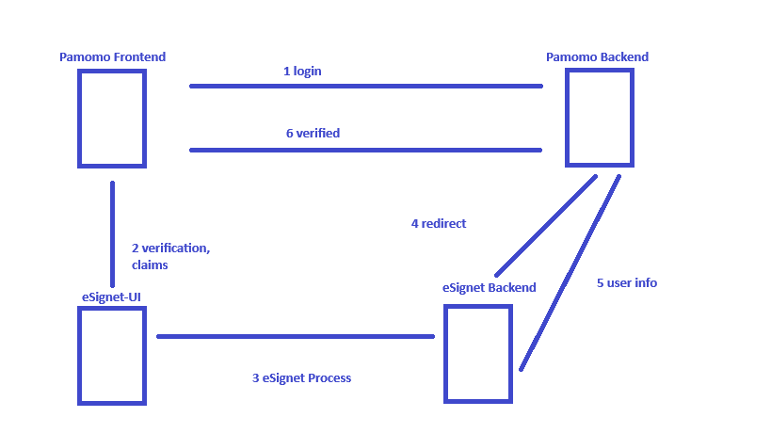
System Architecture
PITCH DECK PRESENTATION

Slide 19
Referernces
Osabutey, E. L. C., & Jackson, T. (2024). Mobile money and financial inclusion in Africa: Emerging themes, challenges and policy implications. Technological Forecasting and Social Change, 1 198, 123339. 2 https://doi.org/10.1016/j.techfore.2024.123339
Tsokota, Theo; Chipfumbu, Collector; and Maseko, Melody. (2023). The Dark Side of Mobile Money Transfer: A Case Study of Zimbabwe.
GSMA. (2024). Mobile Money Fraud Typologies and Mitigation Strategies.
Capital Radio Malawi. (2024, September 26). K185 million lost through mobile money fraud. Capital Radio Malawi
https://www.capitalradiomalawi.com/2024/09/26/k185-million-lost-through-mobile-money-fraud/
Itweb Africa. (2023, September 21). Malawi losing MWK120m monthly to mobile fraud. Itweb Africa.
https://itweb.africa/content/wbrpOqg295lMDLZn
The Condia. (2024). Malawi Mobile Money Wallet Fraud.
PITCH DECK PRESENTATION

Slide 20
Thank You
Merci
Zikomo
PITCH DECK PRESENTATION

