Slide 1
Version File System
Team 2

Slide 2
Contents
Introduction
Metadata Storage
Graphical Interface
Timeline Utility
History Analyzer
Disk Monitor
Versioning Operations
Commit
Checkout/Branch
Revert
Delete
Cleanup Version History
Benchmarking

Slide 3
Introduction
A versioning file system is any computer file system which allows a computer file to exist in several versions at the same time
Kernel level interception of file operations delivers ubiquity
Intuitive timeline GUI hooked to file explorer which makes it usable by laymen unfamiliar with command line
Branching to give a complete versioning system functionality
Better multi user support due to branching

Slide 4
External Integration
File System in User Space – FUSE is used to intercept System Kernel calls
Due to integration at Virtual File System, all higher level applications like Bash, File Explorers and Application Programs work inherently
Versioning Metadata is “perfectly” invisible anywhere over Virtual File System
Versioning operations like Snapshot reduce to copy command
FUSE integrates with ext2, JFS, NTFS and even ISO

Slide 5
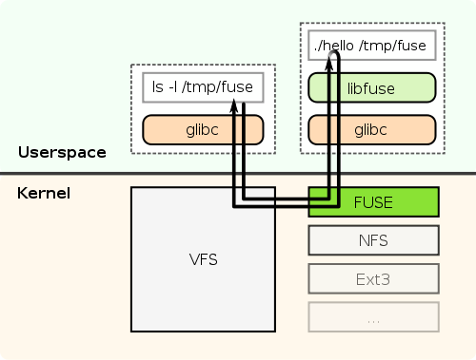
FUSE Architecture

Slide 6
Representing History
Versioning history is best represented as a tree. Let’s see some of the ops.
v1
Commit
v2
Checkout
Commit
Commit/Branch
v3
v5
Commit
Commit
Branch
HEAD
v4
v6
Working
HEAD

Slide 7
Metadata Storage
Metadata is stored in each folder, marked as .ver
.ver has 4 folders and a file
Heads – stores the information about Branch Heads
Trees – Information about File History
Objects – File diffs kept in compressed format
Md_data -- Overhead Profile
Obj_md – Metadata about objects folder
/path/hello/.ver
heads
trees
objects
md_data
Obj_md

Slide 8
Metadata Storage: heads
Heads folder contains per file information about the working heads.
First line is the present working HEAD
Rest line contain list of all possible HEADS
/path/.ver/heads
File1.head
File2.head
File3.head

Slide 9
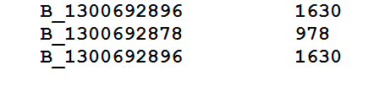
Metadata Storage: Heads
v1
Commit
v2
Commit
Commit/Branch
v3
v5
Commit
Commit
v4
v6
Present working head
Head | Offset

Slide 10
Metadata Storage: Trees
Trees folder contains per file information of complete history info.
Let’s consider the following version tree of a file ….
/path/.ver/heads
File1.head
File2.head
File3.head

Slide 11
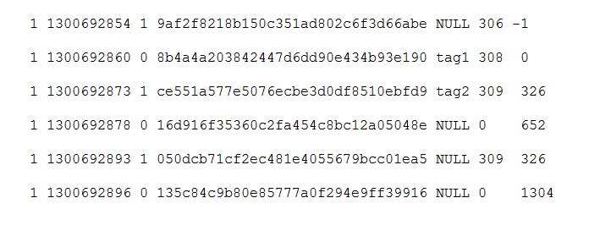
Metadata Storage: Trees
v1
Commit
v2
Commit
Commit/Branch
v3
v5
Commit
Commit
v6
/path/.ver/trees/file1.tree
v4
V | Epoch | T | OBJ Hash | Tag | Diff | Parent
V1
V2
V3
V4
V5
V6

Slide 12
Metadata Storage: Objects/Obj_md
Actual diff/files are kept in .ver/objects in compressed format.
All junctions in the tree are complete files
Other nodes are kept as Diffs.
Let’s take a look at the sample version tree.

Slide 13
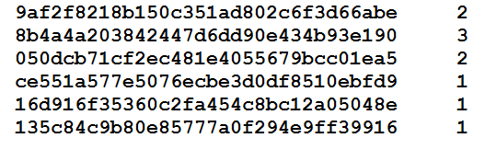
Metadata Storage: Objects/Obj_md
/path/.ver/trees/obj_md
Object Hash | Ref Count

Slide 14
Metadata: Overhead Profile
.ver contains a folder md_data which contains metadata profile( excess storage used )
For each version:
Timestamp
Filesize
Metadata Size
Ratio: Filesize/(Filesize+Metadata Size)
This is used to render a metadata profile of a file in History Analyzer User Interface

Slide 15
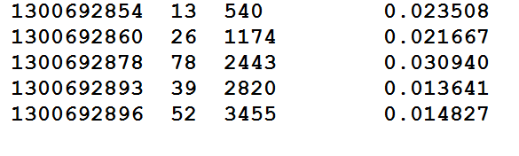
Metadata: Overhead Profile
Epoch | Filesize | Metadata Size | Performance Ratio

Slide 16
Salient Features of Design
MD5 Sum as object names
Avoids redundancy
Tree can be traversed using offsets
No need to load the complete tree for traversal
Distributed Metadata
Ensures smaller metadata for each file
Results in smaller lookup times and better time complexity

Slide 17
Graphical Utilities
A native Graphical Interface developed in QT and works across all platforms
Users are more comfortable with a pictorial representation of versioning history
TortoiseSVN and GitK are similar solutions
Target users for our product are much larger than Code Versioning
Strong need of simple and intuitive User Interface( away from Command Line )

Slide 18
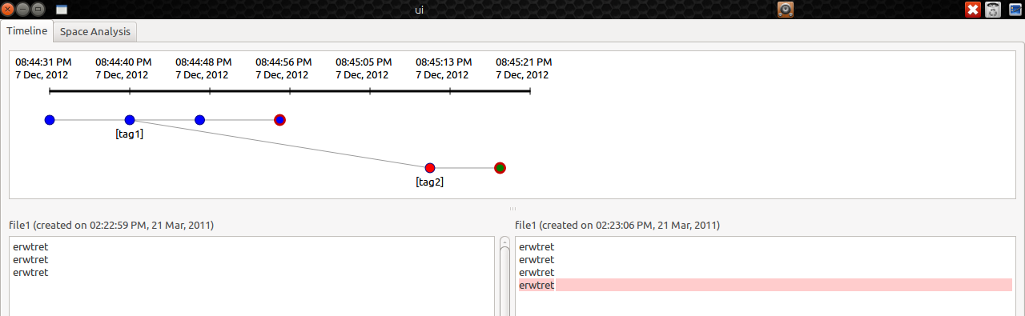
Timeline Interface
Images speak a 1000 words!

Slide 19
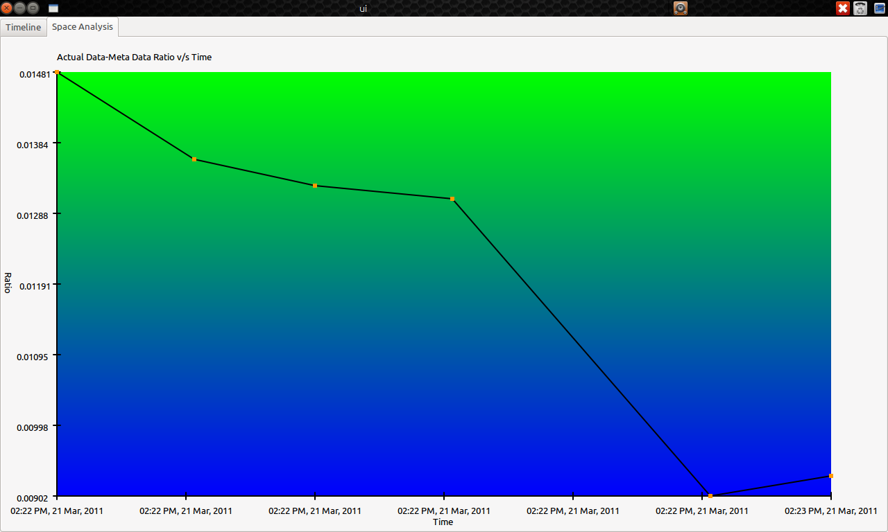
History Analyzer

Slide 20
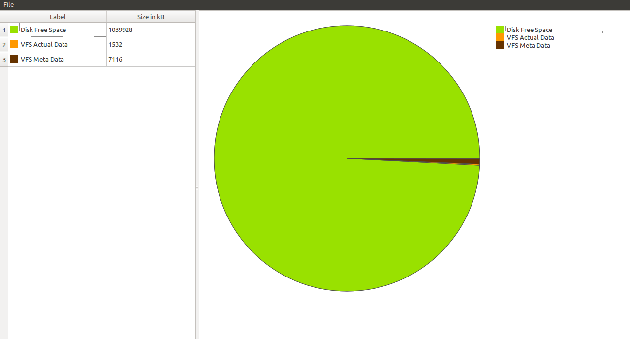
Disk Monitor

Slide 21
Versioning Operations
Commit – make a new version on top of present branch
Checkout – a previously stored file version
Revert – to a previous saved version and delete not-required history

Slide 22
Commit
While working on a current HEAD, on a write, new version is is committed
Commit happens automatically on each save after a minimum time limit
Algorithm:
Read the parent as the present working HEAD from file.head
Write to file.tree a new version with parent extracted above
Replace the present working HEAD with the new version created
Save the diff object to objects folder

Slide 23
Commit: Version tree
v1
v2
v3
v5
Diff(v5-v6) stored
Commit
v4
v6

Slide 24
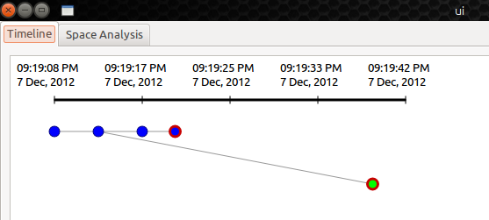
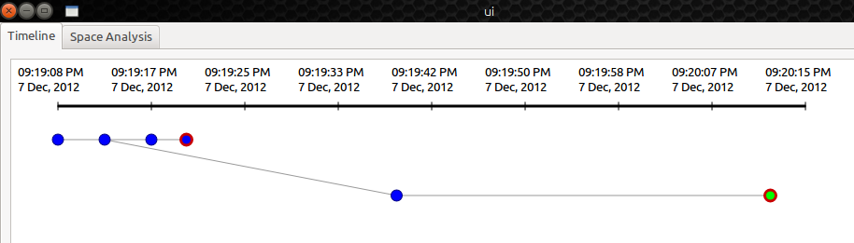
Version History: UI

Slide 25
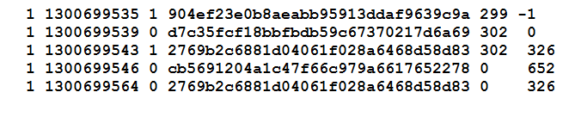
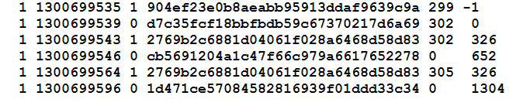
Commit: file.tree

Slide 26


Commit: Heads

Slide 27
Commit: OBJ MD
904ef23e0b8aeabb95913ddaf9639c9a 1
d7c35fcf18bbfbdb59c67370217d6a69 1
2769b2c6881d04061f028a6468d58d83 2
cb5691204a1c47f66c979a6617652278 1
904ef23e0b8aeabb95913ddaf9639c9a 1
d7c35fcf18bbfbdb59c67370217d6a69 1
2769b2c6881d04061f028a6468d58d83 2
cb5691204a1c47f66c979a6617652278 1
1d471ce57084582816939f01ddd33c34 1

Slide 28
Checkout
With checkout you may see an old version
Generally a checkout is followed by a branching
As we save full file objects at all junctions, the algorithm for a checkout is as:
Lookup the HEAD offset in file.tree from file.head
Traverse from the present HEAD to checkout location
Check for closest junction
Rollback diffs to get the checkout version
Bash command: lsver <version epoch>
Interestingly for large branching situations, our algorithm will checkout very fast as it will roll back from nearest junction

Slide 29
Checkout: Version Tree
v1
v2
Closest junction
v8 v6 v5 v2
v3
v5
v4
v6
v7
v8

Slide 30
Revert
With this operation one may delete history and roll back to a previous version in my working branch
Algorithm
Extract working HEAD offset in tree
Traverse from the present HEAD to revert location
Delete all objects until the first junction
Do a checkout from the first junction to the revert location
Bash Command: revert <version epoch>

Slide 31
v1
v1
v2
v2
v3
v5
Revert
v3
v5
v4
v6
v4
v6
v7
v8
v1
v7
v8
v2
v3
v5
Checkout
v4
v6
v7

Slide 32
Branch
It is an implicit combination of a checkout AND revert
A typical workflow is:
Check out to an old version
Commit a new version
Let’s see a representation

Slide 33
Branch: Checkout and Commit
v1
v1
v1
v2
v2
v2
v3
v3
v3
v5
v4
v4
v4
New Head
Working Head

Slide 34
Cleanup Version History
A user may store various versions, without really using the history
Essential to cleanup not-so-essential versioning history
Measures possible:
Delete very old versions
Remove very small diffs
What about time
Also how much to clean ?
Measure used:
#diff / Δt, where Δt is version time difference

Slide 35
Cleanup Algorithm
Version Importance: Vi = #diff / Δt
Disk Efficiency(E): Filesize/(Filesize + Meta)
Algorithm:
Input: file, threshold
do while E<threshold
Create for the file versions Vi and sort them
Merge/Delete version of least Vi and recalculate E
Note:
We do not cleanup junctions and tagged versions because they inflict importance

Slide 36
Performance Analysis
Performance depends on:
No. of versions
Diff b/w versions [ diff size ]
Degree of branching
General user behaviors
Less and long branches
Small Diffs between consecutive writes
We optimize and show our performance for the general user behavior
Small files (0-250 KB) , 5 % branching, 10 % diff, 50 nodes
Large files (1-5 MB) , 5 % branching, 10 % diff, 25 nodes

Slide 37
Use Scenarios
 | Small Files[ 50 ] | Large Files[ 25 ]
Optimal Metadata Size | 296 KB | 3.4 MB
Final Version Size | 456KB | 4.944 MB
Metadata | 1300KB | 18.704MB
Checkout Junction | 0.550 sec | 0.315 sec
Checkout Non Junction | 0.678 sec | 1.468 sec
Metadata After Cleanup | 673KB | 10.21MB

