Slide 1
USB STICK PROXY
Here is where your presentation begins

Slide 2
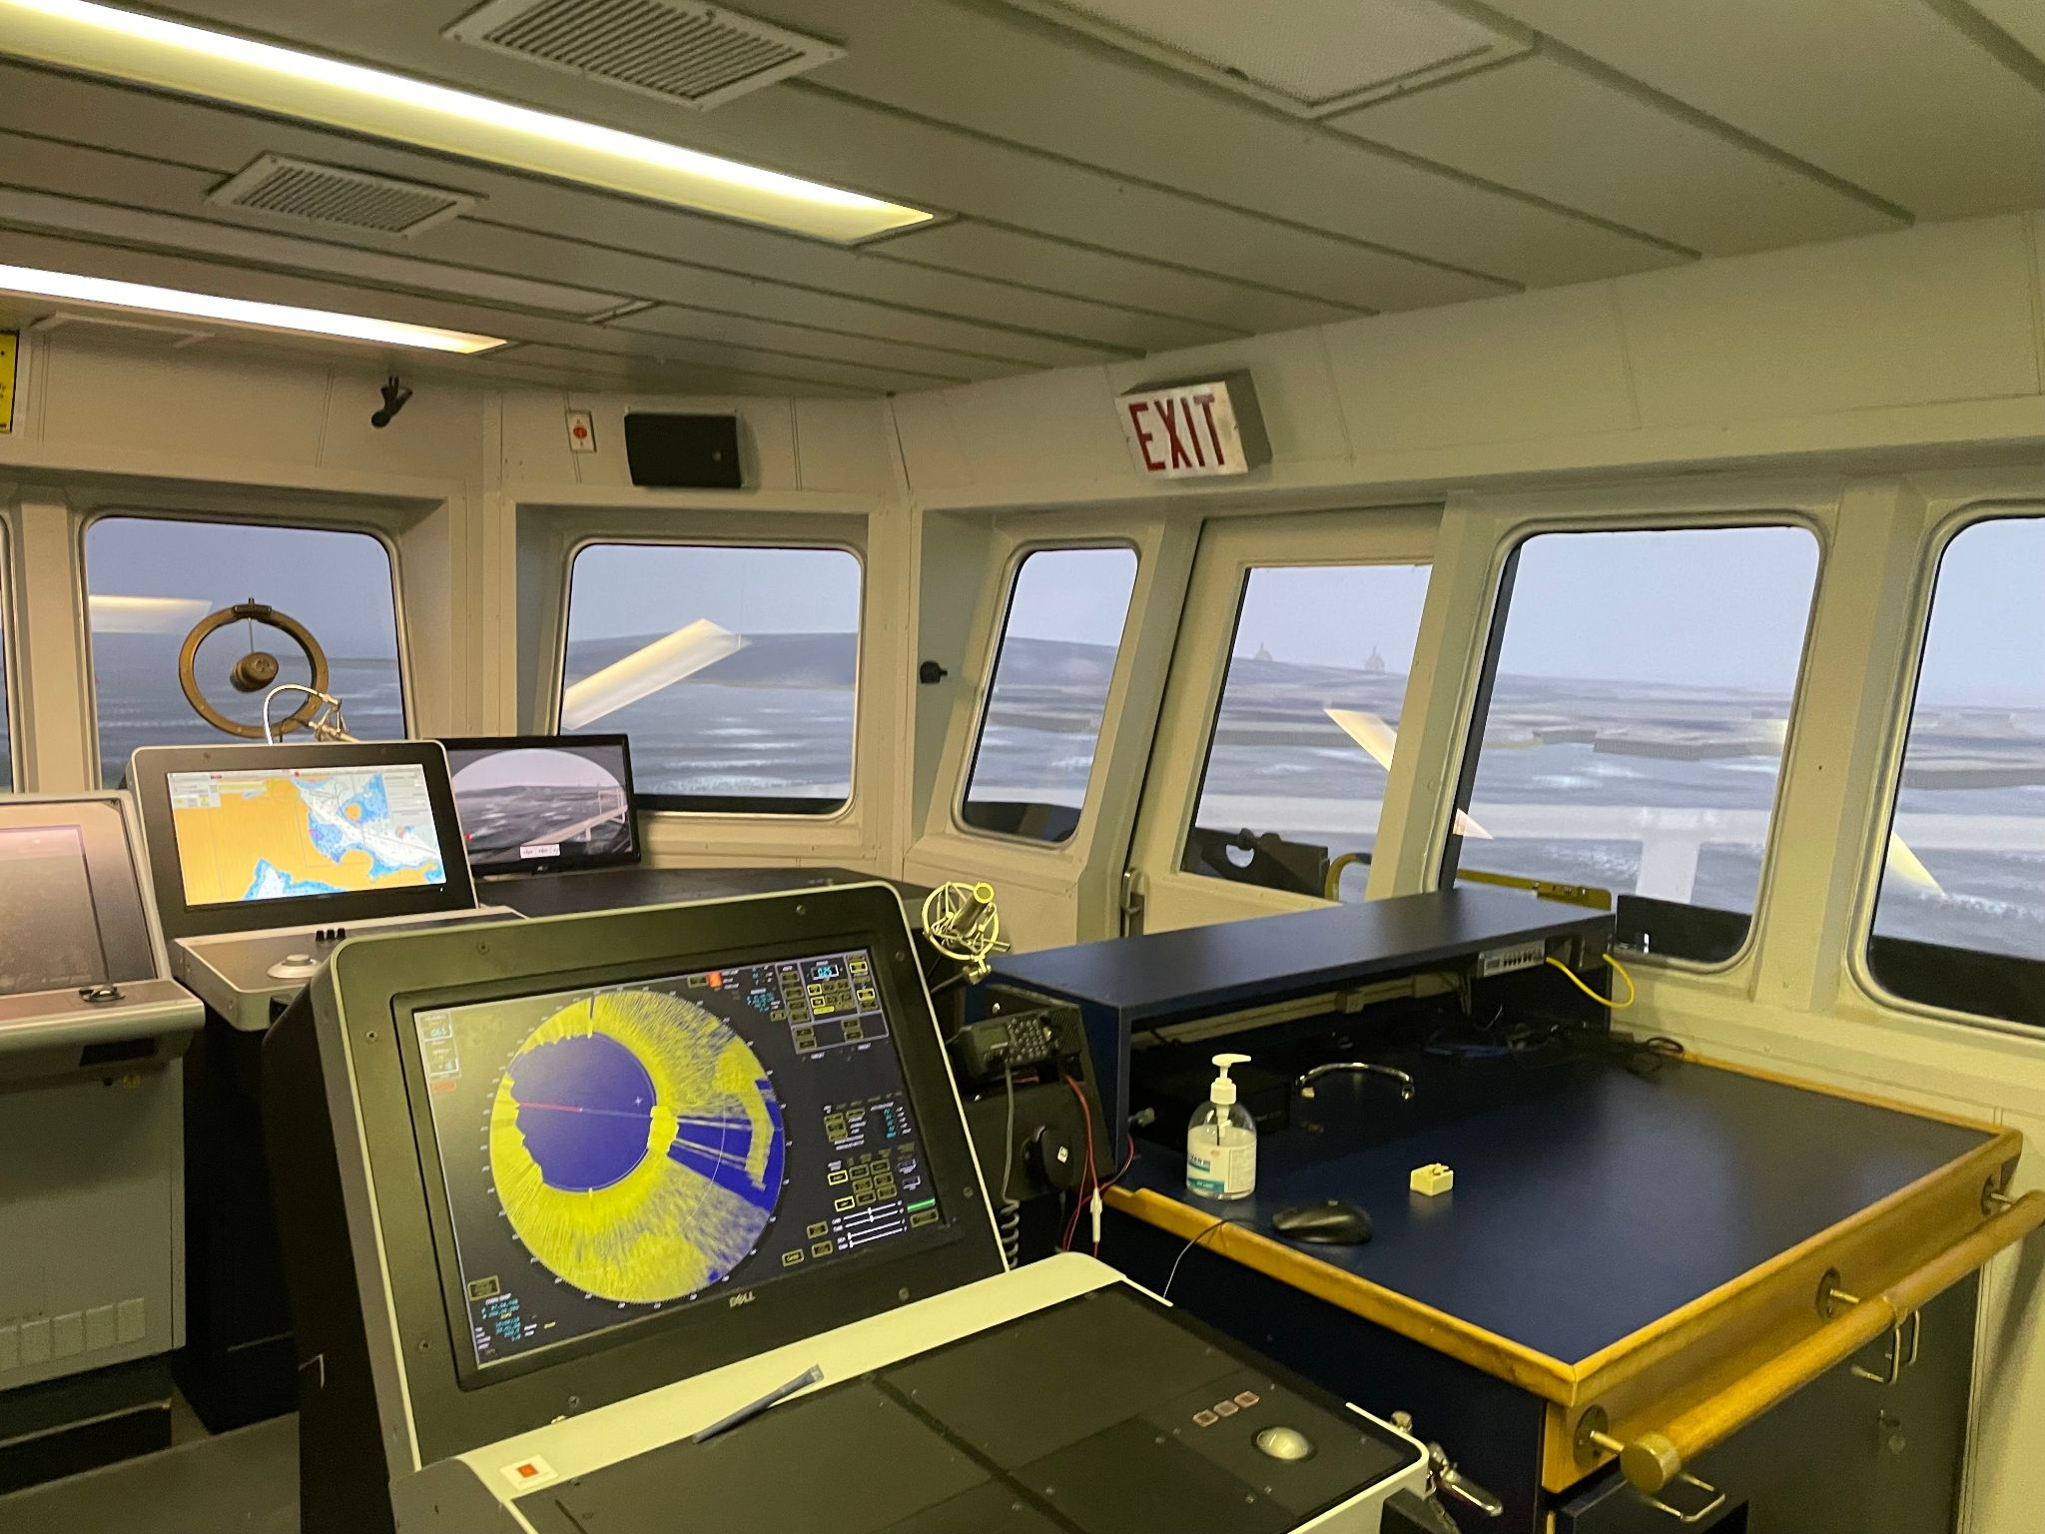

Problem Statement
Marine vehicles require the use of USB to transfer maps that aid their navigation on sea.
However, there could be possible cases of corrupted USB sticks that could adversely affect the network

Slide 3
Proposed Solution
A USB proxy that can detect just the image in the flash drive, amidst other things and display that.
This would mean every other thing in the flash drive is irrelevant apart the file intended to be used

Slide 4
How it works
HPS
FPGA
RAM
The HPS acts as the producer, reading the BMP file from the USB drive and writing decoded pixel data to the shared on-chip RAM.
The FPGA acts as the consumer, continuously reading pixel data from the RAM and driving the VGA display.
The dual-port RAM architecture enables both operations to occur simultaneously without bus contention.

Slide 5
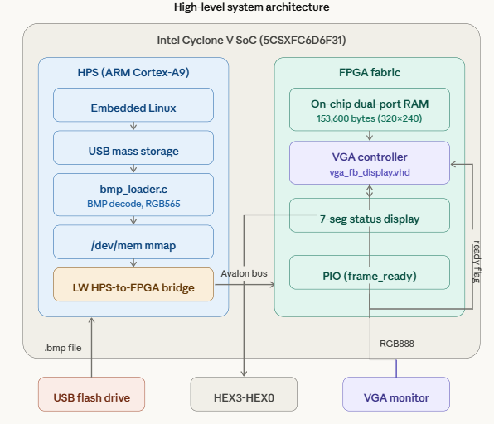

Slide 6
Thanks!

