Slide 1
Comparing Automated Dynamic UI Verification to
Static Walkthroughs in Asynchronous Systems
Innocent Onwukanjo (202487225) · Kelechukwu Innocent Ede (202580616)
ENGI 9839, Software Verification & Validation
System Under Test: Uptime Kuma 1.23.9 (real, unmodified)
Notes:
One line: we compared three ways of verifying a real-time app to see which finds which defects, on a real, high-quality system we did not modify.

Slide 2
Research Question
How well does automated dynamic testing (Playwright) find async UI-state bugs, versus a static walkthrough and exploratory testing?
Notes:
Unlike a normal page (ask, then answer), the server pushes data anytime, so bugs depend on timing you don't control. Exploratory was added by the course; the SUT stays unmodified, so we find real defects.

Slide 3
Problems
The Async UI Paradigm
Server-Pushed Updates: WebSockets replace the traditional request-and-response model, allowing the server to push data at any millisecond.
Continuous Mutation: The UI updates instantly without requiring page refreshes or user actions.
Unpredictable Data Flow: Data can arrive at any moment, breaking the reliable sequence guarantees of standard web pages.
Timing Bugs & State Anomalies
Race Conditions: Rapid updates can arrive duplicated or out of order, causing the UI to render incorrect transitional states.
Stale States: Dropped connections can leave the dashboard silently frozen while appearing to show live data.
Reconnect Vulnerabilities: Tearing down and rebuilding state creates dangerous "clear-then-refill" windows where data is temporarily lost (e.g., flashing an "Unknown" status).
Unbounded Growth: Improperly handling update history during reconnects can cause data lists to grow infinitely, leading to memory leaks
Notes:
Unlike a normal page (ask, then answer), the server pushes data anytime, so bugs depend on timing you don't control. Exploratory was added by the course; the SUT stays unmodified, so we find real defects.

Slide 4
Key Terms: The Three Techniques
Static walkthrough (T1), reading the source code by hand to reason about how it behaves, without running it.
Dynamic testing (Playwright, T2), running the app in a real browser and automatically checking what the user sees;
Exploratory testing (T3), a person testing the running app in guided, time boxed sessions, designing tests while learning it.
Findings are numbered D-001, D-002, ... (for example, D-005).
Notes:
Define each term in one plain sentence before the comparison. Static = read the code; Dynamic = automated browser testing with Playwright; Exploratory = a human exploring the running app in structured sessions.

Slide 5
What is Playwright?
Dynamic UI Automation
An open-source framework developed by Microsoft for automated end-to-end (E2E) testing.
Drives a real browser engine (Chromium, Firefox, WebKit) just like a human user would.
Acts as a "black box" observer, executing the application and verifying the observable UI state.
Built for Async Systems
Identified as the best-performing tool for dynamic, JavaScript-heavy web applications.
Built-in Auto-waiting: Intended to reduce test flakiness in asynchronous environments.
Web-first Assertions: Ensures stable checks over brittle timing or URL validations.
Repeatable Verification
In our study, Playwright provides objective, repeatable confirmation of correct behavior.
Excels at continuous regression testing within a CI pipeline.
Confirmed transient bugs (D-005) by reproducing reload behavior consistently.
Playwright is our dynamic testing tool (T2).
Notes:
Define each term in one plain sentence before the comparison. Static = read the code; Dynamic = automated browser testing with Playwright; Exploratory = a human exploring the running app in structured sessions.

Slide 6
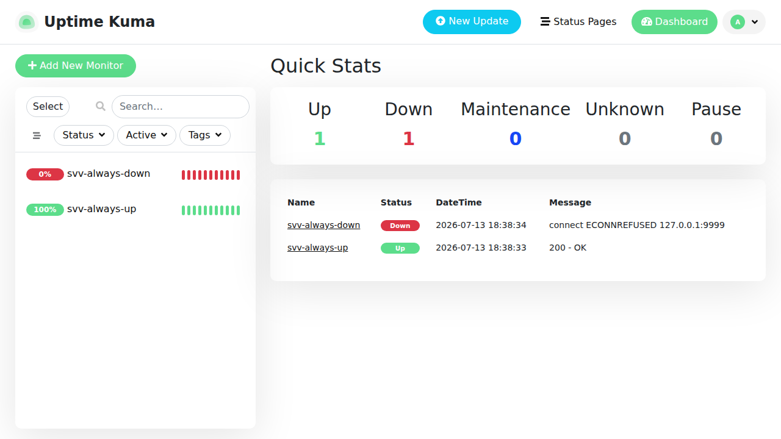
Approach: One Async Target, Three Lenses
SUT, Uptime Kuma 1.23.9, a real Vue and Socket.io dashboard, run unmodified.
Pinned version, the code we read is the exact code the tests run.
Live SUT dashboard: two seeded monitors (up and down) and the Quick-Stats table.
Technique | Executes? | Sees | Best at
T1 Static walkthrough | No, reads code | all code | subtle logic and async faults
T2 Dynamic (Playwright) | Yes, automated | UI-observable | repeatable verification, regression
T3 Exploratory (Tours) | Yes, human | UI-observable | surprising, user facing faults
Notes:
This table is the spine of the talk: each lens sees something different, all aimed at the same code layer, which makes the comparison fair.

Slide 7
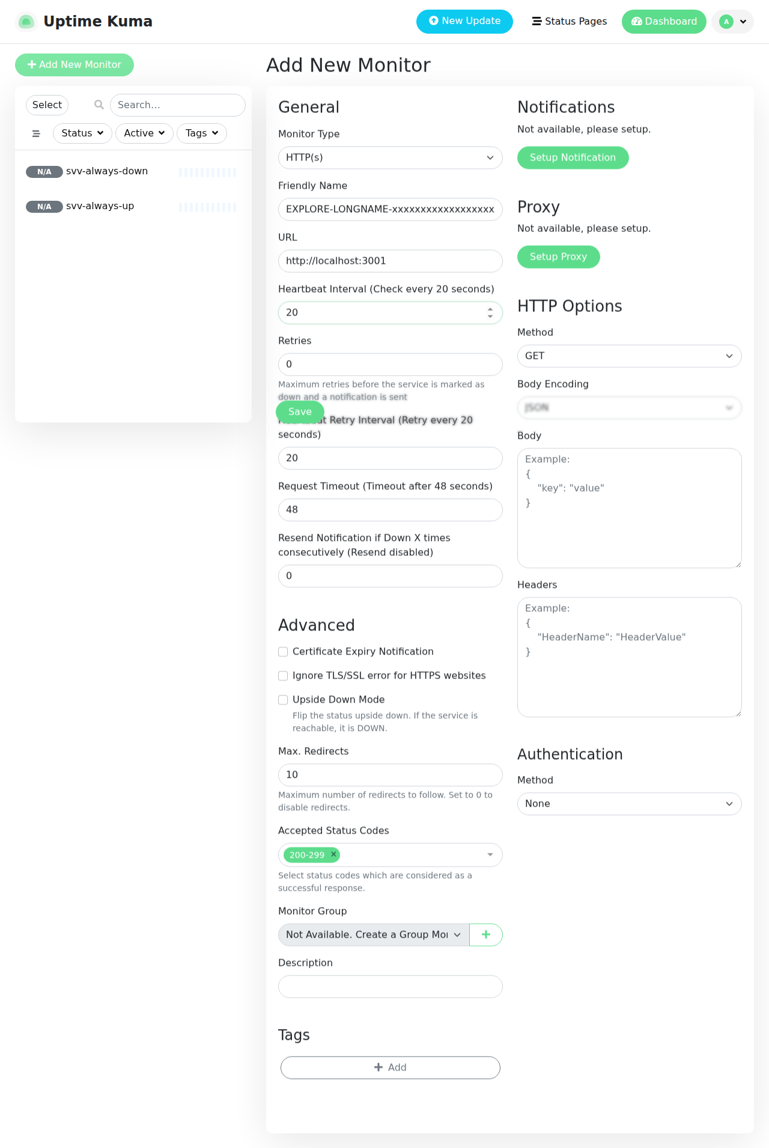
Results
Static, 7, deep async faults found by reasoning about the code.
Exploratory, 3, user-facing faults, name overflow (D-009) and frozen clone (D-010).
Dynamic, 1, confirmed D-005; mostly it verifies correct behaviour in CI.
Overlap, D-003 static and exploratory, D-005 static and dynamic; D-008 was a false alarm.
Technique | Defects
T1 Static walkthrough | 7
T3 Exploratory | 3
T2 Dynamic (Playwright) | 1
Supermodel Tour: a very long monitor name, which overflows the table (D-009).
Notes:
CI runs the Playwright suite on every commit; on a mature app it mostly passes, so its value is repeatable verification, not raw discovery. Show the green pipeline run.

Slide 8
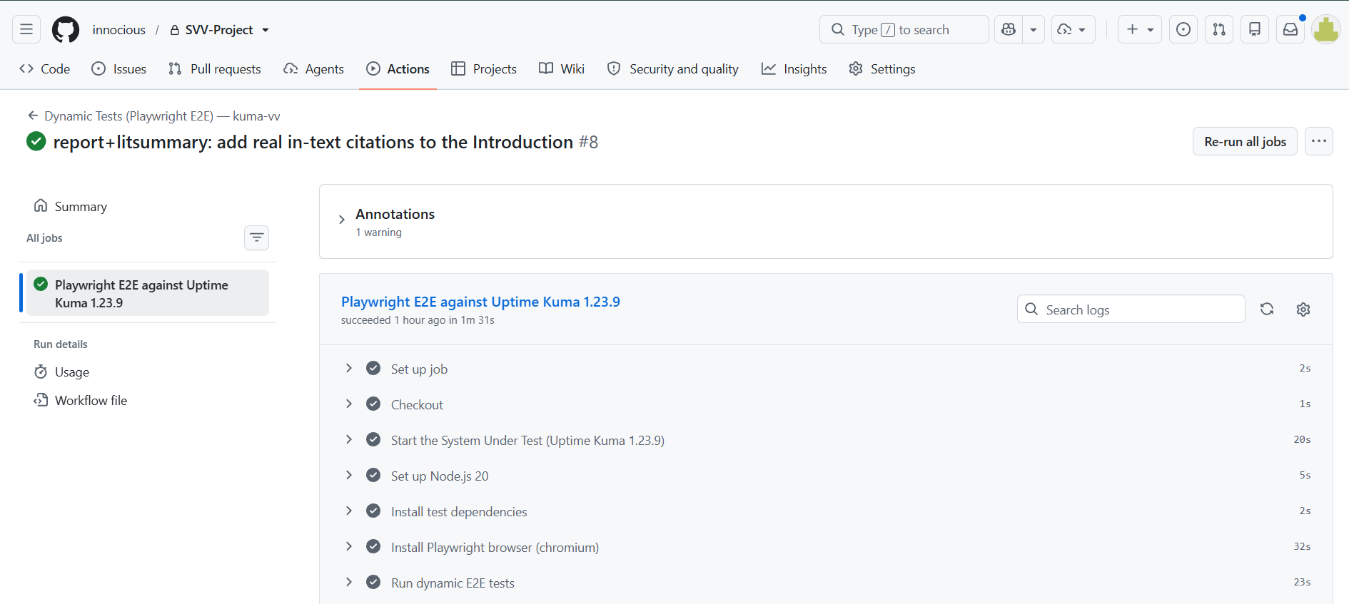
The Automated Suite in Action
Every commit: the pipeline starts Uptime Kuma 1.23.9, installs the browser and runs the whole Playwright suite.
This run finished green in 1 minute 31 seconds, and the HTML report is kept as a downloadable artifact.

Slide 9
Key Findings: What Each Technique Caught
Static walkthrough, 7 defects
Reading the code hides nothing: we followed the reconnect path and saw the empty gap before any test existed.
It finds what runtime hides: D-001 needs hours of running to appear, but as a missing line it took seconds to spot.
Exploratory testing, 3 defects the others missed
A person notices what nobody thought to assert: no plan included a 400 character name, but a human tried it and the table broke (D-009).
It also confirmed what works: create, edit and delete, input validation and two tab syncing were all correct.
Automated testing, 1 confirmed
It only sees the screen, so internal faults stay invisible, and on a mature application most checks simply pass.
It is the only one that repeats: it runs on every commit with no human, and it will catch the day this behaviour breaks.
Notes:
The thesis. Address 'shouldn't dynamic find more?' head-on: a code read sees everything and the app is high quality, so static finds most, but dynamic is the only one you can re-run forever.

Slide 10
The Answer: Why They Are Complementary
We asked one question
How well does automated dynamic testing find state bugs in an asynchronous interface, compared with a static walkthrough and exploratory testing?
The honest answer
On count alone automation came last, 1 against 7 and 3. If the only question is who finds the most bugs, automation loses here.
But count is the wrong measure: a walkthrough happens once and a tester gets tired, while the suite runs again on every commit.
What that means in practice
Each technique failed exactly where another succeeded, so the useful question is not which one wins, it is which one to use for what.
Read the code to find deep timing faults, automate so they cannot come back, and explore to catch what nobody thought to check.

Slide 11
Challenges Faced
Time, three techniques, a report, and a CI pipeline in a short window before the defense.
Scale, Uptime Kuma is a real, industry standard codebase, not a toy, so reading the async layer and standing up a reproducible environment was substantial work.
Transient bugs, the reconnect anomalies are timing dependent, hard to reproduce on demand with a test.
Notes:
Be honest and confident: the scale of the SUT is a strength of the study, not an excuse. It is why the comparison is realistic.

Slide 12
Improvement Areas & Future Work
Control the timing instead of hoping for it: intercept the WebSocket directly so the reconnect fault appears on demand, rather than restarting the server and waiting to get lucky.
Run the reading and the automation together: we finished the walkthrough before writing any tests, so neither fed the other. Side by side, each finding could be confirmed while it was still fresh.
Read past the front end: our review covered the state layer in socket.js only, and never opened the server side that actually produces the heartbeats.
Finish the tours we parked: Saboteur and All Nighter were dropped when time ran out, and All Nighter is the one that would have surfaced the memory growth we only caught by reading code.
Notes:
This maps directly onto the report's Threats to Validity: each improvement answers a specific threat.

Slide 13
Conclusion
What we set out to do
We asked which technique best catches state bugs in an interface driven by pushed events, and we tested it on real software we did not modify.
What we found
Nine real defects in shipping software: seven from reading the code, three from exploring, one confirmed by automation, and two of them found twice.
No single technique found everything, and each one caught something the other two could not.
What we would tell another team
Use all three and use them for what they are good at. Drop any one and a whole class of fault has nobody looking for it.
Evidence, not promises: every dynamic result here came from the pipeline, which starts the app and re-runs the whole suite on every commit.
Questions?
Notes:
End on complementarity. Be ready to walk one finding start to finish: the D-002 to D-003 reconnect chain is your best example.

Slide 14
References (IEEE)
[1] J. Wang, W. Dou, Y. Gao, C. Gao, F. Qin, K. Yin, and J. Wei, “A comprehensive study on real world concurrency bugs in Node.js,” in Proc. IEEE/ACM Int. Conf. Automated Software Engineering (ASE), 2017, pp. 520–531.
[2] C. Q. Adamsen, A. Møller, S. Alimadadi, and F. Tip, “Practical AJAX race detection for JavaScript web applications,” in Proc. ACM ESEC/FSE, 2018, pp. 38–48.
[3] Microsoft, “Playwright: Fast and reliable end-to-end testing for modern web apps,” Playwright Documentation, 2024. [Online]. Available: https://playwright.dev
[4] A. Tymoshchuk, “The Evolution of Test Automation: From Selenium to Playwright...,” International Journal of Computer (IJC), vol. 54, no. 1, pp. 37–45, 2025.
[5] P. Gosik and M. Miłosz, “Comparative analysis of Cypress and Playwright frameworks in end-to-end testing for applications based on Angular,” Journal of Computer Sciences Institute, vol. 36, pp. 320–327, 2025.
[6] S. Talakola, “Automated End to End Testing with Playwright for React Applications,” IJERET, vol. 5, no. 1, pp. 38–47, 2024.
[7] N. Hashemi, A. Tahir, A. Shi, S. Rasheed, and R. Blagojevic, “A Systematic Evaluation of Environmental Flakiness in JavaScript Tests,” arXiv:2602.19098, 2026.
All sources within the last ten years.
Notes:
You don't read this slide; leave it up during Q&A. For the tool choice cite [1] to [4]; for test reliability, [5].

