Slide 1

TOPICS
开源课
OpenClass
Q&A

Slide 2
Questions

Slide 3
[0008] blender 给物体添加骨骼
How to build armatures?

Slide 4
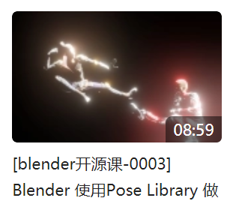
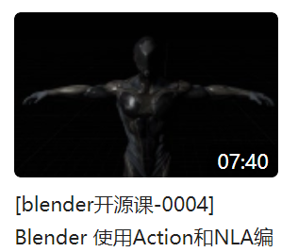
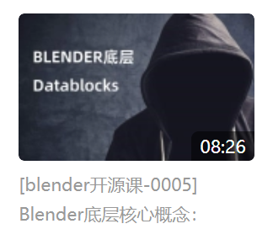

Slide 5
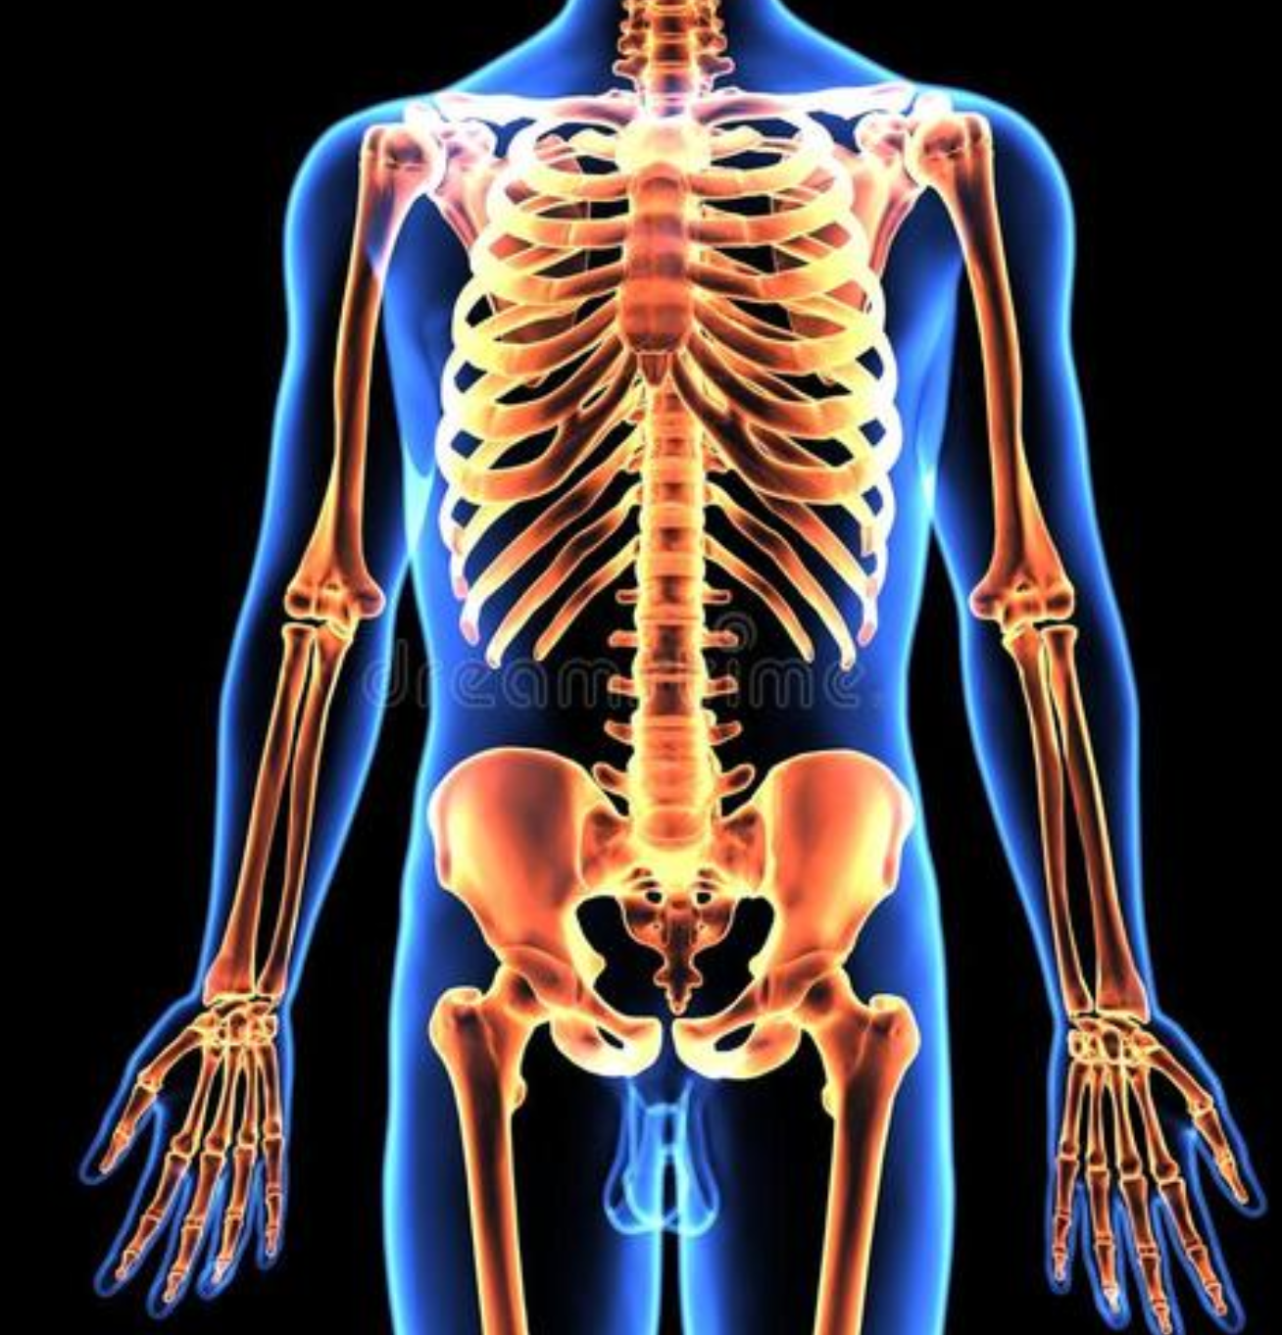
OBJECT
ARMATURE
Bone1
p5
p1
p6
p4
Bone2
p2
Bone3
p7
p3
Point | Weight
P1 | 0.2
P2 | 0.3
P3 | 0
P4 | 0
P5 | 0
P6 | 1
P7 | 0.1
P8 | 0.5
Point | Weight
P1 | 0.2
P2 | 0.3
P3 | 0
P4 | 0
P5 | 0
P6 | 1
P7 | 0.1
P8 | 0.5
Point | Weight
P1 | 0.2
P2 | 0.3
P3 | 0
P4 | 0
P5 | 0
P6 | 1
P7 | 0.1
P8 | 0.5
PN | PX | PY | PZ | CR | CG | CB
p1 | 11 | 23 | 12 | 0.12 | 0.05 | …
p2 | 23 | 45 | 32 | 0.2 | 0.1 | …

Slide 6
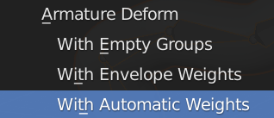
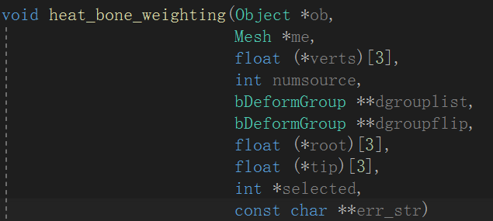
OBJECT
ARMATURE
Bone1
p5
p1
p6
p4
Bone2
p2
Bone3
p7
p3
Point | Weight
P1 | 0.2
P2 | 0.3
P3 | 0
P4 | 0
P5 | 0
P6 | 1
P7 | 0.1
P8 | 0.5
Point | Weight
P1 | 0.2
P2 | 0.3
P3 | 0
P4 | 0
P5 | 0
P6 | 1
P7 | 0.1
P8 | 0.5
Point | Weight
P1 | 0.2
P2 | 0.3
P3 | 0
P4 | 0
P5 | 0
P6 | 1
P7 | 0.1
P8 | 0.5
PN | PX | PY | PZ | CR | CG | CB
p1 | 11 | 23 | 12 | 0.12 | 0.05 | …
p2 | 23 | 45 | 32 | 0.2 | 0.1 | …

Slide 7
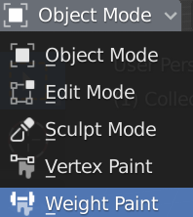
OBJECT
ARMATURE
Bone1
p5
p1
p6
p4
Bone2
p2
Bone3
p7
p3
Point | Weight
P1 | 0.2
P2 | 0.3
P3 | 0
P4 | 0
P5 | 0
P6 | 1
P7 | 0.1
P8 | 0.5
Point | Weight
P1 | 0.2
P2 | 0.3
P3 | 0
P4 | 0
P5 | 0
P6 | 1
P7 | 0.1
P8 | 0.5
Point | Weight
P1 | 0.2
P2 | 0.3
P3 | 0
P4 | 0
P5 | 0
P6 | 1
P7 | 0.1
P8 | 0.5
PN | PX | PY | PZ | CR | CG | CB
p1 | 11 | 23 | 12 | 0.12 | 0.05 | …
p2 | 23 | 45 | 32 | 0.2 | 0.1 | …

Slide 8
Requirement
主角是一个小蚯蚓，有一场舞动的独角戏
Solution
Points:
Armature bones

