Slide 1
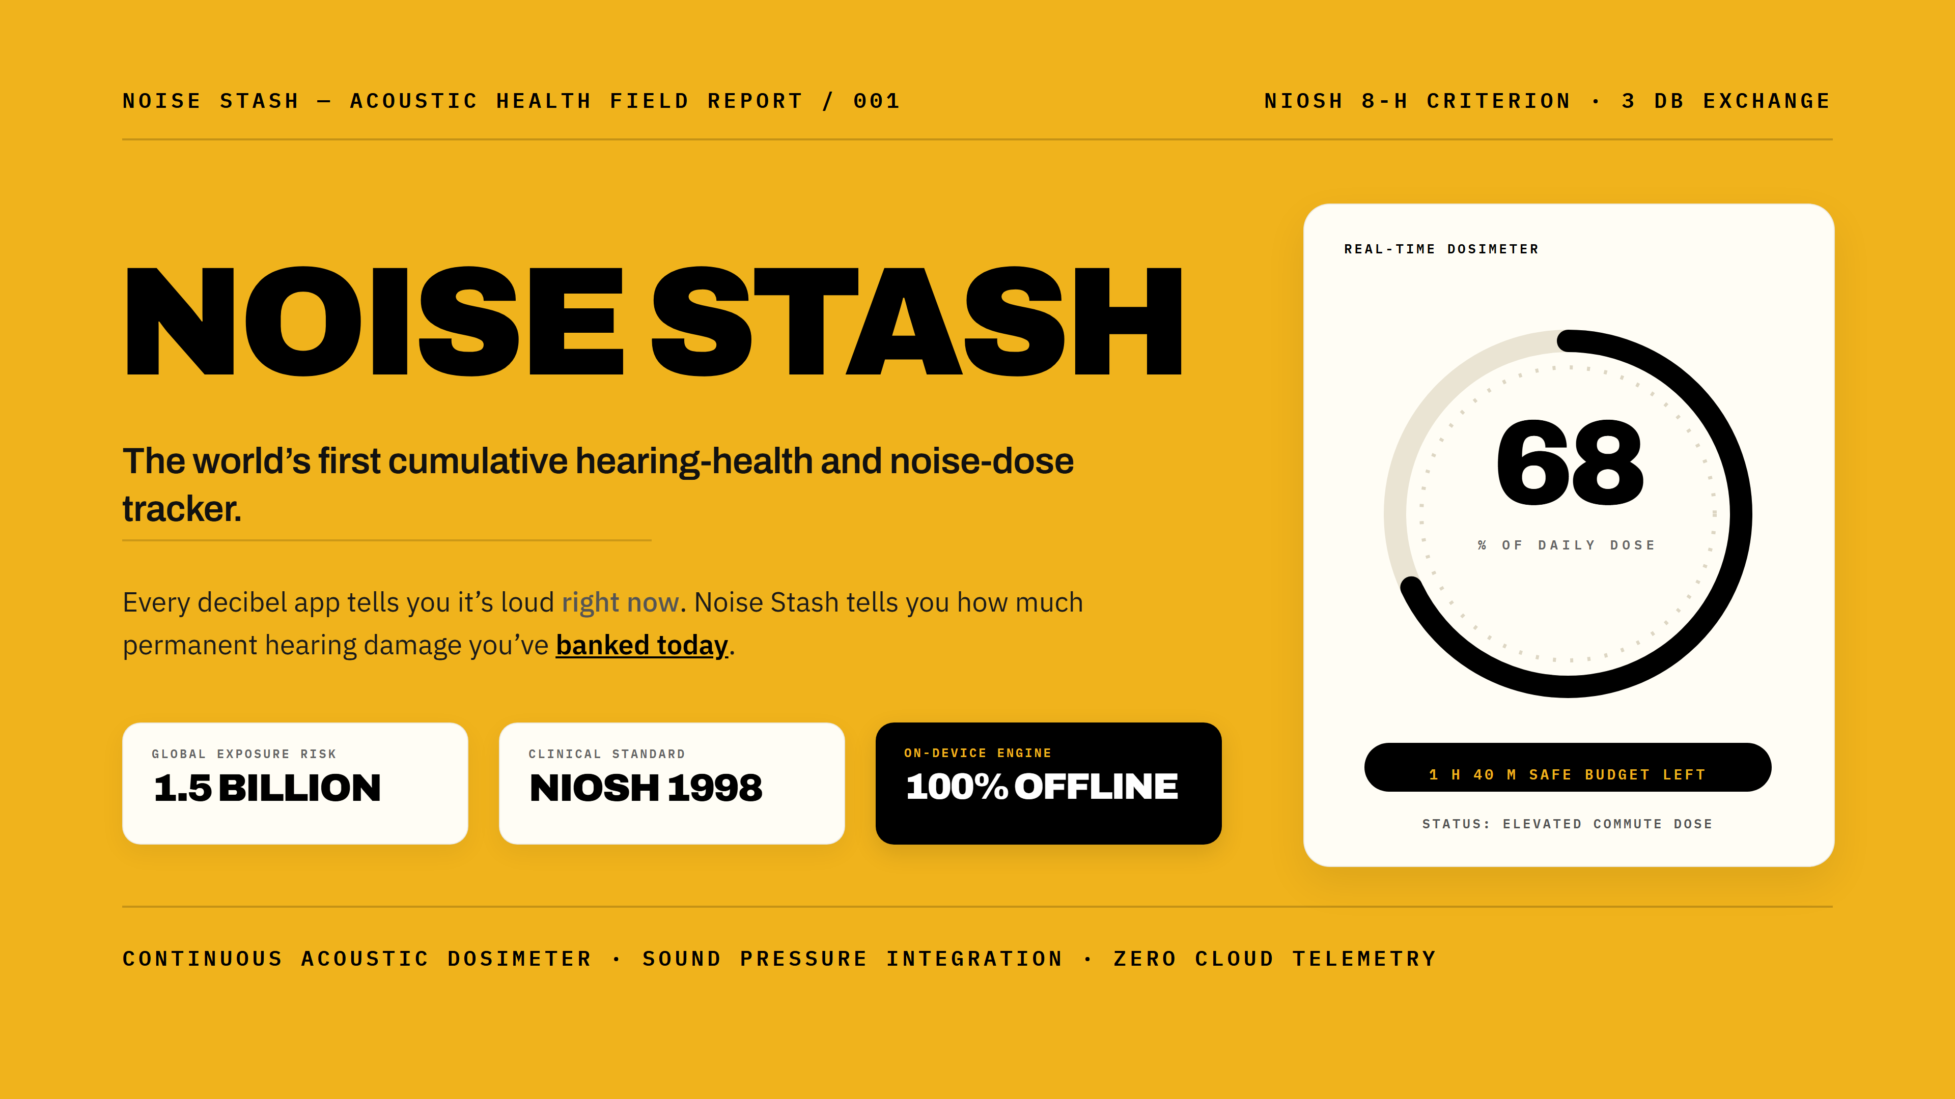
Notes:
Think about how you track your health. You track your steps, your sleep, your heart rate, your screen time. But what about the single most vulnerable, non-regenerative sensory organ in your body — your hearing? Today, over 1.5 billion people worldwide are at risk of irreversible hearing loss. We built Noise Stash to make acoustic health visible, actionable, and personal.

Slide 2
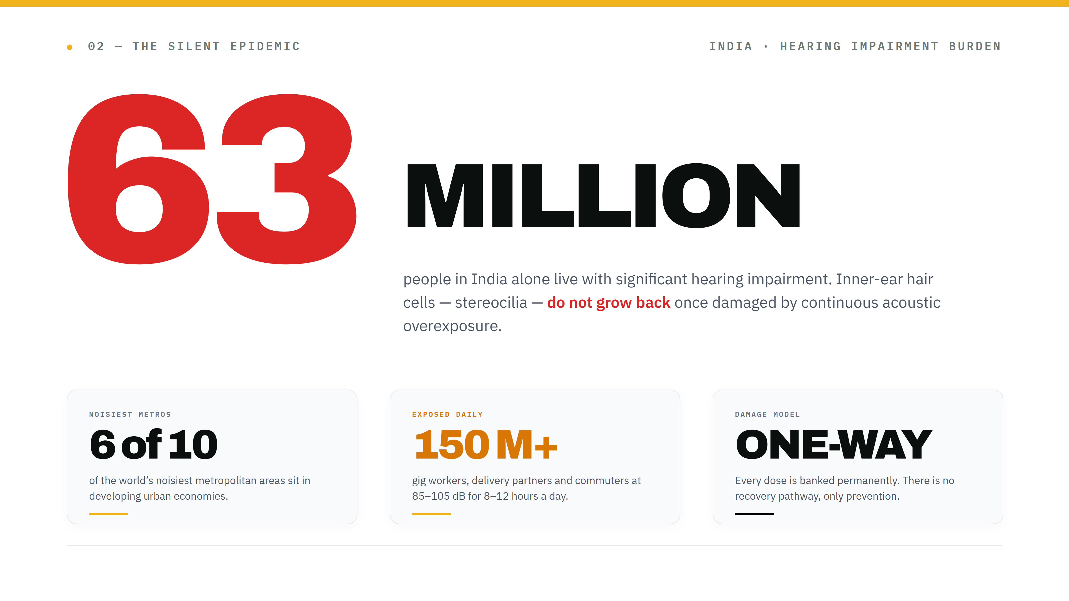
Notes:
Noise pollution isn't just an annoyance — it's an invisible occupational and lifestyle hazard. Metro commuters, delivery riders, factory workers, concertgoers, and headphone users are exposed to dangerous sound levels daily without any awareness of when safe exposure turns into permanent cellular destruction.

Slide 3
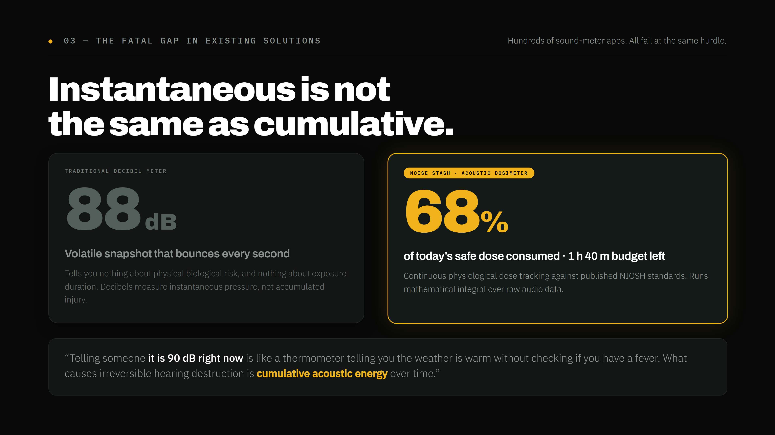
Notes:
There are hundreds of sound meter apps on the Play Store. Every single one fails at the same fundamental hurdle: they show an instantaneous number that bounces up and down. But audiology and medical science prove that hearing loss is not caused by an isolated loud second — it is caused by the cumulative acoustic energy dose absorbed by your ear throughout the day.

Slide 4
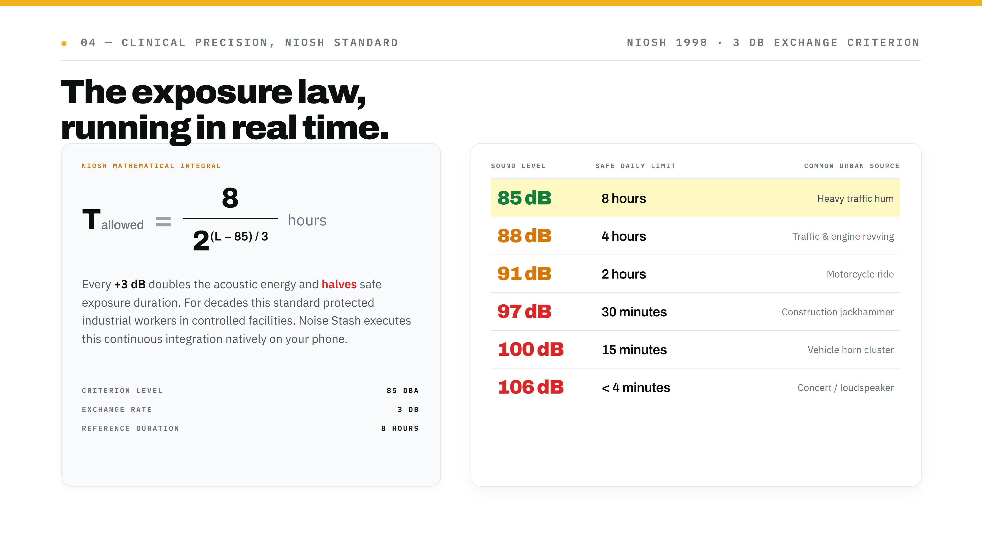
Notes:
For decades, organizations like OSHA and NIOSH have protected industrial factory workers using strict mathematical exposure laws. Every 3 dB increase doubles the acoustic energy and halves the safe exposure duration. Noise Stash brings this exact scientific standard out of specialized industrial sound laboratories and into the hands of everyday consumers.

Slide 5
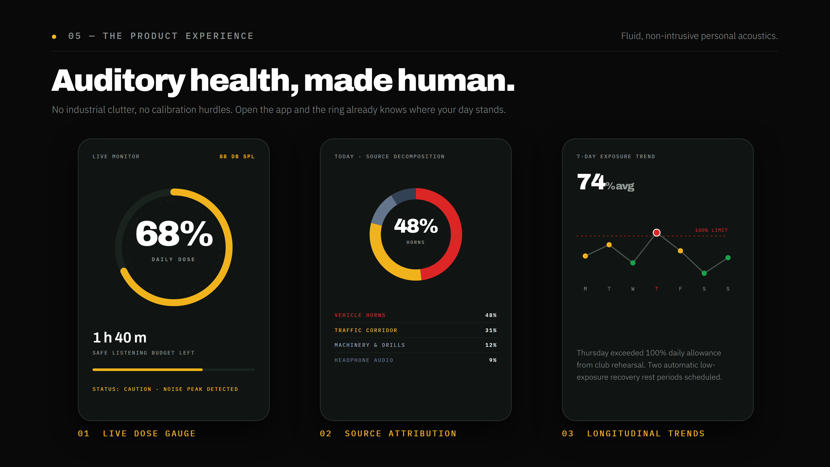
Notes:
Noise Stash is designed from the ground up for consumer simplicity. No industrial clutter, no calibration hurdles. Open the app: a fluid, glowing ring reveals your exact daily dose. If you're safe, it glows in serene emerald. As you enter traffic or loud zones, it shifts to amber and crimson, alerting you through subtle haptic pulses before your ears suffer damage.

Slide 6
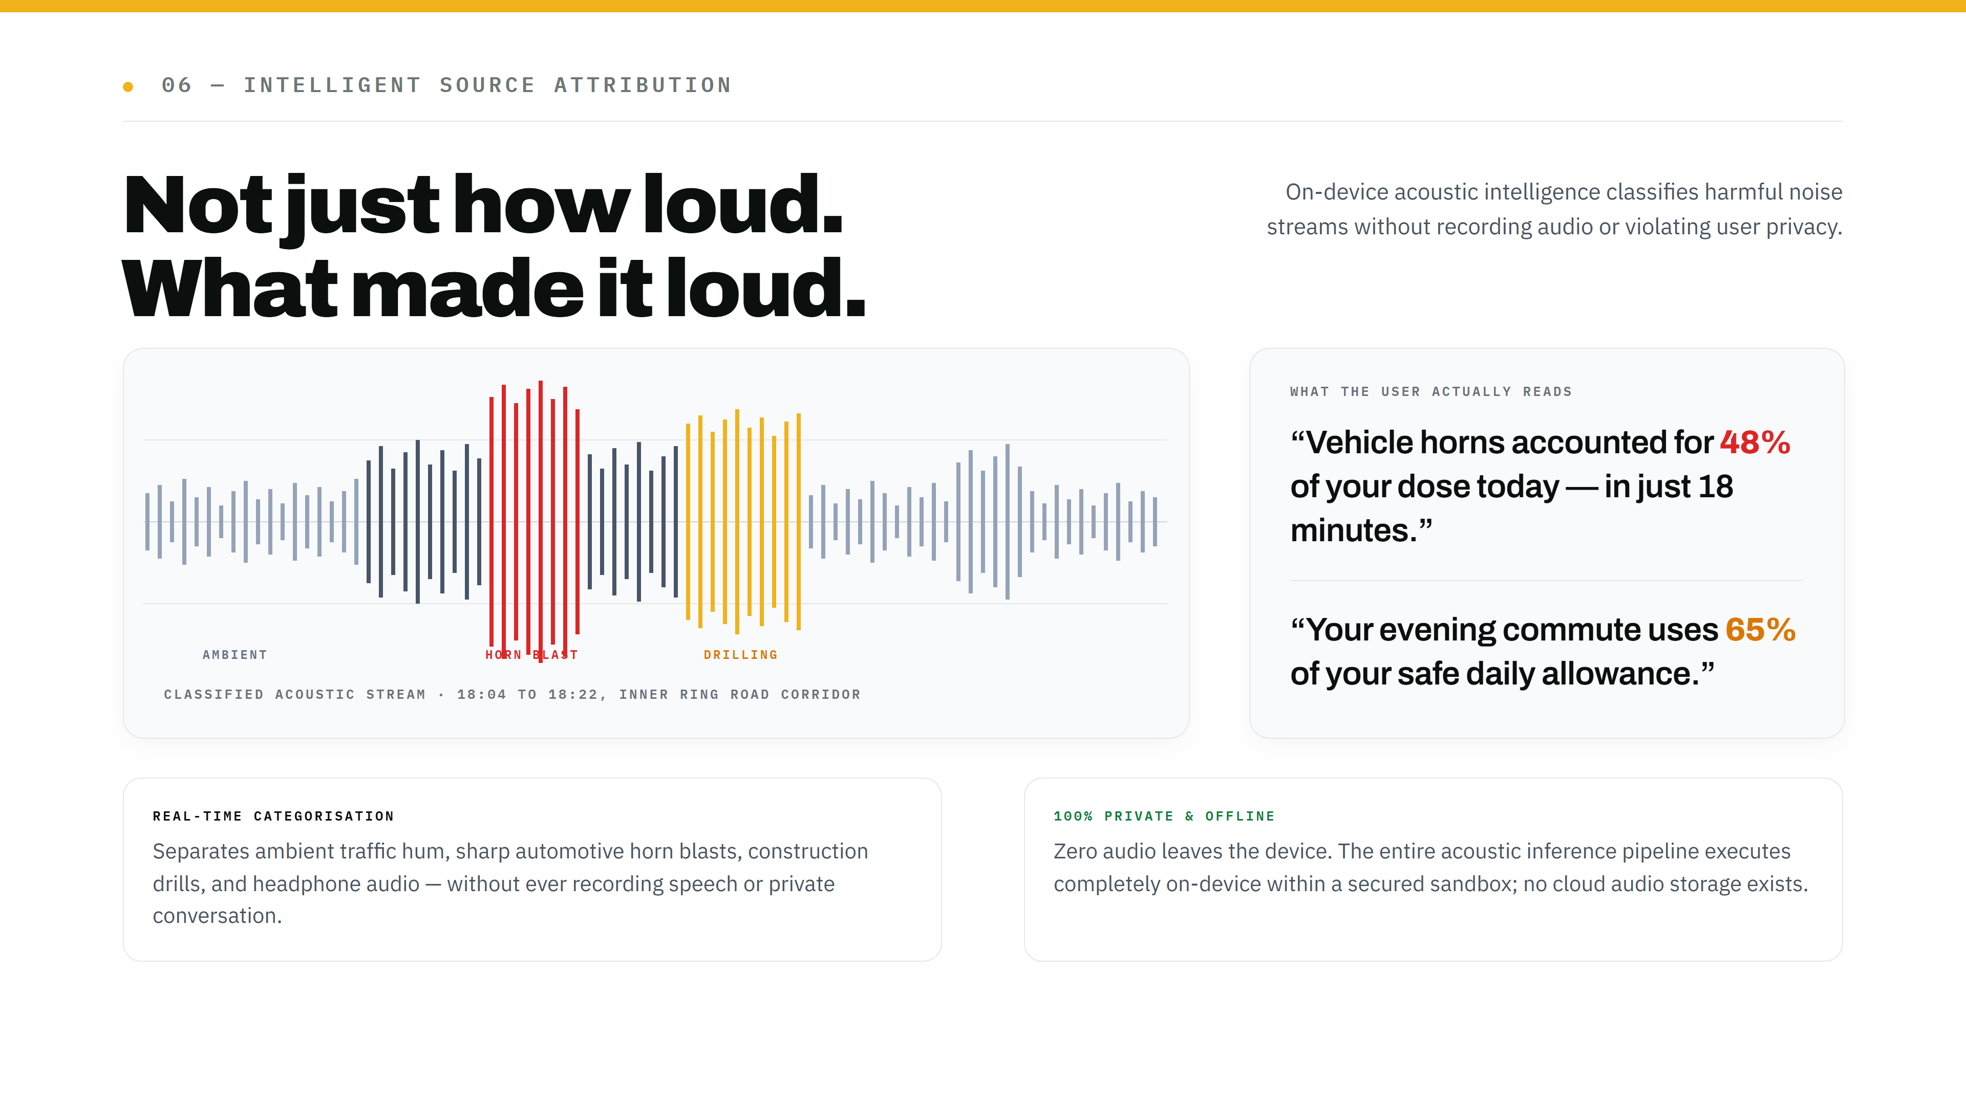
Notes:
We don't just calculate how much acoustic load you've taken — we tell you what caused it. Our local acoustic engine differentiates between general ambient hum, sharp horn blasts, construction drills, and loud audio. It gives users actionable recommendations, such as wearing earplugs during commute hours or relocating workspace desks away from street-facing windows.

Slide 7
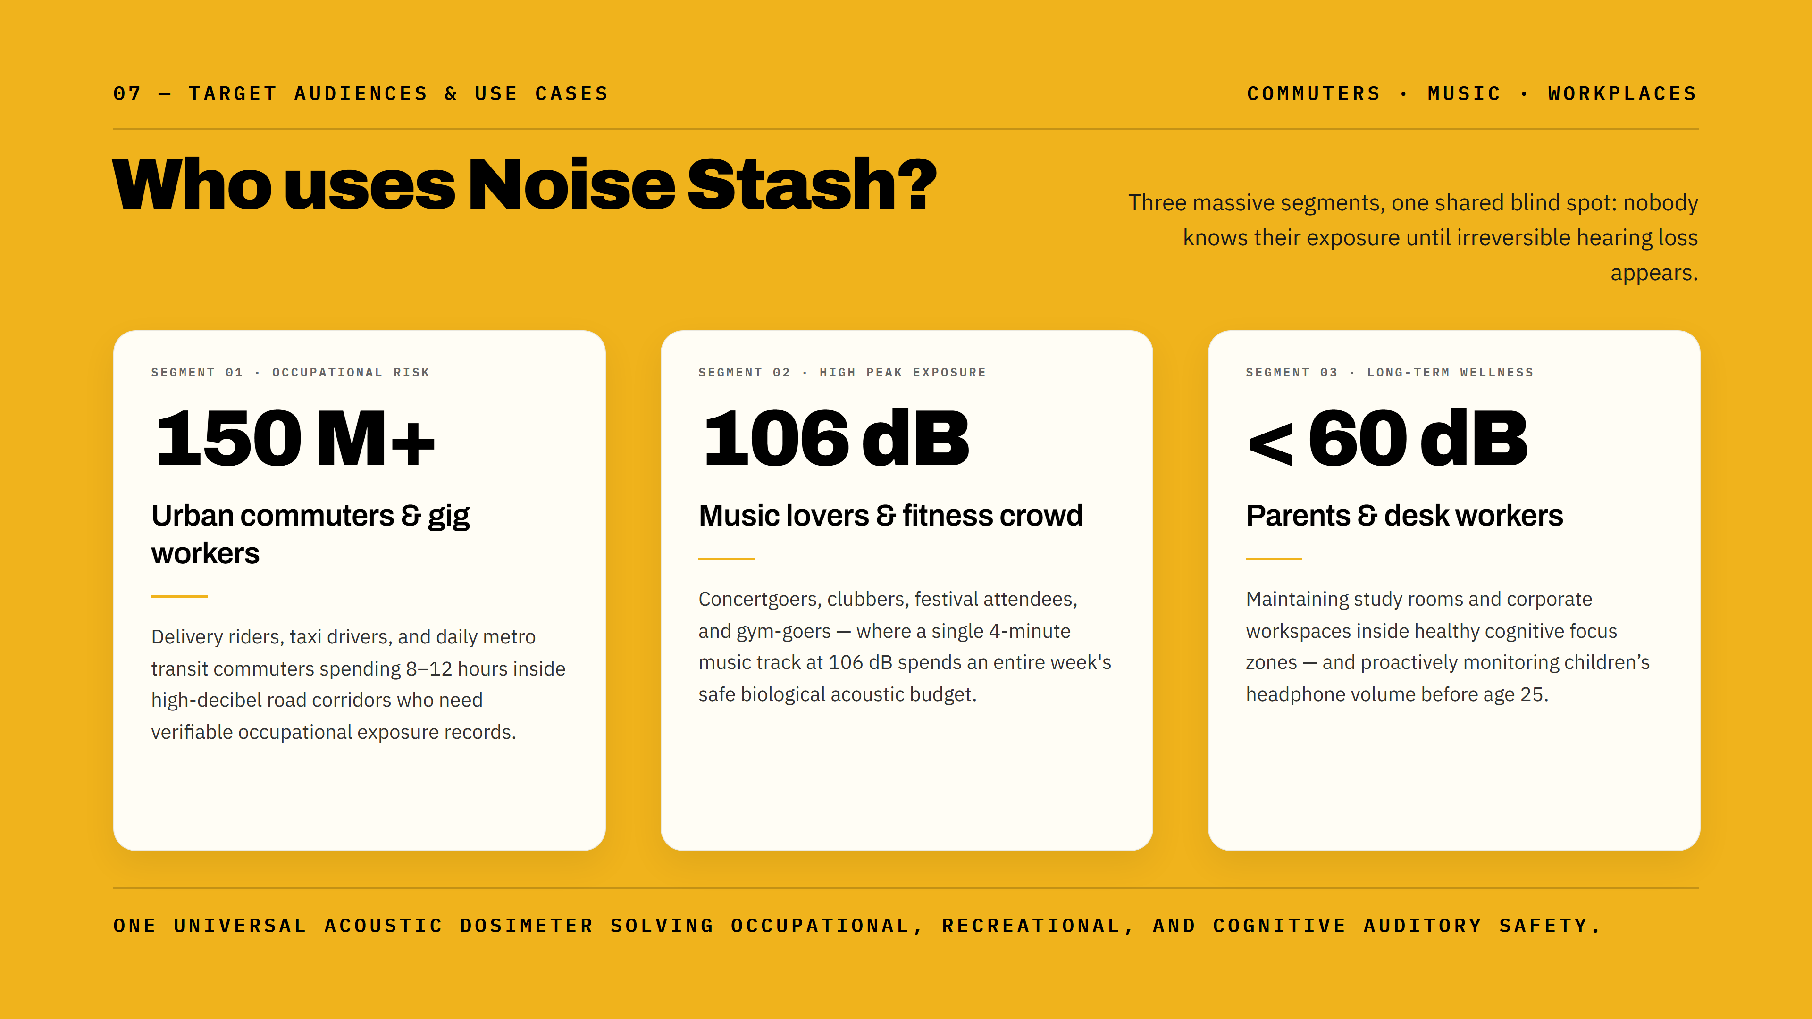
Notes:
Noise Stash addresses massive, diverse consumer segments: from the gig economy worker spending 10 hours navigating street traffic, to the young adult attending weekend music festivals, to parents ensuring their children's headphone habits aren't permanently destroying their hearing before age 25.

Slide 8
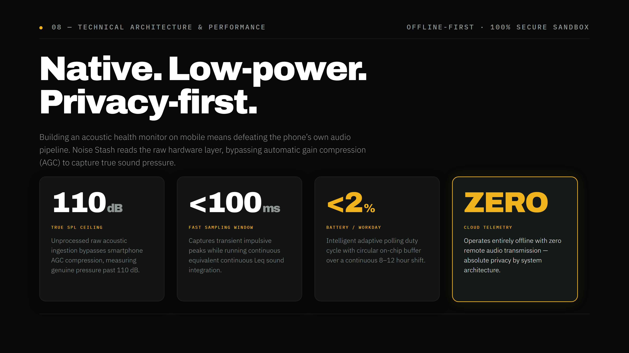
Notes:
Building an acoustic health monitor on mobile requires overcoming aggressive phone audio compression. Noise Stash accesses the raw acoustic hardware layer, bypassing automatic gain compression to capture true physical pressure. It runs with zero internet dependency, maintaining complete user privacy while sipping minimal battery.

Slide 9
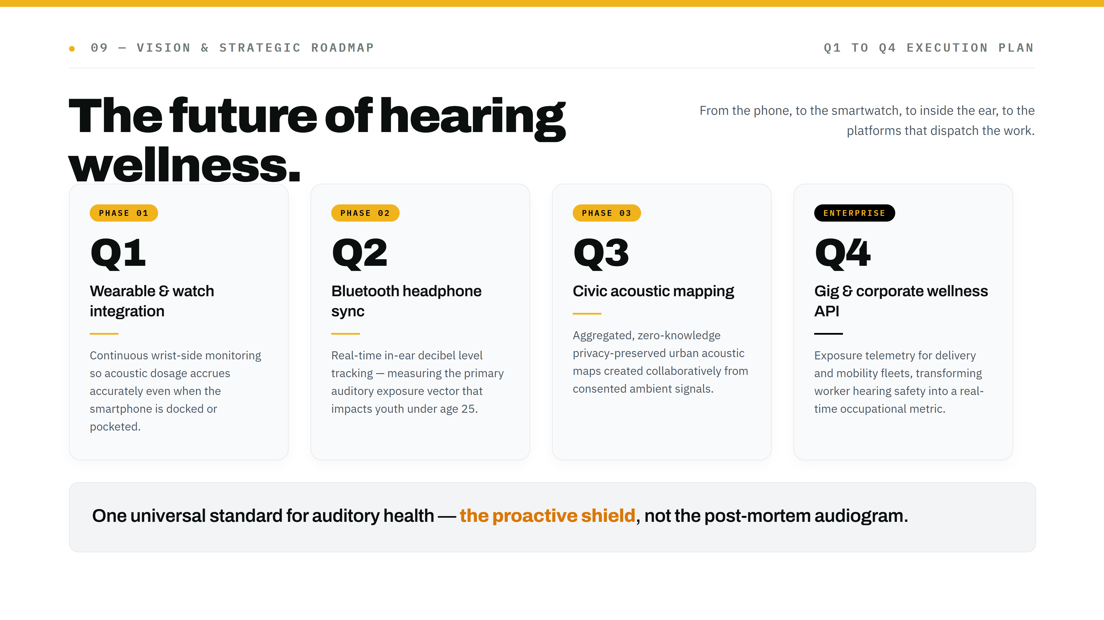
Notes:
We envision Noise Stash becoming the universal standard for auditory health. From your phone to your smartwatch, to direct in-ear headphone integration, Noise Stash is building the proactive shield that preserves hearing for the next generation.

Slide 10
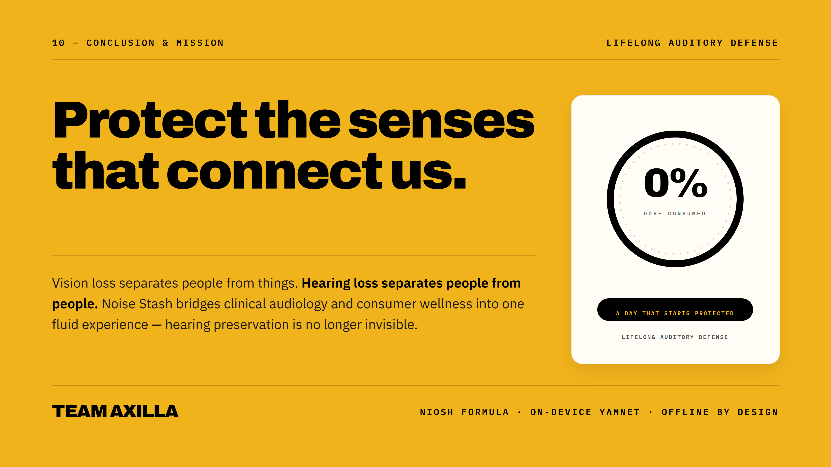
Notes:
Vision loss separates people from things; hearing loss separates people from people. With Noise Stash, hearing preservation is no longer invisible. Thank you.

