Slide 1
VPE TUTORIAL
Memory Maker
Managing a Full Meeting Cycle
A step-by-step walkthrough for the Vice President Education
Generated 2026-06-22 · Memory Maker BETA · For internal club training

Slide 2
CONTENTS
What this deck covers
Phase 1 — Pre-Meeting Planning
Phase 2 — Reception
Phase 3 — Live Meeting
Phase 4 — Wrap-Up & Records
Reference
Memory Maker — VPE Tutorial
2 / 28
1
2
3
4
5
Slides 4–11 · Create the meeting, build the agenda, open booking
Slides 12–13 · SAA handles check-in, you stay reachable
Slides 14–17 · Publish → Start → react → Stop
Slides 18–22 · Voting results, speech logs, Pathways, archive
Slides 23–28 · Status flow, permissions, pitfalls, glossary

Slide 3
OVERVIEW
The four phases of a meeting cycle
1
2
3
4
Pre-Meeting Planning
Reception
Live Meeting
Wrap-Up & Records
T-7 → T-1 day
T-0 18:30
T-0 19:00–21:00
T+0 → T+1
Build the agenda & open booking
SAA checks in guests & members
Publish → Start → react → Stop
Tally votes, log speeches, archive
→ The VPE owns Phase 1 & Phase 3, supports Phase 4, stays reachable in Phase 2.
Memory Maker — VPE Tutorial
3 / 28

Slide 4
PHASE 1
Pre-Meeting Planning
T-7 to T-1 day · The VPE's main work block
4 / 28

Slide 5
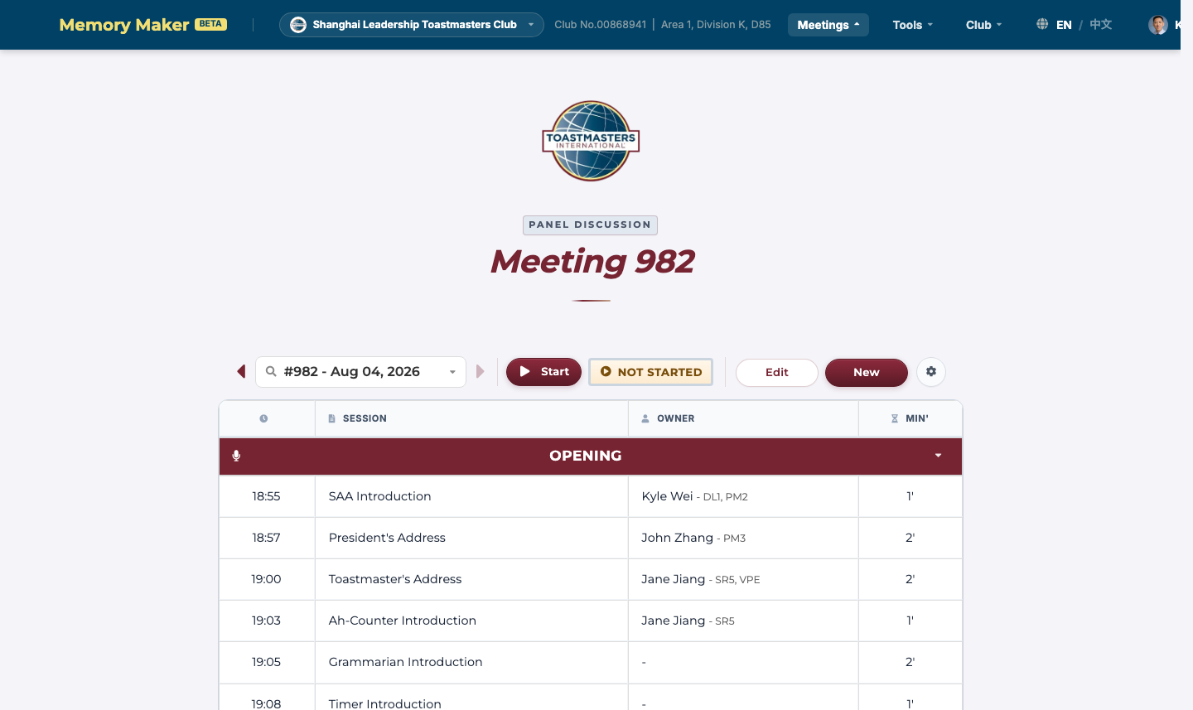
STEP 1.1
Open the Agenda page
Memory Maker's home base for everything meeting-related.
■ Route — /agenda — also reachable from the top nav under Meetings
■ Meeting selector — Use the dropdown to pick the meeting you want to work on
■ Status group — Shows the current meeting's status: Unpublished / Not Started / Running / Finished / Cancelled
■ Agenda table — Lists every session row with time, role, owner, project, and validation flags
The /agenda page — meeting #982 (Aug 04, 2026), status: Not Started
Memory Maker — VPE Tutorial
5 / 28

Slide 6
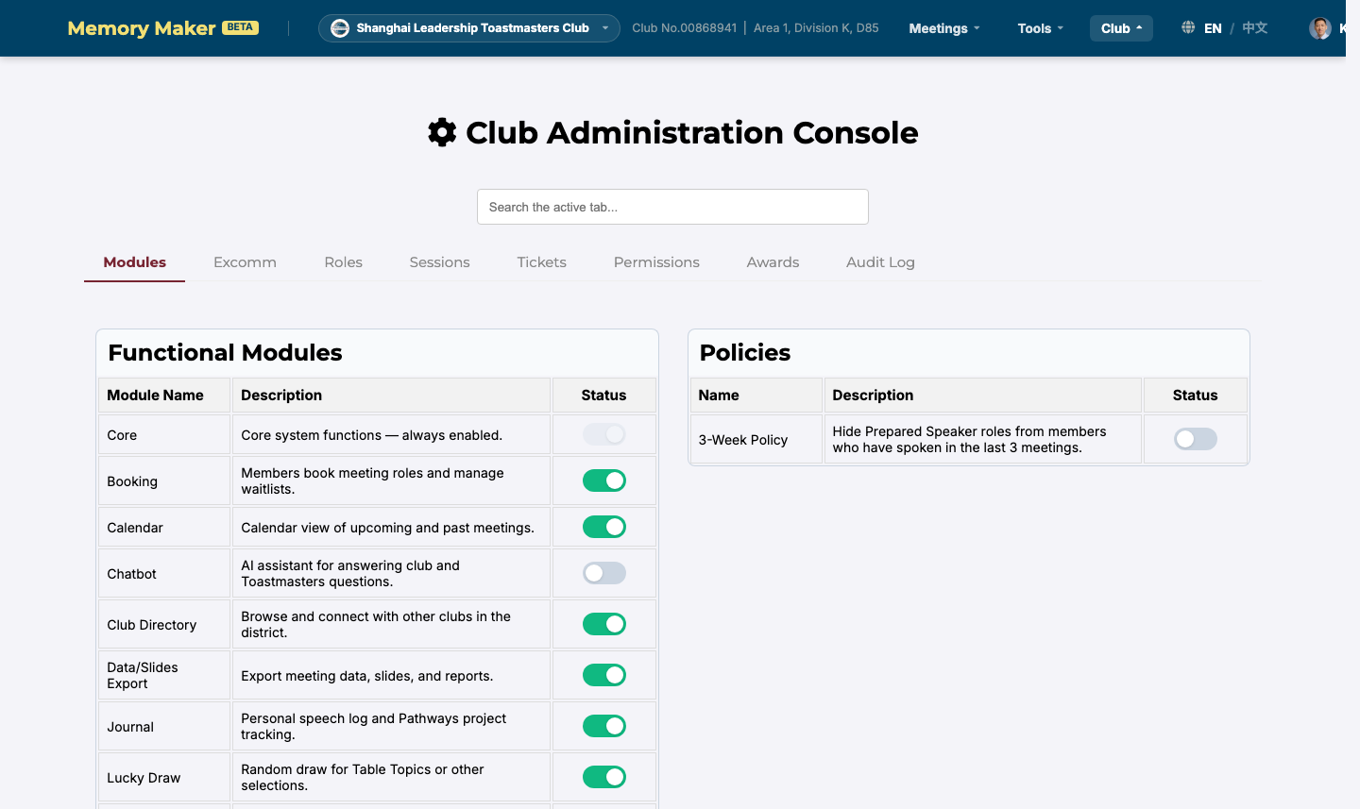
STEP 1.2
Create a meeting from a template
Start a new meeting by filling in the date, theme, and template.
■ Click New — Top of the agenda editor, or via the top-right menu
■ Fill the form — Date, meeting number, title/theme, subtitle, type, media URL, template
■ Template file — Determines the default set of agenda items (Standard Club Meeting, etc.)
■ Save — POST /agenda/create — requires MEETING_CREATE permission
Settings → Modules — make sure 'Data/Slides Export' is on before generating slides
Memory Maker — VPE Tutorial
6 / 28

Slide 7
STEP 1.3
Build the agenda
Edit sessions inline: time, role, project, and meeting-level fields.
■ Add/remove a session — Use the row controls at the bottom of the table
■ Reorder — Drag the row handle, or use the up/down arrows
■ Edit start time — Click the time cell, type 24h HH:MM — overlaps are flagged
■ Word of the Day — Set in the top-of-page wod-display block
■ GE Style — The ge_mode dropdown controls the General Evaluator's report format
■ Red badges — Indicate validation problems — resolve before publishing
The agenda table — session rows are editable inline
Memory Maker — VPE Tutorial
7 / 28

Slide 8
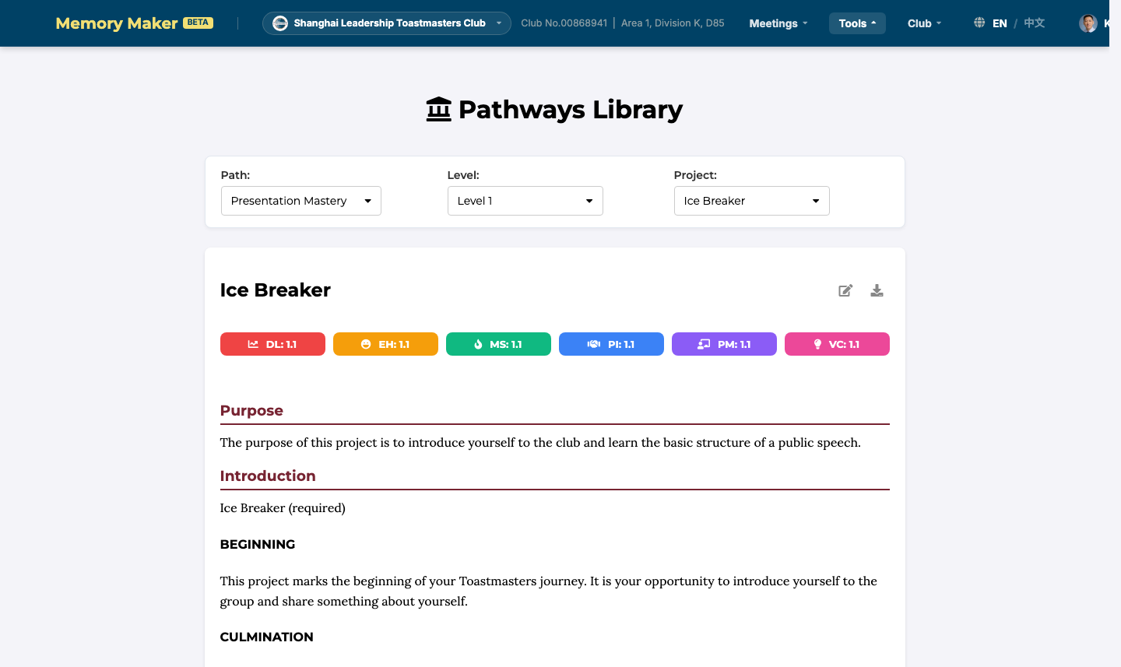
STEP 1.4
Add project info for prepared speeches
Prepared speech slots are flagged Valid_for_Project = true and need a Pathways project.
■ Click the project cell — In the row of the prepared-speech session
■ Pick the pathway — e.g. Dynamic Leadership, Presentation Mastery
■ Pick the project — e.g. Level 1 — Ice Breaker
■ Add an optional title — Used on slides and in speech records
■ If undecided — Leave blank — update before the meeting is Started
Pathways Library — the catalog of projects you assign to speech slots
Memory Maker — VPE Tutorial
8 / 28

Slide 9
STEP 1.5
Open role booking
Publishing unlocks role booking for all members.
■ Click Publish — In the agenda page's status group
■ Confirm the prompt — Memory Maker reminds you that booking opens to all members
■ Status flips — Unpublished → Not Started
■ Members see /booking — Self-booking and waitlists become available
■ Tip — Once published, structural changes to sessions are harder — finalise first
Status group on the agenda — click Publish to open booking
Memory Maker — VPE Tutorial
9 / 28

Slide 10
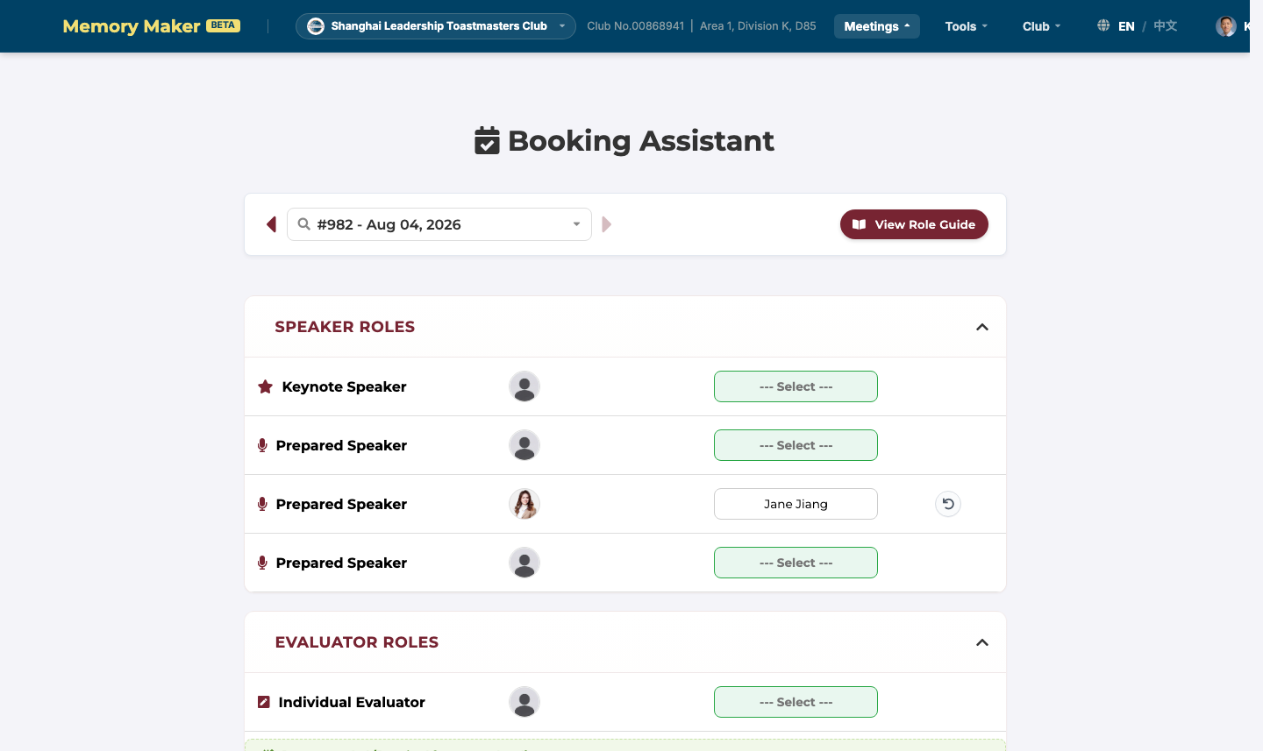
STEP 1.6
Book or assign roles
Members self-book; you backfill empty slots and assign evaluators.
■ Member self-booking — Members visit /booking, pick a meeting, click a slot
■ Waitlists — Full slots show 'Join Waitlist' — auto-promote when owner cancels
■ Officer assignment — Click the owner cell on the agenda page and pick a contact
■ Backfill 24–48h before — Fill any empty required roles; assign evaluators to speeches
■ Tip — Read the Planner page 1–2 days before — it shows members' intentions
/booking — the Booking Assistant as members see it
Memory Maker — VPE Tutorial
10 / 28

Slide 11
STEP 1.7
Day-before checklist
Run through this list the day before the meeting.
■ Agenda has no red validation badges
■ Every prepared speech has a Pathways project assigned
■ Every required role has an owner (or is intentionally left empty for the TME)
■ Word of the Day is set; the WOD speaker knows the definition
■ Slides have been generated and saved to the laptop
■ The SAA has confirmed who will publish and handle voting on the night
■ If all green, you are ready for Phase 3
Memory Maker — VPE Tutorial
11 / 28

Slide 12
PHASE 2
Reception
T-0 18:30 · Owned by the SAA — your job is to stay reachable
12 / 28

Slide 13
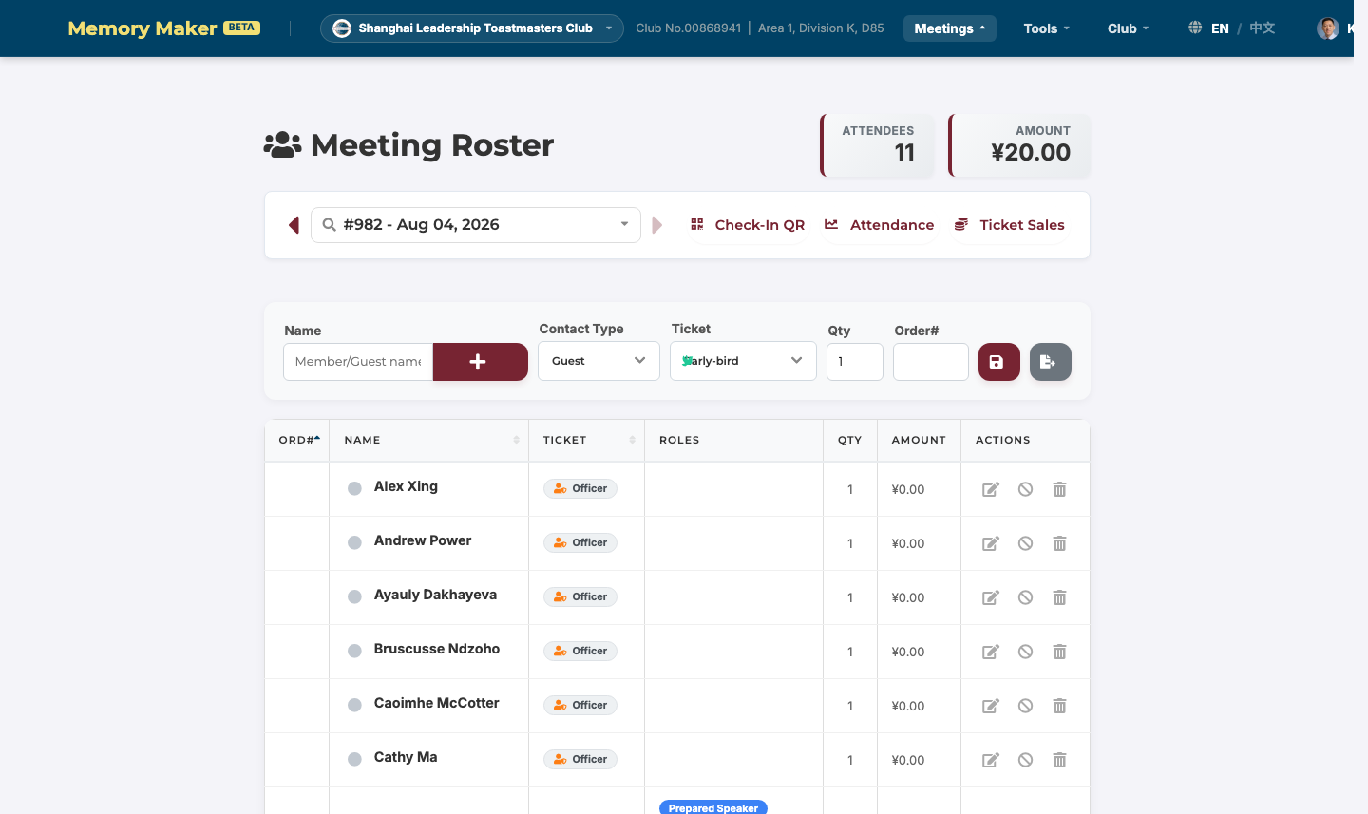
STEP 2.1
Reception & check-in
The SAA runs the door; you confirm the meeting is ready to publish.
■ Route — /roster — SAA adds guests and members as they arrive
■ Ticket types — Early-bird / Walk-in / Officer — order number auto-calculates
■ Live KPI — Total attendees and revenue shown at the top in real time
■ Your only task — Stay reachable. Don't publish/start the meeting until the SAA is ready
■ Last-minute edits — Adding a table topic speaker or roster entry mid-meeting is supported
/roster — the SAA's check-in tool
Memory Maker — VPE Tutorial
13 / 28

Slide 14
PHASE 3
Live Meeting
T-0 19:00–21:00 · The status button is your only control surface
14 / 28

Slide 15
STEP 3.1
Publish and start the meeting
Two clicks: Publish (unpublished → not started), then Start (not started → running).
■ Publish — Click in the status group; status flips to Not Started
■ Wait for 6:55 PM — Start the meeting 5 minutes before call-to-order
■ Click Start — Sets Start_Time to now; status flips to Running
■ Voting enables — Members can submit ballots at /voting; SAA watches live count
■ Reactions enabled — You can edit owners, add sessions, and add table topic speakers on the fly
Status group: Publish → Start → Stop
Memory Maker — VPE Tutorial
15 / 28

Slide 16
STEP 3.2
React to in-meeting changes
Common requests and how to handle each in under a minute.
■ Add a table topic speaker — Click the owner cell of the TT session and pick the person
■ Swap a speaker — Click the owner cell, clear the old, pick the new — no page reload needed
■ Add a TT session on the fly — Use the Add Session control; drag to reorder if needed
■ Forgot an evaluator — Same as owner-edit flow — just pick from the contact list
■ All edits via — POST /agenda/update — one round trip, validated and persisted atomically
Memory Maker — VPE Tutorial
16 / 28

Slide 17
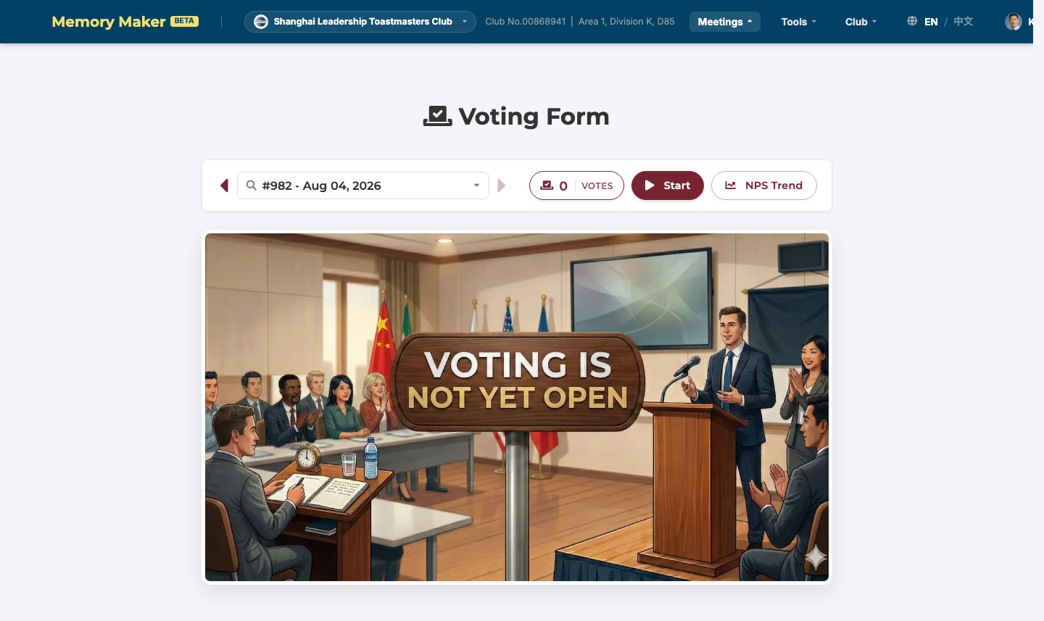
STEP 3.3
End the meeting
Click Stop. Memory Maker seals the meeting and runs the post-meeting bookkeeping.
■ Click Stop — Status flips to Finished
■ Vote tally — Winners are written to the voting records
■ Waitlist cleanup — All waitlist entries for this meeting are deleted
■ Planner sync — booked → completed, waitlist → obsolete, draft stays draft
■ Project auto-complete — Every project's session log is marked Completed and metadata synced
/voting — auto-tallied when the meeting stops
Memory Maker — VPE Tutorial
17 / 28

Slide 18
PHASE 4
Wrap-Up & Records
T+0 to T+1 · Confirm votes, log speeches, archive the meeting
18 / 28

Slide 19
STEP 4.1
Confirm voting results
The SAA reads final results and runs the lucky draw; you verify the data.
■ Route — /voting — final tallies and award winners
■ NPS — /voting_nps — club-level satisfaction trend
■ SAA's verification list — Confirms the right people got the right prizes
■ If something looks wrong — Don't edit ballots directly — file an issue from /issues to preserve the audit trail
/voting — final tallies after Stop
Memory Maker — VPE Tutorial
19 / 28

Slide 20
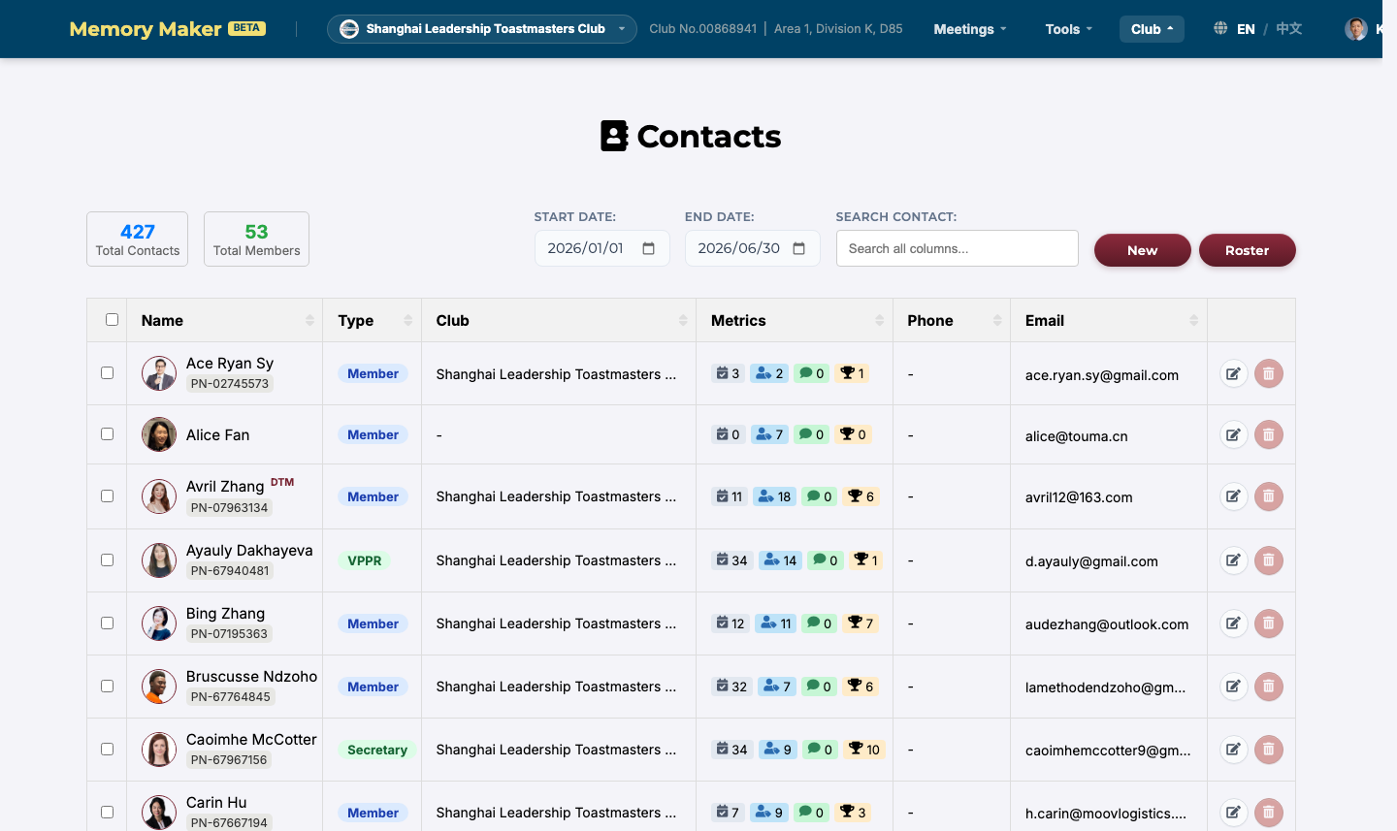
STEP 4.2
Update the media URL
Attach the meeting recording so members can find it later.
■ Back on /agenda — Edit the meeting's Media URL field in the header
■ Save — The recording is now linked to the meeting record
■ Where it shows up — Members see it on their Planner and in the meeting archive
/contacts — review each speaker's record
Memory Maker — VPE Tutorial
20 / 28

Slide 21
STEP 4.3
Review speech logs and Pathways
Auto-completion usually does the work; verify a few key cases.
■ /contacts — Confirm each speaker's project and level are recorded correctly
■ Auto-completion — Project Status flipped to Completed when the meeting was stopped
■ If a project looks wrong — Fix it via /speech_logs and re-save — metadata re-syncs
■ Pathways progress — Visit /pathway_library to confirm a path is selected; level progress increments automatically
■ Common bug — Generic placeholder project (ProjectID.GENERIC) blocks the level increment — replace it
Pathways Library — the catalog that backs the level tracking
Memory Maker — VPE Tutorial
21 / 28

Slide 22
STEP 4.4
Achievements, archive, and planning
Optional wrap-up steps and the planning handoff to the next cycle.
■ Achievements — If your club uses /achievements, award any new badges (e.g. First Ice Breaker)
■ Archive or delete — Leave finished meetings in the archive (default), or click Delete to hard-remove
■ Delete requires — MEETING_CREATE permission; no undo — waitlist, votes, planner entries all go with it
■ Plan ahead — Update templates and settings if this meeting set a new precedent (see template-manager-plan.md)
■ Brief the next VPE — Pass along any quirks (custom sessions, recurring issues) before term handover
Memory Maker — VPE Tutorial
22 / 28

Slide 23
REFERENCE
Meeting status flow
One-way transitions. To re-do a meeting, create a new one.
Publish
Start
Stop
Unpublished
Not Started
Running
Finished
From Finished → Delete (only if MEETING_CREATE permission). Hard delete: votes, roster, waitlist, planner entries, and session logs all removed. No undo.
Auto-actions on Stop:
votes tallied · waitlist cleared · Planner booked→completed · projects auto-completed · contact metadata re-synced
Memory Maker — VPE Tutorial
23 / 28

Slide 24
REFERENCE
Permissions cheat sheet
Most of this deck assumes the standard VPE role grants these.
Action
Permission
Create a meeting
MEETING_CREATE
Edit agenda (sessions, WOD, projects)
MEETING_MANAGE
Assign / remove role owners
MEETING_MANAGE
Publish / Start / Stop the meeting
MEETING_MANAGE
Delete a finished meeting
MEETING_CREATE
View all meetings (incl. unpublished)
MEETING_VIEW_ALL
Generate slides / export
MEETING_MANAGE + module 'Data/Slides Export'
If a button is greyed out, you are missing the corresponding permission. Ask a ClubAdmin or check Settings → Users.
Memory Maker — VPE Tutorial
24 / 28

Slide 25
REFERENCE
Common pitfalls
Things that have bitten VPEs before. Avoid these.
■ Publishing too early — Members can book roles as soon as the meeting is published. Finalise structure first.
■ Wrong Pathways project — A wrong project pollutes the speaker's record. Ask if unsure — don't guess.
■ Clicking Stop by accident — The meeting is sealed. The only recovery path is cloning the meeting or restoring from backup.
■ Forgetting to assign an evaluator — Backfill the night before. Evaluators are just owners of evaluator-type sessions.
■ Editing the date after publishing — Meeting Number auto-renames; the poster file is renamed too. Verify both after the change.
■ Generic project on a prepared speech — ProjectID.GENERIC blocks the level increment. Replace with the real project and re-save.
Memory Maker — VPE Tutorial
25 / 28

Slide 26
REFERENCE
Glossary
Terms used throughout this deck.
■ VPE — Vice President Education — owns the meeting's content and Pathways tracking.
■ SAA — Sergeant at Arms — owns the room, check-in, voting tallying, and lucky draw.
■ TME — Toastmaster of the Evening — runs the meeting on the night.
■ WOD — Word of the Day — the Memory Maker's traditional responsibility; used by speakers and TME.
■ Pathway — Toastmasters' learning experience, made up of projects across multiple levels.
■ Session Log — A row in the agenda table — one per agenda item (TME, Table Topics, Speech, Eval, etc.).
■ Planner — A member's personal plan: which project they intend to deliver in which meeting.
■ Waitlist — Auto-managed queue for full slots. Next person is promoted when the owner cancels.
Memory Maker — VPE Tutorial
26 / 28

Slide 27
REFERENCE
Where to go next
Related docs in this repository.
SAA — checklist view
docs/SAA_MemMaker_User_Manual.md
SAA — grid view
docs/SAA_User_Manual_Grid.md
All officers at-a-glance
docs/getting_started.md
Pathways deep-dive
docs/ (search 'pathways')
Template editing
docs/template-manager-plan.md
Voting / live updates
docs/MAILBOX_REALTIME_DESIGN.md
User / contact model
docs/CONTACT_USER_CLUB_MODEL.md
This deck's source doc
docs/VPE_MemMaker_Tutorial.md
Memory Maker — VPE Tutorial
27 / 28

Slide 28
YOU'RE READY
Manage the cycle with confidence.
Plan with care, publish once, stay calm on the night, and let Memory Maker do the bookkeeping at the end.
Questions? Ping a ClubAdmin or open an issue from /issues.
28 / 28

