Slide 1



RADOSS AGENCY | MANDILAS PANEL PITCH
SLIDE 1 / 28
DIGITAL & CREATIVE PARTNER SHORTLIST PRESENTATION
Mandilas x Radoss
Partnership Strategy Deck
A structured response to Mandilas Group's search for a Digital & Creative partner.
Mandilas Panel Presentation
Session Details
Prepared by Radoss Agency for Mandilas Group.
Thursday, February 19, 2026
12:15 PM physical meeting
60 minutes incl. Q&A
LIGHT THEME EDITION
Speaker Notes: Open confidently and acknowledge shortlist invitation and objective alignment.

Slide 2
RADOSS AGENCY | MANDILAS PANEL PITCH
SLIDE 2 / 28
Agenda & Session Flow
Set navigation and timing expectation.
45-Minute Core Presentation
Q1. Agency Portfolio Overview
Q2. Strategic Framework
Q3. Notable Campaigns & Impact
Working with Radoss. (strategic recommendation)
Q&A + availability confirmation
Speaker Notes: Clarify that slides are organized exactly to match the request email structure.

Slide 3
RADOSS AGENCY | MANDILAS PANEL PITCH
SLIDE 3 / 28
SECTION BREAKER
SECTION 01 | Agency Portfolio Overview
Background, Team, Capabilities, Brands Served
Speaker Notes: Transition into Q1 with an explicit section marker as requested.

Slide 4

RADOSS AGENCY | MANDILAS PANEL PITCH
SLIDE 4 / 28
Who We Are | The Nexus of Business, Marketing & Technology
Brand Perspective from Portfolio
The Nexus of Business, Marketing & Technology
Interconnected solutions, not siloed services
Lagos headquartered with global delivery mindset
Define positioning and DNA.
Integrated Growth Positioning
Radoss connects strategic intent, execution discipline, and technology enablement to unlock measurable growth.
Speaker Notes: Use both current site and legacy portfolio language to show consistency of positioning.

Slide 5
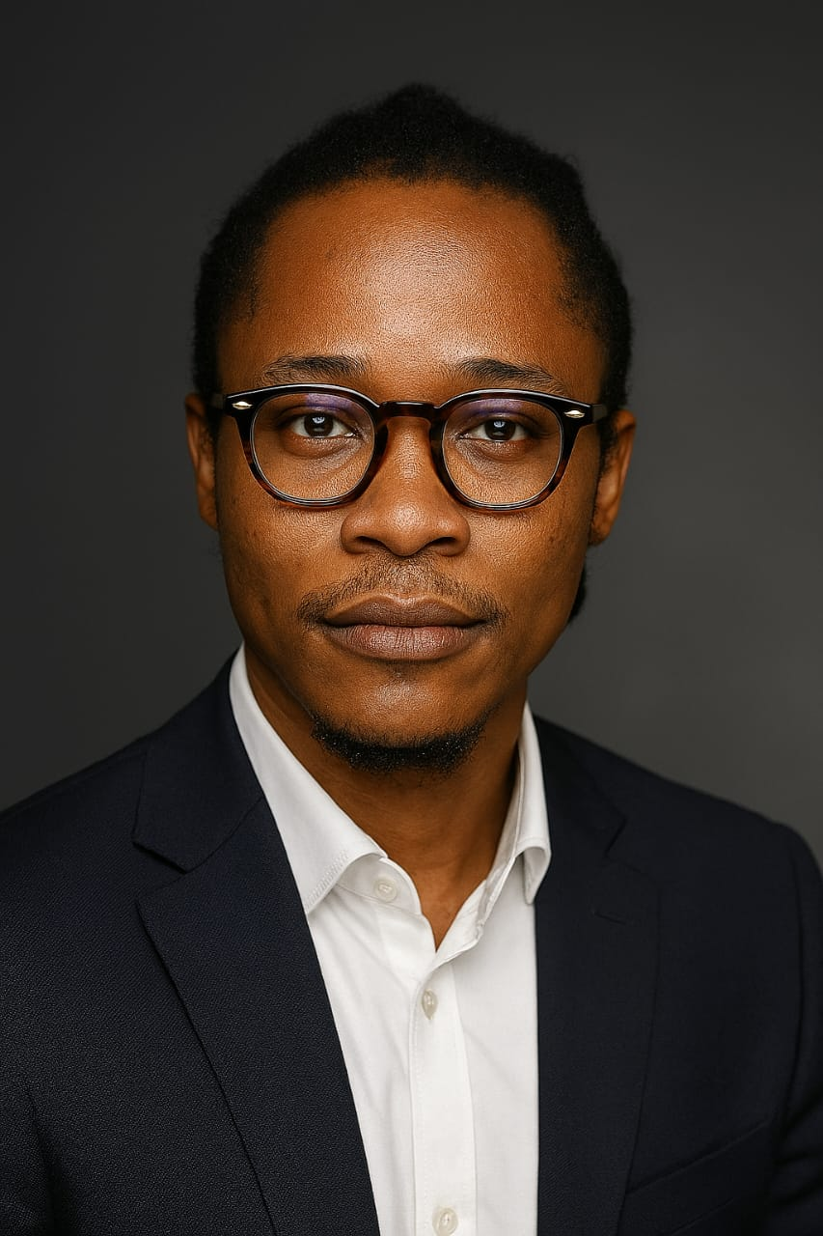
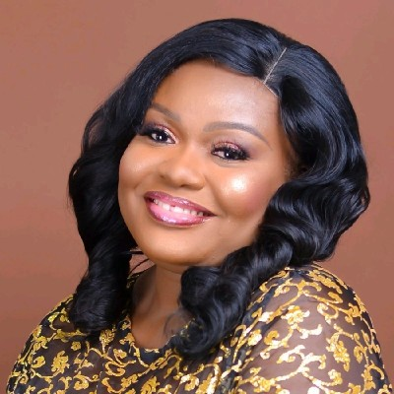
RADOSS AGENCY | MANDILAS PANEL PITCH
SLIDE 5 / 28
Leadership & Key Team
Present complete team details and delivery coverage.
Uchenna Innocent, MCIM
Timi Uk
Ebere Agbaje
Chief Digital Architect & Founder
Chief Operating Officer & Co-Founder
Business Operations Lead
Digital transformation, growth strategy, technology enablement
Performance operations, campaign governance, delivery quality
Operations planning, research intelligence, growth analytics
Team Execution Lens
Strategy + transformation design
Performance + brand operations
Research + growth analytics + governance
Speaker Notes: Highlight role clarity and leadership-to-delivery continuity.

Slide 6
RADOSS AGENCY | MANDILAS PANEL PITCH
SLIDE 6 / 28
Core Service Offerings & In-House Capabilities
Business & Digital Transformation
Sales-marketing alignment
MarTech/process optimization
Technology integration
Change management support
Map capability pillars to outcomes.
Digital & Performance Marketing
SEO and content strategy
PPC and paid media
Social and lifecycle automation
Analytics and attribution
Brand & Traditional Marketing
Brand strategy and identity
ATL and BTL activations
Integrated TTL campaign planning
Speaker Notes: Demonstrate full-funnel and full-stack capacity within one partner.

Slide 7



RADOSS AGENCY | MANDILAS PANEL PITCH
SLIDE 7 / 28
Brands the Agency Currently Serves / Has Served
Brand Reference Matrix
Provide brand proof and relevance.
Publicly Referenced Brands
Zenith Bank
Tolaram Group (Indomie)
Miva University
Eatalia
Healthtracka
Bracken
HippoAds
Sterling Bank
Evidence Basis
Compiled from radoss.agency/work, radossdigital.com, and portfolio deck.
Speaker Notes: Stay within publicly verifiable names and logos only.

Slide 8
RADOSS AGENCY | MANDILAS PANEL PITCH
SLIDE 8 / 28
Portfolio Perspective | Consistency Across Years
Why It Matters for Mandilas
Consistent operating philosophy reduces onboarding friction and speeds up activation.
Leverage old portfolio as continuity proof.
What Stayed Consistent
Integrated strategy and execution posture
Case-led storytelling and measurable outcomes
Cross-industry experience over 10+ years
Speaker Notes: Use this to show institutional continuity, not nostalgia.

Slide 9
RADOSS AGENCY | MANDILAS PANEL PITCH
SLIDE 9 / 28
SECTION BREAKER
SECTION 02 | Strategic Framework
From Business Objectives to Insight-Led Strategy
Speaker Notes: Transition into strategy framework as the second required block.

Slide 10
RADOSS AGENCY | MANDILAS PANEL PITCH
SLIDE 10 / 28
Strategic Philosophy | Connecting Objectives to Outcomes
Decision Principle
Evidence first, assumptions second, execution discipline always.
Explain strategic translation model.
How We Translate Objectives
Start with commercial goals and constraints
Convert to market and customer hypotheses
Operationalize through accountable execution
Use measurement loops for optimization
Speaker Notes: Frame this as the lens before deep M-C-I-A breakdown.

Slide 11
RADOSS AGENCY | MANDILAS PANEL PITCH
SLIDE 11 / 28
M-C-I-A Overview | Strategic Flywheel
Expected Benefits
Better prioritization
Reduced execution waste
Faster adaptation under market change
Introduce map-connect-implement-analyse cycle.
Map | Connect | Implement | Analyse
A non-linear strategic flywheel that compounds decision quality each cycle.
Speaker Notes: Keep this high-level and executive-friendly.

Slide 12
RADOSS AGENCY | MANDILAS PANEL PITCH
SLIDE 12 / 28
M | Map the Market
Outputs + Decision Gates
Detail market diagnosis and priority setting.
Market map and strategic thesis
Risk register with mitigation owners
KPI architecture before execution
Key Questions
What are market realities and constraints?
Where are high-value opportunities?
What should be prioritized now versus later?
Speaker Notes: Stress prioritization and risk clarity before resource commitment.

Slide 13
RADOSS AGENCY | MANDILAS PANEL PITCH
SLIDE 13 / 28
C | Connect with the Consumer
Outputs
Audience blueprints
Journey intervention matrix
Message architecture by intent stage
Detail consumer relevance design.
Customer Insight Questions
What jobs and anxieties drive decision?
Where is journey friction highest?
What value exchange builds trust?
Speaker Notes: Position connect as conversion and retention foundation.

Slide 14
RADOSS AGENCY | MANDILAS PANEL PITCH
SLIDE 14 / 28
I | Implement with Impact
From Brief to Rollout
Detail execution methodology and rollout governance.
Creative and channel orchestration
Quality controls
Weekly operating cadence
Execution System
Roadmap, ownership, and release rhythm
Cross-functional dependency governance
Instrumentation and attribution readiness
Speaker Notes: Show execution as a managed system, not ad hoc campaigns.

Slide 15
RADOSS AGENCY | MANDILAS PANEL PITCH
SLIDE 15 / 28
A | Analyse, Adapt & Amplify
Compounding Effect
Insights from Analyse feed the next Map phase to improve future cycle ROI.
Detail performance optimization loop.
Optimization Model
Lagging and leading scorecards
Causal analysis and budget reallocation
Playbook codification for scale
Speaker Notes: Link this directly to measurable accountability.

Slide 16
RADOSS AGENCY | MANDILAS PANEL PITCH
SLIDE 16 / 28
Data, Consumer Insights & Market Intelligence in Practice
Decision Uses
Prioritization
Creative iteration
Channel mix optimization
Board-level reporting
Show data system that powers strategy decisions.
Data Inputs
Search and social intent signals
Funnel conversion behavior
Campaign test performance
Competitive and market context
Speaker Notes: Demonstrate discipline in turning data into action.

Slide 17
RADOSS AGENCY | MANDILAS PANEL PITCH
SLIDE 17 / 28
SECTION BREAKER
SECTION 03 | Notable Campaigns & Impact
Strategic Challenge • Creative Approach • Channels • Outcomes
Speaker Notes: Set expectation for case-study depth and structure.

Slide 18
RADOSS AGENCY | MANDILAS PANEL PITCH
SLIDE 18 / 28
Case 1 | Zenith Bank - Acquisition Efficiency
Present challenge, execution, and measurable result.
Challenge
Outcome
Acquire minimum 2,000 customer accounts via Beta Life Promo.
Target benchmark: 2,000+ new accounts
Reported average acquisition cost: 750 naira/account
Approach
Social campaign buzz + direct-response focus
Audience targeting and promo mechanics
Speaker Notes: Keep numbers as published in public sources only.

Slide 19
RADOSS AGENCY | MANDILAS PANEL PITCH
SLIDE 19 / 28
Case 2 | Eatalia - Digital Process Optimization
Show transformation + digital execution impact.
Challenge
Outcome
Website functionality, order infrastructure, and operational inefficiencies.
Reduced manual errors
Improved operational tracking
Increased digital footfall
Approach
Built website and online ordering portal
Implemented POS/inventory/stock systems
Speaker Notes: Emphasize cross-functional impact beyond marketing metrics alone.

Slide 20
RADOSS AGENCY | MANDILAS PANEL PITCH
SLIDE 20 / 28
Case 3 | Miva University - Integrated ATL/OOH Support
Show integrated channel planning and efficiency.
Challenge
Outcome
Early enrollment push requiring offline OOH support for digital campaign.
Increased visibility in target corridors
Enrollment goals achieved
Lower OOH component cost
Approach
BRT branding route selection
Audience-proximity channel design
Speaker Notes: Show integration of offline and digital logic.

Slide 21
RADOSS AGENCY | MANDILAS PANEL PITCH
SLIDE 21 / 28
Case 4 | Tolaram Group (Indomie) - Campaign Continuity
Show execution reliability and continuity enablement.
Outcome
Payment delays removed
Always-on campaign delivery maintained
Challenge
Payment bottlenecks on Meta threatened campaign continuity.
Approach
Direct ad-account funding support
Operational continuity management
Speaker Notes: Position as reliability case with operational value.

Slide 22
RADOSS AGENCY | MANDILAS PANEL PITCH
SLIDE 22 / 28
Cross-Case Impact Synthesis
Business Lens
Brand growth, engagement, and revenue efficiency improve when strategy, execution, and systems are integrated.
Connect campaign outcomes to business impact dimensions.
Impact Pattern
Improved acquisition economics
Reduced operational friction
Higher delivery continuity
Stronger visibility and engagement trajectories
Speaker Notes: Synthesize learnings before moving into Mandilas-specific recommendations.

Slide 23
RADOSS AGENCY | MANDILAS PANEL PITCH
SLIDE 23 / 28
SECTION BREAKER
SECTION 04 | Working with Radoss.
Industry Research + Consumer Insight + M-C-I-A Action Plan
Speaker Notes: Signal transition from retrospective proof to forward plan.

Slide 24
RADOSS AGENCY | MANDILAS PANEL PITCH
SLIDE 24 / 28
Mandilas Context | Opportunity Map
Frame Mandilas operating context from available public signals.
Mandilas Public Context
Strategic Implication
Heritage business founded in 1950 with multi-sector positioning [1]
Public channels indicate Carrier franchise + Toyota dealership + aftersales/fleet/leasing [2][5]
Official site currently under reconstruction, creating digital front-door opportunity [4]
Mandilas can win by modernizing demand generation and lifecycle service experience across mobility and engineering touchpoints.
Citations are embedded as [n] and fully listed in the final references slide.
Speaker Notes: Anchor the recommendation on official/publicly visible facts only.

Slide 25
RADOSS AGENCY | MANDILAS PANEL PITCH
SLIDE 25 / 28
Consumer Behaviour & Industry Signals (Nigeria / SSA)
Provide trusted-source insight to guide recommendations.
Key Signals
Mandilas-Relevant Implications
Nigeria: 150M mobile connections, 107M internet users, 38.7M social identities in early 2025 [6]
Population ~235M; urban population ~63.0% (2024), accelerating city-based service demand [7]
Inflation ~33.2% (2024) indicates stronger price-value sensitivity [7]
SSA connectivity still has a large usage gap while 4G/5G adoption rises through 2030 [8]
Mobile-first discovery and service journeys are non-negotiable
Trust, convenience, and response speed are decisive
Retention programs must balance value and affordability
Citations are embedded as [n] and fully listed in the final references slide.
Speaker Notes: Use this as the evidence base for strategic recommendations.

Slide 26
RADOSS AGENCY | MANDILAS PANEL PITCH
SLIDE 26 / 28
Working with Radoss | M-C-I-A Applied to Mandilas
Translate insights into top-line strategic recommendation.
M - Map (0-30 days)
C - Connect (30-60 days)
Category and demand map per business line
Competitor and channel gap scan
KPI baseline and risk register
Segmented journeys: retail, fleet, B2B projects
WhatsApp-first service and lead workflows
Message architecture by value drivers
Citations are embedded as [n] and fully listed in the final references slide.
Speaker Notes: Present as practical and phased, not abstract consulting language.

Slide 27
RADOSS AGENCY | MANDILAS PANEL PITCH
SLIDE 27 / 28
Quick Wins (First 90 Days) + Partnership Operating Model
Operating Cadence
Weekly execution reviews
Bi-weekly optimization checkpoints
Monthly strategic steering with Mandilas leadership
Offer practical early wins and governance structure.
Quick Wins
Unified lead capture and routing for Toyota/Carrier/service inquiries
WhatsApp service reminders and quote follow-up sequences
Conversion-focused landing pages for high-intent service categories
Executive dashboard linking spend to inquiries, bookings, and closed revenue
Availability Confirmation
Radoss confirms availability for the physical panel meeting on Thursday, February 19, 2026 at 12:15 PM.
Speaker Notes: Close with confidence and practical next step options.

Slide 28
RADOSS AGENCY | MANDILAS PANEL PITCH
SLIDE 28 / 28
References & Citations
Provide transparent source references used in recommendation section.
[1] https://www.linkedin.com/company/mandilas-group
[2] https://www.instagram.com/mandilasgroup/
[3] https://www.facebook.com/MandilasGroup/
[4] https://www.mandilasng.com/
[5] https://toyotanigeria.com/dealers/mandilas-enterprises-ltd/
[6] https://datareportal.com/reports/digital-2025-nigeria
[7] World Bank API indicators: SP.URB.TOTL.IN.ZS, FP.CPI.TOTL.ZG, NY.GDP.MKTP.KD.ZG
[8] https://www.gsma.com/solutions-and-impact/connectivity-for-good/mobile-economy/sub-saharan-africa-2024/
[9] /Users/radossagency/Documents/Business/Radoss/Contracts/Radoss Portfolio.pdf
Speaker Notes: Keep sources visible for panel credibility and Q&A defensibility.

